Slide 1
Using Delimited Files
Alan Hunt – March 1st, 2017

Slide 2
Agenda
Files as data storage and transfer mechanisms
Structured file types
Fixed Width
Delimited
XML
Proprietary Formats
CSV – Why is it popular?
Simple example (CSVReader.java)
More complex example (SubscriberSplit.java)

Slide 3
POLL
https://answergarden.ch/443738

Slide 4
Legacy Systems
Delimited Text
Simple Tabular Data Transfer
Proprietary Format
XML
Complex Relational Data Transfer
Data persistence
Fixed Width

Slide 5
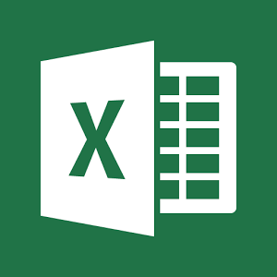
Why CSV?
Tabular Data transfer between systems
Human Readable
Many existing applications can support import/export
Stable
Notes:
CSV = Comma Separated Values
Story on mail merge
Story on MetricStream and excel
Story on FedEx and

Slide 6
Simple CSV Example
File of student data – load and display
Last Name
First Name
E-Mail address
Student Number

Slide 7
POLL
https://answergarden.ch/443739

Slide 8
More Complex CSV Example
File of subscriber data – load, sort, write to multiple files
(https://www.briandunning.com/sample-data/)
First Name
Last Name
Company
Address
City
County (where applicable)
State/Province (where applicable)
ZIP/Postal Code
Phone 1
Phone 2
Email
Web

