Slide 1
Minimum Spanning Tree
Prim and Kruskal

Slide 2
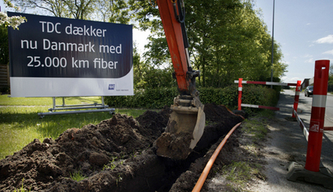
Building a fiber network
Lay down fibers to connect n locations
All n locations should be connected
Laying down a fiber costs money
What is the cheapest way to lay down the fibers?

Slide 3
Today’s agenda
Minimum Spanning Tree (MST) Problem
Greedy algorithm(s) for MST problem

Slide 4
Minimum Spanning Tree (MST)
Input: A connected graph G=(V,E), c_{e}> 0 for every e in E
Output: A tree containing all V that minimizes the sum of edge weights
How do we solve this?

Slide 5
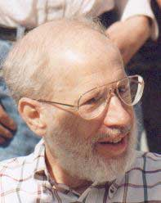
Kruskal’s Algorithm
Input: G=(V,E), c_{e}> 0 for every e in E
T = Ø
Sort edges in increasing order of their cost
Joseph B. Kruskal
Consider edges in sorted order
If an edge can be added to T without adding a cycle then add it to T

Slide 6
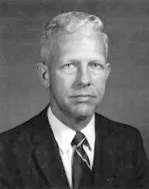
Prim’s algorithm
Similar to Dijkstra’s algorithm
2
0.5
1
3
50
51
Robert Prim
2
0.5
Input: G=(V,E), c_{e}> 0 for every e in E
S = {s}, T = Ø
1
50
While S is not the same as V
Among edges e= (u,w) with u in S and w not in S, pick one with minimum cost
Add w to S, e to T

Slide 7
Reverse-Delete Algorithm
2
0.5
1
3
50
51
Input: G=(V,E), c_{e}> 0 for every e in E
2
0.5
T = E
1
3
50
Sort edges in decreasing order of their cost
51
Consider edges in sorted order
If an edge can be removed T without disconnecting T then remove it

Slide 8
Cut Property Lemma for MSTs
Condition: S and V\S are non-empty
V \ S
S
Cheapest crossing edge is in all MSTs
Assumption: All edge costs are distinct

Slide 9
Prove correctness of Kruskal’s and Prim’s algorithms using the Cut Property Lemma

Slide 10
Optimality of Kruskal’s Algorithm
V \ S
S
Nodes connected to red in (V,T)
Input: G=(V,E), c_{e}> 0 for every e in E
S is non-empty
T = Ø
V\S is non-empty
Sort edges in increasing order of their cost
First crossing edge considered
Consider edges in sorted order
If an edge can be added to T without adding a cycle then add it to T

Slide 11

Is (V,T) a spanning tree?
No cycles by design
G is disconnected!
Just need to show that (V,T) is connected
V \ S’
S’
No edges here

Slide 12
Cut Property Lemma for MSTs
Condition: S and V\S are non-empty
V \ S
S
Cheapest crossing edge is in all MSTs

Slide 13
Optimality of Prim’s algorithm
S is already defined for us!
By induction, show that (S,T) is a tree
S not Ø
Input: G=(V,E), c_{e}> 0 for every e in E
S = {s}, T = Ø
While S is not the same as V
Among edges e= (u,w) with u in S and w not in S, pick one with minimum cost
Add w to S, e to T

Slide 14
Running time for Prim’s algorithm
Similar to Dijkstra’s algorithm
O(m log n)
Input: G=(V,E), c_{e}> 0 for every e in E
S = {s}, T = Ø
While S is not the same as V
Among edges e= (u,w) with u in S and w not in S, pick one with minimum cost
Add w to S, e to T

Slide 15
Running time for Kruskal’s Algorithm
Can be implemented in O(m log n) time (Union-find DS)
Input: G=(V,E), c_{e}> 0 for every e in E
O(m²) time overall
T = Ø
Sort edges in increasing order of their cost
Joseph B. Kruskal
Consider edges in sorted order
If an edge can be added to T without adding a cycle then add it to T
Can be verified in O(m+n) time

Slide 16
Prove the Cut Property Lemma
Condition: S and V\S are non-empty
V \ S
S
Cheapest crossing edge is in all MSTs
Assumption: All edge costs are distinct

Slide 17
Removing distinct cost assumption
Change all edge weights by very small amounts
Make sure that all edge weights are distinct
MST for “perturbed” weights is the same as for original
Changes have to be small enough so that this holds
EXERCISE: Figure out how to change costs

