Slide 1
Asymptotic Runtime Analysis

Slide 2



Definition of Efficiency
An algorithm is efficient if, when implemented, it runs quickly on real instances
Implemented where?
Platform independent definition
What are real instances?
Worst-case Inputs
N = 2n² for SMP
Efficient in terms of what?
Input size N

Slide 3
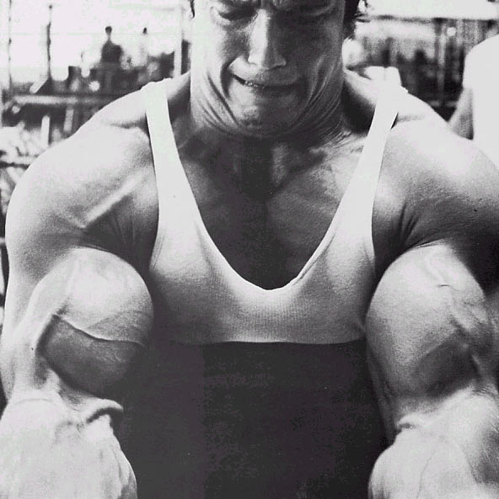
Definition-II
Analytically better than brute force
n!
How much better? By a factor of 2?

Slide 4
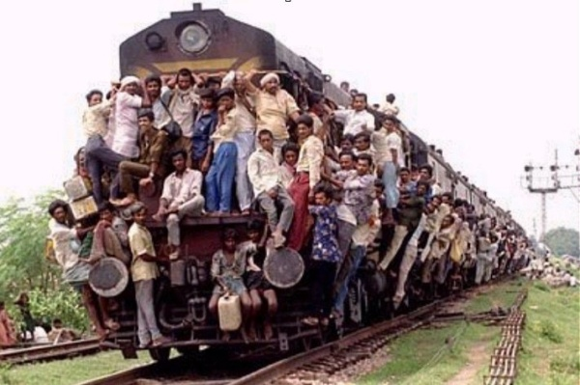
Definition-III
Should scale with input size
If N increases by a constant factor,
so should the measure
Polynomial running time
At most c.N^{d} steps (c>0, d>0 absolute constants)
Step: “primitive computational step”

Slide 5
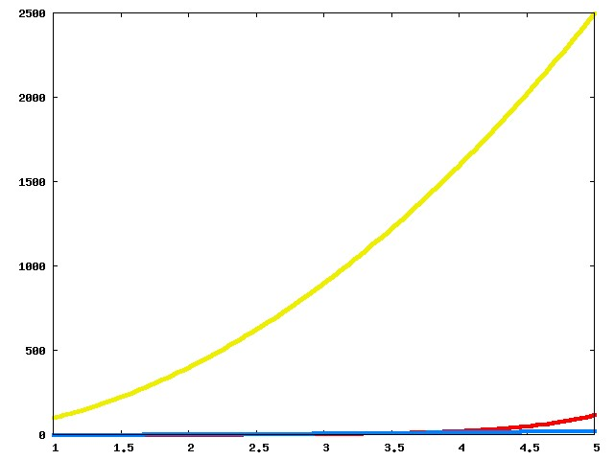
Which one is better?

Slide 6
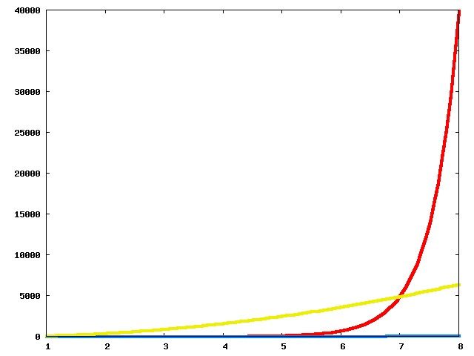
Now?

Slide 7
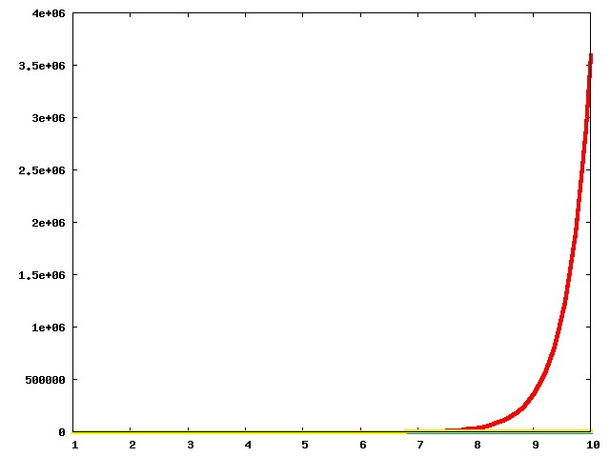
And now?

Slide 8
The actual run times
n!
100n²
Asymptotic View
n²

Slide 9
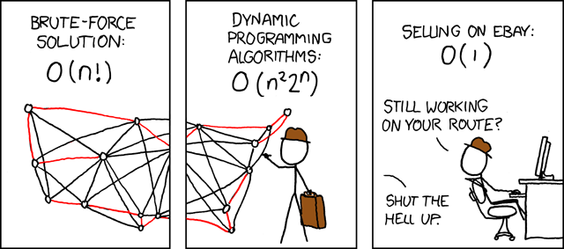
Asymptotic Analysis
Travelling Salesman Problem
(http://xkcd.com/399/)

Slide 10
Asymptotic Notation
O is similar to ≤
Ω is similar to ≥
Θ is similar to =

Slide 11
g(n) is O(f(n))
c*f(n) for some c>0
g(n)
n
n₀

Slide 12
g(n) = pn² + qn + r
Is g(n) in O(n³)?
Yes
Is g(n) in O(n²)?
Yes
Is g(n) in O(n)?
No

Slide 13
g(n) is Ω(f(n))
g(n)
ε*f(n) for some ε>0
n
n₁

Slide 14
g(n) = pn² + qn + r
Is g(n) in Ω(n³)?
No
Is g(n) in Ω(n²)?
Yes
Is g(n) in Ω(n)?
Yes

Slide 15
g(n) is Θ(f(n))
c*f(n) for some c>0
g(n)
ε*f(n) for some ε>0
n
n₀

Slide 16
g(n) = pn² + qn + r
Is g(n) in Θ(n³)?
No
Is g(n) in Θ(n²)?
Yes
Is g(n) in Θ(n)?
No

Slide 17
Properties of asymptotic (applies to O, Ω, and Θ)
Transitivity:
if (g is O(h)) and (h is O(f))
-then (g is O(f))
Sum of functions (sequential code):
if (g is O(f)) and (h is O(f))
-then (g+h is O(f))
Multiplication of functions (nested code):
if (g is O(f₁)) and (h is O(f₂))
-then g•h is O(f₁•f₂)

Slide 18
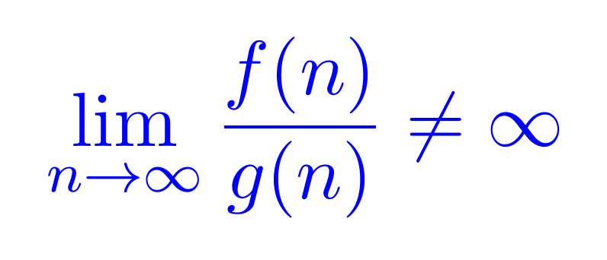
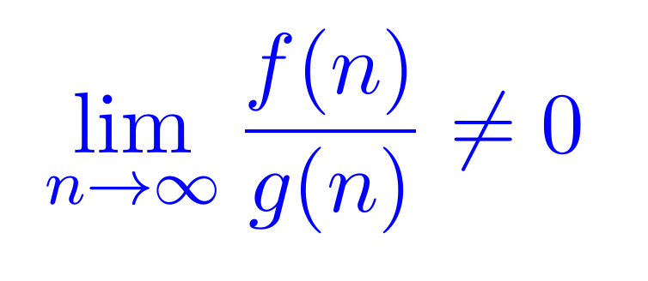
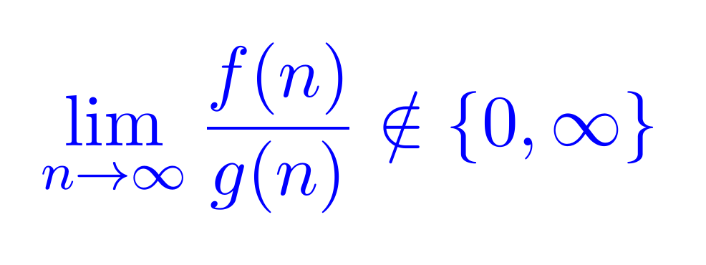
Calculus for Asymptotic Analysis
f(n) is O(g(n))
f(n) is Ω(g(n))
f(n) is Θ(g(n))

Slide 19
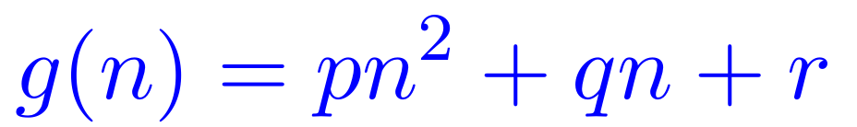
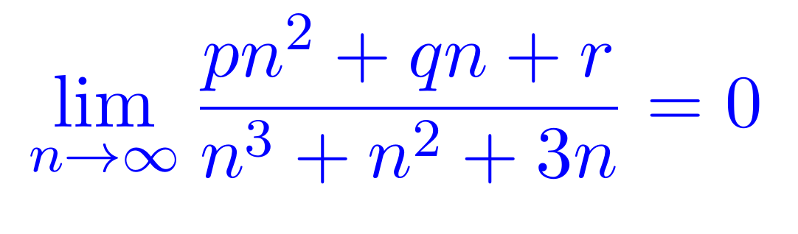
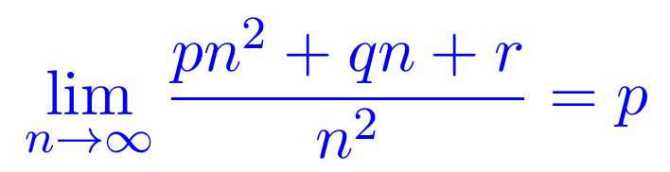
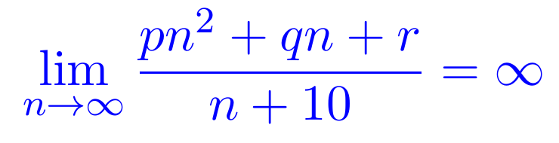
Calculus for Asymptotic Analysis
f(n) is O(n³)
f(n) is Θ(n²)
f(n) is Ω(n)

Slide 20
Asymptotic Analysis for Algorithms
T(n) = the maximum number of steps taken by an algorithm for any input of size n (worst-case runtime)
If T(n)<u(n) for all n>n₀ then T(n) is in O(u(n))
Need to show that the number of steps taken is less than u(n) for all inputs of size n>n₀
If T(n)>L(n) for all n>n₀ then T(n) is in Ω(L(n))
Need to show that there exists at least one input that takes more than L(n) steps for all n>n₀

Slide 21
Asymptotic Analysis for Problems
To prove that a problem is O(f(n))
Provide an algorithm that solves the problem with T(n) that is O(f(n)) time
The problem is upper bounded by f(n)
Example: The Gale-Shapley algorithm proves that the Stable Matching Problem is O(n²)
The Stable Matching Problem has an upper bound of n²

Slide 22
Asymptotic Analysis for Problems
To prove that a problem is Ω(f(n))
Prove that there can not exist any algorithm that solves the problem and has a T(n) that is Ω(f(n))
The problem is lower bounded by f(n)
Proving a lower bound is much more difficult than proving an upper bound!
No lower bounds for cryptographic primitives
P vs. NP could be solved with an exponential lower bound on any NP-complete problem
When the proven upper and lower bounds are the same, the bounds are tight and we get to use Θ
The upper bound is always the same as the lower bound, but we can’t always prove it

Slide 23
Gale-Shapley Algorithm
Initially all men and women are free
While there exists a free woman who can propose
Let w be such a woman and m be the best man she has not proposed to
w proposes to m
If m is free
(m,w) get engaged
Else (m,w’) are engaged
If m prefers w’ to w
w remains free
Else
(m,w) get engaged and w’ is free
Output the engaged pairs as the final output. These engaged pairs get married.

Slide 24
Implementation Steps
How to represent the input?
How do we find a free woman w?
How would w pick her best unproposed man m?
How do we know who m is engaged to?
How do we decide if m prefers w’ to w?

Slide 25
Arrays and Linked Lists
n numbers a₁,a₂,…,a_{n}
Last
Front
1
a₁
a₁
a₂
a₃
a_{n}
2
a₂
3
a₃
Array
Linked List
Access ith element
O(1)
O(i)
Is e present?
O(n)
(O(log n) if sorted)
O(n)
Insert an element
O(n)
O(1) given pointer
n
a_{n}
Delete an element
O(n)
O(1) given pointer
Static vs Dynamic
Static
Dynamic

Slide 26
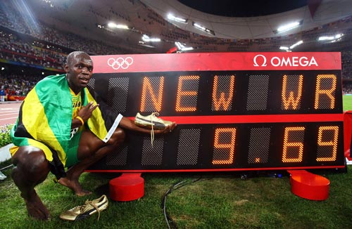
Today’s first goal
O(n²) implementation of the Gale-Shapley algorithm
More practice with run time analysis

Slide 27
Gale-Shapley Algorithm
At most n² iterations
Initially all men and women are free
While there exists a free woman who can propose
Let w be such a woman and m be the best man she has not proposed to
w proposes to m
O(1) time implementation
If m is free
(m,w) get engaged
Else (m,w’) are engaged
If m prefers w’ to w
w remains free
Else
(m,w) get engaged and w’ is free
Output the engaged pairs as the final output. These engaged pairs get married.

Slide 28
Puzzle
Prove that any algorithm for the SMP takes Ω(n²) time

Slide 29





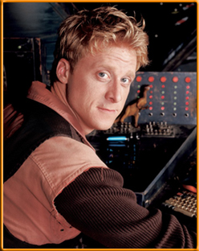

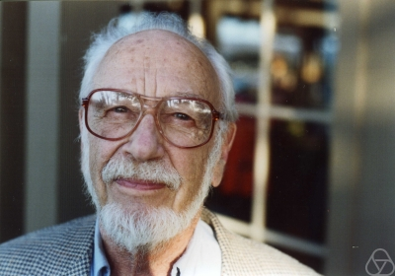
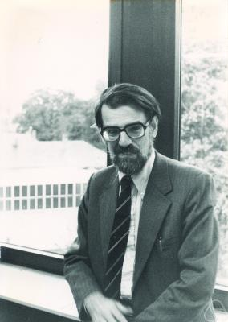
Main Steps in Algorithm Design
Problem Statement
Problem Definition
Algorithm
n!
“Implementation”
Analysis
Correctness Analysis

