Slide 1
Security

Slide 2
Security Flaws
Errors that can be exploited by attackers
Constantly exploited

Slide 3
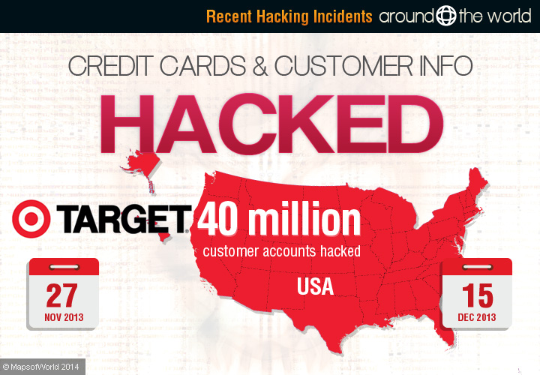
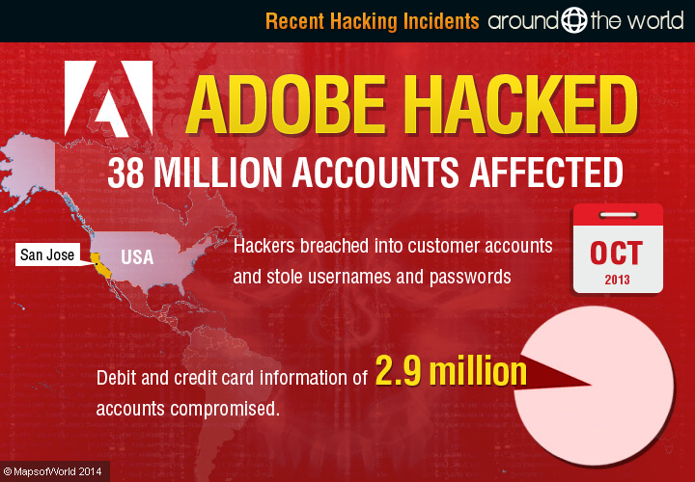
Database Breaches
Sony PSN (2011)
~77 million users
Target (2013)
Reports of 40-110 million customers affected
JP Morgan Chase (2014)
~76 million users
Many others

Slide 4
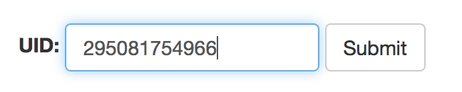
SQL
$query = “SELECT name, email FROM user WHERE uid=‘” + $_POST[“UID”] + “’”;
$query = “SELECT name, email FROM user WHERE uid=‘295081754966’”;
…
“Jesse Hartloff”, “hartloff@buffalo.edu”
Allow anyone to get information about any user by UID

Slide 5
SQL Attack
$query = “SELECT name, email FROM user WHERE uid=‘” + $_POST[“UID”] + “’”;
Attacker wants all emails to send spam
Needs to know every UID
Can brute force UID’s
Easy to detect
Stop taking requests from same IP

Slide 6
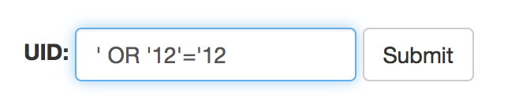
SQL Injection
$query = “SELECT name, email FROM user WHERE uid=‘” + $_POST[“UID”] + “’”;
$query = “SELECT name, email FROM user WHERE uid=‘’ OR ‘12’=‘12’”;
“Uh oh”
Returns every users’ name and email address
Spammers rejoice!

Slide 7
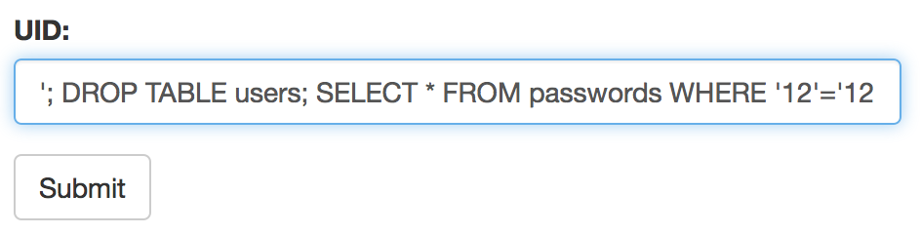
SQL Injection
$query = “SELECT name, email FROM user WHERE uid=‘” + $_POST[“UID”] + “’”;
$query = “SELECT name, email FROM user WHERE uid=‘’; DROP TABLE users; SELECT * FROM passwords WHERE ‘12’=‘12’”

Slide 8
SQL Injection - Prevention
Validate user inputs
Use language functions to clean inputs
Prevents most attacks
Still one of the most common software attacks

Slide 9

SQL Injection

Slide 10
Buffer Overflow
“In every sufficiently large C program”
char values[80];
values = inputFromUser();
Intended functionality
User can input any data in the array
User can input data larger than 80 char’s
Very bad!
User can write anything in the memory after the end of the array
Control statement that runs malicious code

Slide 11
More C Code
…
memcpy(bp, pl, payload);
…
User supplies pl and payload
pl : User supplied data
payload: size of pl
Copy payload bytes of data from pl to bp
Send bp back to the user

Slide 12
More C Code
memcpy(bp, pl, payload);
User supplies
pl = “information”;
payload = 11;
User receives 11 bytes of data containing “information”

Slide 13
More C Code
memcpy(bp, pl, payload);
User supplies
pl = “”;
payload = 2000;
User receives 2000 bytes of server data
Whatever happened to be sitting in bp when its memory was allocated

Slide 14
Heartbleed
memcpy(bp, pl, payload);
This line of code was found in OpenSSL
Security protocol used extensively across the internet
This line was in a function called heartbeat
Heartbleed bug

Slide 15
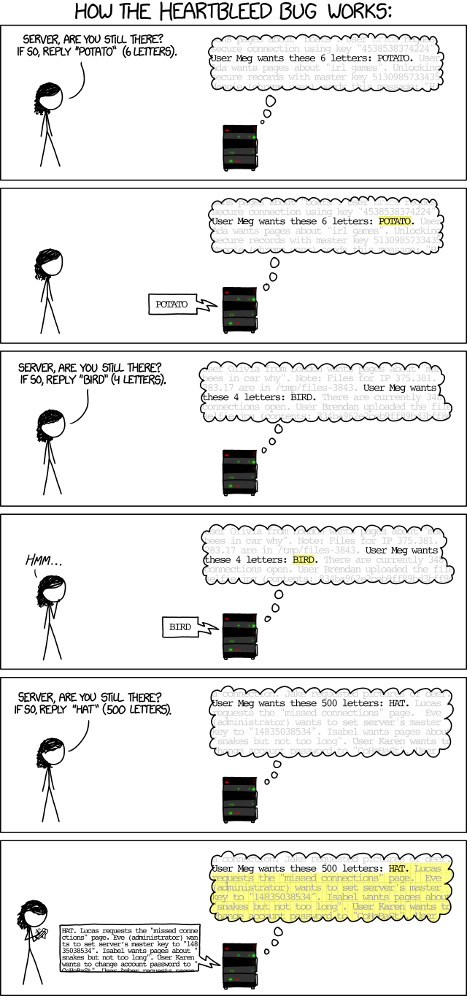

Slide 16
Secure Communication
RSA
Public key encryption
Factoring is hard
We hope
SSH
Setting up git without HTTPS
Need to upload public key
Used to connect to CSE servers
Not built into Windows (PuTTY)

Slide 17
Secure Hashing
One way function
Easy to compute hash
Computationally infeasible to inverse
Small input space leads to lack of security
Weak passwords
Brute force search
Dictionary attack
Rainbow table
Avalanche effect

Slide 18
Passwords and Hashing
SHA256 hash of my password
1906bc7c801f03c41551b06e2fd406e8f471787c51357e8731ec61dd599f04c8
SHA256 hash of my password with 1 edit
6410ef0d3a6d3324fcba02131e5742215c99301055398a75457a27ac89dffb5f
Inputs must match exactly

Slide 19
Network Attacks
Man-in-the-middle
Where does security start?
What if someone replaces your public key while you’re uploading
Intercept all communication and replace with their own
Replay attack
Resend observed network traffic

Slide 20
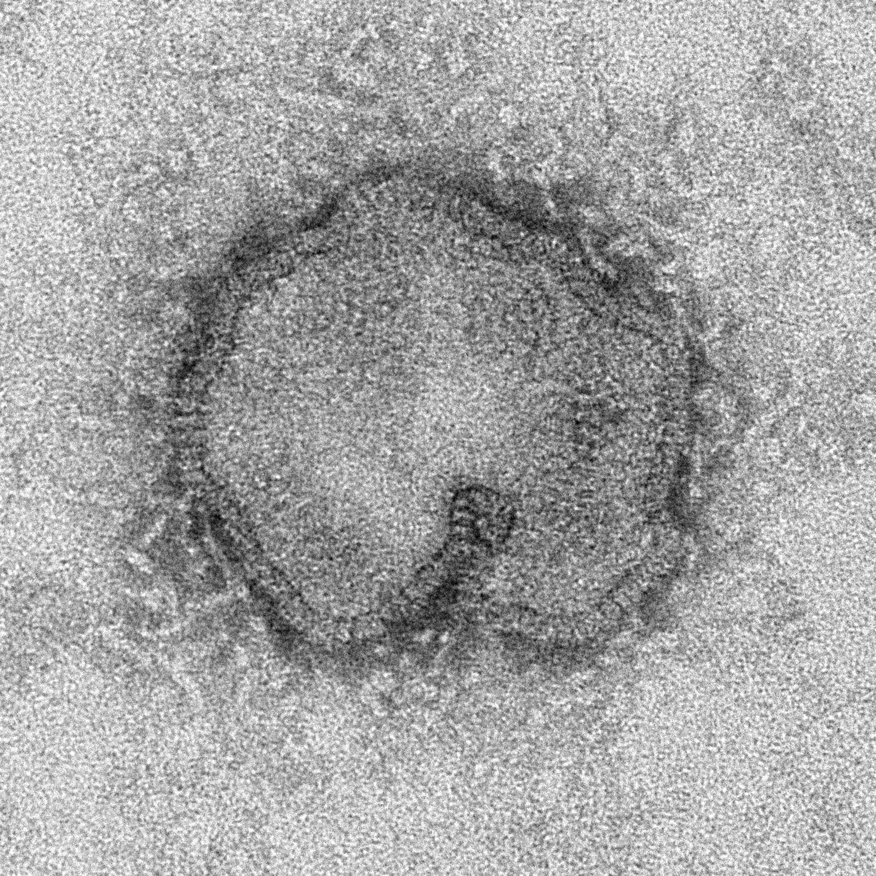
Virus - Biology
Needs a host to reproduce
Contains DNA or RNA
Protective coating of proteins

Slide 21
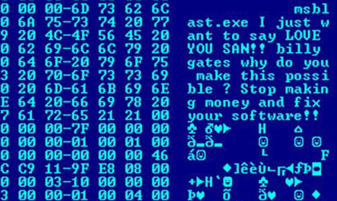
Virus - Computer
Needs a host to reproduce
Contains code (not genetic)
Packaged as a program

Slide 22
Computer Viruses
Once it finds a host
Reproduce and spread
Often has a mission
Motivation
Senseless destruction?
A good virus does not kill it’s host
Revenge?
Sometimes
Challenge?
Seems legit
Financial?
BotNet

Slide 23
BotNet Scenario
Legit company hires an ad agency
Pays per click
Pays for traffic
Ad agency maliciously controls a BotNet
Puts BotNet to work spreading spam and clicking links
Ad agency cashes big checks
Motivation to keep hosts alive and healthy

Slide 24
DoS – Denial of Service Attack
Spam a site to shut it down
Simplest version is easy to detect
Many requests from a single IP
Stop taking requests from that IP
More dangerous with IP-Spoofing
Spoofing detection is possible
With a BotNet
Distributed DoS (DDos)

Slide 25
Social Engineering
The most vulnerable point in a well-designed security system?
Humans

Slide 26
Challenge
HTML/PHP code injection

