Slide 1
Branching

Slide 2
Version Control - Branching
A way to write code without affecting the rest of your team
Merge branches to integrate your changes

Slide 3
Why use branching?
So you can push unstable code
Work independently
Still use remote version control
Only merge stable/functioning code
What if everyone pushes to the same branch?

Slide 4
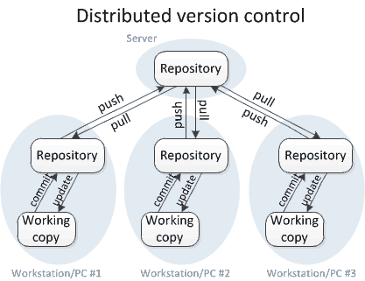
Version Control with git - Recall

Slide 5

Without Branching - Scenario
All team member push to master
Susan is updating the backend
Will take weeks
Stable when complete
Intermediate changes have unpredictable consequences elsewhere
John is making changes to the frontend
Sees side effects caused by Susan’s pushes
Thinks his code caused the changes

Slide 6

Without Branching - Scenario
Tempting solution
Don’t push to the remote repo until all changes are complete
Changes only exist locally during development
One hard drive error away from losing weeks of work!
If there are 10+ developers with different tasks on the same codebase?
Complex interactions between modules can multiply issues

Slide 7
Without Branching – Worse Scenario
Someone pushes code with errors
Code breaks
Who broke it?
Everyone’s workflow halts and the search begins
It happens
All code functions locally
Combined pushes doesn’t contains error
ex: A function header is changed

Slide 8
Branching
New commits are only added to the current branch
Can implement experimental code without affecting others
When the life of the branch is over
Merge it into the primary codebase
Branching is crucial on large teams

Slide 9
Merging
Once the changes are complete and stable
Merge the branch back to the codebase
Typically:
Initiate a pull request
If your team performs code reviews
It will likely happen here
Choose how to merge the code
Conflict resolution can be time consuming
Helps to coordinate with your team and limit editing the same files

Slide 10
Branching in git
git checkout –b <newBranchName>
Creates branch off of current branch
Equivalent to:
git branch <newBranchName>
git checkout <newBranchName>
Alternatively
Create a branch in GitHub
git checkout <branchName>

Slide 11
A Branching Model
A suggested method for branching

Slide 12
Master and Develop
The two primary branches
Master is the default branch in git
Use for stable releases
Create develop branch
Use for untested code
Primary working branch for the team
Contains the latest features
Close to a release
Test develop branch for stability
Merge commits in develop into master
Test and release master
Continue to code on develop through the release

Slide 13
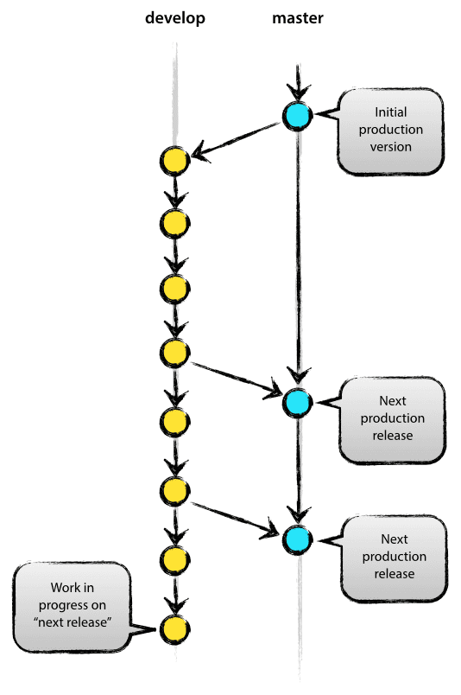

Slide 14
Feature Branch
Branch off of develop
Primary working branches for an individual(s)
When new feature is finished
Merge into develop
Code reviews (If applicable)
Hope it doesn’t break develop (it might)
nightly builds to find out
Temporary branches
Can be many feature branches being developed in parallel
If the feature is a failure
Delete the branch without merging into develop

Slide 15
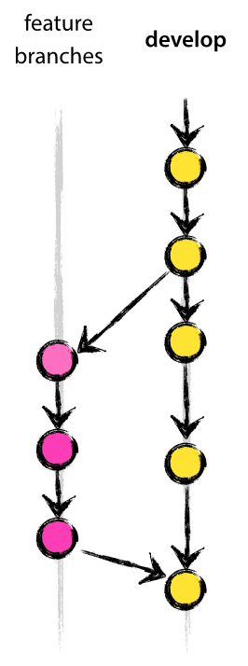

Slide 16
Merging
To retain branch information
git merge --no-ff
no fast-forward
With fast-forward
Existence of the branch is lost
Without meaningfully tagging commit messages
looking through history is confusing
Especially with many features developed in parallel

Slide 17
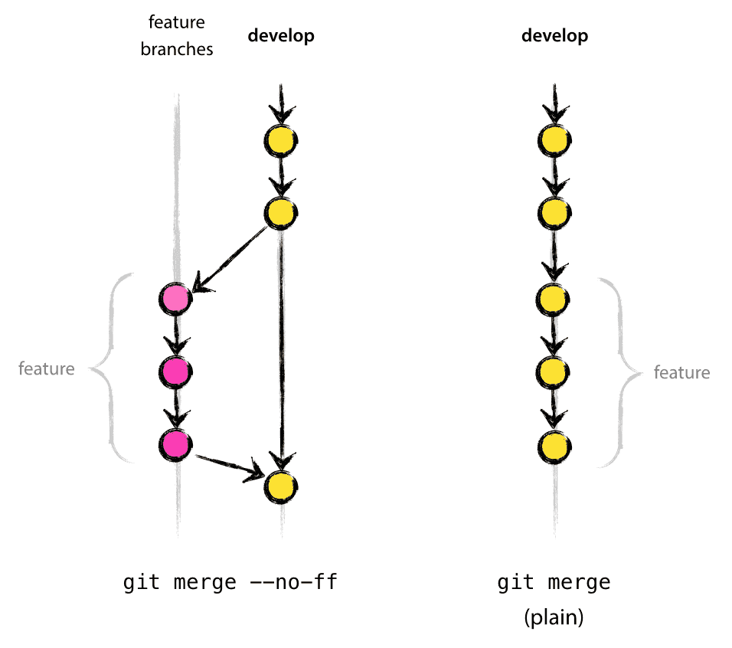

Slide 18
Hotfixes
Production release contains a bug
Create a hotfix branch from master
Fix the bug
merge fix into:
Next production release
Develop

Slide 19
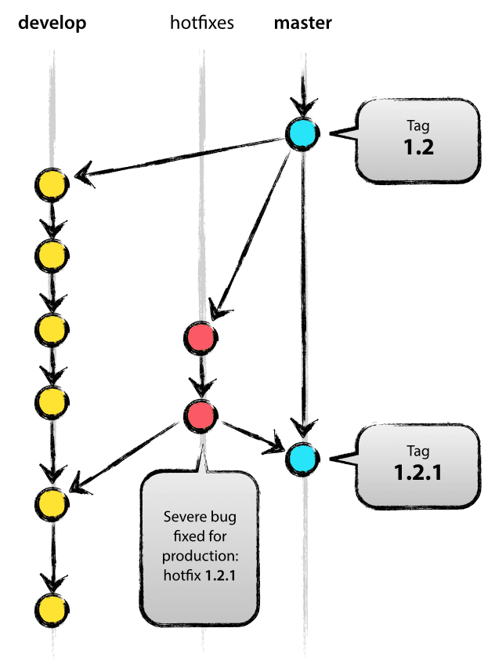

Slide 20
Release Branch
Branch off develop when approaching a release
No features added
Extensive testing and bug fixes
Merge all changes back to develop
When confidently stable
Merge into master as a release

Slide 21
Versioning
Tag the current state of the code
Can easily work with a previous version if needed
Use versioning on master

Slide 22


