Slide 1
CALL YOUR SHOT
PREDICT / RUN / BREAK / REPAIR / CHANGE
A hostile Hello World lab for people who already think this is stupid.
No grades for confidence. Call the next frame.
Notes:
[TONE SHIFT] Do not defend the topic. Agree with the hostility.
Say: Some of you think this is beneath you. Some think it has nothing to do with you. Excellent. Both claims are testable.
[PAUSE] The test is not whether the sketch runs. The test is whether you can call what happens next.
MEME NOTE: Two Buttons — 'This is too easy' / 'I have no idea what happens next.'
TRANSITION: Let us remove the easiest false positive first: visible output.
[Sources]
- https://www.naur.com/comp/c1-4.html
- https://p5js.org/reference/p5/setup/
- https://p5js.org/reference/p5/draw/

Slide 2
THE CHALLENGE
02
The sketch runs. So what?
Working output can hide copied code, accidental correctness, and a false model of execution.
RUNS
COPIED?
PREDICT?
REPAIR?
output appeared
maybe yours
call next state
recover on purpose
Already advanced? Prove control. Brand new? Stop guessing.
PREDICT / RUN / BREAK / READ / REPAIR / CHANGE
p5.js prediction lab
Notes:
Ask advanced students: Can you predict an unfamiliar program without running it?
Ask novices: Would three answer choices make that prediction possible?
DAD JOKE: A screenshot walked into a compiler. The compiler said, 'I do not see your type.'
TRANSITION: Confidence is cheap. We are going to make wagers.
[Sources]
- https://www.naur.com/comp/c1-4.html

Slide 3
THE RULES
03
The room runs on wagers, not confidence
1
CALL IT
Choose the next value or branch.
2
RUN IT
Compare execution with your claim.
3
BREAK IT
Force one assumption into view.
4
CHANGE IT
Make the program survive a new demand.
PREDICT / RUN / BREAK / READ / REPAIR / CHANGE
p5.js prediction lab
Notes:
Give everyone ten seconds per prediction. Advanced students must name the exact state or condition; novices may vote A/B/C.
No one loses points for a wrong prediction. They lose the chance to learn if they predict after the reveal.
MEME NOTE: Drake — rejects 'It works'; approves 'I called the next frame.'
TRANSITION: Enough claims. First wager.
[Sources]
- https://www.naur.com/comp/c1-4.html
- https://p5js.org/tutorials/field-guide-to-debugging/

Slide 4
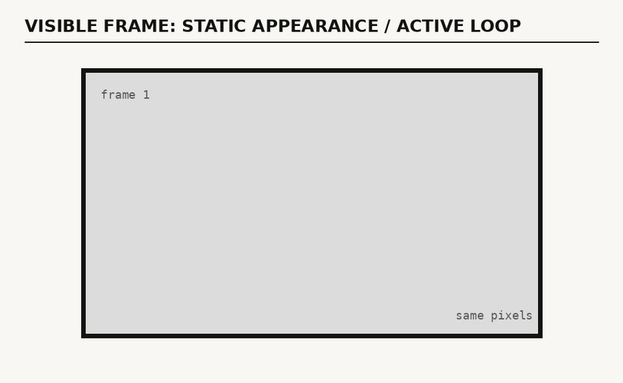
QUIZ 1 — LIFECYCLE
04
What happens after setup() finishes?
READ THE CODE
CHOOSE BEFORE THE CLICK
function setup() {
createCanvas(400, 200);
}
function draw() {
background(220);
}
A draw() runs once B draw() repeats C only a click runs it
PREDICT / RUN / BREAK / READ / REPAIR / CHANGE
p5.js prediction lab
Notes:
[PAUSE] Hands or fingers: A, B, or C. Do not accept 'it depends' unless the student names the dependency.
Advanced extension: Who calls draw()? Where is the loop if no loop appears in the text?
DAD JOKE: setup() is a one-time offer. draw() keeps renewing the subscription.
[CLICK] Advance without talking.
[Sources]
- https://p5js.org/reference/p5/setup/
- https://p5js.org/reference/p5/draw/

Slide 5
ANSWER 1 — LIFECYCLE
05
Answer B — draw() repeats
THE TEXT HIDES THE LOOP
THE FRAME LOOKS STILL
function setup() {
createCanvas(400, 200);
}
function draw() {
background(220);
}
setup() builds the stage once. draw() keeps performing the scene.
PREDICT / RUN / BREAK / READ / REPAIR / CHANGE
p5.js prediction lab
Notes:
Let the correct voters enjoy one second of unbearable superiority.
Then ask: What evidence on the screen proves repetition? Answer: none. We need the execution contract.
MEME NOTE: 'Nothing is happening' — meanwhile draw() is quietly doing the same job sixty times a second.
TRANSITION: Repetition gives a variable the chance to acquire a past.
[Sources]
- https://p5js.org/reference/p5/setup/
- https://p5js.org/reference/p5/draw/

Slide 6
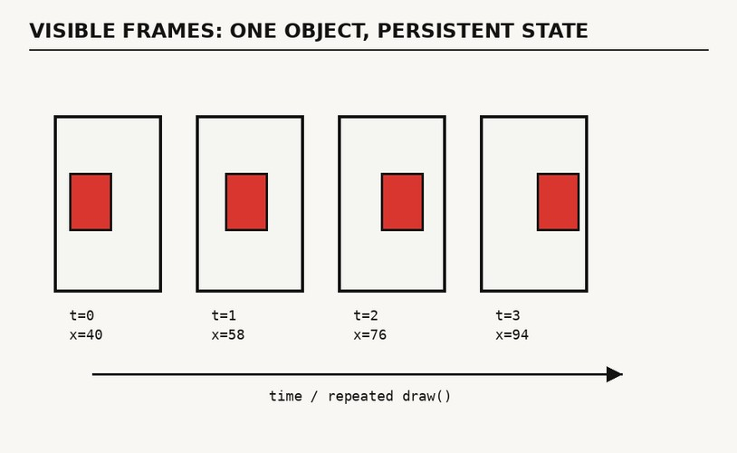
QUIZ 2 — STATE
06
What carries information into the next frame?
READ THE UPDATE
CHOOSE BEFORE THE CLICK
let x = 40;
function setup() {
createCanvas(400, 200);
}
function draw() {
background(245);
fill(217, 53, 43);
rect(x, 60, 80, 80);
x = x + 18;
}
A PIXELS B x C setup()
PREDICT / RUN / BREAK / READ / REPAIR / CHANGE
p5.js prediction lab
Notes:
[PAUSE] A, B, or C. Require advanced students to name the lifetime and scope of the state.
Novice foothold: ask which value exists before draw() starts again.
DAD JOKE: x wanted character development, so we gave it state.
[CLICK] Reveal.
[Sources]
- https://p5js.org/reference/p5/draw/
- https://p5js.org/tutorials/variables-and-change/

Slide 7
ANSWER 2 — STATE
07
Answer B — x carries the past
STATE SURVIVES THE FRAME
WATCH x SURVIVE
let x = 40;
function setup() {
createCanvas(400, 200);
}
function draw() {
background(245);
fill(217, 53, 43);
rect(x, 60, 80, 80);
x = x + 18;
}
PIXELS FORGET. x REMEMBERS.
PREDICT / RUN / BREAK / READ / REPAIR / CHANGE
p5.js prediction lab
Notes:
The image is redrawn. The variable x survives and changes, so it carries the object's history.
This is why 'What do I see?' and 'What state now exists?' are different questions.
MEME NOTE: Spider-Man pointing — the pixels point at x; x points at the next frame.
TRANSITION: One present image can hide more than one future.
[Sources]
- https://p5js.org/reference/p5/draw/
- https://p5js.org/tutorials/variables-and-change/

Slide 8
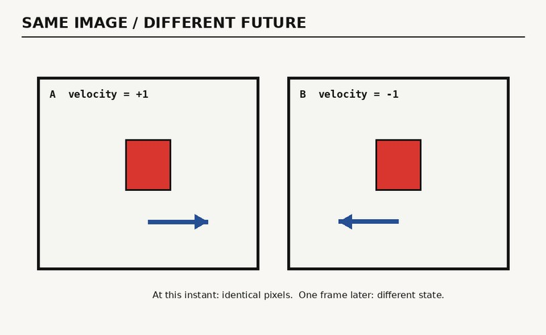
QUIZ 3 — FUTURE
08
Which program moves left next?
let x = 150;
let velocity = 1;
function setup() {
createCanvas(400, 200);
}
function draw() {
background(245);
rect(x, 60, 80, 80);
x += velocity;
}
let x = 150;
let velocity = -1;
function setup() {
createCanvas(400, 200);
}
function draw() {
background(245);
rect(x, 60, 80, 80);
x += velocity;
}
A B BOTH
PROGRAM A
PROGRAM B
PREDICT / RUN / BREAK / READ / REPAIR / CHANGE
p5.js prediction lab
Notes:
[PAUSE] Ask for the line of evidence, not only the letter.
Advanced extension: Name the smallest text change that reverses the future without changing the current frame.
DAD JOKE: Velocity signed the contract. Direction was in the fine print.
[CLICK] Reveal.
[Sources]
- https://p5js.org/tutorials/variables-and-change/

Slide 9
ANSWER 3 — FUTURE
09
Answer B — the next frame exposes the difference
let x = 150;
let velocity = 1;
function setup() {
createCanvas(400, 200);
}
function draw() {
background(245);
rect(x, 60, 80, 80);
x += velocity;
}
let x = 150;
let velocity = -1;
function setup() {
createCanvas(400, 200);
}
function draw() {
background(245);
rect(x, 60, 80, 80);
x += velocity;
}
CURRENT PIXELS CONCEAL FUTURE BEHAVIOR.
PROGRAM A
PROGRAM B
PREDICT / RUN / BREAK / READ / REPAIR / CHANGE
p5.js prediction lab
Notes:
The two screenshots are true and still insufficient. Their future depends on signed velocity.
MEME NOTE: Distracted Boyfriend — current screenshot looks at appearance; program state walks past carrying the future.
TRANSITION: Now we will let a wrong theory collide with the world.
[Sources]
- https://www.naur.com/comp/c1-4.html
- https://p5js.org/tutorials/variables-and-change/

Slide 10
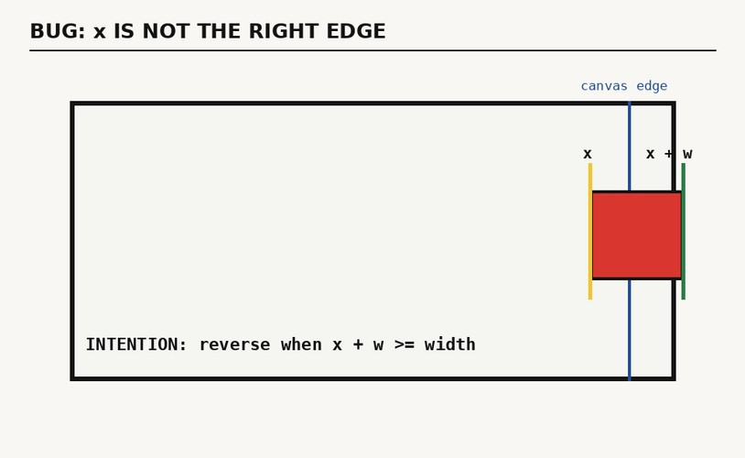
QUIZ 4 — BOUNDARY
10
When should the rectangle turn around?
THE CODE TESTS x > width
let x = 40;
let velocity = 2;
const w = 80;
function setup() {
createCanvas(400, 200);
}
function draw() {
background(245);
rect(x, 60, w, 80);
x += velocity;
if (x > width) {
velocity *= -1;
}
}
A x>width B x+w>=width C x=0
PREDICT / RUN / BREAK / READ / REPAIR / CHANGE
p5.js prediction lab
Notes:
[PAUSE] Ask students to point to the part of the rectangle named by x.
Novice foothold: x is the left edge. The object is still w pixels wide.
DAD JOKE: The rectangle crossed the line because nobody taught it edge-iquette.
[CLICK] Reveal.
[Sources]
- https://p5js.org/tutorials/variables-and-change/
- https://p5js.org/tutorials/field-guide-to-debugging/

Slide 11
ANSWER 4 — BOUNDARY
11
Answer B — the right edge is x + w
THE BUG REVEALS THE MODEL
let x = 40;
let velocity = 2;
const w = 80;
function setup() {
createCanvas(400, 200);
}
function draw() {
background(245);
rect(x, 60, w, 80);
x += velocity;
if (x > width) {
velocity *= -1;
}
}
The code confused the object's position with the object's full extent.
PREDICT / RUN / BREAK / READ / REPAIR / CHANGE
p5.js prediction lab
Notes:
This is the Heideggerian moment: smooth use stops, and the hidden relation becomes visible.
Say: The bug did not merely interrupt understanding. The bug produced it.
MEME NOTE: Surprised Pikachu — when the left edge reaches the right boundary eighty pixels too late.
TRANSITION: A visual failure shows what ran. An error message can show what stopped.
[Sources]
- https://www.beyng.com/pages/en/BeingandTimeMR/BeingandTimeMR.102.html
- https://p5js.org/tutorials/field-guide-to-debugging/

Slide 12
READ THE ERROR
12
An error names the operation that stopped
Read it as a failure report: stopped operation, broken condition, preserved state, recovery.
REFERENCEERROR
refresh is not defined
OPERATION STOPPED
refresh preview
FIRST BROKEN CONDITION
required operation missing
COMPLETED
source captured
NOT COMPLETED
canvas rebuilt
STATE PRESERVED
editor text
RECOVERY
define refresh or disable the control
PREDICT / RUN / BREAK / READ / REPAIR / CHANGE
p5.js prediction lab
Notes:
Ask: Which operation was attempted? Which state still exists? What is the smallest valid recovery?
Do not say 'the code broke.' Name the operation: the preview refresh stopped because refresh was undefined.
DAD JOKE: The function was undefined. Honestly, same before coffee.
TRANSITION: The console tells us what participated. It does not automatically tell us what never happened.
[Sources]
- https://p5js.org/tutorials/field-guide-to-debugging/

Slide 13
READ THE ABSENCE
13
Debug the operation that never ran
Breakdown reveals what participated.
Negative space reveals what was absent.
WHAT RAN
WHAT NEVER RAN
event handler
state update
boundary test
render call
validation
missing event
rejected branch
recovery path
ASK: WHAT SHOULD HAVE HAPPENED—BUT DID NOT?
PREDICT / RUN / BREAK / READ / REPAIR / CHANGE
p5.js prediction lab
Notes:
Use Goodin's negative-space question: What did the system omit, reject, or never attempt?
Ask the room for one missing event, one rejected branch, and one absent recovery path.
MEME NOTE: John Travolta looking around — the missing validation step is not in the room.
TRANSITION: Once the missing operation is visible, repair the rule that should have governed it.
[Sources]
- https://ntrs.nasa.gov/citations/20110024177
- https://p5js.org/tutorials/field-guide-to-debugging/

Slide 14
REPAIR
14
Repair the rule, not the bruise
let x = 40;
let velocity = 2;
const w = 80;
function setup() {
createCanvas(400, 200);
}
function draw() {
background(245);
rect(x, 60, w, 80);
x += velocity;
if (x + w >= width) {
x = width - w;
velocity = -abs(velocity);
} else if (x <= 0) {
x = 0;
velocity = abs(velocity);
}
}
GEOMETRIC THEORY
x
left edge
x + w
right edge
INVARIANT
0 ≤ x ≤ width - w
The repaired boundary restores both position and direction.
PREDICT / RUN / BREAK / READ / REPAIR / CHANGE
p5.js prediction lab
Notes:
Contrast patches: changing width to width - 80 hides one symptom; naming x + w repairs the geometric theory.
Ask advanced students for another valid invariant-preserving repair. Ask novices to read the invariant aloud.
DAD JOKE: We did not move the goalpost. We finally measured the whole rectangle.
TRANSITION: If the rule matters, the prompt must state it before code generation.
[Sources]
- https://www.naur.com/comp/c1-4.html
- https://www.cs.utexas.edu/~EWD/transcriptions/EWD03xx/EWD303.html
- https://p5js.org/tutorials/field-guide-to-debugging/

Slide 15
PROMPT
15
A prompt is a contract for behavior
Build one complete p5.js sketch.
PURPOSE — move one rectangle; keep every pixel inside.
STATE — x, y, width, height, velocity
LOOP — draw → move → test → reverse
INVARIANT — 0 ≤ x ≤ canvas width - rectangle width
FAILURE — name operation, condition, preserved state, recovery.
DELIVER — runnable code + rule-to-code map.
PREDICT / RUN / BREAK / READ / REPAIR / CHANGE
p5.js prediction lab
Notes:
Do not read the full prompt aloud. Point to PURPOSE, ENTITIES, OPERATIONS, INVARIANT, FAILURE REPORT, OUTPUT.
Tell advanced students: this is a lightweight behavioral specification. Tell novices: this is how you stop asking AI for magic.
MEME NOTE: Genie contract — precise wish, fewer cursed side effects.
TRANSITION: A strong contract can produce runnable text. Runnable is still not owned.
[Sources]
- https://www.naur.com/comp/c1-4.html
- https://p5js.org/tutorials/field-guide-to-debugging/

Slide 16
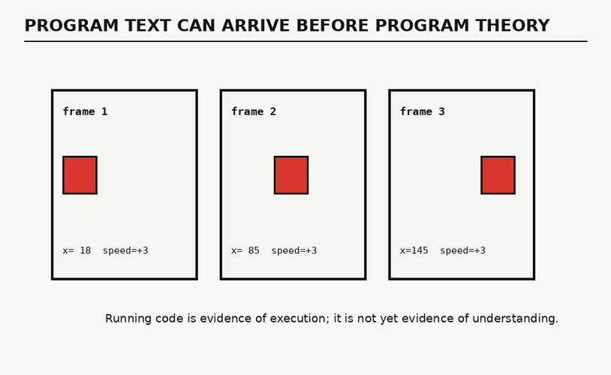
AI-GENERATED TEXT
16
Generated code is borrowed until audited
let x = 40;
let speed = 3;
const w = 60;
function setup() {
createCanvas(400, 200);
}
function draw() {
background(240);
fill(217, 53, 43);
rect(x, 70, w, 60);
if (x + speed < 0 || x + speed + w > width) {
speed *= -1;
}
x += speed;
}
OWNERSHIP TEST
Which rule keeps it inside?
Why is speed signed?
Where does the diagram disagree?
PREDICT / RUN / BREAK / READ / REPAIR / CHANGE
p5.js prediction lab
Notes:
Ask the three questions without accepting a run as proof. The diagram-code mismatch is deliberate: its labeled x positions do not follow speed = 3.
Advanced students should catch the contradiction. Novices can point to the boundary expression and explain signed speed.
DAD JOKE: The AI gave you code. Unfortunately, the maintenance plan was sold separately.
TRANSITION: Ownership appears when a new demand arrives.
[Sources]
- https://www.naur.com/comp/c1-4.html
- https://p5js.org/tutorials/variables-and-change/

Slide 17
MODIFICATION TEST
17
New demand: pause every third collision
What new memory must the program acquire?
const box = { x: 40, y: 60, w: 80, h: 80, v: 3 };
let collisions = 0, resumeAt = 0;
function setup() {
createCanvas(400, 200);
}
function draw() {
background(245);
fill(217, 53, 43);
rect(box.x, box.y, box.w, box.h);
if (millis() < resumeAt) return;
box.x += box.v;
if (box.x <= 0 || box.x + box.w >= width) {
box.x = constrain(box.x, 0, width - box.w);
box.v *= -1;
collisions++;
if (collisions % 3 === 0) {
resumeAt = millis() + 1000;
}
}
}
NEW PERSISTENT STATE
collisions
remembers boundary events
resumeAt
represents waiting state
The old pixels contain no collision count and no waiting state.
PREDICT / RUN / BREAK / READ / REPAIR / CHANGE
p5.js prediction lab
Notes:
Ask before showing the right column: What must persist? Expected answers: collision count and resume time.
This is the change test: the learner must invent state that the original screenshot never contained.
MEME NOTE: Final Boss music starts when the client says, 'One tiny change.'
TRANSITION: State explains behavior. Representation explains what the behavior is for.
[Sources]
- https://www.naur.com/comp/c1-4.html
- https://p5js.org/tutorials/variables-and-change/

Slide 18
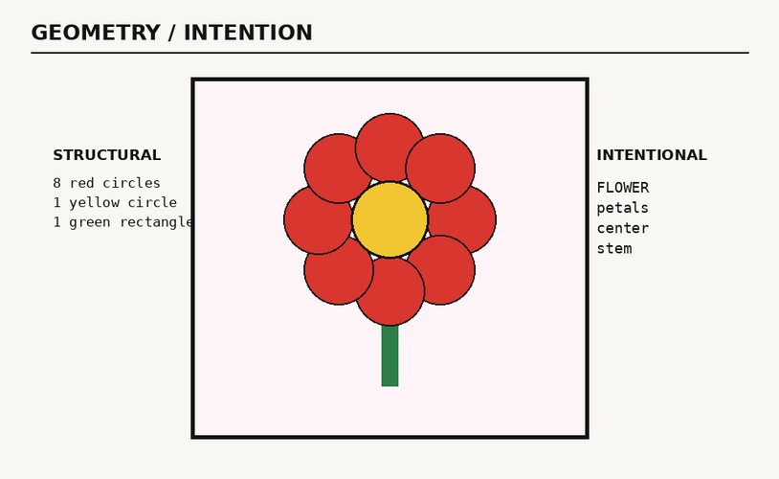
REPRESENTATION / INTENTION
18
The flower is a loop wearing petals
function setup() {
createCanvas(300, 300);
noLoop();
describe("A red flower with a yellow center and green stem.");
}
function draw() {
background(255, 248, 250);
fill(47, 143, 91);
rect(145, 145, 10, 110);
translate(150, 125);
fill(217, 53, 43);
for (let i = 0; i < 8; i++) {
const a = TWO_PI * i / 8;
circle(cos(a) * 48, sin(a) * 48, 55);
}
fill(242, 194, 48);
circle(0, 0, 58);
}
STRUCTURE
8 circles + 1 circle + 1 rectangle
INTENTION
a flower with petals, center, and stem
PREDICT / RUN / BREAK / READ / REPAIR / CHANGE
p5.js prediction lab
Notes:
Ask: Which statement helps a screen reader? Which statement helps a programmer modify petal count? We need both.
Advanced extension: identify the mapping from loop index i to angle a.
DAD JOKE: The flower had an array of petals. It was outstanding in its field.
TRANSITION: We need an inspector that keeps structure and intention visible together.
[Sources]
- https://p5js.org/tutorials/writing-accessible-canvas-descriptions/
- https://p5js.org/tutorials/variables-and-change/

Slide 19
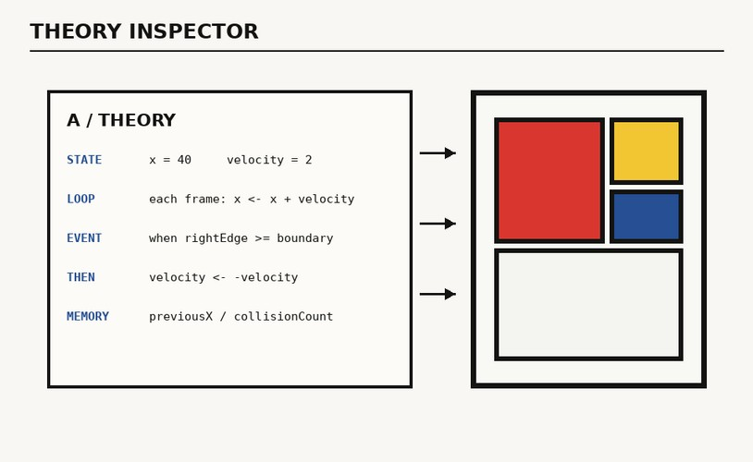
THEORY INSPECTOR
19
A theory names what the blocks hide
STATE
what persists
LOOP
what repeats
EVENT
what changes the branch
MEMORY
what makes history matter
MAKE RELATIONS VISIBLE
PREDICT / RUN / BREAK / READ / REPAIR / CHANGE
p5.js prediction lab
Notes:
Walk clockwise: state persists; loop repeats; event selects a branch; memory lets history matter.
Ask one advanced student to falsify the diagram. Ask one novice to point to each relation in the code.
MEME NOTE: Pepe Silvia corkboard—but with four labels and an actual causal model.
TRANSITION: Convert the diagram into six questions students can reuse without us.
[Sources]
- https://www.naur.com/comp/c1-4.html

Slide 20
REFERENCE
20
Six questions replace 'Do you understand?'
LIFECYCLE
STATE
Who calls this, and when?
What survives the current execution?
TRANSITION
CONDITION
What rule produces the next state?
Which alternate future becomes active?
REPRESENTATION
INVARIANT
What does each value stand for?
What must remain true after change?
PREDICT / RUN / BREAK / READ / REPAIR / CHANGE
p5.js prediction lab
Notes:
Use this as the reusable worksheet. Students may answer in code comments, console logs, diagrams, or spoken predictions.
Pair advanced and novice students only after each person records an individual prediction.
DAD JOKE: There are 10 kinds of people: those who predict binary jokes and those still tracing the branch.
TRANSITION: These questions also tell us what good failure looks like.
[Sources]
- https://www.naur.com/comp/c1-4.html
- https://p5js.org/tutorials/field-guide-to-debugging/

Slide 21
GOOD CODE
21
Good code fails near the cause
BAD BREAK
GOOD BREAK
elsewhere
later
ambiguously
silently
irreversibly
near the cause
at an explicit boundary
with preserved evidence
inside a limited blast radius
toward a valid recovery
MAKE NORMAL USE QUIET. MAKE FAILURE SPEAK.
PREDICT / RUN / BREAK / READ / REPAIR / CHANGE
p5.js prediction lab
Notes:
Ask the class to improve one failure along a single axis: distance, timing, ambiguity, evidence, blast radius, or recovery.
Say: Congratulations—the bug just explained the program better than the comments did.
MEME NOTE: This Is Fine becomes useful only when the console names which room is on fire.
TRANSITION: One final demand decides whether the program is actually yours.
[Sources]
- https://p5js.org/tutorials/field-guide-to-debugging/
- https://www.cs.utexas.edu/~EWD/transcriptions/EWD03xx/EWD303.html
- https://www.beyng.com/pages/en/BeingandTimeMR/BeingandTimeMR.102.html

Slide 22
FINAL BOSS
22
Change the demand
CALL
RUN
BREAK
REPAIR
CHANGE
A program becomes yours when it survives a change you did not anticipate.
PREDICT / RUN / BREAK / READ / REPAIR / CHANGE
p5.js prediction lab
Notes:
Give the class a new requirement not shown in the deck: add a second rectangle with a different width and keep both inside the canvas.
Require: prediction, named invariant, deliberate break, evidence, repair, and one further change.
Exit line: If the sketch merely runs, we have output. If you can change it without guessing, you have a program.
[Sources]
- https://www.naur.com/comp/c1-4.html
- https://www.beyng.com/pages/en/BeingandTimeMR/BeingandTimeMR.102.html
- https://p5js.org/tutorials/field-guide-to-debugging/

Slide 23
SOURCES
23
Sources for the theory, code, and debugging method
NAUR
p5.js
Programming as Theory Building (1985)
setup() and draw() references
https://www.naur.com/comp/c1-4.html
https://p5js.org/reference/p5/setup/
https://p5js.org/reference/p5/draw/
DIJKSTRA
p5.js
On the Reliability of Programs
Variables and Change
https://www.cs.utexas.edu/~EWD/transcriptions/EWD03xx/EWD303.html
https://p5js.org/tutorials/variables-and-change/
HEIDEGGER
p5.js
Being and Time, section 16
Field Guide to Debugging
https://www.beyng.com/pages/en/BeingandTimeMR/BeingandTimeMR.102.html
https://p5js.org/tutorials/field-guide-to-debugging/
GOODIN / NASA
p5.js
Negative Space and System Safety
Accessible Canvas Descriptions
https://ntrs.nasa.gov/citations/20110024177
https://p5js.org/tutorials/writing-accessible-canvas-descriptions/
PREDICT / RUN / BREAK / READ / REPAIR / CHANGE
p5.js prediction lab
Notes:
Keep this slide available during questions. The deck distinguishes the philosophical analogy from the programming documentation and NASA system-safety application.
[Sources]
- https://www.naur.com/comp/c1-4.html
- https://p5js.org/reference/p5/setup/
- https://p5js.org/reference/p5/draw/
- https://p5js.org/tutorials/variables-and-change/
- https://p5js.org/tutorials/field-guide-to-debugging/
- https://p5js.org/tutorials/writing-accessible-canvas-descriptions/
- https://www.cs.utexas.edu/~EWD/transcriptions/EWD03xx/EWD303.html
- https://www.beyng.com/pages/en/BeingandTimeMR/BeingandTimeMR.102.html
- https://ntrs.nasa.gov/citations/20110024177

