Slide 1
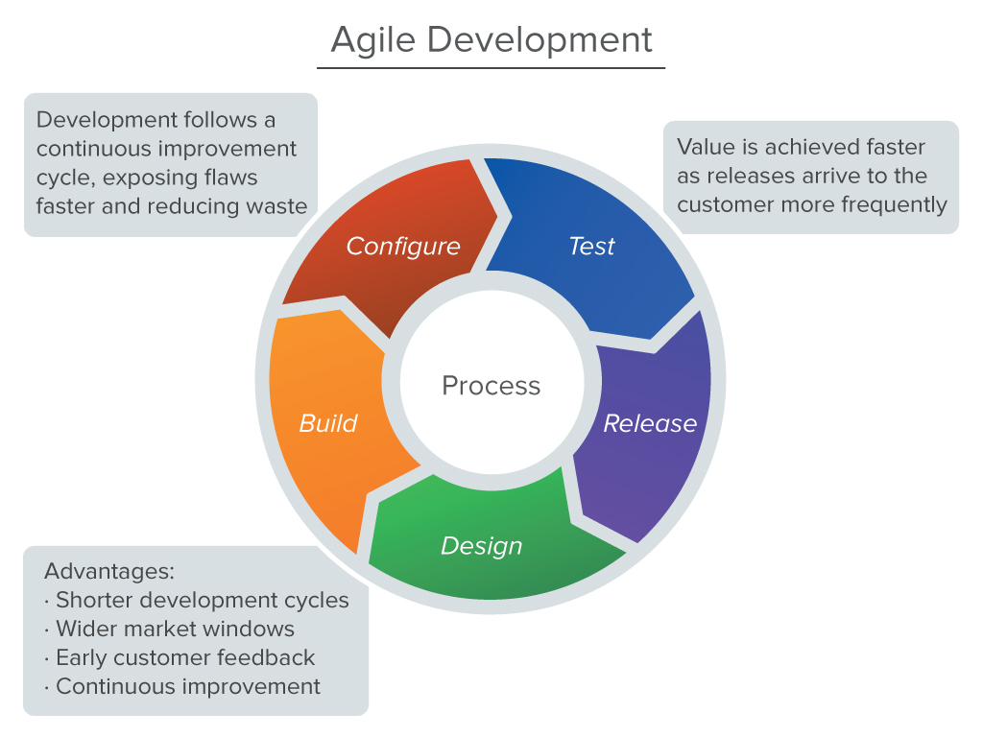
Museum Beacon System
Michael Hartung, Matthew Armand, Carlton Bennett, Gina Sietz, Dan Hoover
Introduction
Mobile
Process
We have developed a product which will allow museum professionals to configure “beacons” to work with exhibits in their museums. Our application can be use to display information about the exhibits. Our web application will allow the museum creative control over the information they would like to provide for each exhibit. This information may include additional descriptions, history, images, and audio to help their guests understand the pieces they are looking at.
For our project, we used the Agile methodology to plan what we would accomplish during each phase, or sprint. Essential to this planning process was the project management tool JIRA, which allowed us to assign tasks, detail levels of involvement for each task, and chart our progress. We started our project planning by making a list of features we would like our project to include. From this list, we developed a priority level for each task and estimated the time for completion. This document was helpful in deciding what features we would add for the next sprint. After assigning these tasks, we worked both independently and with other group members for the next two weeks on our individual project components. During the sprint, we pushed our code to our Github repository. After the sprint was complete, we met to show our progress, review our code, and plan the next sprint.
What is a Beacon?
“Estimote Beacons are small wireless sensors that you can attach to any location or object. They broadcast tiny radio signals which your smartphone can receive and interpret, unlocking micro-location and contextual awareness.” – estimote.com
Android/iOS Mobile App
App pulls data from Parse
Parse Database
Museum updates exhibit data
Tools & Frameworks
Node.js Web App
Project Management
JIRA
Github
Toggl
Whiteboards
Communication
Google Hangouts
Android
Android Studio
Estimote SDK
Parse SDK
iOS
Xcode
Core Location Framework
Parse SDK
SWRevealViewController (Slider)
Web
Node.js
Express.js
Passport.js
MongoDB
Bootstrap
jQuery
Parse SDK
Jade Templating Framework
Go (Dropped)
Google App Engine (Dropped)
Image Courtesy of http://www.drew-fuller.com/agile-development-methodology-diagram.html
Web
Future Implementations
Config App
Hotspot Tracking
Rating/Voting
Social Sharing
Appearance Improvements
More Template Options

