Slide 1
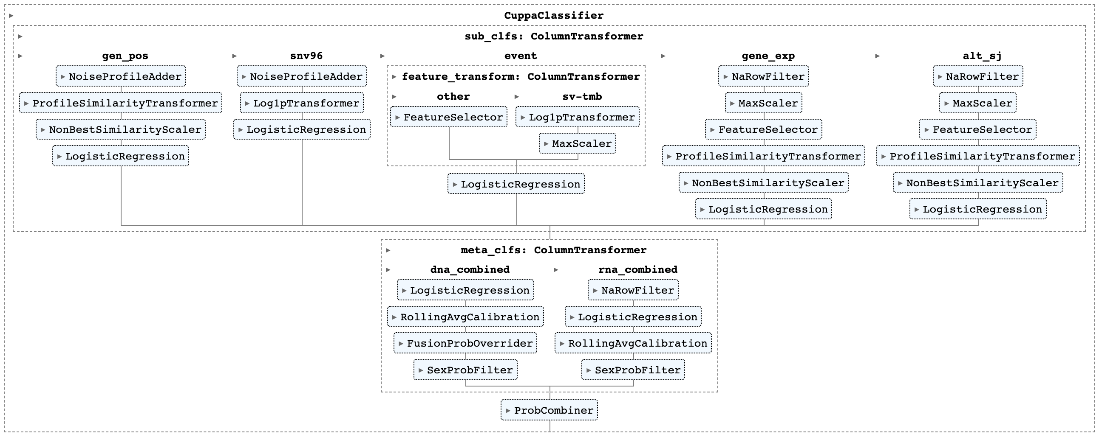

Slide 2
GEN_POS
SNV96
EVENT
GENE_EXP
ALT_SJ
SNVs per 500kb bin
96-trinucleotide
counts
Drivers, fusions,
virus, sex, WGD
SVs, TMB
Gene expression
Alternative splice junctions
NaRowFilter
NaRowFilter
Sub-classifiers
NoiseProfileAdder
MaxScaledChi2FeatureSelector
MaxScaledChi2FeatureSelector
ProfileSimilarityTransformer
NoiseProfileAdder
Chi2FeatureSelector
Log1pTransformer
ProfileSimilarityTransformer
ProfileSimilarityTransformer
NonBestSimilarityScaler
Log1pTransformer
MaxScaler
NonBestSimilarityScaler
NonBestSimilarityScaler
LogisticRegression
LogisticRegression
LogisticRegression
LogisticRegression
LogisticRegression
Probabilities
Probabilities
Probabilities
Probabilities
Probabilities
DNA_COMBINED
RNA_COMBINED
LogisticRegression
NaRowFilter
RollingAvgCalibration
LogisticRegression
Meta-classifiers
FusionProbOverrider
RollingAvgCalibration
SexProbFilter
SexProbFilter
Probabilities
Probabilities
COMBINED
ProbCombiner
Probabilities

Slide 3
Features
One new sample
Feature values
Cancer types
Train
Final classifier
Final
model
Probabilities
Performance
evaluation
Features
Iteration
Repeat
Predictions on
whole dataset
1
2
3
…
10
Feature values
Cancer type labels
Predict on
held out
samples
Samples
Split
Train
…
Performance
metrics
Classifier of
iteration 1

Slide 4
GEN_POS bins
Breast
Sum
Per cancer type
GEN_POS profiles
GEN_POS profile for a new
breast cancer sample
Liver
Sum
Samples
Prostate
⋮
Cosine
similarities
0.96
0.41
0.65
⋮
Sum
⋮
Other cancer types

Slide 5
