Slide 1
Cancer Clinical Trial Curation
Using Agentic Workflow
Hartwig Medical Foundation, Australia
30 July 2026

Slide 2
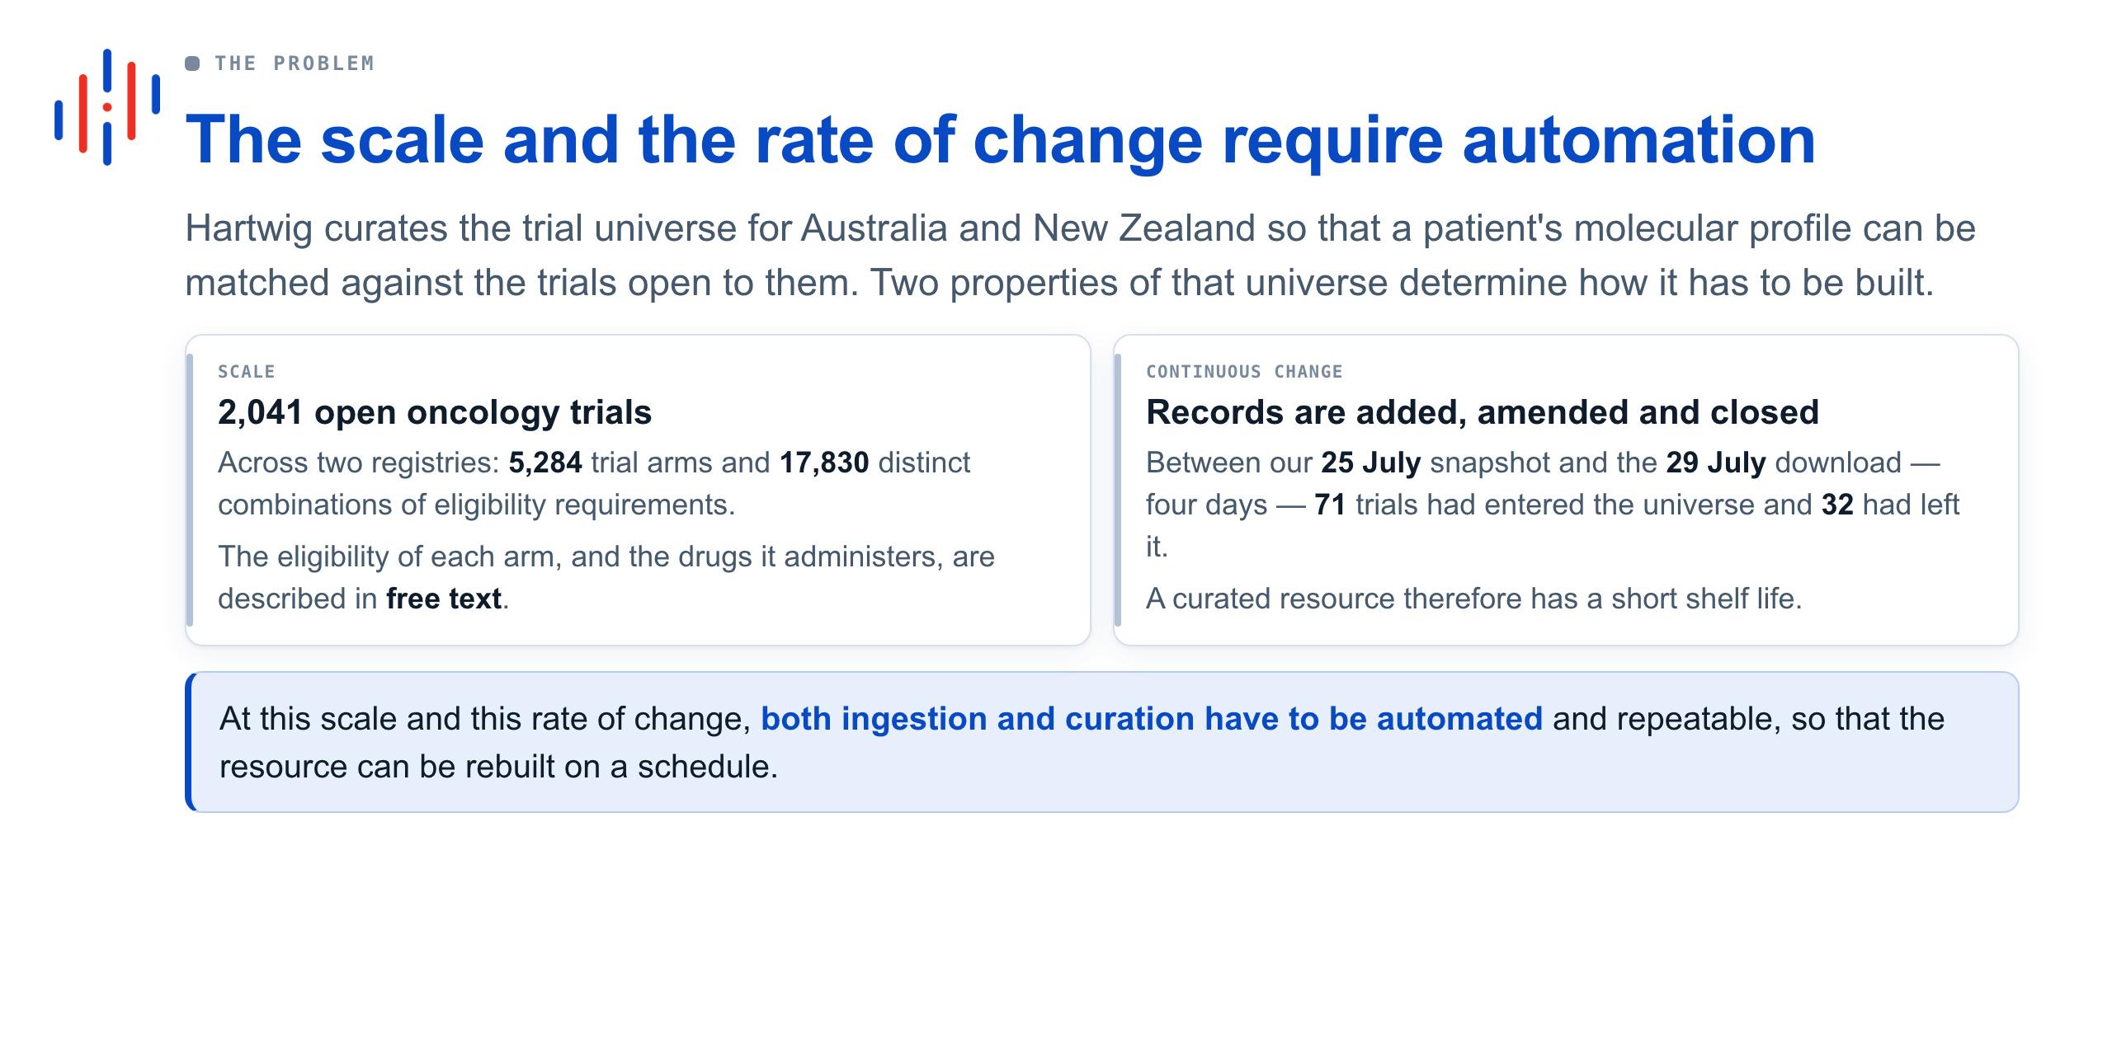

Slide 3
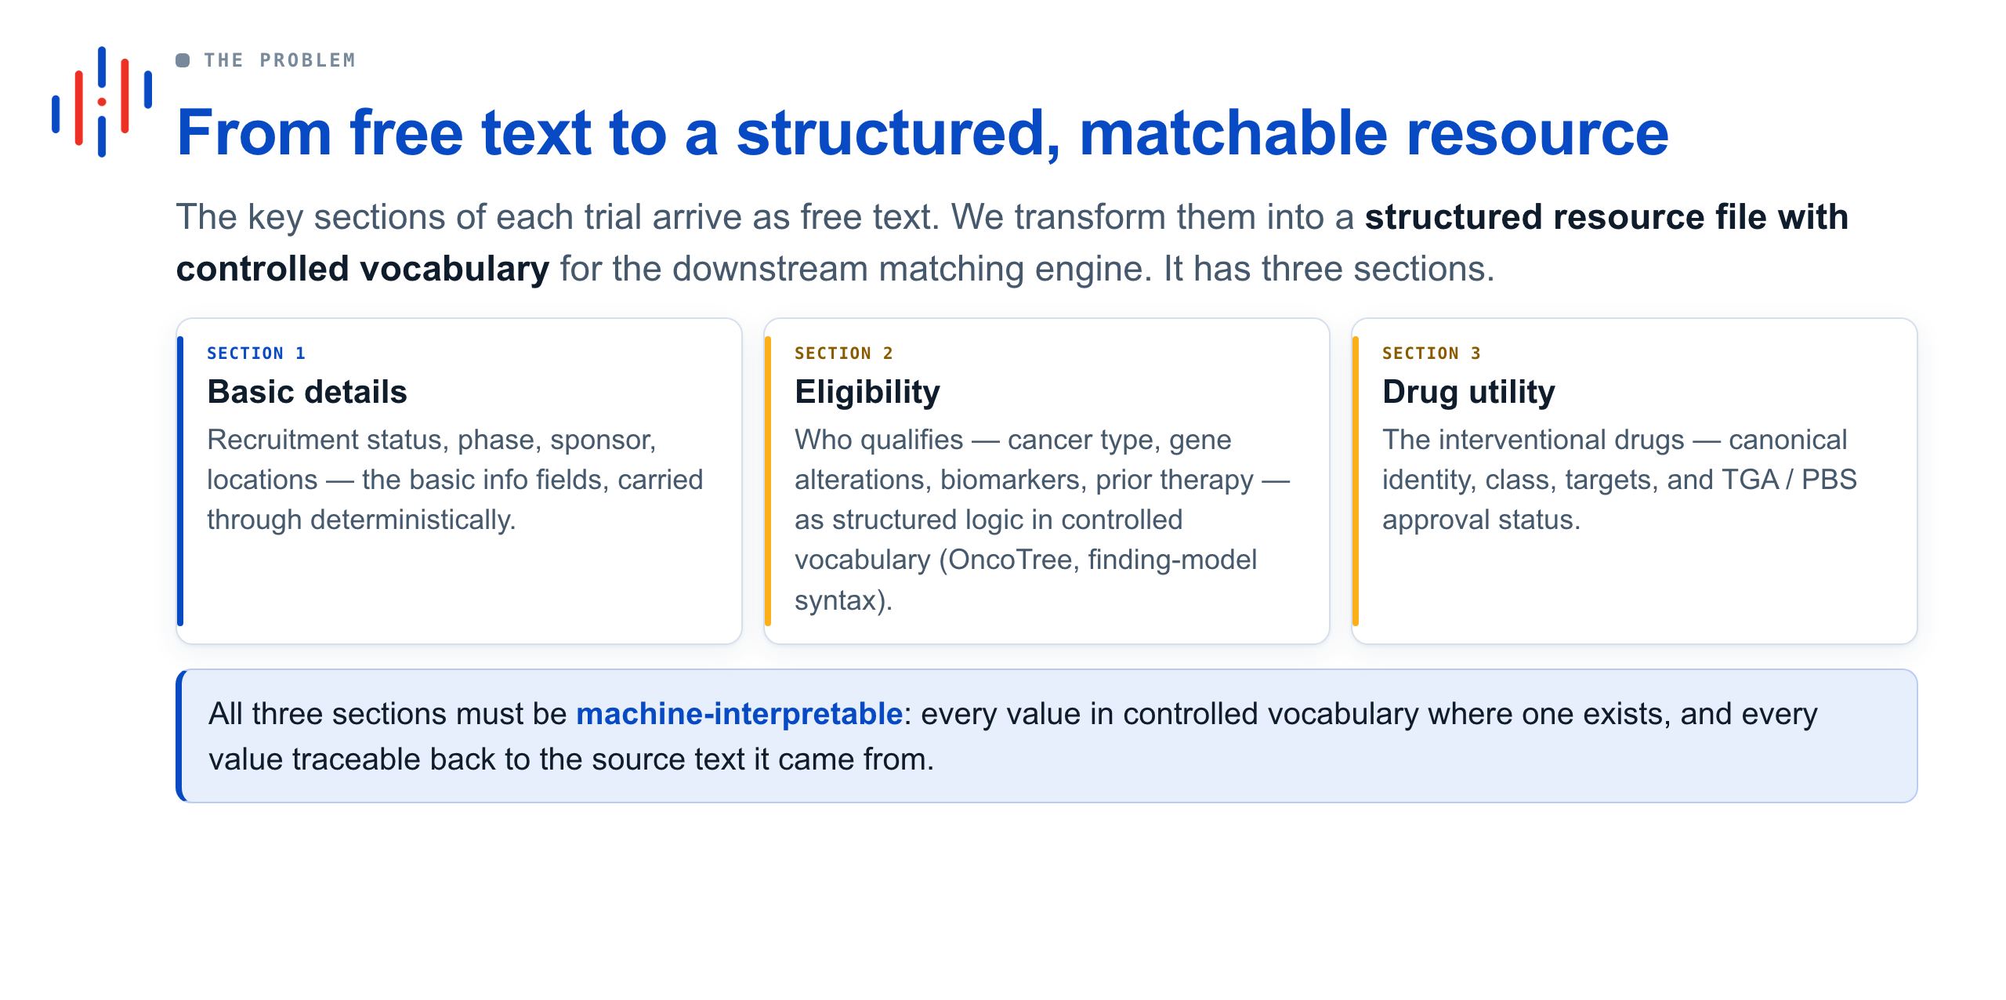

Slide 4
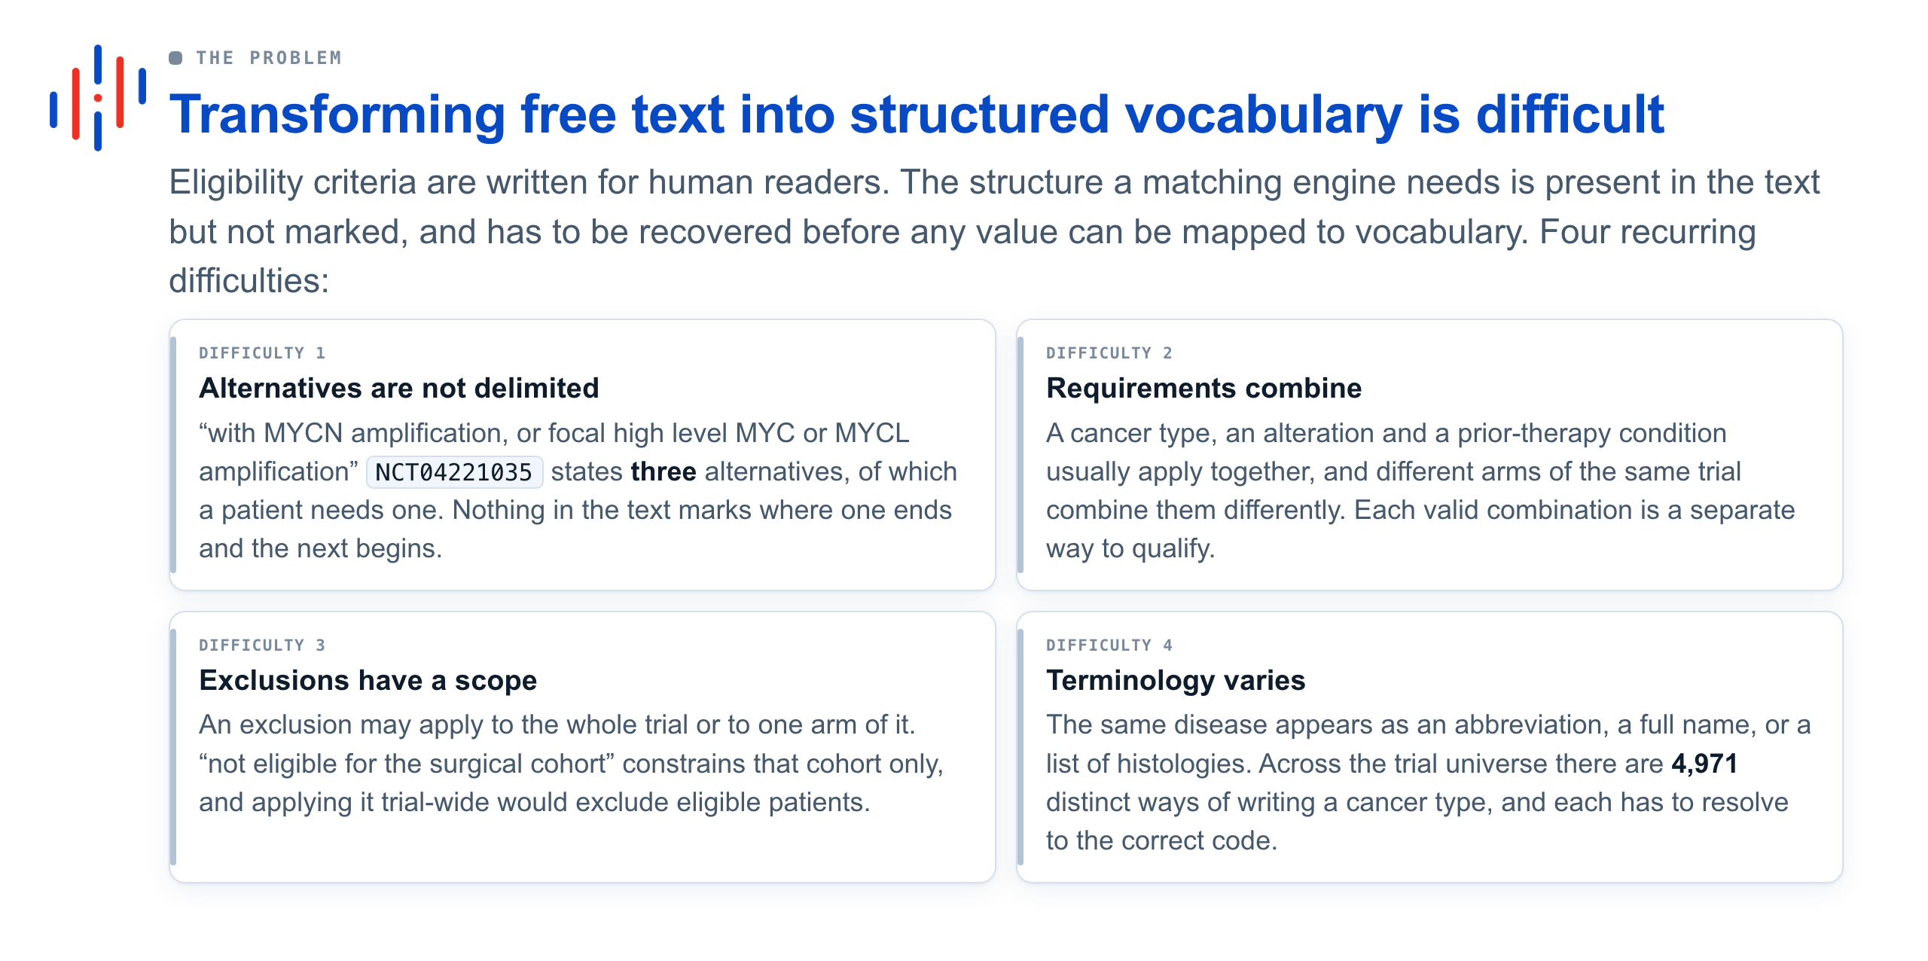

Slide 5
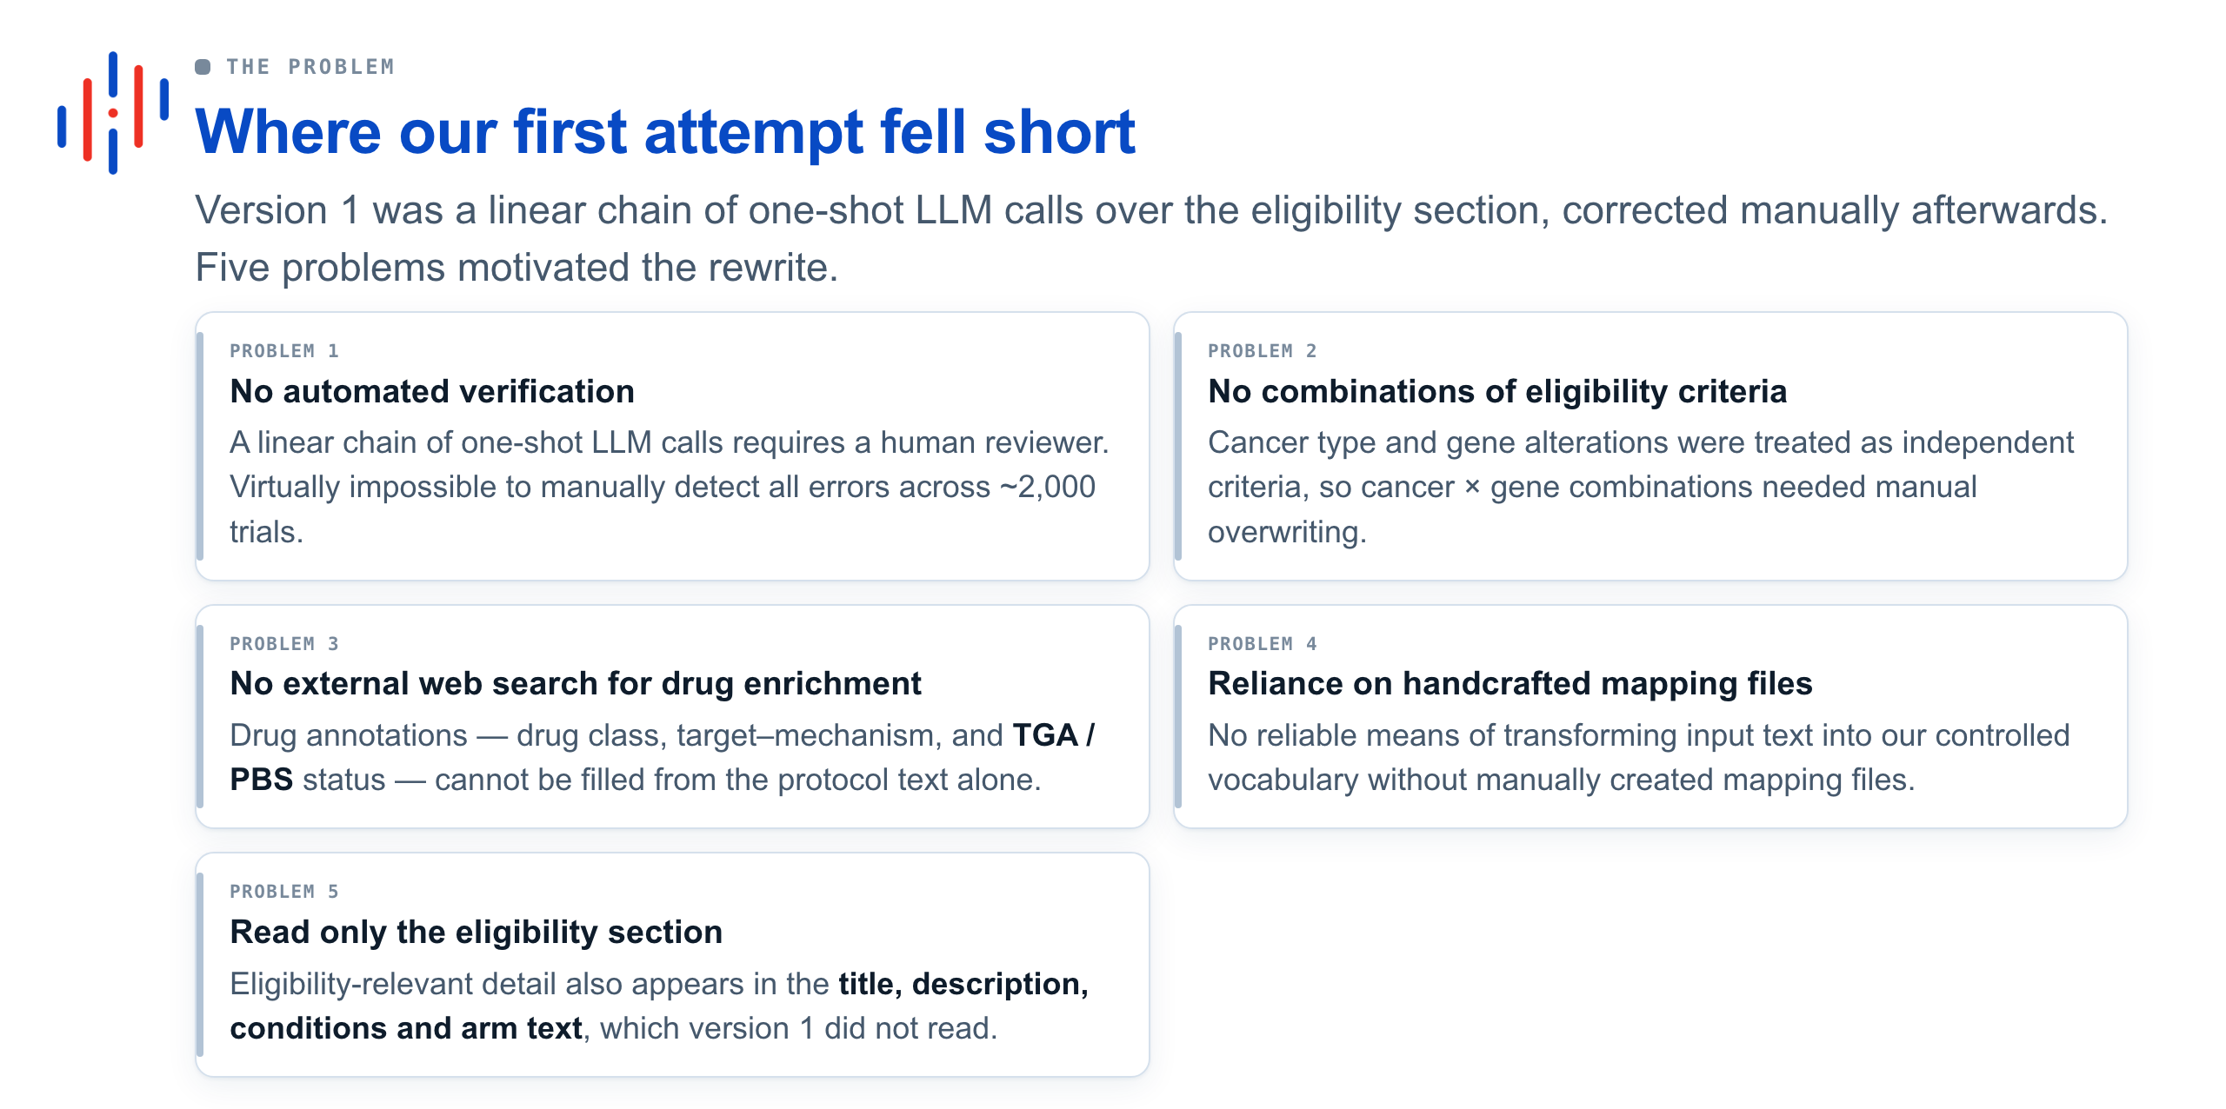

Slide 6
The pipeline, end to end

Slide 7
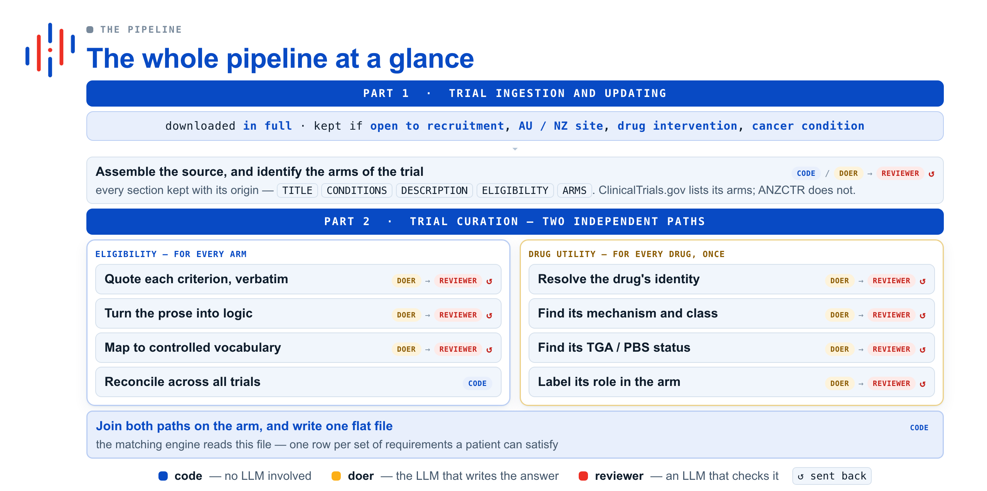

Slide 8
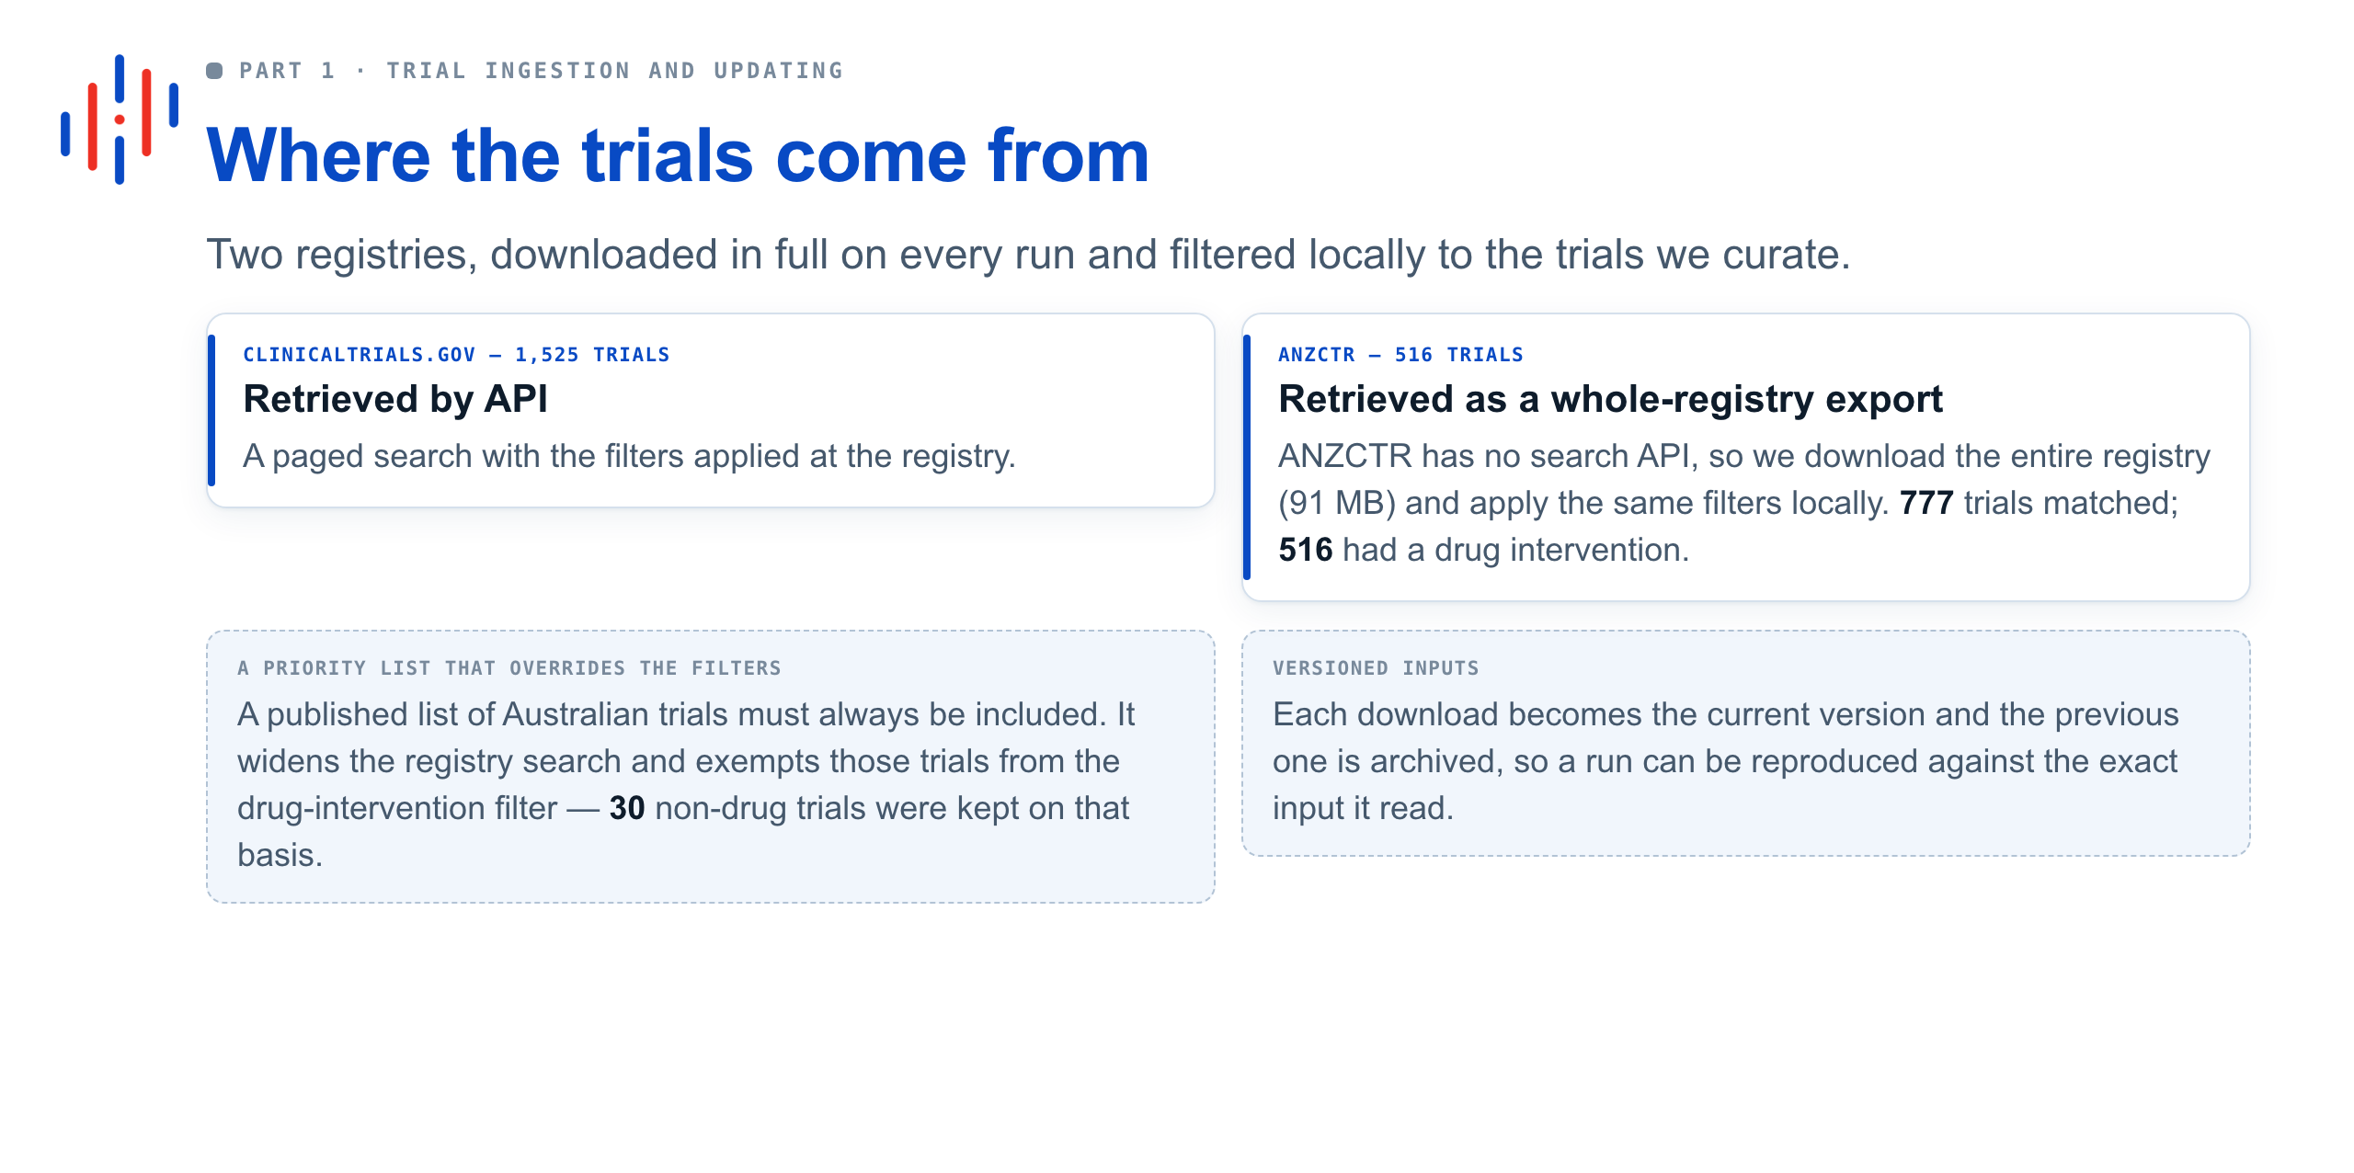

Slide 9
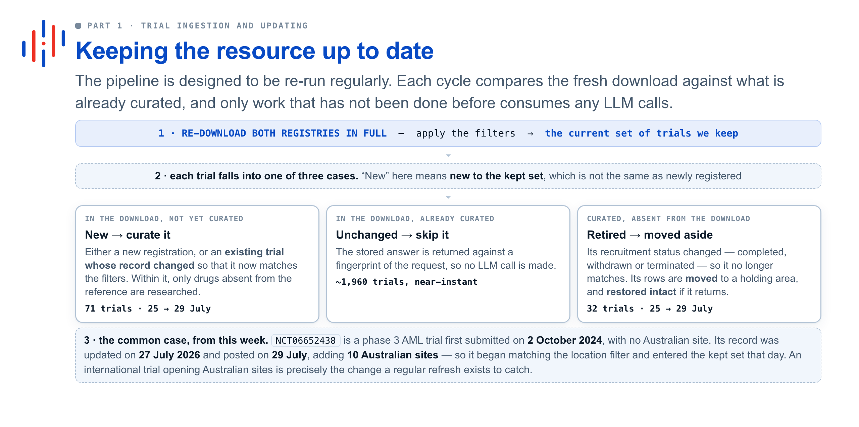

Slide 10
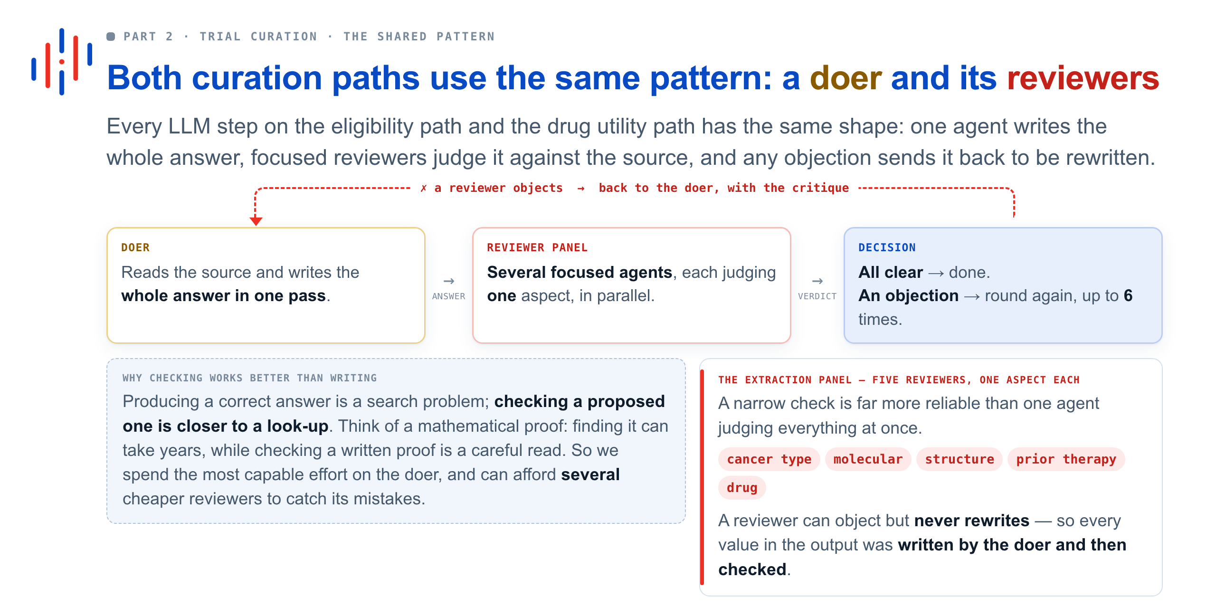

Slide 11
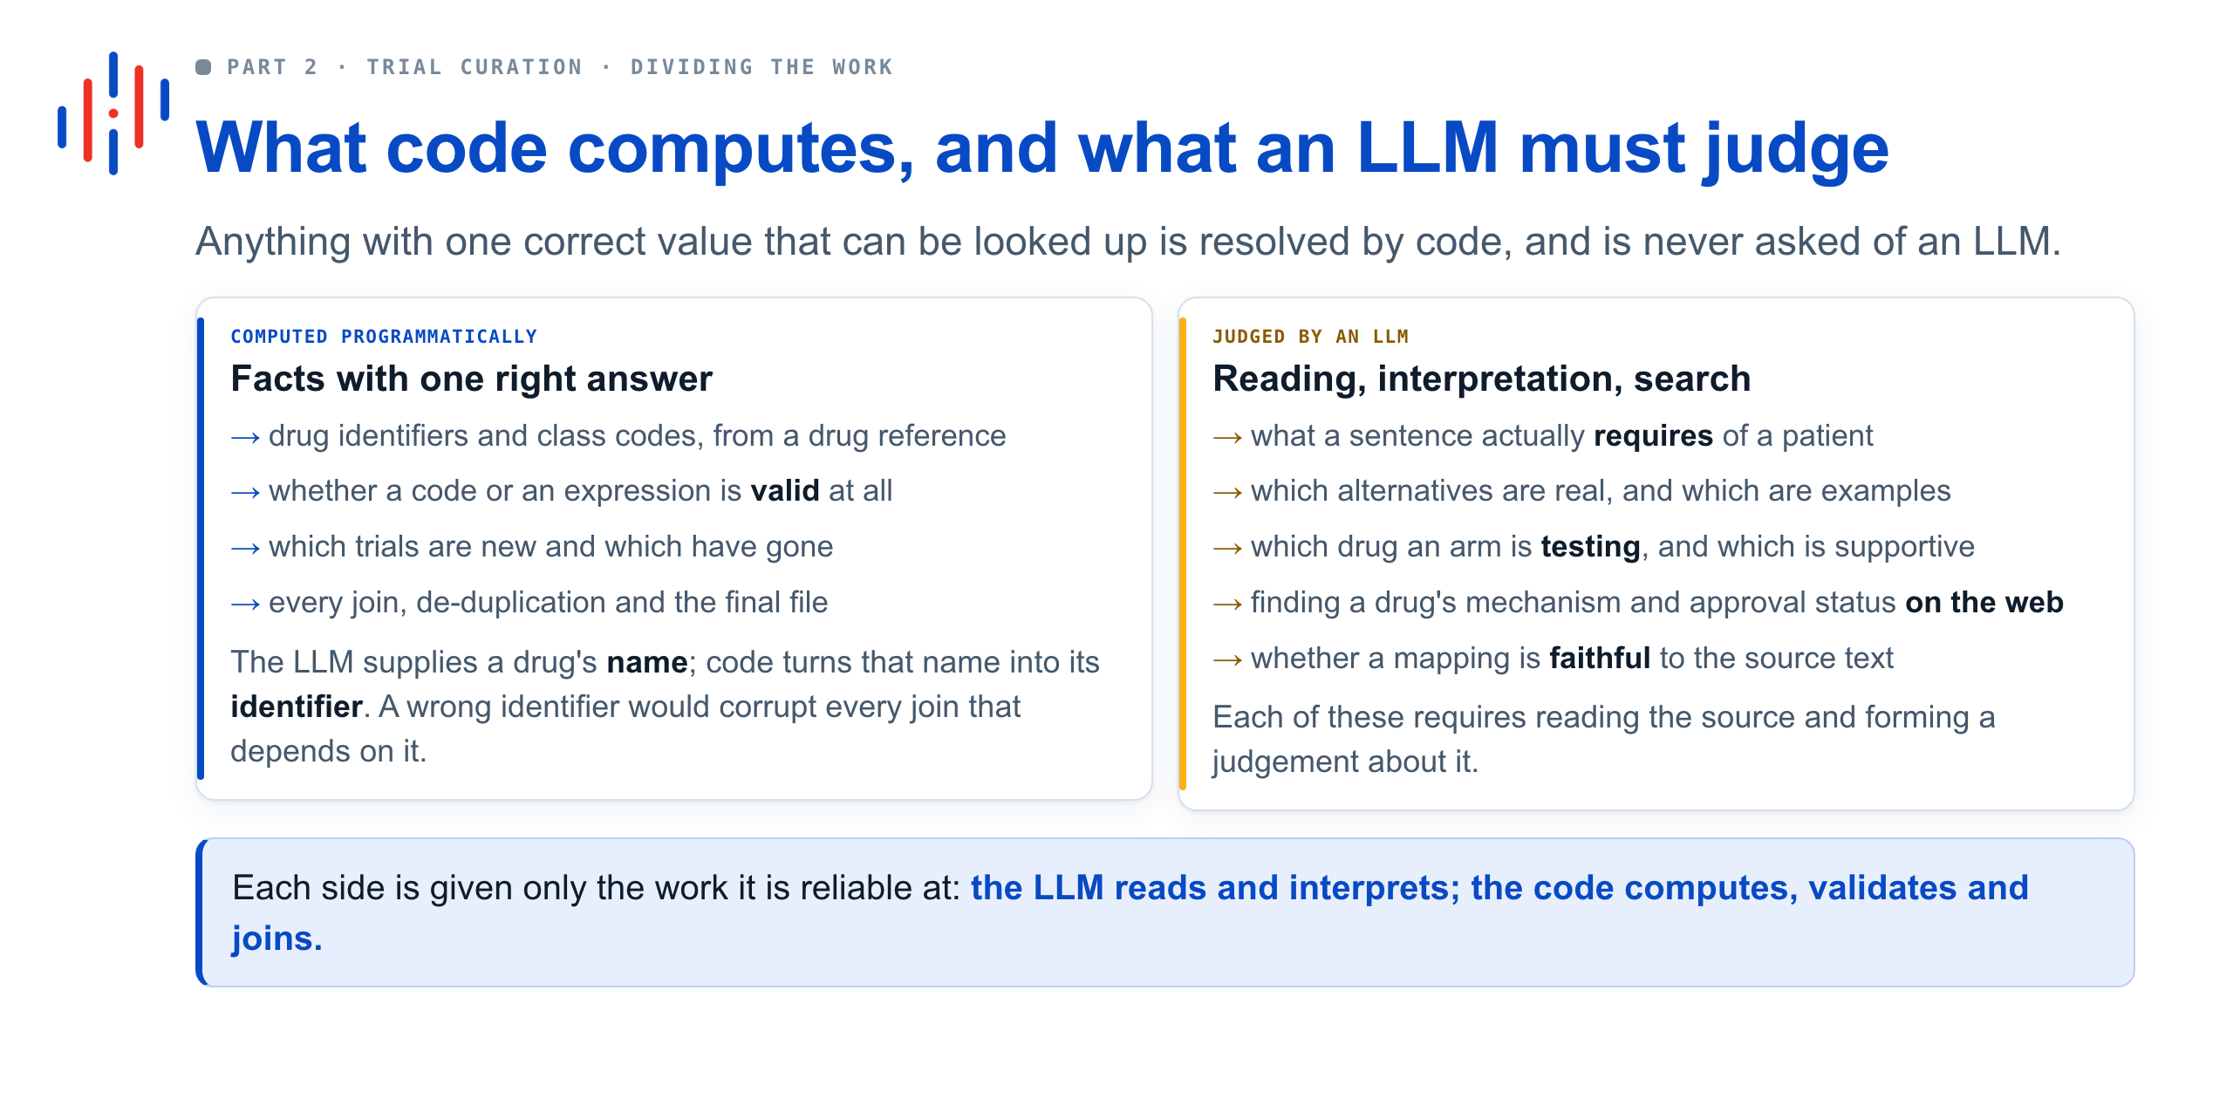

Slide 12
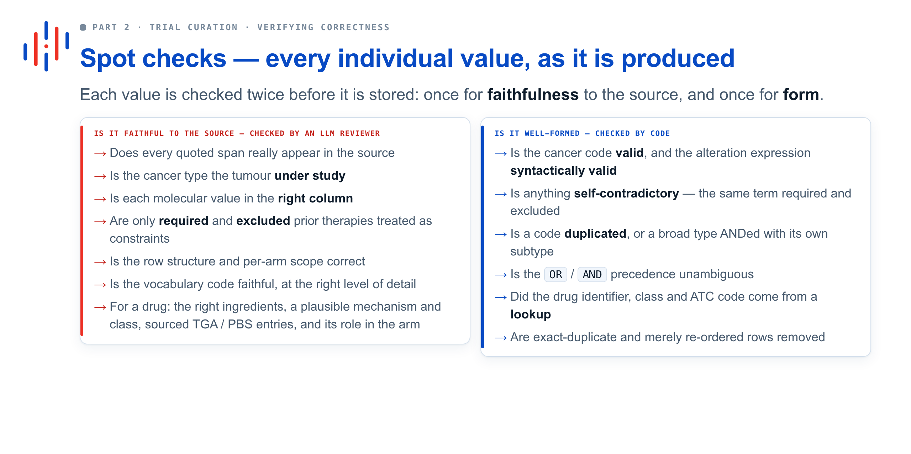

Slide 13
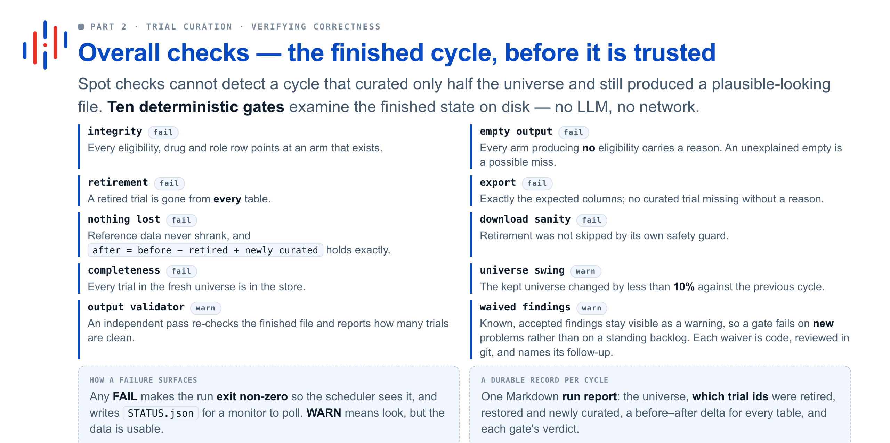

Slide 14
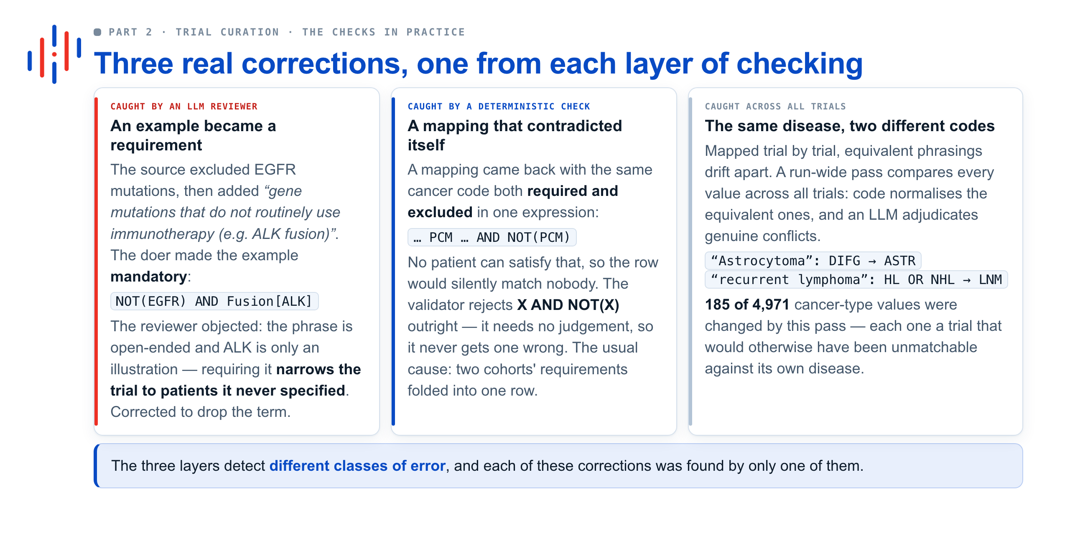

Slide 15
What it produces, and what we learned

Slide 16
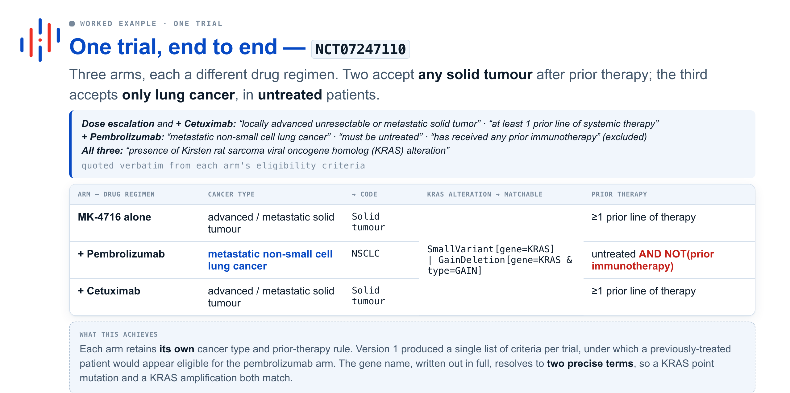

Slide 17
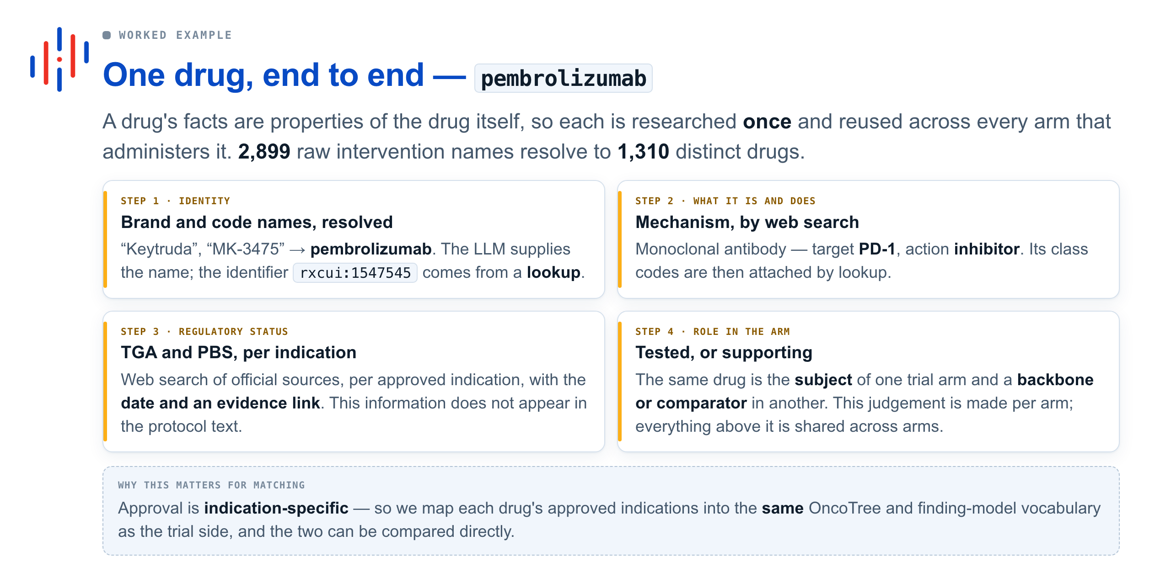

Slide 18
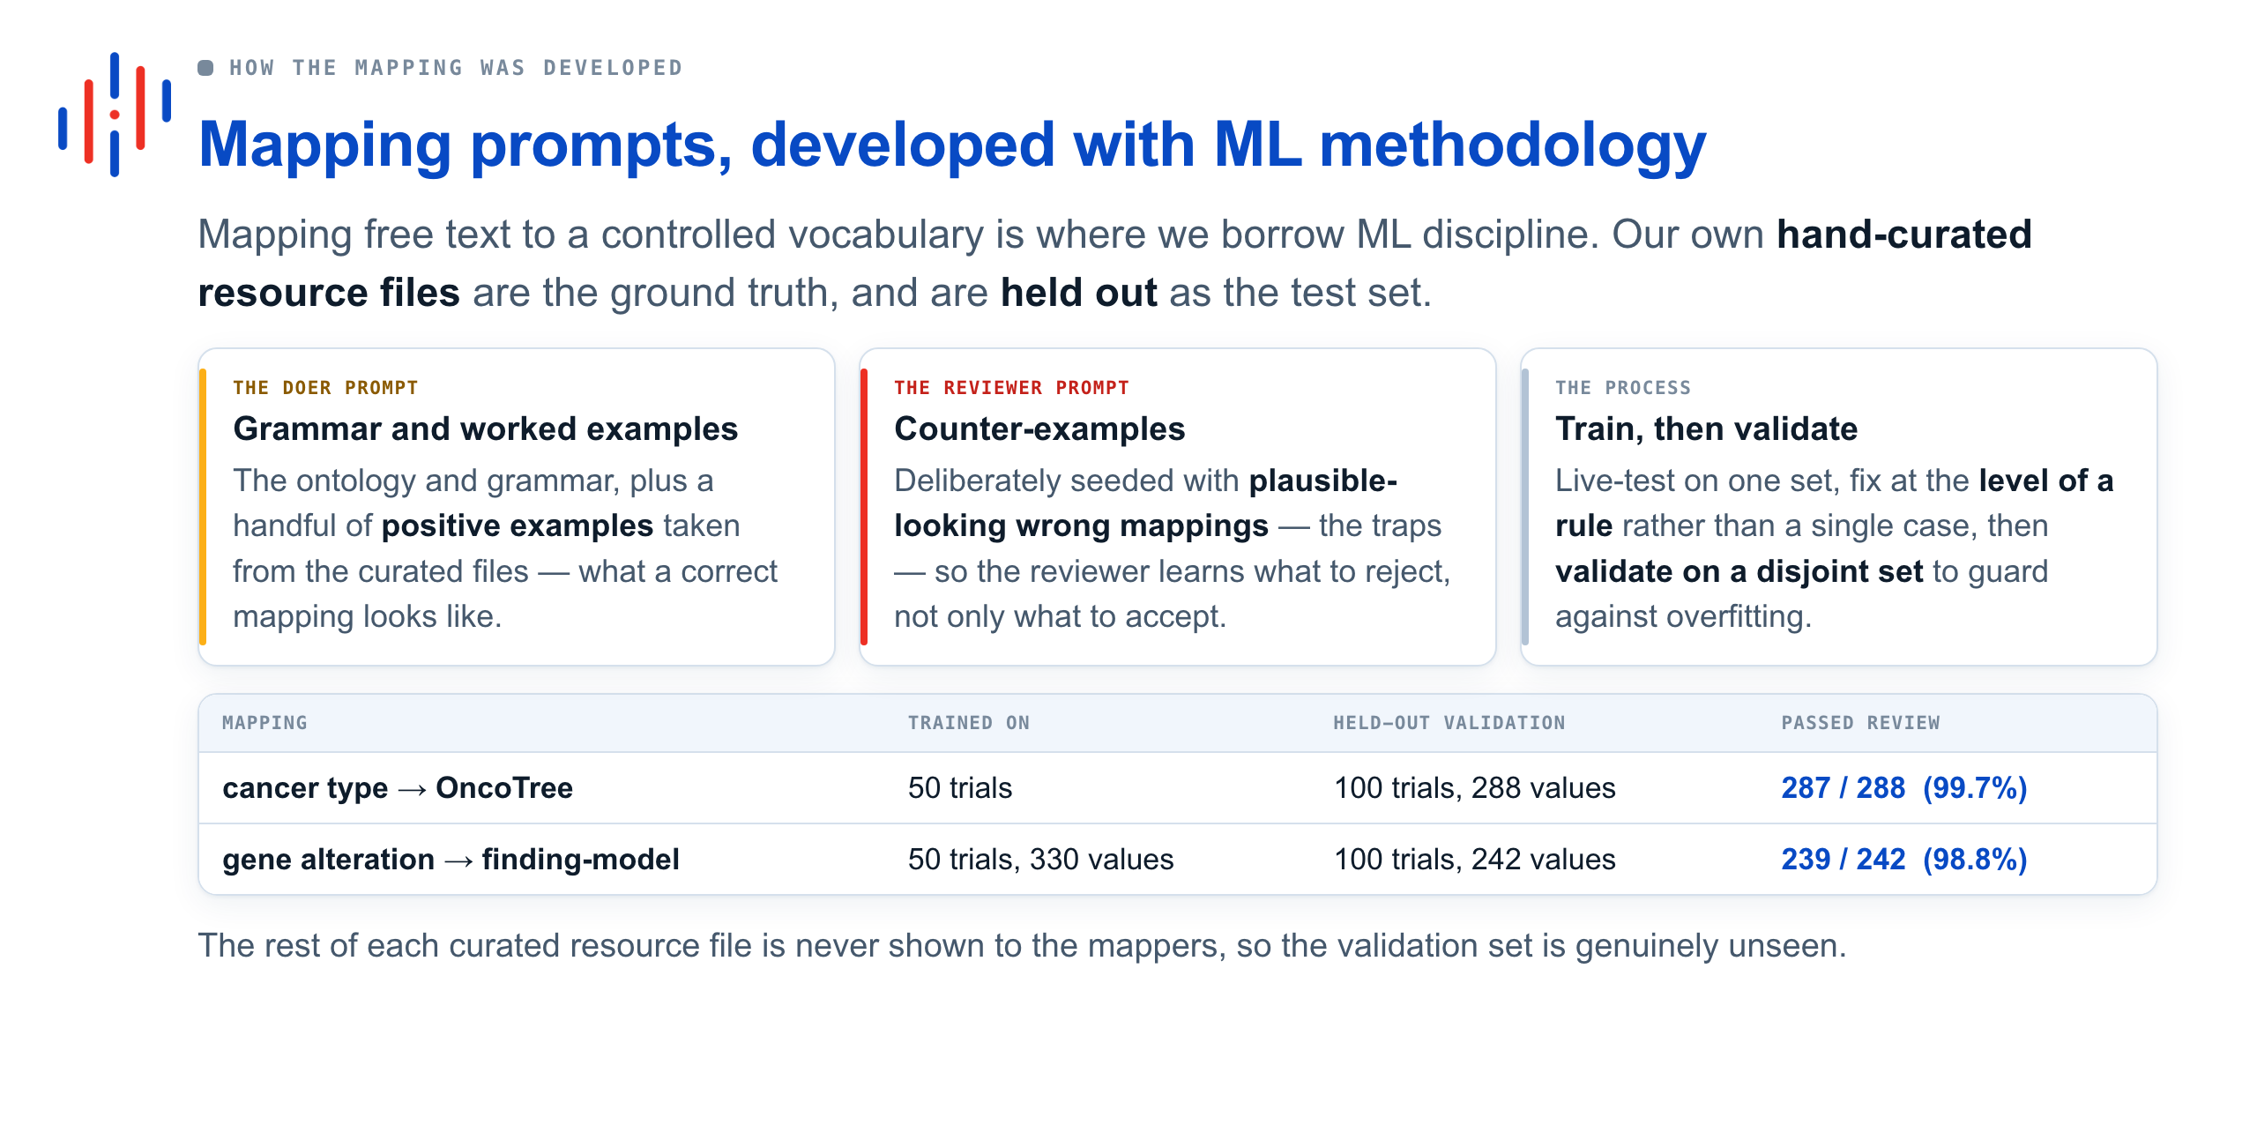

Slide 19
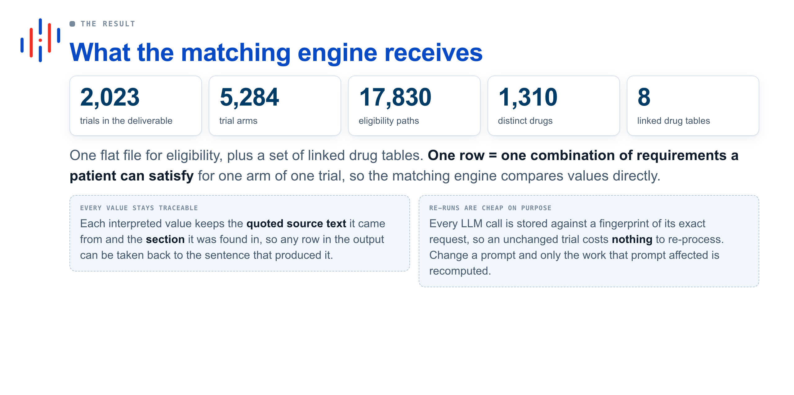

Slide 20
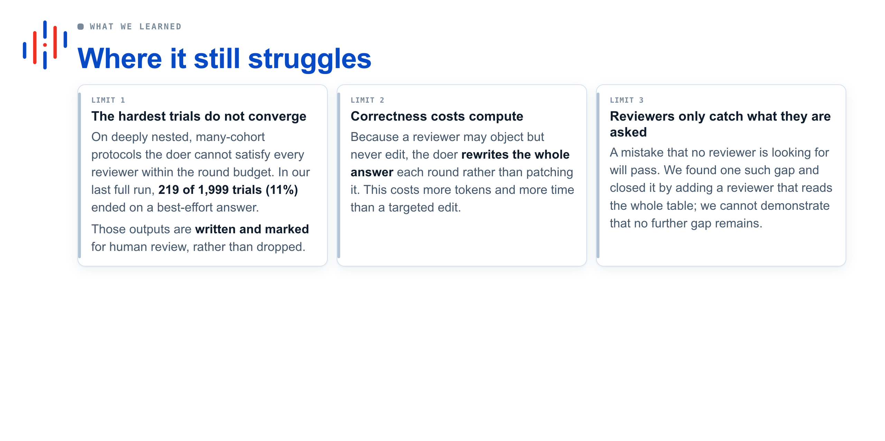

Slide 21
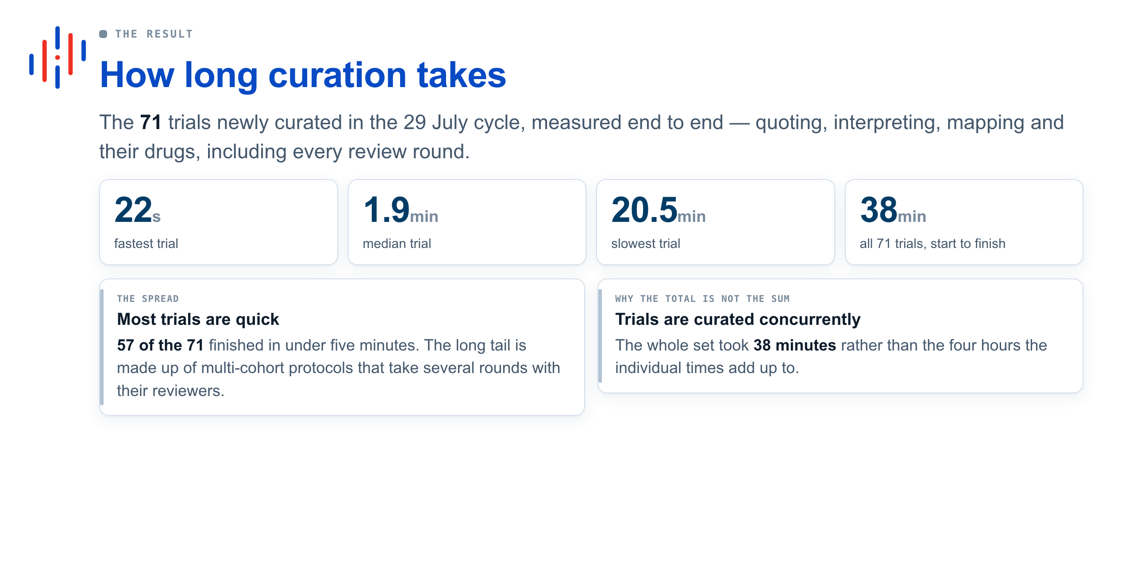

Slide 22
Thank you!
Hong Wing Lee: h.lee@hartwigmedicalfoundation.nl
Peter Priestley: P.Priestley@hartwigmedicalfoundation.nl
Junran Cao: j.cao@hartwigmedicalfoundation.nl

