Slide 1

BOOTCAMP
v2023

Slide 2

HTML Tables

Slide 3

HTML TABLES
HTML Tables are used to arrange data (like texts, images, links, other tables) into rows and columns of cells.
To create an HTML table:
<table></table>

Slide 4
TABLE
<table>
1 | 2 | 3
4 | 5 | 6
7 | 8 | 9
</table>

Slide 5
Table Row
The tr element defines a row inside a table. A table row can contain one or more <th> or <td>.
To create a row:
<tr> </tr>

Slide 6
TR
<table>
1 | 2 | 3
4 | 5 | 6
7 | 8 | 9
1st row <tr>
</tr>
2nd row <tr>
</tr>
3rd row <tr>
</tr>
</table>

Slide 7
Table Data
The td element defines a data cell inside the table.
To create a data cell:
<td> </td>

Slide 8
TD
<table>
1 | 2 | 3
4 | 5 | 6
7 | 8 | 9
1st row <tr>
<td>
</td>
<td>
</td>
<td>
</td>
</tr>
2nd row <tr>
<td>
</td>
<td>
</td>
<td>
</td>
</tr>
3rd row <tr>
<td>
</td>
<td>
</td>
<td>
</td>
</tr>
</table>

Slide 9
Table Header
thead is used to group the header content of an HTML table.
To create a table header:
<thead> </thead>

Slide 10
Header Cell
The header cells contain the header information or the column names of the table. By default, the font weight is bold, and aligned to the center.
To create a header cell:
<th> </th>

Slide 11
THEAD + TH
<table>
Name | Age | Email
John | 29 | john@email.com
Jane | 27 | jane@email.com
<tr>
<th>
<thead>
</th>
<th>
</th>
<th>
</th>
</tr>
</thead>
<tr>
</tr>
<tr>
</tr>
</table>
Notes:
Edit this:

Slide 12
Table Body
tbody is used to group the body content of an HTML table.
To create a table body:
<tbody> </tbody>

Slide 13
TBODY
<table>
Name | Age | Email
John | 29 | john@email.com
Jane | 27 | jane@email.com
<tr>
</tr>
<tr>
</tr>
<tbody>
<tr>
</tr>
</tbody>
</table>
Notes:
Edit this:

Slide 14
Colspan
Colspan attribute is used to make a cell span for more than 1 column.
Syntax: <td colspan=“2”>

Slide 15
Colspan
Name | Contact Numbers
Bill | 12345 | 67890
Steve | 13579 | 24680
<th colspan=“2”>
</th>

Slide 16
Rowspan
Rowspan attribute is used to make a cell span for more than 1 row.
Syntax: <td rowspan=“2”>

Slide 17
TABLES: Rowspan
Name | Bill | Steve
Contact Numbers | 12345 | 13579
 | 67890 | 24680
<td rowspan=“2”>
</td>

Slide 18
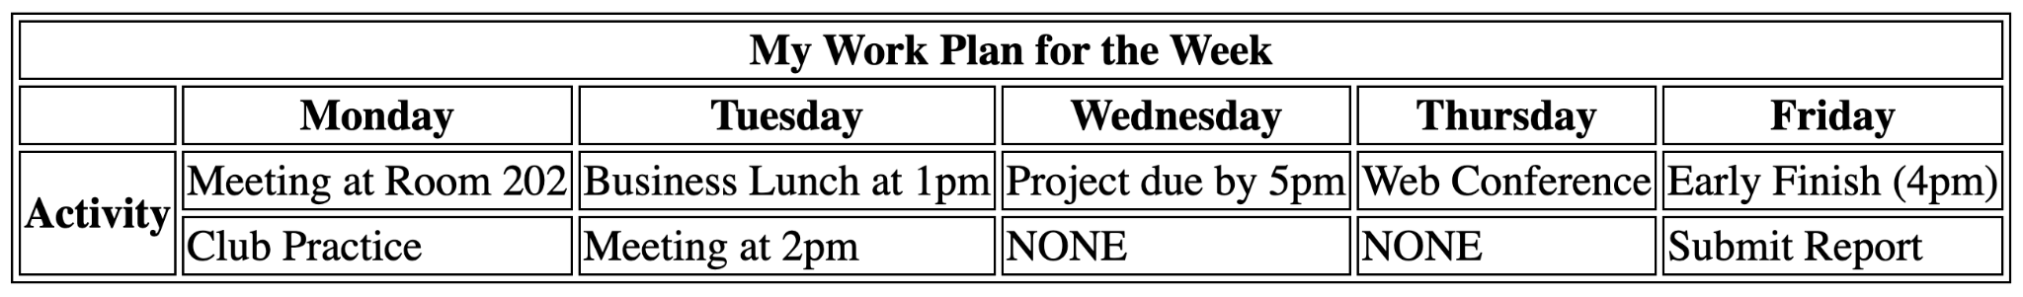
HTML Activity 3
html-act3.html

Slide 19
HTML Forms

Slide 20
HTML Forms
HTML Forms are used to collect different kinds of user inputs such as contact details like name, email address, phone numbers, or details like credit card information, etc.

Slide 21

FORM STRUCTURE
<form action="#" method="#">
<label for="full-name">Full Name</label> <input type="text" name="full_name" id="full-name">
<input type="submit" name="btn_submit" value="Submit">
</form>
Milestone 2

Slide 22
Form Structure
The form structure consists of an opening and closing tag of <form>. This is to declare that you are creating an HTML Form.
The action attribute defines where should the form-data go after it is submitted.
The method attribute defines how the form-data is passed.

Slide 23
Labelling Form Controls
Labelling form controls is needed to make the form more user-friendly as it shows the user what should be filled up inside the input field.
To label form controls:
Note: The for attribute should be equal to the id of the input field.
<label for="input-id">Label Name</label>

Slide 24
HTML Form Controls
Form Controls are used to ‘control’ the different types of data or values inputted by the user.

Slide 25
Kinds of Form Controls
Text Input
Password Input
Number Input
Date
Email
Text Area
Radio Button
Checkbox
Dropdown List Box
Multiple Select Box
File Input Box
Button
Form Validation
Placeholder

Slide 26
Text Input
Syntax
Web Page
<label for="first-name">First Name</label> <input type="text" name="first_name" id="first-name">
<label for="last-name">Last Name</label> <input type="text" name="last_name" id="last-name">

Slide 27
Name
The name attribute specifies the name of the form control to use for form submission. It is submitted with the value.

Slide 28

Password Input
Syntax
Web Page
<label for="password">Password: </label> <input type="password" name="user_password" id="password">

Slide 29

Number Input
Syntax
Web Page
<label for="age">Age</label> <input type="number" name="age" id="age">

Slide 30

Date Input
Syntax
Web Page
<label for="bday">Birthday</label> <input type="date" name="bday" id="bday">

Slide 31

Email Input
Syntax
Web Page
<label for="email">Email: </label> <input type="email" name="email" id="email">

Slide 32
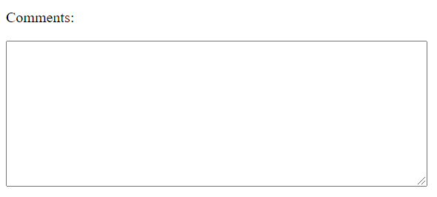
Textarea
Syntax
Web Page
<label for="comments">Comments:</label>
<br>
<textarea name="comments" id="comments" cols="60" rows="10"></textarea>

Slide 33

Radio Button
Syntax
Web Page
<p>Please select your favorite music genre:</p> <input type="radio" name="music" id="rock" value="rock">
<label for="rock">Rock</label>
<input type="radio" name="music" id="pop" value="pop">
<label for="pop">Pop</label>
<input type="radio" name="music" id="jazz" value="jazz">
<label for="jazz">Jazz</label>

Slide 34

Checkbox
Syntax
Web Page
<p>Please select your favorite food:</p> <input type="checkbox" name="food" id="ramen" value="ramen">
<label for="ramen">Ramen</label>
<input type="checkbox" name="food" id="sushi" value="sushi">
<label for="sushi">Sushi</label>
<input type="checkbox" name="food" id="curry" value="curry">
<label for="curry">Curry</label>

Slide 35

Dropdown List
Syntax
Web Page
<label for="device">What is your device?</label> <select name="device" id="device">
<option value="macbook">Macbook</option>
<option value="ipad">iPad</option>
<option value="iphone">iPhone</option>
</select>

Slide 36
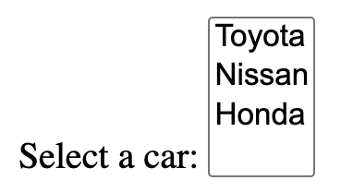
Multiple Select
Syntax
Web Page
<label for="car">Select a car:</p> <select name="car" id="car" multiple>
<option value="toyota">Toyota</option>
<option value="nissan">Nissan</option>
<option value="honda">Honda</option>
</select>

Slide 37

File Input Box
Syntax
Web Page
<input type="file" name="file">

Slide 38

Input:Submit
Syntax
Web Page
<input type="submit" name="submit" value="Submit">

Slide 39
Button:Submit
Syntax
Web Page
<button type="submit" name="submit">Submit</button>

Slide 40
Form Validation
HTML5 has the ability to validate most user data once submitted. This is done by using validation attributes in the form elements.

Slide 41
Form Validation
required attribute checks whether the input field is filled in or not before being submitted.
min / max attribute limits the minimum or maximum value of a numeric type input fields.

Slide 42
Placeholder
placeholder attribute provides a small hint or description for the users on what they will put in the input field.

Slide 43

Placeholder
Syntax
Web Page
<label for="full-name">Full Name</label> <input type="text" name="full_name" id="full-name" placeholder="John Doe">

Slide 44
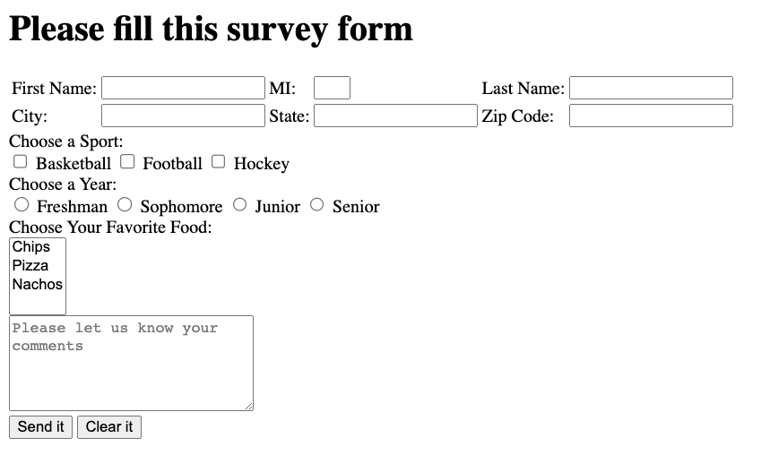
HTML Activity 4
html-act4.html

