Slide 1

BOOTCAMP
v2023

Slide 2

CSS Box Model and Background Color

Slide 3

CSS Background Color
background-color
the background-color property defines color of the background of an element.
Example: background-color: white;

Slide 4
CSS Background Color
Color Name
SALMON
RGB
rgb(250, 128, 114)
Opacity
opacity: 1
rgba(250, 128, 114, 1)
RGBA
#fa8072
Hexcode

Slide 5
Height & Width
The height property adjusts the height of the element. You can use % or px
The width property adjusts the width of the element. You can use % or px

Slide 6
BOX MODEL
MARGIN
PADDING
CONTENT
BORDER
is the yellow box.

Slide 7
Margin
margin
the margin property sets the margin for an element.
Note: Margin values are applied clockwise

Slide 8
Margin
1 - value margin:
-the value applies the margin to all four sides.
Example:
margin: 10px;
2 - value margin:
first value = top and bottom side
second value = right and left side
Example:
margin: 10px 20px;

Slide 9
Margin
3 - value margin:
first value = top side
second value = right and left side
third value = bottom side
Example:
margin: 10px 20px 30px;
4 - value margin:
first value = top side
second value = right side
third value = bottom side
fourth value = left side
Example:
margin: 10px 20px 30px 40px;

Slide 10
Margin
Note: margin property is a shorthand.
To apply margin on individual sides you can use the following properties:
margin-top
margin-right
margin-bottom
margin-left

Slide 11
Padding
padding
The padding property sets the padding for an element.
Padding values are applied clockwise

Slide 12
Padding
1 - value padding:
the value applies the padding to all four sides.
Example:
padding: 10px;
2 - value padding:
first value - top and bottom side
second value - right and left side
Example:
padding: 10px 20px;

Slide 13
Padding
3 - value padding:
first value - top side
second value - right and left side
third value - bottom side
Example:
padding: 10px 20px 30px;
4 - value padding:
first value - top side
second value - right side
third value - bottom side
fourth value - left side
Example:
padding: 10px 20px 30px 40px;

Slide 14
Padding
Note: padding property is a shorthand.
To apply padding on individual sides you can use the following properties:
padding-top
padding-right
padding-bottom
padding-left

Slide 15
Border
border
The border property adds a border to the element.

Slide 16
Border
border shorthand
border: border-width border-style border-color;

Slide 17
Border
border-color:
sets the color of the border.
The value of the border-color can be: color name, rgb, or hexcode
border-width:
sets the width of the border.
The value of the border-width can be: px

Slide 18
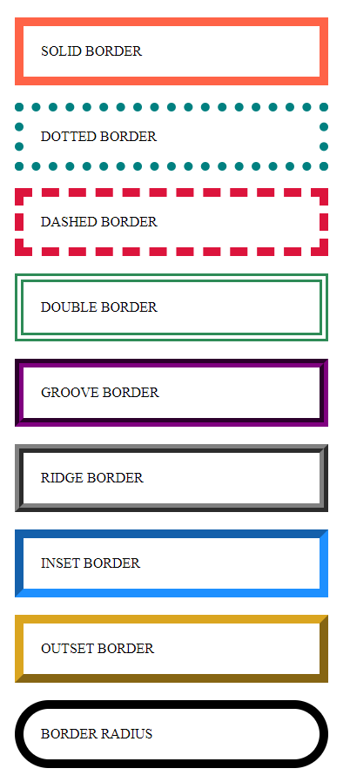
Border Style
.solid{
border: 10px solid tomato;
}
.dotted{
border: 10px dotted teal;
}
.dashed{
border: 10px dashed crimson;
}
.double{
border: 10px double seagreen;
}
.groove{
border: 10px groove purple;
}
.ridge{
border: 10px ridge gray;
}
.inset{
border: 10px inset dodgerblue;
}
.outset{
border: 10px outset goldenrod;
}
.radius{
border: 10px solid black;
border-radius: 50px;
}

Slide 19
Border
Note: To apply border on individual sides you can use the following properties:
border-top
border-right
border-bottom
border-left
And to apply border-radius on an element:
border-radius
border-radius can use px or %

Slide 20
OVERFLOW
The overflow property tells the browser what to do if the content contained within a box is larger than the box itself.
overflow: hidden;
hides the extra content that does not fit in the box
overflow: scroll;
adds a scrollbar to the box so that the user can scroll to see the missing content.

Slide 21
Box Shadow
box-shadow
The box-shadow property adds a shadow to an element

Slide 22
Border
box-shadow shorthand
box-shadow: h-offset v-offset blur spread color;

Slide 23

BOX SHADOW
.box-shadow{
box-shadow: 10px 15px 10px 5px red;
border: 1px solid black;
}

Slide 24
BOX SIZING
By default (box-sizing: content-box;), the width and height of an element is calculated like this:
width + padding + border = actual width of an element
height + padding + border = actual height of an element
The box-sizing property allows us to include the padding and border in an element's total width and height.

Slide 25
Centering Content
To center a text,
you can simply use text-align
To center a block element,
you can simply use:
margin-left: auto;
margin-right: auto;

Slide 26
CSS Layouting

Slide 27
FLOATING
float: left;
Aligns the element and its surrounding elements to the left side of the page.
float: right;
Aligns the element and its surrounding elements to the right side of the page.

Slide 28
CLEAR
clear: none;- the element is not moved down to clear past floats.
clear: left; - the element is moved down to clear past left floats.
clear: right;- the element is moved down to clear past right floats.
clear: both; - the element is moved down to clear past both left and right floats.

Slide 29

CSS Activity 2
css-act2.html

