Slide 2
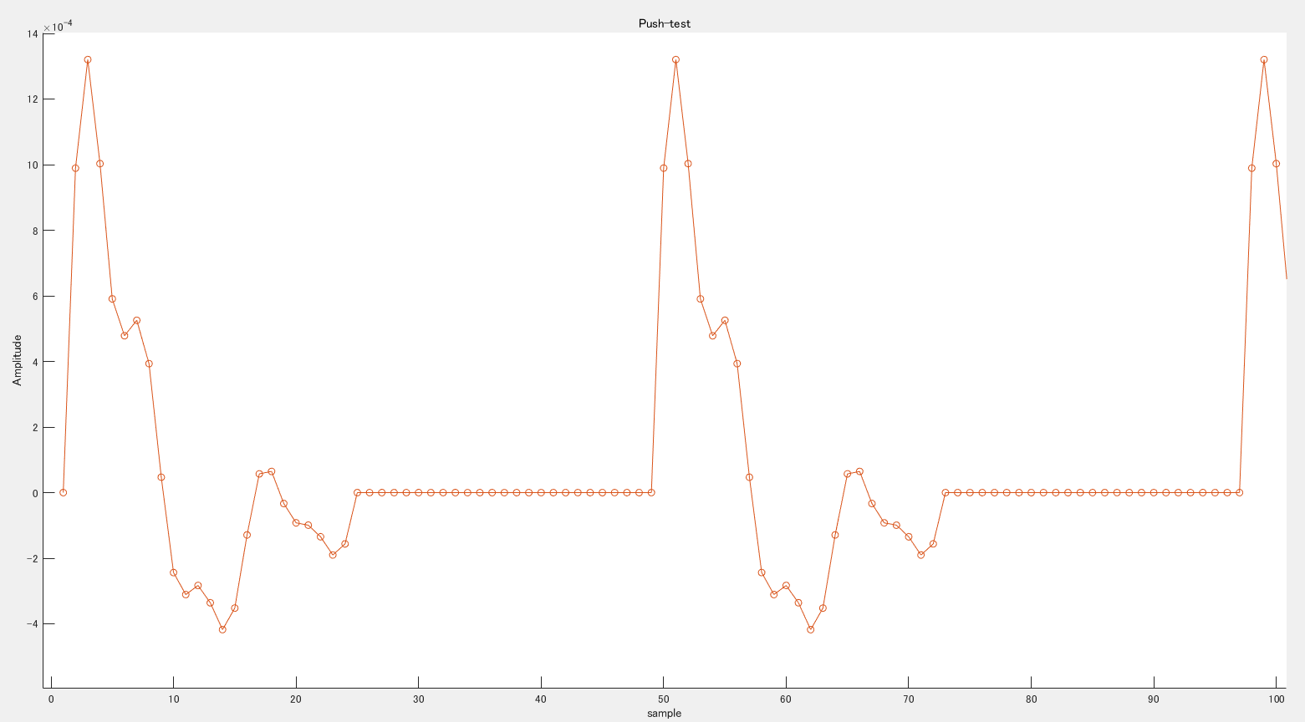
24 sample
24 sample
24 sample
24 sample
反転開始点
反転開始点

Slide 3
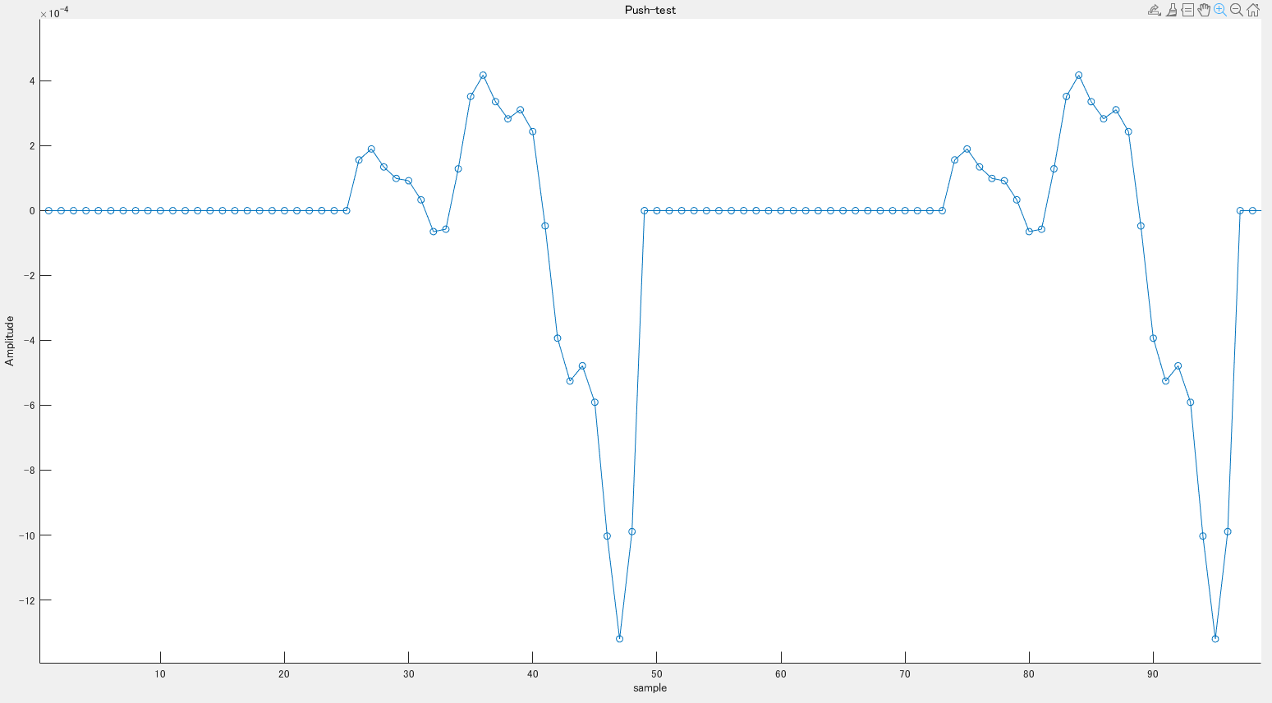
24 sample
24 sample
24 sample
24 sample
反転開始点
反転開始点

