Slide 1
Figures for the book full stack AI

Slide 2
My code environment
SO (System Operating)
Pyenv (Python Version Manager)
Poetry (Packaging and dependency manager for Python )
Python installation (3.10.0)
Poetry environment
Python standard
library
Site Packages
(Installed from PIP)
Site Packages for my project
uses
My project
(python scripts)
Python installation (3.11.0)
Python standard
library
Site Packages
(Installed from PIP)

Slide 3
Frontend
Software Development Life Cycle
Requirement gathering and Analysis
Development
Testing
maintenance
Designing
Backend
Data
ML Model
Infrastructure
Hardware

Slide 4
Server-Based vs Serverless architectures
User Interface (UI)
Monolithic Application
Microservices Application
Serverless Application
API gateway
API gateway
Business layer/logic
Direct Call
Request
Cloud Function
Data access layer
Microservice
Microservice
Microservice
Business layer/logic
Business layer/logic
Business layer/logic
Indirect Call
Event
Data access layer
Data access layer
Data access layer
Database
Cloud service
Cloud Function
Cloud Storage
Database
Database
Database

Slide 5
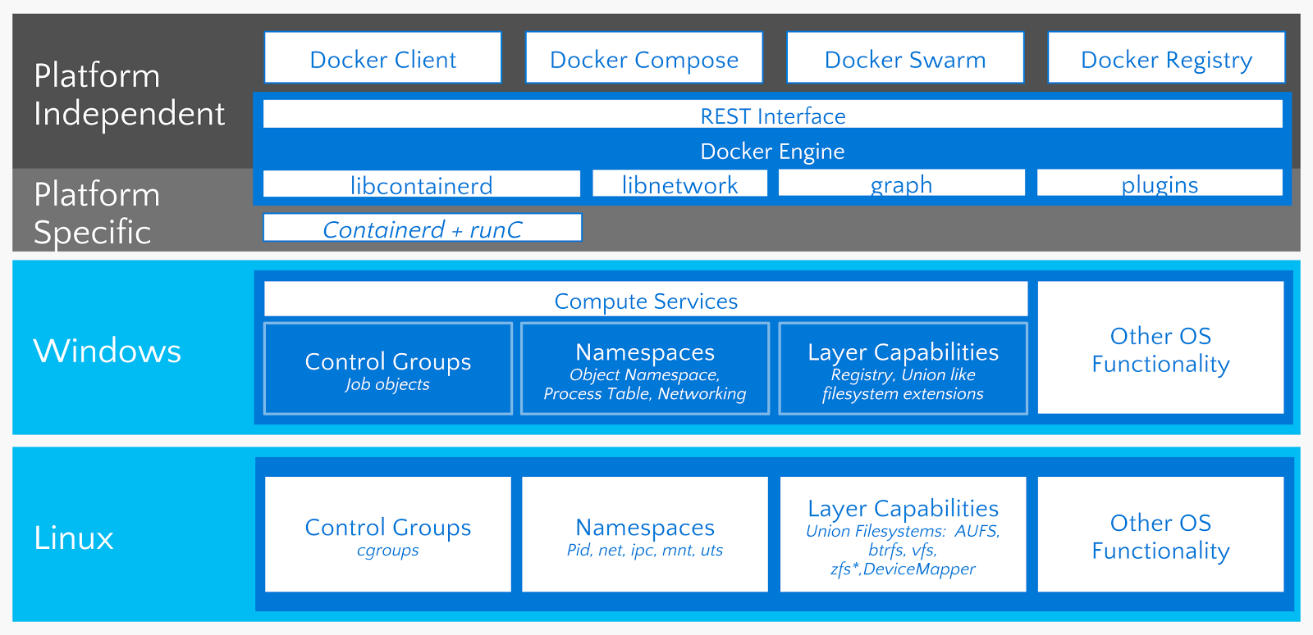

Slide 6

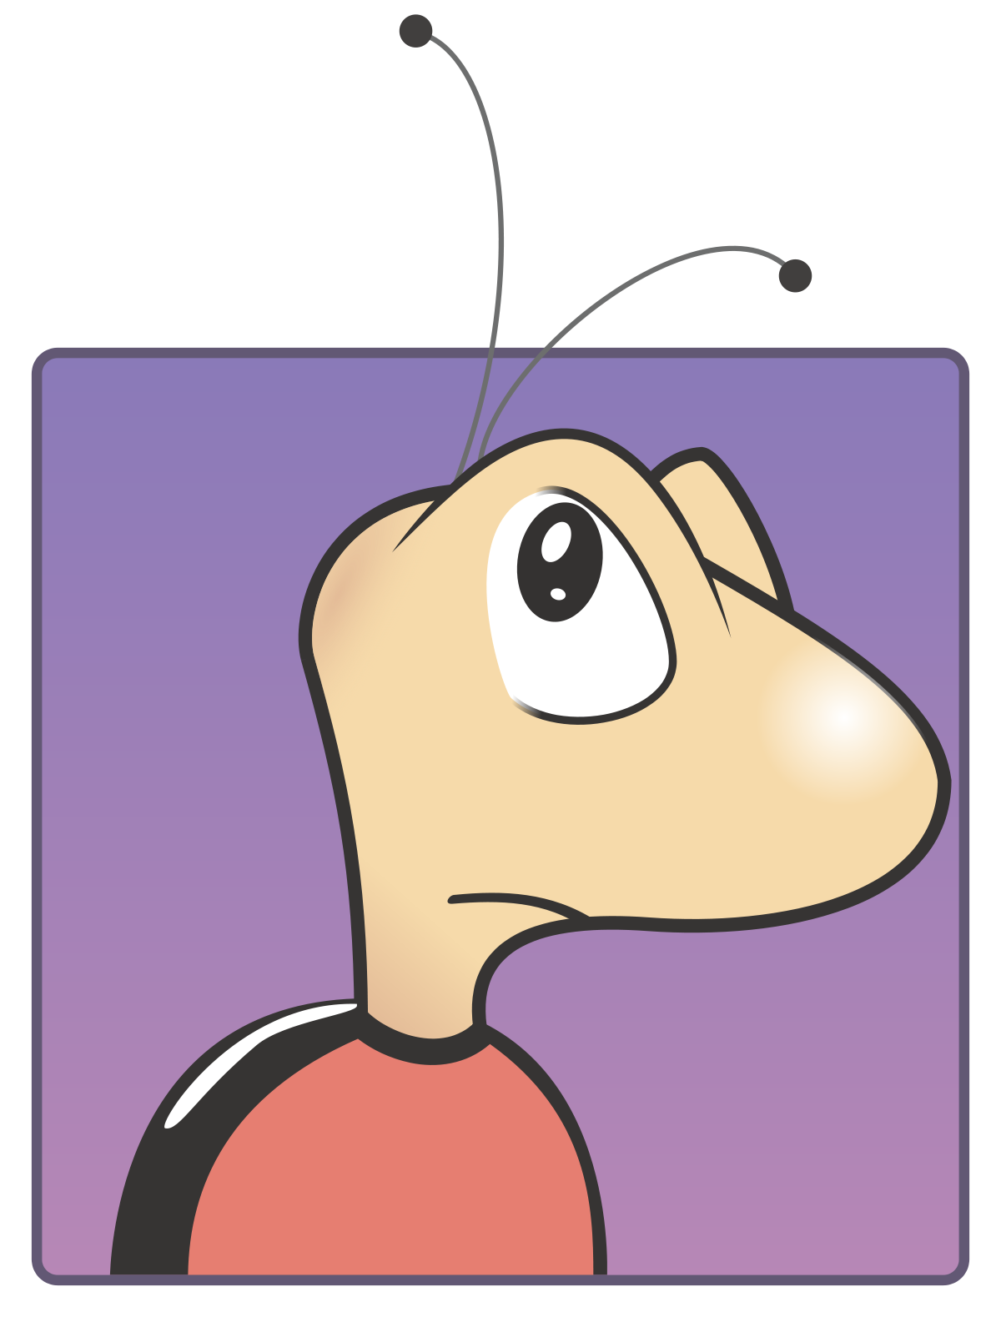
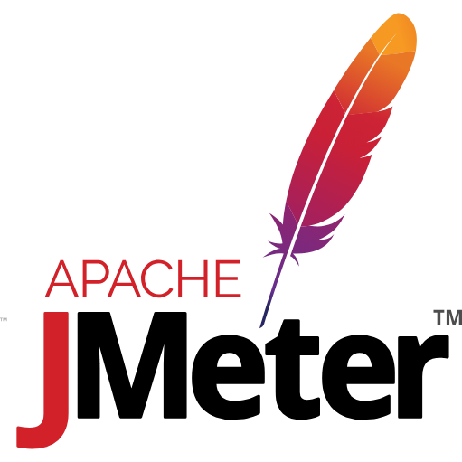
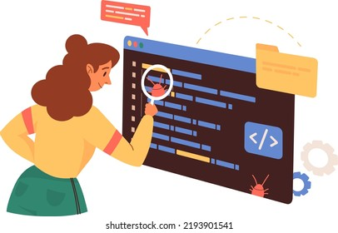

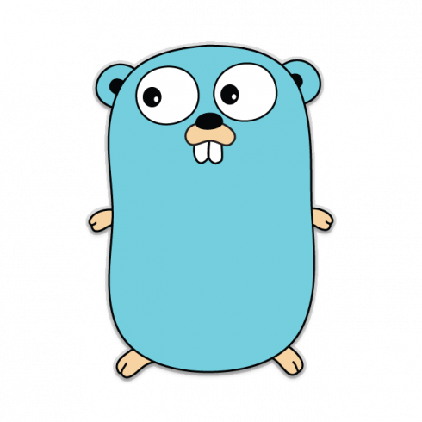
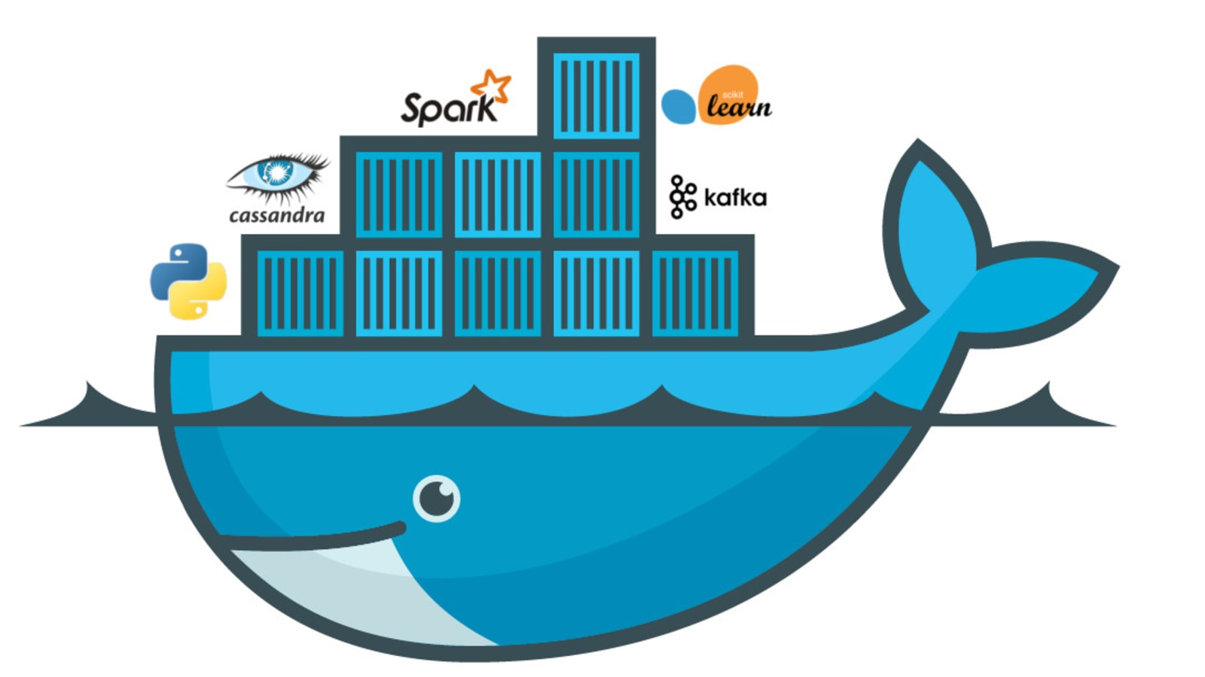
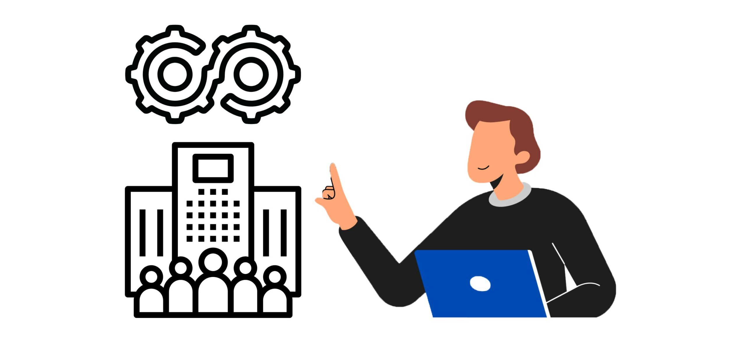


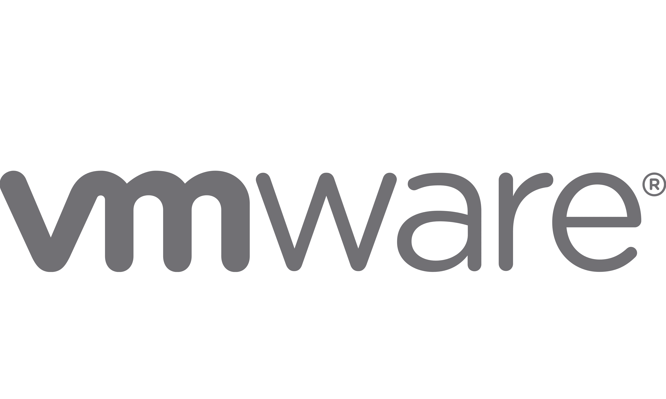

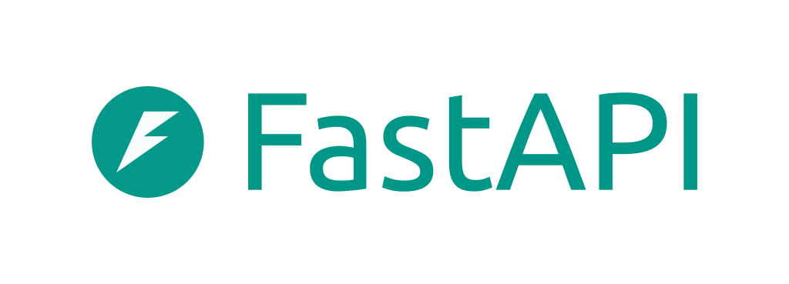
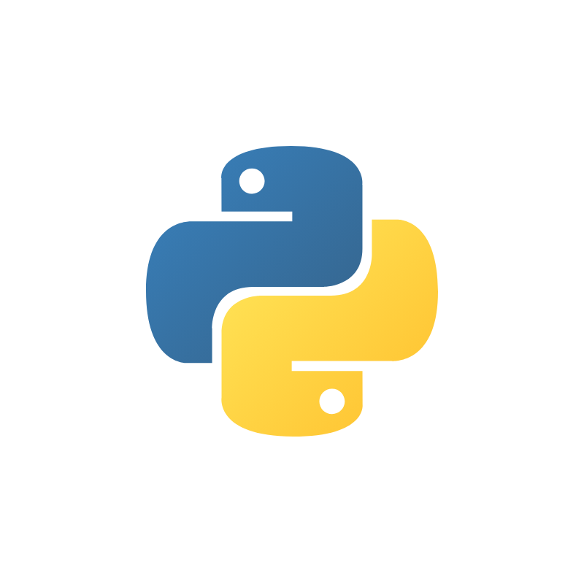


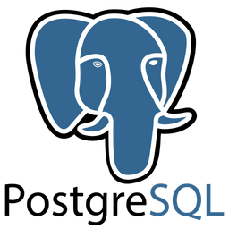

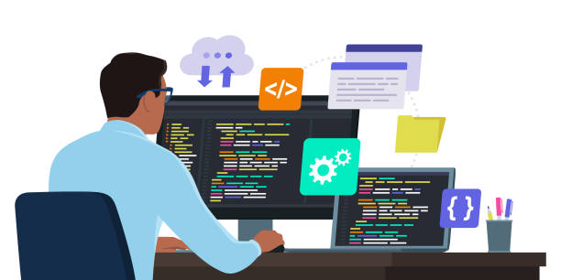


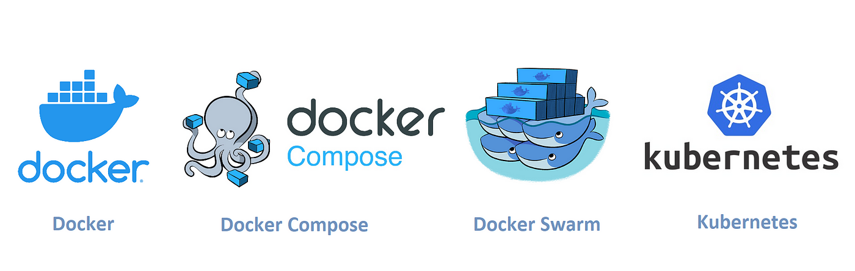
Push & Pull
Push & Pull
QA Engineers
Dev & Ops Engineers
Pull
Push & Pull
Frontend
Backend
Db
My APP
Ship to
Software Developers
Cloud Providers

