Slide 1
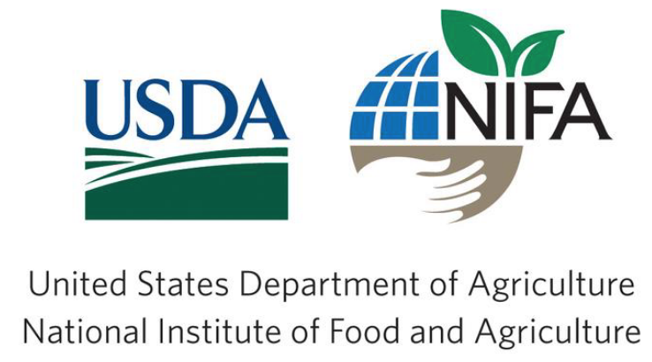
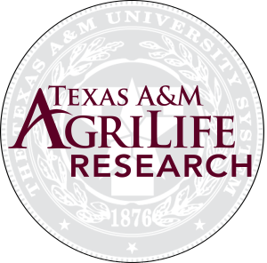
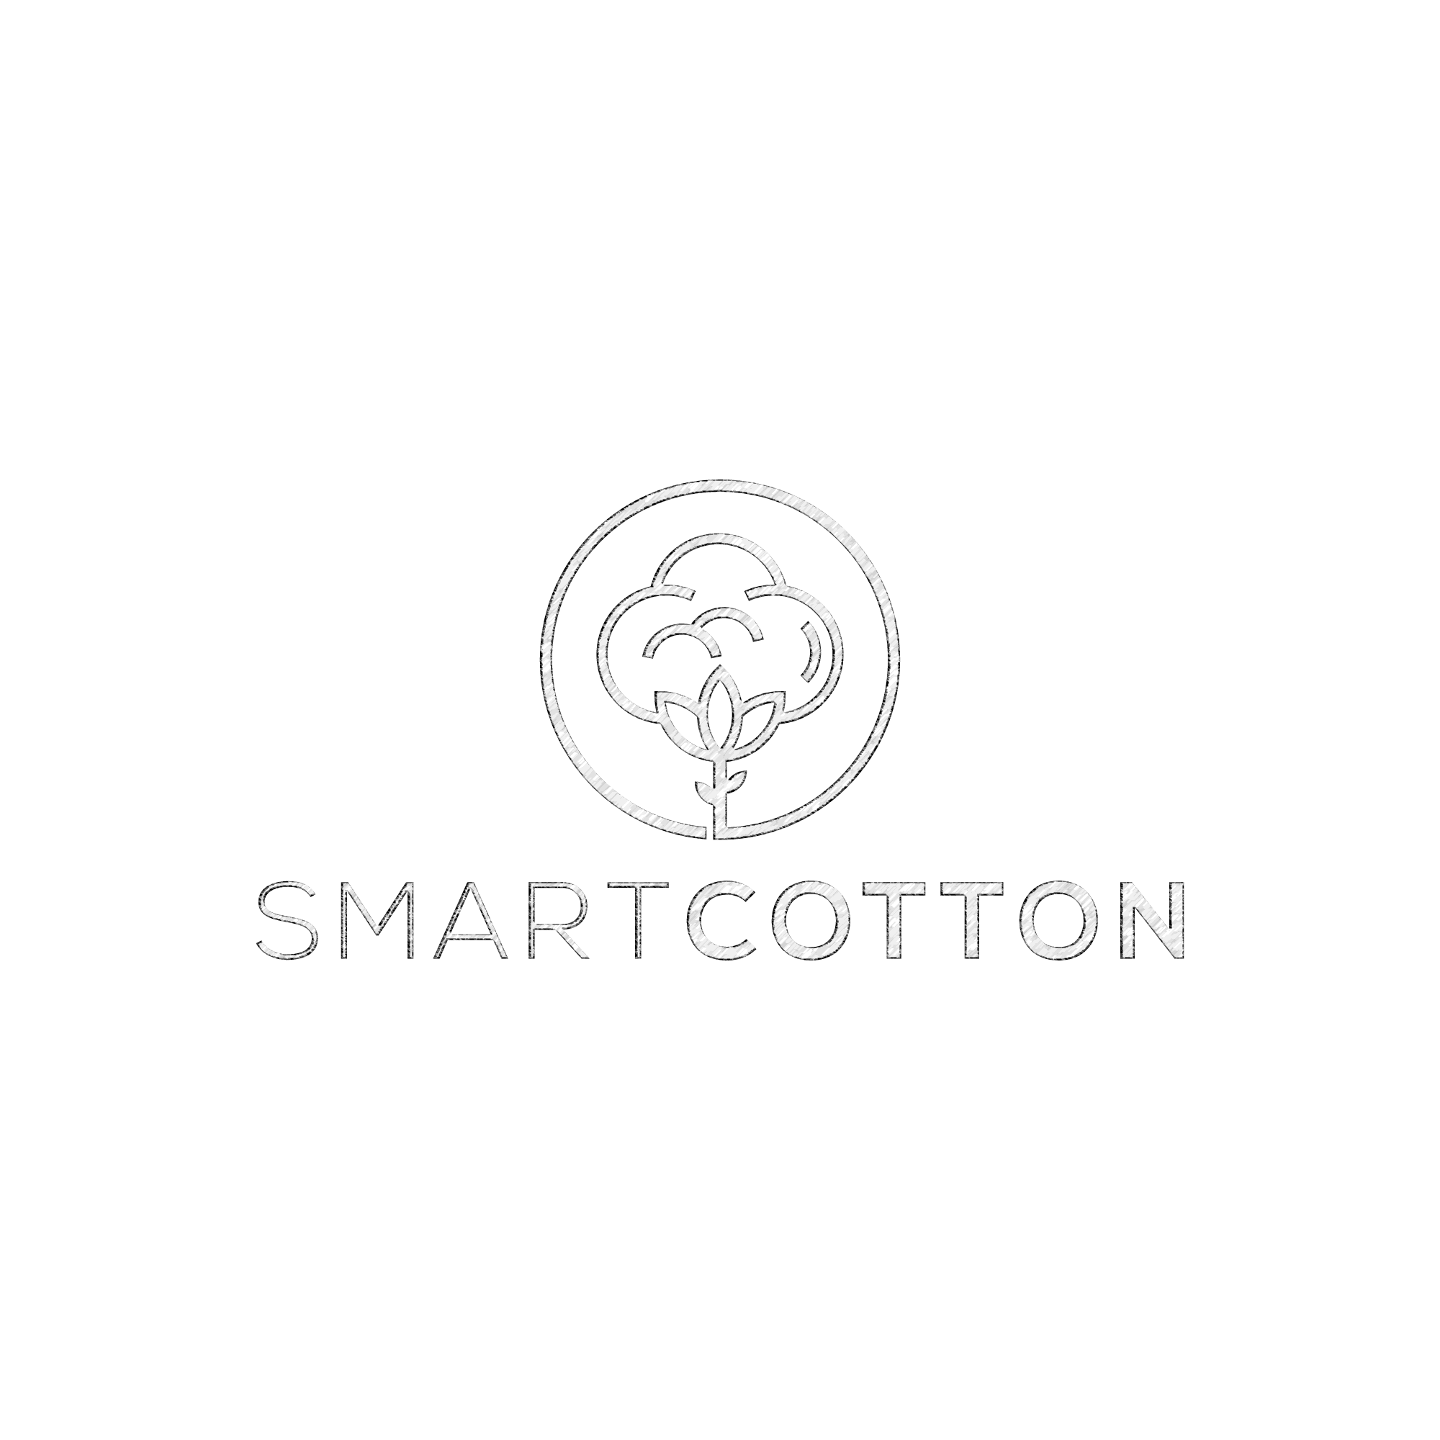
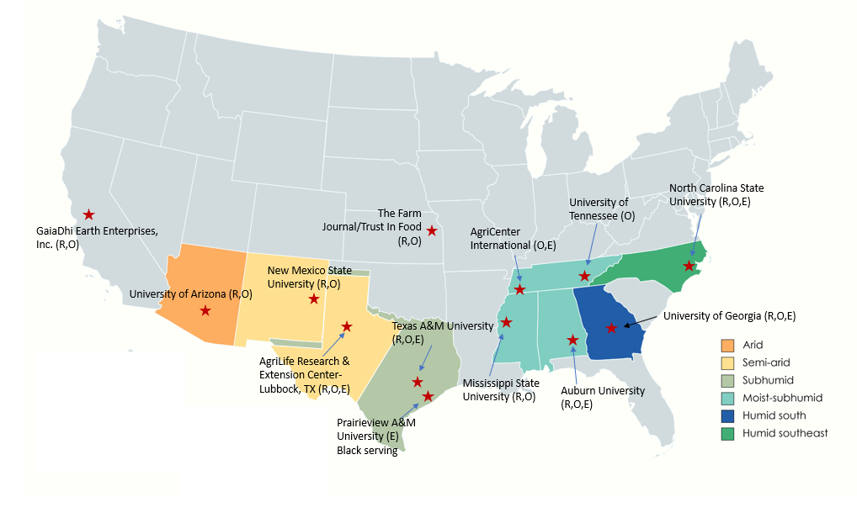
A Multi-state Precision Regenerative Cotton Research Network Across the U.S. Cotton Belt
Deepak Loura¹*, and the Project Team
*Project Manager
¹Department of Soil and Crop Sciences, Texas A&M University, College Station, TX; *Contact: deepak.loura@agnet.tamu.edu; muthu@tamu.edu
Background
Multi-State Partnership
Cotton is a major crop in the U.S., valued at $7 billion annually and covering ~12.5 million acres.
Sustainability is challenged by intensive tillage, soil degradation, and pesticide resistance across the Cotton Belt.
Adoption of conservation tillage, cover crops, living mulches, and other regenerative practices can enhance soil health and carbon sequestration.
Integrating AI/ML-based precision practices can reduce input use, lower GHG emissions, and move U.S. cotton towards a sustainable future.
A USDA-NIFA Sustainable Agriculture Systems-Coordinated Agriculture Project (SAS-CAP) addresses these challenges in different ecoregions across the U.S. Cotton Belt, with multi-state and multi-institutional partnerships (Fig. 1).
R | Research
O| Outreach
E | Education
Project Objectives
Develop and evaluate regionally suitable regenerative cotton production practices to enhance soil health and sustainability.
Establish soil organic carbon and carbon intensity baselines across the U.S. Cotton Belt ecoregions.
Integrate precision, AI/ML, and smart technologies for resource-efficient cotton management.
Assess economic feasibility and new market opportunities for cotton.
Understand farmers’ perceptions and adoption barriers to regenerative practices.
Strengthen education, training, and outreach to build a skilled workforce supporting the U.S. cotton industry.
Fig. 1. Project performance locations and roles across the six ecoregions (Partner institutions: TX, AL, GA, NC, NM, MS, AZ, LA) in the US Cotton Belt
Research Highlights
Established a multi-state precision regenerative cotton research network (>30 experimental sites) across the U.S. Cotton Belt.
Initiated baseline soil carbon and soil health assessments across the different ecoregions.
Launched field trials on novel cover crop systems, living mulches, and conservation practices.
Advancing research on the development and implementation of AI/ML technologies for cotton production.
Reached 3,000+ stakeholders through 25+ outreach and training events.
Student training: >20 graduate and 70 undergraduate students involved.
Project Team
University of Arizona: Dr. Debankur Sanyal, Dr. Randy Norton
New Mexico State University: Dr. Sangu Angadi, Dr. Rajan Ghimire, Dr. Prakriti Bista
Texas A&M University: Dr. Katie Lewis, Dr. Joseph Burke, Dr. Peter Dotray, Dr. Benjamin McKnight, Dr. David Kerns, Dr. Thomas Isakeit, Dr. Scott Nolte, Dr. Mahendra Bhandari, Dr. Uday Vaddevolu, Dr. Nithya Subramanian, Dr. Jake Mowrer, Dr. Sanjay Antony Babu, Dr. Nithya Rajan, Dr. Muthukumar Bagavathiannan*
Texas Tech University: Dr. Darren Hudson
USDA-ARS, College Station: Dr. Daniel Martin
Prairie View A&M University: Dr. Ram Ray
Mississippi State University: Dr. Drew Gholson, Dr. Prakash Jha
University of Tennessee: Dr. Tyson Raper
AgriCenter International, Memphis: Andy Jordan, Ashley Barth
Auburn University: Dr. Alvaro Sanz-Saez, Dr. Aniruddha Maity
University of Georgia: Dr. Nicholas Basinger, Dr. Jennifer Thomson
North Carolina State University: Dr. Ramon Leon, Dr. Charlie Cahoon
GaiaDhi Earth Intelligence, Inc: Karthik Kannappan, Vasu Vijay
The Farm Journal/Trust In Food: Lauren Dowler, Candace Bergesch, Kaeli Elisco
Project Evaluators: Kevan Lamm, Dr. Craig Bednarz, Dr. Girish Panicker, Dr. Wayne Ebelhar
Stakeholder Advisory Panel: Paul Hishmeh, Gaylon Morgan, Jeremy Brown, Aradhya Chandrasekhar, Kody Bessent/Shawn Wade, Sandra Marquardt, Tom Dowling, Corrie Bowen, Jane Deaver
Ongoing Activities…
Expand soil sampling across all participating states to strengthen baseline data.
Continue multi-season, multi-site field trials on regenerative cotton management practices.
Accelerate AI/ML technology development using multi-modal data collection and advanced analytics.
Conduct economic and market analyses to assess grower benefits associated with precision regenerative production practices.
Launch on-farm demonstrations and outreach events to enhance producer engagement.
Develop training modules and summer research programs for undergraduate and graduate students.
A
B
Acknowledgements
USDA-NIFA Sustainable Agricultural Systems Project
Award Number: 2024-68012-41750

