Slide 1
Marp
1

Slide 2
---
Markdown
2

Slide 3
def hello_world():
print("Hello, Marp!")
3

Slide 4
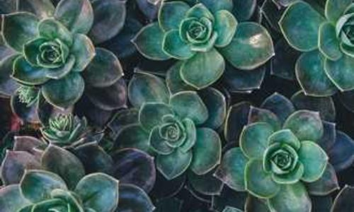
4

Slide 5
2
1
2
3
4
5

Slide 6

6

Slide 7
7

