Slide 1
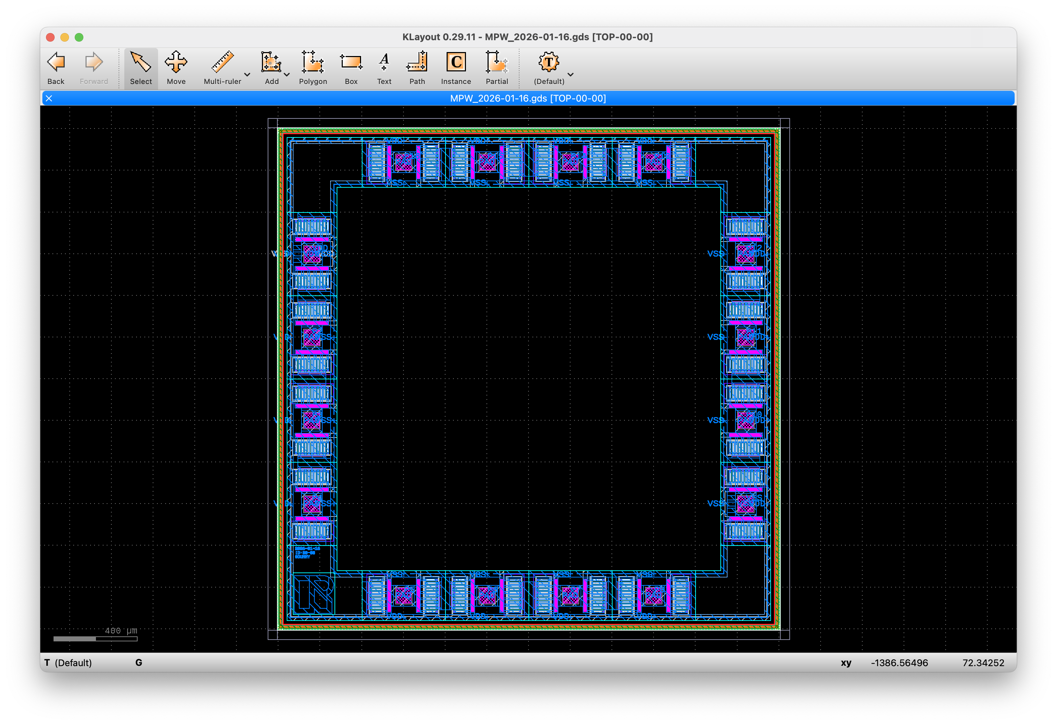
(1250,1250)
Reserved Area for Project Supporters
top_cell:name
“OSS_FRAME” on (0,0)
(0,0)
(-1250,-1250)

Slide 2
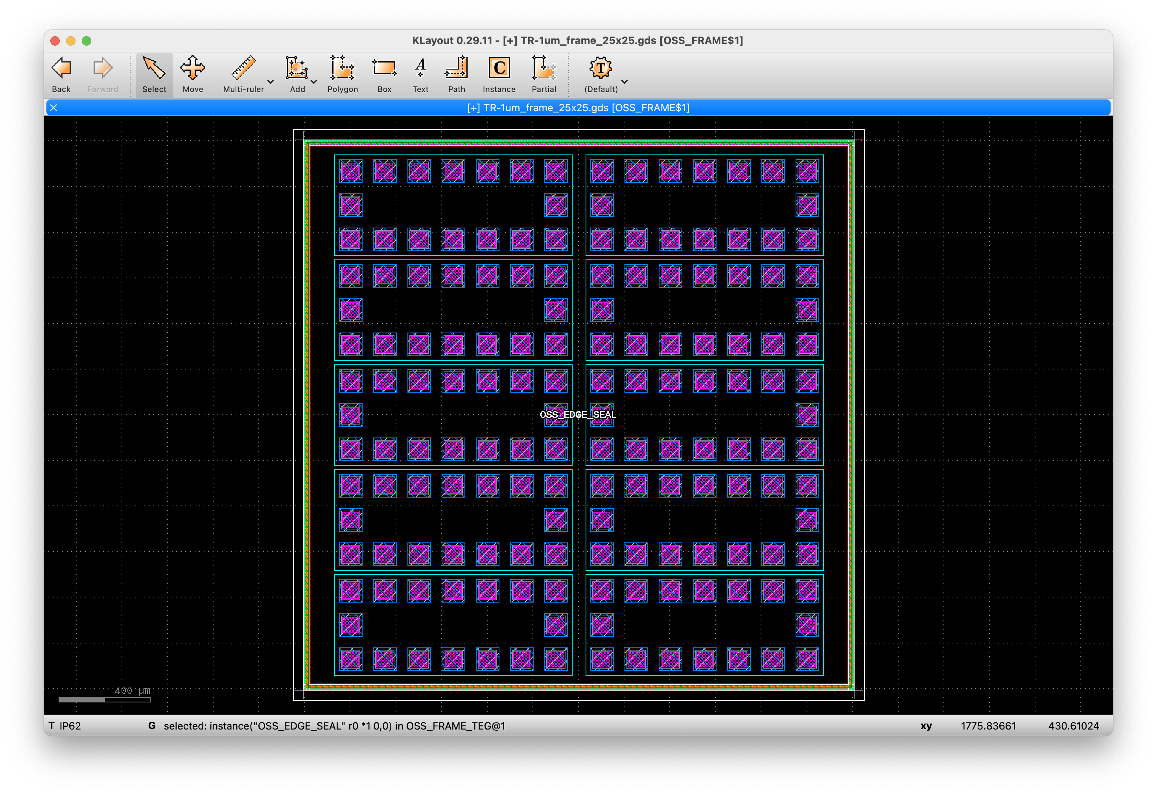
(1250,1250)
top_cell:name
“OSS_FRAME_TEG” on (0,0)
(0,0)
(-1250,-1250)

