Slide 1
Executive Summary of Marketing Plan
Here is where your presentation begins

Slide 2
Contents of this template
You can delete this slide when you’re done editing the presentation
Fonts | To view this template correctly in PowerPoint, download and install the fonts we used
Used and alternative resources | An assortment of graphic resources that are suitable for use in this presentation
Thanks slide | You must keep it so that proper credits for our design are given
Colors | All the colors used in this presentation
Icons and infographic resources | These can be used in the template, and their size and color can be edited
Editable presentation theme | You can edit the master slides easily. For more info, click here
For more info: SLIDESGO | BLOG | FAQs
You can visit our sister projects: FREEPIK | FLATICON | STORYSET | WEPIK | VIDEVO

Slide 3
Table of contents
01
02
03
04
05
Name of the section
Name of the section
Name of the section
You can describe the topic of the section here
You can describe the topic of the section here
You can describe the topic of the section here
Name of the section
Name of the section
You can describe the topic of the section here
You can describe the topic of the section here

Slide 4
Whoa!
This can be the part of the presentation where you introduce yourself, write your email…

Slide 5
01
Name of the section
You can enter a subtitle here if you need it

Slide 6
Do you need longer text?
Mercury is the closest planet to the Sun and the smallest one in the entire Solar System. This planet’s name has nothing to do with the liquid metal, since Mercury was named after the Roman messenger god. Despite being closer to the Sun than Venus, its temperatures aren’t as terribly hot as that planet’s. Its surface is quite similar to that of Earth’s Moon, which means there are a lot of craters and plains
Speaking of craters, many of them were named after artists or authors who made significant contributions to their respective fields. Mercury takes a little more than 58 days to complete its rotation, so try to imagine how long days must be there! Since the temperatures are so extreme, albeit not as extreme as on Venus, and the solar radiation is so high, Mercury has been deemed to be non-habitable for humans

Slide 7
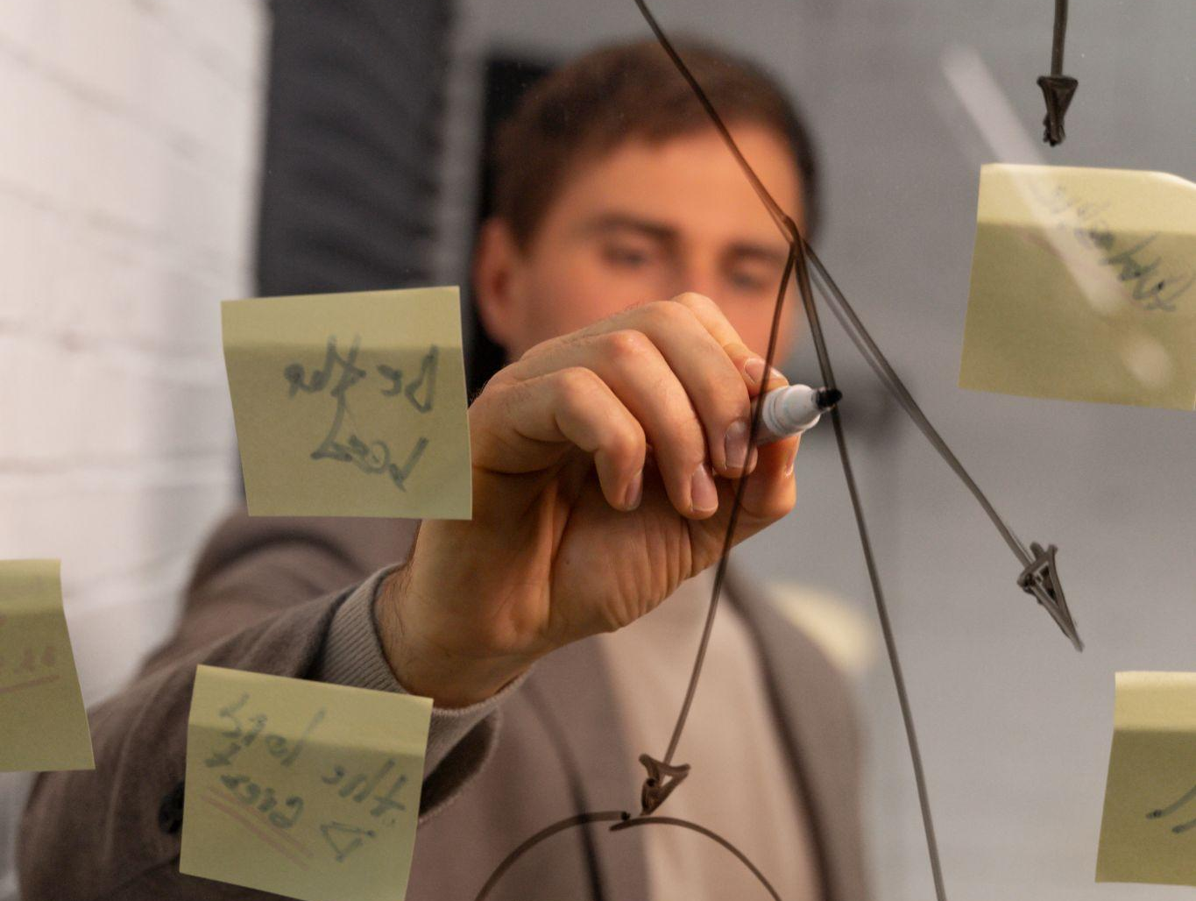
The slide title goes here!
Do you know what helps you make your point crystal clear? Lists like this one:
They’re simple
You can organize your ideas clearly
You’ll never forget to buy milk!
And the most important thing: the audience won’t miss the point of your presentation

Slide 8
02
Name of the section
You can enter a subtitle here if you need it

Slide 9
Divide the content
Venus
Mercury
Venus has a beautiful name and is the second planet from the Sun. It’s hot and has a poisonous atmosphere
Mercury is the closest planet to the Sun and the smallest one in the Solar System—it’s only a bit larger than the Moon

Slide 10
Here are three important ideas
Venus
Venus has a beautiful name and is the second planet from the Sun
Mars
Mercury
Despite being red, Mars is actually a cold place. It’s full of iron oxide dust
Mercury is the closest planet to the Sun and the smallest of them all

Slide 11
Divide the content in four ideas
Saturn
Mars
Saturn is a gas giant and has several rings
Mars is actually a very cold place
Jupiter
Venus
Jupiter is the biggest planet of them all
Venus has extremely high temperatures

Slide 12
Reviewing concepts is a good idea
Mercury
Mars
Saturn
Mercury is the closest planet to the Sun
Mars is actually a very cold place
Saturn is a gas giant with several rings
Venus
Jupiter
Neptune
Venus has extremely high temperatures
Jupiter is the biggest planet of them all
Neptune is the farthest planet from the Sun

Slide 13
03
Name of
the section
You can enter a subtitle here if you need it

Slide 14
Awesome words

Slide 15
—Someone Famous
“This is a quote, words full of wisdom that someone important said and can make the reader get inspired”

Slide 16

A picture is worth a thousand words

Slide 17
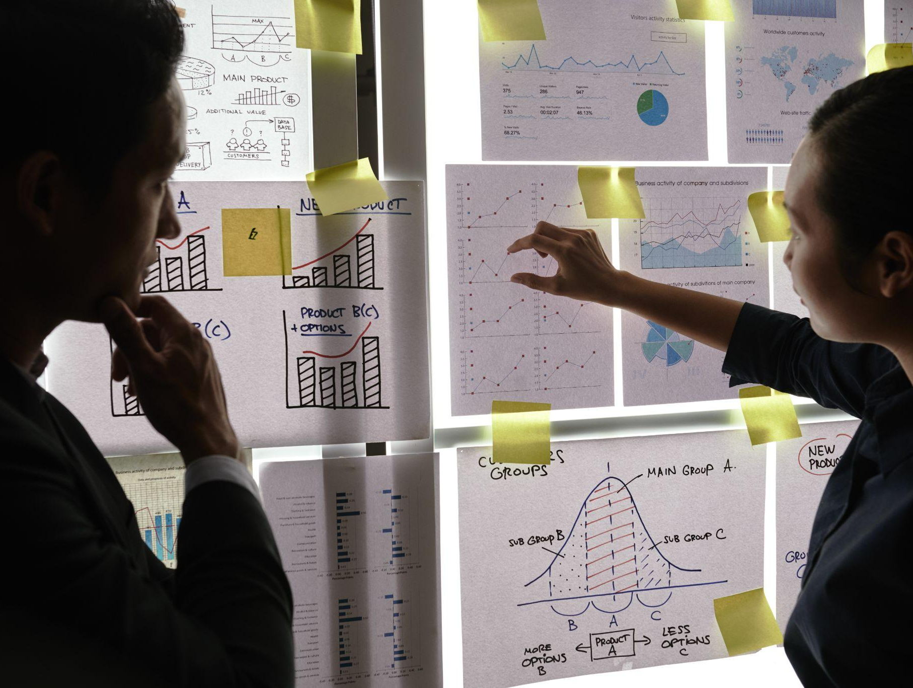
A picture always reinforces
the concept
Images reveal large amounts of data, so remember: use an image instead of a long text. Your audience will appreciate it

Slide 18
Marketing plan
95%
55%
15%
Mercury
Earth
Saturn
Mercury is the closest planet to the Sun and the smallest of them all
Earth is the third planet from the Sun and the only one that harbors life in the Solar System
Saturn is a gas giant and has several rings. It’s composed mostly of hydrogen and helium

Slide 19
4,498,300,000
Big numbers catch your audience’s attention

Slide 20
9h 55m 23s
333,000
386,000 km
Jupiter’s rotation period
The Sun’s mass compared to Earth’s
Distance between Earth and the Moon

Slide 21
Let’s use some percentages
25%
45%
30%
Mercury
Mars
Venus
Mercury is the closest planet to the Sun and the smallest of them all
Despite being red, Mars is actually a cold place. It’s full of iron oxide dust
Venus has a beautiful name and is the second planet from the Sun

Slide 22
Executive summary
Venus is a hot planet
Venus has a beautiful name and is the 2nd planet from the Sun. It’s terribly hot, even hotter than Mercury, and its atmosphere is extremely poisonous. It’s the second-brightest natural object in the night sky after the Moon
Mars | Earth
Mars is a cold planet Mars is full of iron oxide dust Despite being red, Mars is actually a cold place Despite being red, Mars is very cold Mars was named after a god | Earth is the third planet from the Sun Earth is the planet on which we all live Earth is the only planet that harbors life Earth is the 3th planet from the Sun Earth is the only planet known to harbor life

Slide 23
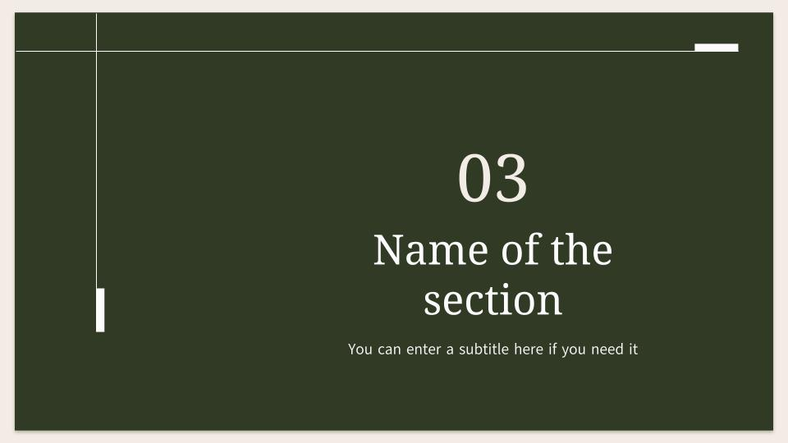
Computer mockup
You can replace the image on the screen with your own work. Just right-click on it and select “Replace image”

Slide 24
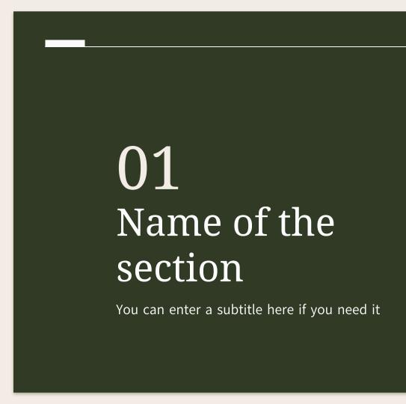
Tablet mockup
You can replace the image on the screen with your own work. Just right-click on it and select “Replace image”

Slide 25
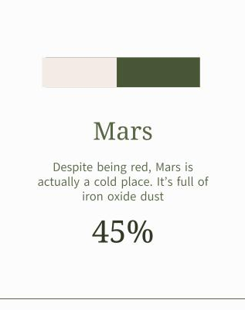
Phone mockup
You can replace the image on the screen with your own work. Just right-click on it and select “Replace image”

Slide 26
A timeline always works well
01
02
03
04
Mercury
Mercury is the closest planet to the Sun
Mars
Venus
Mars is actually a very cold place
Venus has extremely high temperatures
Jupiter
Jupiter is the biggest planet of them all

Slide 27
This is a map
Mercury
Mercury is the closest planet to the Sun
Mars
Despite being red, Mars is a very cold place

Slide 28
Infographics are visual
Mars
Mars is actually a very cold place
Mercury
Saturn
Earth
Mercury is the closest planet to the Sun
Saturn is a gas giant with several rings
Jupiter
Earth is the planet with life
Jupiter is the biggest planet of them all
Venus
Neptune
Venus has extremely high temperatures
Neptune is very far from the Sun

Slide 29
Tables represent your data
Solar System
Earth | Mars | Jupiter | Saturn | Neptune
Earth is the only planet known to harbor life | Despite being red, Mars is actually a cold place | Jupiter is the biggest planet in the Solar System | Saturn has a high number of moons, like Jupiter | Neptune is the farthest planet from the Sun
Mars is cold | Mercury is small | Jupiter is big | Earth has life | Saturn has rings
150 | 250 | 175 | 300 | 420

Slide 30
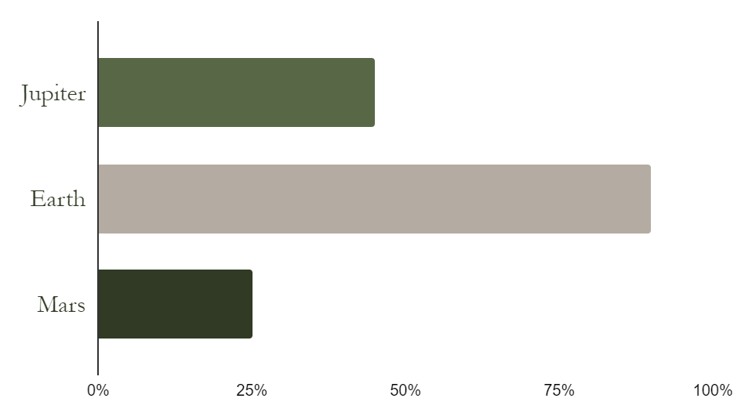
You can use this graph
Jupiter
Jupiter is a gas giant
Earth
We all live on the Earth
Mars
Mars is a cold planet
Follow the link in the graph to modify its data and then paste the new one here. For more info, click here

Slide 31
Five important ideas
Mars
Neptune
Jupiter
Despite being red, Mars is very cold
Neptune is the eighth planet from the Sun
Jupiter is the biggest planet of them all
Mercury
Saturn
Mercury is the closest planet to the Sun
Saturn is composed of hydrogen and helium

Slide 32
Key milestones
Jan
Feb
Mar
Apr
May
Jun
Mars
Venus
Neptune
Despite being red, Mars is actually a cold place. It’s full of iron oxide dust, which gives the planet its reddish cast
Venus has a beautiful name and is the second planet from the Sun. It’s terribly hot, even hotter than Mercury
Neptune is the farthest planet from the Sun. It’s also the fourth-largest planet by diameter in the Solar System

Slide 33
Three marketing plans
Neptune
Neptune is the farthest planet from the Sun. It’s also the fourth-largest planet by diameter in the Solar System
Jupiter
Mars
Jupiter is a gas giant and the biggest planet in the Solar System. It’s the fourth-brightest object in the night sky
Despite being red, Mars is actually a cold place. It’s full of iron oxide dust, which gives the planet its reddish cast

Slide 34


Our team
Timmy Jimmy
You can speak a bit about this person here
Sofia Hill
You can speak a bit about this person here

Slide 35
Thanks!
Do you have any questions?
youremail@freepik.com
+91 620 421 838
yourwebsite.com
Please keep this slide for attribution

Slide 36
Alternative resources
Here’s an assortment of alternative resources whose style fits the one of this template:
Vectors
Geometric shapes flat background

Slide 37
Resources
Did you like the resources in this template? Get them for free at our other websites:
Photos
Business owner working on their strategy
Top view people working with laptops
Male and female colleagues standing by window and looking at business graphs
Corporate employee posing at the office
Smiley man holding project documents

Slide 38
Instructions for use
If you have a free account, in order to use this template, you must credit Slidesgo by keeping the Thanks slide. Please refer to the next slide to read the instructions for premium users.
As a Free user, you are allowed to:
Modify this template.
Use it for both personal and commercial projects.
You are not allowed to:
Sublicense, sell or rent any of Slidesgo Content (or a modified version of Slidesgo Content).
Distribute Slidesgo Content unless it has been expressly authorized by Slidesgo.
Include Slidesgo Content in an online or offline database or file.
Offer Slidesgo templates (or modified versions of Slidesgo templates) for download.
Acquire the copyright of Slidesgo Content.
For more information about editing slides, please read our FAQs or visit our blog:
https://slidesgo.com/faqs and https://slidesgo.com/slidesgo-school

Slide 39
Instructions for use (premium users)
As a Premium user, you can use this template without attributing Slidesgo or keeping the "Thanks" slide.
You are allowed to:
Modify this template.
Use it for both personal and commercial purposes.
Hide or delete the “Thanks” slide and the mention to Slidesgo in the credits.
Share this template in an editable format with people who are not part of your team.
You are not allowed to:
Sublicense, sell or rent this Slidesgo Template (or a modified version of this Slidesgo Template).
Distribute this Slidesgo Template (or a modified version of this Slidesgo Template) or include it in a database or in any other product or service that offers downloadable images, icons or presentations that may be subject to distribution or resale.
Use any of the elements that are part of this Slidesgo Template in an isolated and separated way from this Template.
Register any of the elements that are part of this template as a trademark or logo, or register it as a work in an intellectual property registry or similar.
For more information about editing slides, please read our FAQs or visit our blog:
https://slidesgo.com/faqs and https://slidesgo.com/slidesgo-school

Slide 40
Fonts & colors used
This presentation has been made using the following fonts:
Noto Serif Ethiopic
(https://fonts.google.com/noto/specimen/Noto+Serif+Ethiopic)
Akatab
(https://fonts.google.com/specimen/Akatab)
#586847
#fcfcfc
#f3ece6
#b4aca2
#475735
#303a24

Slide 41





Storyset
Create your Story with our illustrated concepts. Choose the style you like the most, edit its colors, pick the background and layers you want to show and bring them to life with the animator panel! It will boost your presentation. Check out how it works.
Pana
Amico
Bro
Rafiki
Cuate

Slide 42
Use our editable graphic resources...
You can easily resize these resources without losing quality. To change the color, just ungroup the resource and click on the object you want to change. Then, click on the paint bucket and select the color you want. Group the resource again when you’re done. You can also look for more infographics on Slidesgo.

Slide 45
JANUARY
FEBRUARY
MARCH
APRIL
MAY
JUNE
PHASE 1
Task 1
Task 2
PHASE 2
Task 1
Task 2
JANUARY
FEBRUARY
MARCH
APRIL
PHASE 1
Task 1
Task 2

Slide 48
...and our sets of editable icons
You can resize these icons without losing quality.
You can change the stroke and fill color; just select the icon and click on the paint bucket/pen.
In Google Slides, you can also use Flaticon’s extension, allowing you to customize and add even more icons.

Slide 49
Educational Icons
Medical Icons

Slide 50
Business Icons
Teamwork Icons

Slide 51
Help & Support Icons
Avatar Icons

Slide 52
Creative Process Icons
Performing Arts Icons

Slide 53
Nature Icons

Slide 54
SEO & Marketing Icons

Slide 55


