Slide 1
GoThru
App Store Screenshot Concepts
Option 1 vs. Option 2
6 features • Apple App Store & Google Play

Slide 2
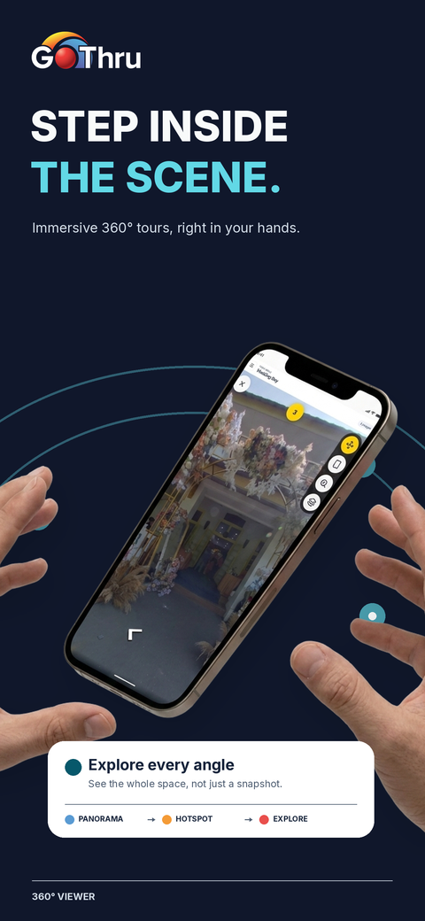
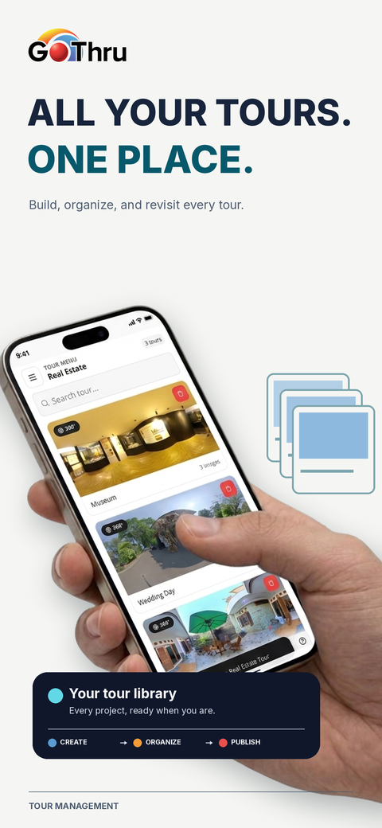
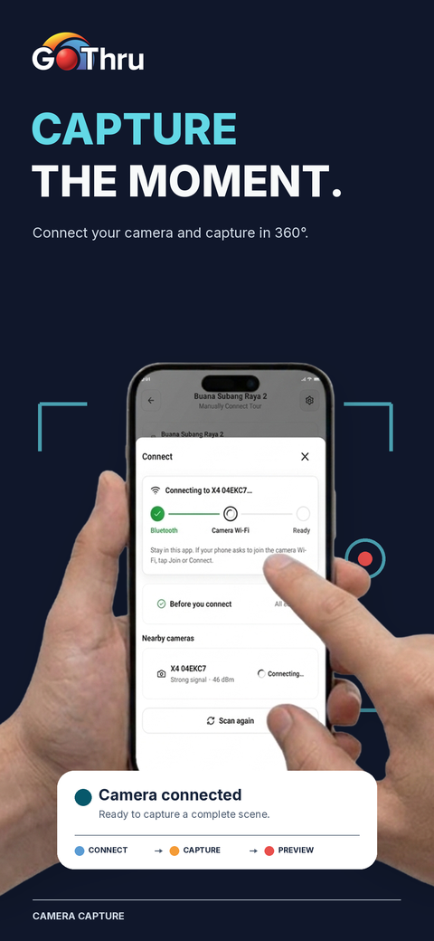
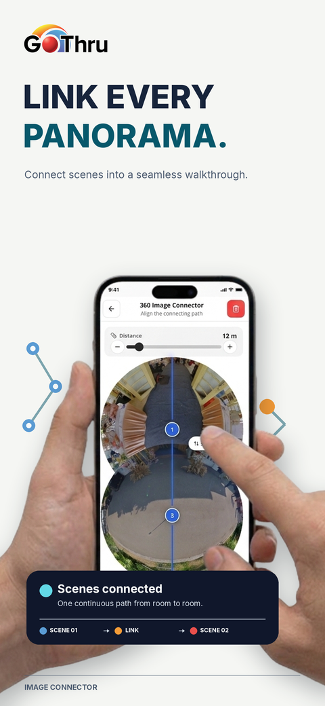
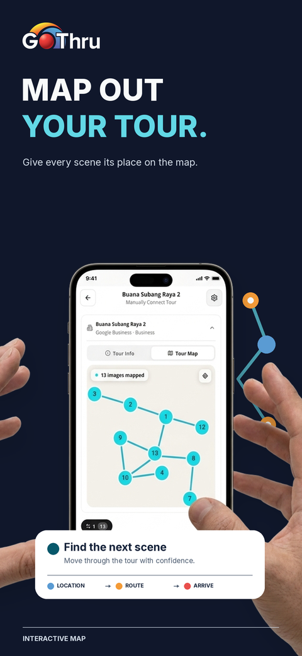
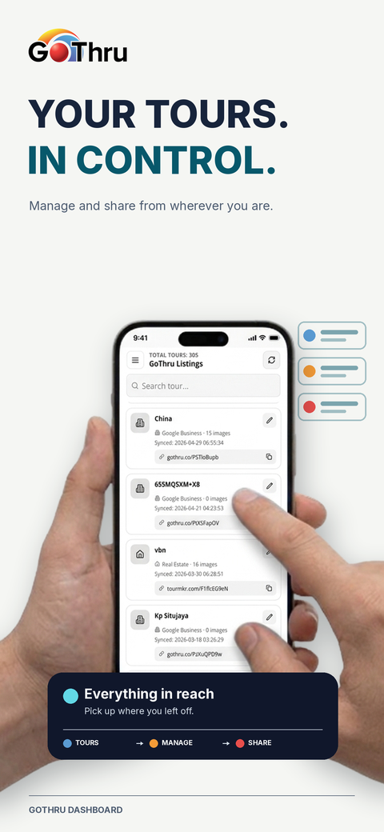
OPTION 1
1 / 2
GoThru · App Store Screenshots
Solid-color layouts featuring real in-app content.
01 360° Viewer
02 Tour Management
03 Camera Capture
04 Image Connector
05 Interactive Map
06 GoThru Dashboard

Slide 3
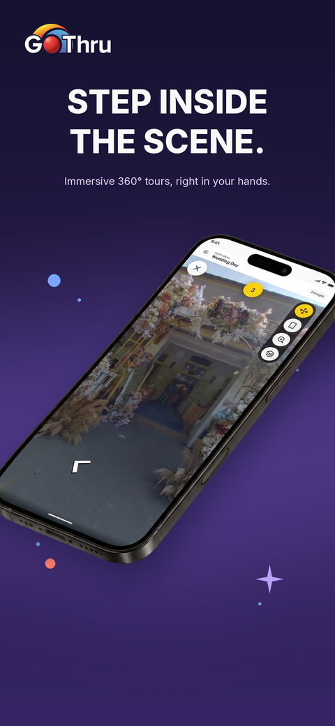
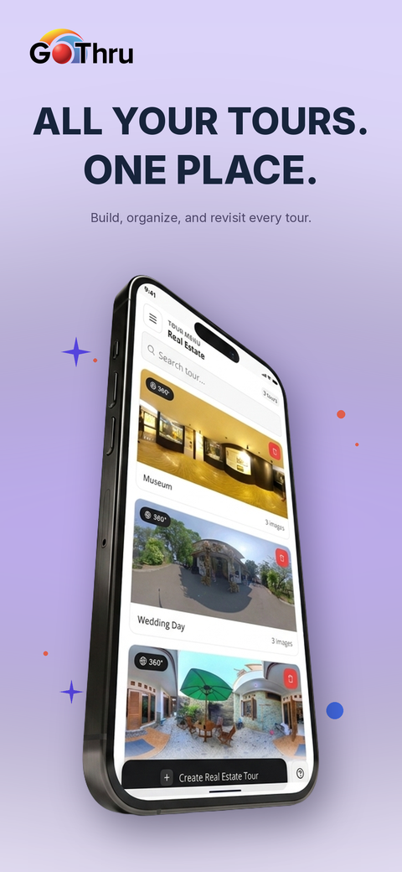
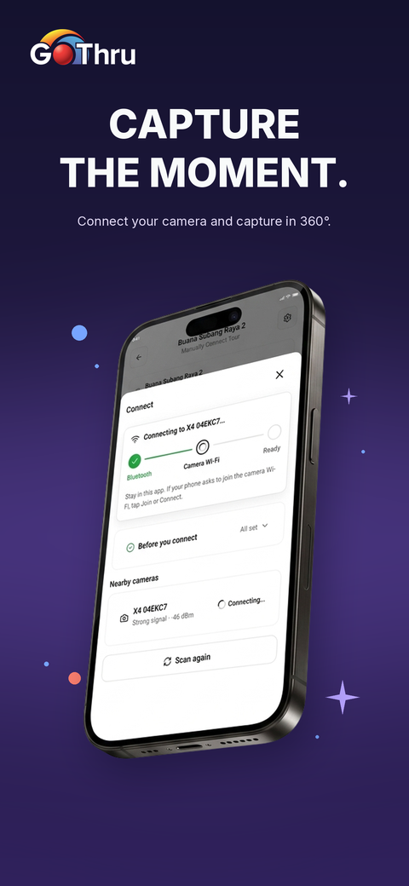
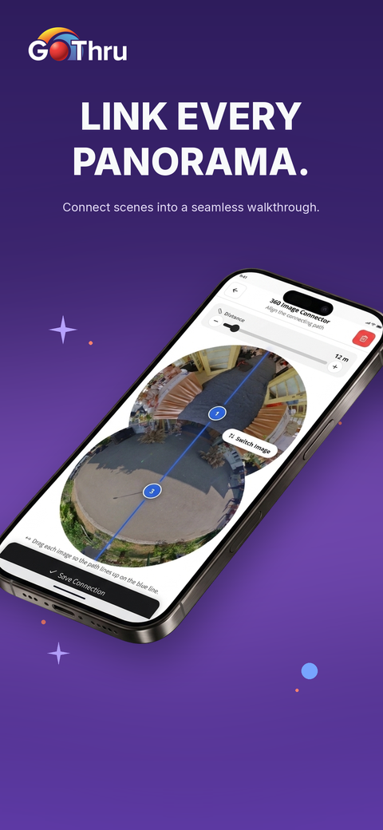
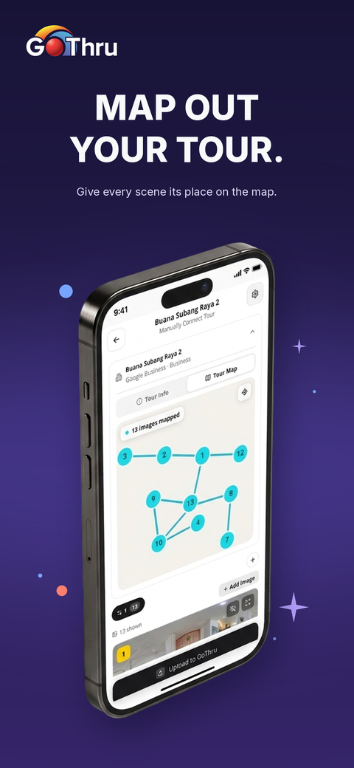
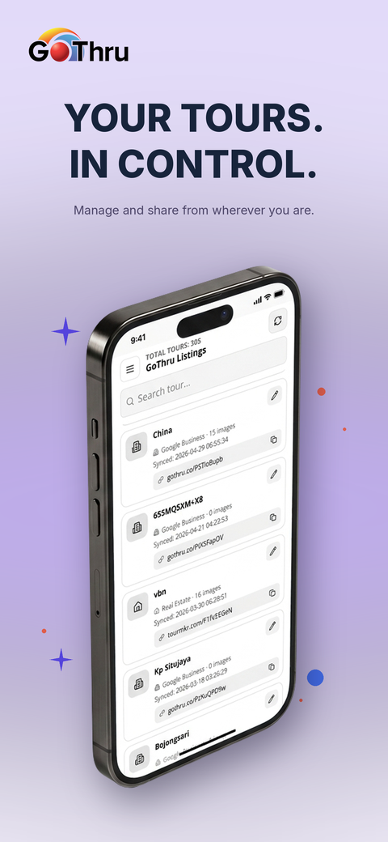
OPTION 2
2 / 2
GoThru · App Store Screenshots
Violet backgrounds, bold typography, and playful accents.
01 360° Viewer
02 Tour Management
03 Camera Capture
04 Image Connector
05 Interactive Map
06 GoThru Dashboard

