Slide 1

Student #1: Harun Durmuş ID: 270206025 Student #2: Necmettin Yiğit Dübek ID: 260206049
Student #3: Mustafa Eren Çelebi ID: 270206053
EE451 - Project Group 3
Comparison of Zero-Forcing and MMSE Equalizers in Different AWGN Channels

Slide 2
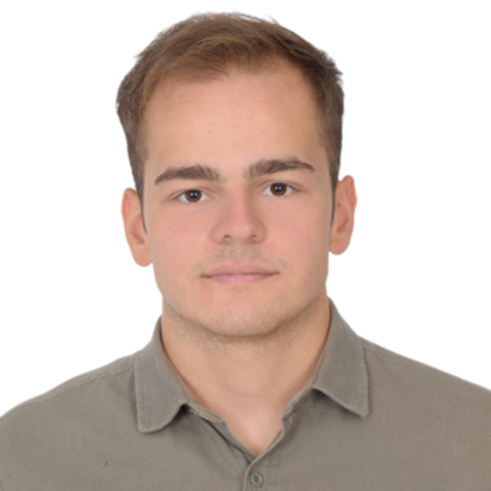
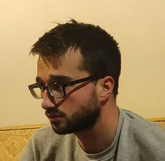
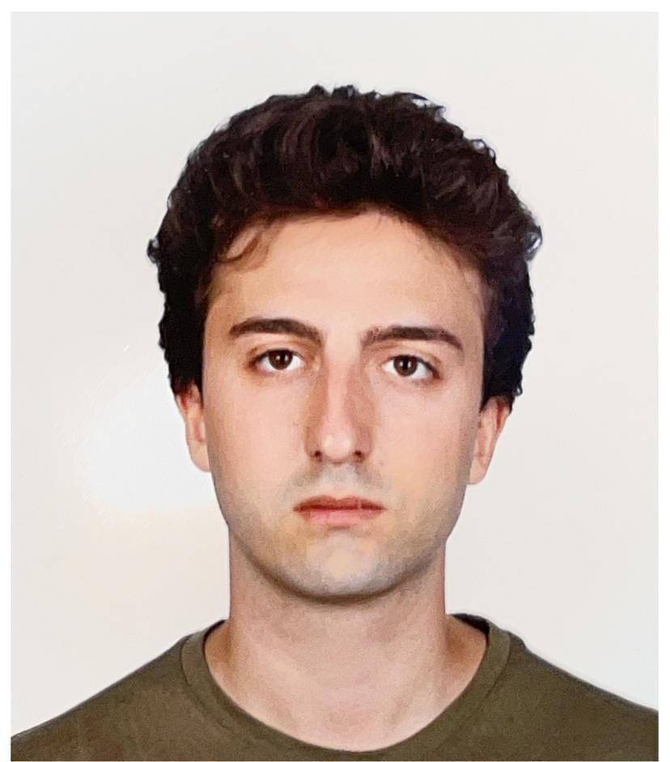
Team
Harun Durmuş
Necmettin Yiğit Dübek
Mustafa Eren Çelebi
Project Group 3 – Comparison of Zero-Forcing and MMSE Equalizers in Different AWGN Channels

Slide 3
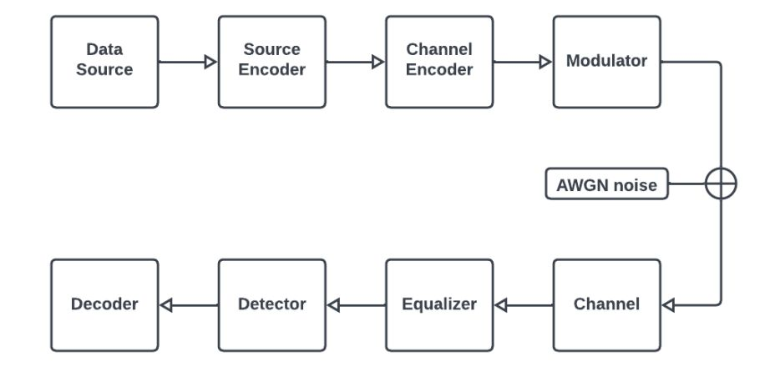
General Process of the Project
Project Group 3 – Comparison of Zero-Forcing and MMSE Equalizers in Different AWGN Channels

Slide 4
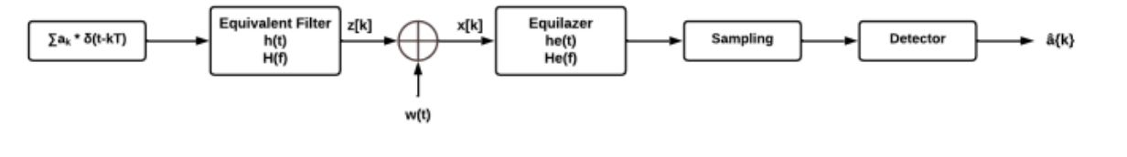
Equalization Overview
Transversal Filtering:
Zero Forcing Equalizer
Minimum Mean Square Error Equalizer (MMSE)
Project Group 3 – Comparison of Zero-Forcing and MMSE Equalizers in Different AWGN Channels

Slide 5
Zero Forcing Equalizer
Mathematical Definition:
${\left\{C_{n}\right\}}_{n=−N}^{N}$ => Z(k) = $\left\{\begin{matrix}1,k=0 \\ 0,k=±1,2…±N\end{matrix}\right.$
Advantages:
Interference Elimination​
Simplicity​
Reduced Complexity
Disadvantages:
Noise Sensitivity​
Channel State Information (CSI) Requirement
Project Group 3 – Comparison of Zero-Forcing and MMSE Equalizers in Different AWGN Channels

Slide 6
MMSE Equalizer
Mathematical Definition:
${\left\{C_{n}\right\}}_{n=−N}^{N}$ =>$\min{E}$⌊(z(k)-x(k))^2⌋
Advantages:
Noise Consideration​
Optimal Performance​
Robustness to Channel Variations
Disadvantages:
Higher Computational Complexity​
Need for Accurate Channel State Information (CSI)​
Implementation Challenges
Project Group 3 – Comparison of Zero-Forcing and MMSE Equalizers in Different AWGN Channels

Slide 7
Communication Channels
What is a channel?
Guided propagation:
Telephone channel
Optical fibers
Free propagation:
Wireless broadcast channels
Satellite channel
Project Group 3 – Comparison of Zero-Forcing and MMSE Equalizers in Different AWGN Channels

Slide 8
Communication Channels
Rayleigh Fading Channel:
Characteristics: Random amplitude variations.
Applicability: Mobile communications in urban scenarios.
Rician Fading Channel:
Characteristics: Multipath fading with a dominant line of sight component.
Applicability: Wireless communication within open environment with infrequent obstacles.
Project Group 3 – Comparison of Zero-Forcing and MMSE Equalizers in Different AWGN Channels

Slide 9
Communication Channels
Additive White Gaussian Noise Channel (AWGN):
Characteristics: Noise is Gaussian-distributed with zero mean and constant power spectral density.
Applicability: Mostly used in theoretical analysis and simulation.
Why do we prefer AWGN?
Simplicity
Mathematical trackability
It is used in perfomance comparison in different SNRs.
Project Group 3 – Comparison of Zero-Forcing and MMSE Equalizers in Different AWGN Channels

Slide 10
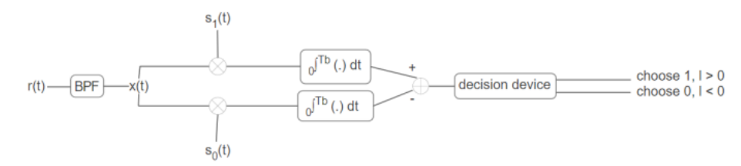
Demodulation
What is demodulation?
Extracting the original information.
Fundamental step in communication systems.
Project Group 3 – Comparison of Zero-Forcing and MMSE Equalizers in Different AWGN Channels

Slide 11
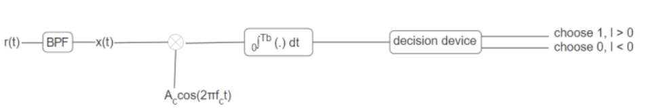
Demodulation
Demodulation technique that is used:
Binary Phase Shift Keying (BPSK):
Coherent Demodulation.
Demodulation involves coherent detection of the phase changes to recover the binary data.
Project Group 3 – Comparison of Zero-Forcing and MMSE Equalizers in Different AWGN Channels

Slide 12
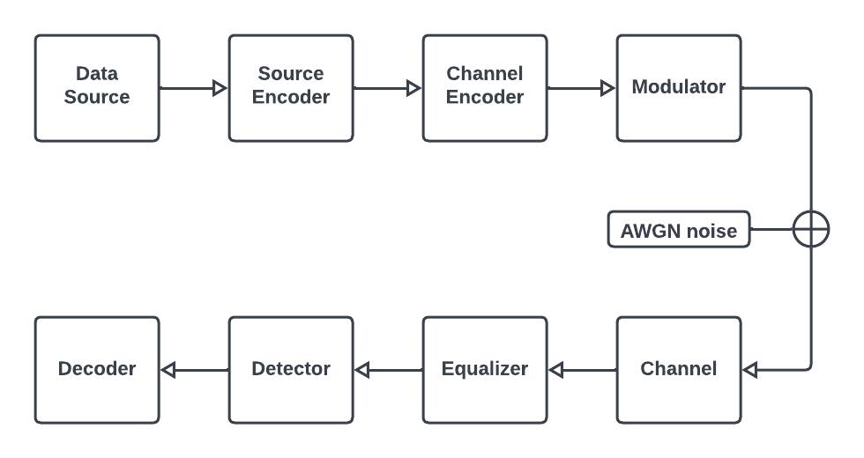
MATLAB DEMONSTRATION
Project Group 3 – Comparison of Zero-Forcing and MMSE Equalizers in Different AWGN Channels

Slide 13
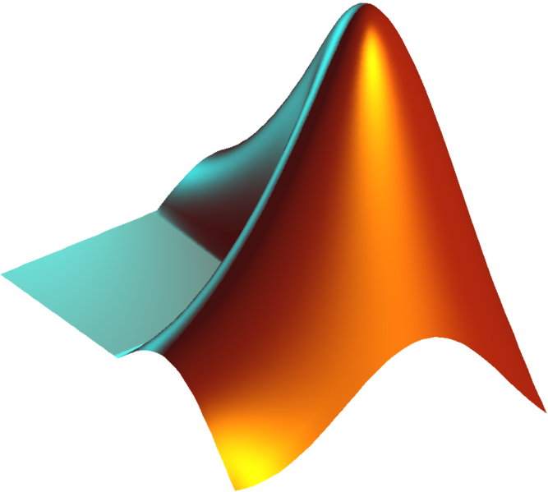
MATLAB DEMONSTRATION
Defining input data (as random bits)
Reshaping (Sampling)
Carrier Definition
B-PSK Modulation
Project Group 3 – Comparison of Zero-Forcing and MMSE Equalizers in Different AWGN Channels

Slide 14
MATLAB DEMONSTRATION
Project Group 3 – Comparison of Zero-Forcing and MMSE Equalizers in Different AWGN Channels

Slide 15
MATLAB DEMONSTRATION
Defining input data (as random bits)
Reshaping (Sampling)
Carrier Definition
B-PSK Modulation
Project Group 3 – Comparison of Zero-Forcing and MMSE Equalizers in Different AWGN Channels

Slide 16
MATLAB DEMONSTRATION
Project Group 3 – Comparison of Zero-Forcing and MMSE Equalizers in Different AWGN Channels

Slide 17
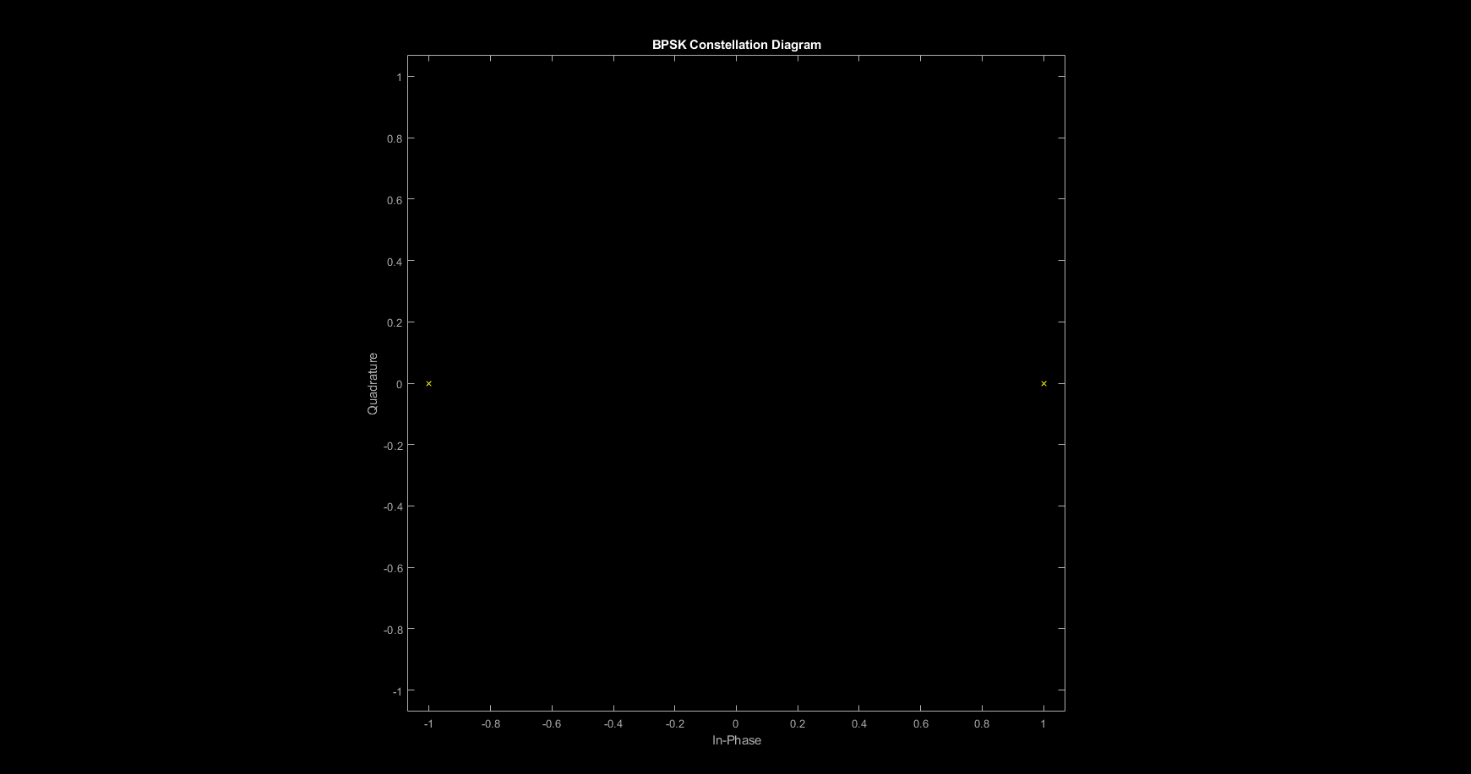
MATLAB DEMONSTRATION
Project Group 3 – Comparison of Zero-Forcing and MMSE Equalizers in Different AWGN Channels

Slide 18
MATLAB DEMONSTRATION
Channel Modelling
Noise Addition
Equalization
Decoding
Project Group 3 – Comparison of Zero-Forcing and MMSE Equalizers in Different AWGN Channels

Slide 19
MATLAB DEMONSTRATION
Channel Modelling
Noise Addition
Equalization
Decoding
Project Group 3 – Comparison of Zero-Forcing and MMSE Equalizers in Different AWGN Channels

Slide 20
RESULTS & CONCLUSION
Physical (Hardware) Representations
Performance analysis with different SNR values
Difference Between Zero-Forcing (ZF) and Minimum Mean Square Error (MMSE) equalizers
Conclusions about the use of these two methods
Project Group 3 – Comparison of Zero-Forcing and MMSE Equalizers in Different AWGN Channels

Slide 21
RESULTS & CONCLUSION
Physical (Hardware) Representations
Performance analysis with different SNR values
Difference Between Zero-Forcing (ZF) and Minimum Mean Square Error (MMSE) equalizers
Conclusions about the use of these two methods
Project Group 3 – Comparison of Zero-Forcing and MMSE Equalizers in Different AWGN Channels

Slide 22
RESULTS & CONCLUSION
Project Group 3 – Comparison of Zero-Forcing and MMSE Equalizers in Different AWGN Channels

Slide 23
RESULTS & CONCLUSION
Physical (Hardware) Representations
Performance analysis with different SNR values
Difference Between Zero-Forcing (ZF) and Minimum Mean Square Error (MMSE) equalizers
Conclusions about the use of these two methods
Project Group 3 – Comparison of Zero-Forcing and MMSE Equalizers in Different AWGN Channels

Slide 24
RESULTS & CONCLUSION
Project Group 3 – Comparison of Zero-Forcing and MMSE Equalizers in Different AWGN Channels

Slide 25
RESULTS & CONCLUSION
Physical (Hardware) Representations
Performance analysis with different SNR values
Difference Between Zero-Forcing (ZF) and Minimum Mean Square Error (MMSE) equalizers
Conclusions about the use of these two methods
Project Group 3 – Comparison of Zero-Forcing and MMSE Equalizers in Different AWGN Channels

Slide 26
RESULTS & CONCLUSION
 | 0 dB | 10 dB
Zero Forcing
MMSE
Project Group 3 – Comparison of Zero-Forcing and MMSE Equalizers in Different AWGN Channels

Slide 27
REFERENCES
"Comparison of Zero-Forcing and MMSE Equalizers in Different AWGN Channels", H. Durmuş, N.Y. Dübek, M.E. Çelebi, January, 2024.
MATLAB Code "P3.m"
Project Group 3 – Comparison of Zero-Forcing and MMSE Equalizers in Different AWGN Channels

Slide 28
MATLAB DEMONSTRATION
Project Group 3 – Comparison of Zero-Forcing and MMSE Equalizers in Different AWGN Channels

Slide 29
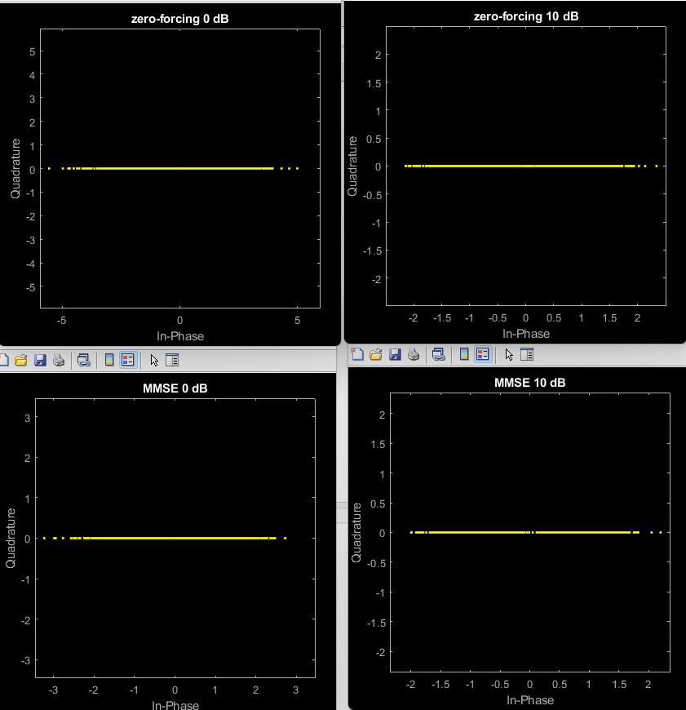
Project Group 3 – Comparison of Zero-Forcing and MMSE Equalizers in Different AWGN Channels

