Slide 1
WHERE TO START FAST CASUAL INDIAN RESTAURANT IN THE DFW AREA
Analyst: Harun Khalid

Slide 2
INDEX
INTRODUCTION
DATA
ANALYSIS
MACHINE LEARNING
RESULTS

Slide 3
INTRODUCTION
Problem Statement: I am a an analyst looking to help investors start a fast casual Indian restaurant in the DFW area. Through this analysis I am looking to identify the ideal neighborhood for this purpose.
Background:
Fast-casuals restaurants are growing rapidly across the USA
Unlike NYC & San Francisco, DFW residents only have the option to go to old-school Indian restaurants where the chef dictates what and how to eat the meal due to lack of fast casual Indian restaurants
DFW residents deserve the opportunity to experience the joy of crafting and enjoying their healthy indian meal
Audience: Entrepreneurs and businesses who intend to provide the citizens of the DFW area with the ability to craft their own indian meal for a small premium that wouldn't push the costs into a range of what one would pay at an old-school sit down Indian restaurant.

Slide 4
DATA
The following data points for neighborhoods were used to determine the optimal location to start a fast casual Indian restaurant in the DFW area:
Population
Median Age
Median Household Income
Crime Rate
Number of Chipotles & Shake Shacks
Number of Restaurants

Slide 5
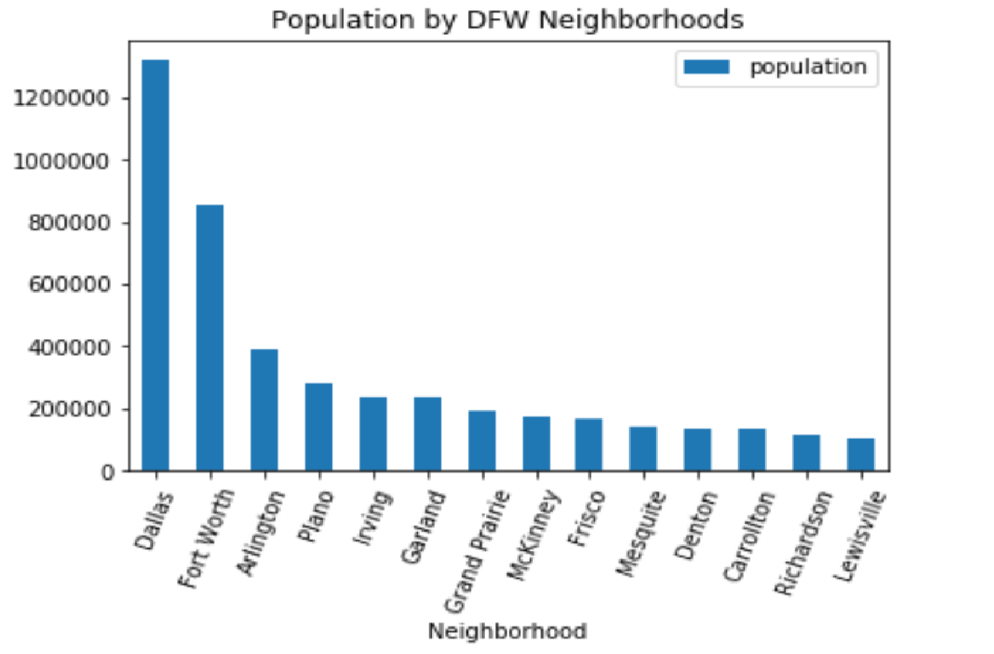
ANALYSIS
As for any business, volume/traffic is a key factor that is required to be successful. For restaurants, the volume mainly comes from population/residents of neighborhoods where the restaurants are located in. From our initial look, we can see that Dallas and Fort Worth are the most populated neighborhoods in the DFW area. However, we must explore further before solidifying these neighborhoods as potential locations.

Slide 6
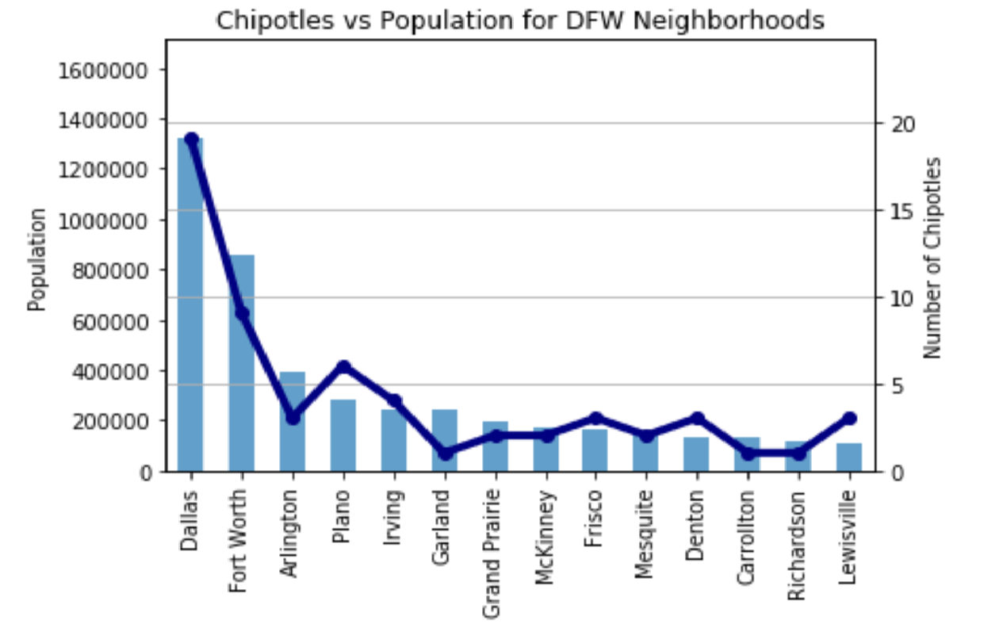
ANALYSIS (cont.)
Taking a look at how fast casual chain Chipotle has been growing in the DFW area we can see that number of chipotles are not necessarily proportional to the population of the neighborhoods. What stands out is that Plano & Irving have more Chipotles than Arlington which has a higher population than the former neighborhoods. This shows that we need to consider factors beyond population in making our decision for optimal location for the fast casual Indian restaurant.

Slide 7
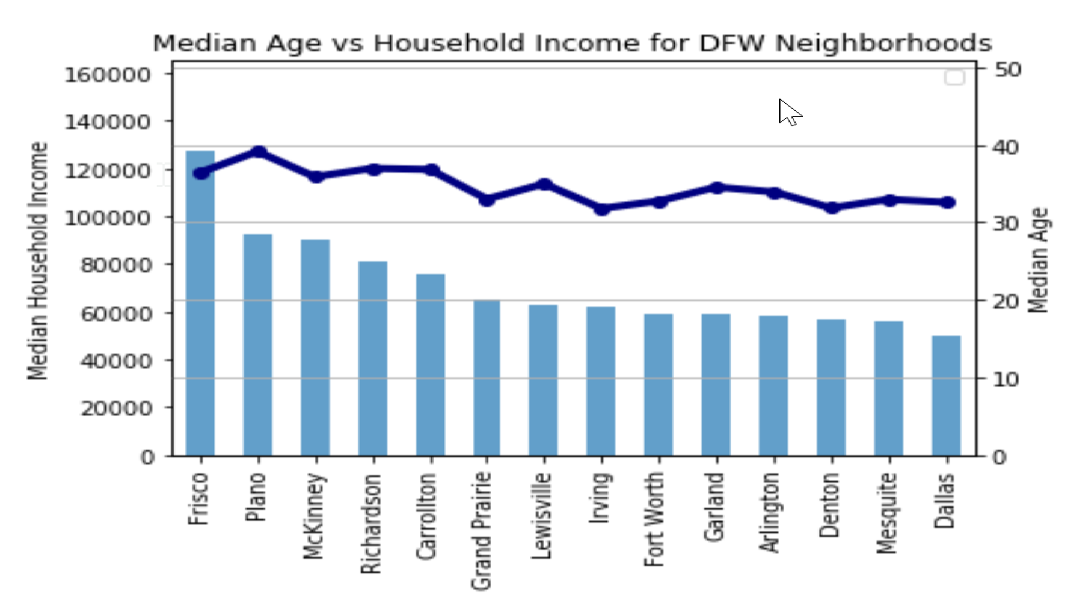
ANALYSIS (cont.)
Overlaying the median ages of neighborhoods to the income chart, we can see that median ages for all neighborhoods under consideration are between 30-40. Frisco has a younger population than Plano and has more income. This could be because Frisco is a newer neighborhood than Plano and has benefited tremendously from the influx of corporations moving to the area in the recent past. However, the fact that Plano has a high number of Chipotles suggests that the Plano population is willing to eat out at fast casual restaurants.

Slide 8
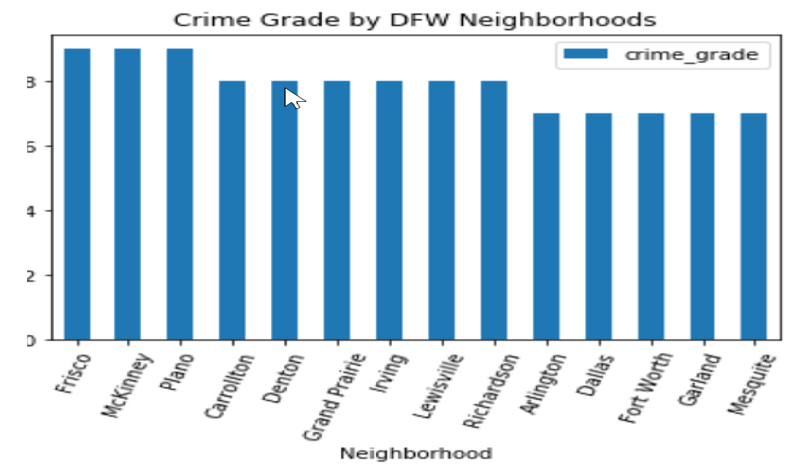
ANALYSIS (cont.)
Safety is a high priority for our stakeholders, taking a look at the crime grades, we can see that Frisco, McKinney and Plano have the best crime grades (lowest crime rate) amongst cities we considered for this analysis. We can also see in the chart below that Dallas and Fort Worth have poor ratings for crime.

Slide 9
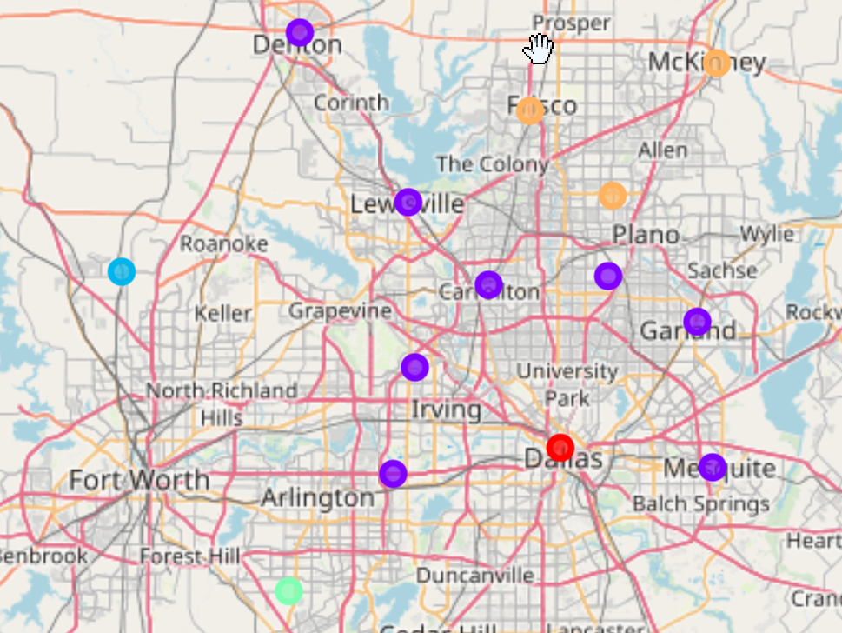
MACHINE LEARNING
As the purpose of this exercise is not to predict an outcome but to pick a location, we will use the k means clustering algorithm to determine how the cities we explored compare to each other across all the data points that are available to us (15+ fields). This will come in handy when picking locations for expansion of the fast casual Indian Restaurant
Since we are looking at 14 neighborhoods, we dissected them into 5 clusters to be more precise.
We can see that Plano, Frisco and Mckinney are in the same cluster which should be targeted as the location for the restaurant

Slide 10
RESULTS
From our exploratory analysis, Plano and Frisco stand out as strong candidates for starting a fast casual Indian restaurant due to having a relatively young population that earns well and low crime rates.
The fact that Chipotle has a strong presence in these areas relative to their population is also a promising sign that fast casual restaurants succeed in these areas.

