Slide 1
Data Preprocessing
Practical Machine Learning with SciKit Learn

Slide 2
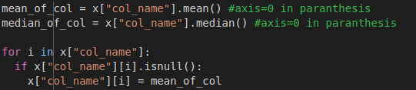
Dealing With Missing Data
Remove the feature
Remove the datapoint
Set the missing value to the mean/median of the dataset

Slide 3
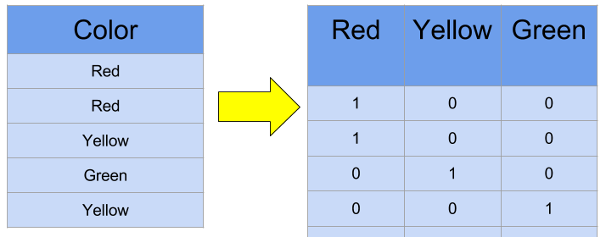
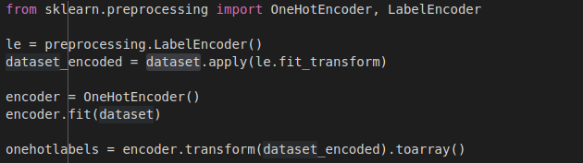
Categorical Variables

Slide 4
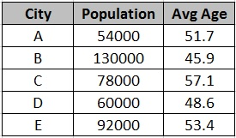
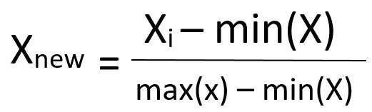
Feature Scaling

Slide 5
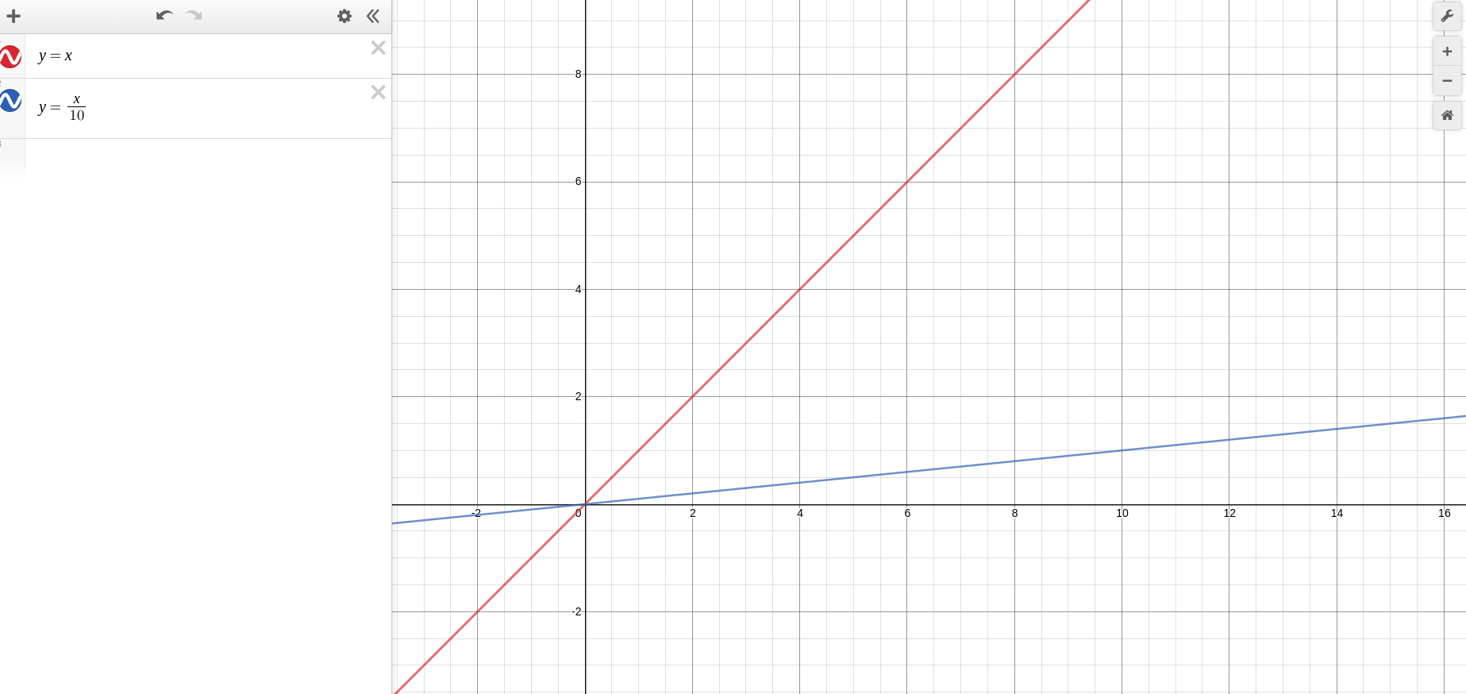


Slide 6
Choosing Features
Less features than data points
Features correlated to the output
Features not related to other features

Slide 7
Code in GitHub

