Slide 1


LinkedIn : https://www.linkedin.com/in/harunraseed/
Harun Raseed Basheer
Senior Consultant
Hitachi Solutions
Blog : https://medium.com/@harun.raseed093

Slide 2
Apache Spark
An unified, open source, parallel, data processing framework for Big Data Analytics
Spark SQL
Interactive
Queries
Spark MLlib
Machine
Learning
Spark
Streaming
Stream processing
GraphX
Graph
Computation
  Spark Unifies:
  Batch Processing
  Interactive SQL
  Real-time processing
  Machine Learning
  Deep Learning
  Graph Processing
Spark Core Engine
Yarn
Mesos
Standalone Scheduler
Spark MLlib
Machine
Learning
Spark Structured
Streaming
Stream processing

Slide 3
Spark - Benefits
Performance
Using in-memory computing, Spark is considerably faster than Hadoop (100x in some tests).
Can be used for batch and real-time data processing.
Developer Productivity
Easy-to-use APIs for processing large datasets.
Includes 100+ operators for transforming.
Unified Engine
Integrated framework includes higher-level libraries for interactive SQL queries, Stream Analytics, ML and graph processing.
A single application can combine all types of processing.
Ecosystem
Spark has built-in support for many data sources, rich ecosystem of ISV applications and a large dev community.
Available on multiple public clouds (AWS, Google and Azure) and multiple on-premises distributors

Slide 4
Azure Databricks
Core Concepts

Slide 5
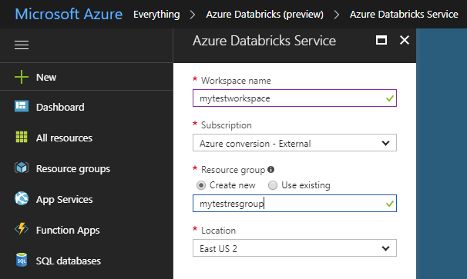
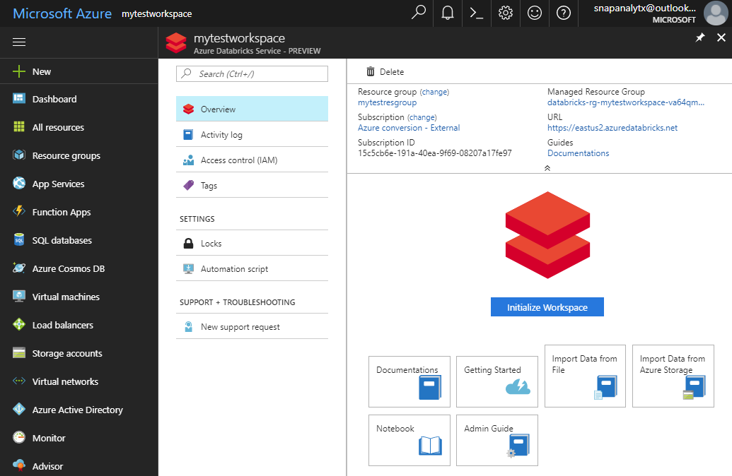
Provisioning Azure Databricks WORKSPACE
  Azure Databricks is provisioned directly from the Azure Portal like any other Azure service
    In contrast, with other clouds, it has to be provisioned through the Databricks portal.
    With Azure Databricks, the Azure Portal offers a unified portal to provision and administer Azure Databricks as well as other Azure services.
  Any Azure user with the appropriate subscription and authorization can provision Azure Databricks service*.
    There is no need for a separate Databricks account
Provisioning the Azure Databricks Service
After provisioning the is complete
    * During the current preview phase, the subscription has to be whitelisted.
Notes:
It is possible for a non-Azure user to access the Databricks cluster through a public URL. Such users have limited rights.

Slide 6
General Spark Cluster Architecture
Driver Program
SparkContext
  ‘Driver’ runs the user’s ‘main’ function and executes the various parallel operations on the worker nodes.
  The results of the operations are collected by the driver
  The worker nodes read and write data from/to Data Sources including HDFS.
  Worker node also cache transformed data in memory as RDDs (Resilient Data Sets).
  Worker nodes and the Driver Node execute as VMs in public clouds (AWS, Google and Azure).
Cluster Manager
Worker Node
Worker Node
Worker Node
Cache
Cache
Cache
Task
Task
Task
Data Sources (HDFS, SQL, NoSQL, …)

Slide 7





Azure Databricks Core ARTIFACTS
Clusters
Libraries
Workspaces
Azure Databricks
Jobs
Notebooks

Slide 8
Clusters

Slide 9
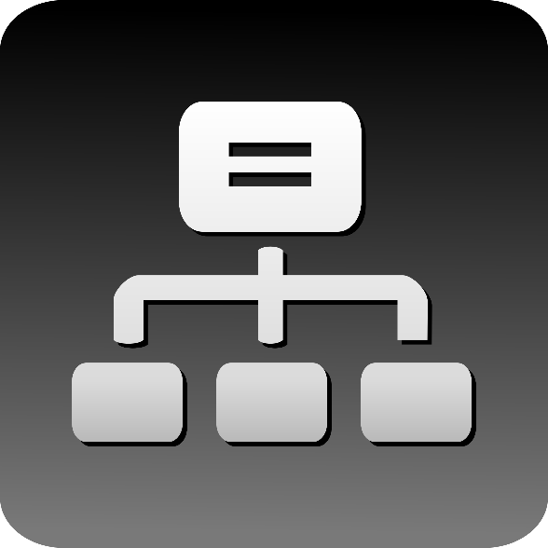
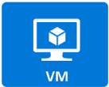
Clusters
  Azure Databricks clusters are the set of Azure VMs that host the Spark Worker and Driver Nodes
  Your Spark application code (i.e. Jobs) runs on the provisioned clusters.
  Azure Databricks clusters are launched in your subscription—but are managed through the Azure Databricks portal.
  Azure Databricks provides a comprehensive set of graphical wizards to manage the complete lifecycle of clusters—from creation to termination.

Slide 10
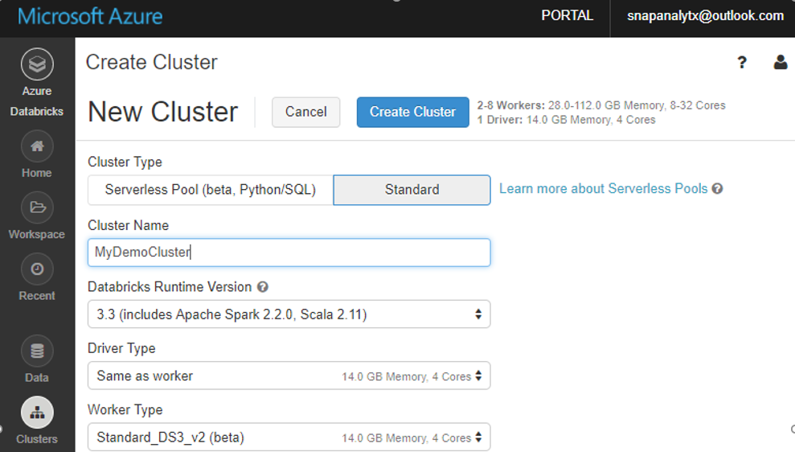
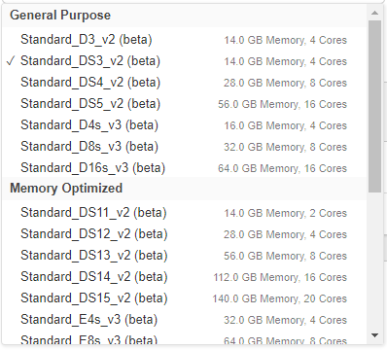
Cluster Creation
  You can create two types of clusters – Standard and Serverless Pool (see next slide)
  While creating a cluster you can specify:
    Number of nodes
    Autoscaling and Auto Termination policy
    Auto Termination policy
    Spark Configuration details
    The Azure VM instance types for the Driver and Worker Nodes
Graphical wizard in the Azure Databricks portal to create a Standard Cluster

Slide 11
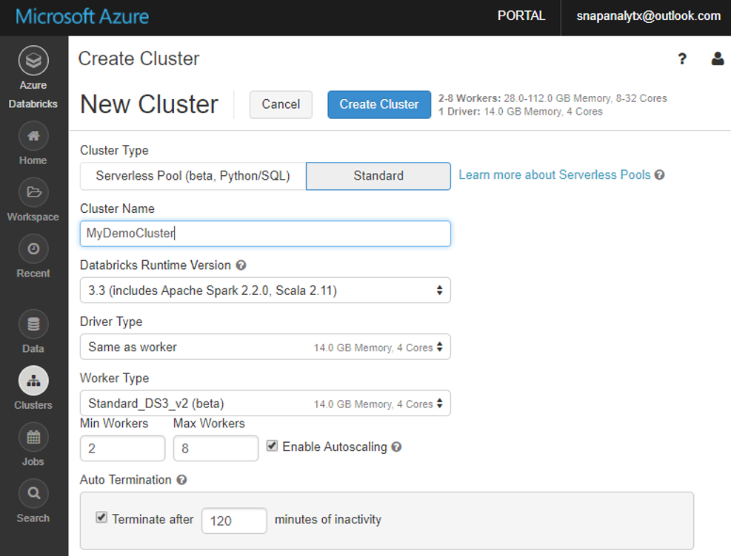
Clusters: Auto Scaling and Auto Termination
Simplifies cluster management and reduces costs by eliminating wastage
  When creating Azure Databricks clusters you can choose Autoscaling and Auto Termination options.
  Autoscaling: Just specify the min and max number of clusters. Azure Databricks automatically scales up or down based on load.
  Auto Termination: After the specified minutes of inactivity the cluster is automatically terminated.
  Benefits:
  You do not have to guess, or determine by trial and error, the correct number of nodes for the cluster
  As the workload changes you do not have to manually tweak the number of nodes
  You do not have to worry about wasting resources when the cluster is idle. You only pay for resource when they are actually being used
  You do not have to wait and watch for jobs to complete just so you can shutdown the clusters

Slide 12
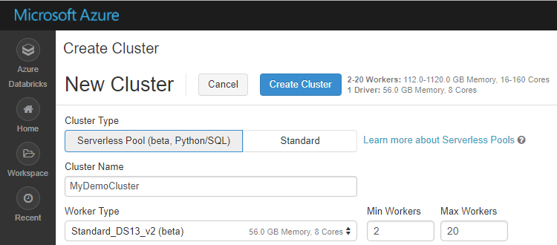
Serverless Pool
A self-managed pool of cloud resources, auto-configured for interactive Spark workloads
  You specify only the minimum and maximum number of nodes in the cluster—Azure Databricks provisions and adjusts the compute and local storage based on your usage.
  Limitation: Currently works only for SQL and Python.
Benefits of Serverless Pool
Auto-Configuration | Databricks chooses the best configuration for Spark to get the best performance Users don’t need to worry about providing any of the Databricks runtime version or Spark configuration. Databricks also chooses the best cluster parameters to save cost on infrastructure
Elasticity | Automatically scales the compute and local storage, independently, based on usage
Fine grained Sharing | Offers maximum resource utilization and minimum query latencies Preemption: Databricks proactively preempts Spark tasks from over-committed users to ensure all users get their fair share of cluster time and their jobs complete in a timely manner even when contending with dozens of other users. Uses the “Task Preemption for High Concurrency” feature of Spark in Databricks. Fault isolation: Databricks sandboxes the environments belonging to different notebooks from one another.

Slide 13
Jobs

Slide 14

Jobs
Jobs are the mechanism to submit Spark application code for execution on the Databricks clusters
  Spark application code is submitted as a ‘Job’ for execution on Azure Databricks clusters
  Jobs execute either ‘Notebooks’ or ‘Jars’
  Azure Databricks provide a comprehensive set of graphical tools to create, manage and monitor Jobs.

Slide 15
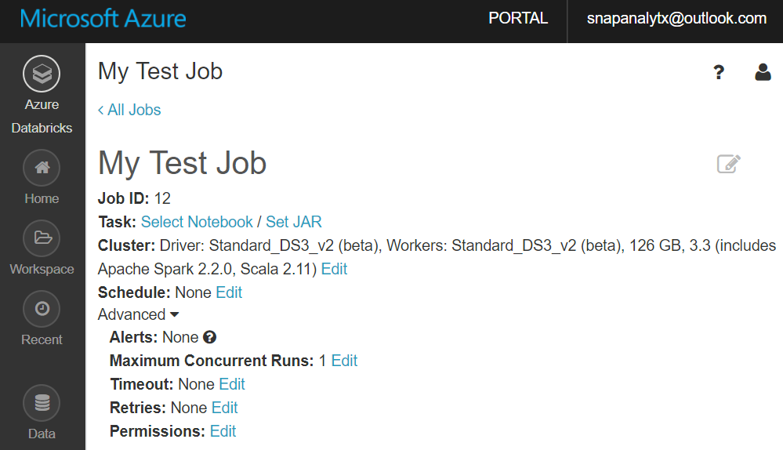
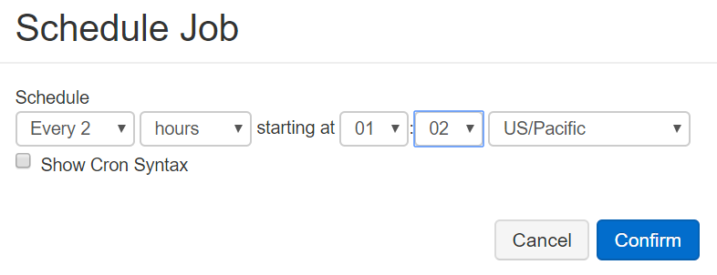
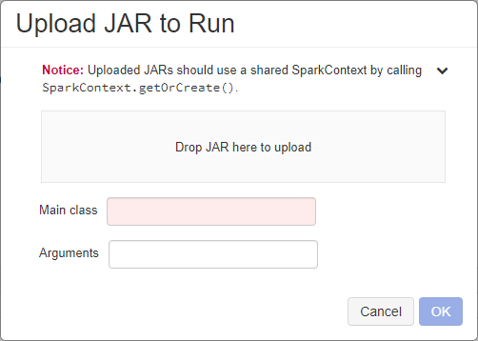
Creating and Running Jobs (1 of 2)
  When you create a new Job you have to specify:
  The Notebook or Jar to execute
  Cluster: The cluster on which the Job execute. This could be an exiting or new cluster.
  Schedule i.e. how often the Job runs. Jobs can also be run one time right away.

Slide 16
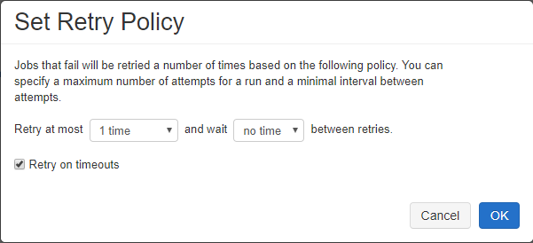
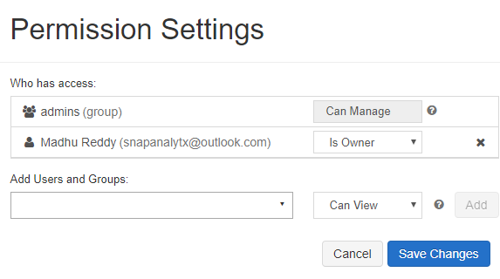
Creating and Running Jobs (2 of 2)
  When you create a new job you can optionally specify advanced options:
  Maximum number of concurrent runs of the Job
  Timeout: Jobs still running beyond the specified duration are automatically killed
  Retry Policy: Specifies if—and when—failed jobs will be retried
  Permissions: Who can do what with jobs. This allows for Job definition and management to be securely shared with others (see next slide)

Slide 17
Workspaces & Folders

Slide 18
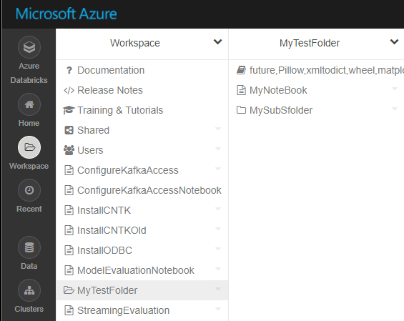
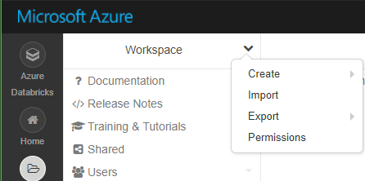

Workspaces
Workspaces enables users to organize—and share—their Notebooks, Libraries and Dashboards
  Workspaces—sort of like Directories— are a convenient way to organize an user’s Notebook, Libraries and Dashboards.
  Everything in a workspace is organized into hierarchical folders. Folders can hold Libraries, Notebooks, Dashboard or more (sub) folders.
    Icons indicate the type of the object contained in a folder
  Every user has one directory that is private and unshared.
    By default, the workspace and all its contents are available to users.
  Fine grained access control can be defined on workspaces (next slide) to enable secure collaboration with colleagues.

Slide 19
Notebooks, Libraries, Visualization

Slide 20
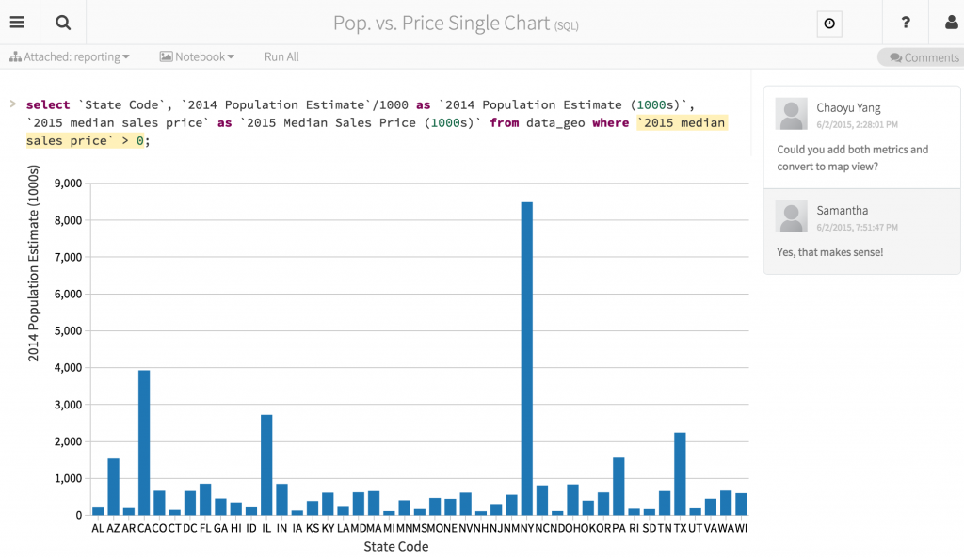
Azure Databricks Notebooks Overview
Notebooks are a popular way to develop, and run, Spark Applications
  Notebooks are not only for authoring Spark applications but can be run/executed directly on clusters
    Shift+Enter
    click the at the top right of the cell in a notebook
    Submit via Job
  Notebooks support fine grained permissions—so they can be securely shared with colleagues for collaboration (see following slide for details on permissions and abilities)
  Notebooks are well-suited for prototyping, rapid development, exploration, discovery and iterative development
  Notebooks typically consist of code, data, visualization, comments and notes

Slide 21
Mixing Languages in Notebooks
You can mix multiple languages in the same notebook
  Normally a notebook is associated with a specific language. However, with Azure Databricks notebooks, you can mix multiple languages in the same notebook. This is done using the language magic command:
    %python Allows you to execute python code in a notebook (even if that notebook is not python)
    %sql Allows you to execute sql code in a notebook (even if that notebook is not sql).
    %r Allows you to execute r code in a notebook (even if that notebook is not r).
    %scala Allows you to execute scala code in a notebook (even if that notebook is not scala).
    %sh Allows you to execute shell code in your notebook.
    %fs Allows you to use Databricks Utilities - dbutils filesystem commands.
    %md To include rendered markdown
Notes:
Note that %run lets you run one notebook from within another
Scala and Python notebooks support error highlighting
Tabular result output can be downloaded to local machine
Notebooks track revision history to support collaboration

Slide 22
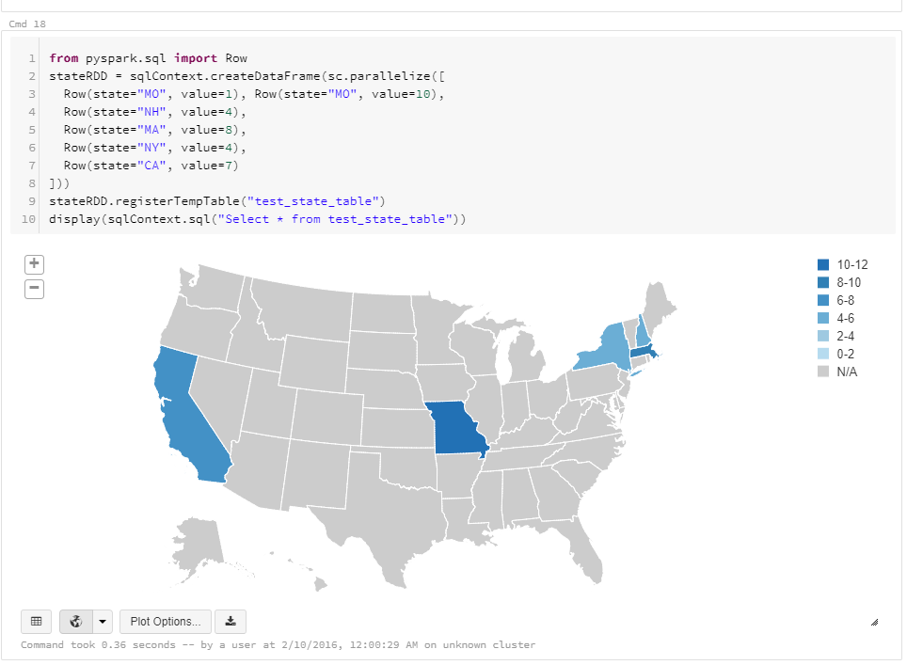
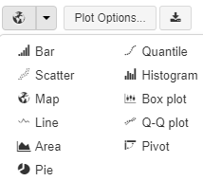
Visualization
Azure Databricks supports a number of visualization plots out of the box
  All notebooks, regardless of their language, support Databricks visualizations.
  When you run the notebook the visualizations are rendered inside the notebook in-place
  The visualizations are written in HTML.
    You can save the HTML of the entire notebook by exporting to HTML.
    If you use Matplotlib, the plots are rendered as images so you can just right click and download the image
  You can change the plot type just by picking from the selection
Notes:
Additionally, all Azure Databricks programming language notebooks (python, scala, R) support using interactive HTML graphics using javascript libraries like D3.
To use this, you can pass any HTML, CSS, or JavaScript code to the displayHTML() function to render its results.
You can display MatPlotLib and ggplot objects in Python notebooks
You can use Plotly, an interactive graphing library
Azure Databricks supports htmlwidgets. With R htmlwidgets you can generate interactive plots using R’s flexible syntax and environment.

