Slide 1

The Intersection of Fake News and AI
Mehmet Harun Şahinol
Antalya Bilim University

Slide 2
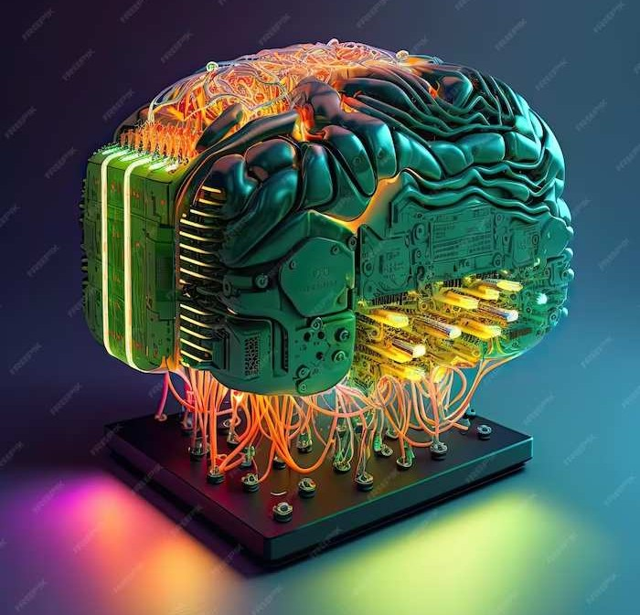
Why this topic is important?
Fake news is a critical issue in today's society. This presentation will delve into the impact of AI on the spread of fake news and the challenges it presents_{[1]}.

Slide 3
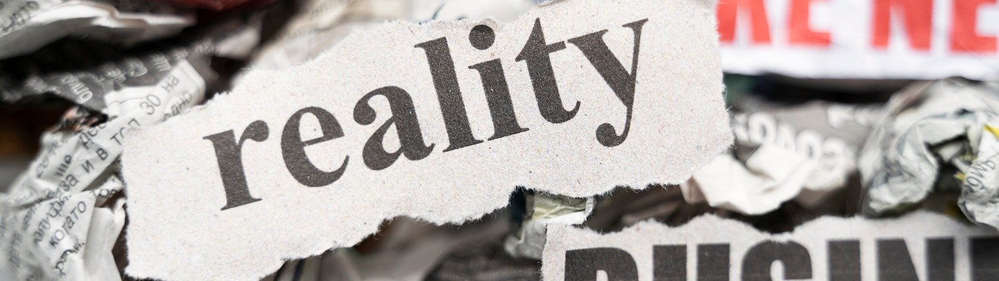
Fake news is false information that is spread on purpose to deceive people. It can be anything from a fake news article to a made-up social media post.[1].
Understanding Fake News

Slide 4
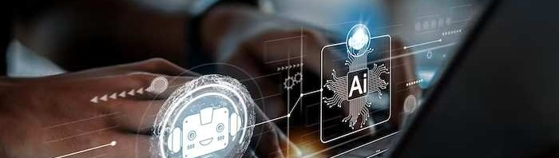
AI can be used to spread fake news, but it can also be used to fight it. AI bots can post fake articles on social media, but AI algorithms can also be used to identify fake news articles and fact-check them.
Role of AI in Fake News

Slide 5

Detecting Fake News with AI
What is TF-IDF (term frequency–inverse document frequency) and why important?
TF-IDF is a way of representing text as meaningful numbers, also known as vector notation.
TF = Total number of a Term/ Total number of term in document
IDF = log(Total number of documents / Number of documents containing term)

Slide 6
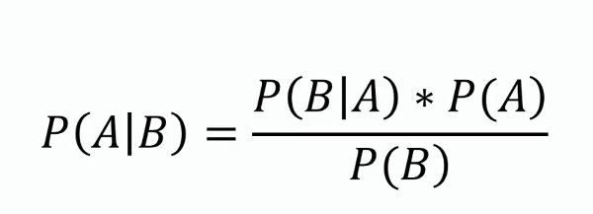
Naive Bayes Algorithm
Naive Bayes algorithm is a supervised learning algorithm based on Bayer's theorem and used to solve classification problems._{[2]}
P(A|B) is the probability of occurrence of event A when event B occurs.
P(B|A) is the probability of occurrence of event B when event A occurs.
P(A) and P(B) are the a priori probabilities of events A and B.

Slide 7



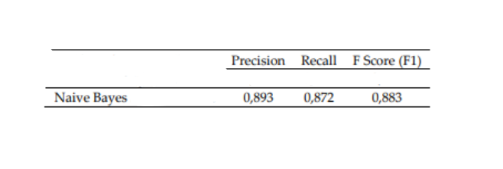
Result of Naive Bayes
(How good is this?)
Recall
F Score
Precision
Naive Bayes can detect 89% of fake news! _{[3]}

Slide 8
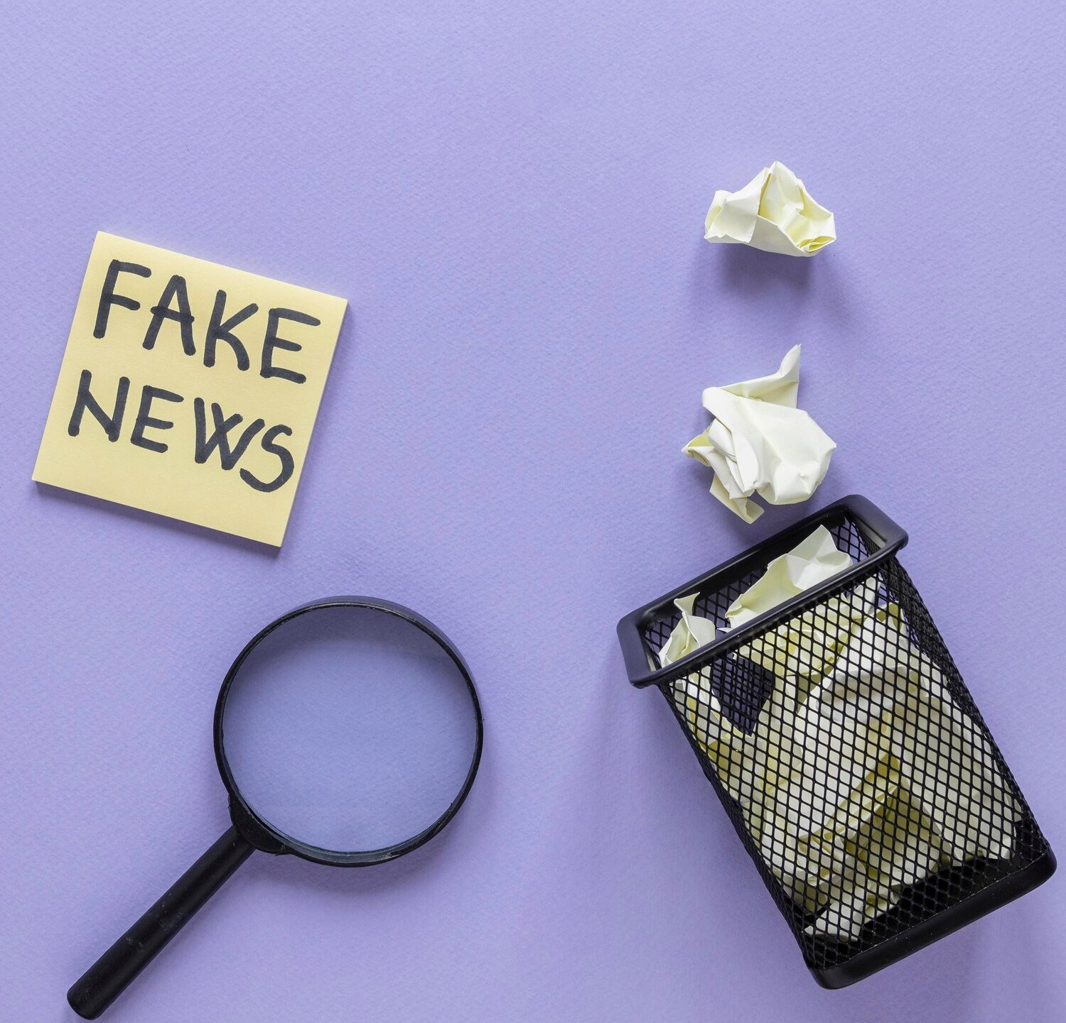
Conclusion
Fake news is made-up information that is spread to misleading people. AI can be used to spread fake news more easily, but it can also be used to find fake news and stop it.

Slide 9
Resources [1]https://www.sciencedirect.com/science/article/abs/pii/S0378437119317546#fig4 [2]https://www.sciencedirect.com/science/article/abs/pii/S0925231223001376 [3]https://dergipark.org.tr/en/download/article-file/3015090

Slide 10
Thanks!
Do you have any questions?

