Slide 1
Paper ID : 3
ICCIT2020
Title: Genre Recognition of Artworks Using Convolutional Neural Network
Authors:
Md. Kamran Hosain , Harun-Ur-Rashid, Tasnova Bintee Taher, Mohammad Masudur Rahman
Presented by
Md. Kamran Hosain

Slide 2
Outline
1. Introduction
2. Objective
3. Motivation
4. Challenges
5. Dataset Overview
6. Working Process
7. Methodology
8. Result
9. Outcome
10. Future work
11. Conclusion

Slide 3
Introduction
According to the objects and depicted themes, artworks can be divided by genre. In this research, Explanation from Variation of artworks has been conducted by images.

Slide 4
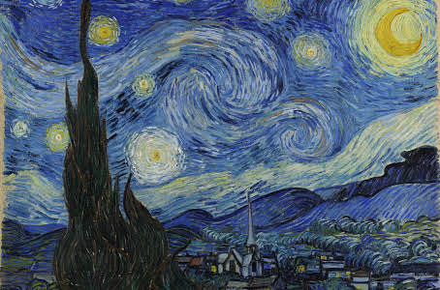
Motivation
Post- Impressionism

Slide 5
Motivation
For reducing the difficulties to identify artworks genre
For knowing the meaning of artworks

Slide 6
Objective
Delineate artworks features: Identify artworks features and themes of artworks.
Automate this problem: Make this problem automated.
Accuracy: Identify the genre with better accuracy.

Slide 7
Challenges
1. Dataset Gathering
2. Data Pre-processing
3. Make Variation of model according to dataset perspective

Slide 8
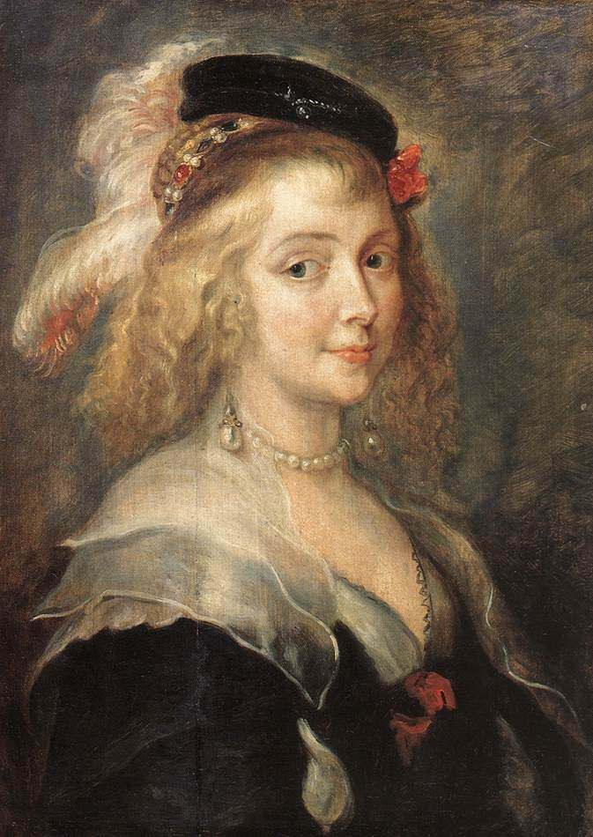
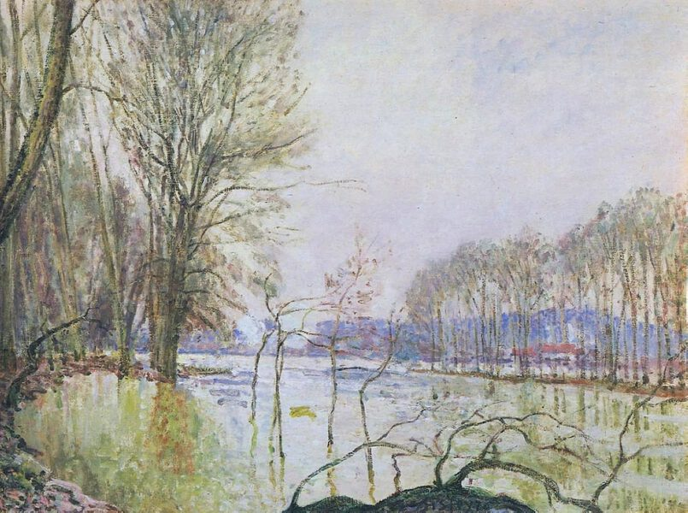
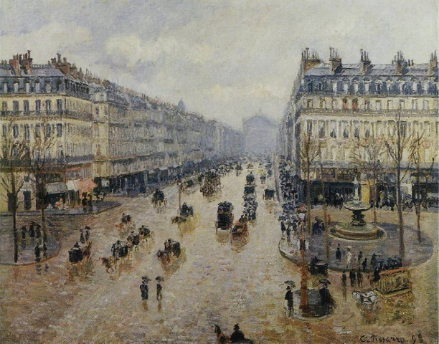
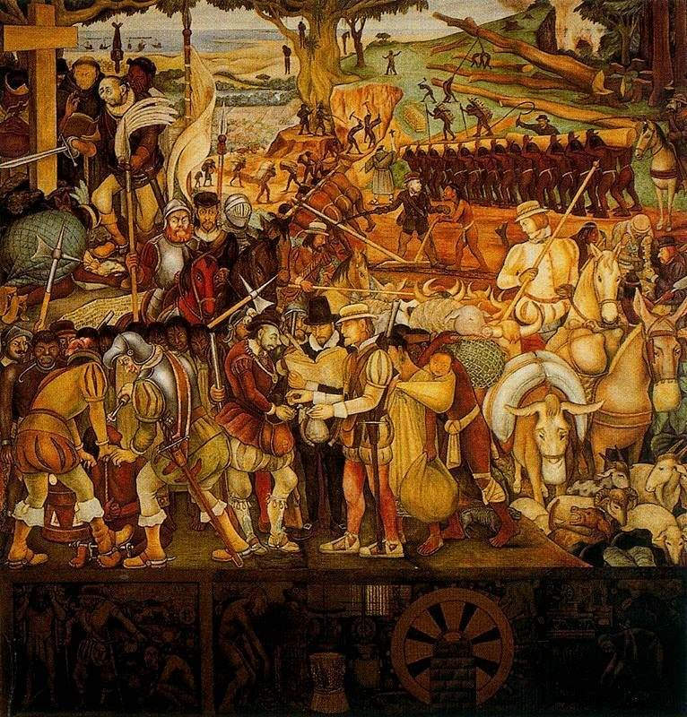
Dataset Overview
Baroque
Impressionism
Impressionism,Post-Impressionism
Social Realism,Muralism

Slide 9

Dataset Overview

Slide 10
Methodology
Model Apply
VGG-16 Network
Proposed Variation of CNN
Inception v3

Slide 11
Working Process
Preprocess Datasets
Apply Deep learning models
Apply Proposed Variation of CNN Model
Compare the models
Data Visualization

Slide 12
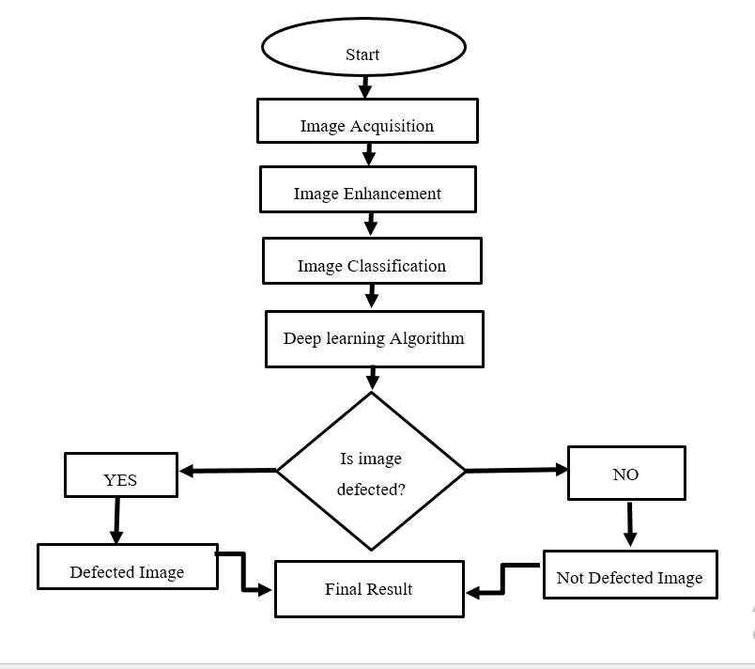
Working Process
Start
Image acquisition
Data preprocessing
Apply Deep Learning Models
Identify Genre for Images
Compare Results
End

Slide 13
Proposed Variation of CNN Model
5 Convolutional layer
Relu as activation Function
Dropout set to 25%
Classifier as Softmax

Slide 14
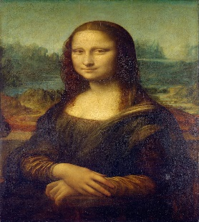






Proposed Variation of CNN Model
High Renaissance 0.976
Impressionism 0.176
Post-Impressionism 0.025
maxpool
CFigure: Proposed Variation of CNN model

Slide 15
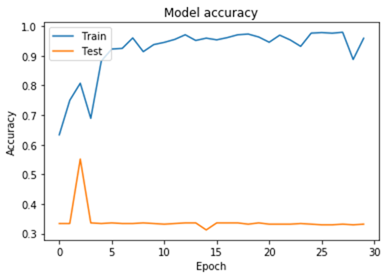
VGG-16 Model
The VGG-16 Model was trained on the ImageNet database. It has a lot of hidden layers and parameters and its gives quite a good performance in image datasets for its extensive feature.
Training Loss: 0.1263
Training Accuracy: 0.9264
Validation loss: 10.3640
Validation accuracy: 0.3570

Slide 16
Inception_V3 Model
Inceptionv3 is a Convolutional neural network for assisting in image analysis and object detection and got its start as a module for Google net.
Training Loss: 0.7283
Training Accuracy: 0.9594
Validation loss: 11.0284
Validation accuracy: 0.3319

Slide 17
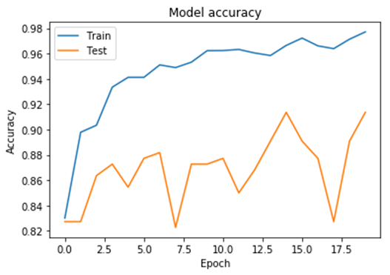
Proposed Variation of CNN Model
In this model we have modified the kernels , paddings and all of its features so that the defected images can easily be extracted for not defected images.
Training Loss: 0.1043
Training Accuracy: 0.9689
Validation loss: 0.4306
Validation accuracy: 0.9136

Slide 18
Model Evaluation Metrics
Models | Loss | Accuracy | Precision | Recall | F1-Score
VGG16 | 0.1263 | .9264 | 0.8823 | 0.6845 | 0.7233
Inception v3 | 0.0226 | .8597 | 0.9509 | 0.9418 | 0.9464
Proposed Variation of CNN | 0.0473 | .9821 | 0.9406 | 0.7279 | 0.8183

Slide 19
Result Analysis

Slide 20
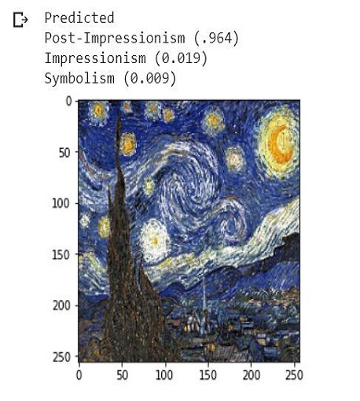
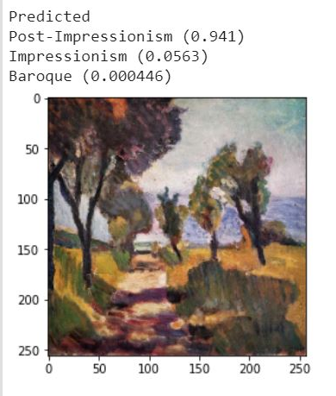
Result Analysis
The most Accurate Model is generated from Convolutional Neural Network with 98% of Accuracy

Slide 21
Outcome
Expected Outcome from this proposed model:
Deep learning based genre recognition approach
Can detect various types of artworks effectively
Efficient genre classification process
Help people to know about the meaning of unknown artworks.

Slide 22
Future Work
Intended to work with higher dataset
To identify lots of genres of artwork.
Generating new artwork from artworks of famous artist.
Publish a new paper on these above topics.

Slide 23
Conclusion
To conclude, The difficulties of comprehending artworks is no more. Features and meaning of artworks can easily be interpreted by this research. Then ,Comparison of deep learning of model has been demonstrated . Furthermore, New artist are highly benefited and can be motivated by knowing the genres of their artworks and they can also test their genres of images as well, through this research.

Slide 24
Thank You

