Slide 1
Report
Loss function evaluation
Optimization of all the developed Hybrid methods.
Doing more experience with more data for some of developed approaches
Developing one more hierarchical taxonomy for China-Geo data, defining 163 logic rules.
Updating available libraries from old papers code.
Working on a research plan
Target a conference to submit a paper
20th International Conference on Principles of Knowledge Representation and Reasoning
Paper submission deadline: March 14, 2023
5 patents submitted (2 accepted so far)
Writing paper (4 pages so far)

Slide 2
Differentiations for Lenovo’s Hybrid AI
Model Explainability: By using hybrid learning to inject knowledge into deep learning, hybrid AI could be explainable;
Human-Centric & Human-AI Collaboration: By supporting human-AI collaboration, human and AI systems can build better trust and augment each other;
Extrapolation Capability: Estimating values, which extend beyond a particular collection of data or observation (that are typically used for model training), is critical for enhancing model robustness.

Slide 3
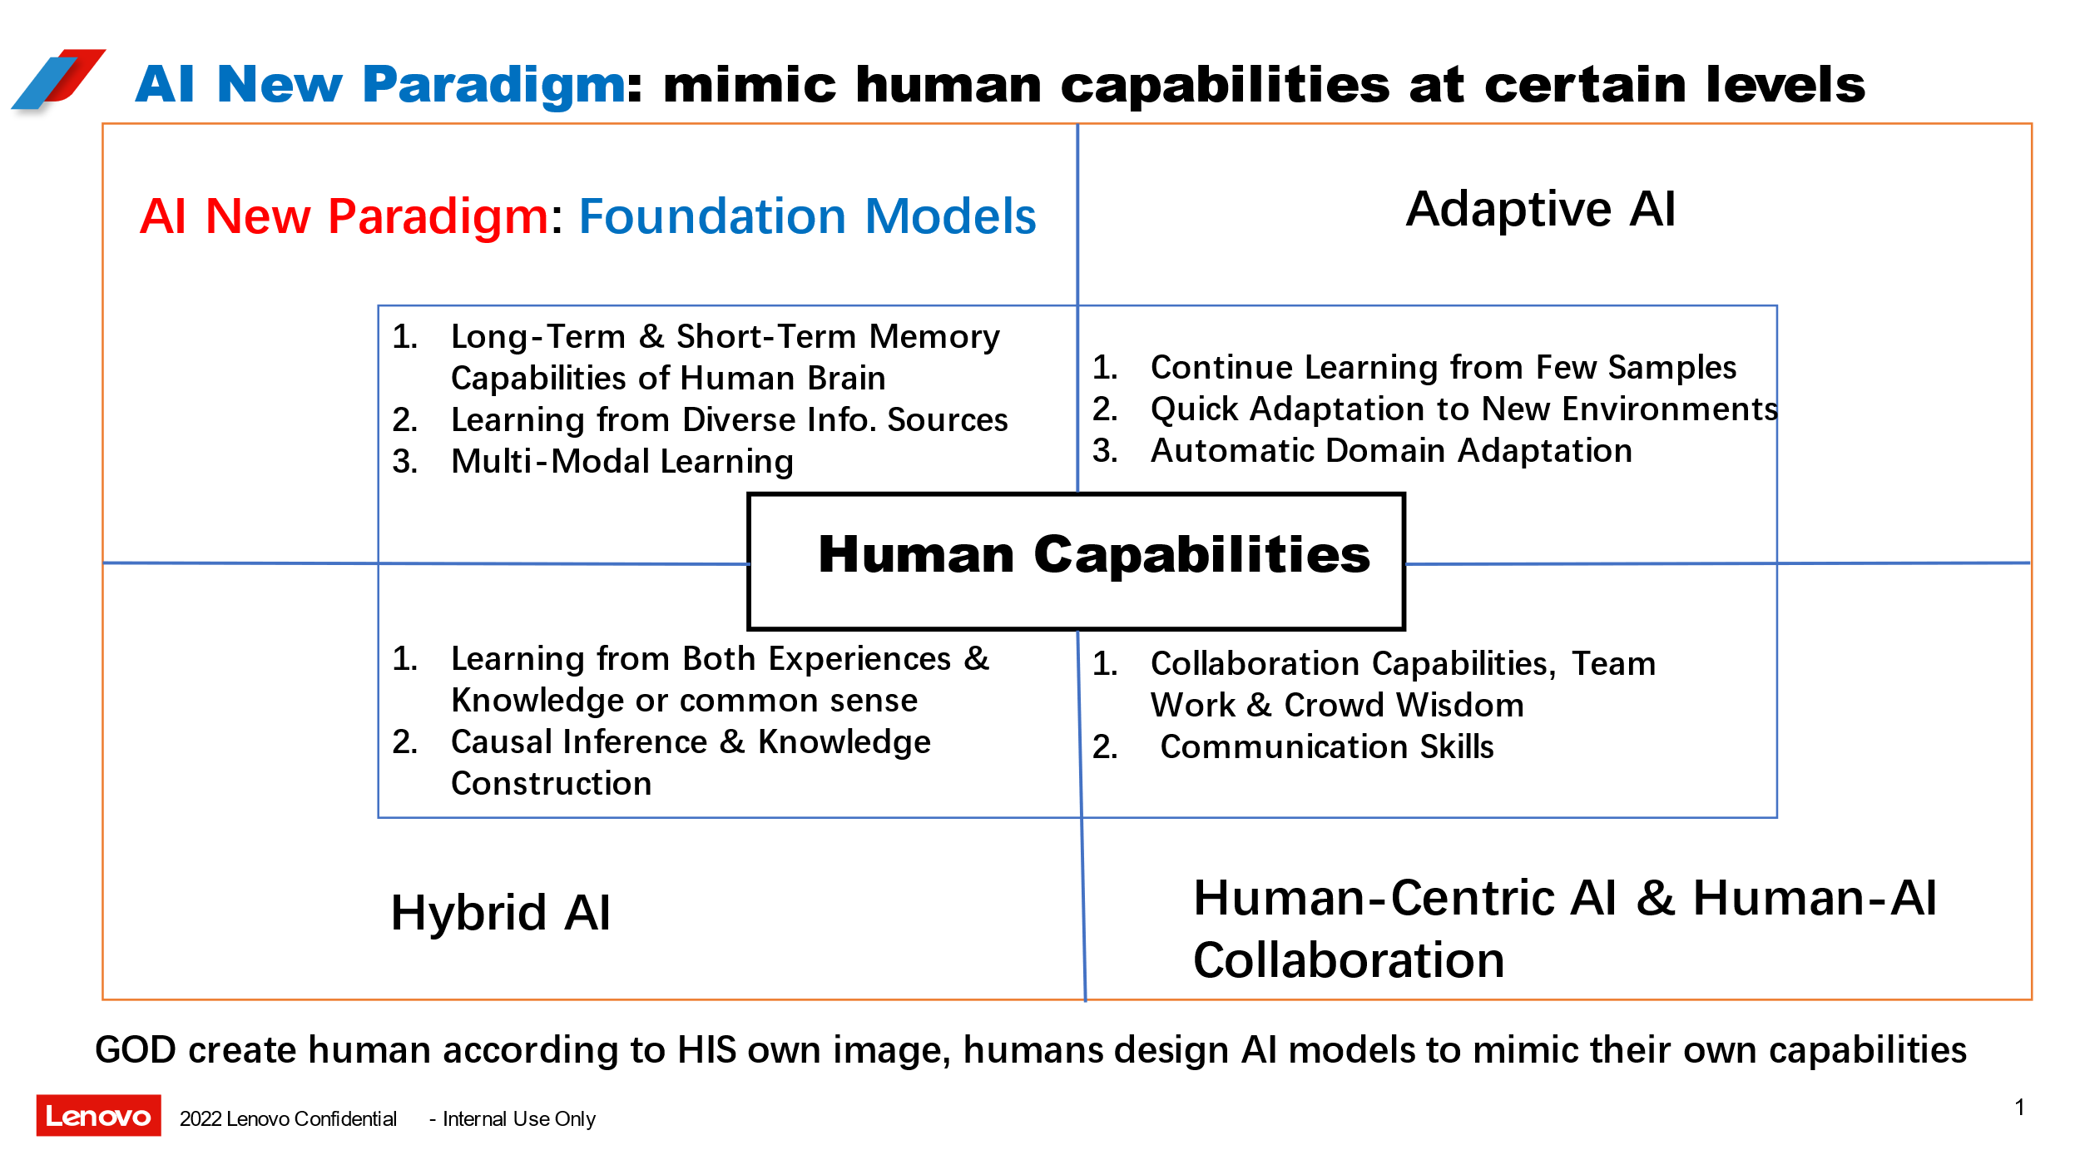

Slide 4

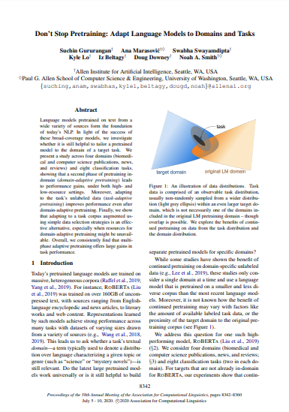
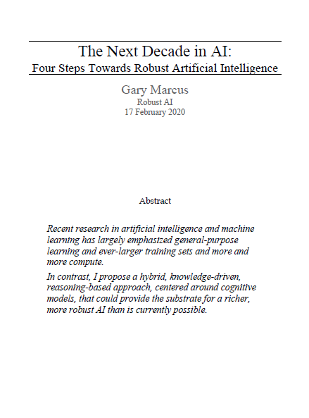
Law
Best paper 2020
3rd wave
Explainable
Pre-trained models
Neuro-Symbolic
Notes:
Objectives

Slide 5
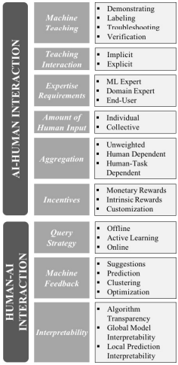
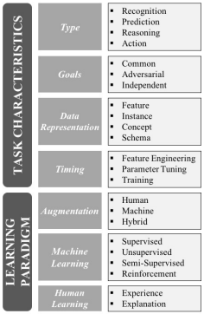
Adapting to Taxonomy of Hybrid Intelligence design
Task Characteristics
Learning Paradigm
Human-AI Interaction
AI-Human Interaction

Slide 6
Challenges of building Human Intelligence (HI) systems
Collaborative HI: How do we develop AI systems that work in synergy with humans?
Adaptive HI: How can these systems learn from and adapt to humans and their environment?
Responsible HI: How do we ensure that they behave ethically and responsibly?
Explainable HI: How can AI systems and humans share and explain their awareness, goals, and strategies?

Slide 7


$$\left(A+B\right)×C$$

Slide 8
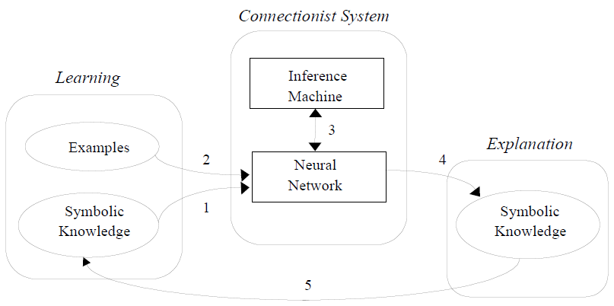
Neural-Symbolic Learning Systems
Bayesian Networks/Learning
A symbolic approach to Explain Bayesian Networks
Compiling Bayesian Network Classifier into Decision Graphs

Slide 9
Bayesian Learning
Task 1
Task 2
Task 3
Bayesian Learning
Task 4
Task 5

Slide 10
Learning
Inference
Task 1
Task 2
Task
Task 9
Task 10
Compilation
A
m1
Task 3
Explanation
m2
m9
m10
B
C
Task 5
Task 4
Solution
Task 6
m3
D
E
F
m5
Task 11
G
H
Task 8
m4
Task 7
m6
A general illustration
m11
m8
m7
Notes:
Every model “m” is trained in BNN

Slide 11
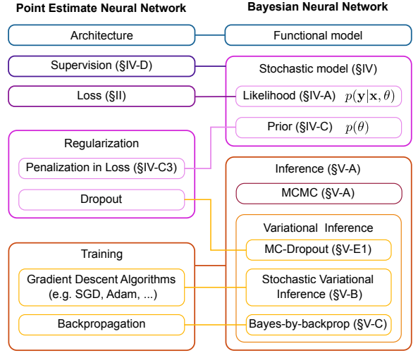
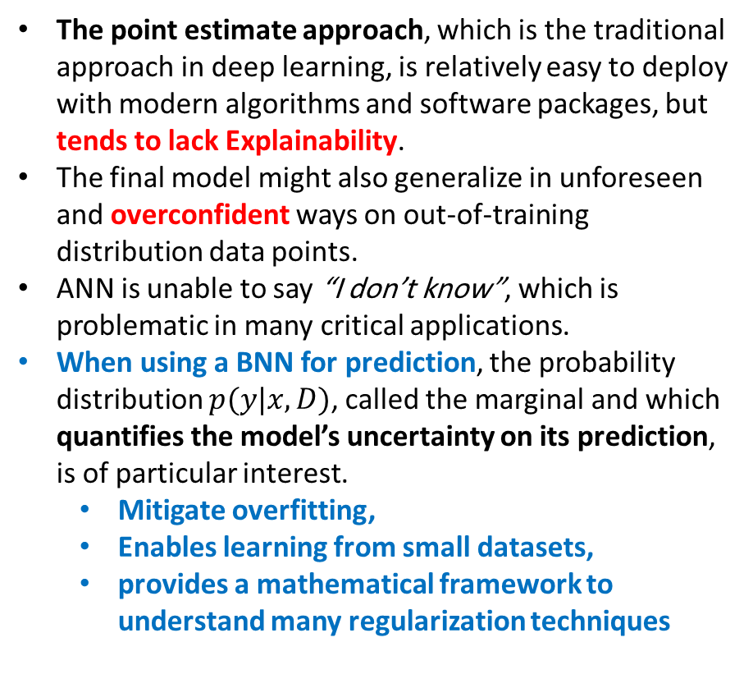
BNN vs. ANN
The point estimate approach, which is the traditional approach in deep learning, is relatively easy to deploy with modern algorithms and software packages, but tends to lack Explainability.
The final model might also generalize in unforeseen and overconfident ways on out-of-training distribution data points.
ANN is unable to say “I don’t know”, which is problematic in many critical applications.
When using a BNN for prediction, the probability distribution $p(y|x, D)$, called the marginal and which quantifies the model’s uncertainty on its prediction, is of particular interest.
Mitigate overfitting,
Enables learning from small datasets,
provides a mathematical framework to understand many regularization techniques

Slide 12
Workflow
Knowledge Construction
Training
KL Validation
Stochastic Model
Prior
KL Extraction
Our Target
Inference
Explanation
Critical Tasks/Applications
Description
Requirements
…
KL Representation
BNN
Decision Graph
Symbolic
Break down the Task into smaller tasks
LLM
Knowledge background
Visualization
LLM
Knowledge / Tasks Matching
In-context
Coverage/Generalization
Regularization
Task Specialization
Learner Architecture

Slide 13
Iteration in a NN
Understanding Data
Knowledge/logic statement, in a way that suit our data
Expressing/representing knowledge in a suitable language
PL
FOL
Model(s) building
Network
Activation function
Loss function
Validation
E.g., loss function validation (Differentiability, Monotonicity, Semantic equivalence, Identity, Label-literal correspondence)
Computation structure
Tensor network
Issue of stacking computation on GPU device
Batch computation
Graph
Variables (e.g., variables for imbalance data in LTN)
Available & correct
Knowledge Extraction
Need to be extract & validate
validation
Knowledge Representation?
Loss validation
NN validation
Rep validation
Knowledge validation
Rules
Graph
Model block?
NN
Loss function

Slide 14





Hybrid Learning + in-context Learning
Instruction prompt tuning
Prompt generation
Adapting LLM to a Domain
Few-shot/in-context learning (GPT-2, MetaICL, Fairseq 13B,..)
Loss function modification
EXP
LLM
$$A$$
$$B$$
$$C$$
BNN
$if$ the query is about Delivery $∧$ customer is Very Angry $→$ priority is High
BN
Solution
$$∨$$
Data-driven $+$ $ℙ$ $→$ class C
DNN

Slide 15






Hybrid Learning + in-context Learning
Query
1
2
Knowledge Generation
$$if A ∧B ∧C →D$$
Memory Matrix
$$A$$
$$B$$
$$C$$
$$D$$
Prompts
Generation
Inference
NNF Generation
Hidden States
3
SDD
WMC
$$Loss=L_{logic}+L_{data}$$
4
Training
M

Slide 16
Hybrid Center
Task 1
Task 2
Text
Task 3
Task 1
Generation
Tabular
Task 2
Task 1
multimodal
Representation
Task 2
Task 3
Regularization
Knowledge
Task specific
Model
Learning
Model
Hybrid Learning
Human-in-loop
Symbolic
Knowledge
Validation
Explanation
Visualization
Explanation
Output
Paper writing
Model

Slide 17
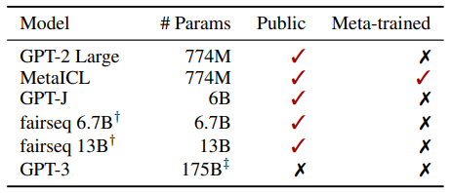
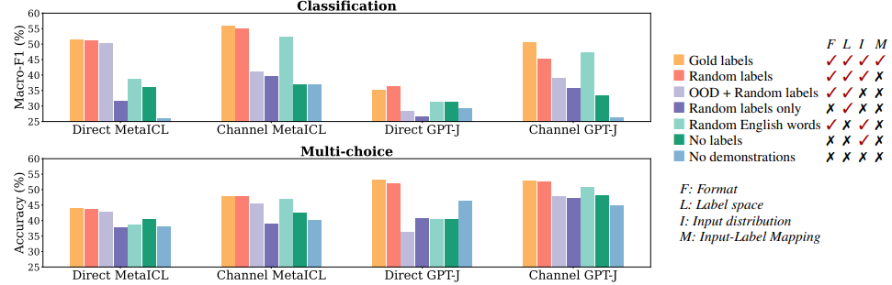
Rethinking the Role of Demonstrations: What Makes In-Context Learning Work?

Slide 18
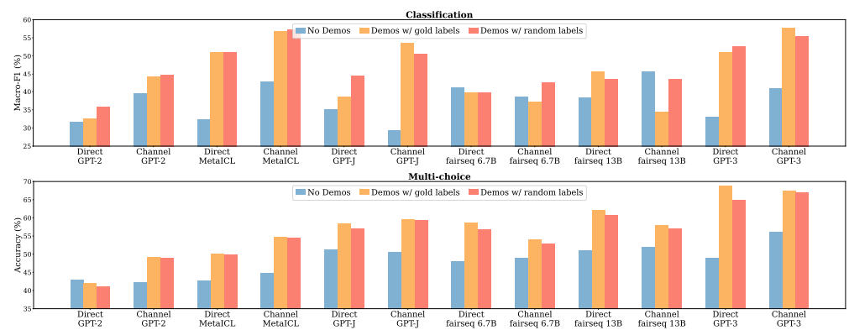
Rethinking the Role of Demonstrations: What Makes In-Context Learning Work?

Slide 19
Timeline
Steps
Output framework
Milestone
Publication
Patents
End
11
4
Submitting several patent corresponding to the developed ideas
1
16
Break down the task into smaller tasks as atomic concepts for a bigger task:
It should be corresponded to the generated knowledges
18
Define a project on a real scenario for a critical Application:
Law,
Medical,
…
12
Finish first iteration of developing loop and evaluation:
Knowledge, data, model, and explanation human in loop validation
Output Framework:
Portfolio,
Visual explanation,
On-line adjustment, API ,..
Experimental results:
Various dataset,
optimization
3
8
10
15
24
Finish the first loop of Knowledge generation:
A human in loop process to identifying an expressing required knowledge
Develop a system to transfer knowledge (Expert, commonsense, …) to axioms (logical representation), a Human in-loop platform
Define architecture of the learning algorithm:
Hybrid Learning, LLM, In-context Learning,
Stochastic models,
Likelihood,
Prior,
Inference,
MCMC,
Stochastic variational inference
Explanation:
Compilation,
Symbolic,
Decision Graph,
Human-like explanation,
Domain Adaptation:
Making a domain adaptive framework in other critical domain and even suitable for non-critical projects
14
Writing paper(s) based on the solid ideas and their experimental results

Slide 20
Risks
Risk description | Occurring Time | Occurring Prob. | Contingency Plan/Mitigation response
Knowledge generation and Evaluation: Human in loop process requires more manpower for Identifying knowledge, expert knowledge, commonsense knowledge, and transforming knowledge to axioms and required formula. | Month 3-4 | 30% | The risk related to Human capabilities, the percentage dropped, of course, by increasing human in-loop capability.
Development: Not available open packages, Old version of package required long time upgrading | Month 6-8 | 20% | Had similar experiences, knowledgeable. The main portion belongs to the libraries in symbolic reasoning due to some principal approaches developed in old version of code.
Explanation evaluation: Crowdsourcing issues, … | Month 14-15 | 10% | Manageable

Slide 21
4 steps to define Bayesian Network
Variables
Edges
Local condition distribution
Joint distribution

