Slide 1
Image Captioning
Deep Learning
Group 7

Slide 2
Table of contents
01
02
03
04
Introduction
Model and data
Overfitting Problems
Vanishing Problems

Slide 3
01
Introduction
What is Image Captioning ?

Slide 4
Image Captioning is the process of generating textual description of an image. It uses both Natural Language Processing and Computer Vision to generate the captions.
The dataset will be in the form [image → captions]. The dataset consists of input images and their corresponding output captions.

Slide 5
02
Model and Data
Classification and Detection

Slide 6
Model
In this project, we can use different model to generate a captions of an image like RNN, LSTM, VGG16…
But in our project we used VGG16 and InceptionV3

Slide 7
What is VGG16 ?
A convolutional neural network is also known as a ConvNet, which is a kind of artificial neural network. A convolutional neural network has an input layer, an output layer, and various hidden layers. VGG16 is a type of CNN (Convolutional Neural Network) that is considered to be one of the best computer vision models to date.
VGG16 is used for object detection and classification algorithm which is able to classify 1000 images of 1000 different categories with 92.7% accuracy. It is one of the popular algorithms for image classification and is easy to use with transfer learning.

Slide 8
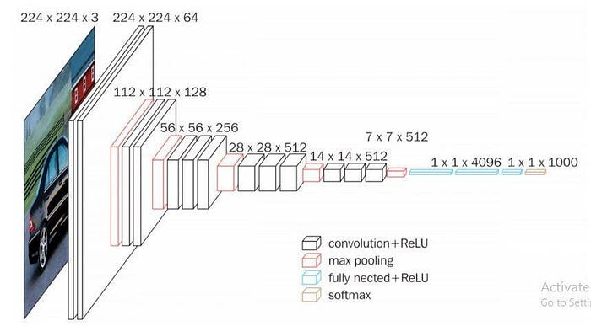
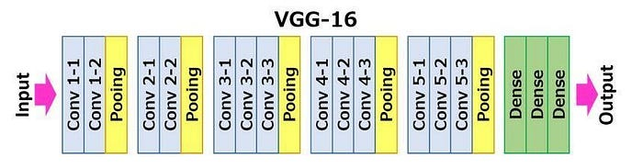
VGG16 Architecture
VGG16 Architecture

Slide 9
What is InceptionV3 ?
Inception-v3 is a convolutional neural network architecture from the Inception family that makes several improvements including using Label Smoothing, Factorized 7 x 7 convolutions, and the use of an auxiliary classifer to propagate label information lower down the network

Slide 10
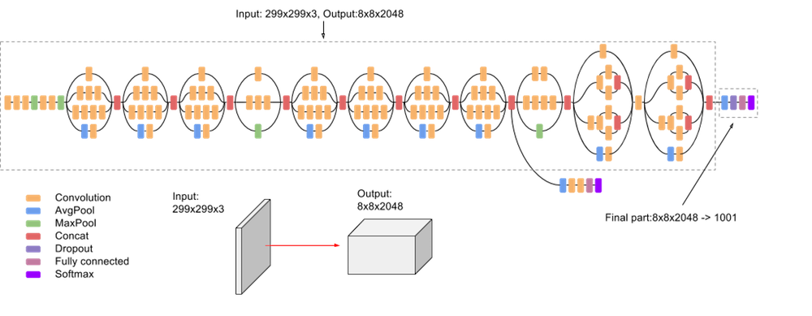
InceptionV3 Architecture
InceptionV3 Architecture

Slide 11
Prepared Data
We are using data Flickr8k Dataset for this Project
It is a new benchmark collection for sentence-based image description and search, consisting of 8,000 images that are each paired with five different captions which provide clear descriptions of the salient entities and events. … The images were chosen from six different Flickr groups, and tend not to contain any well-known people or locations, but were manually selected to depict a variety of scenes and situations
*The explanation for code and how it look is in this link for more detail:
https://github.com/haruto02/DeepLearning_MidTerm

Slide 12
Overfitting Problems
03

Slide 13
Definition of Overfitting Problems
Overfitting is an undesirable machine learning behavior that occurs when the machine learning model gives accurate predictions for training data but not for new data. When data scientists use machine learning models for making predictions, they first train the model on a known data set.
It can be solved through many different ways such as: Dropout, EarlyStopping, Gather more data, Use regularization...
But here we use the method Dropout is a technique to help avoid overfitting similar to regularization by removing the random p% node of the layer => making the model less complicated.

Slide 14
04
Vanishing Problems

Slide 15
Definition of Vanishing Problems
When there are more layers in the network, the value of the product of derivative decreases until at some point the partial derivative of the loss function approaches a value close to zero, and the partial derivative vanishes. It is called the vanishing gradient problem.
There are many different ways like reducing learning rate, Changing your architecture, batch normalizing… But in this project we will use Relu to solve vanishing problem.
So what is Relu?
Relu: keeps the sigmoid and TanH saturated regions linear, thus responding better to vanishing / exploding gradients. You can also use different types like Leaky-ReLu, Randomized ReLu, etc.

Slide 16
Thanks!

