Slide 1

SWIN TRANSFORMER
Nhóm 12
Trần Cự Phú - 520H0667
Lê Bá Duy - 520H0622

Slide 2

Introduction
Swin Transformer is a transformer-based deep learning model with state-of-the-art performance in vision tasks. Unlike the Vision Transformer which precedes it, Swin Transformer is highly efficient and has greater accuracy. Due to these desirable properties, Swin Transformers are used as the backbone in many vision-based model architectures today

Slide 3

Swin Transformer: Improving the ViT
In recent years, transformers have dominated deep learning architectures in natural language processing tasks
In 2020, the Vision Transformer garnered much attention from the AI community, notable for its pure transformer architecture with promising results in vision tasks
In 2021, Microsoft researchers published the Swin Transformer , arguably one of the most exciting piece of research following up from the original ViT

Slide 4
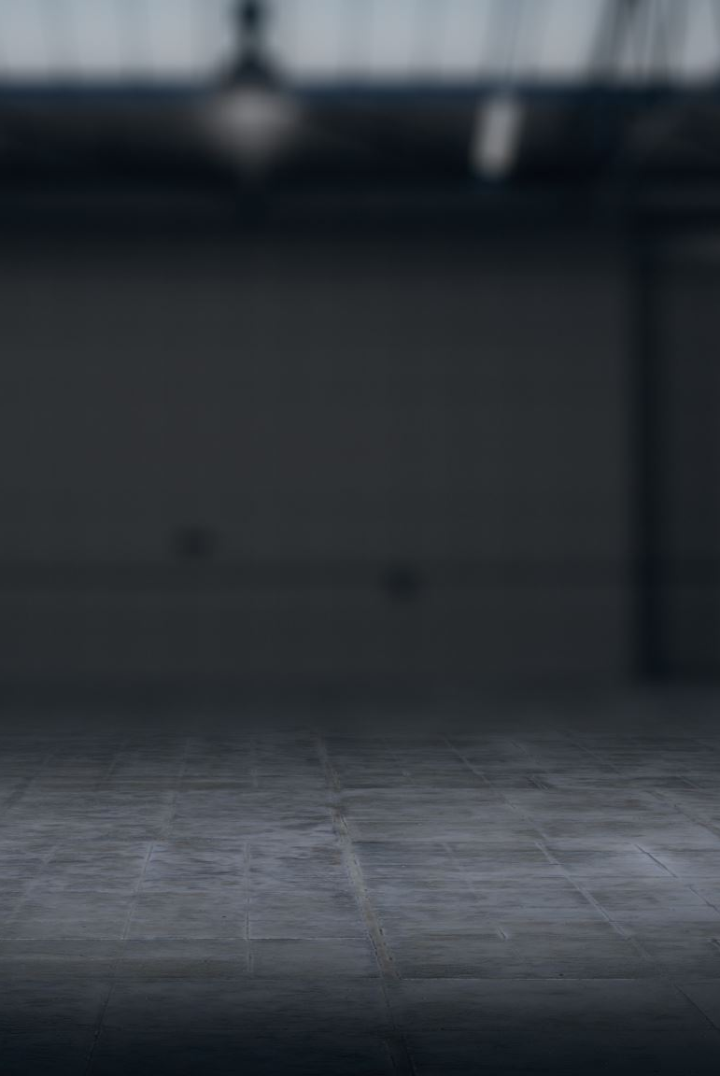
Swin Transformer Architecture & Key Concepts
The Swin Transformer introduced two key concepts to address the issues faced by the original ViT — hierarchical feature maps and shifted window attention. In fact, the name of Swin Transformer comes from “Shifted window Transformer”. The overall architecture of the Swin Transformer is shown below

Slide 5
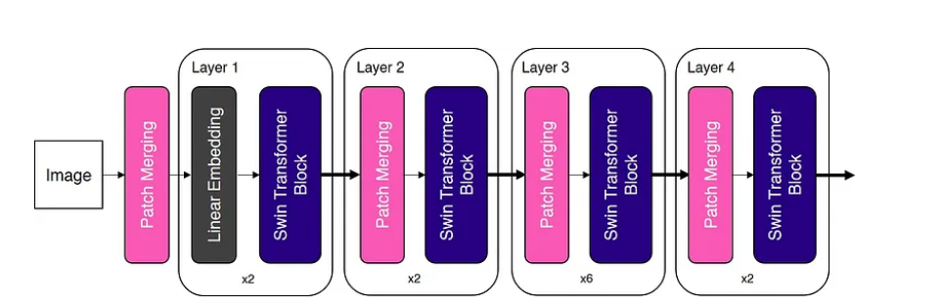
Swin Transformer Architecture & Key Concepts

Slide 6
Hierarchical Feature Maps
The first significant deviation from ViT is that Swin Transformer builds ‘hierarchical feature maps’.
First, ‘feature maps’ are simply the intermediate tensors generated from each successive layer. As for ‘hierarchical’, in this context, it refers to the fact that the feature maps are merged from layer to layer , effectively reducing the spatial dimension of the feature maps from one layer to another

Slide 7

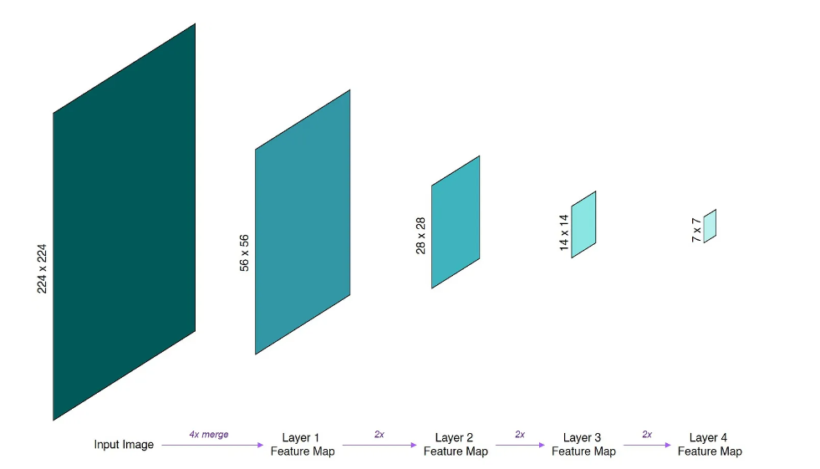
Hierarchical Feature Maps

Slide 8
Patch Merging
In the previous section, we have seen how hierarchical feature maps are built by progressively merging and downsampling the spatial resolution of the feature maps. In convolutional neural networks such as ResNet, downsampling of feature maps is done using the convolution operation. How then, can we downsample feature maps in a pure transformer network without using convolution?
The convolution-free downsampling technique used in Swin Transformer is known as patch merging. In this context, a ‘patch’ refers to the smallest unit in a feature map. In other words, in a 14x14 feature map, there are 14x14=196 patches.
To downsample feature maps by a factor of n, patch merging concatenates the features of each group of n x n neighbouring patches.

Slide 9
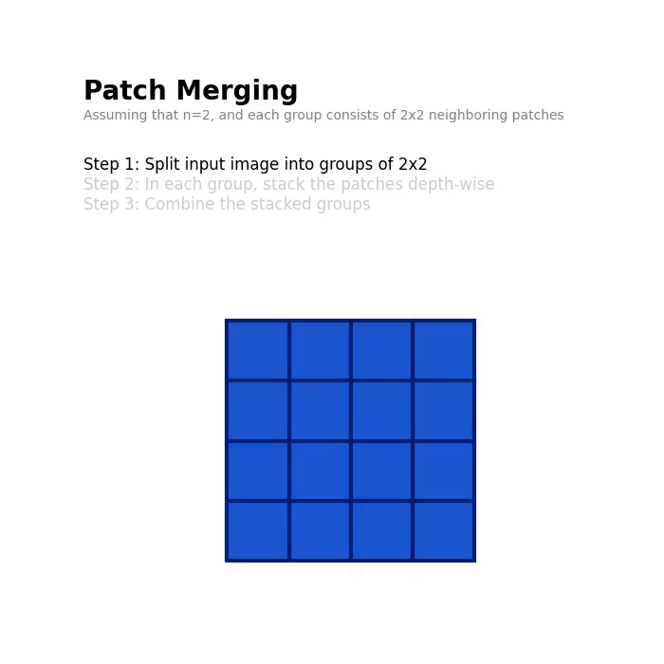
Patch Merging

Slide 10

Swin Transformer Block
The transformer block used in Swin Transformer replaces the standard multi-head self-attention module used in ViT with a Window MSA and a Shifted Window MSA module
The Swin Transformer block consists of two sub-units
The first sub-unit uses a Window MSA module while the second sub-unit uses a Shifted Window MSA module

Slide 11
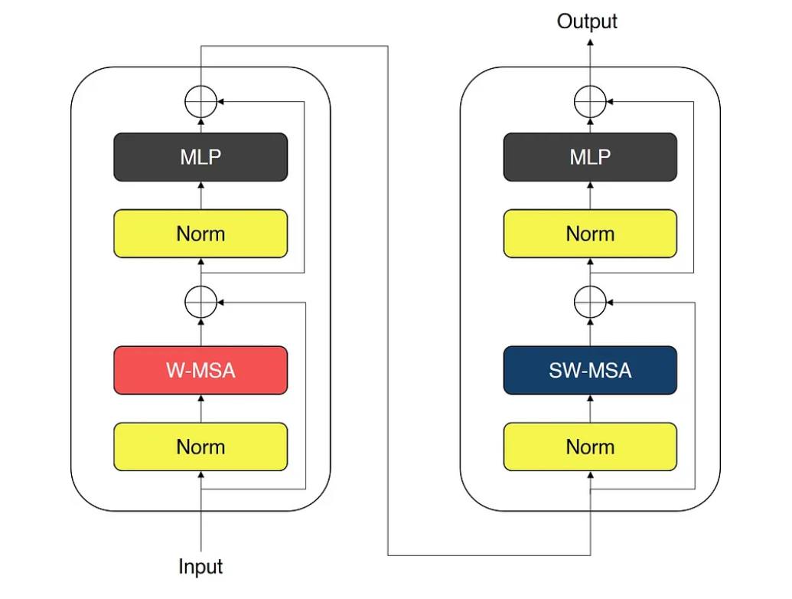
SWIM TRANSFORMER BLOCK

Slide 12
Window-based Self-Attention
The standard MSA used in ViT performs global self-attention, and the relationship between each patch is computed against all other patches

Slide 13
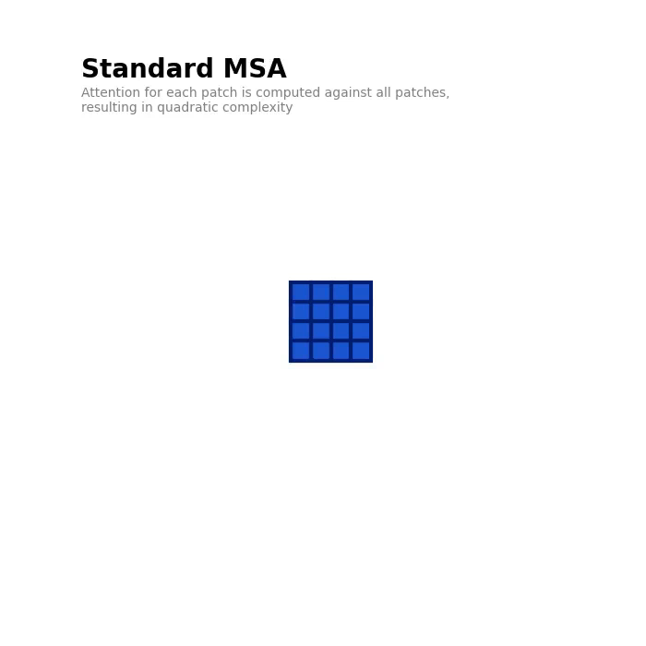
WINDOW-BASED SELF-ATTENTION
Standard msa

Slide 14
Window-based Self-Attention
This results in a quadratic complexity with respect to the number of patches, making it unsuitable for high resolution images
As the window size is fixed throughout the network, the complexity of window-based MSA is linear with respect to the number of patches , a great improvement over the quadratic complexity of standard MSA

Slide 15
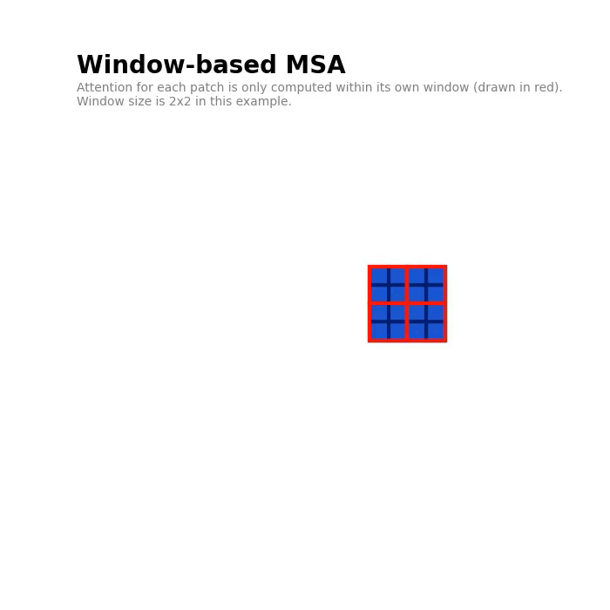
WINDOW-BASED SELF-ATTENTION
window-based msa

Slide 16

Shifted Window Self-Attention
To address this, Swin Transformer uses a Shifted Window MSA module after the W-MSA module
To introduce cross-window connections, Shifted Window MSA shifts the windows towards the bottom right corner by a factor of M/2, where M is the window size
Swin Transformer applies a ‘Cyclic Shift’ technique , which moves the ‘orphaned’ patches into windows with incomplete patches

Slide 17
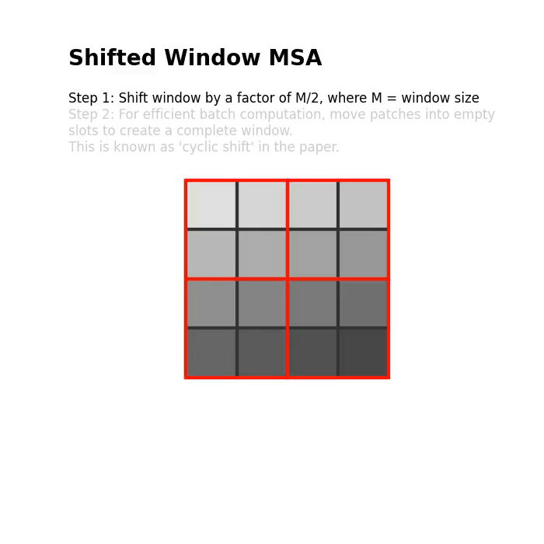
SHIFTED WINDOW SELF-ATTENTION

Slide 18
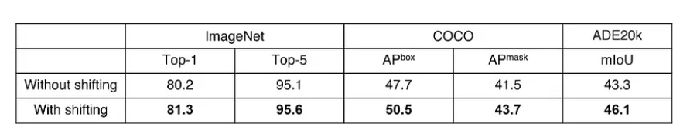
SHIFTED WINDOW SELF-ATTENTION
However, this shift results in ‘orphaned’ patches that do not belong to any window, as well as windows with incomplete patches. Swin Transformer applies a ‘Cyclic Shift’ technique (step 2 in the animation above), which moves the ‘orphaned’ patches into windows with incomplete patches. Note that after this shift, a window may consist of patches that are not adjacent in the original feature map, so a mask is applied during computation to limit self-attention to adjacent patches.
This shifted window approach introduces important cross-connections between windows, and is found to improve the performance of the network.

Slide 19
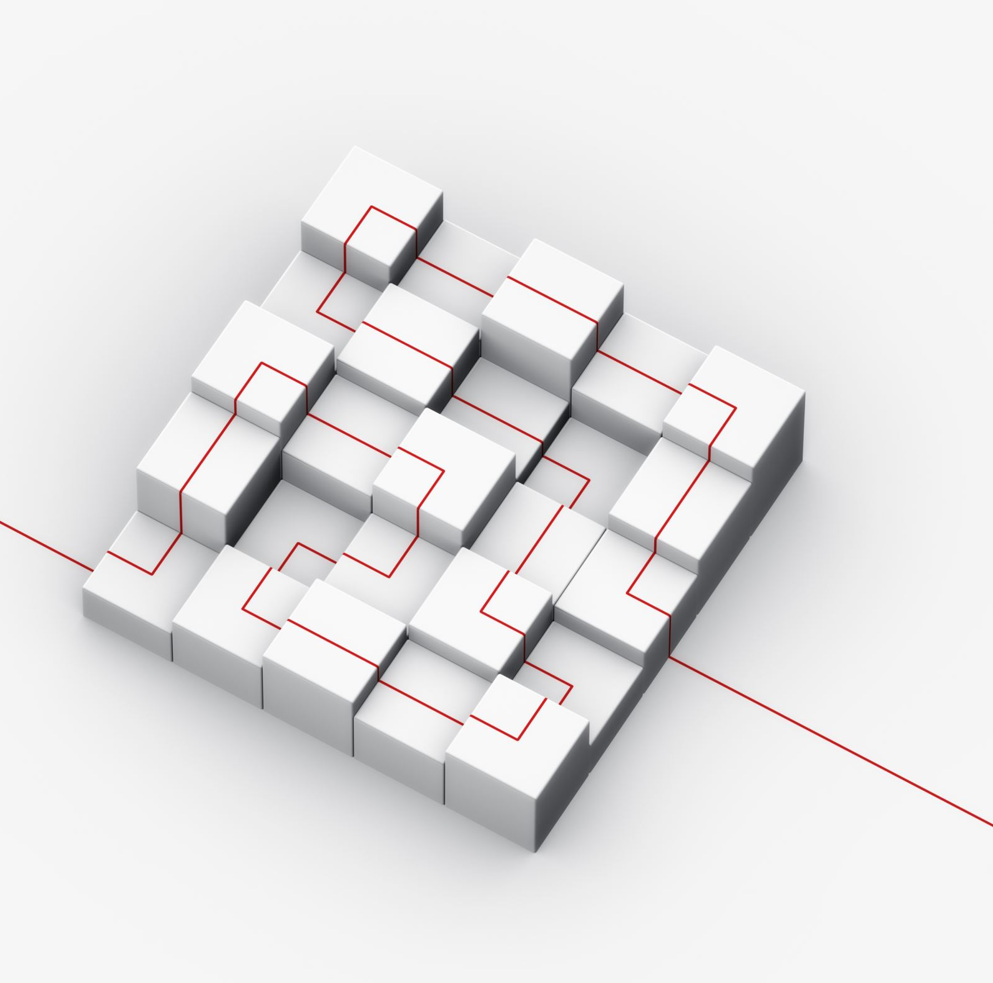
Conclusion
The Swin Transformer is probably the most exciting piece of research following the original Vision Transformer
Using hierarchical feature maps and shifted window MSA, the Swin Transformer resolved the issues that plagued the original ViT
Today, the Swin Transformer is commonly used as a backbone architecture in a broad range of vision tasks, including image classification and object detection

