Slide 1
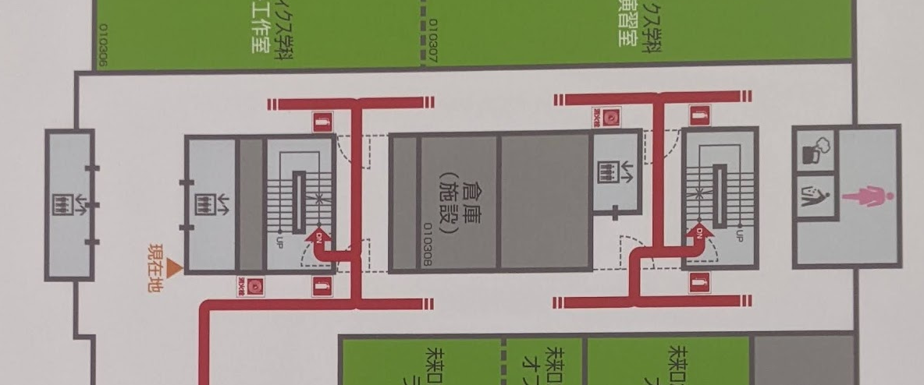



A
C
B
D
: 3-way intersection
: 2-way intersection
: corner

