Slide 1
DATABASE MANAGEMENT SYSTEMS | CS304
Academic Conference Paper Submission
& Review System DBMS
Review 1 (Week 7): Scope, Conceptual ER Design & Relational Schema
PROJECT METADATA & TEAM
• Presenter / Team: [Your Name / Team Members]
• Register / Roll No: [Your Register Number]
• Target Database: PostgreSQL / MySQL | Evaluation Weightage: 5 Marks

Slide 2
Problem Statement: Why Email & Spreadsheets Fail
2 / 10
📁 Version Confusion
• Authors email updated PDFs; reviewers evaluate old drafts.
• Loss of camera-ready final files.
⚖ Conflict of Interest (COI)
• Reviewers assigned papers written by close collaborators.
• Ethical breach & biased evaluation.
⏳ Workload Imbalance
• Some reviewers get 10 papers, others get none.
• Missed deadlines & missing 3-review quota.
📅 Schedule Collisions
• Authors with multiple papers booked in two halls at once.
• Overlapping presentation slots.
✔ Solution: A 3NF relational database enforcing versioning, automated COI blocking, and slot validation.
Academic Conference DBMS • Review 1 (Week 7)

Slide 3
Project Scope & Core Objectives
3 / 10
🎯 CORE OBJECTIVES
✔ 3NF Database Design: Eliminate data redundancy & anomalies.
✔ Double-Blind Peer Review: Conceal author identity from reviewers.
✔ Automated COI Prevention: Block biased reviewer assignments.
✔ Multi-Version Tracking: Preserve initial drafts & camera-ready PDFs.
✔ Conflict-Free Scheduling: No author or hall presentation clashes.
📦 SYSTEM SCOPE & USERS
IN-SCOPE FOR REVIEW 1:
• 14 Principal Entities & ER Diagram
• Initial Relational Schema in 3NF
• Primary Keys, Foreign Keys, CHECK constraints
USER ROLES (RBAC):
• Program Chair & Track Chairs
• Authors & Co-Authors
• Reviewers & Attendees
Academic Conference DBMS • Review 1 (Week 7)

Slide 4
System Workflow: From Submission to Presentation
4 / 10
Submission
• Author uploads paper
• Co-authors assigned
• Blinded PDF (V1)
STEP 1
Reviewer Match
• Topic expertise set
• Conflicts declared
• Zero-COI assignment
STEP 2
Peer Review
• ≥ 3 Reviews/paper
• Scores 1 to 10
• Dual comments
STEP 3
Decision
• Chair records verdict
• Accept / Reject
• Camera-ready PDF
STEP 4
Scheduling
• Author registers
• Hall & slot assigned
• No time overlaps
STEP 5
⚡ Automated Progression: Each stage is strictly gated by database integrity constraints.
Academic Conference DBMS • Review 1 (Week 7)

Slide 5
Key Functional Requirements
5 / 10
• Unique auto-increment paper_id
• Blinded manuscript upload
• Multi-version tracking (V1, V2, Camera-ready)
1. Paper & Versioning
• Reviewers set topic competence
• Explicit conflict declaration
• Automated conflict barring
2. Expertise & COI
• Max workload limit per reviewer
• Minimum 3 reviews required per paper
• Workload balance tracking
3. Reviewer Assignment
• 1 to 10 scale (Originality, Soundness, Clarity)
• Public comments to author
• Confidential remarks to Chair
4. Review Scoring
• Formal verdict: Accept / Reject / Revise
• Only decided after ≥ 3 reviews
• Author notification logging
5. Editorial Decisions
• Verification of paid author registration
• Hall & time slot allocation
• Zero author schedule overlap
6. Presentation Scheduling
Academic Conference DBMS • Review 1 (Week 7)

Slide 6
Conceptual Design: The 14 Principal Entities
6 / 10
Conferences
Root event, dates, deadline
Tracks
Conference research domains
Topics
Keywords for paper matching
1. STRUCTURE
Authors
Researcher profile, ORCID
Papers
Master submission record
Versions
Drafts & camera-ready PDFs
2. SUBMISSION
Reviewers
Evaluator profile & capacity
Expertise
Topic competence level
Conflicts
COI declaration records
Assignments
Paper-to-reviewer link
Reviews
1-10 scores & feedback
3. REVIEW ENGINE
Decisions
Official Accept/Reject log
Registrations
Author fee & clearance
Presentation_Slots
Hall & session time slot
4. SCHEDULING
✔ Plus supporting entities: Users (central accounts) and Paper_Authors (multi-author bridge).
Academic Conference DBMS • Review 1 (Week 7)

Slide 7
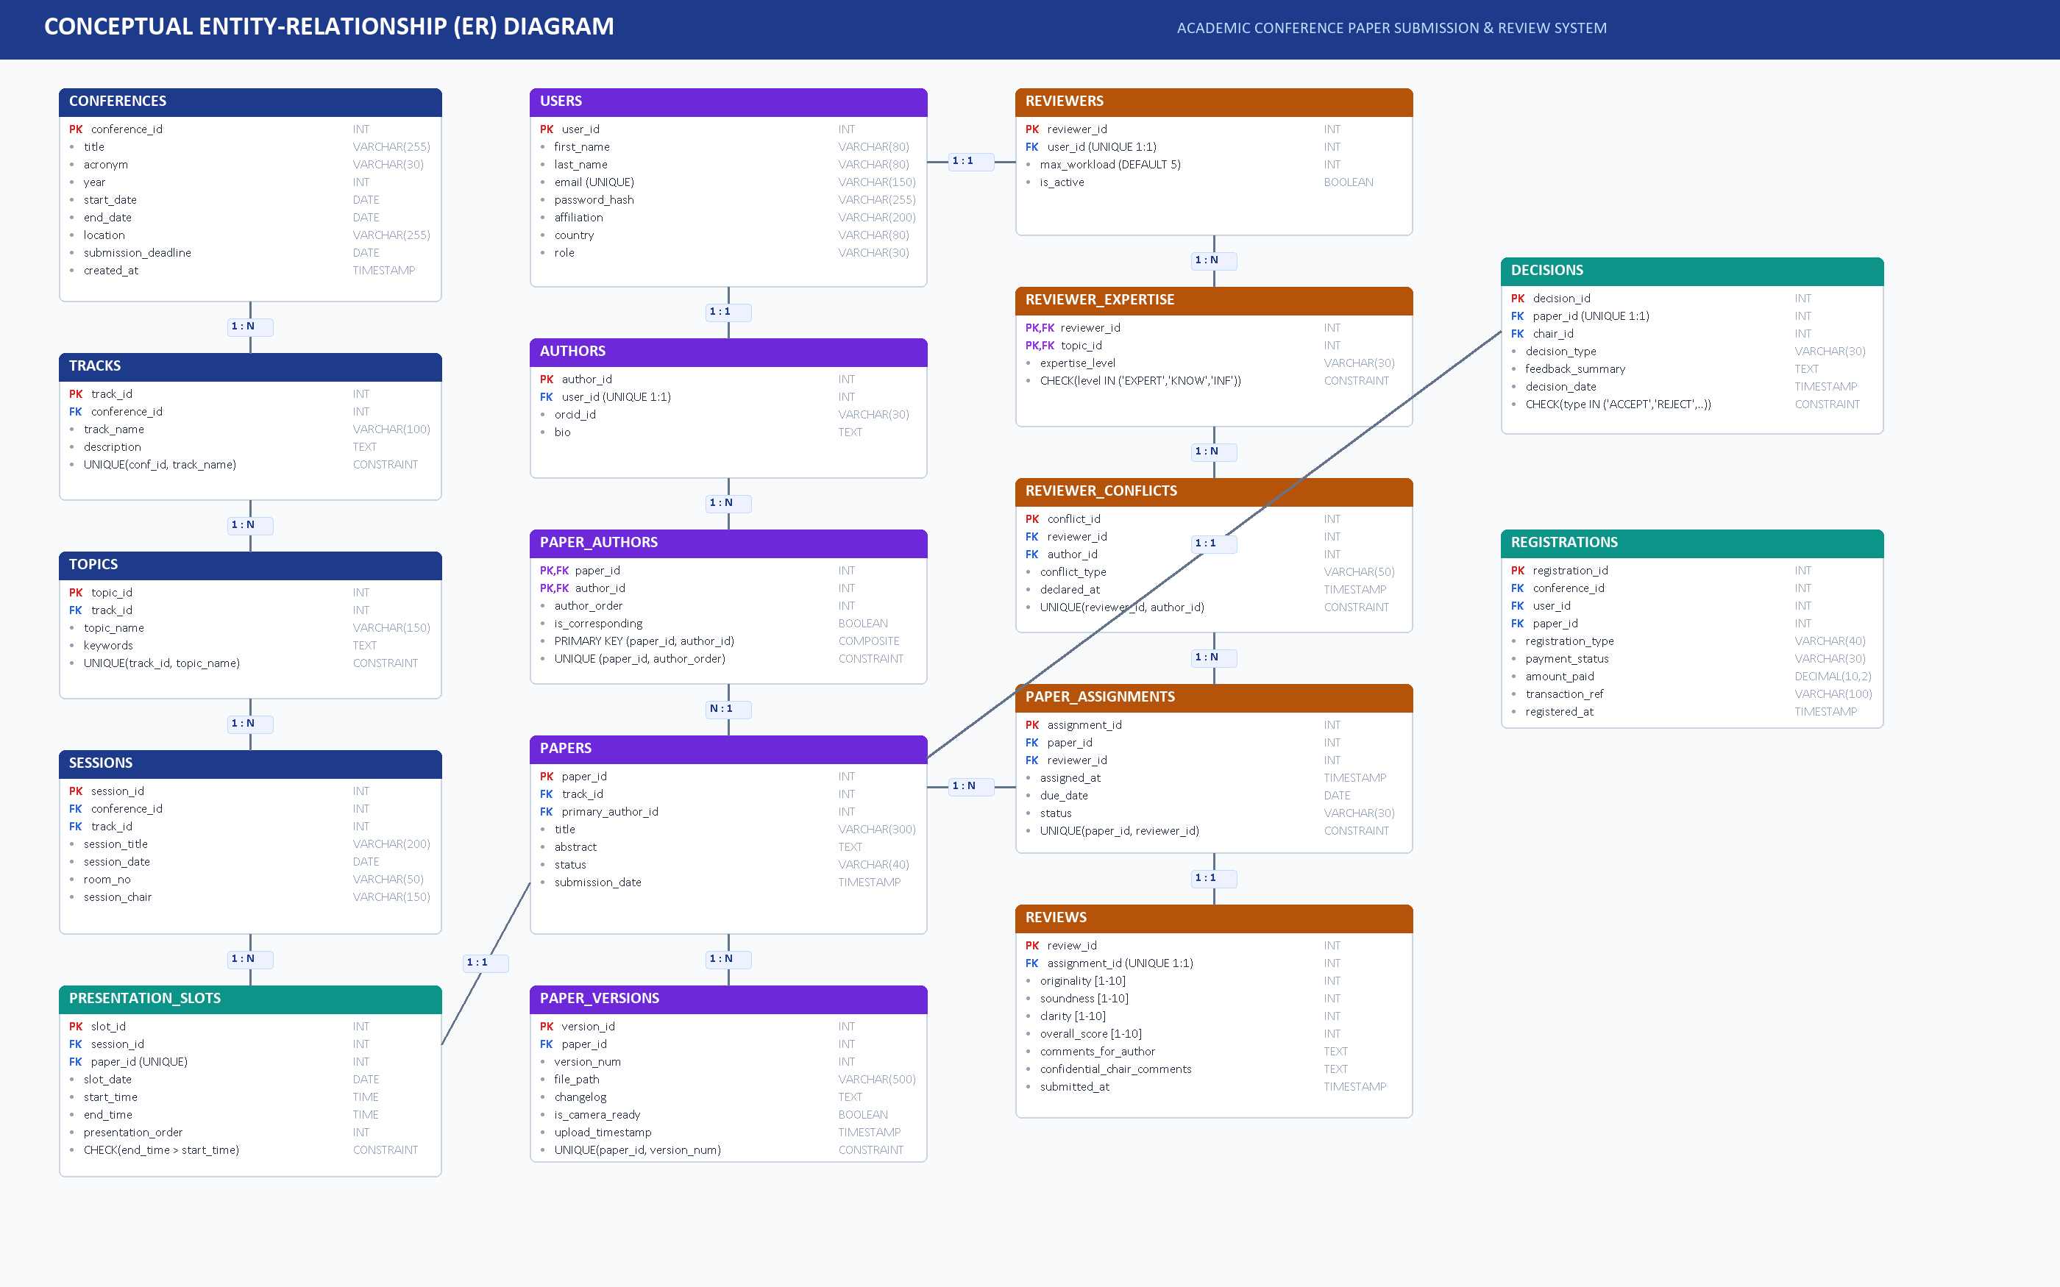
Conceptual Entity-Relationship (ER) Diagram
7 / 10
Academic Conference DBMS • Review 1 (Week 7)

Slide 8
Initial Relational Schema: Tables & Keys
8 / 10
Table Name | Primary Key | Foreign Keys | Key Constraints
Conferences | conference_id | None | UNIQUE(acronym, year), end_date >= start_date
Tracks | track_id | conference_id | UNIQUE(conference_id, track_name)
Topics | topic_id | track_id | UNIQUE(track_id, topic_name)
Users | user_id | None | UNIQUE(email), role IN ('CHAIR','AUTHOR','REVIEWER')
Authors | author_id | user_id | 1:1 with Users; stores ORCID & bio
Papers | paper_id | track_id, primary_author | status IN ('SUBMITTED','UNDER_REVIEW','ACCEPTED','REJECTED')
Paper_Versions | version_id | paper_id | UNIQUE(paper_id, version_num), version_num >= 1
Reviewers | reviewer_id | user_id | 1:1 with Users; max_workload > 0 (DEFAULT 5)
Reviewer_Conflicts | conflict_id | reviewer_id, author_id | UNIQUE(reviewer_id, author_id); blocks COI assignments
Paper_Assignments | assignment_id | paper_id, reviewer_id | UNIQUE(paper_id, reviewer_id), status IN ('ASSIGNED','COMPLETED')
Reviews | review_id | assignment_id (UNIQUE) | CHECK scores BETWEEN 1 AND 10 for all 3 criteria
Decisions | decision_id | paper_id (UNIQUE) | decision_type IN ('ACCEPT','REJECT','REVISE')
Presentation_Slots | slot_id | session_id, paper_id (UK) | CHECK(end_time > start_time), no room or author overlaps
Academic Conference DBMS • Review 1 (Week 7)

Slide 9
Normalization (1NF → 3NF) & Business Rules
9 / 10
NORMALIZATION STRATEGY
✔ First Normal Form (1NF)
All attributes are atomic scalar values.
• Co-authors split into Paper_Authors table
• Multi-version files split into Paper_Versions
✔ Second Normal Form (2NF)
No partial functional dependencies on composite PK.
• In Paper_Authors(paper_id, author_id), order depends on both keys
• Author bio moved to Authors table
✔ Third Normal Form (3NF)
No transitive functional dependencies.
• Track names decoupled from Papers (stored in Tracks)
• User details centralized in Users table
5 ENFORCED BUSINESS RULES
✔ 1. Unique Submission ID
Every paper receives an auto-increment PK.
✔ 2. Strict Conflict Barring
Reviewers cannot evaluate collaborator papers.
✔ 3. Minimum Review Quota
≥ 3 completed reviews required before decision.
✔ 4. Standardized Scores
CHECK (score BETWEEN 1 AND 10).
✔ 5. No Schedule Overlap
Authors cannot present in two rooms at once.
Academic Conference DBMS • Review 1 (Week 7)

Slide 10
Summary & Evaluator Discussion
10 / 10
REVIEW 1 DELIVERABLES COMPLETED
✔ Deliverable 1: Problem identification, scope, SMART objectives, 6 user roles, functional requirements.
✔ Deliverable 2: Conceptual design & ER diagram covering all 14 principal entities + relationships.
✔ Deliverable 3: Initial 3NF relational schema, primary/foreign keys, domain CHECK constraints & business rules.
Thank You!
We are ready for questions and suggestions from the evaluators.
Academic Conference DBMS • Review 1 (Week 7)

