Slide 1

Using Google Co-lab & Python for Geospatial Analysis and Visualization
Lead Instructor: Devika Kakkar
Teaching Assistant: Jaiany Rocha
Center for Geographic Analysis, Harvard University

Slide 2
Chapter 1
Introduction & Goals
Using Google Co-lab & Python for Geospatial Analysis and Visualization

Slide 3
Who we are?
Devika Kakkar
    AI and Data Science Manager
  Jaiany Rocha
    PhD Research Fellow

Slide 4
Who are you?
Short round of introduction
  Name & field of research
  Why are you here? What do you hope to take away from this workshop? What do you want to use Spatial Data Science for?
Warm up
  Have you worked with the Python before? The command line?
  How do you rate your own programming experience level?
Notes:
Corners:
Have you worked with the FASRC before?
The command line?
Line: How do you rate your own programming experience level?

Slide 5
Agenda
Introduction and Goals
Google Colab Setup
Python Geospatial Foundations & Hands-on Exercises
  Python for Spatial Autocorrelation Analysis and Visualization
  Python for Spatial Clustering Analysis and Visualization
  Python for Spatial Heterogeneity Analysis and Visualization
  Python for Spatial Accessibility Analysis
  Recap & Wrap-up

Slide 6
By the end, participants will be able to:
Use Google Colab for geospatial Python workflows
Convert health event data into spatial point data
Join health events to county boundaries
Analyze spatial patterns and clusters
Estimate AED accessibility using 2SFCA
Model local risk-factor effects using GWR

Slide 7
The Data Sets
Out-of-Hospital Cardiac Arrest Data
  OHCA points within Georgia counties: 5963
  Georgia Department of Public Health
  Time Range: 2019 – 2021
  Source: https://dph.georgia.gov/
CDC/ATSDR Social Vulnerability Index Data
  U.S. Census variables from the 5-year American Community Survey (ACS) to identify communities that may need support
  Time Range: 2020
  Source:
  Meta Data: CDC/ATSDR SVI 2020 Documentation svi_variables_code.pdf https://drive.google.com/file/d/1Q6O5HwHH86HkVAvo8eUDM3RTVoZ2Ly7F/view?usp=sharing

Slide 8
Out-of-Hospital Cardiac Arrest Dataset
No. | Variables | No. | Variables
1 | Incident Date | 13 | Cardiac Arrest Indications Resuscitation Attempted By EMS (eArrest.03)
2 | Scene GPS Latitude (eScene.11) | 14 | Cardiac Arrest Witnessed By (eArrest.04)
3 | Scene GPS Longitude (eScene.11) | 15 | Cardiac Arrest CPR Provided Prior To EMS Arrival (eArrest.05)
4 | Cardiac Arrest Etiology (eArrest.02) | 16 | Cardiac Arrest Who Provided CPR Prior To EMS (eArrest.06)
5 | Patient Gender (ePatient.13) | 17 | Cardiac Arrest AED Use Prior To EMS Arrival (eArrest.07)
6 | Patient Race List (ePatient.14) | 18 | Cardiac Arrest Who Used AED Prior To EMS (eArrest.08)
7 | Patient Age (ePatient.15) | 19 | Cardiac Arrest Type Of CPR Provided List (eArrest.09)
8 | Response Beginning Vehicle Odometer Reading (eResponse.19) | 20 | Cardiac Arrest Patient Outcome At End Of EMS Event (eArrest.18)
9 | Response On Scene Vehicle Odometer Reading (eResponse.20) | 21 | Scene Incident Location Type (eScene.09)
10 | Incident PSAP Call Date Time (eTimes.01) | 22 | Medical Device Type Of Shock (eDevice.09)
11 | Incident Unit Arrived On Scene Date Time (eTimes.06) | 23 | Outcome Emergency Department Disposition Description (eOutcome.01)
12 | Situation Initial Patient Acuity (eSituation.13) | 24 | Outcome Hospital Disposition Description (eOutcome.02)

Slide 9
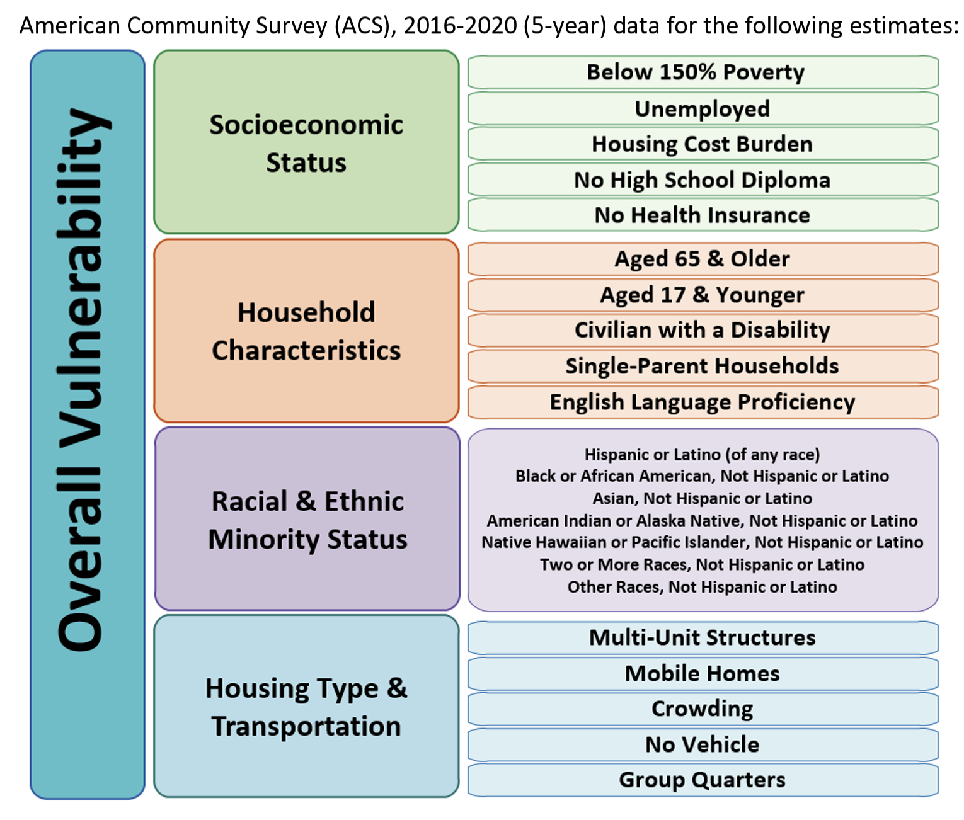
CDC/ATSDR Social Vulnerability Index Data

Slide 10
Chapter 2
Google Colab Setup
Using Google Co-lab & Python for Geospatial Analysis and Visualization

Slide 11
Why Google Colab?
Zero Configuration: You don't need to install Python or manage complex libraries on your computer; everything is pre-configured and ready to use in the cloud.
Free GPU/TPU Access: It provides free access to powerful hardware accelerators like NVIDIA GPUs and Google TPUs, which are essential for training deep learning models that would otherwise be too slow on a standard laptop.
Seamless Collaboration: Like Google Docs, you can share your notebooks with others for real-time editing and commenting.
Google Integration: Notebooks are automatically saved to Google Drive, and you can easily import datasets from Drive, GitHub, or local files.

Slide 12
Google Colab Setup
Download all required data and code files from GitHub.
Upload the downloaded files to your Google Drive.
Open the files from Google Drive in Google Colab.
Mount Google Drive in Google Colab to access and read the data directly from Drive.
Install all required Python packages and dependencies.

Slide 13
Chapter 3
Python geospatial foundations
Using Google Co-lab & Python for Geospatial Analysis and Visualization

Slide 14
Python Geospatial Foundations
  Python for Spatial Autocorrelation Analysis and Visualization
  Python for Spatial Clustering Analysis and Visualization
  Python for Spatial Heterogeneity Analysis and Visualization
  Python for Spatial Accessibility Analysis

Slide 15
Chapter 3.1
Python for Spatial Autocorrelation Analysis and Visualization

Slide 16
  Python for Spatial Autocorrelation Analysis and Visualization
Spatial autocorrelation means that values observed at nearby locations may be more similar, or more different, than values farther apart.
Tobler’s First Law of Geography
Everything is related to everything else, but near things are more related than distant things.
Nearby counties may share similar population, environment, infrastructure, and risk.
    Health events may show geographic dependence.
    Ignoring spatial dependence can miss important public health patterns.
Notes:
“Traditional statistics often assumes observations are independent. In spatial data, nearby counties may influence or resemble each other.”
Health outcomes are often not randomly distributed.
Examples:
Disease burden may cluster in disadvantaged neighborhoods.
Emergency events may concentrate in older or denser populations.
Healthcare access may vary across urban and rural areas.

Slide 17
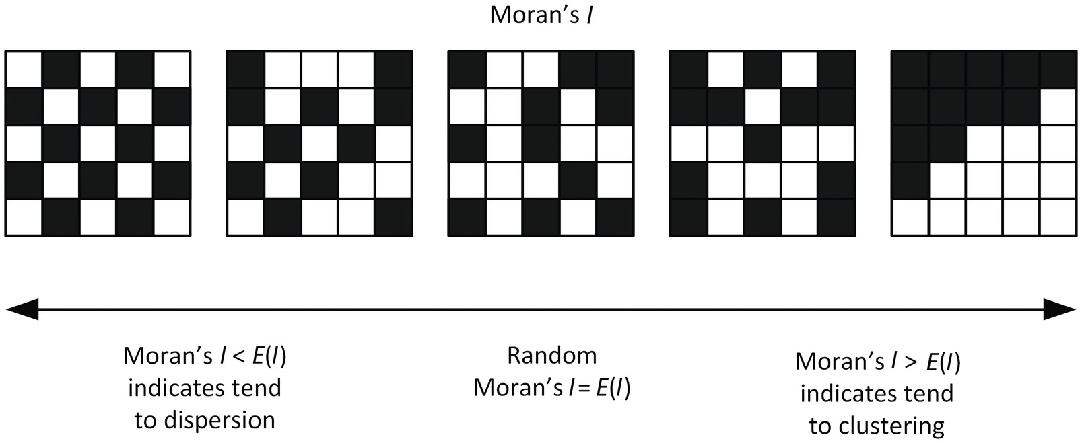
  Python for Spatial Autocorrelation Analysis and Visualization
Global Moran's I measures overall spatial autocorrelation (clustering or dispersion) across a whole dataset. Determines if the spatial pattern of a variable is clustered, dispersed, or random.
Values range from -1 (dispersed) to +1 (clustered), with ~0 indicating a random pattern.
Notes:
Usage: It provides a single summary value for the entire study area

Slide 18
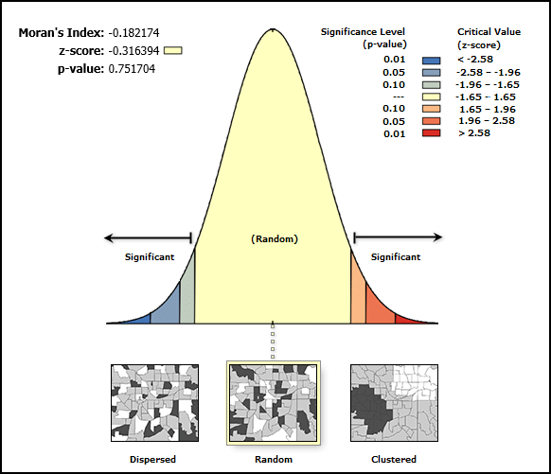
  Python for Spatial Autocorrelation Analysis and Visualization
Global Moran's I
Moran’s I > 0: clustering of similar values
Moran’s I near 0: random spatial pattern
Moran’s I < 0: neighboring areas are dissimilar
A significant positive Moran’s I suggests similar values are spatially clustered.
Notes:
Usage: It provides a single summary value for the entire study area

Slide 19
  Python for Spatial Autocorrelation Analysis and Visualization
LISA (Local Moran's I)
Decomposes Global Moran's I to identify specific, significant locations where similar values cluster (hot/cold spots) or where outliers exist.
LISA maps show High-High (red), Low-Low (blue), and outliers Low-High (light blue) or High-Low (pink).
Key point: Evaluated using simulations (e.g., permutations) to identify hot/cold spots
Notes:
Global Moran’s I is a single summary statistic; LISA provides a value for every observation.

Slide 20
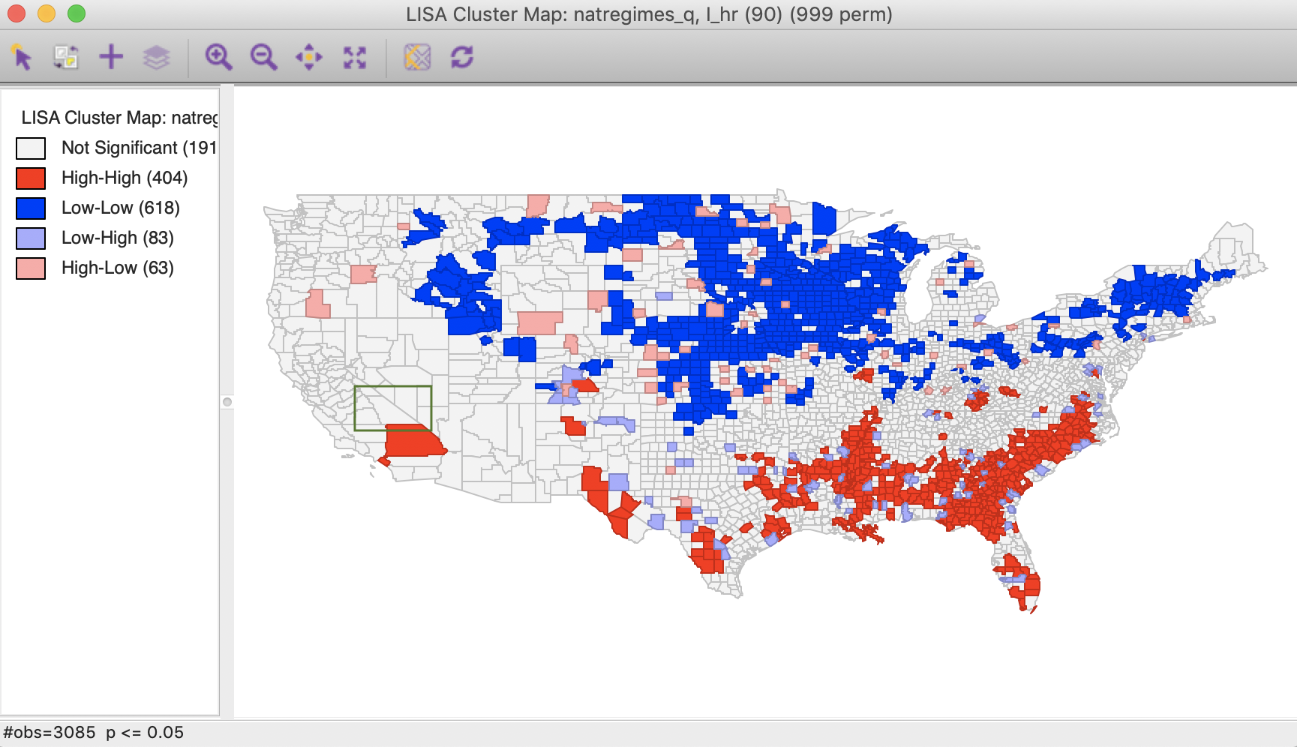
  Python for Spatial Autocorrelation Analysis and Visualization
LISA (Local Moran's I)
Notes:
Map interpretation:
High-High: high OHCA counties near other high OHCA counties
Low-Low: low OHCA counties near other low OHCA counties
High-Low / Low-High: spatial outliers

Slide 21
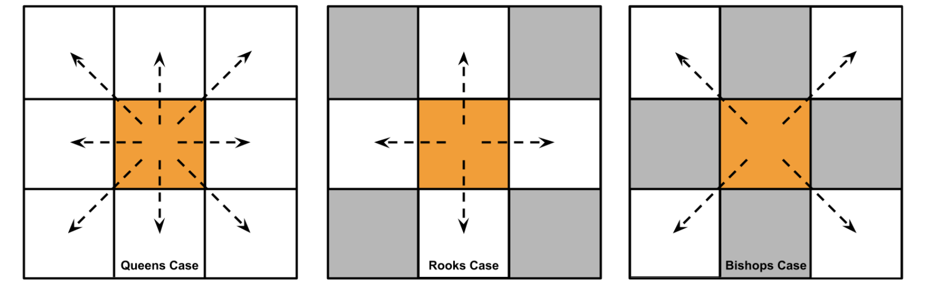
  Python for Spatial Autocorrelation Analysis and Visualization
Spatial Weight Matrix defines which counties are neighbors.
Contiguity Neighbors
Notes:
In the example above we can see the designation of neighbors can be identified by a chess analogy: horizontal/vertical cases (rooks), diagonal cases (bishops), or in all cases (queens) along a regular grid. In irregular polygons, rooks neighbors are connected along edges, bishop neighbors by points, and queens neighbors by both points and edges. So in this example, the neighborhood established using the queens case contains eight (8) neighbors, four (4) neighbors by edges in the rooks case, and four (4) neighbors by points in the bishops case.

Slide 22
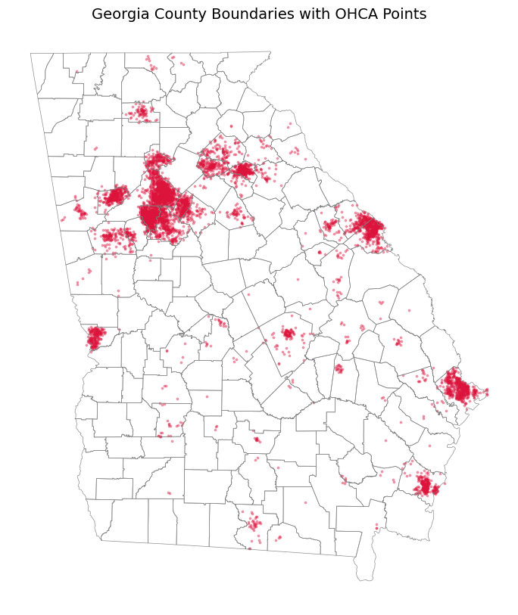
  Python for Spatial Autocorrelation Analysis and Visualization
Research Question
Are Out-of-Hospital Cardiac Arrest cases spatially clustered across Georgia counties? Whether nearby areas have similar values.
Notes:
“Traditional statistics often assumes observations are independent. In spatial data, nearby counties may influence or resemble each other.”

Slide 23
  Python for Spatial Autocorrelation Analysis and Visualization
Hand-on Coding Exercises
→ Convert to GeoDataFrame
→ Load Georgia county polygons
→ Spatial join points to counties
→ Count OHCA events by county
→ Build spatial weights matrix
→ Run Moran’s I and Local Moran’s I
→ Map LISA clusters
Notebook: ohca_zcta_spatial_autocorrelation_colab.ipynb
Try Other Contiguity Neighbor Methods.
Notes:
“Traditional statistics often assumes observations are independent. In spatial data, nearby counties may influence or resemble each other.”

Slide 24
Chapter 3.2
Python for Spatial Clustering Analysis and Visualization

Slide 25
  Python for Spatial Clustering Analysis and Visualization
Why Spatial Point Clustering?
Detect spatial concentrations of health events
Identify high-risk areas and hotspots
Support disease surveillance and emergency response
Guide public health resource allocation
Generate hypotheses about place-based risk factors
Provide a foundation for further spatial analysis
Notes:
“Traditional statistics often assumes observations are independent. In spatial data, nearby counties may influence or resemble each other.”

Slide 26
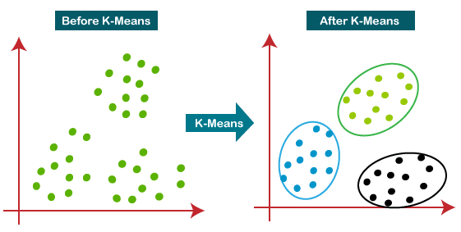
  Python for Spatial Clustering Analysis and Visualization
How does the K-Means algorithm work?
Choose the number of clusters, K.
Randomly initialize K centroids.
Assign each data point to the nearest centroid.
Recalculate the centroid of each cluster.
Repeat steps 3 and 4 until convergence is achieved.
Notes:
. Instead of assuming that clusters are spherical like K-Means, DBSCAN can identify clusters of arbitrary shape

Slide 27
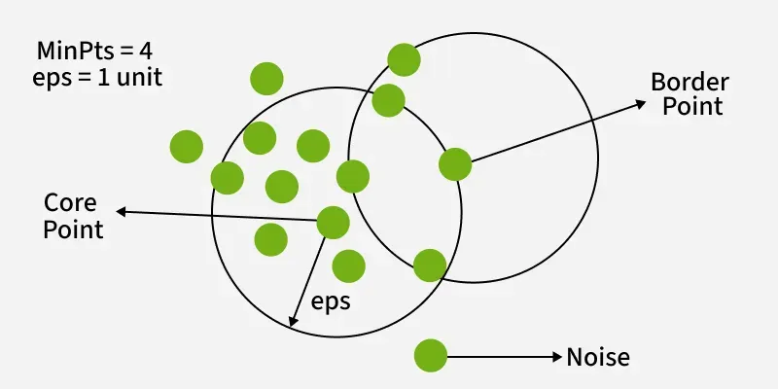
  Python for Spatial Clustering Analysis and Visualization
DBSCAN (Density-Based Spatial Clustering of Applications with Noise) is a unsupervised machine learning algorithm that groups closely packed data points and identifies outliers (noise) in low-density regions. Unlike K-Means, it finds arbitrary-shaped clusters and does not require specifying the number of clusters in advance.
How does DBSCAN algorithm work?
Pick an unvisited Core Point: Start a new cluster and mark it as visited.
Find density-reachable points: Find all neighbors within the radius. If a neighbor is also a Core Point, its own neighbors are added to the cluster.
Incorporate Border Points: Add Border Points to the cluster, but do not use them to expand the cluster further.
Repeat: Continue this recursive process until no more points can be added to the current cluster
Notes:
. Instead of assuming that clusters are spherical like K-Means, DBSCAN can identify clusters of arbitrary shape
DBSCAN is a density-based clustering algorithm that groups data points that are closely packed together and marks outliers as noise based on their density in the feature space. It identifies clusters as dense regions in the data space separated by areas of lower density. Unlike K-Means or hierarchical clustering which assumes clusters are compact and spherical, DBSCAN perform well in handling real-world data irregularities

Slide 28
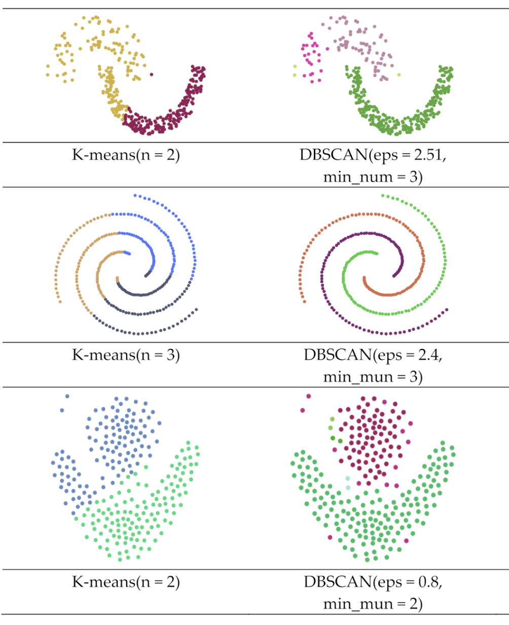
  Python for Spatial Clustering Analysis and Visualization
K-Means VS DBSCAN
Instead of assuming that clusters are spherical like K-Means, DBSCAN can identify clusters of arbitrary shape
Notes:
. Instead of assuming that clusters are spherical like K-Means, DBSCAN can identify clusters of arbitrary shape

Slide 29
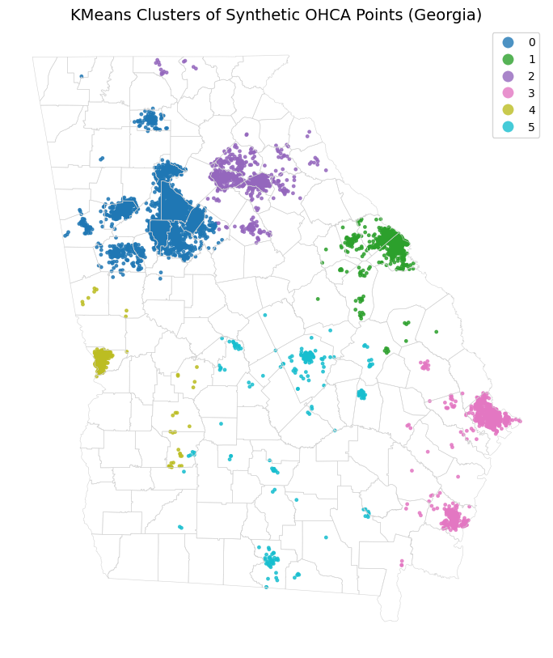
  Python for Spatial Clustering Analysis and Visualization
Hand-on Coding Exercises
Spatial Clustering Analysis Workflow
→ Project to meters
→ Extract x/y coordinates
→ Run K-Means/DBSCAN
→ Assign cluster labels
→ Map clusters
Notebook: ohca_aed_accessibility_analysis_colab.ipynb
Notes:
. Instead of assuming that clusters are spherical like K-Means, DBSCAN can identify clusters of arbitrary shape

Slide 30
Chapter 3.3
Python for Spatial Heterogeneity Analysis and Visualization

Slide 31
  Python for Spatial Heterogeneity Analysis and Visualization
Spatial heterogeneity refers to spatial nonstationarity, meaning that the relationships between variables vary across different locations.
Geographically Weighted Regression (GWR) is a local spatial statistical technique that models varying relationships between variables by fitting a separate regression equation for every feature in a dataset. Unlike global Ordinary Least Squares (OLS) regression, GWR handles non-stationary data, capturing how relationships change across space by weighting nearby observations more heavily
Notes:
1. Why GWR?
Ordinary regression estimates one relationship for the whole study area:
OHCA cases = β0 + β1 poverty + β2 uninsured + ...
GWR asks:
Do these relationships vary across space?
For example, poverty may be strongly associated with OHCA counts in one part of Georgia but weakly associated elsewhere.

Slide 32
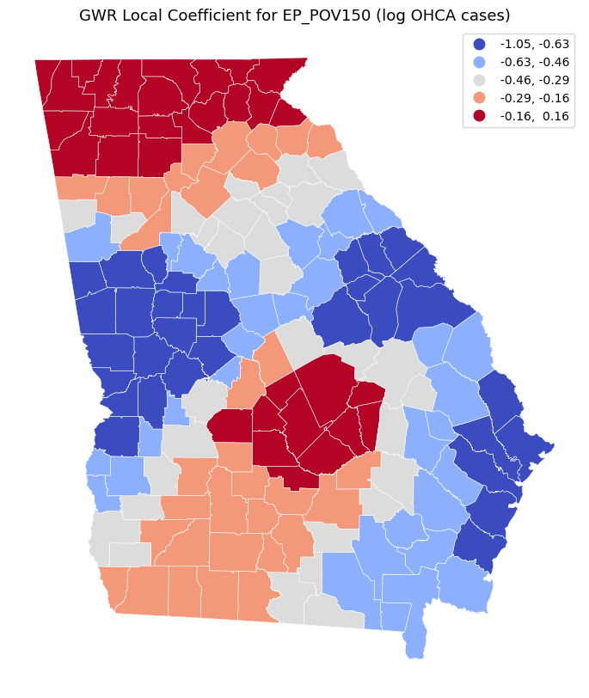
  Python for Spatial Heterogeneity Analysis and Visualization
GWR estimates a separate local regression around each county.
Each county gets:
        local intercept
        local coefficient for each SVI variable
local R², shows where the model explains OHCA counts better or worse. High local R²: SVI variables explain more local variation Low local R²: other unmeasured factors may matter more
        local fitted value / residual
The key output is not one coefficient, but a map of coefficients.
Notes:
. Instead of assuming that clusters are spherical like K-Means, DBSCAN can identify clusters of arbitrary shape

Slide 33
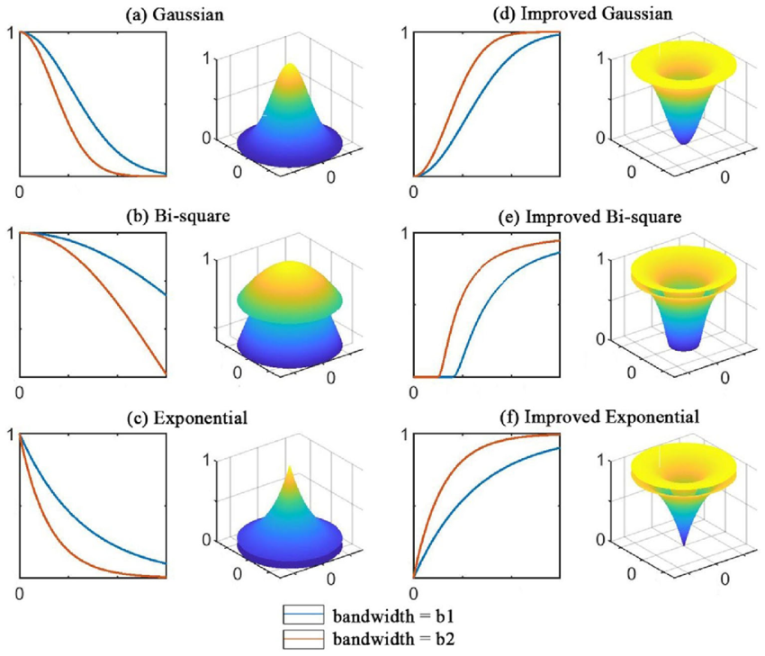
  Python for Spatial Heterogeneity Analysis and Visualization
Key Parameters of GWR:
1. Bandwidth
The most important parameter. It controls how many nearby observations are used to estimate the local regression at each location.
Small bandwidth, more local variation, more sensitive/noisy. Large bandwidth, smoother results, closer to global regression
2. Kernel function
Defines how nearby observations are weighted. Closer observations usually receive higher weights.
Gaussian, bisquare, and exponential kernels
Notes:
. Instead of assuming that clusters are spherical like K-Means, DBSCAN can identify clusters of arbitrary shape

Slide 34
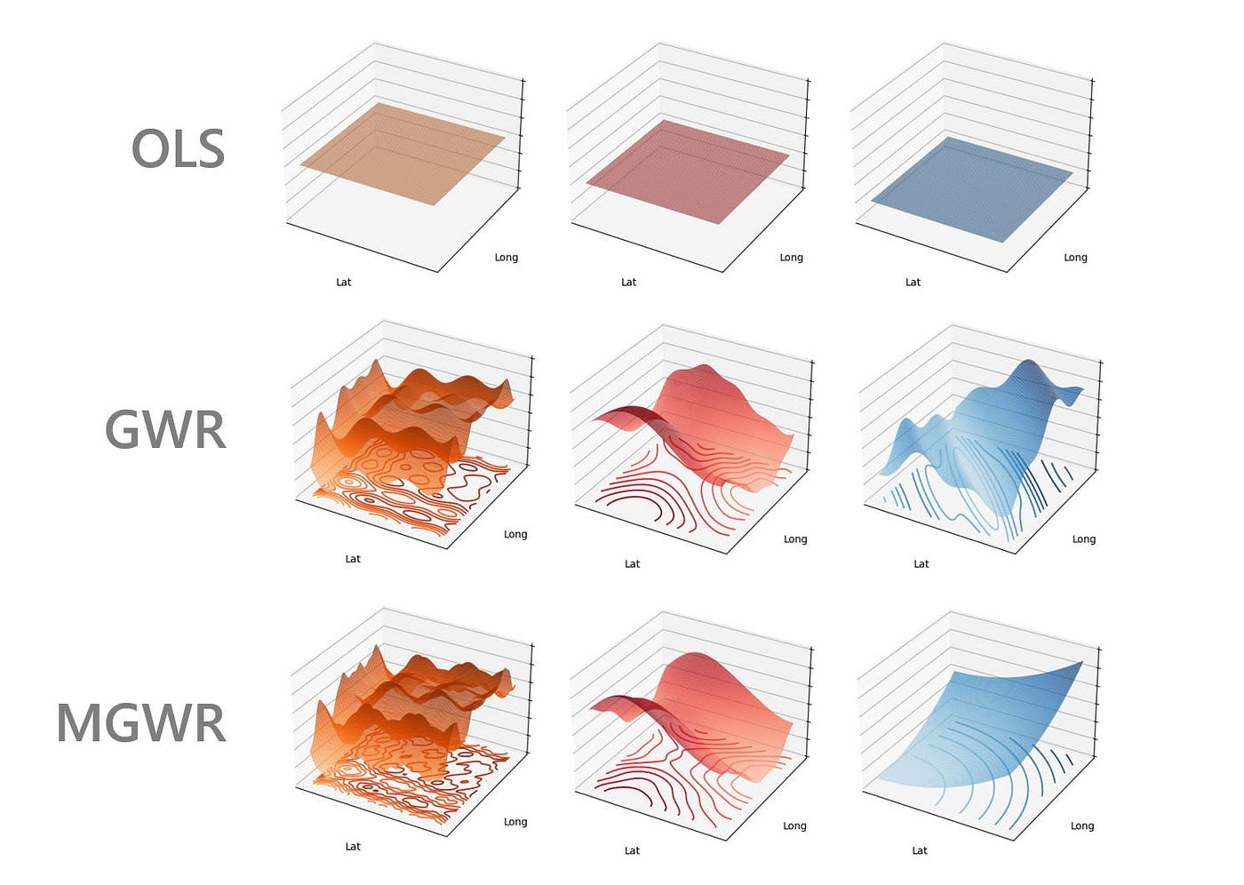
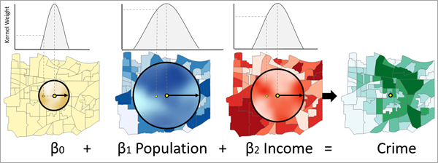
  Python for Spatial Heterogeneity Analysis and Visualization
Key Parameters of GWR:
3. Fixed vs. adaptive bandwidth
Fixed bandwidth uses the same distance threshold everywhere.
Adaptive bandwidth uses a varying distance so that each local model includes a similar number of neighbors, which is useful when data density varies across space.
MGWR
Notes:
. Instead of assuming that clusters are spherical like K-Means, DBSCAN can identify clusters of arbitrary shape

Slide 35
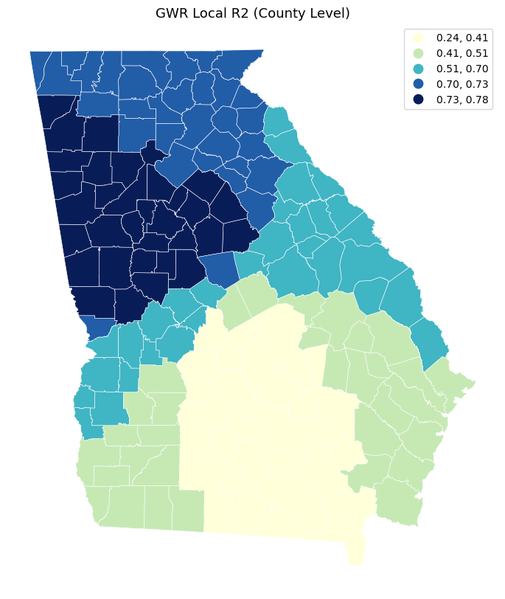
  Python for Spatial Heterogeneity Analysis and Visualization
Hand-on Coding Exercises
Notebook: ohca_county_gwr_svi_analysis_colab.ipynb
Workflow:
→ Convert OHCA records to spatial point data.
→ Spatially join OHCA points to counties.
→ Count OHCA cases by county.
→ Merge OHCA county counts with SVI risk factors.
→ Prepare GWR inputs: outcome, predictors, and county coordinates.
→ Select optimal GWR bandwidth.
→ Fit GWR model.
→ Extract local coefficients and local R².
→ Map GWR results and interpret spatially varying risk-factor effects.
Try to get the GWR coefficients for Other Explanatory Variables!
Notes:
. Instead of assuming that clusters are spherical like K-Means, DBSCAN can identify clusters of arbitrary shape

Slide 36
Chapter 3.4 (Take-Home Exercises)
Python for Spatial Accessibility Analysis and Visualization

Slide 37
  Python for Spatial Accessibility Analysis and Visualization
2SFCA: Two-Step Floating Catchment Area Method
Suppose you are measuring AED accessibility for out-of-hospital cardiac arrest cases.
Demand: OHCA cases or population at risk
Supply: AED locations
Catchment: 5-minute walking distance or 3-minute driving distance
Goal: identify areas where OHCA cases have poor AED access
In Step 1, each AED receives a supply-to-demand ratio based on how many nearby people or OHCA cases may need it.
In Step 2, each neighborhood or OHCA case location receives an accessibility score based on the AEDs it can reach.
Notes:
. Instead of assuming that clusters are spherical like K-Means, DBSCAN can identify clusters of arbitrary shape

Slide 38
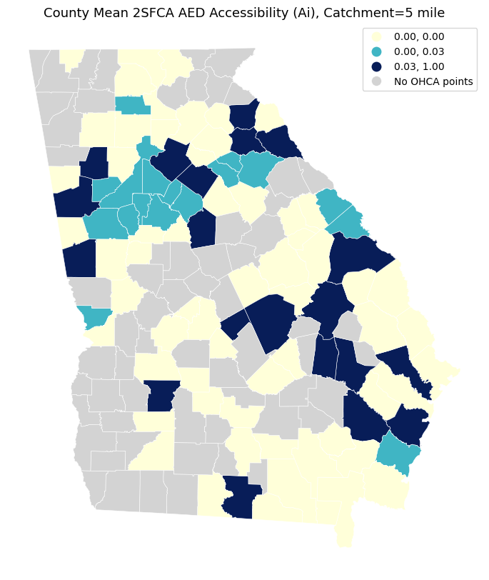
  Python for Spatial Accessibility Analysis and Visualization
Hand-on Coding Exercises
Notebook: ohca_county_gwr_svi_analysis_colab.ipynb
Workflow:
→Map OHCA points and AEDs.
→ Project OHCA and AED points to a meter-based CRS.
→ Calculate OHCA-to-AED distance matrix.
→ Define AED catchment threshold.
→ Compute AED supply-to-demand ratio R_{j}.
→ Compute OHCA accessibility score A_{i}.
→ Summarize 2SFCA accessibility by county.
→ Map county-level AED accessibility.
→ Export AED points, accessibility table, and map.
Notes:
. Instead of assuming that clusters are spherical like K-Means, DBSCAN can identify clusters of arbitrary shape

Slide 39
Chapter 4
Recap & Wrap-up
Using Google Co-lab & Python for Geospatial Analysis and Visualization

Slide 40
Status Update
What were you working on, how far did you get?
What’s your most important take away?

Slide 41

Feedback
Please take a moment to let us know how we could do better and what you liked about today
→ https://gis.harvard.edu/workshop-evaluation

Slide 42
Questions & Comments?
Thank You for Joining Us!

