Slide 1
Harvard System-Theory Talk Series
Algorithms in Programmable Switches
Minlan Yu
Harvard University

Slide 2

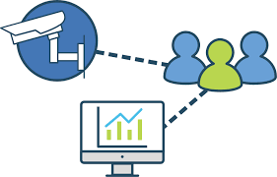

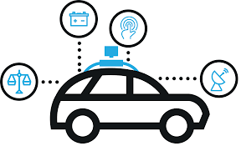
Exciting Times in Systems
Machine learning
Video Analytics
Cloud
Streaming games
Cloud assisted Self-driving cars
Increasing needs for high throughput and low latency

Slide 3
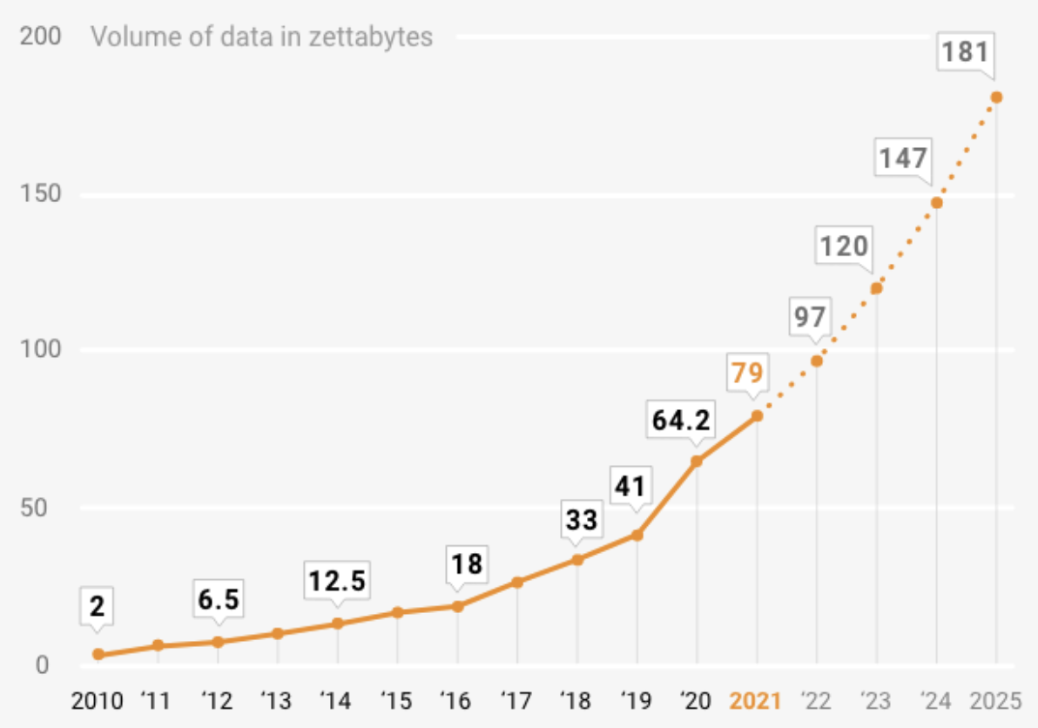
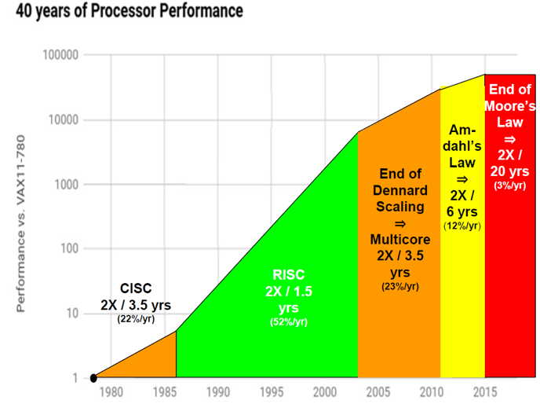
Compute Cannot Keep Up with Data Growth
Significant data growth
The data created and consumed worldwide to exceed 180 Zetabytes by 2025
Compute cannot keep up
Facing the end of Moore’s law

Slide 4
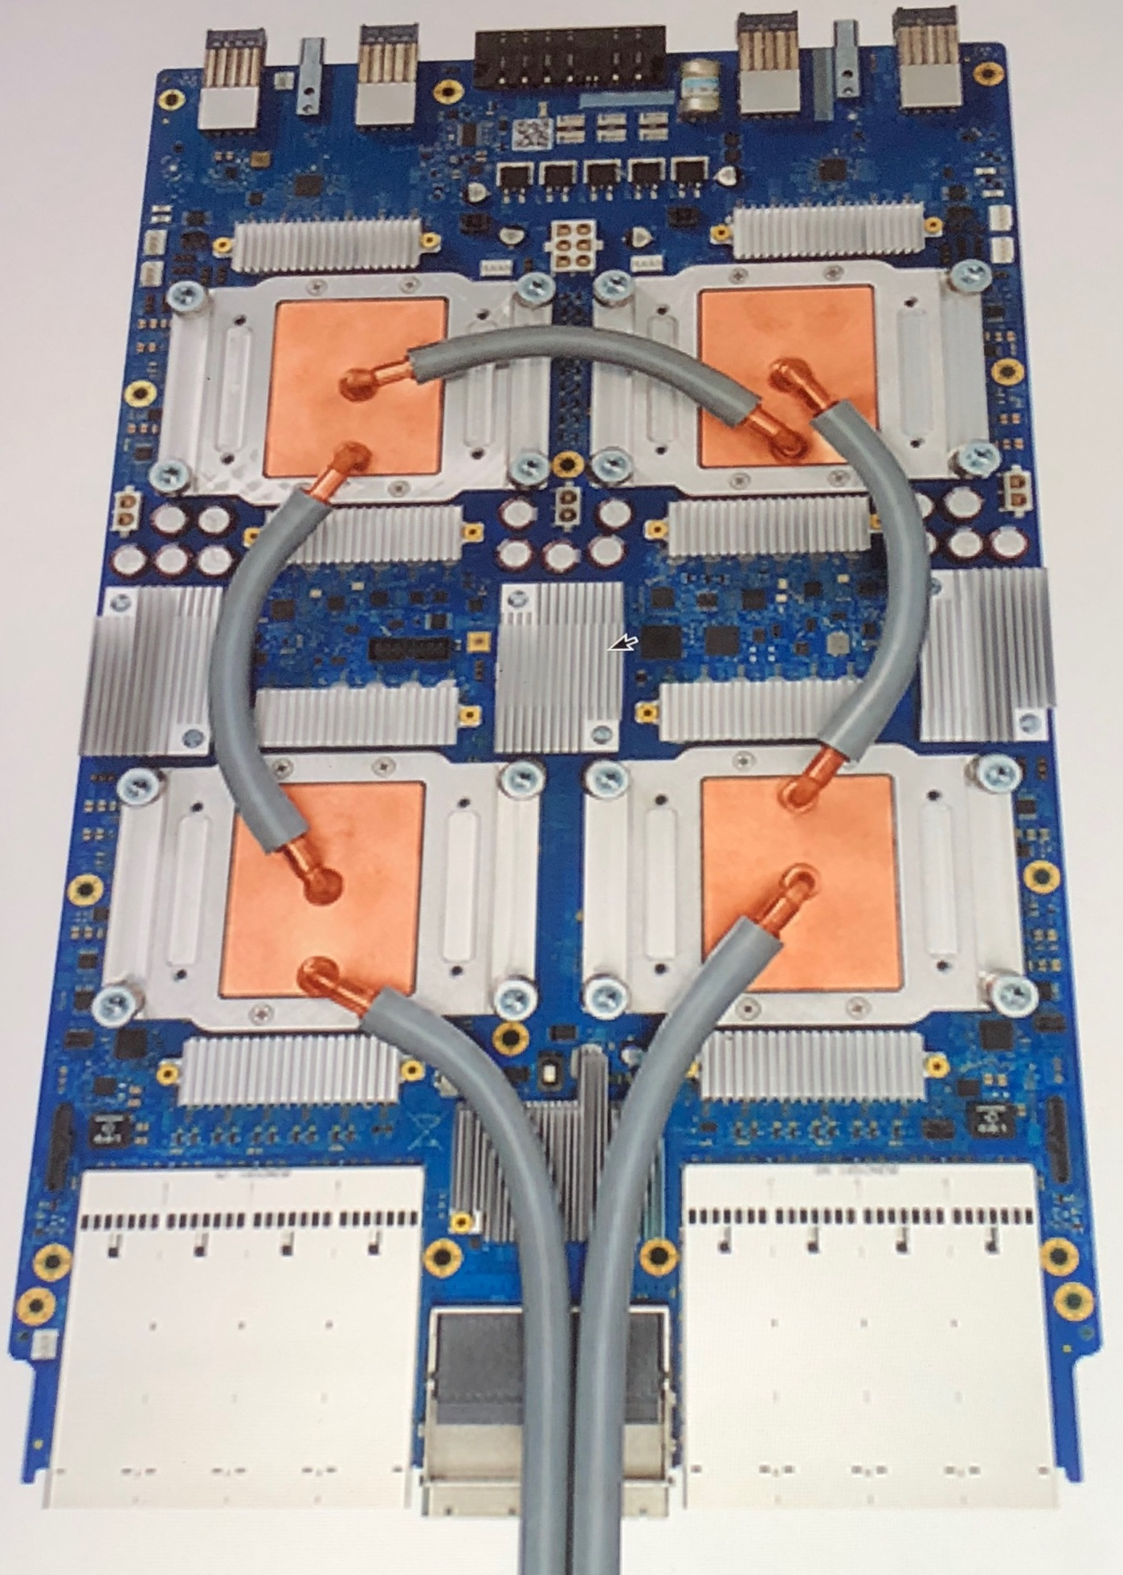
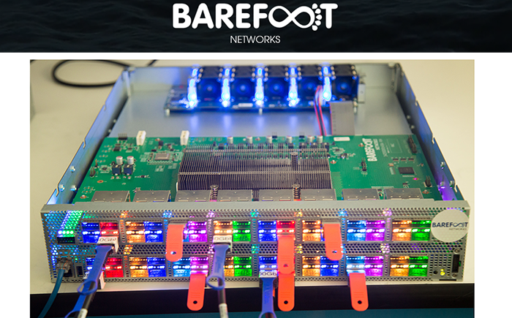
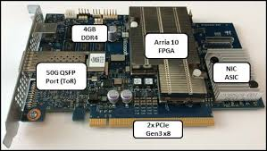
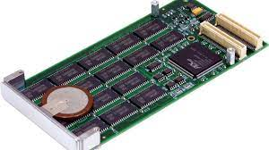
The Rise of Heterogeneous Devices
Compute:
GPU, TPU, FPGA
Network:
Programmable switches
Smart NICs
RDMA
Storage:
Non-volatile memory
SSDs
Provide high throughput and low latency for specific functions

Slide 5
Fundamental Challenge 1
How to provide high performance for applications
by leveraging the full potential of heterogeneous devices?

Slide 6


Increasing Network Scale
Cloud:
Hundreds of thousands of switches
Millions of servers
Edge:
Billions of IoT devices

Slide 7
Fundamental Challenge 2
Measure:
Detailed, real-time,
large-scale telemetry data
Control:
Fast, automated, programmable decisions
Self-driving networks
How to manage many heterogeneous devices with a fast measure-control loop?

Slide 8
Call for Theoretical Contributions
How to provide high performance for applications by leveraging the full potential of heterogeneous devices?
Compact data structures, streaming algorithms
Given the programmability, memory, and network constraints
Resource allocation across applications
How to manage many heterogeneous devices with a fast measure-control loop?
Distributed algorithms for coordination
Approximation algorithms
Division of labor across many parties

Slide 9
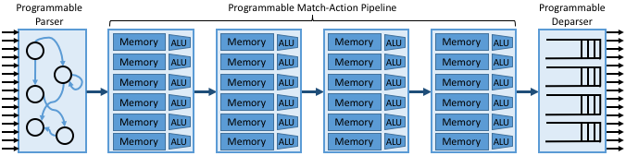


Example: Programmable Switches
+ High throughput: Multi-Tbps
+ Low Latency: <1us per packet

Slide 10
Two Example Applications on Programmable Switches
Network telemetry
Collect fine-grained data across many switches while supporting diverse queries?
High throughput, low latency for self-driving networks
In-network computing
Offload high-level applications to switches
Database queries: Low query completion time
DDoS defenses: High throughput

Slide 11
Challenges of Programmable Switches
Growing applications
Switch limitations
Significant data growth
Limited memory
Diverse programs
Limited programmability
Increasing line rate
Limited per packet processing

Slide 12
Two Example Applications on Programmable Switches
Network telemetry
Collect fine-grained data across many switches while supporting diverse queries?
In-network telemetry: Reduce bits in packets
Direct-telemetry access: Reduce collection overhead
In-network computing
Offload high-level applications to switches for high throughput
Database queries: Run best effort queries at switches
DDoS defense: Support diverse defense tasks with limited resources.

Slide 13
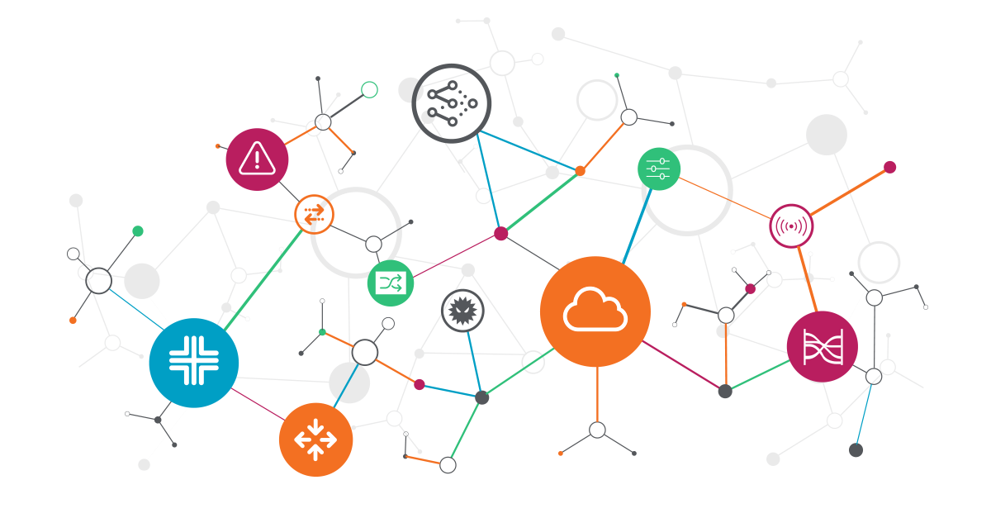
Network Telemetry

Slide 14







Network Telemetry
Attack detection
Perf. Diagnosis
Traffic engineering
Network queries on the collector
… …
… …
… …
14

Slide 15
Measuring Packet-level Events
Diverse queries on packet lifetime
Which path do my packets take?
Which firewall rules do my packets follow?
Which switch/link has the highest latency for my packets?
Useful for real-time control and feedback loop
E.g., congestion control, load balancing, troubleshooting, etc.

Slide 16

INT: In-band Network Telemetry
INT: add switch states in packets and analyze at the receiver
E.g., Switch ID, Queuing delay, link utilization
Already supported in switches today
pkt
pkt
pkt
INT
INT
Sender
Receiver
Notes:
Brings insight into packet lifetime, already supported in

Slide 17
Key Problems
High bit overhead
Path query w/ a single telemetry info (switch ID): 28 Bytes
Even more bytes if we add other info (e.g., queuing delay, timestamps)
Lead to up to 20% goodput drop
High processing overhead
Collect such information from many switches to a centralized collector
High bandwidth and processing overhead at the collector

Slide 18
Reduce Bit Overhead
PINT: Probabilistic In-band Network Telemetry
Encode telemetry information on packets with fewer bits
Insight
Most apps don’t need per-packet per-switch values, but aggregated data
Leverage probabilistic solutions to aggregate across packets and flows

Slide 19



Data Aggregation in PINT
Static Per-flow aggregation
For a flow with packets 𝑝_1,𝑝_2,…
E.g., flow-level path tracing
Switches
Packets
$$p_{1}$$
Static Per-flow
$$p_{2}$$
Output
$$…$$

Slide 20




Data Aggregation in PINT
dynamic per flow aggregation
For each switch on the path, aggregate (e.g., estimate the median) over 𝑣(𝑝_1,𝑠),𝑣(𝑝_2,𝑠),….
E.g., median/tail latency of (switch, flow) pairs
Switches
Packets
$$p_{1}$$
$$p_{2}$$
$$…$$
Dynamic Per-flow
$$g( )$$
$$g( )$$
$$g( )$$
$$g( )$$
20

Slide 21
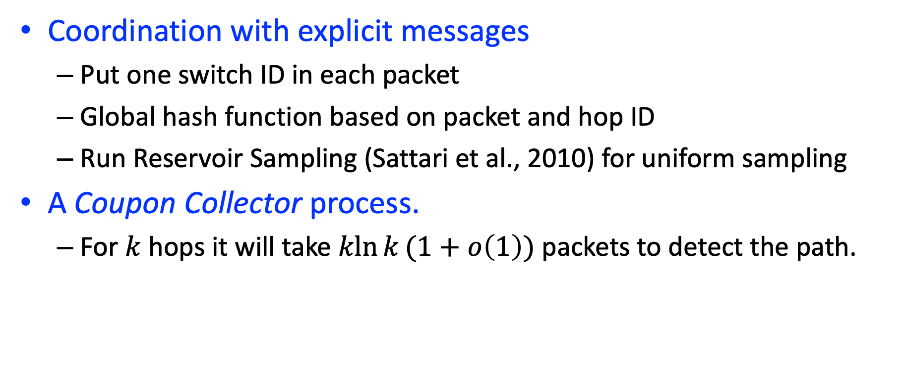
Flow-level Path Tracing
Coordination with explicit messages
Put one switch ID in each packet
Global hash function based on packet and hop ID
Run Reservoir Sampling (Sattari et al., 2010) for uniform sampling
A Coupon Collector process.
For $k$ hops it will take $\operatorname{kln}{k}(1+o\left(1\right))$ packets to detect the path.
A
B
C
D
C
A
A
D
A
C
B
Notes:
Coordinate switches without explicit collaboration
run Reservoir Sampling (Sattari et al., 2010).

Slide 22
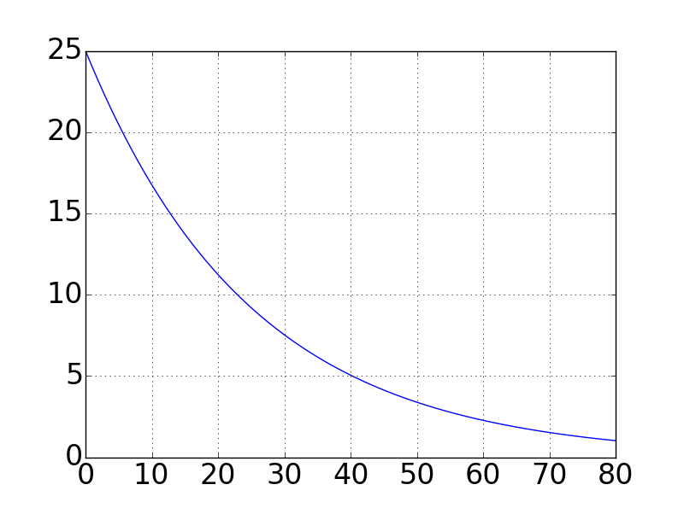
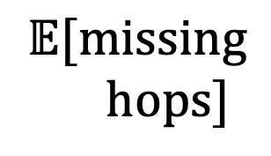
Coupon Collector Process
$$𝔼[missing$$
$$hops]$$
Number of samples
22

Slide 23

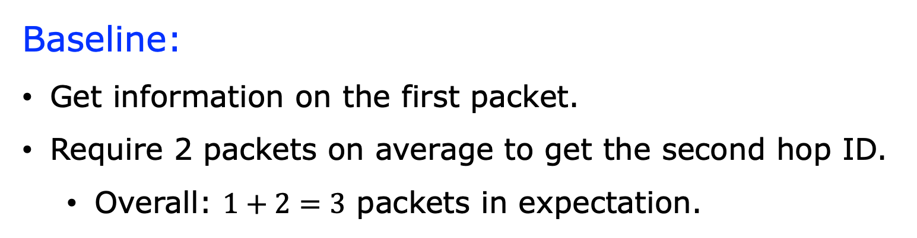



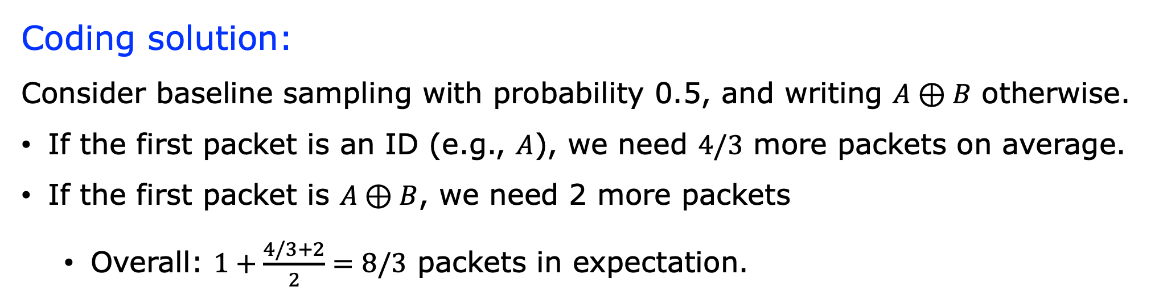
The Power of Coding
A
B
Baseline:
Get information on the first packet.
Require 2 packets on average to get the second hop ID.
Overall: $1+2=3$ packets in expectation.
$$A$$
$$A$$
$$B$$
Coding solution:
Consider baseline sampling with probability 0.5, and writing $A⊕B$ otherwise.
If the first packet is an ID (e.g., $A$), we need $4/3$ more packets on average.
If the first packet is $A⊕B$, we need 2 more packets
Overall: $1+\frac{4/3+2}{2}=8/3$ packets in expectation.
$$A$$
𝐴⊕𝐵
Notes:
In contrast, consider an algorithm that uses this sampling with probability 50%, and otherwise writes the bitwise-xor of both IDs. That is, each packet has probability 25% to carry the ID $A$, 25% to have $B$, and 50% to have $A\oplus B$. This modification reduces the expected number of packets we require to $8/3$. For example, if the first packet carried $A$, we have a probability of 75% of inferring $B$ in each consecutive packets. This is because we get B itself w.p. 25%, and A$\oplus$B with 50%. When getting $A\oplus B$, we can get $B$ from $A\oplus(A\oplus B)$ since we already know A.

Slide 24
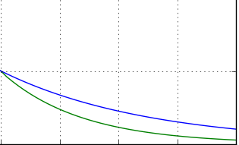
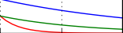
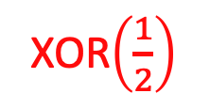
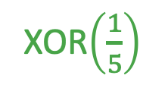
Improve the Coupon Collector w/ XOR Coding
Baseline
XOR$\left(\frac{1}{5}\right)$
XOR$\left(\frac{1}{2}\right)$
$$𝔼[missing$$
$$hops]$$
Number of samples
24

Slide 25
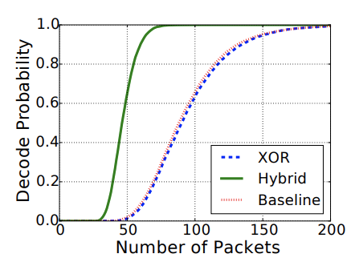


Complete Algorithm
With probability $τ$, run the coupon collector algorithm.
Otherwise, choose one XOR layer at random.
The XOR instances have increasing probabilities.
$$…$$
XOR2
XOR1
Coupon collector
Notes:
Comparison with Linear Network Coding. Several algorithms can be adapted to work in the distributed encoding setting. For example, Linear Network Coding (LNC) [32] allows one to decode a message in a near-optimal number of packets by taking random linear combinations over the message blocks. That is, on every packet, each block is xor-ed into its digest with probability 1/2. Using global hash functions to select which blocks to xor, one can determine the blocks that were xor-ed onto each digest. LNC requires just ≈ k + log2 k packets to decode the message. However, in some cases, LNC may be suboptimal and PINT can use alternative solutions. First, the LNC decoding algorithm requires matrix inversion which generally takes O(k 3 ) time in practice (although theoretically faster algorithms are possible). If the number of blocks is large, we may opt for approaches with faster decoding. Second, LNC does not seem to work when using hashing to reduce the overhead. As a result, in such a setting, LNC could use fragmentation, but may require a larger number of packets than the XOR-based scheme using hashing.

Slide 26
Key Problems
High bit overhead
Global hash function and reservoir sampling
Randomized algorithm with XOR-based encoding
High processing overhead
Collect such information from many switches to a centralized collector
High bandwidth and processing overhead at the collector

Slide 27



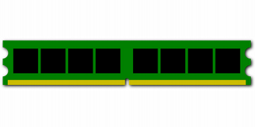

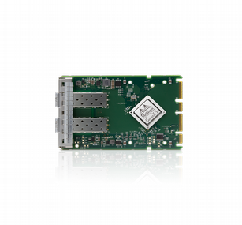
Aggregating Network Data to a Collector
Telemetry generates tons of data!
Overloads collector CPU
Reduced insight
We redesign telemetry collection
Bypassing the CPU
Increased insight
Reports
O(1Mpps)
Per switch & metric
RDMA
Add spoken: “of course I’m gonna show it’s not as simple as just ‘use RDMa and it works’”
Take it already here
Introduce RDMA here
“we use RDMA with is HPC tech to bypass CPU” “okay to repeat some”
End “but why do we need to redesign it?”
Notes:
[End] But why is this a problem now? What has changed?

Slide 28
But RDMA is limited...
Limited verbs
Read, Write, Fetch-and-Add, Compare-and-Swap
Cannot support complex data structures
Limited # of RDMA connections
Need queues and states per connection
Cannot scale to many switches
Assume lossless network
a
a
0
[2]=c
b
1
c
2
_
[2]=e
_
3

Slide 29
Direct Telemetry Access with A Translator
Collector
Limited verbs
→Switch-level primitive extensions
Limited # of RDMA connections
→Translator aggregates connections across switches
Assume lossless network
→Flow control between switches and translator
RDMA
Translator (ToR)
DTA
Notes:
Potential question: “But you still use RDMA!!!”
Explain some benefits of just a single RDMA link

Slide 30
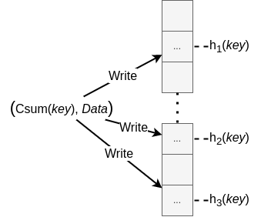
Key-Write
For key-value store
E.g., (5 tuple flows, counters)
A shared hash table across switches
With global hash function on arbitrary keys
Problem: Collisions, data overwrite
N redundant data insertions
Checksum to validate keys
Plurality vote on values
Provable bounds on missing or wrong values
Fig: Data indexing, N=3

Slide 31
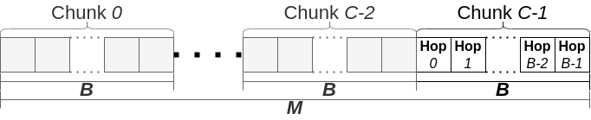
Postcard Write
Each switch sends postcards to the collector
E.g., tracing a flow path: (packet/flow ID, switch hop, Data)
Strawman: Key-Write
Many random memory accesses
Postcard Write: aggregate hops for the same flow into chunks
Assume each path has at most B hops
Translator batches writes to improve performance and reduce collisions
Allow N redundancy writes
4.3x faster than Key-Write

Slide 32
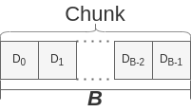

Postcards with Encoding
Strawman solution:
Write value and checksum directly in each slot
Instead, encoding to reduce bits
Hashing value to fixed #bits
XOR checksum of key with hashed value
Can still extract values by enumerating hops

Slide 33
Key Problems and Solutions
PINT: Reduce bit overhead
Global hash function and reservoir sampling
Randomized algorithm with XOR-based encoding
DTA: reduce collector overhead
Introduce a translator to support new primitives for complex data structures
Global hash table with redundant insertion
Batching and encoding for postcards across hops

Slide 34
Theoretical Questions in Network Telemetry
Reduce bits in packets and memory
Hashing, encoding, approximation
By leveraging redundances across hops, packets, and flows
Coordinate with minimal messages
Answer a network-wide query with switch-local information
Coordinate across switches, hosts, and collectors
Support diverse queries
Query-based optimization of data structures given limited programmability
Resource sharing across queries
How to redesign systems to make theory easier
Notes:
Given limited programmability at switches and RDMA

Slide 35
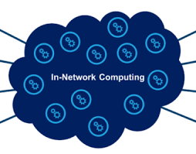
In-Network Computing

Slide 36
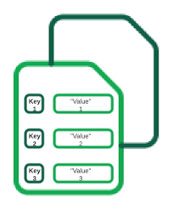

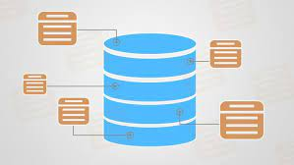
Distributed Data Processing Applications
Increasing needs for high throughput and low latency
databases
Key-value stores
ML training & inferences
DDoS Defenses
Can programmable switches help improve the performance?
Switches already sit in the network;
provide high throughput and low latency for some functions
Notes:
Distributed data processing applications are the critical infrastructure for many applications and services.
Banking, education, social networks, online shopping, and manufacturing

Slide 37
Two examples
Offload database queries
Complex queries
Limited programmability and resources at switches
Best effort at switches
Offload DDoS detection
Diverse detection and mitigation modules
Limited resources at switches
Full defenses at switches

Slide 38



Cheetah: Accelerate Database Queries via Switches
Database queries
Multiple workers parallelize data processing
A master node aggregate results and answer the query
Use switches to accelerate the data processing
Query
Plan
Query planner
Master Node
Query
Switch
Worker
Data
User
Result
Data

Slide 39
Key Challenges of Using Programmable Switches
Memory
Limitation 2:
small per-stage memory
0
1
2
3
0
1
2
3
0
1
2
3
Limitation 1:
small number of stages
Limitation 3:
Supports basic arithmetic ops
39

Slide 40
The Pruning Abstraction
Query on pruned dataset = Query on original dataset
Master Node
Worker
A, B, C, D, E
A, B, A, A, C, D, D, E, A, B, C, C, D, A, E, A, D, A, C
Query results
Switch
Original dataset
A, B, A, C, D, E, B, A, E, A, A, C
Pruned data set using switches

Slide 41
Example: Distinct Query Pruning
Selects all the distinct values
SELECT DISTINCT seller FROM Products
Strawman solution: Bloom Filters
Problem: False positives which may drop distinct entries
A, B, C, D, E
A, B, A, C, D, E, B, A, E, A, A, C
A, B, A, A, C, D, D, E, A, B, C, C, D, A, E, A, D, A, C
Query results
Pruned data set using switches
Original dataset
Notes:
Is this deployed anywher?

Slide 42
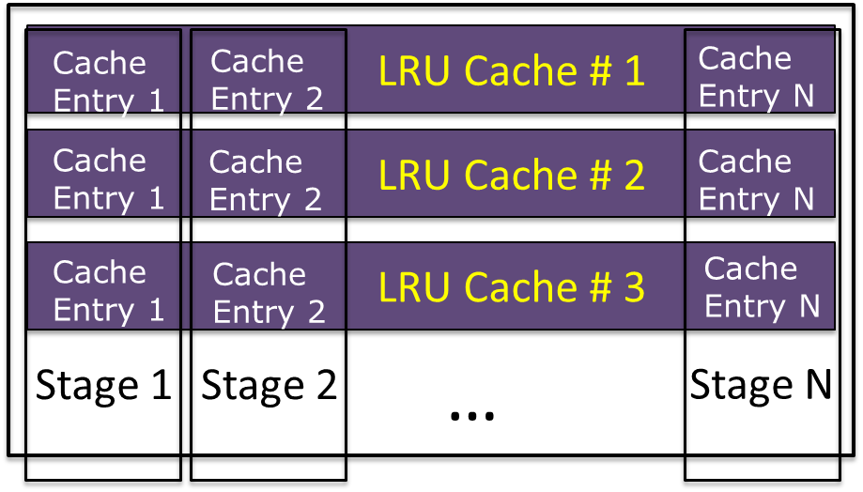
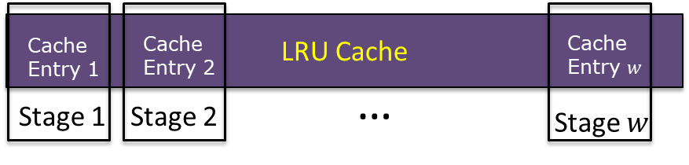
Example: Distinct Query Pruning
Selects all the distinct values
SELECT DISTINCT seller FROM Products
Strawman solution: Bloom Filters
Problem: False positives which may drop distinct entries
But a cache works!
Implement LRU with a rolling replacement across stages
Our solution: Multi-row LRU cache
Hash packets to a row
Reduce #per-packet comparison
Notes:
Is this deployed anywher?

Slide 43
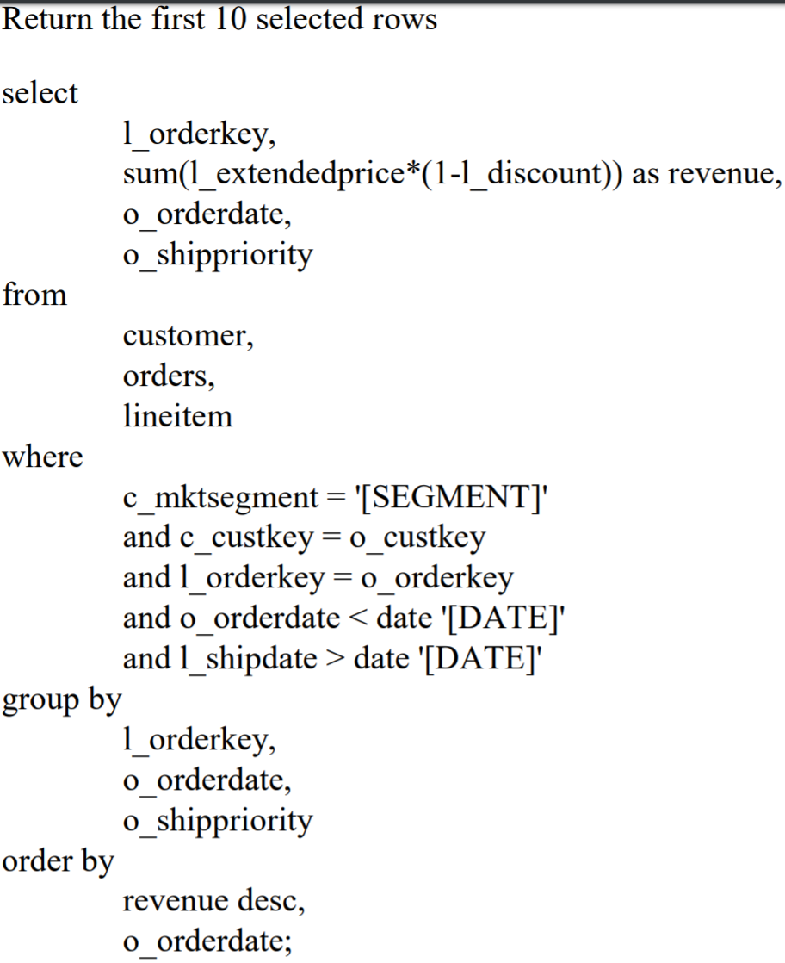
Cheetah Results
Many Queries
Distinct, Top N
Join, Group-By, Having
Skyline, Filtering
and their combinations
Spark + Tofino implementation
github.com/harvard-cns/cheetah-release
40-75 % faster completion time on database benchmarks
E.g., TPC-H Query 3

Slide 44
Two examples
Offload database queries
Complex queries
Limited programmability and resources at switches
Best effort at switches
Offload DDoS detection
Diverse detection and mitigation modules
Limited resources at switches
Broad-spectrum defenses at switches

Slide 45



Jaqen: Switch-Native DDoS Defense for ISP
ISP network as a defender
DDoS
Victims
Provide large volumes with low latency
Handle diverse attack vectors for both detection and mitigation
Notes:
To answer this question, our vision is a switch-native ddos defense system called Jaqen that turns an ISP network into a defender. No out-of-band detection, no scrubbing centers, no what’s so ever.
Jaqen integrates detection and mitigation completely in the programmable switches and designed for switch-native mitigation efforts towards volumetric attacks.

Slide 46

Jaqen’s Full Stack Design
Controller
DDoS
Victims
1.
Broad-Spectrum Detection
2.
Dynamic Resource Allocation
3.
Fast On-demand Mitigation
Notes:
In jaqen, we have three compoents

Slide 47
Broad-Spectrum and Always-On Detection
+
SYN
…
RST
Attack types
Attack volumes
Unidentified
Packet
Parser
+
…
+
+
DNS
…
NTP
+
Universal Sketches
Attack Signatures
e.g., elephant flows, distinct flows, heavy sources, entropy
A wide-spectrum detection of volumetric attacks.
Compact design with future-proof universal sketches.
Detection metric API: Query (proto, func, mode, freq)
Notes:
In the Detection components, our design leverage universal sketches to estimate a large range of statistics or even unforeseen functions for different flow identities.
In addition to the sketches, we add a few signature counters as a complement
Together, we can estimate various attacks and volumes.
For users, we provide
Mode: pulling or pushing
To that end, we design an API with Query(proto,func,mode ,freq) to precisely obtain the metrics for detection, where proto defines the queried protocol, func defines the function of the metric, mode defines the reporting mode (e.g., self-triggering with a threshold), and freq is the reporting frequency. For example, we can query the UDP srcIP heavy flows above a 0.5% threshold every 5 seconds in a self-reporting mode. A

Slide 48
Fast On-Demand Mitigation
Detection results
Available resources
Quick resource allocation
(Optimization solver)
Mitigation Modules:
M1, M2, M3, …
Cannot afford preloading all possible mitigation modules.
Notes:
Once we have the detection results, along with the network-wide available resources

Slide 49
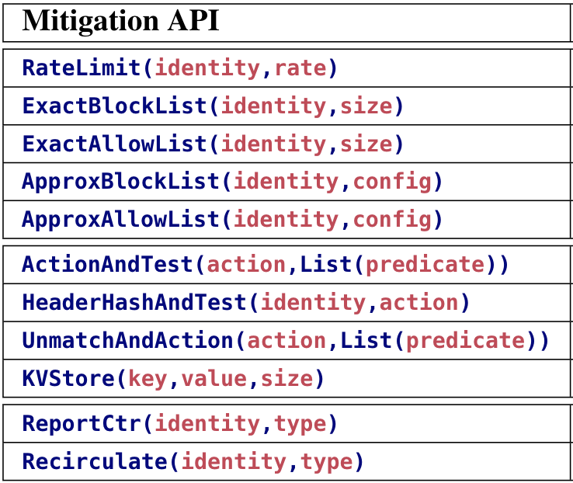
Switch-Optimized Mitigation Library
SYN Cookie/proxy [BSDC’02, RFC4987]
Block-List [WDFIA’07]
Allow-List [WDFIA’07]
ICMP block
DNS filter
…
Sketches
Bloom filters
Counting bloom filters
SYN Proxy with filters
Exact-match table
Rater limiter
…
Best-practice mitigation
Switch-optimized library
Mitigation API
Preserve O(10 Million) legitimate connections
with O(10 MB) on-switch memory.
Support mitigation strategies on 21 attacks.
Notes:
In designing mitigation modules, we explore a set of best-practice mitigation strategies, extract their workflow as a few key components and redesign each component with efficient probabilistic data structures. Finally, we provide API for each component to help construct mitigation strategies for current and possibly future attacks.

Slide 50
Switch-Native SYN Proxy
Client
Switch
Server
Client
SYN Proxy
Server
SYN
SYN Cookie & conn table
SYN
Cookie w/o states
Per-conn state!
Error SYN-ACK
w/ cookie
SYN-ACK
w/ cookie
Verify cookie +allowlist
Bloom filter for the allowlist
RST
w/ cookie
Verify cookie
ACK w/ cookie+1
SYN
SYN
SYN-ACK
SYN-ACK
ACK
Seq. # adjustment
ACK
SYN Proxy [NDSS’20]
Jaqen SYN Proxy
Notes:
Generate RST with received seq number
Implementing mitigation functions in switches require careful redesign.
Only keep those data that have passed the test. Bloom filter
The typical workflow of a SYN proxy can be described as: (1) When a SYN is received, the proxy server generates a unique cookie [69] with 5-tuple and adds it to the sequence number (seq. no.) header field of the corresponding SYN-ACK reply. (2) When a legitimate client receives the SYN-ACK it will acknowledge back an ACK packet with cookie+1 in its seq. no.; Otherwise, an attacker would not send the cookie back. (3) Once the proxy verifies the correctness of the cookie, it will record session information (e.g., seq. no. difference) and construct a new SYN to the designated destination to establish the connection. The succeeding packets will go through the proxy to translate the seq. no. in order to continue the original TCP handshake.
Unfortunately, the current switch-based SYN proxy that directly implements the above server-based design (e.g., Poseidon [3]) has scalability issues when there is a large number of legitimate connections. They maintain seq. no. translation data for each legitimate connection using a single hash table (e.g., size 65536). Inevitably, using a single hash table for per-connection state storage would break the correctness of many legitimate connections due to hash collisions. For instance, keeping 65536 legitimate connections on a hash table of size 65536 has expected 24109 collisions.4 To address this issue, we design two SYN proxy modes with HeaderHashAndTest(identity,action) to perform a “cookie” operation on designated header fields with hashing and send back a response packet (e.g., SYN-ACK) to “test” if the client is legitimate. Note that in our design, one can use ApproxAllowList(identity,config) to record a large number of legitimate identities that have passed the tests. The approximation errors will not affect legitimate traffic since Bloom filters do not create false negatives.

Slide 51
Two examples
Offload database queries
Complex queries
Limited programmability and resources at switches
Best effort at switches
Offload DDoS detection
Diverse detection and mitigation modules
Limited resources at switches
Broad-spectrum defenses at switches

Slide 52


Theoretical Questions for In-Network Computing
Complex functions vs limited programmability
Redesign algorithms with new constraints
Division of labor
Best effort at switches; Full query at hosts
Broad-spectrum detection vs on demand mitigation
Room for approximation
Compensate with host functions and system design
Understand system impact of different approximation solutions

Slide 53
Going Forward…
Systems
Programmable switches
Smart NICs
FPGA
Storage, Compute
Edge servers, IoTs
A broader set of applications
Theory
Hashing, coding, randomization
Distributed algorithms
Queuing
Scheduling
Caching
Machine learning

Slide 54
Going Forward…
A theoretical foundation for systems
Programmable switches as an example:
Formal models on switch capabilities and resource tradeoffs
A library of data structures and algorithms for switches
Redesign systems to facilitate theory design
Programmable switches as an example:
What new features should we add to systems?
How to realize theoretical assumptions in practice?

Slide 55
Thank you!

