Slide 1
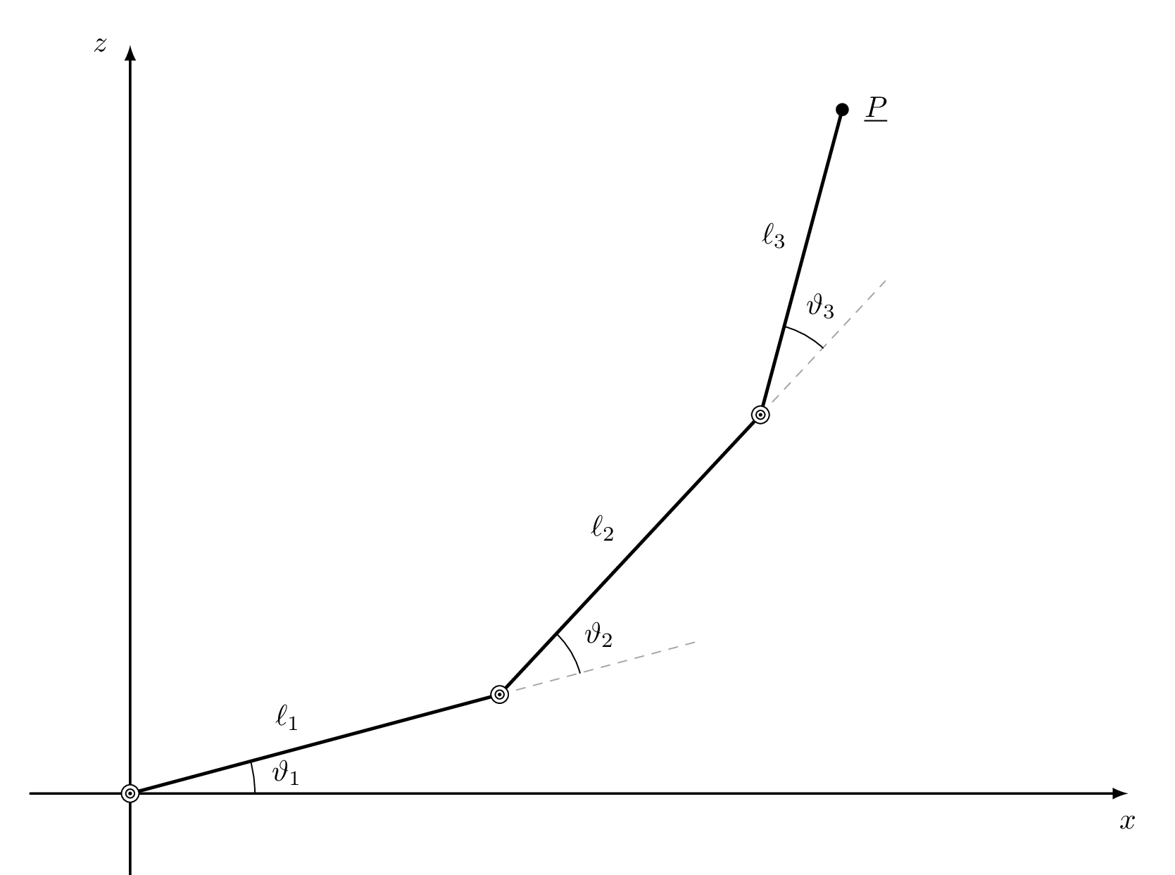
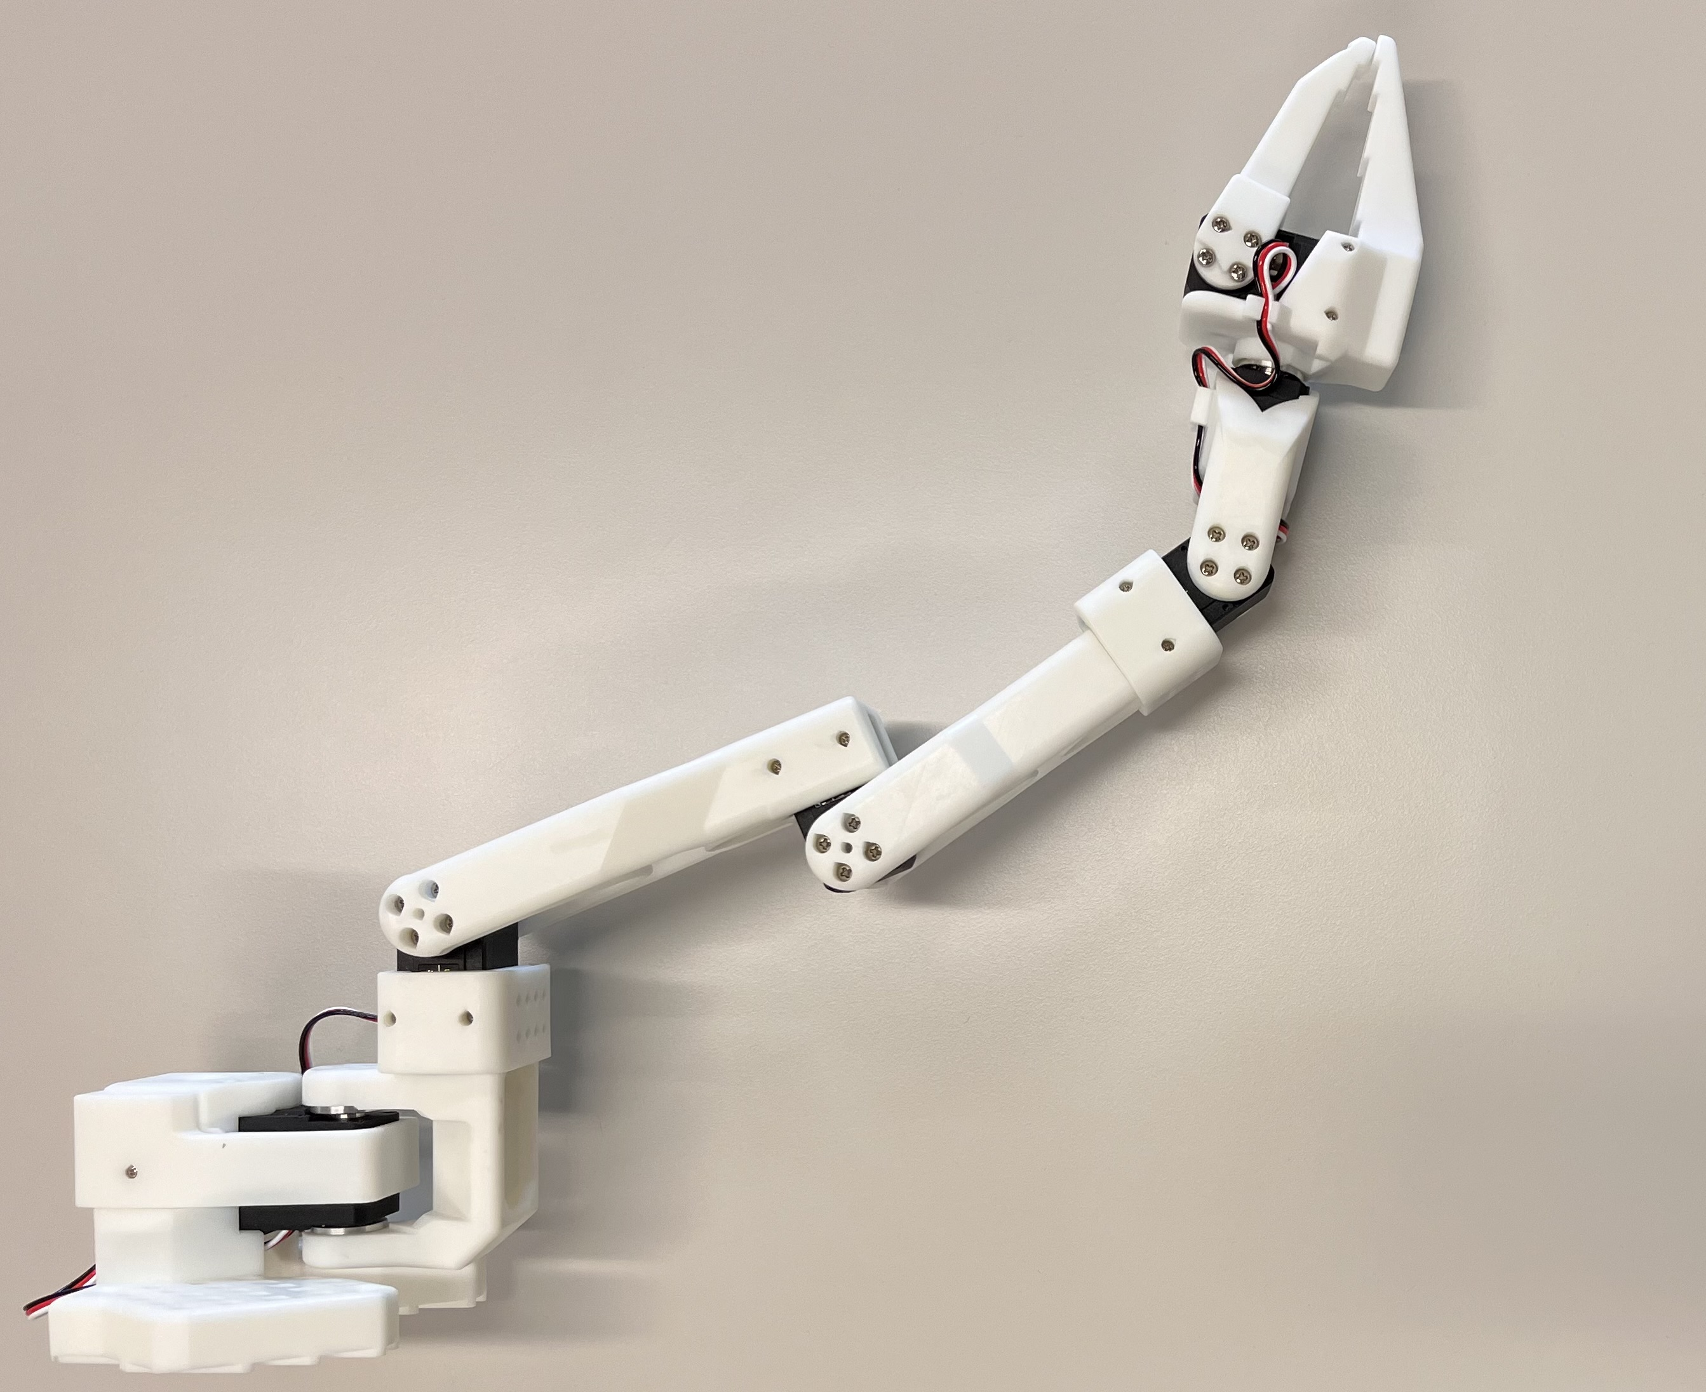
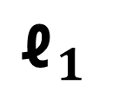

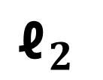
$${\text{ℓ}}_{3}$$
$${\text{ℓ}}_{1}$$
$${\text{ℓ}}_{2}$$

