Slide 1
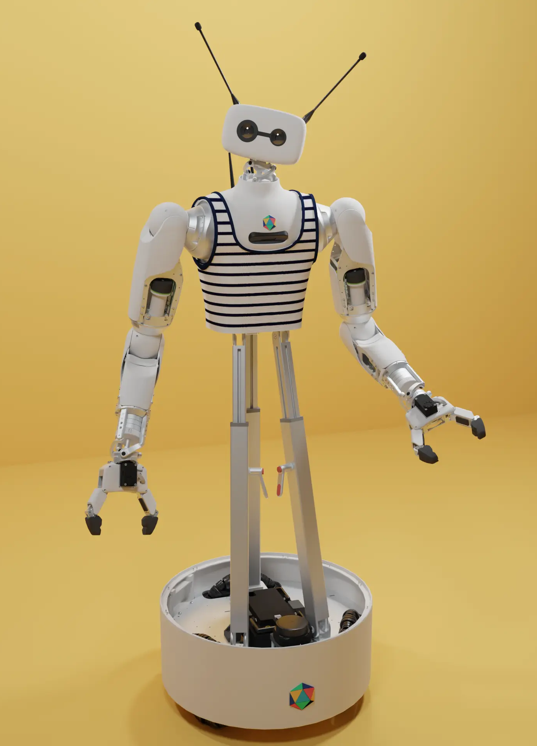
PRIVATE PARTNERSHIP PROPOSAL
Physical AI
Engineering
Measure, Place, and Govern
Closed-Loop AI Systems
Prepared for Arduino and Qualcomm
Curriculum · labs · reference system · executive technical leadership
Vijay Janapa Reddi · Harvard University
Notes:
Open with the problem and the discipline, not the products. This is a private consulting proposal for jointly developing the curriculum, reference implementation, and release program.

Slide 2
THE PREMISE
A learned policy is not yet
a physical system.
The difficult work begins when inference receives authority over a body, acts into a changing world, and must live with what happens next.
WORLD MOVES
KNOWLEDGE STALES
ACTION CHANGES THE NEXT INPUT
02
Notes:
The curriculum starts from a constraint. Closed-loop systems pay costs that decoupled AI can ignore. Let this statement land before introducing the proposed discipline.

Slide 3
THE GAP
The missing engineering layer
Training explains the model. Deployment demands the system around it.
PHYSICAL AI
ENGINEERING
LEARNED POLICY
PHYSICAL CONSEQUENCE
A black-box component
with measurable properties
→
→
A body acting in real time
and human space
Measure the running loop
Place capability against budgets
Govern delegated authority
03
Notes:
Name the white space as the subject of the engagement. The curriculum does not teach model internals. It teaches the coupling, placement, measurement, and authority system around the model.

Slide 4
THE DISCIPLINE
Two constraints organize the field.
01 FEEDBACK
02 DELEGATION
Can the system remain
correct while the world moves?
Can the system be trusted
with authority in human space?
Freshness · estimation · delay
stability · placement · recovery
Safety · privacy · consent
inspectability · human approval
The curriculum joins both without pretending one explains the other.
04
Notes:
This two-axis framing keeps governance intellectually honest. Feedback concerns dynamics. Delegation concerns authority. The capstone requires evidence on both.

Slide 5
GRADUATE CAPABILITY
Seven verbs define the discipline
The learner graduates with repeatable engineering actions, not product familiarity.
FRAME
DESIGN
GROUND
MEASURE + PLACE
ASSURE
SUPERVISE
DIAGNOSE
Every chapter builds one capability. The capstone demands evidence for all seven.
05
Notes:
These verbs are the curriculum spine and the evaluation language. They also give partners a durable vocabulary that survives any single board or robot generation.

Slide 6
THE GRADUATE PROMISE
A graduate can take a physical-AI problem they have never seen and defend the whole system.
01
Architect
a continuous system
02
Measure
the running loop
03
Place
each capability against a fixed budget
04
Assure
safe state and on-device privacy
05
Supervise
human teaching and approval
06
Diagnose
world-induced failure
06
Notes:
This is the outcome statement behind the engagement. The promise is intentionally stronger than completing a collection of tutorials. The learner must defend choices with evidence.

Slide 7
CURRICULUM ARCHITECTURE
Thirteen chapters. Six balanced parts.
The sequence moves from the feedback constraint into delegated authority and a defended capstone.
I
THE DISCIPLINE
2 chapters
II
MEASURING + RUNNING
2 chapters
III
CLOSING THE LOOP
4 chapters
IV
THE WHOLE SYSTEM
2 chapters
V
INTO A HOME
2 chapters
VI
DEFEND THE SYSTEM
1 capstone
07
Notes:
The current Quarto site still reflects the older structure. This is the canonical partner-facing architecture. The detailed drafting blueprints and site migration are the next content task.

Slide 8
THE DELIVERY SYSTEM
Two artifacts. Evidence in every lab.
REACHY
UNO Q
EVIDENCE
makes consequence felt
makes mechanism reproducible
makes decisions inspectable
The scene, stakes, and honest system limits.
One board exposes the MPU–MCU handoff.
Every lab records its setup, uncertainty, result, and decision.
Measurement stays inside the work.
08
Notes:
This is the hinge of the pitch. Reachy recruits and grounds. UNO Q reproduces the mechanism. Measurement remains inside every lab and the reference runtime rather than becoming a third product.

Slide 9
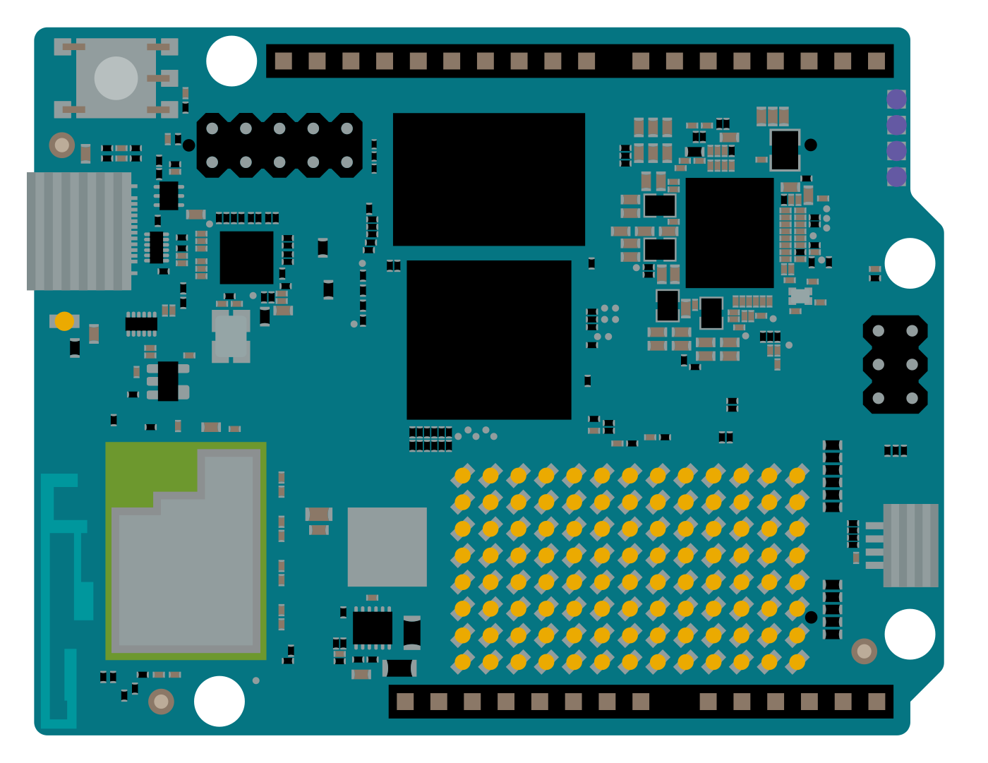
REFERENCE ARCHITECTURE
UNO Q makes the boundary teachable
The board already places high-level computing and real-time control in separate processing domains.
MPU
Qualcomm Dragonwing
QRB2210
Debian Linux · perception · reasoning · services
MCU
STM32U585
Arduino Core on Zephyr · real-time I/O
Sources: Arduino UNO Q documentation and user manual; Qualcomm UNO Q developer page.
09
Notes:
Do not claim that the UNO Q is a certified safety architecture. The curriculum uses the existing dual-domain topology as a teaching implementation for a measured propose-and-dispose boundary.

Slide 10
PEDAGOGICAL INVARIANT
Every lab ends in a decision
A visible effect recruits attention. Measurement disciplines it. The decision turns evidence into engineering.
01
02
03
VISIBLE SIGNAL
→
DEFENSIBLE NUMBER
→
ENGINEERING DECISION
Make an invisible property physically observable.
Define, calibrate, measure, and report uncertainty.
Keep, reject, or re-place part of the system.
The lab is not complete when the code runs.
10
Notes:
This invariant is the quality bar for the curriculum. It separates a serious engineering program from a collection of demos.

Slide 11
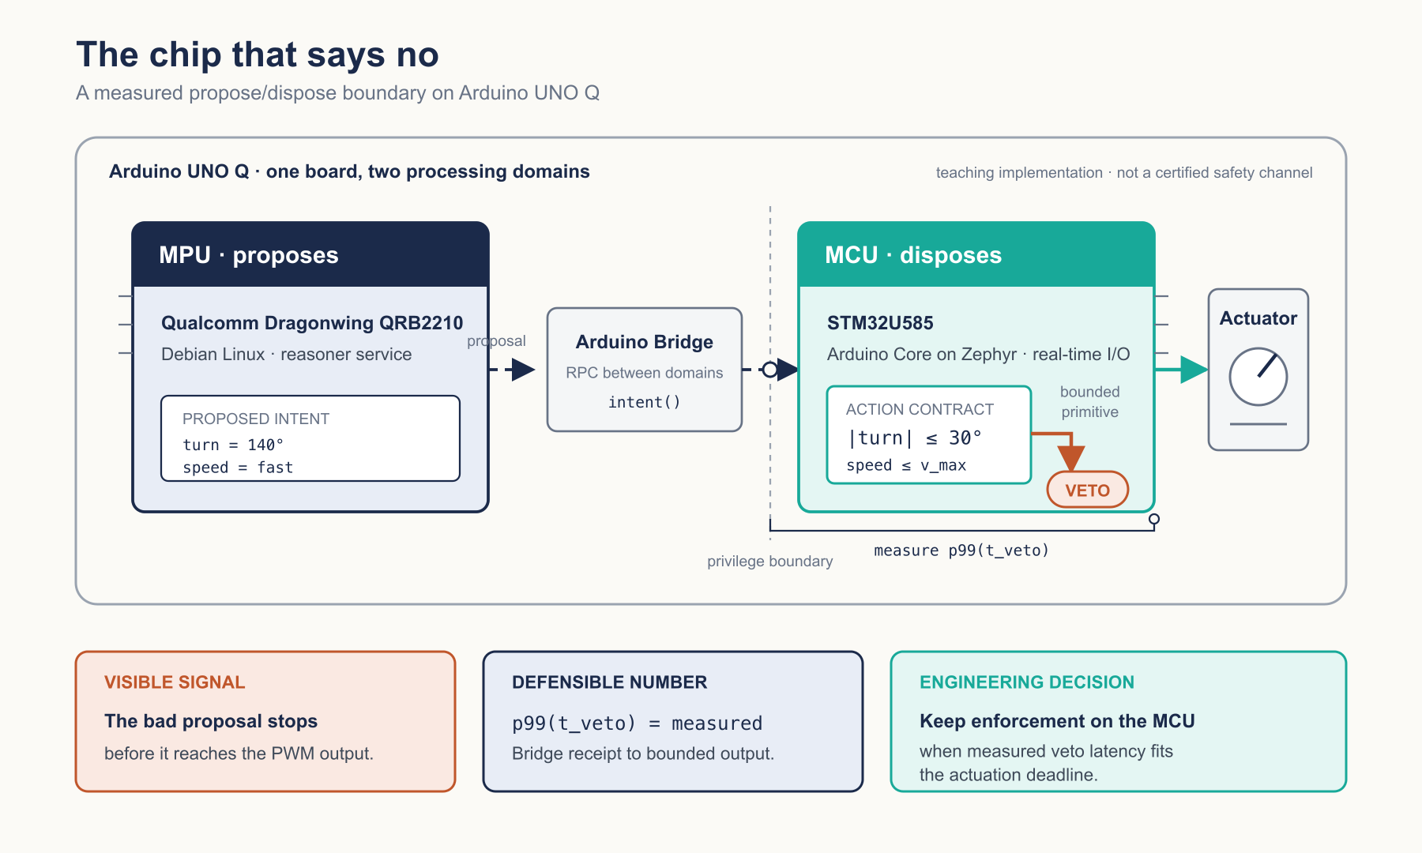
FLAGSHIP DEMONSTRATION
A proposal is not an action
Teaching implementation. No benchmark result is asserted; veto latency is measured in the lab.
11
Notes:
Walk left to right. The MPU proposes intent. The MCU disposes within an action contract. A bad proposal becomes a visible veto. The lab measures Bridge receipt to bounded output and uses the measured tail to defend placement.

Slide 12
EMBEDDED MEASUREMENT
Every lab leaves
an evidence trail
veto-latency / evidence record
$ define event_A
Bridge receipt
$ define event_B
bounded MCU output
$ collect trials
calibration recorded
$ report
p50 · p95 · p99
uncertainty · regime
Reusable instrumentation belongs to the growing runtime. Every lab defines its events, records calibration, and reports uncertainty.
The harness serves the reference system,
not a separate software product.
12
Notes:
The curriculum carries a common evidence format without promising a standalone measurement product. The slide shows the measurement contract and reporting shape embedded in each lab.

Slide 13
RELEASE MODEL
Each release is a complete learning unit
Partners review a coherent package, not isolated manuscript pages.
01
CHAPTER
A precise narrative and detailed section architecture.
02
LAB
A reproducible manifestation on UNO Q, with Reachy where consequence matters.
03
FIGURE SET
Clean SVG mechanisms, measured plots, tables, and callouts.
04
EVIDENCE CARD
Definitions, uncertainty, result, and the engineering decision it supports.
13
Notes:
The cadence is staged by completed learning units. Dates and volume commitments are intentionally left for scoping. The review object is substantial enough for technical and editorial feedback.

Slide 14
CONTROLLED PARALLELISM
Build in waves, then reconcile
Parallel chapter production becomes safe after every chapter has a canonical production packet.
WAVE 1
WAVE 2
WAVE 3
WAVE 4
Manifesto · Quickstart · Chapters 1–4
Chapters 5–8
Chapters 9–12
Capstone · appendices · whole-book audit
REVIEW + RECONCILE
REVIEW + RECONCILE
REVIEW + RECONCILE
REVIEW + RECONCILE
No fixed calendar is proposed before scope, review depth, and hardware access are agreed.
14
Notes:
This answers the parallel-generation question. We can parallelize within waves once the production packets, cumulative runtime state, and terminology are locked. Reconciliation is part of every wave.

Slide 15
VALUE FOR ARDUINO
Give UNO Q a teachable
physical-AI identity
A reference architecture
The dual-domain boundary becomes a recurring engineering pattern.
A cumulative build
One runtime grows across the curriculum instead of resetting every chapter.
A release program
Each chapter brings a lab, figure set, and measurable decision.
The board is not a sponsor placement. It is where the mechanism becomes reproducible.
15
Notes:
The Arduino value is a rigorous learning identity for the UNO Q. Avoid making adoption or sales claims. The concrete deliverable is a coherent reference architecture and release program.

Slide 16
VALUE FOR QUALCOMM
Teach engineers to place
Dragonwing inside a governed loop
QUALCOMM DRAGONWING
QRB2210
high-level compute
inside a measured boundary
01
Make edge AI placement measurable, not rhetorical.
02
Connect high-level compute to real-time control through an explicit contract.
03
Create technical curriculum that travels from education into practice.
Platform facts: Arduino and Qualcomm UNO Q documentation.
16
Notes:
The Qualcomm value is technical literacy around placement and governed handoff. Avoid promises about workforce pipelines or market leadership. The engagement can demonstrate a credible pattern on current hardware.

Slide 17
ENGAGEMENT STRUCTURE
A bounded consulting partnership
The first scope aligns deliverables, review authority, hardware access, and rights before production accelerates.
DELIVERABLES
TERMS TO DEFINE TOGETHER
Narrative and curriculum architecture
Book chapters and release editing
UNO Q labs and reference implementation
Embedded measurement and evidence records
Executive technical leadership
Authorship and attribution
Preexisting and newly created IP
Hardware-specific contributions
Branding, reuse, and licensing
Review process and acceptance
Commercial scope and legal terms follow the agreed deliverables. This deck does not set them.
17
Notes:
This is private consulting. The valuable package is larger than a manuscript. The next conversation should define the deliverable matrix, review obligations, and ownership posture before attaching a fee or calendar.

Slide 18
THE ASK
Define the first proof
together.
A joint working session to align the narrative, select the first complete release, and scope the private consulting engagement.
01
Lock the canonical curriculum
02
Choose the flagship release
03
Define scope and terms
Physical AI Engineering
Vijay Janapa Reddi · Harvard University
Notes:
End with a low-risk, concrete next step. The requested commitment is a working session, not agreement to an undefined scope. Propose the session while the team is in the room.

