Slide 1
Introduction to PDF Raster
Jon Harju
Chair TWAIN Working Group, CTO Visioneer
May 16, 2017
Notes:
My name is Jon Harju, I have been in the document imaging industry roughly 23 years, specializing in scanner drivers and scanning applications. I am presently CTO at Visioneer, a scanner company and since December of 2015 I have been Chairman of the TWAIN Working Group, an organization I’ll describe in a moment. I’m here to talk to you about a specialization of PDF that may interest you and explain how we got there.

Slide 2
Agenda
What is TWAIN and Who is the TWG?
Why PDF/raster?
What is PDF/raster?
When, Where can I get it?
Notes:
Last year my colleague Rene Rebe was here and introduced the work we were doing and I am here this year to go over the major details and review the final product with you.
I plan to discuss the important points, who, why, what where and when

Slide 3
What is TWAIN and Who is the TWG?
Notes:
What is…? Who is…?
TWG shortform should not to be confused with the PDF association Technical Working Group

Slide 4
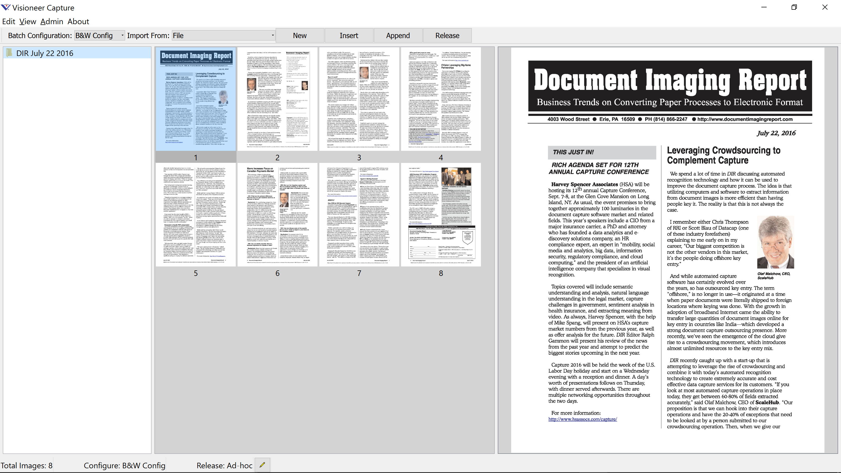

What is TWAIN and Who is the TWG?
Notes:
It’s safe to say, if you use scanners connected to a desktop computer, you have probably used TWAIN at some point.
TWAIN is a royalty free open standard protocol that facilitates communication between Image Capture Applications and Image Capture Devices
The TWAIN Working Group is the not for profit organization responsible for maintaining and improving the TWAIN standard

Slide 5














Notes:
The TWAIN Working Group membership is made up of commercial scanner hardware and software vendors and here is the present roster of companies.

Slide 6
Why PDF/raster?
Notes:
So what drove the need for PDF raster? To explain I have to take a step back to recent TWAIN Working Group activities. Besides maintaining the current standard, the group has been busy looking ahead to the future.

Slide 7


TWAIN Direct Goals
Driverless
Network Scanning Protocol/Language
Simplified application development
Best user experience
Notes:
The future is Mobile and Cloud ... primary influence of a new standard called TWAIN Direct.
Conversation was with a driver
With IOT, everything is a network appliance… Every interesting platform… network interface
To promote adoption and robust scanning solutions we focused on making it easy for app devs.
To achieve the best possible user experience, the protocol has been designed with success as the default outcome.
No matter the settings or the scanner capability - the user will get an image.
For example: we completely abandoned the property get / set interrogation style model of current protocols and moved to an intent based job description language – by default settings are merely suggestions so if any setting cannot be met the scanner does best guess… job requests 240 DPI but scanner can do 200 result will be 200. 9 out of 10 users will be fine with this, the 1 in 10 user will figure out they picked the wrong tool for the job. Neither user will be confronted with a cryptic TWAIN Error / or classic TWAIN Bummer Error… it is still possible to fail, but the person creating the job has to go out of their way to make that happen.

Slide 8


Data Format Goals
Transfer fully formed files
Uncompressed raster image data
Common scanner compressions
Secure
Notes:
So I’m not here to focus on TWAIN Direct...
Key to any imaging protocol design (Star of the show) is the image data and the image data format.
Experience led us to decide that our new protocol would transfer fully formed files. In the past…
To select a file format it would have to support uncompressed scanner image data and common scanner compressions.
Given our cloud and network focus, we also recognized that security was important.
We immediately narrowed the options to TIFF and PDF. Spoiler alert - PDF was selected – but I just wanted to quickly walk you through some of the reasons for this choice.

Slide 9
TIFF
Pros
Supports req’d data formats
Well known
Cons
Not actively maintained
Ongoing B&W Pixel Gender
Ongoing JPEG reader support
No standard Encryption / Signing support
No native support on popular mobile platforms
Meta data typically stored in separate files
Notes:
We did a quick pro/con analysis of both formats…
TIFF supports all our required image data formats and it is very well known.
On the negative side, TIFF is not an active or evolving standard.
We have ongoing negative user experiences like inverted B&W images and failure to read some JPG encoded files.
Likely related to the fact it is not active or evolving, there was also no standard encryption.
It is not supported natively on popular mobile platforms
Lastly capture solutions require meta data which is typically stored in a separate files creating some challenges keeping an image file together with related meta data.

Slide 10
PDF
Pros
Supports req’d data formats
Well known
Active and evolving standard
Standard Encryption / Signing support
Native support on popular mobile platforms
Embedded meta data
Cons
Too many features
Notes:
PDF had many more pros, data formats supported, well known.
It is an active and evolving with standard encryption and signing support.
From a user experience point of view, there is native support on the most popular mobile platforms.
Standard support for embedded meta data solves the problem of keeping image and meta data together.
The downside we found was that PDF is too robust with many rich content possibilities.

Slide 11
What is PDF/raster?
Notes:
So this was the process that led us to desire a specialized version of PDF to be used at the point of digitization of digital documents.
We knew PDF would result in the best user experience, but many point of capture implementers might find it very intimidating if we didn’t set some boundaries.
Please recall – I am scanner protocol expert, I assume you all have a level of PDF knowledge greater than mine and I may have to lean on my colleague to answer detailed questions but here are the highlights!

Slide 12
PDF/raster
100% Compatible with any PDF Reader
Lightweight writer/reader
Security features
Encryption
Signing
Notes:
PDF raster is a highly restricted version of PDF for scanners that is fully compatible with any PDF reader.
Because of the restricted and predictable nature, it is possible to read and write with very lightweight code footprint.
Since data would now be travelling through the cloud, it was critical to retain the signing and encryption features.
After meeting Duff at HSA a few years ago, we embarked upon a co-design activity with the PDF Association with the intent of making it an ISO standard
From here I will dig into the nuts and bolts of the specification.

Slide 13
Identification and Version
PDF-raster-x.y
trailer
<<
/Info 58 0 R
/Size 59
/Root 1 0 R
/ID
[ <D7916DF85B0EE1998036EA145A1CE7B4>
<D7916DF85B0EE1998036EA145A1CE7B4>
]
>>
%PDF-raster-1.0
startxref
177317
%%EOF
Re-save becomes regular PDF
Notes:
Most of the PDF raster specification is documenting restrictions.. The single new concept is an additional mark we require.
This mark is a comment containing PDF raster, safely inserted right before the last startxref entry.
We are confident this benign and will be discarded if the file is edited by a non-PDF raster aware processor ending it’s existence as a PDF raster

Slide 14
PDF Subset - Unencrypted
Header
%PDF-1.4
%PDF-1.5
%PDF-1.6
%PDF-1.7
Filter
FlateDecode
CCITTFaxDecode (only for bitonal images)
DCTDecode (only for 8-bit grayscale or RGB images)
Notes:
For an unencrypted PDF it is possible to create valid PDF raster files using features only described in 1.4

Slide 15
PDF Subset - Encrypted
Header
%PDF-2.0
Filter
FlateDecode
CCITTFaxDecode (only for bitonal images)
DCTDecode (only for 8-bit grayscale or RGB images)
Crypt
Notes:
For an encrypted PDF it was decided to follow the latest version of the standard and pickup all the security best practices

Slide 16
PDF Subset – Unencrypted and Encrypted
All indirect references shall refer to valid objects.
Stream dictionaries shall not contain a Type key with a value of ObjStm.
Notes:
I hope this is normal for all PDF’s but all indirect references must refer to valid objects.
Use of object streams are forbidden, the PDF processor can find all the objects without additional decoding.

Slide 17
Catalog Dictionary
Entries required by ISO 32000-1, Table 28
Optional entries:
Version, ViewerPreferences, PageLayout, PageMode, AcroForm, and Metadata
Notes:
Type and Pages required
May contain version, viewer preferences, page layout, page mode, form information and metadata – these may be useful but can be ignored by a viewer that is only interested in accessing the raw scanned data.

Slide 18
Metadata
Catalog dictionary
Page dictionary
http://ns.twain.org/ns/pdfraster/v1/extra_metadata
http://ns.twain.org/ns/pdfraster/v1/some_other_fields
http://ns.some_company.com/ns/pdf_raster/version_1/company_specific_fields
TWAIN Metadata defined separately
Document information dictionary
Creator, Producer, CreationDate, ModDate
Notes:
Document level meta data is in the catalog dictionary while page level meta data is found in the page dictionary – maybe anything already defined by ISO 32000-1 or custom using a namespace.
TWAIN specific meta will use a namespace and will be documented separately with the TWAIN Direct specification.
A document information dictionary may exist containing Creator, Producer, CreationDate and Modified Date – if it exists the corresponding document level xmp meta data will exist

Slide 19
Page Objects
Each Image is a Page Object
Entries required by ISO 32000-1, Table 30
Optional entries:
Contents, Rotate, Metadata, Annots, and PZ
Notes:
Required entries are Type, Parent, LastModified, Resources
Optional entries with some restrictions described later, again have no impact on the interpretation of the raw image data

Slide 20
PageObject - highlights
PageTreeNodes - No inheritance
MediaBox – Size before rotation
Annots – Only digital signatures, no visual
Resources – Dictionary of “stripx” Xobjects
Rotate – only page object, not nodes
Contents – single stream, Do, as-is, Intent
q, Q, cm, Do
Notes:
Mediabox is the size before rotation
Annots only type digital signature and no visual representation
Resources contain dictionary of Xobjects - First strip is called Strip0, followed by Strip1 and so on… order of appearance is dictated by name
Rotate may be found in Page Object but not the Page Tree Nodes
Contents stream only draws the strips as-is – no clipping or masks, or inline images

Slide 21
Strips
XObject Image dictionaries containing only
Type, Subtype, Length, Filter, DecodeParms, Width, Height, ColorSpace, BitsPerComponent and Intent
Bitonal, Grayscale or RGB
XRes and YRes may differ
Risk of gaps in non-PDF/raster aware viewers
Notes:
All strips of a page image will have the same width
Data shall be bitonal, grayscale or RGB
X and Y resolution may differ from each other
Xres and Yres of all strips in a page image is the same

Slide 22
Strips - Bitonal
Bitonal
BitsPerComponent 1
Colorspace DeviceGray or CalGray
Gamma 2.2
BlackIs1 = false, Decode = [0.0 1.0]
Filter NULL or CCITTFaxDecode
Notes:
BlackIs1 is false or not present
Filter is uncompressed or CCITTFaxDecode

Slide 23
Strips - Grayscale
Grayscale
BitsPerComponent 8 or 16
Colorspace CalGray + Gamma 2.2
Filter NULL or DCTDecode for 8 bit
Filter NULL for 16 bit
Notes:
DCTDecode is not supported for 16 bit data

Slide 24
Strips - RGB
RGB
BitsPerComponent 8 or 16
Colorspace ICCBased or CalRGB
Filter NULL or DCTDecode for 8 bit
Filter NULL for 16 bit
Notes:
16 bit data is uncompressed

Slide 25
Incremental Updates
Only permitted for multiple Digital Signatures
Notes:
Incremental updates are supported only for the purposes of allowing multiple digital signatures.
It was agreed that we may have a document signed at the scanner by both the company that owns the equipment and the operator

Slide 26
Encryption
Encrypt Dictionary
Security handler and AES algorithm and key length of 256
V key value shall be 5

Slide 27
Short distance to PDF/A
use CalGray for bitonal images
Add document level XMP metadata + PDF/A part number
Unencrypted only

Slide 28
Challenges
A little harder to parse
Light weight Reader / Writer code from TWG
Strips and Gaps
Specialized / PDF raster aware readers
Resolution must be calculated
XRes = 72 * 1st strip width / mediabox width
YRes = 72 * total height / mediabox height
Notes:
When compared to TIFF, PDF raster is a little harder to parse
To compensate the TWAIN Working Group is providing light weight reader and writer code
A non-PDF raster aware processor may render gaps between strips.
Strips in PDF/raster is a very specialized case (very long documents or low memory scanners) and a PDF/raster aware processor can easily turn into a single strip at earliest opportunity without gaps.
Resolution must be calculated using width of the first strip and height of all the strips

Slide 29
When, Where can I get it?
Notes:
So where to I get it?

Slide 30
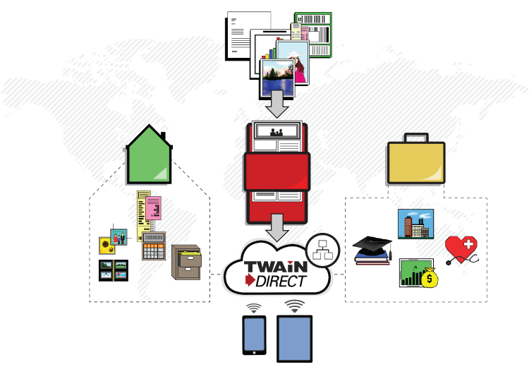

Notes:
PDF is now an integral part of the future TWAIN standard.
Future TWAIN software will have to produce and/or consume compliant PDF/R files in order to be declared TWAIN Direct Compliant.

Slide 31
Schedule
TWAIN Local
By Mid-2017
TWAIN Direct on TWAIN
By Mid-2017
TWAIN Cloud
By 2017 Year End
Notes:
TWAIN Local for scanning over local area networks is scheduled for mid-2017 launch
TWAIN Direct on TWAIN bridge technology will be available at the same time to enable application developers to work with existing scanners.
TWAIN Cloud will be available by the end of the year.

Slide 32
Replace TIFF?
PDF/raster has all the familiar benefits of TIFF
PDF/raster supports encryption, digital signatures and embedded meta data
PDF/raster will continue to evolve
PDF/raster is the onramp to rich PDF content
Notes:
For point of capture, PDF/raster has all the familiar benefits of tiff
PDF/raster has all the encryption, signatures and embedded meta data
Unlike TIF, PDF/R will continue to evolve to meet the needs of modern scanning solutions
Best of all PDF raster is an onramp for rich PDF content later it the workflow process.

Slide 33
For More Information…
Visit our web sites at:
www.twain.org – www.twaindirect.org – www.pdfraster.org
Contact:
Erin Dempsey at erin.dempsey@twain.org
Jon Harju at jharju@visioneer.com
Notes:
PDF/R and TWAIN Direct for Local Area Networks is scheduled for release on July 1st. The documentation is going through IP review at the moment so keep any eye on our websites for updates and previews…
Feel free to contact Erin or me by email or better yet feel free to catch up with me later.
Thank you and that’s all I have for now!
Really want to take a moment to thank everyone who helped out from the PDF Association
Duff Johnson
Olaf Drummer
Roman Toda encryption etc…

