Slide 1
CS181: Introduction to
Machine Learning
Lecture 22 RL Part II
Spring 2021
Finale Doshi-Velez and David C. Parkes
Harvard Computer Science
Notes:
1
introductions

Slide 2
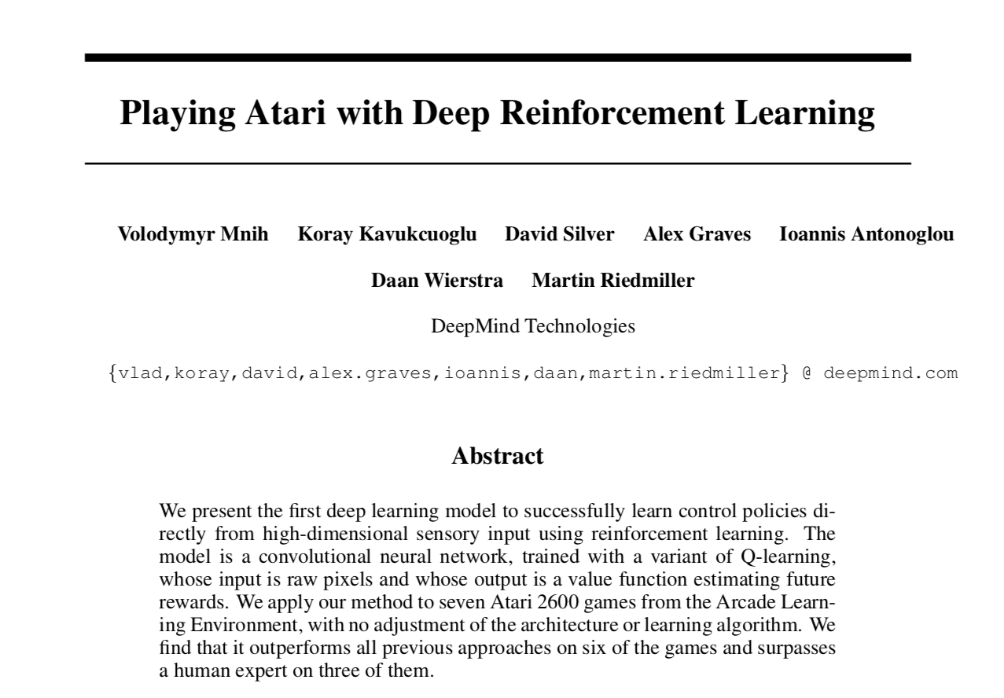

Slide 3
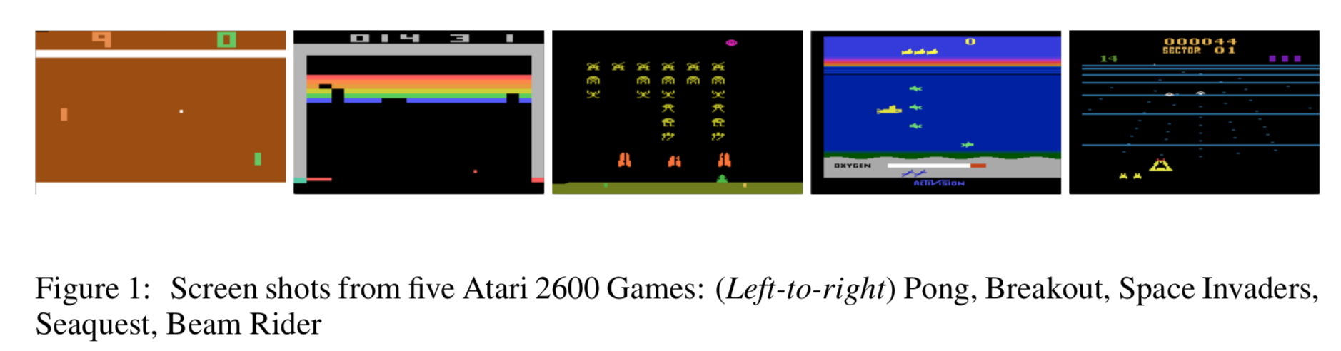

Slide 4
Breakout

Slide 5

Notes:
AlphaGo - The Movie (2018)

Slide 6
The Challenge

Slide 8
The Madness

Slide 9
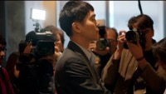

Slide 10
Move 37

Slide 12
Something changed

Slide 14
The Tragedy

Slide 16
Lee Sedol Win

Slide 18
The Final Game

Slide 20
Reflection

