Slide 1
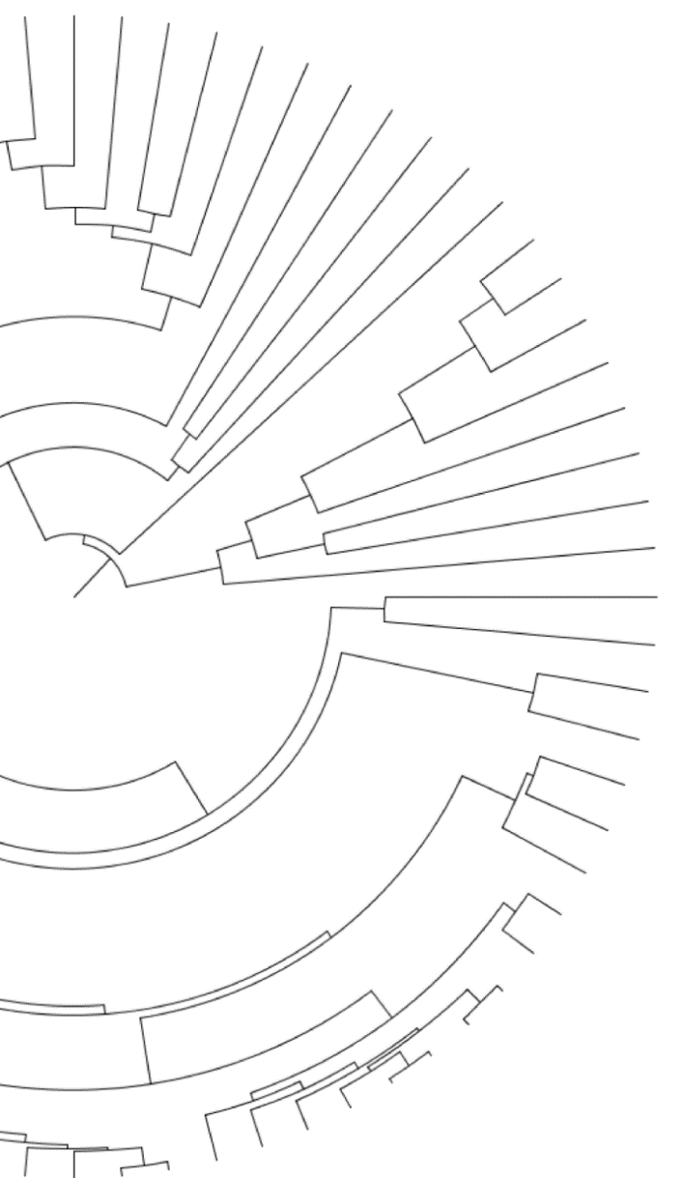


Quantifying and mitigating reference bias in comparative genomics
Gregg Thomas
gwct.github.io
Notes:
Hi everyone, my name is Gregg Thomas and I’m currently in the informatics group at Harvard. So I’ll be talking about some of the ways we’re using phylogenetic concordance factors to help us select which models to run when estimating substitution rates from genomic data.

Slide 2

Genomics is good and cheap and lets us do lots of things
ATCATCGAAGGTA
Notes:
So, one of the exciting opportunities in the age of genomics is the ability to link genotype to phenotype… that is to see which elements of an organism’s genome may affect the traits we observe. And genomes from a single species give us a lot of opportunities to do this.
Just to name a couple, this has been done successfully to study adaptations to high altitude in humans and coat color change in rodents.

Slide 3
Read mapping is one of those things and is common

Slide 4
Read mapping has drawbacks

Slide 5
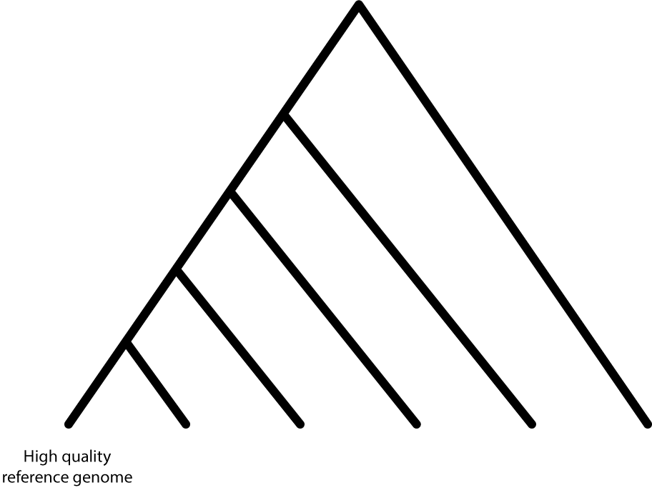
Does read mapping capture all the variation we want it to?
Notes:
But another powerful method for relating genotype to phenotype is comparative phylogenomics, where we compare genomes from many species to identify where they differ from one another and correlate those differences with variation we observe in their phenotypes, such as loss of flight in certain birds.

Slide 6
Probably not

Slide 7
This is known as reference bias, this is why we think it happens, but we really don’t know a lot about it

Slide 8
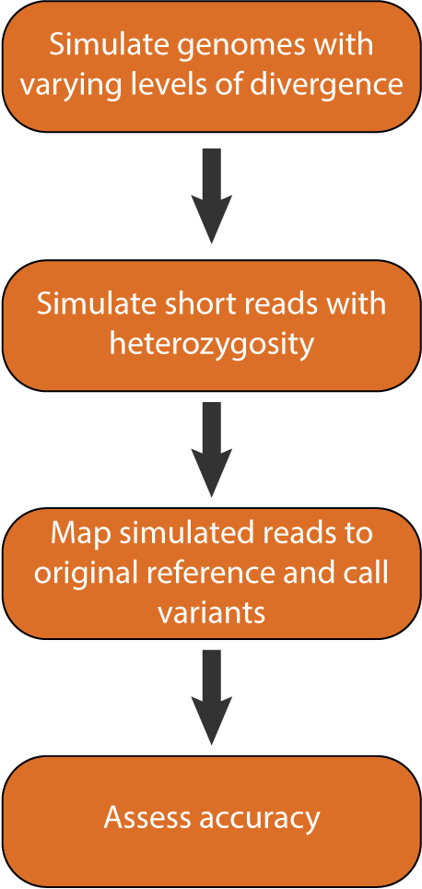
Read simulations
0.02, 0.04, 0.06, 0.08, 0.10
30X coverage,
0.005 heterozygosity
BWA, GATK

Slide 9
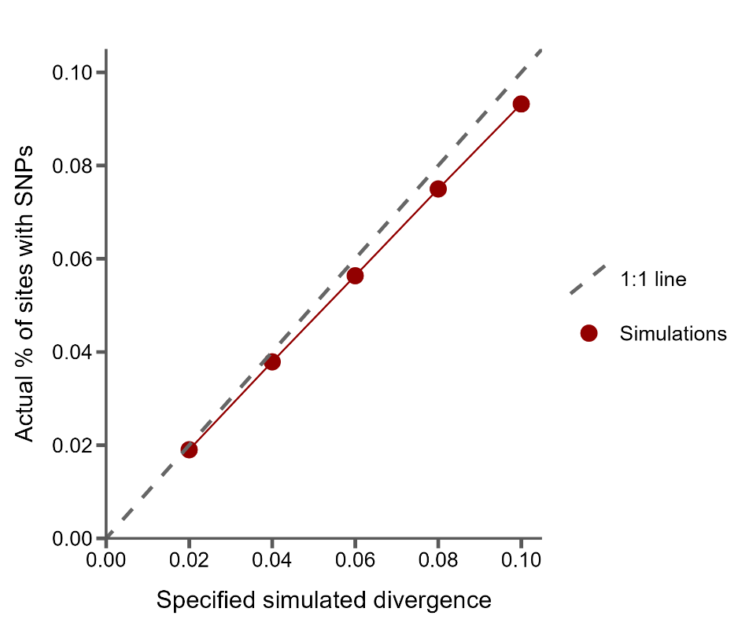
Sanity check: the % of SNPs simulated tracks specified divergence
However, with increasing divergence, fewer SNPs than expected are simulated
Possibly due to double hits

Slide 10
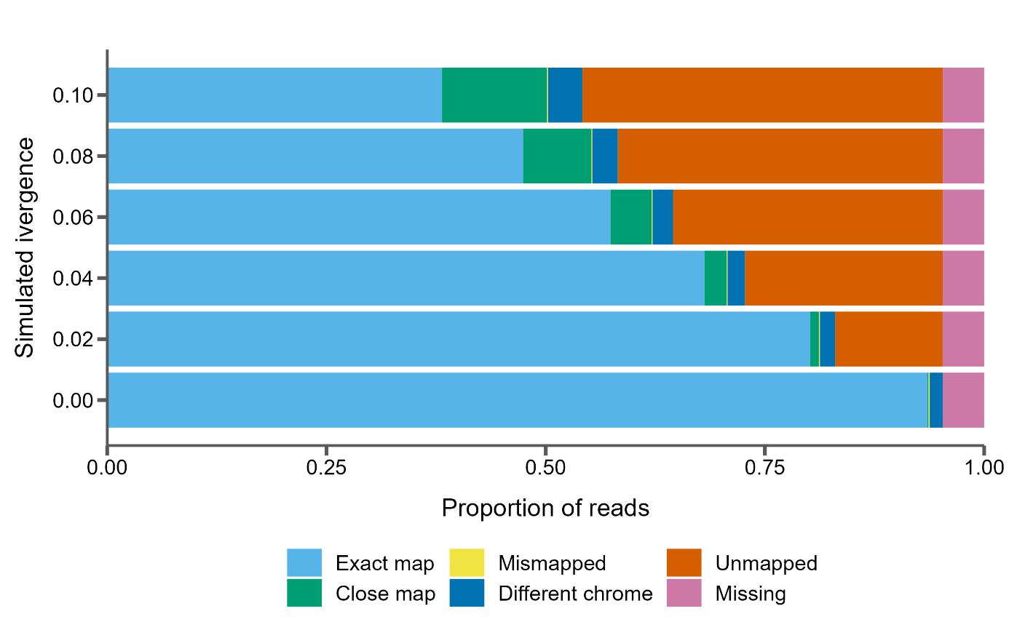
The proportion of unmapped reads scales linearly with divergence
However, with increasing divergence, fewer SNPs than expected are simulated
Notes:
Keep simulated divergence 0?
Chrome?

Slide 11
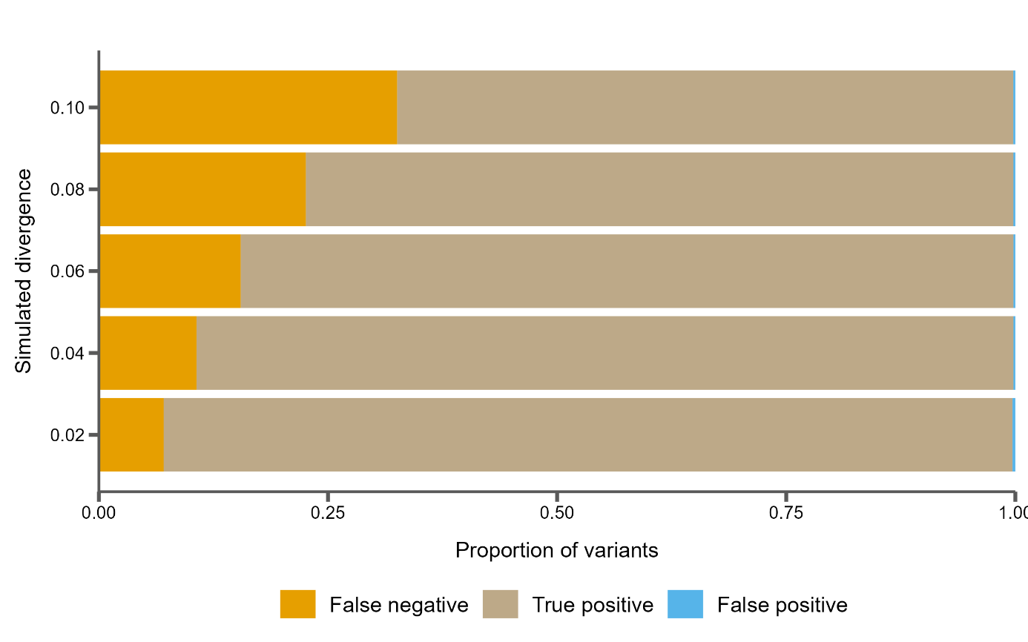
Consequently, variants are increasingly not called
However, with increasing divergence, fewer SNPs than expected are simulated
Notes:
Keep simulated divergence 0?
Chrome?

Slide 12
Iterative mapping to mitigate the effects of reference bias
However, with increasing divergence, fewer SNPs than expected are simulated
Notes:
Keep simulated divergence 0?
Chrome?

Slide 13
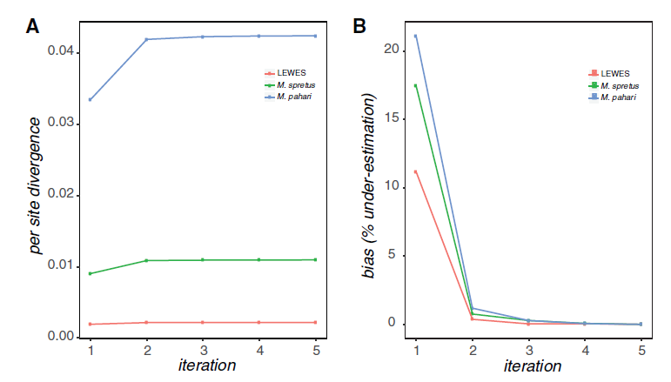
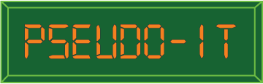
Iterative mapping to mitigate the effects of reference bias
Source: Sarver et al. 2017, GBE
Notes:
Keep simulated divergence 0?
Chrome?

Slide 14
Read simulations
0.02, 0.04, 0.06, 0.08, 0.10
30X coverage,
0.005 heterozygosity
BWA, GATK

Slide 15
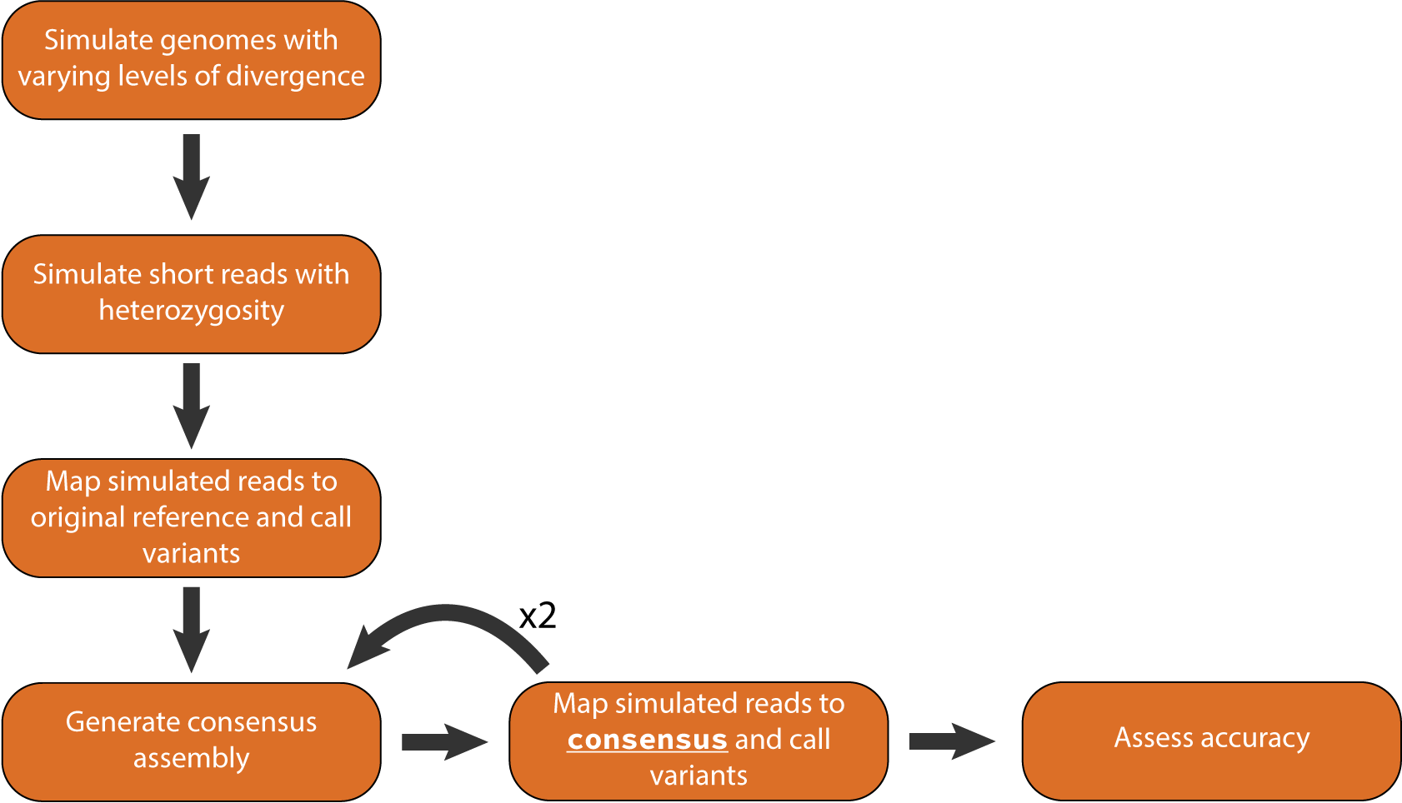
Read simulations with iterative mapping
0.02, 0.04, 0.06, 0.08, 0.10
30X coverage,
0.005 heterozygosity
BWA, GATK
bcftools
BWA, GATK, minimap2

Slide 16
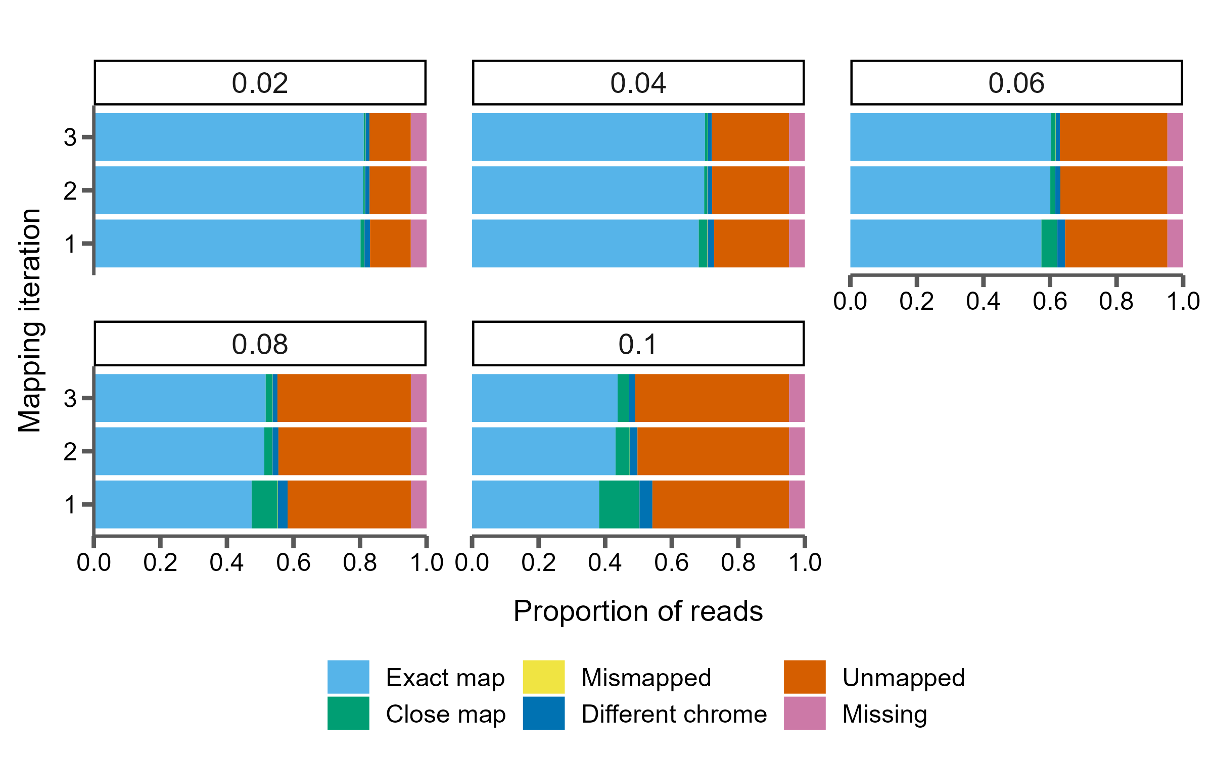
One extra iteration of mapping increases correctly mapped reads at high levels of divergence
However, with increasing divergence, fewer SNPs than expected are simulated
Notes:
Chrome?

Slide 17
One extra iteration of mapping increases correctly mapped reads at high levels of divergence
However, with increasing divergence, fewer SNPs than expected are simulated
Notes:
Chrome?

Slide 18
We show that an extra iteration of mapping might help at higher levels of divergence

Slide 19
And mapping to a genome graph is equivalent

Slide 20
Next
Long reads and mappers
Where are the false negatives (genes, repeats, etc.)?
Heterozygosity? Coverage? How do these things affect everything?

Slide 21





AACATCGGAGCCA
AACATCGGAGCCA
AACATCGGAGCCA
ATCATCGAAGGTA
GACGTCATAGCGC
= Flightless
Notes:
But another powerful method for relating genotype to phenotype is comparative phylogenomics, where we compare genomes from many species to identify where they differ from one another and correlate those differences with variation we observe in their phenotypes, such as loss of flight in certain birds.

Slide 22
AACATCGGAGCCA
AACATCGGAGCCA
AACATCGGAGCCA
ATCATCGAAGGTA
Accelerated
GACGTCATAGCGC
= Flightless
Accelerated
Notes:
And one way to do this is to look for specific parts of the genome that have a higher rate of substitutions in some species than in others. For example, in this cartoon the flightless ostrich and kiwi have accelerated rates of substitution for this element of the genome compared to these flying birds. This let’s us hone in on genomic elements that may play a role in this trait.
A lot of software does this in the context of coding sequences, where they compare synonymous to non-synonymous substitution rates to test for accelerated evolution. But this isn’t applicable to study regulatory regions which lack this natural comparison.

Slide 23
AACATCGGAGCCA
AACATCGGAGCCA
PhyloAcc v1
AACATCGGAGCCA
Hu et al. 2019
ATCATCGAAGGTA
Accelerated
GACGTCATAGCGC
= Flightless
Accelerated
Notes:
So a few years ago, the first version of our program, PhyloAcc, tried to address this in a Bayesian framework by using genome-wide estimates of neutral substitution rates as a baseline comparison for rates in non-coding regions. It then tests several models against each other to determine which elements have accelerated rates on which lineages.

Slide 24

PhyloAcc v1
Hu et al. 2019
283,369 non-coding loci
62 mammal species
2,106 loci accelerated in marine mammals
Hu et al. 2019
Notes:
And using this framework, an analysis of non-coding sequences found 2,106 elements accelerated in marine mammals

Slide 25
284,001 non-coding loci
42 bird species
806 loci accelerated in ratites
Sackton et al. 2019
Hu et al. 2019
PhyloAcc v1
Hu et al. 2019
283,369 non-coding loci
62 mammal species
2,106 loci accelerated in marine mammals
Hu et al. 2019
Notes:
And 806 elements accelerated specifically in flightless birds, reflecting that regulatory evolution may play a role in the convergence of traits associated with these lifestyles.

Slide 26
AACATCGGAGCCA
AACATCGGAGCCA
PhyloAcc v1
AACATCGGAGCCA
Hu et al. 2019
ATCATCGAAGGTA
Accelerated
GACGTCATAGCGC
= Flightless
Accelerated
Notes:
So the first version of PhyloAcc shows that we can expand our analysis of sequence evolution beyond coding regions, opening up a new window into regulatory elements in a phylogenomic workflow.
However, this method uses the same input species tree for every locus it tests.

Slide 27
AACATCGGAGCCA
AACATCGGAGCCA
PhyloAcc v1
Phylogenetic discordance poses a problem for inferring rates of molecular evolution
AACATCGGAGCCA
Hu et al. 2019
ATCATCGAAGGTA
Accelerated
GACGTCATAGCGC
= Flightless
Accelerated
Notes:
This can be a problem if the histories of the underlying loci differ from that of the species tree. This can cause problems for any inference of molecular evolution, so I want to briefly explain what I mean by phylogenetic discordance.

Slide 28
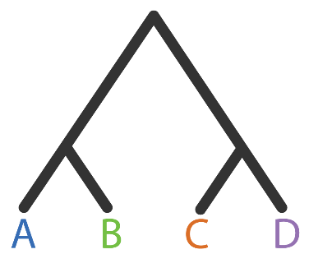
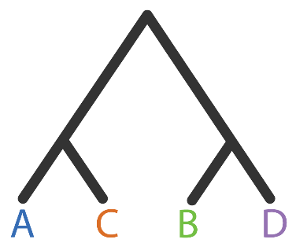
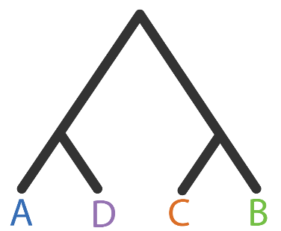
Phylogenies from different loci can disagree with each other
Gene tree 1
Gene tree 2
Gene tree 3
Notes:
So, in its most basic definition, phylogenetic discordance simply means that, for the same set of species, phylogenies inferred from different parts of the genome may disagree with each other. In this quartet example, we have three gene trees with discordant topologies. In the first tree A is sister to B, while in the second A is sister to C, and in the third A is sister to D.

Slide 29
Phylogenies from different loci can disagree with an inferred species tree
Concordant
Discordant 1
Discordant 2
Gene tree 1
Gene tree 2
Gene tree 3
Species tree
Notes:
Now, when we combine the information from all of our genes to infer a single species tree, we inevitably see discordance between that tree and many of the underlying gene trees. For instance, if we used some method to infer a species tree here and decide that this first tree’s topology matches species tree, the other two are then discordant with the species tree. So gene trees can be discordant among themselves and with the inferred species tree.

Slide 30


Mapping traits or variation onto a species tree from discordant loci can cause incorrect inferences
Species tree
Gene tree
Adapted from Mendes & Hahn 2016
Notes:
When this happens, mapping traits, including DNA sequences, onto discordant phylogenies can affect inferences about them.
For example, let’s say we have our species tree, and the gene tree from one locus for these species. These topologies disagree, with A and B being sister in the species tree and B and C sister in the gene tree.

Slide 31

Mapping traits or variation onto a species tree from discordant loci can cause incorrect inferences
Species tree
Gene tree
1 mutation on branch (B,C)
Adapted from Mendes & Hahn 2016
Notes:
Then at this locus we know there is a single mutation that has arisen in the branch leading to B and C, and here I’m just representing this mutation as a change in branch colors. This is, in truth, one mutation.

Slide 32
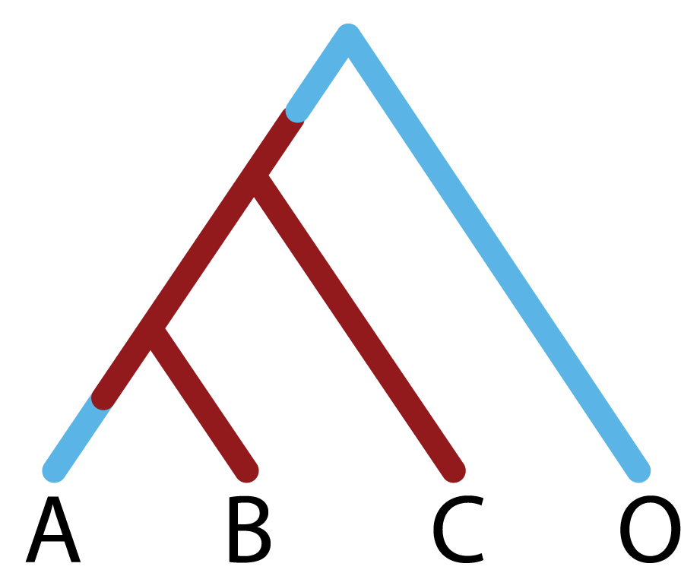
Mapping traits or variation onto a species tree from discordant loci can cause incorrect inferences
Species tree
Gene tree
1 mutation on branch (B,C)
Adapted from Mendes & Hahn 2016
Notes:
But then let’s say we try to make an inference about this mutation using the species tree. The only way to explain lineages B and C sharing this red state is to propose

Slide 33
Mapping traits or variation onto a species tree from discordant loci can cause incorrect inferences
Species tree
Gene tree
1 mutation on branch (A,B,C)
1 mutation on branch (A)
1 mutation on branch (B,C)
Adapted from Mendes & Hahn 2016
Notes:
Multiple mutations, for instance a mutation in the branch ancestor to A B and C, and then a reversion to the ancestral state on branch A.
Of course, we want to use the correct tree when making inferences, which is the gene tree in this context, but in a lot of cases it is still common practice to use a single species tree topology when counting substitutions along a phylogeny.

Slide 34
AACATCGGAGCCA
AACATCGGAGCCA
PhyloAcc v1
AACATCGGAGCCA
Hu et al. 2019
ATCATCGAAGGTA
Accelerated
GACGTCATAGCGC
= Flightless
Accelerated
Notes:
So this was part of the motivation for the next version of PhyloAcc, where instead of only considering the species tree,

Slide 35


AACATCGGAGCCA
AACATCGGAGCCA
AACATCGGAGCCA
Yan et al. in prep
ATCATCGAAGGTA
Accelerated
GACGTCATAGCGC
= Flightless
Accelerated
Notes:
We also estimate a distribution of gene trees for each locus to better account for phylogenetic discordance, which should improve accuracy when identifying elements with accelerated rates of evolution.

Slide 36
AACATCGGAGCCA
713 out of 806 originally found to be accelerated in ratites are still found when using the gene tree model
AACATCGGAGCCA
AACATCGGAGCCA
Yan et al. in prep
ATCATCGAAGGTA
Accelerated
GACGTCATAGCGC
= Flightless
Accelerated
Notes:
And we can already tell this method is having an affect on our results. As Han mentioned, when she re-ran this on the ratite dataset, only 713 out of the original 806 accelerated elements are still found to be accelerated when using the gene tree model. So accounting for discordance is hopefully eliminating these as false positives.

Slide 37
AACATCGGAGCCA
713 out of 806 originally found to be accelerated in ratites are still found when using the gene tree model
AACATCGGAGCCA
AACATCGGAGCCA
Gene tree models take much longer to run
Yan et al. in prep
ATCATCGAAGGTA
Accelerated
GACGTCATAGCGC
= Flightless
Accelerated
Notes:
However, unfortunately, as with most Bayesian phylogenetic methods, this takes much longer to run because we’re now having to infer gene trees for each locus in addition to estimating substitution rates.

Slide 38
Runtime for Bayesian phylogenetic inference can be exorbitant
1 hour per locus
(4 threads)
284,000 loci
Sackton et al. 2019
Notes:
To give you an idea of the scale of this problem: if we take our 284,000 non-coding elements from the ratite dataset, each locus takes about 1 hour to run through the gene tree model with 4 threads.

Slide 39
Runtime for Bayesian phylogenetic inference can be exorbitant
1 hour per locus
(4 threads)
284,000 loci
32 years
Sackton et al. 2019
Notes:
This means running all of these loci in serial would take 32 years to complete the entire dataset….

Slide 40
Runtime for Bayesian phylogenetic inference can be exorbitant
15 minutes per locus
(16 threads)
284,000 loci
8 years
Sackton et al. 2019
Notes:
Increasing to 16 threads shortens the runtime to 15 minutes per locus, but still takes 8 years

Slide 41
Runtime for Bayesian phylogenetic inference can be exorbitant
2 minutes per locus
(128 threads)
284,000 loci
1 year
Sackton et al. 2019
Notes:
And if this continues to scale linearly, even if we could give 128 threads to each locus, at 2 minutes runtime a piece this still would take about a year to complete…. Obviously this is not tractable.

Slide 42
Runtime for Bayesian phylogenetic inference can be exorbitant
Some algorithms are inherently computationally intensive
2 minutes per locus
(128 threads)
284,000 loci
1 year
Sackton et al. 2019
Notes:
And this isn’t to say that the underlying code is insufficient or un-optimized, but rather that some algorithms are inherently computationally intensive. Bayesian phylogenetics is well-known for this, and its our job to try and figure out other ways to reduce run-time and energy costs.

Slide 43
Goals for efficiency and usability
Notes:
So another big aspect of the development of PhyloAcc version 2 is computational efficiency and usability.

Slide 44
Goals for efficiency and usability
Use phylogenetic signal from the data to inform model selection with site concordance factors
Goal 1:
Notes:
And for this we had 2 goals: one, we want to use some signal from the data we already have to inform our model selection. Basically, not every locus necessarily needs to be run through the gene tree model, so we want to figure out a way to find the ones that need it the most and then we can use the faster species tree model for all the rest.

Slide 45
Goals for efficiency and usability
Use phylogenetic signal from the data to inform model selection with site concordance factors
Goal 1:
Facilitate batching of loci for parallel runs on HPCs
Goal 2:
Notes:
And 2, we want to help the user to allocate their resources as well, which means batching loci into common run types that can be submitted in parallel to a cluster.

Slide 46
Goals for efficiency and usability
Use phylogenetic signal from the data to inform model selection with site concordance factors
Goal 1:
Facilitate batching of loci for parallel runs on HPCs
Goal 2:
Notes:
So, first I’ll tell you about how we used concordance factors to inform model selection.

Slide 47
Site concordance factors measure phylogenetic discordance
Concordant
Discordant 1
Discordant 2
Notes:
So, back to our example trees…

Slide 48
Site concordance factors measure phylogenetic discordance
Concordant
Discordant 1
Discordant 2
A | G | A | C | G | A | G | G | T
B | G | A | A | T | A | T | G | T
C | T | A | C | G | C | T | G | T
D | T | A | C | T | C | G | G | A
Notes:
We can get an idea how concordant the underlying sequence is by simply looking at the alignment. SO here is a small cartoon alignment, where rows correspond to the sequences of the tips in the trees, and columns to sites in the alignment.

Slide 49
Site concordance factors measure phylogenetic discordance
Concordant
Discordant 1
Discordant 2
A | G | A | C | G | A | G | G | T
B | G | A | A | T | A | T | G | T
C | T | A | C | G | C | T | G | T
D | T | A | C | T | C | G | G | A
Notes:
And when we do that we see that there are site patterns that can exist in an alignment that reflect each of the three possible topologies around a quartet of species. Some of them being concordant with the species tree

Slide 50
Site concordance factors measure phylogenetic discordance
Concordant
Discordant 1
Discordant 2
A | G | A | C | G | A | G | G | T
B | G | A | A | T | A | T | G | T
C | T | A | C | G | C | T | G | T
D | T | A | C | T | C | G | G | A
Notes:
And others that imply discordant topologies.

Slide 51
Site concordance factors measure phylogenetic discordance
Concordant
For each branch in the species tree:
$$sCF_{quartet}=\frac{Number of alignment sites with concordant grouping }{Total number of decisive alignment sites}$$
Minh et al. 2019, IQ-TREE 2
A | G | A | C | G | A | G | G | T
B | G | A | A | T | A | T | G | T
C | T | A | C | G | C | T | G | T
D | T | A | C | T | C | G | G | A
Notes:
So we can summarize concordance for a given quartet, by simply counting all of the concordant site patterns in the alignment and dividing by the total number of decisive alignment sites. This is called the site concordance factor, and was first implemented by Minh et al. in Iqtree 2 where it is used to summarize discordance across loci for branches in a species tree.
But instead of averaging over all loci, here we re-implement this calculation, but summarize sCF for every locus in the dataset. Then we can use that concordance factor to tell us whether we need to run each locus through the computationally intensive gene tree model or if the faster species tree model will suffice.

Slide 52
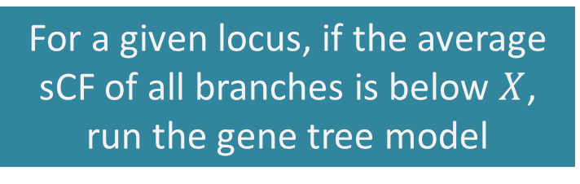
Using average site concordance to partition loci to different phylogenetic models
For a given locus, if the average sCF of all branches is below $X$, run the gene tree model
Notes:
And we’ve implemented a couple of ways to use sCF to help here, but in the interest of time I’ll only talk about one.
So for each locus, we can calculate sCF for every branch in the tree and then average all sCF values to get an overall sCF for the locus itself.
Then we can decide on some cutoff and run every locus below this cutoff, the most discordant loci, through the gene tree model, and all others through the species tree model.

Slide 53
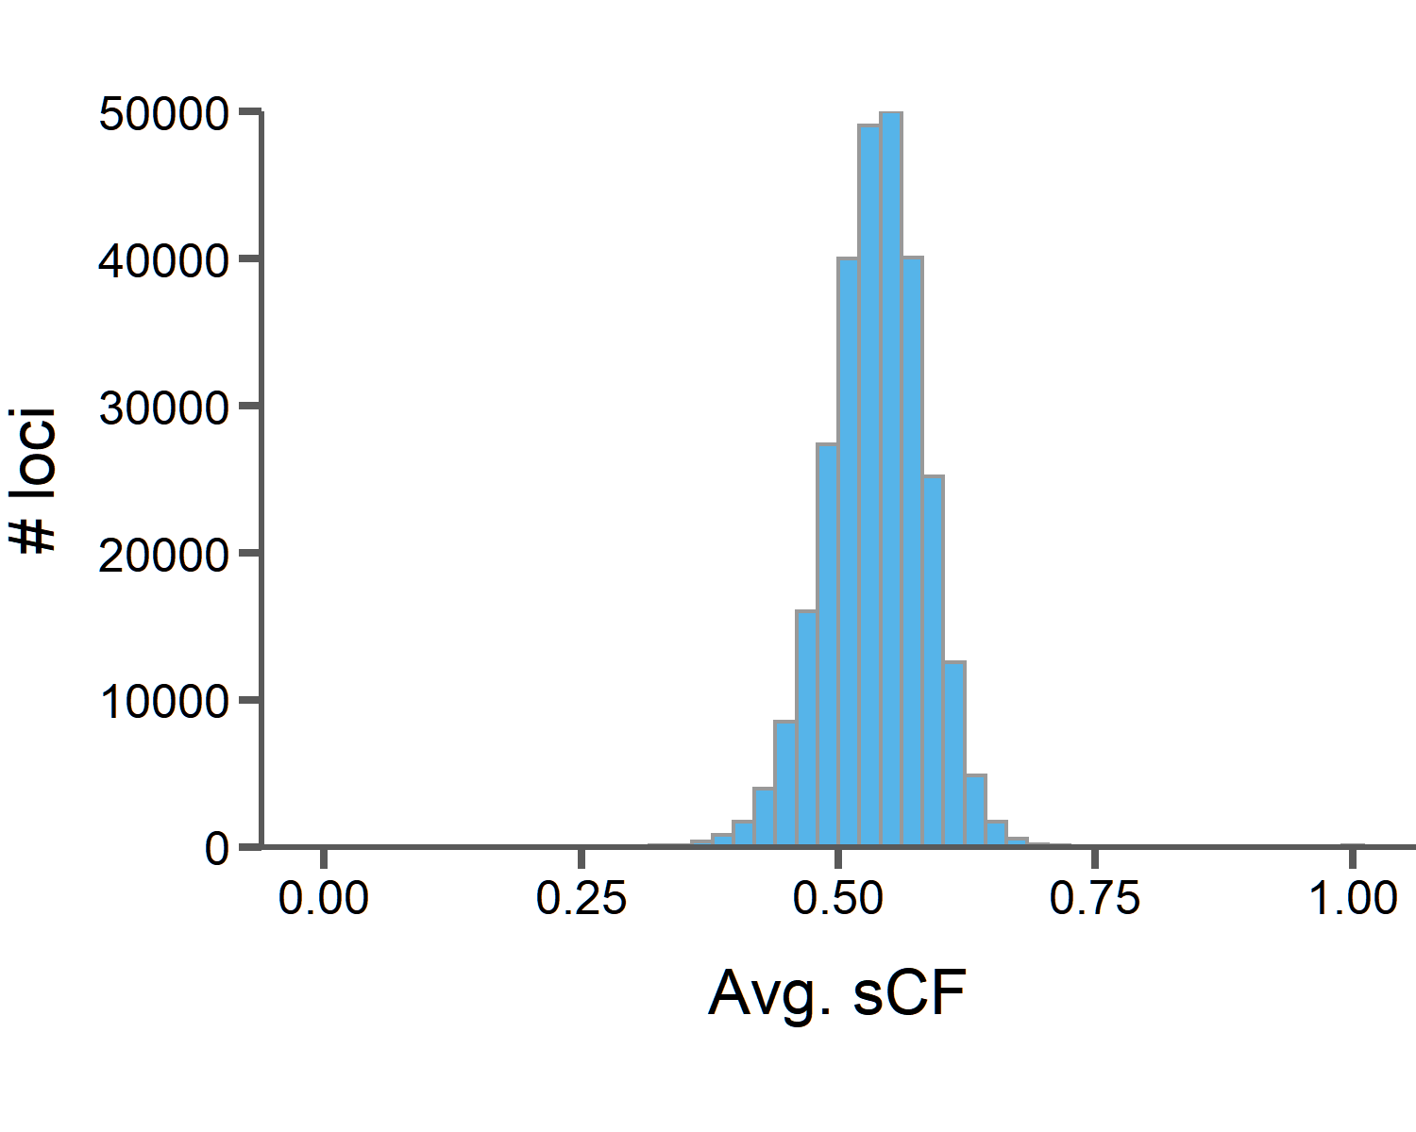
Using average site concordance to partition loci to different phylogenetic models
For a given locus, if the average sCF of all branches is below $X$, run the gene tree model
Notes:
And when we do this for the 284000 loci in the ratite dataset, we see this distribution of average sCF values over all loci. On average, a given element in this dataset has an sCF of just over 0.5, meaning over 50% of sites support the species tree for most branches in the alignment.
Then if we pick a cutoff, X, and say all genes with average sCF below this cutoff will be run with the gene tree model and all others with the species tree model, we can see how this effects runtime for the whole dataset.

Slide 54
Using average site concordance to partition loci to different phylogenetic models
For a given locus, if the average sCF of all branches is below $X$, run the gene tree model
Avg. sCF = 0.4
1,659 loci for gene tree model
17 days with 16 threads
Notes:
For example, if we have a cutoff of 0.4, that means only 1659 loci will be run through the gene tree model, and if they are run serially with 16 threads each, that means these will finish in just over 2 weeks. Still a significant amount of time, but way better than the years it would take to run all loci with the gene tree model.

Slide 55
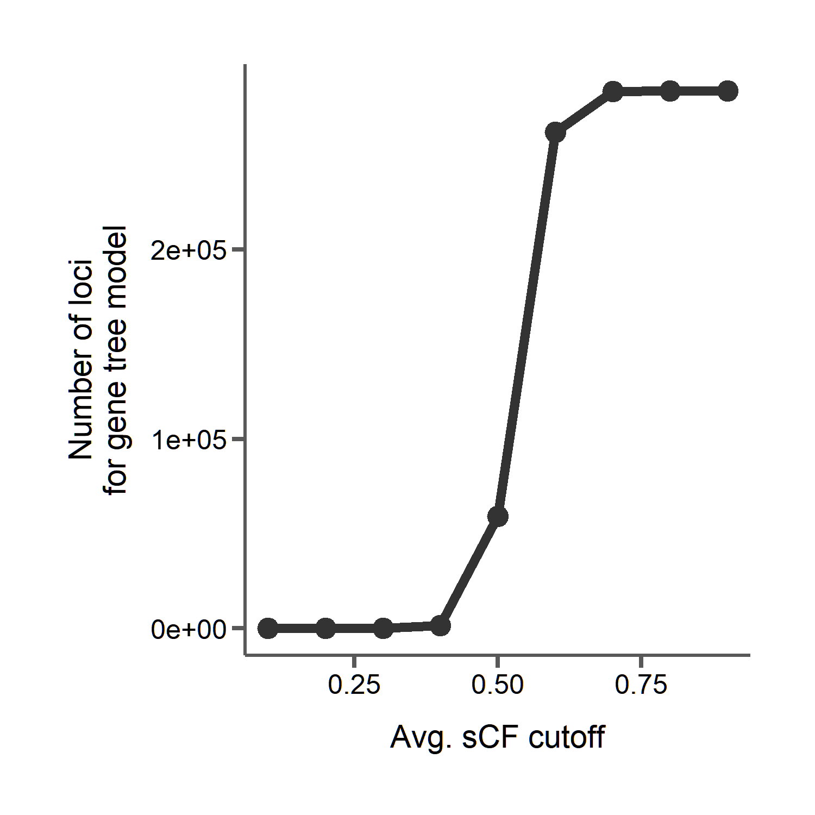
Using average site concordance to partition loci to different phylogenetic models
Notes:
And we can try different cutoffs to see how many loci would then be run through the gene tree model. Lower cutoffs mean fewer genes, with a big jump around the average since that distribution was pretty normal with a small variance.

Slide 56
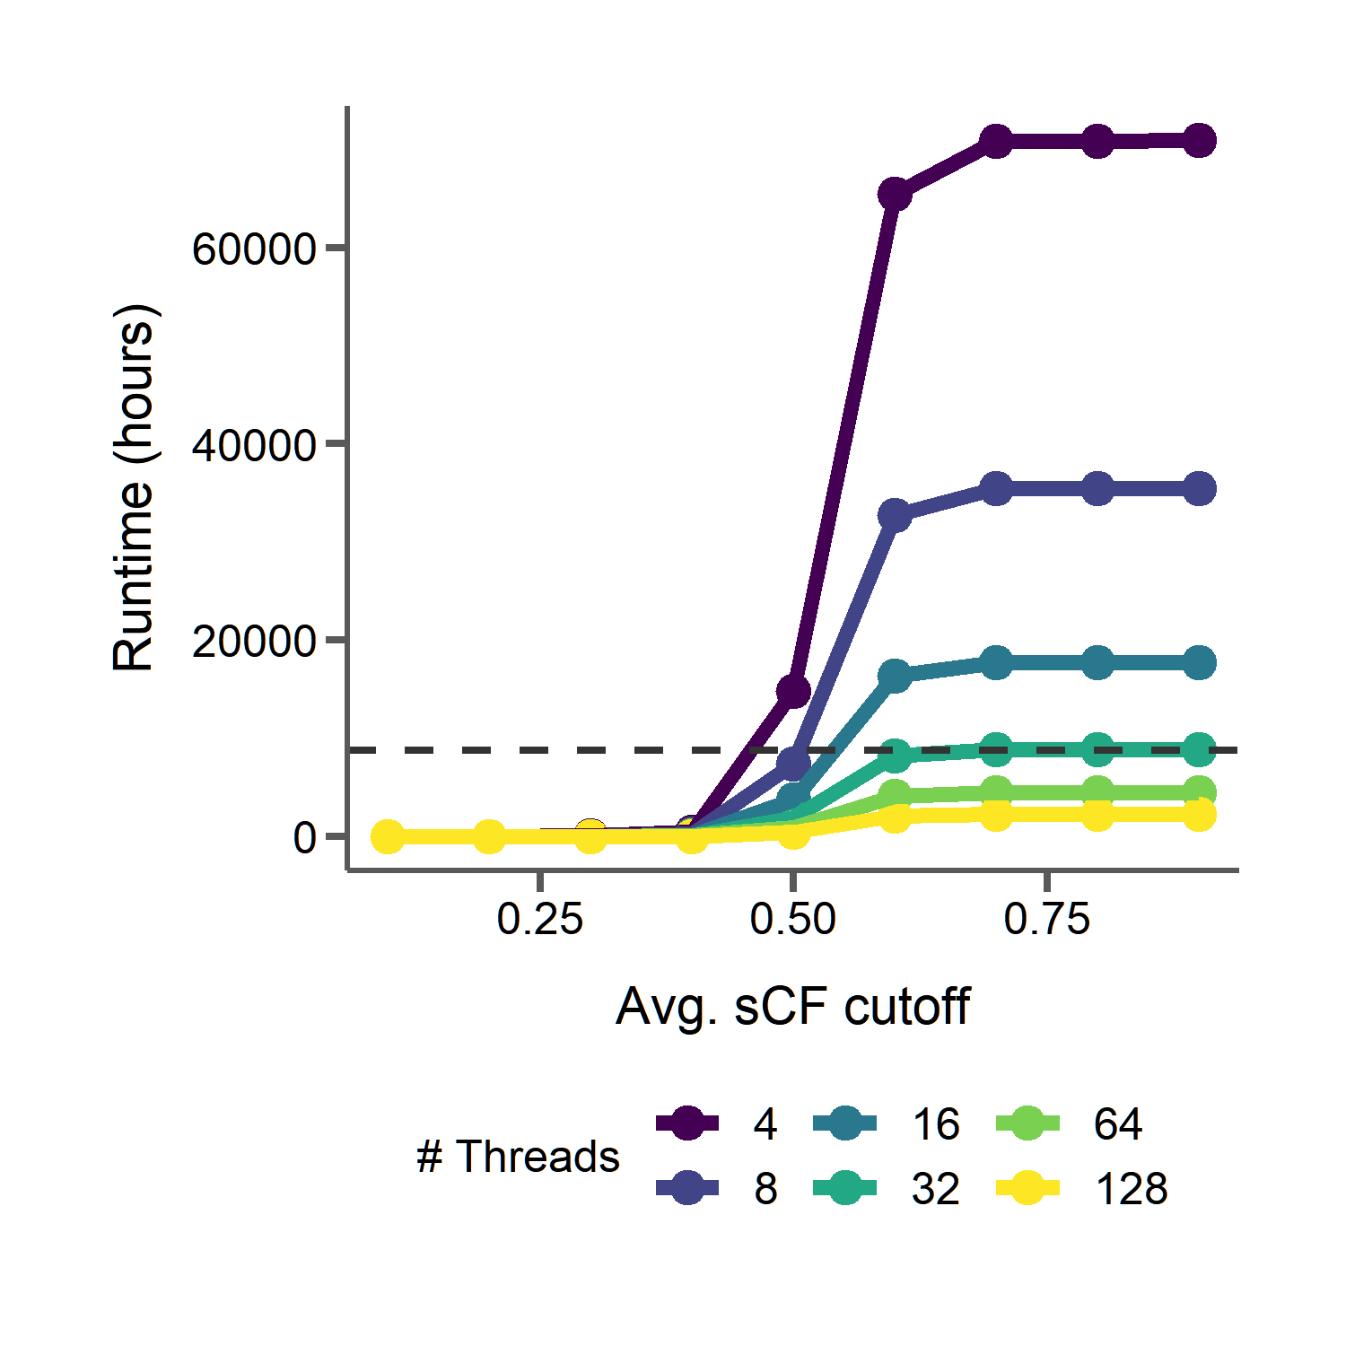
Using average site concordance to partition loci to different phylogenetic models
1 year
Notes:
And we can see here that, with a low enough cutoff, we’re reducing runtimes drastically, and when they are low the importance of the number of threads, which are represented by the different colored lines here, matters less and less.

Slide 57
Goals for efficiency and usability
Use phylogenetic signal from the data to inform model selection with site concordance factors
Goal 1:
Facilitate batching of loci for parallel runs on HPCs
Goal 2:
Notes:
This is how we can use the underlying data to help inform our model selection with PhyloAcc, and we’re thinking of other ways to do this as well

Slide 58
Not all situations require the most complicated model
Goals for efficiency and usability
Use phylogenetic signal from the data to inform model selection with site concordance factors
Goal 1:
Facilitate batching of loci for parallel runs on HPCs
Goal 2:
Notes:
But an important general message that we want to convey is that not all situations require the most complicated model.

Slide 59
Not all situations require the most complicated model
Goals for efficiency and usability
Use phylogenetic signal from the data to inform model selection with site concordance factors
Goal 1:
Trade years of CPU time for ~1 hour to calculate sCF
Drastically reduce the number of compute cycles and energy used
Facilitate batching of loci for parallel runs on HPCs
Goal 2:
Notes:
Using the data you have to look for signals that can inform model selection can help to reduce runtime and conserve energy when processing large datasets. Here, we’ve traded years of compute time for under an hour of calculating concordance factors.

Slide 60
Not all situations require the most complicated model
Goals for efficiency and usability
Use phylogenetic signal from the data to inform model selection with site concordance factors
Goal 1:
Trade years of CPU time for ~1 hour to calculate sCF
Drastically reduce the number of compute cycles and energy used
No need to pre-estimate gene trees
Facilitate batching of loci for parallel runs on HPCs
Goal 2:
Notes:
And site concordance factors are perfect for this because we have no need to transform the data that we already have as input for PhyloAcc.

Slide 61
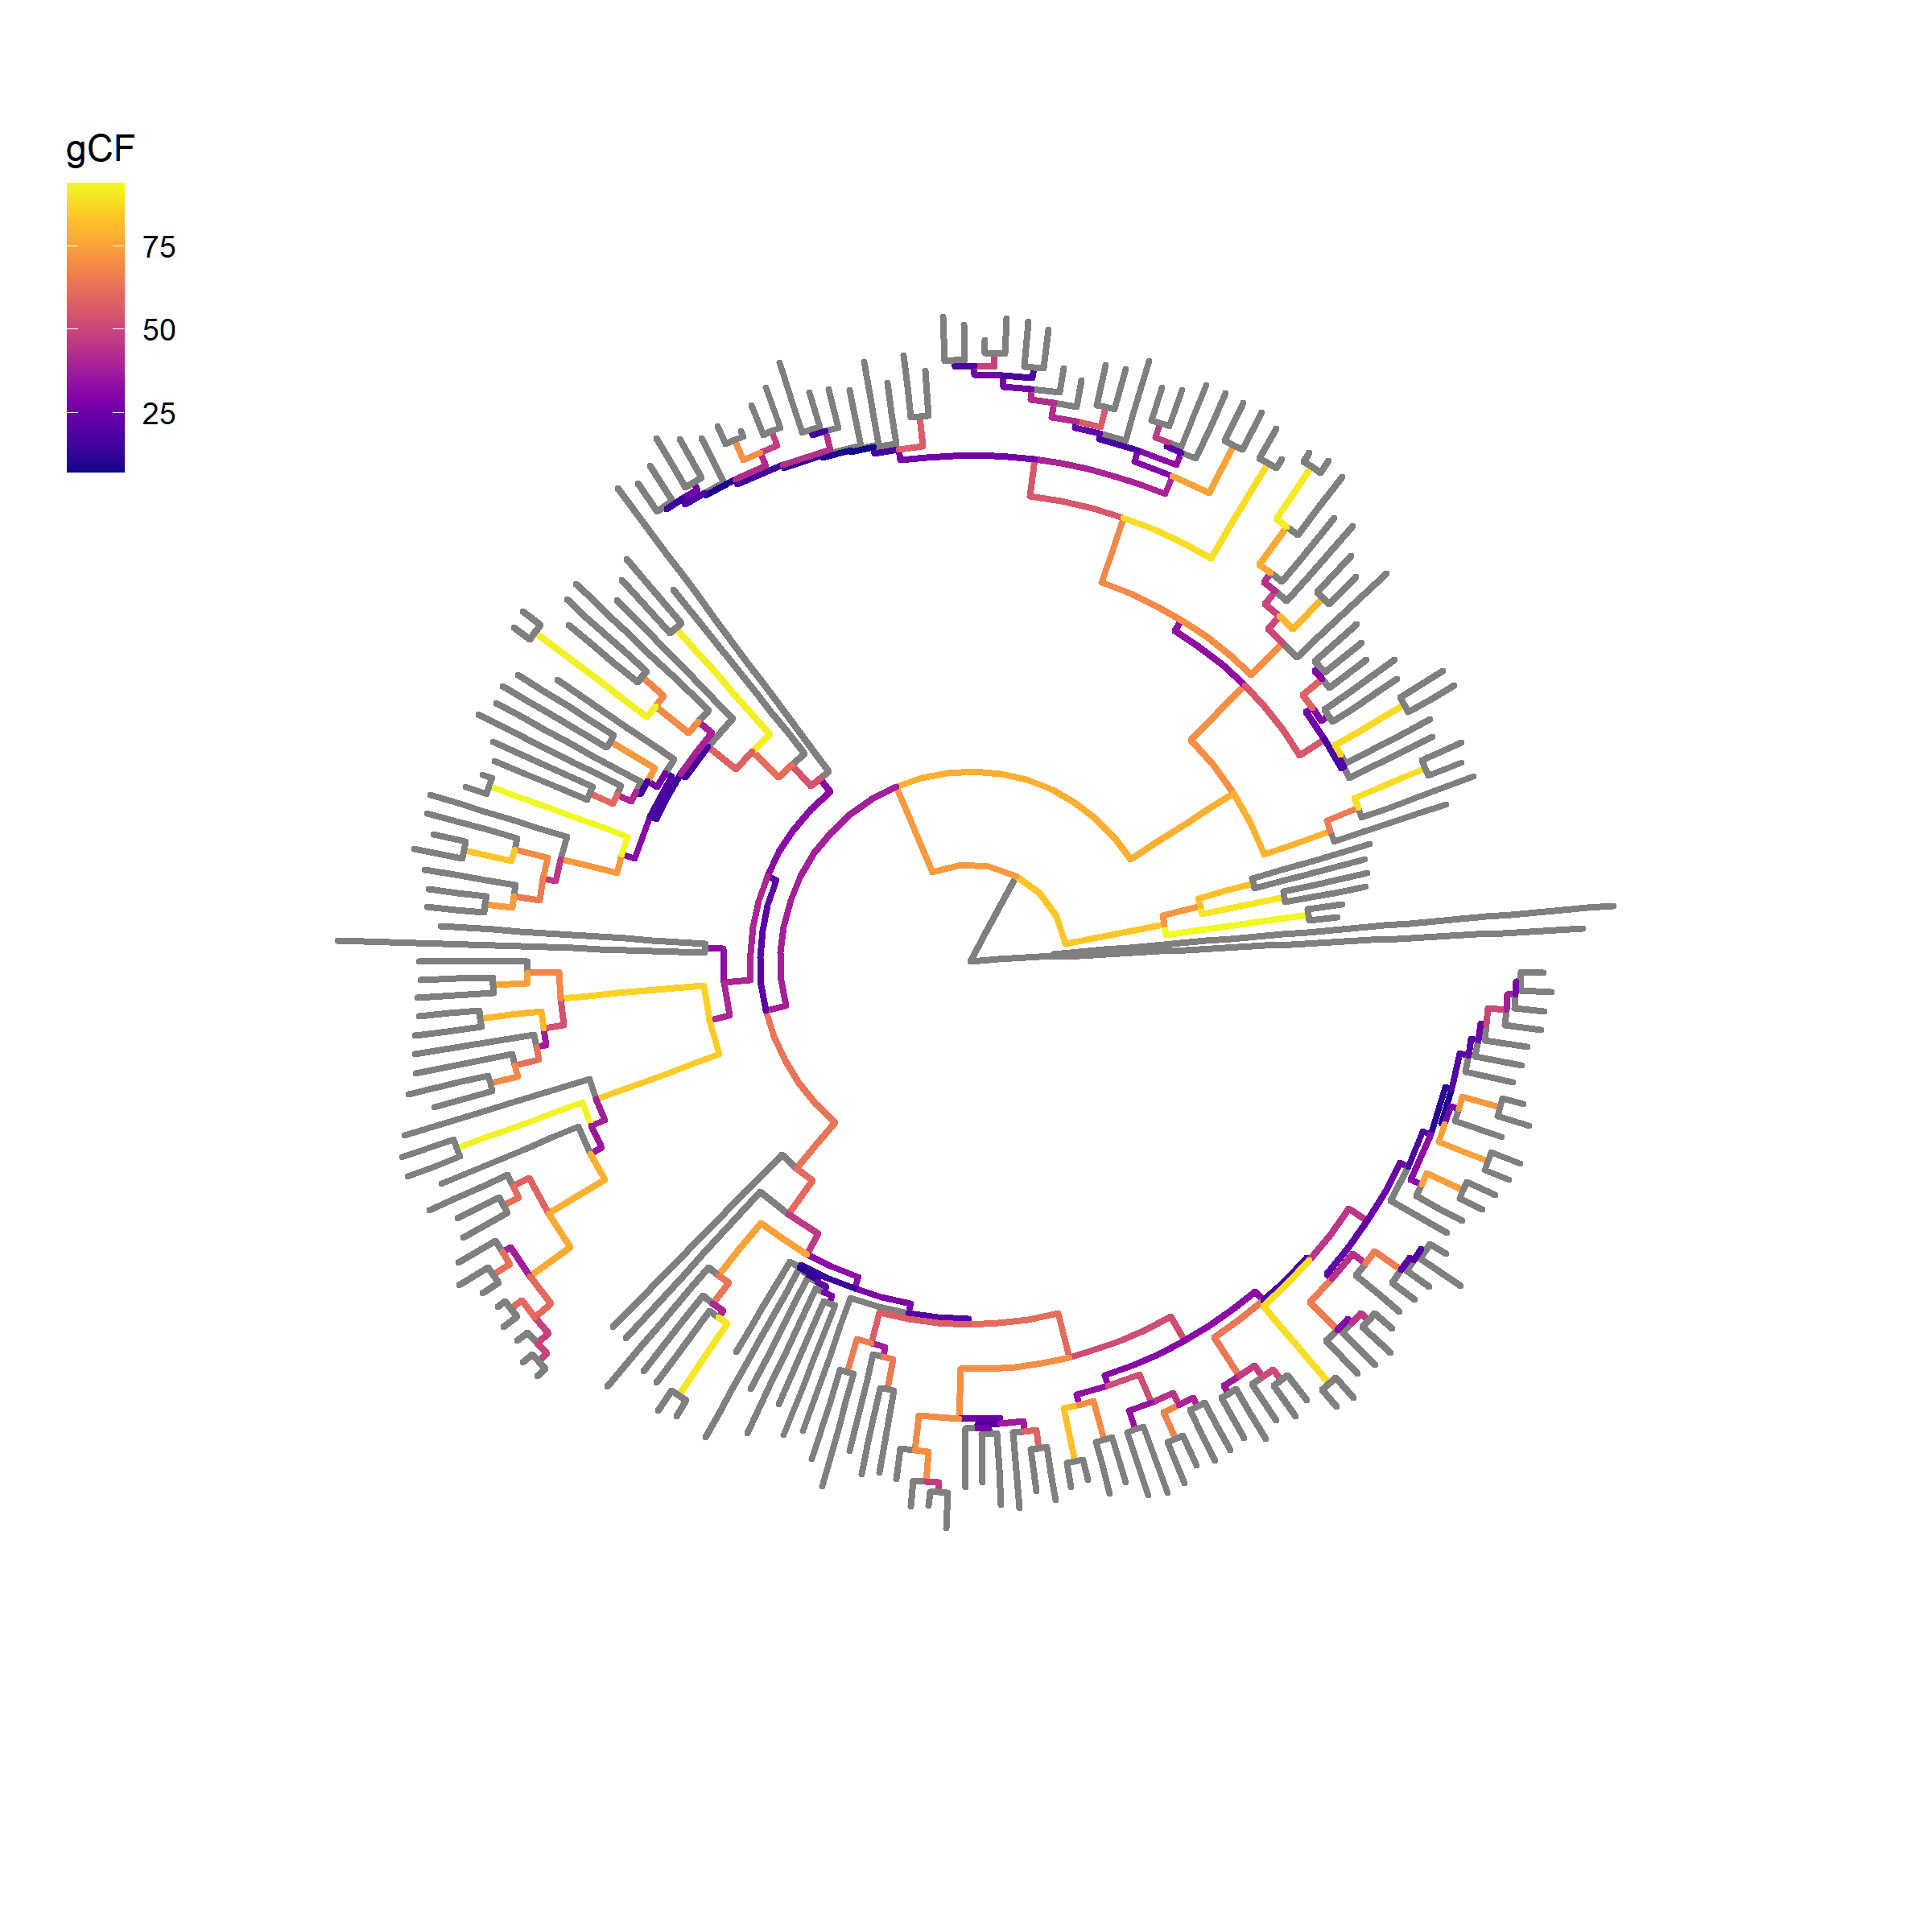
Concordance factors can also be used to reduce tree-size
~12,000 genes
188 species rodent phylogeny
Notes:
And we can use concordance factors in other ways to improve tractability of large datasets. For PhyloAcc we’ve been using them to inform model selection for our input alignments, but we could also use them to help decide which branches of the tree are concordant in most genes and then prune the tree accordingly.
For instance, in another project we have a large phylogeny of 188 rodents and we’d like to estimate substitution rates for 12,000 genes, and here is the tree with branches colored by concordance factor. So if we wanted to process all 12,000 alignments on such a large tree the analysis could take weeks or even months.

Slide 62
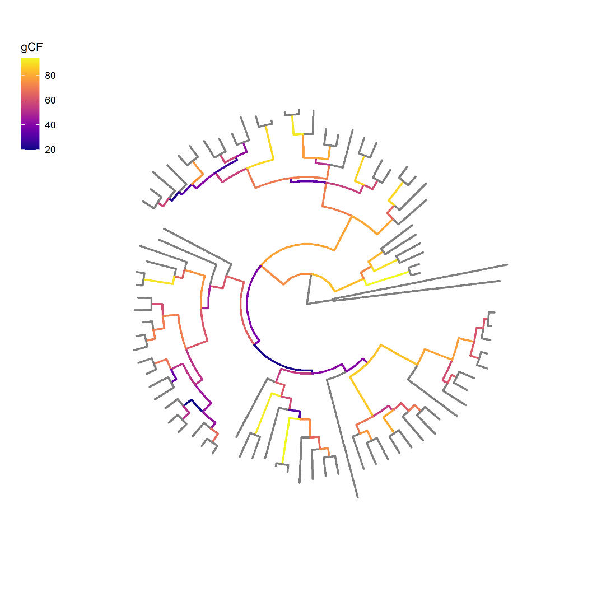
Concordance factors can also be used to reduce tree-size
~12,000 genes
Prune based on concordance and branch length
188 species rodent phylogeny
83 species pruned rodent phylogeny
Notes:
But using concordance factors along with branch lengths to inform tree pruning we can reduce the tree size while keeping the branches that are most concordant, consequently reducing runtime for our analyses.

Slide 63

Concordance factors can also be used to reduce tree-size
~12,000 genes
Prune based on concordance and branch length
https://github.com/gwct/bonsai
188 species rodent phylogeny
83 species pruned rodent phylogeny
Notes:
And this algorithm is being developed in a software package called bonsai, which will have a suite of concordance factor calculations to aid in these sort of analyses. So using the data we have already to inform how we run our analyses can be a big factor in computational efficiency.

Slide 64
Goals for efficiency and usability
Use phylogenetic signal from the data to inform model selection with site concordance factors
Goal 1:
Facilitate batching of loci for parallel runs on HPCs
Goal 2:
Notes:
So, up until now I’ve basically been focused on running each locus with PhyloAcc one at a time, but of course many of us have access to larger compute clusters that allow us to run many loci or batches of loci at once. So that was the second goal for PhyloAcc’s efficiency, to introduce some way to facilitate batching and running on clusters.

Slide 65
Inputs
+
PhyloAcc C++
Rates
Alignments
+
Neutral rates
Notes:
So, originally, the way you’d run PhyloAcc was you’d take all of your alignments and your species tree and feed them to the C++ codebase which would do its work and give you back substitution rates and rate categories. While this is multi-threaded, it didn’t have an easy way to split things up to run multiple loci at once.
This is actually a common theme I’ve observed among bioinformatics software: optimized for a single locus, even though many use cases require them to be run on many thousands of loci. So again, we hope our solution to this problem in the context of PhyloAcc can be easily adaptable to other stuff.

Slide 66
Inputs
+
PhyloAcc
Python interface
Alignments
+
Neutral rates
Notes:
And our solution was to introduce a new layer of Python code that would handle all of the inputs

Slide 67
Gene tree batch
Inputs
Gene tree batch
Species tree batch
Species tree batch
Species tree batch
+
PhyloAcc
Python interface
Alignments
Species tree batch
.
.
.
+
Neutral rates
Filtered loci
Snakemake script for job submission
Notes:
This python interface would do all of the concordance factor calculations I talked about in the first half of the talk in addition to some filtering based on the number of informative sites, and then batch loci together based on which model they are to be run with based on the user’s cutoffs.
This interface also generates a snakemake script that handles all job submission to a cluster.

Slide 68

Gene tree batch
PhyloAcc-GT C++
Inputs
Gene tree batch
PhyloAcc-GT C++
Species tree batch
PhyloAcc C++
Species tree batch
PhyloAcc C++
Species tree batch
PhyloAcc C++
+
PhyloAcc
Python interface
Rates
Alignments
Species tree batch
PhyloAcc-GT C++
.
.
.
+
PhyloAcc C++
Neutral rates
Filtered loci
Snakemake script for job submission
Notes:
Then once the interface is run, the snakefile is executed and runs each job with the appropriate C++ codebase to get the same rates and categories as before.

Slide 69
Gene tree batch
PhyloAcc-GT C++
Inputs
Gene tree batch
PhyloAcc-GT C++
Species tree batch
PhyloAcc C++
Species tree batch
PhyloAcc C++
Species tree batch
PhyloAcc C++
+
PhyloAcc
Python interface
Rates
Alignments
Species tree batch
PhyloAcc-GT C++
.
.
.
+
PhyloAcc C++
Neutral rates
Filtered loci
Snakemake script for job submission
Notes:
Except I want to note in this one case, where we send a batch designated for the species tree model to the gene tree codebase, and this can be done if you want to get an idea of a possible false negative rate.
And this all works out because we’re using these tools for what they’re optimized for. C++ is great and fast for the numerical calculations required by the Bayesian model. Python is great at handling files and strings like trees, and snakemake is made for workflow management. This also gives us the flexibility to add new features at the appropriate level in the future. So this design is really taking advantage of each tool’s strengths. And as a result we get much faster runtimes and more ease of use than if everything were packaged into just python or C++.

Slide 70
Batching loci by model type can also drastically reduce runtime for PhyloAcc
1 year
Notes:
So recall, if we use average sCF as a cutoff to decide how many loci are run through the gene tree model, and we run all loci one after another, we get these runtimes. With a low enough cutoff, these are reasonable, but can still be on the order of weeks. And with higher cutoffs these are excessive.

Slide 71
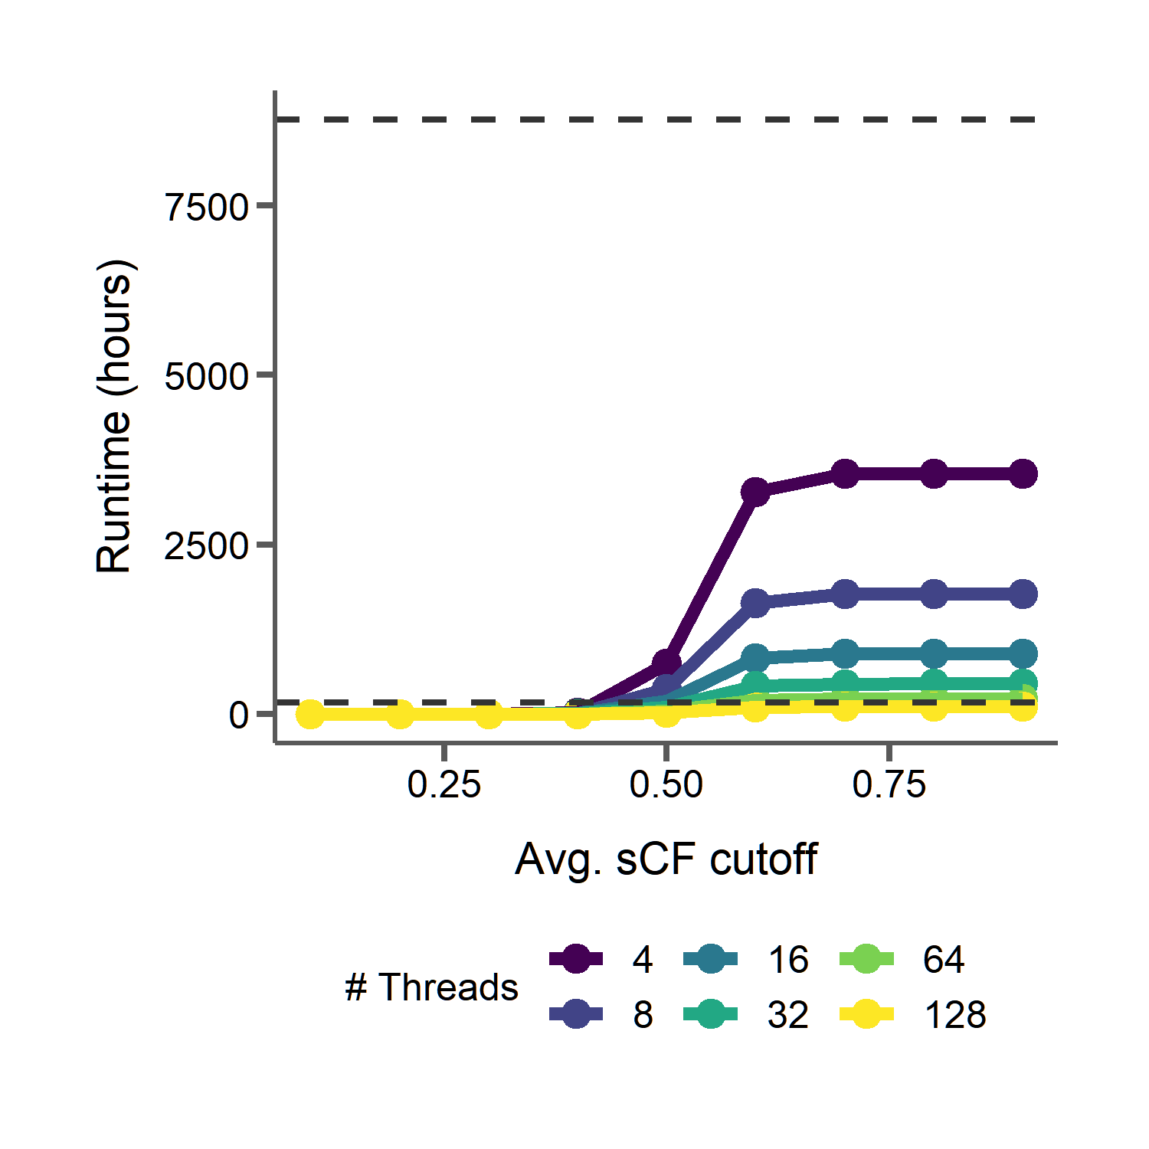
Batching loci by model type can also drastically reduce runtime for PhyloAcc
1 year
20 batches
1 year
1 week
Notes:
Now, if we use the interface to batch all the gene tree loci and run them 20 at a time, this is reduced even more, in many cases taking only a few days to run completely.

Slide 72
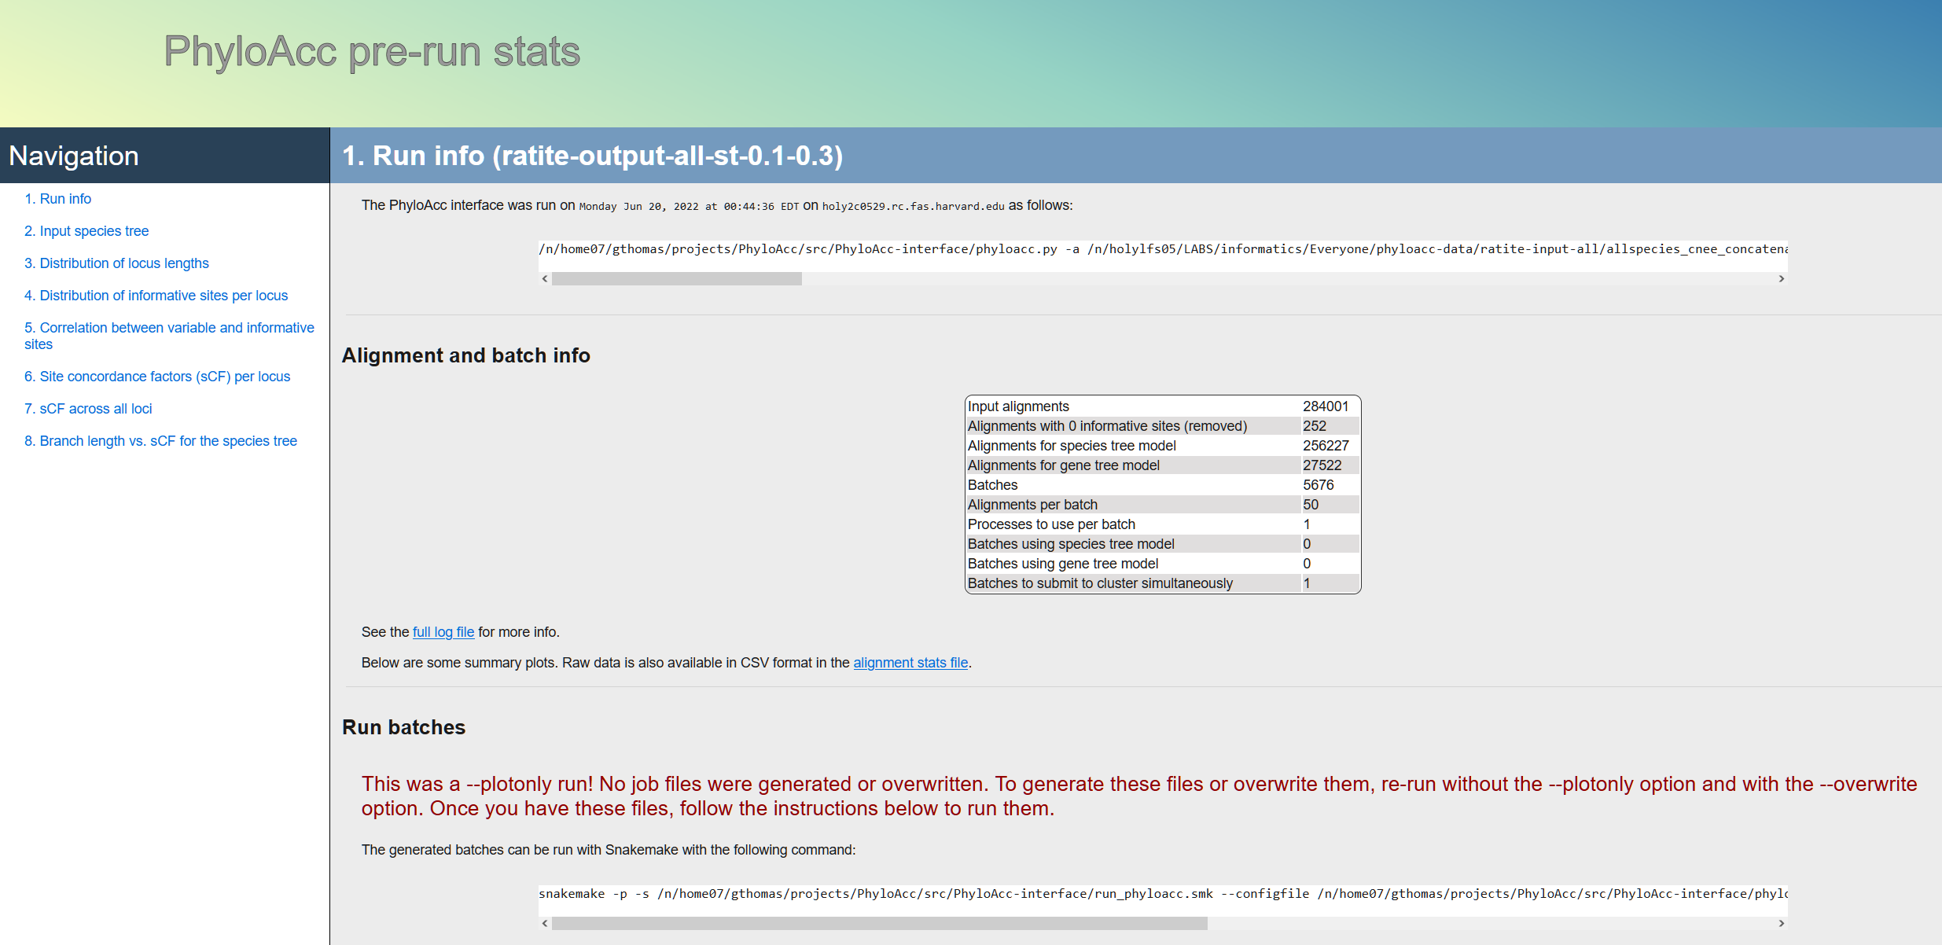
Notes:
The interface has a ton of new ease of use features as well, including summary html files both before and after running PhyloAcc with tables and plots and even instructions on how to execute the workflow.

Slide 73
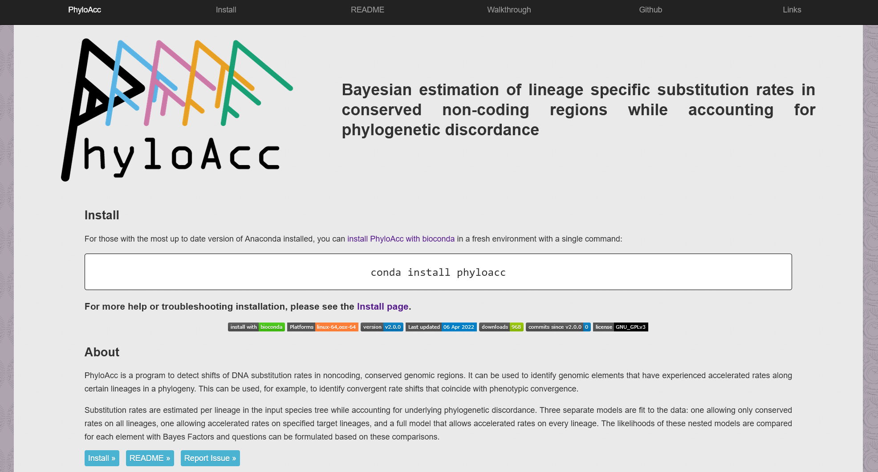
https://phyloacc.github.io/
Notes:
And of course we want everything to be documented and reproducible, so we have a new webpage. This is still under construction as we speak but should be complete soon. But I want to highlight that we wanted to overcome another headache that users might have: installation. Installing and building from source can be a pain, especially with all the dependencies we have, so we now package everything with conda, which if you already have setup PhyloAcc can be installed with this one command. If not we provide more instructions on the install page. We currently have builds for Linux and Mac and are working on Windows as well.

Slide 74






Tim Sackton | Han Yan | Scott Edwards
Zhirui Hu | Jun Liu | Nathan Weeks
Patrick Gemmell | Taehee Lee | Subir Shakya
Adam Freedman | Danielle Khost | Daren Card
Acknowledgements
Jeff Good | Emily Kopania | Carl Hutter
Jake Esselstyn | Kevin Rowe | Sebastian Mortimer
Clara Boothby
Notes:
But with that…

Slide 75
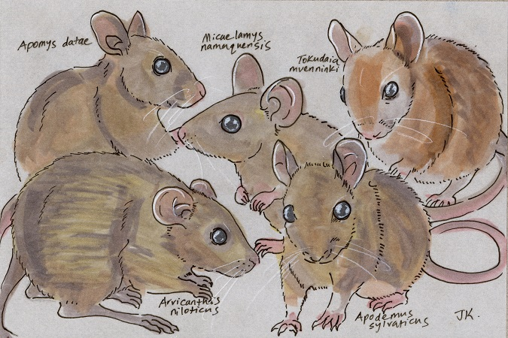
Thanks
Molecular and morphological evolution across the most species-rich radiation in mammals (Poster board 105) TODAY!
http://dailymammal.com/murines-five-ways/

Slide 78
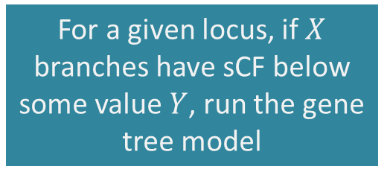
Using branch count thresholds of concordance to partition loci to different phylogenetic models
For a given locus, if $X$ branches have sCF below some value $Y$, run the gene tree model
Option 2:
Notes:
Another way we could decide which loci to give to the gene tree model is to set a threshold of the number of branches that have low sCF. For example, if one third of all branches in a locus have sCF below 0.5, we give that locus to the gene tree model.

Slide 79
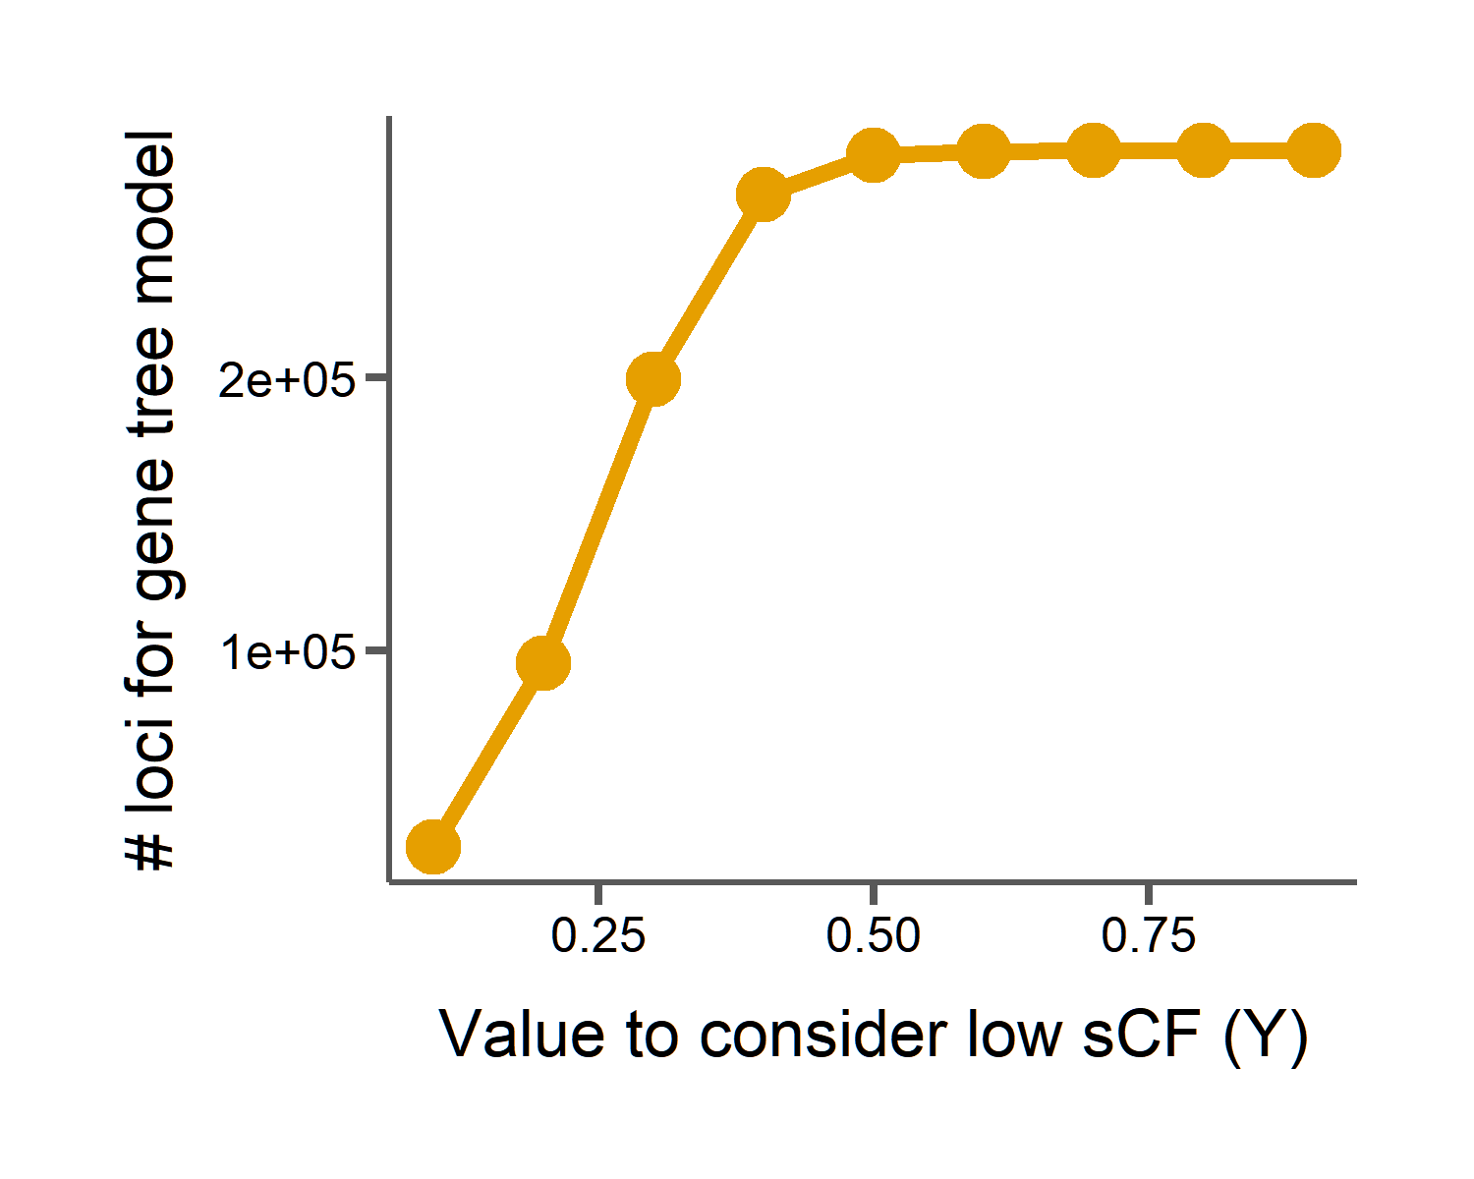
Using branch count thresholds of concordance to partition loci to different phylogenetic models
For a given locus, if $X$ branches have sCF below some value $Y$, run the gene tree model
Option 2:
Notes:
And again, if we set our X here to 0.3 and vary cutoff for low sCF we see dramatic drop-offs in the number of loci we would run with the gene tree model, however not quite as drastic as simply using the average sCF of all branches.

Slide 80
Using branch count thresholds of concordance to partition loci to different phylogenetic models
For a given locus, if $X$ branches have sCF below some value $Y$, run the gene tree model
Option 2:
Low sCF = 0.1
27,522 loci for gene tree model
9.5 months with 16 threads
Notes:
In this case, if our value to consider a branch having low sCF is 0.1, we will still have 27,000 loci for the gene tree model, which when run serially with 16 threads each will take over 9 months to run.

Slide 81
Phylogenies from different loci can disagree with an inferred species tree
Concordant
Discordant 1
Discordant 2
Gene tree 1
Gene tree 2
Gene tree 3
Species tree
Causes of discordance
Gene tree error | Incomplete lineage sorting | Introgression
Notes:
What causes different regions of the genome to have different topologies?
Of course, if we make errors in gene tree estimation, we might get different trees. So we try to minimize that at every step of the way. But discordance can also arise because of biological phenomena.
For instance, variation in ancestral populations leading to incomplete lineage sorting
And introgression between species can both lead to discordant topologies.

Slide 82
Site concordance factors measure phylogenetic discordance
Concordant
Discordant 1
Discordant 2
G | G | C | C
G | G | C | C
G | G | C | C
For each branch in the species tree:
$$sCF_{quartet}=\frac{Number of alignment sites with concordant grouping }{Total number of decisive alignment sites}$$
Notes:
So we can summarize concordance for a given quartet, by simply counting all of the concordant site patterns in the alignment and dividing by the total number of decisive alignment sites. This is called the site concordance factor, and has been used to summarize discordance across loci for branches in a species tree.
But instead of averaging over all loci, here we are going to summarize sCF for every locus in the dataset. Then we can simply summarize sCF for a given alignment and use that concordance factor to tell us whether we need to run this through the computationally intensive gene tree model or if the faster species tree model will suffice.

Slide 83
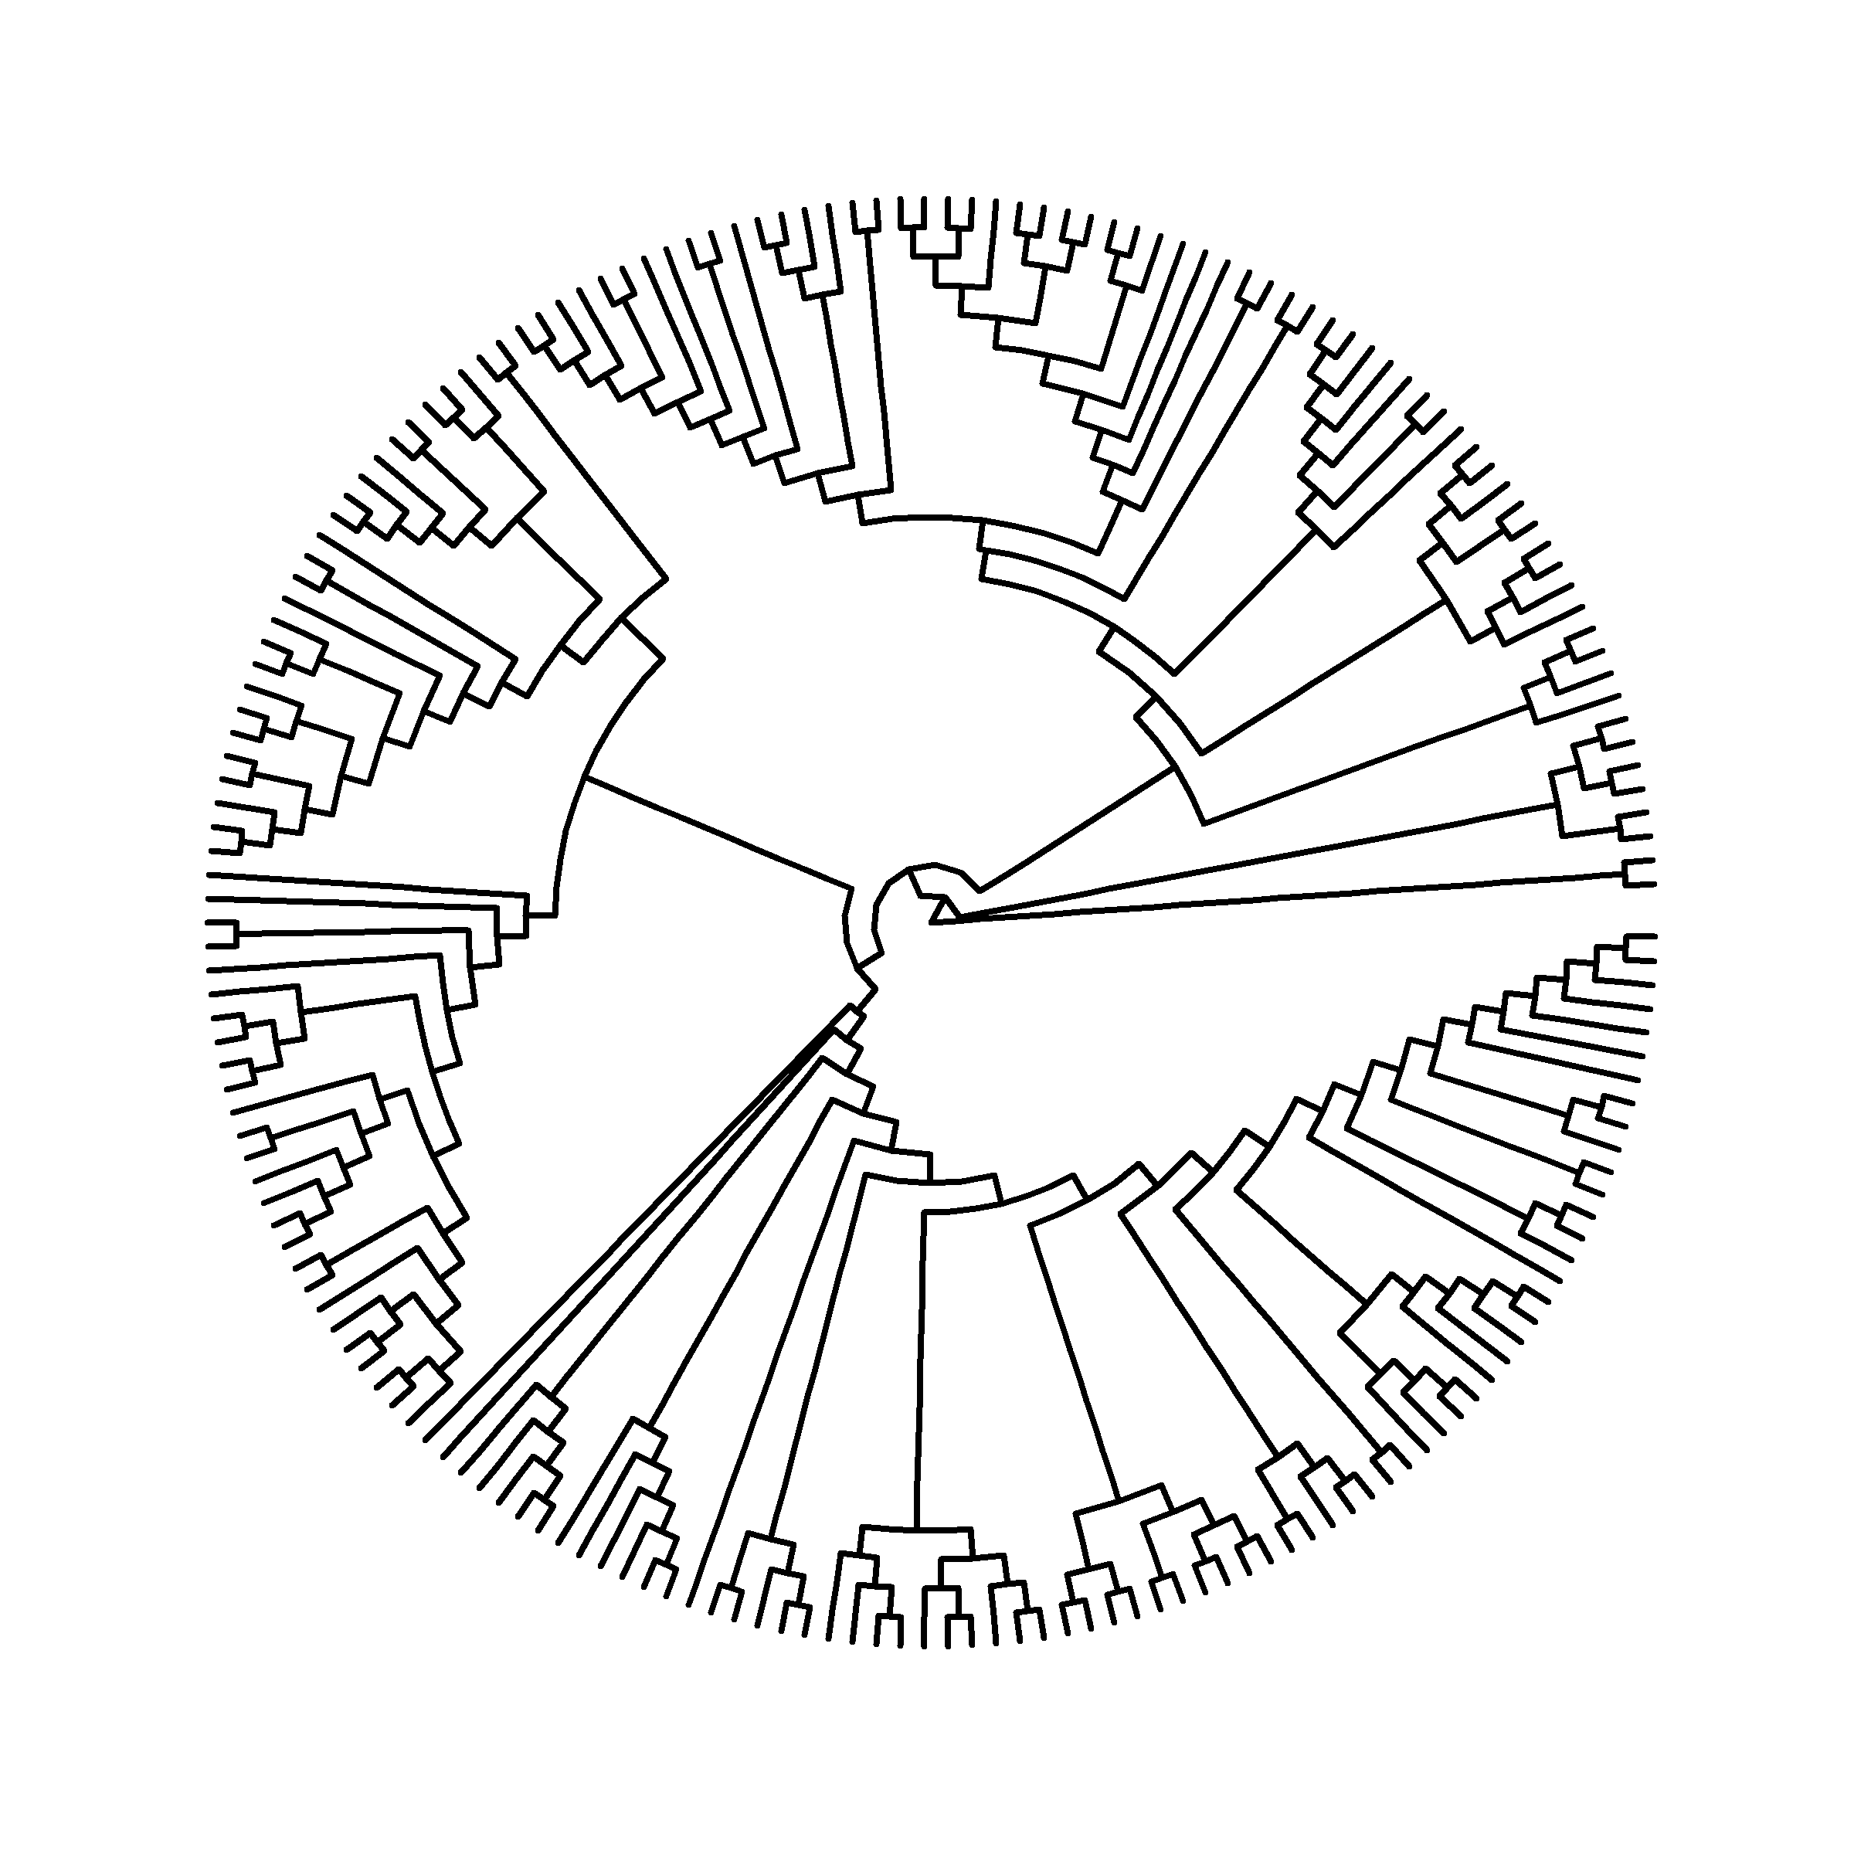
Phylogenetic discordance in rodent exomes
Notes:
And here I’m going to show this pure topological representation of the tree so we can get a closer look without all the sample names that we can’t read anyways cluttering it up. But this is the same inferred tree topology that I showed before.
So, unlike the insect dataset, where we have relatively sparse sampling over deep time, here we’ve got 200 species, which span only 15 million years of evolution.

Slide 84
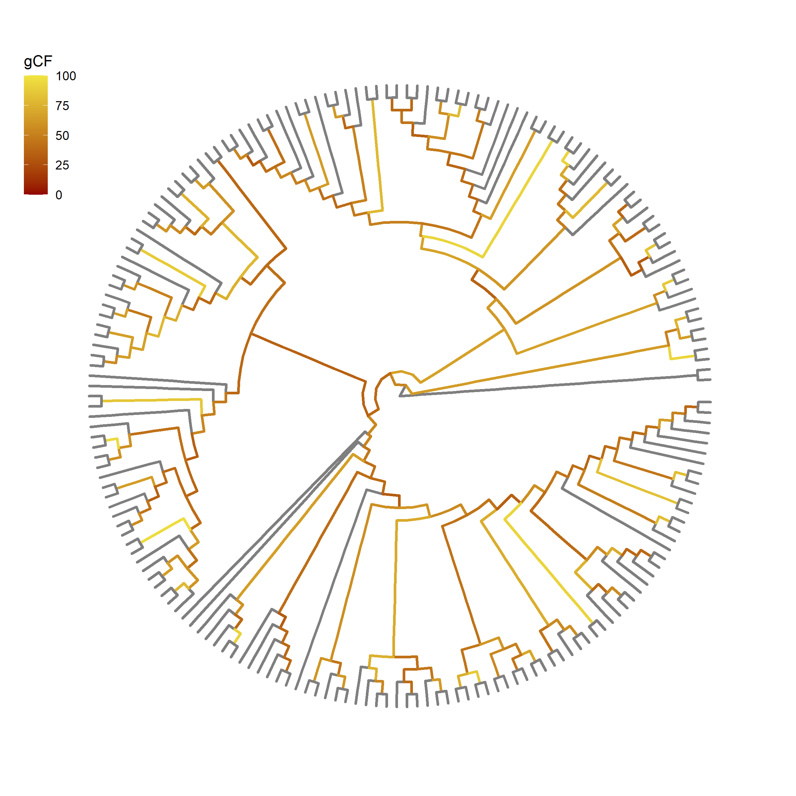

Gene concordance factors (gCF) show extensive discordance among rodent exomes
$$gCF=\frac{Number of gene trees with branch}{Total number of gene trees}$$
Notes:
So here we have lots of discordance. And here I’ve colored the branches by gene concordance factor, which is the percent of gene trees that contain a given branch in the species tree. Sometimes fewer than a quarter of the gene trees support a given branch in the species tree, looking at these really dark branches.
gCF is also a useful tool for detecting the sources of discordance. Using the patterns of the discordant topologies around each branch we can actually test for introgression. And this is a particularly interesting question in rodents, since there’s bound to be lots of secondary contact as species re-colonize or are re-introduced to the islands in Indonesia and the philippines. So we thought that there might be widespread hybridization leading to gene flow in this group.

Slide 85
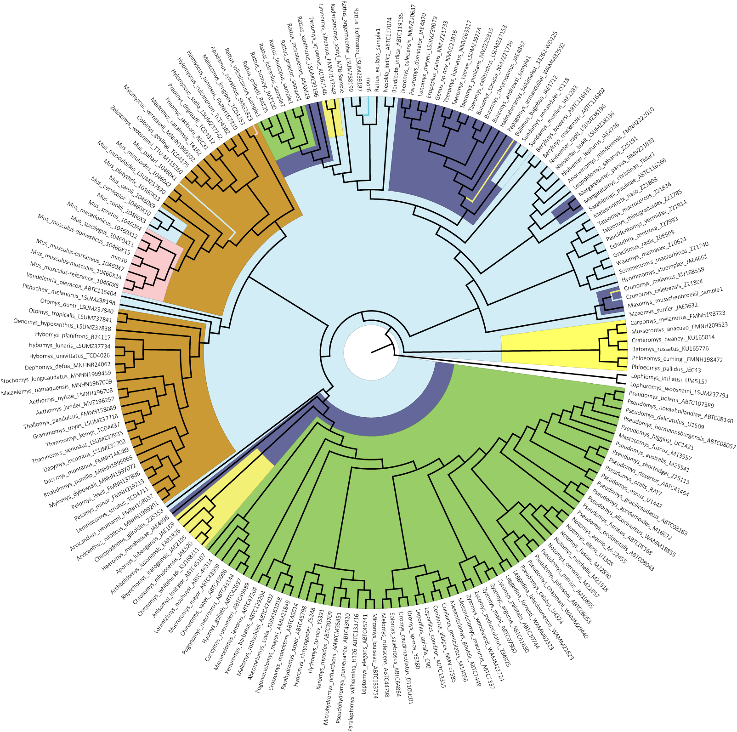
Phylogenetic discordance in rodent exomes
Notes:
Ok, so what does all of this mean for our rodent exomes, where one of our main goals is to infer substitution rates and correlate them with trait evolution.

Slide 86
Phylogenetic discordance in rodent exomes
Notes:
And here I’m going to show this pure topological representation of the tree so we can get a closer look without all the sample names that we can’t read anyways cluttering it up. But this is the same inferred tree topology that I showed before.
So, unlike the insect dataset, where we have relatively sparse sampling over deep time, here we’ve got 200 species, which span only 15 million years of evolution.

Slide 87
Gene concordance factors (gCF) show extensive discordance among rodent exomes
$$gCF=\frac{Number of gene trees with branch}{Total number of gene trees}$$
Notes:
So here we have lots of discordance. And here I’ve colored the branches by gene concordance factor, which is the percent of gene trees that contain a given branch in the species tree. Sometimes fewer than a quarter of the gene trees support a given branch in the species tree, looking at these really dark branches.
gCF is also a useful tool for detecting the sources of discordance. Using the patterns of the discordant topologies around each branch we can actually test for introgression. And this is a particularly interesting question in rodents, since there’s bound to be lots of secondary contact as species re-colonize or are re-introduced to the islands in Indonesia and the philippines. So we thought that there might be widespread hybridization leading to gene flow in this group.

Slide 88
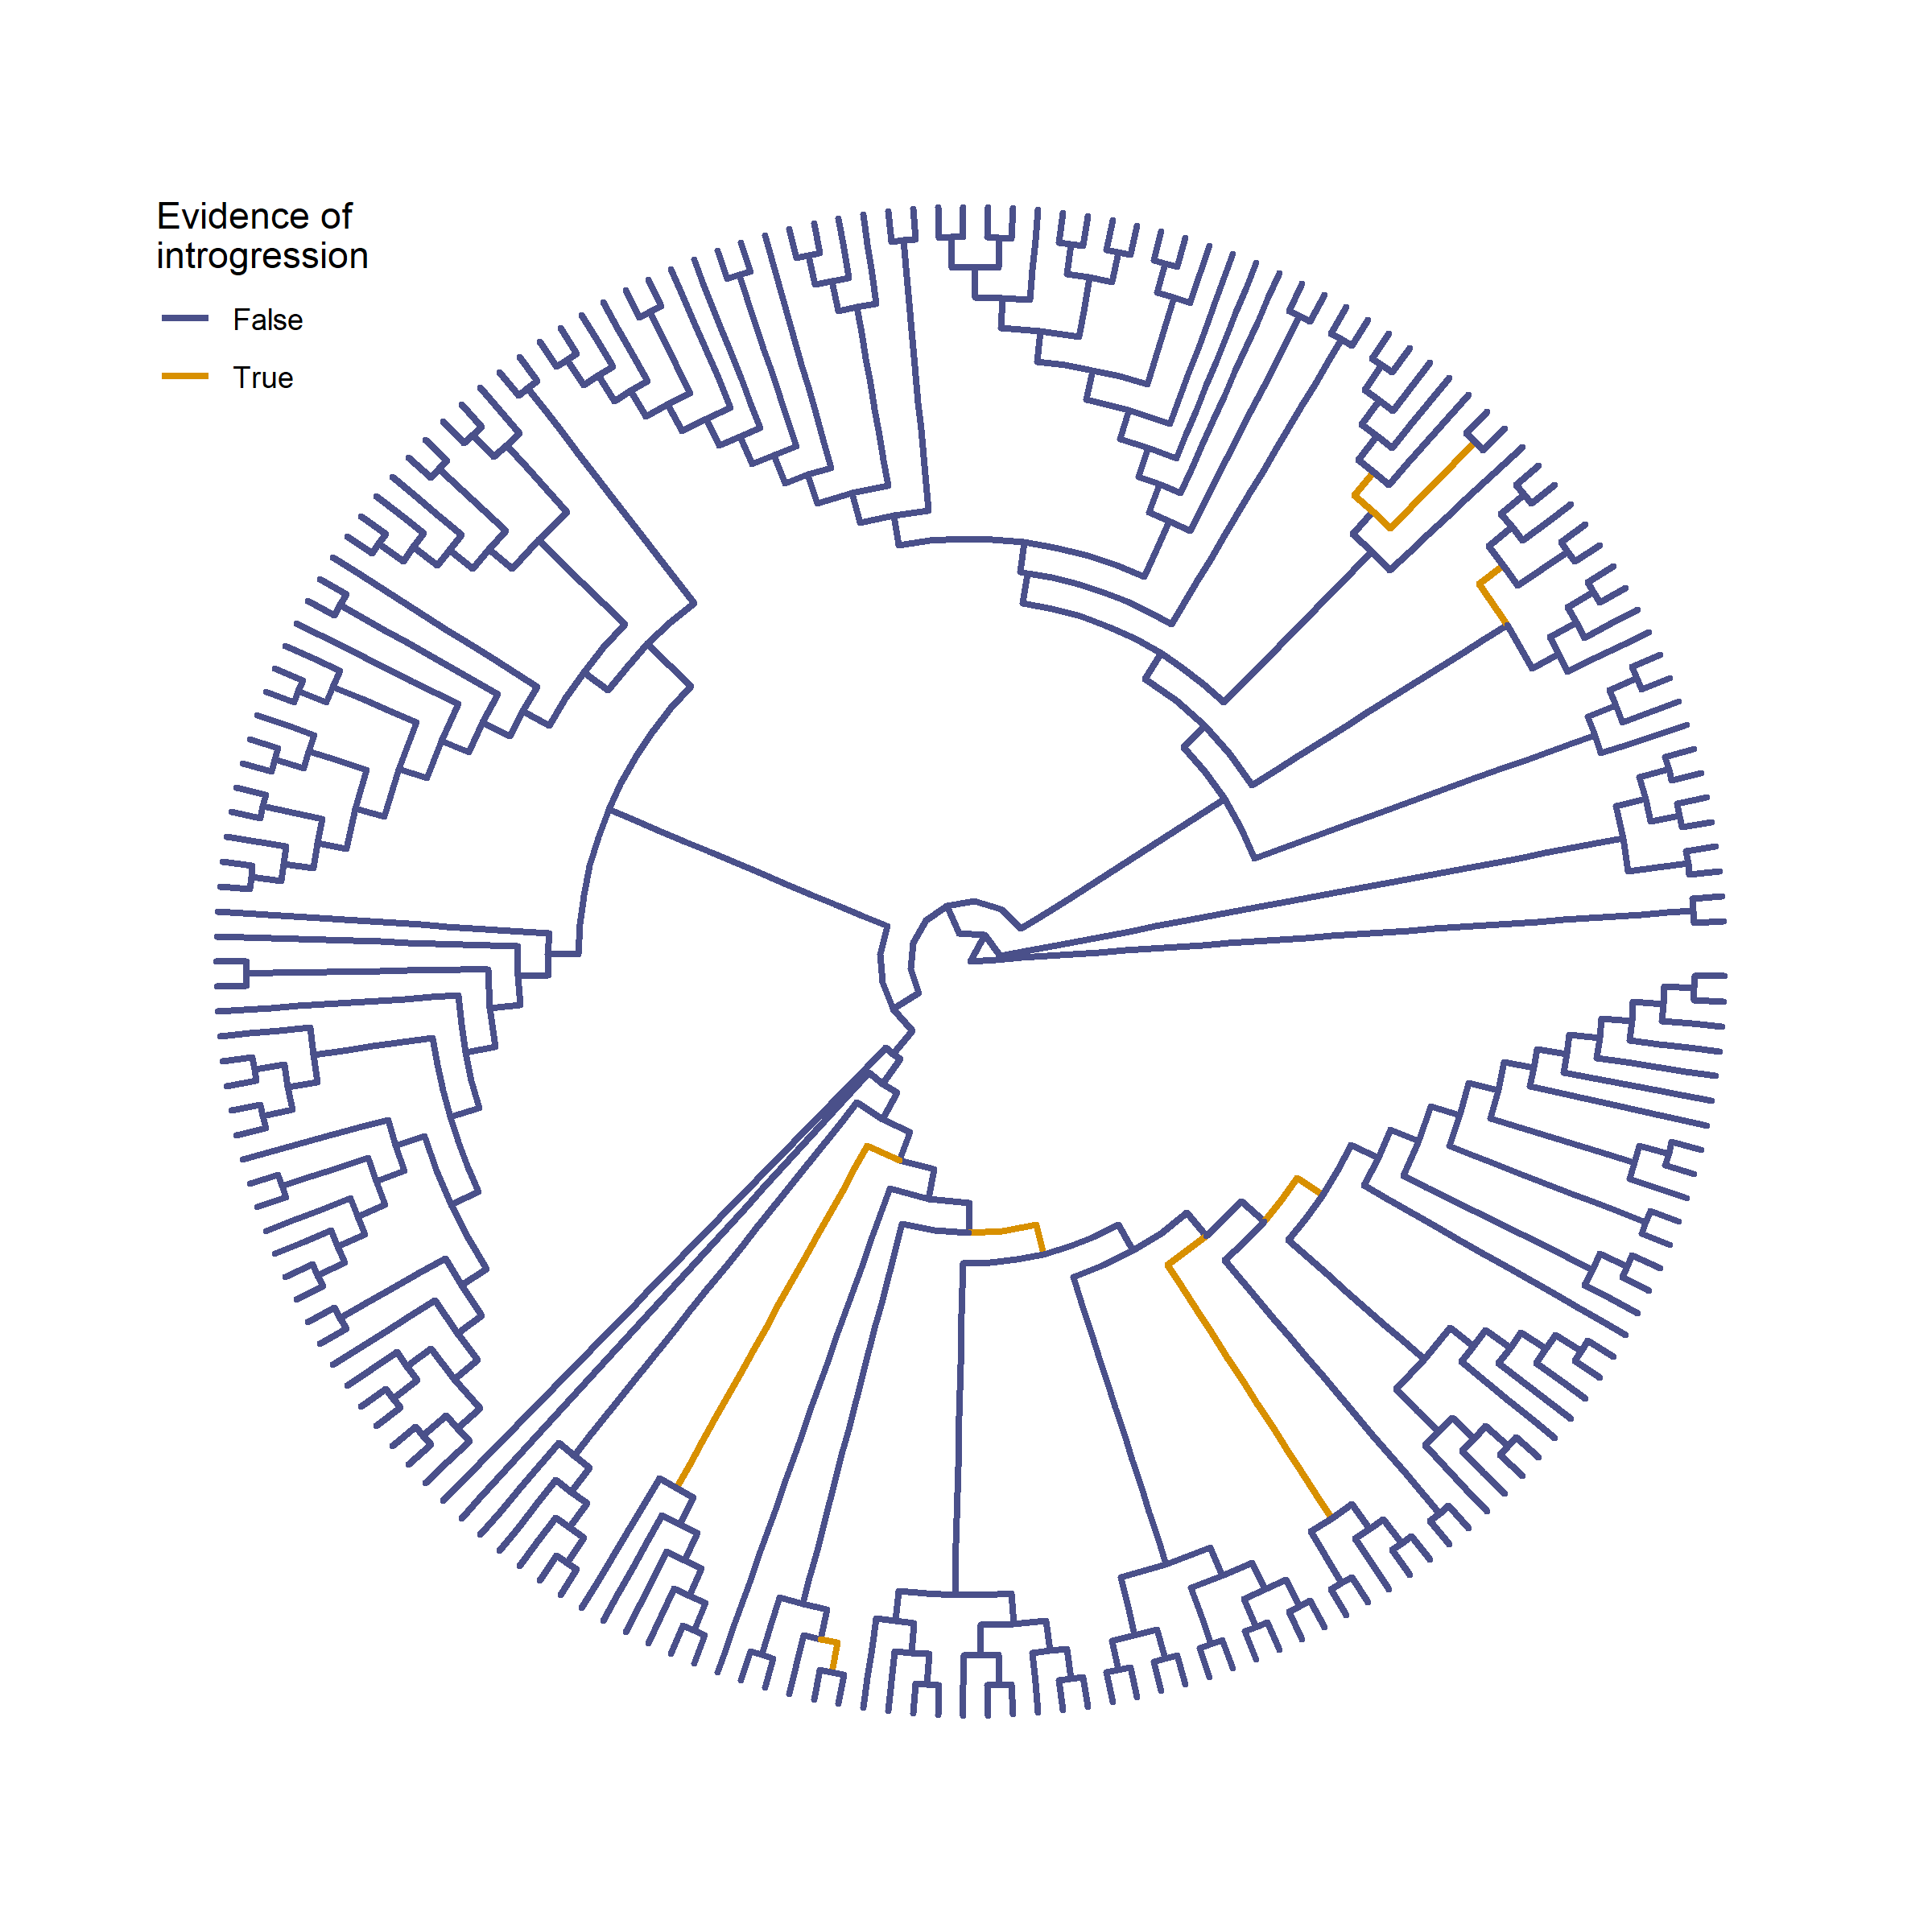
Introgression is limited to only a few murine lineages
Notes:
But as it turns out, we only see significant evidence for introgression in a few lineages, mostly within the large Australian radiation. So it doesn’t look like secondary contact within the Indonesian or Philippine islands happened, or if it did it didn’t lead to lasting gene flow. This means that most of the phylogenetic discordance we observe throughout the tree is likely due to ancestral variation, which makes sense given the rapid speciation that we think occurred among murine rodents.
But based on our previous results, this discordance could cause a lot of problems when counting substitutions along the phylogeny inferring rates of molecular evolution. So how do we deal with this?

Slide 89
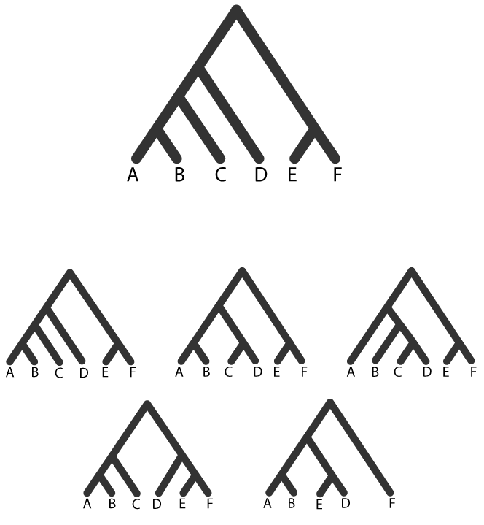

How to infer rates while accounting for discordance?
For gene-based inferences use gene trees
Species tree
Gene trees
Notes:
The easiest thing to do when counting substitutions is to just use gene trees for everything. And indeed for any inference of substitution rate we should be using the gene tree. And this works great for gene based analyses – say when we’re asking individually of each gene whether there are indications of positive selection.

Slide 90
How to infer rates while accounting for discordance?
For gene-based inferences use gene trees
For lineage-based inferences use only gene trees that match the species tree?
Species tree
Gene trees
Notes:
But we may still want to count substitutions using gene trees and map these counts back on to species tree to ask which lineages have experienced accelerated evolution. And its in these lineage or branch based analyses that discordance could cause inflations of counts by mis-mapping them onto different topologies.
So we could just use gene trees that exactly match the species tree. This is a simple way of sidestepping this problem, and may work in some instances. But what we’re finding out is that discordance is prevalent in many phylogenomic datasets,

Slide 91

How to infer rates while accounting for discordance?
For gene-based inferences use gene trees
For lineage-based inferences use only gene trees that match the species tree?
Species tree
Gene trees
Notes:
so in most cases this means throwing out a lot of data… every gene tree that doesn’t exactly match the species tree would have to be removed. And if we restrict our inferences in rodents only to those genes that match the species tree, we’ll be throwing away a lot of our data… basically all of it. So we can’t really do that.

Slide 92
How to infer rates while accounting for discordance?
For gene-based inferences use gene trees
For lineage-based inferences use only gene trees that match the species tree?
Species tree
Gene trees
Notes:
so in most cases this means throwing out a lot of data… every gene tree that doesn’t exactly match the species tree would have to be removed. And if we restrict our inferences in rodents only to those genes that match the species tree, we’ll be throwing away a lot of our data… basically all of it. So we can’t really do that.

Slide 93
How to infer rates while accounting for discordance?
For gene-based inferences use gene trees
For lineage-based inferences use only gene trees that match the species tree?
For lineage-based inferences, count substitutions by branch
Species tree
Gene trees
Notes:
Instead, we can count substitutions branch by branch. For each branch in the species tree, we go and find gene trees where that branch exists – where it is not discordant – and then we count all the sites and substitutions across genes for this branch to get a more accurate calculation of rate while keeping a lot more of our data.

Slide 94
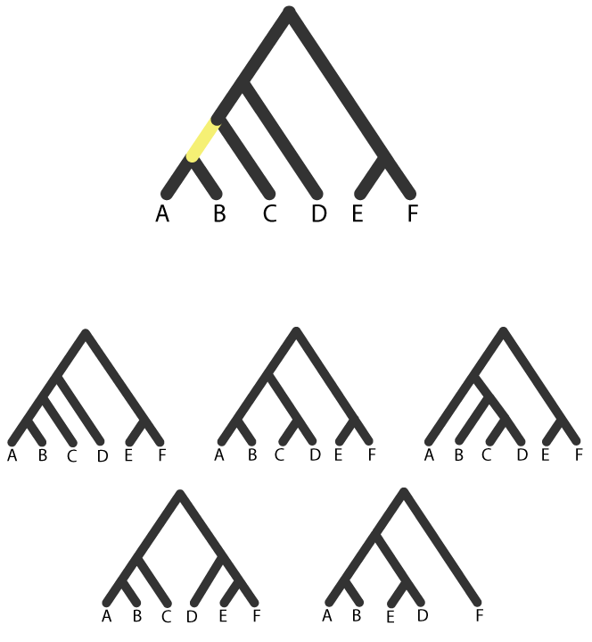
How to infer rates while accounting for discordance?
For gene-based inferences use gene trees
For lineage-based inferences use only gene trees that match the species tree?
For lineage-based inferences, count substitutions by branch
Species tree
Gene trees
Notes:
For example, for this yellow branch leading to A and B, we can find

Slide 95
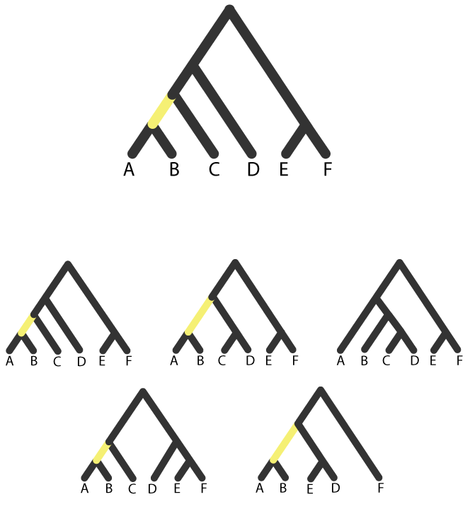
How to infer rates while accounting for discordance?
For gene-based inferences use gene trees
For lineage-based inferences use only gene trees that match the species tree?
For lineage-based inferences, count substitutions by branch
Species tree
Gene trees
Notes:
All the gene trees that also have a branch leading to A and B and count substitutions along those. And we lose much less data, only this tree here that doesn’t have that branch. But this tree isn’t excluded completely… it can still be counted for the other species tree branches it does contain

Slide 96
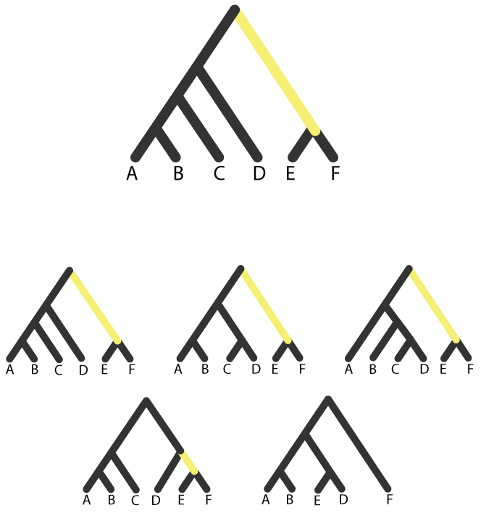
How to infer rates while accounting for discordance?
For gene-based inferences use gene trees
For lineage-based inferences use only gene trees that match the species tree?
For lineage-based inferences, count substitutions by branch
Species tree
Gene trees
Notes:
Like this branch leading to E and F, which we find in a different set of gene trees, but we’re still able to use more of the data than if we restricted to gene trees that exactly match the species tree.

Slide 97
How to infer rates while accounting for discordance?
For gene-based inferences use gene trees
For lineage-based inferences use only gene trees that match the species tree?
For lineage-based inferences, count substitutions by branch
Species tree
Gene trees
Notes:
Like this branch leading to E and F, which we find in a different set of gene trees, but we’re still able to use more of the data than if we restricted to gene trees that exactly match the species tree.

Slide 98
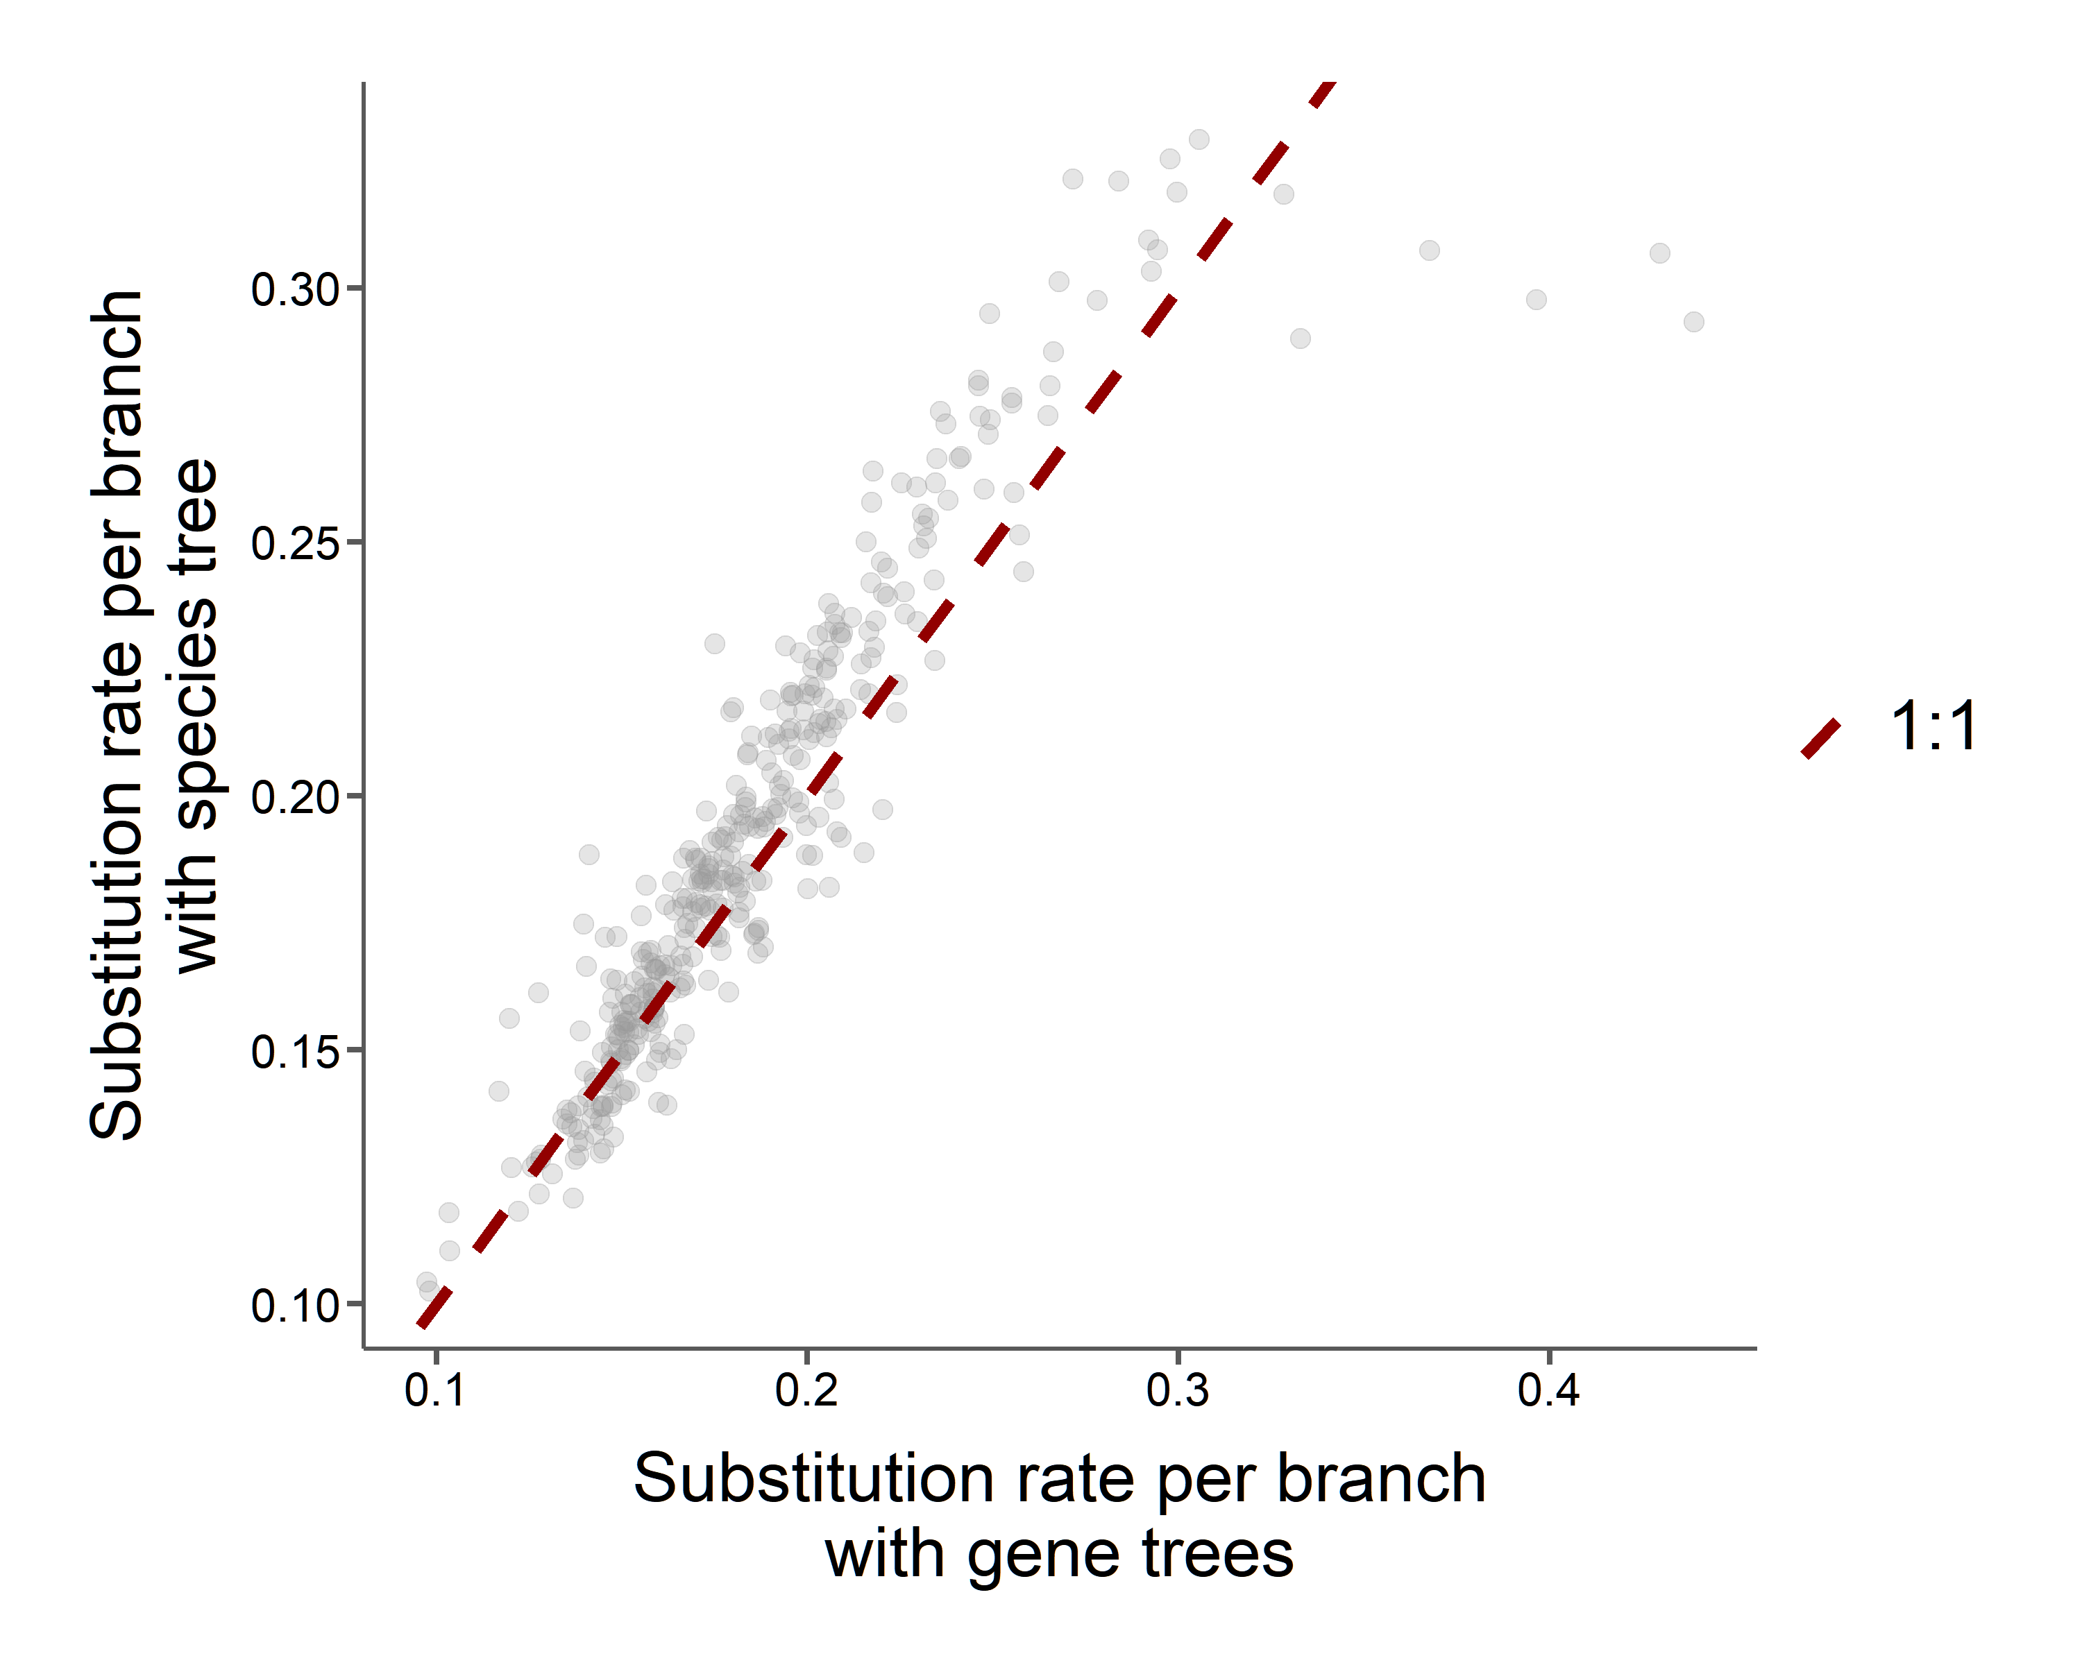
How to infer rates while accounting for discordance?
Lower rates with gene trees
Species tree
Gene trees
Notes:
And we can see the effects of doing this. So here, like I did with the selection tests, I’ve counted substitutions on each branch of our rodent phylogeny using gene trees with our branch counting method or a single species tree for all genes. And this line represents the 1-1 line, not a regression line… so it is what we would expect if the tree had no effect on our rate inferences.
But what we see is that for most lineages, using gene trees pushes their rates to the left of this line, so their rates are actually lower. And that’s what we would expect in most cases, when those substitutions are mis-mapped they can be inflating the counts on different branches. But we also see some branches that actually have higher rates when using gene trees. And I think this is somewhat expected too… when you correct the mis-mapping of substitutions, some branches get more substitutions. So we think this method is going to give us more accurate rates across the board.

Slide 99
How do substitution rates vary across lineages?
Do lineages descending from colonization experience faster rates?
Do genes relating to certain phenotypes experience faster rates?
Notes:
So now we can come back to our interesting questions about molecular evolution across the rodent phylogeny, more confident in our estimates of substitution rate.
First… how do substitution rates vary across lineages?

Slide 100
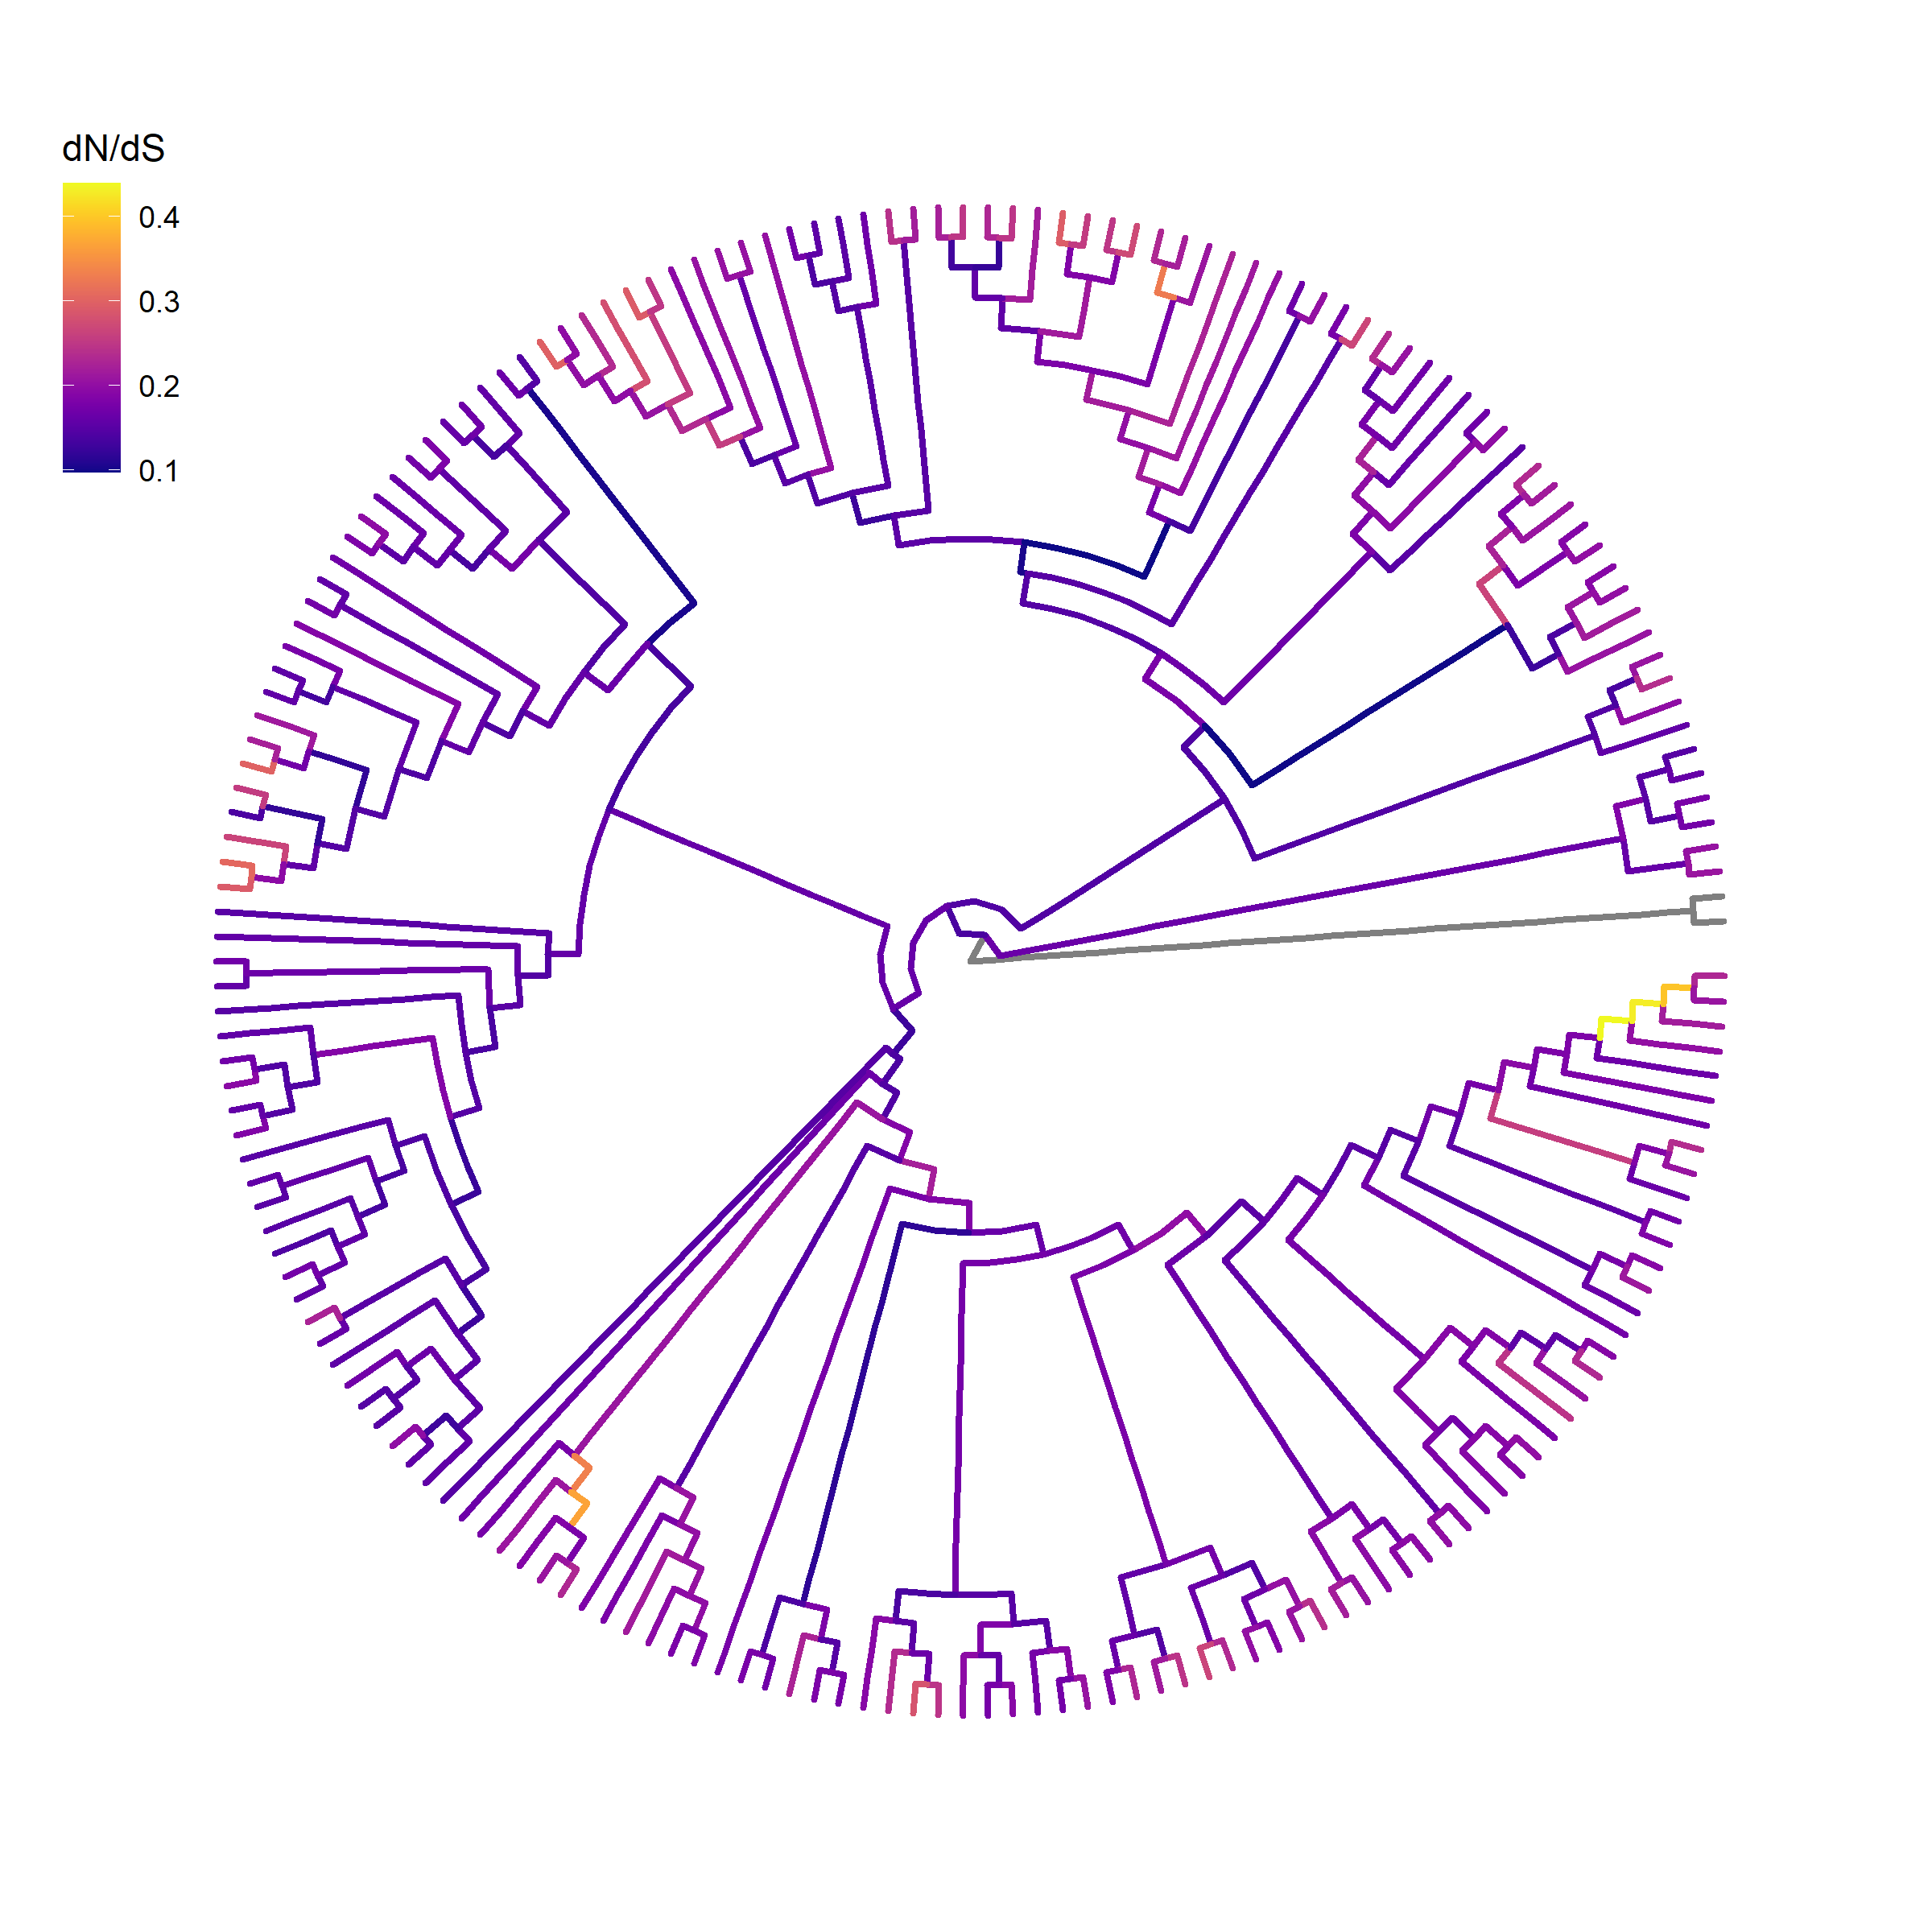
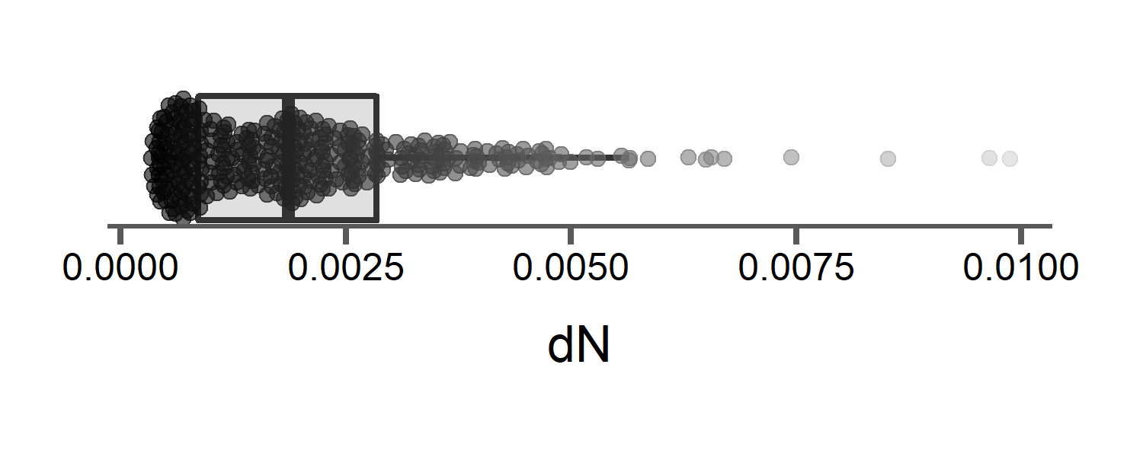
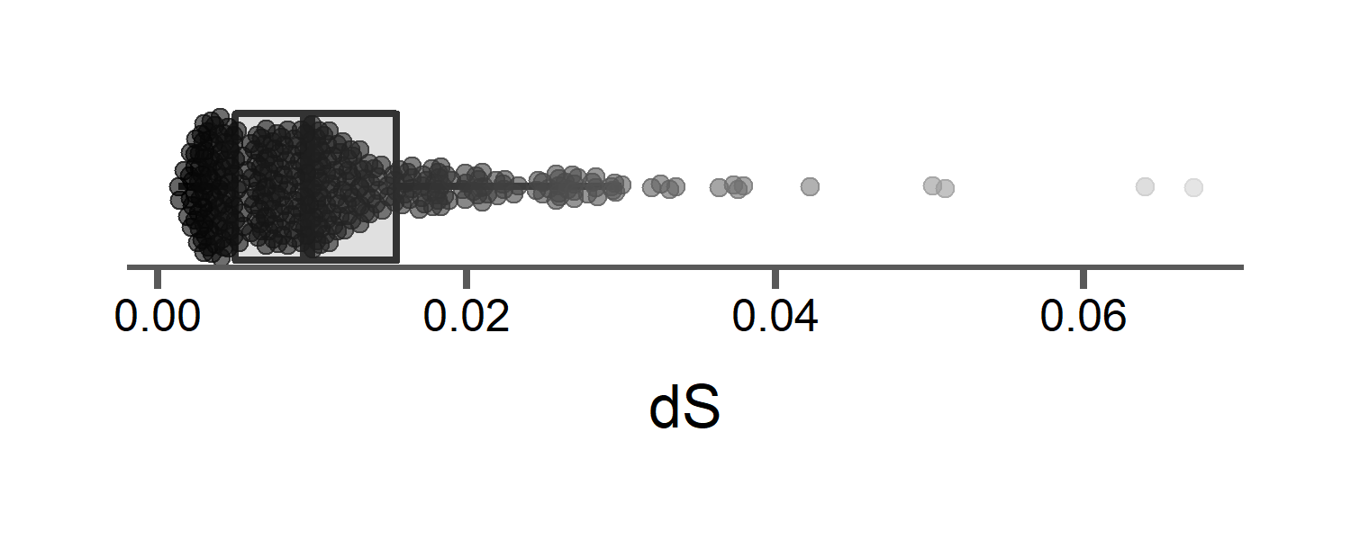
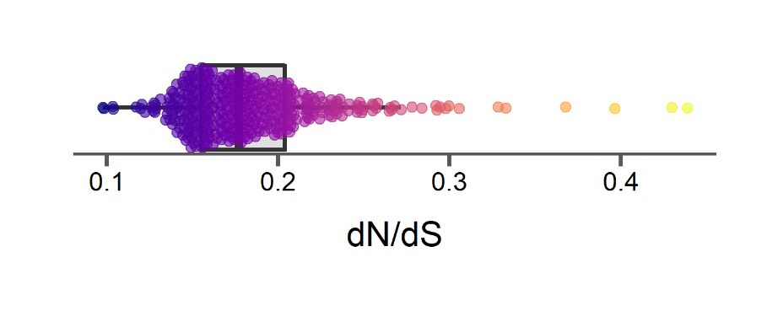
Little variation in average substitution rates across the rodent phylogeny
Notes:
Again, switching to the purely topological representation of the rodent tree..
And when we measure rates along the tree, we come up with these distributions. So here each point represents one branch of the tree, and we’re measuring non-synonymous nucleotide substitutions, these are ones that change the resulting amino acid, abbreviated as dN, synonymous substitutions that don’t change the amino acid, abbreviated as dS, and the ratio of the two. Since we assume that most synonymous changes, the ones that don’t change the amino acid, are mostly neutral, and ones that do are under more selective constraint, then the ratio of the two types can give us an estimate of the strength of selection acting at on a gene while controlling for neutral changes.
So I’ve colored the branches on the left by this ratio, dn/ds, to see if we can localize where these bursts of adaptive substitutions occur. And for the most part we don’t actually see that much variation, a little bit here in some of the Australian lineages. It’s very similar to the insects with not a lot of extreme rate variation.

Slide 101

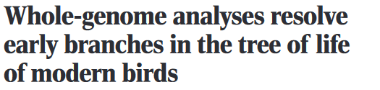
Discordance is common
“No single intron, exon, or UCE locus from our TENT data set had an estimated topology identical to the ExaML TENT or MP-EST* TENT”
Jarvis et al.
Notes:
So phylogenetic discordance discordance among loci both within a species and between species is I think a generally well-known phenomena, but basically discordance is just when two loci are sampled and used to reconstruct a phylogeny and they give different answers, specifically regarding the topology of the tree. We can talk about discordance among loci, but also its common to talk about discordance between a certain locus and an inferred species tree.

Slide 102

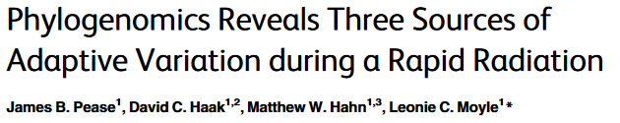
Discordance is common
“No single intron, exon, or UCE locus from our TENT data set had an estimated topology identical to the ExaML TENT or MP-EST* TENT”
Jarvis et al.
“Among the 2,745 trees generated from nonoverlapping 100 kb segments of the genome, we inferred 2,743 different topologies”
Notes:
So phylogenetic discordance discordance among loci both within a species and between species is I think a generally well-known phenomena, but basically discordance is just when two loci are sampled and used to reconstruct a phylogeny and they give different answers, specifically regarding the topology of the tree. We can talk about discordance among loci, but also its common to talk about discordance between a certain locus and an inferred species tree.

Slide 103


Discordance is common
“No single intron, exon, or UCE locus from our TENT data set had an estimated topology identical to the ExaML TENT or MP-EST* TENT”
Jarvis et al.
“Among the 2,745 trees generated from nonoverlapping 100 kb segments of the genome, we inferred 2,743 different topologies”
“However, inspecting the gene trees reveals extreme levels of discordance: none of their topologies matches the topology of the tree inferred from concatenation, and nearly every gene tree has a unique topology.”
Sun et al.
Notes:
So phylogenetic discordance discordance among loci both within a species and between species is I think a generally well-known phenomena, but basically discordance is just when two loci are sampled and used to reconstruct a phylogeny and they give different answers, specifically regarding the topology of the tree. We can talk about discordance among loci, but also its common to talk about discordance between a certain locus and an inferred species tree.

Slide 104
Discordance is common
“No single intron, exon, or UCE locus from our TENT data set had an estimated topology identical to the ExaML TENT or MP-EST* TENT”
Jarvis et al.
“Among the 2,745 trees generated from nonoverlapping 100 kb segments of the genome, we inferred 2,743 different topologies”
“However, inspecting the gene trees reveals extreme levels of discordance: none of their topologies matches the topology of the tree inferred from concatenation, and nearly every gene tree has a unique topology.”
Sun et al.
Notes:
So phylogenetic discordance discordance among loci both within a species and between species is I think a generally well-known phenomena, but basically discordance is just when two loci are sampled and used to reconstruct a phylogeny and they give different answers, specifically regarding the topology of the tree. We can talk about discordance among loci, but also its common to talk about discordance between a certain locus and an inferred species tree.

Slide 105
Discordance is common
“No single intron, exon, or UCE locus from our TENT data set had an estimated topology identical to the ExaML TENT or MP-EST* TENT”
Jarvis et al.
“Among the 2,745 trees generated from nonoverlapping 100 kb segments of the genome, we inferred 2,743 different topologies”
“However, inspecting the gene trees reveals extreme levels of discordance: none of their topologies matches the topology of the tree inferred from concatenation, and nearly every gene tree has a unique topology.”
Sun et al.
Notes:
So phylogenetic discordance discordance among loci both within a species and between species is I think a generally well-known phenomena, but basically discordance is just when two loci are sampled and used to reconstruct a phylogeny and they give different answers, specifically regarding the topology of the tree. We can talk about discordance among loci, but also its common to talk about discordance between a certain locus and an inferred species tree.

Slide 106
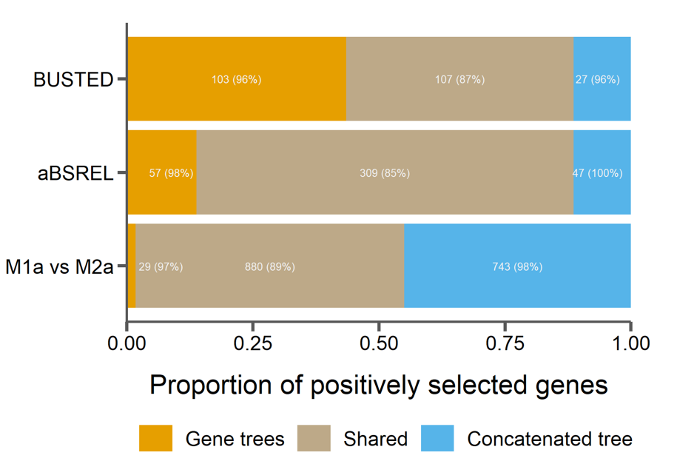
Discordance causes spurious inferences of selection
Thomas et al. in prep
16,000 genes from 7 rodent whole genomes
Species tree
Notes:
Specifically, among about 16,000 genes, we ran 3 different tests for selection, which are dependent on accurately counting substitutions along a phylogeny. For each test we ran all genes either with their inferred gene tree or with the single species tree inferred from concatenation of all gene sequences. And here for each test I’m showing those genes that were found to have evidence for positive selection using only the gene tree in orange, only the species tree in blue, and with both trees in tan.

Slide 107
Discordance causes spurious inferences of selection
Thomas et al. in prep
16,000 genes from 7 rodent whole genomes
Species tree
(false negatives when using species tree)
(false positives when using species tree)
Notes:
And the big take-away from that is this it doesn’t matter what type of selection test you use, if you use a single species tree for all of your genes, you will get a large number of false positives (in blue) and miss a lot of true positives (in orange).
Another interesting thing… the numbers here indicate the raw counts of genes in each category, and the percentage of those genes that have gene trees that disagree with the species tree. In every case almost all genes that are false positives or false negatives when using the concatenated tree are discordant with that tree. So this means that discordance may be playing a big role in these spurious results.

