Slide 1
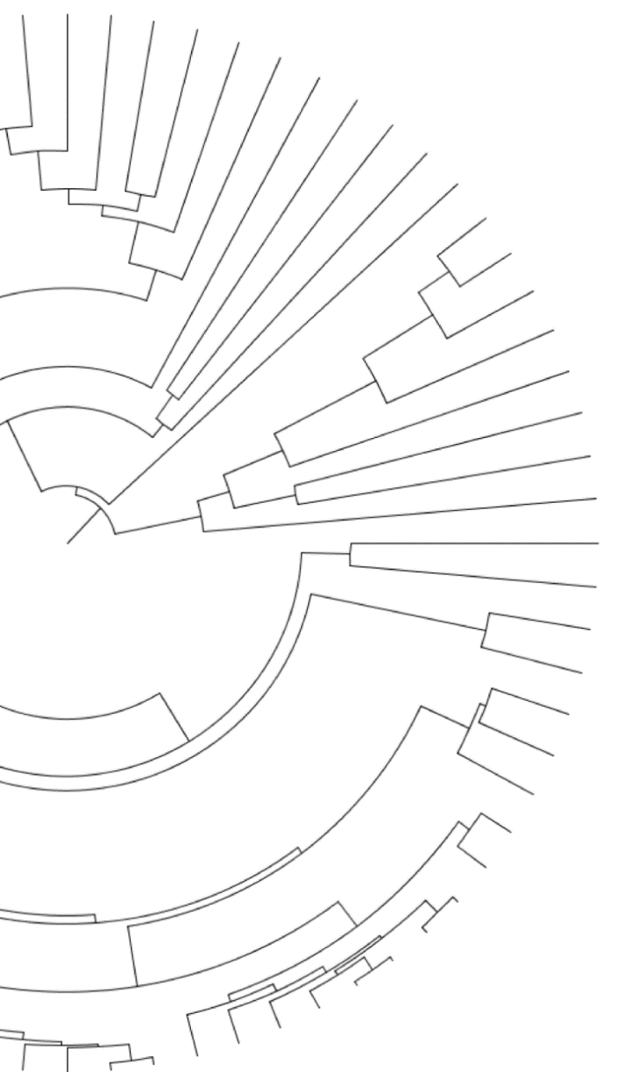


Quantifying and mitigating reference bias in comparative genomics
Gregg Thomas
gwct.github.io
Notes:
Hi everyone, my name is Gregg Thomas and I’m from the informatics group at Harvard. Today I’ll be talking about our project to quantify reference bias in comparative genomics.

Slide 2
Quantifying and mitigating reference bias in comparative genomics
Gregg Thomas
gwct.github.io
Notes:
And while this is the main goal of the project, this is very much a work in progress on both of these fronts, but hopefully what we’ve got will still be interesting.

Slide 3
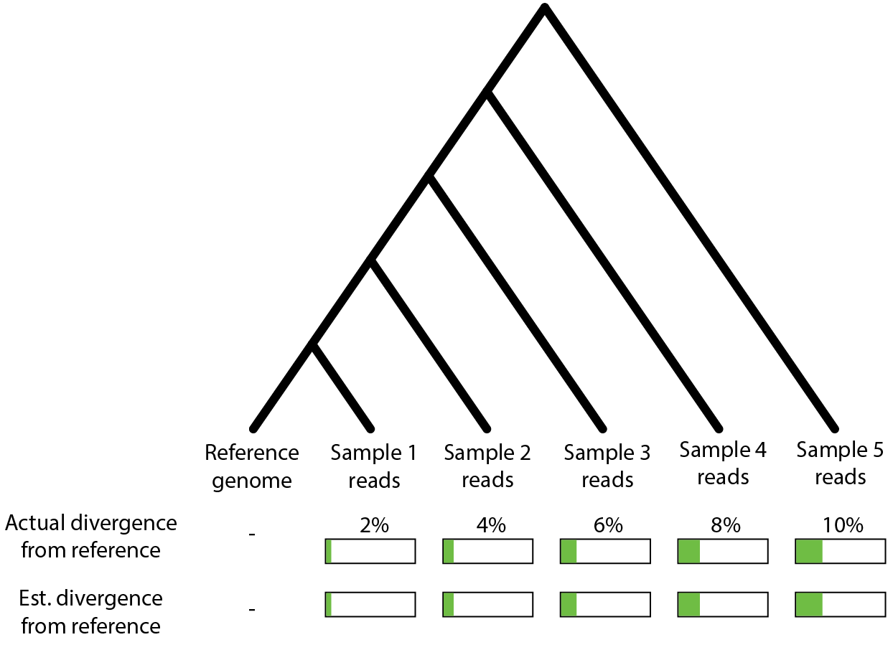
Reference-based read mapping is common to assess variation between samples
Notes:
A common scenario in both population and comparative genomics, especially for non-model organisms, is to have sequenced reads from a bunch of samples or species and one high-quality genome assembly. Since we’ve spent all this time getting this one high quality reference, its often most efficient to just map the reads from these samples to it. And with this strategy we can hopefully capture short variation like SNPs and indels, between our samples.
And there’s a lot we can do with this information: we can estimate divergence or heterozygosity, we can infer substitution rates and phylogenetic relatedness, or lift over annotations from the reference genome to identify functional sites we think may have experienced positive selection.

Slide 4
Samples mapped to the reference have varied levels of divergence from it
Notes:
However, these samples exist at varying levels of divergence from the reference, which we may not know exactly ahead of time,

Slide 5
Samples mapped to the reference have varied levels of divergence from it
Notes:
Then, if read mapping is effective, when we map the reads and call variants to estimate divergence, we should see roughly the same estimates as their actual divergence.

Slide 6
Does read mapping accurately capture variation among samples?
?
?
?
?
?
Notes:
So my question is: Is this what actually happens?

Slide 7
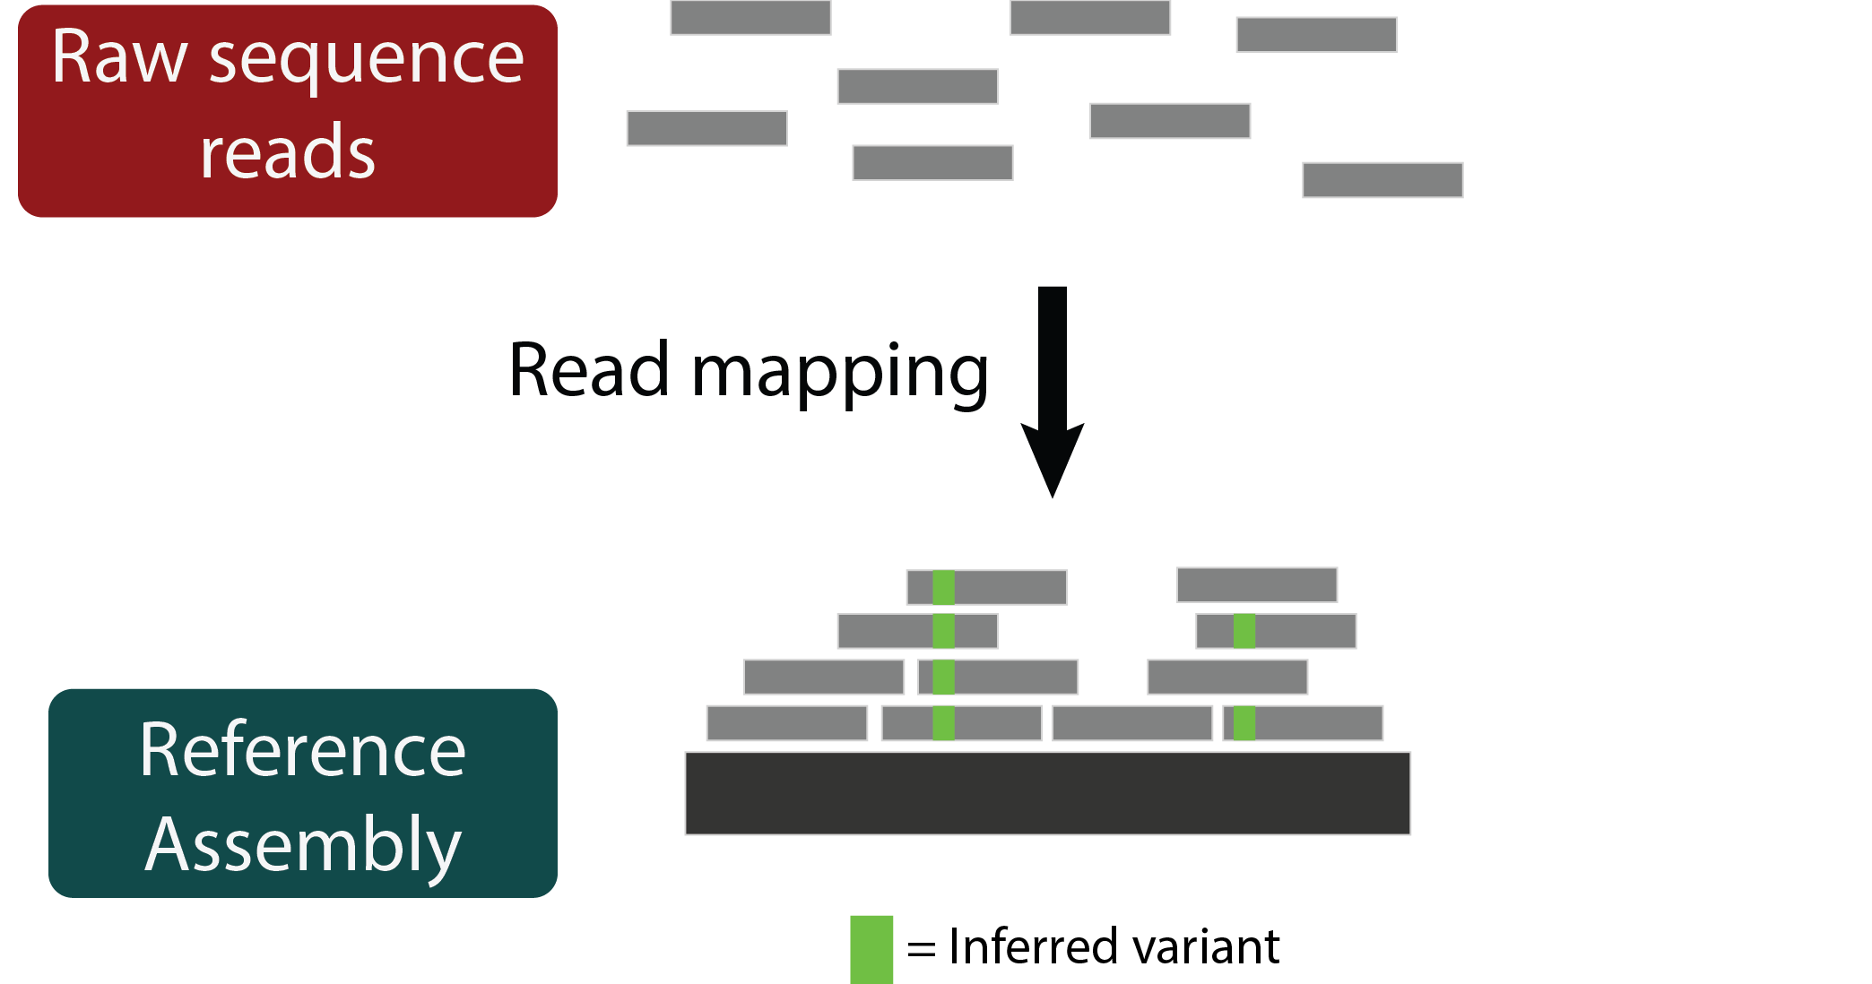
Read mapping may struggle with reads that have lots of variation relative to the reference
Notes:
And to explain the reason we think we may not be accurately capturing variation with read mapping I’ll show you another cartoon, which outlines the read mapping process, so we have our raw reads and our reference genome, and when we align the reads we can see where the sample differs from the reference, these are our inferred variants.

Slide 8
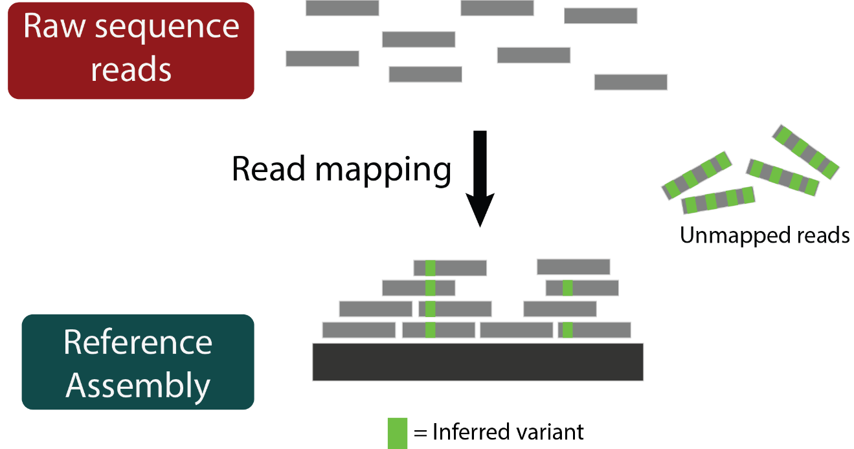
Read mapping may struggle with reads that have lots of variation relative to the reference
Notes:
Since read mapping is sequence alignment, its effectiveness is based on sequence similarity. That means reads that contain lots of actual variants may be unmapped simply because of those variants. This is called reference bias and means that those highly diverged regions may not be reflected in the final set of variants called, so we may expect lower estimates of divergence.

Slide 9
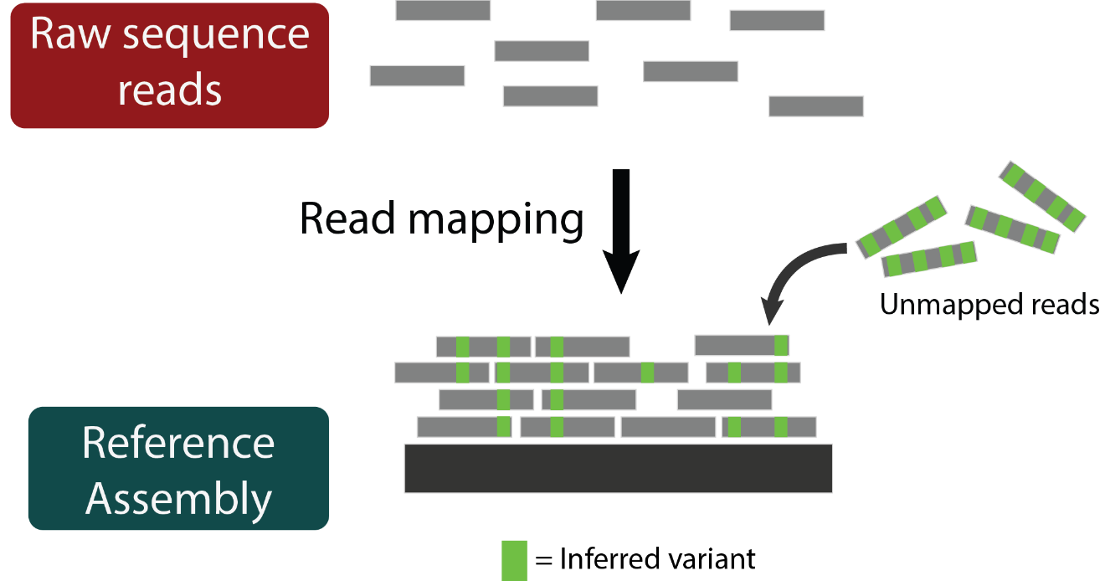
Read mapping may struggle with reads that have lots of variation relative to the reference
Notes:
Consequently if we could map those reads, we would incorporate that variation into our estimates and they would be more accurate.

Slide 10
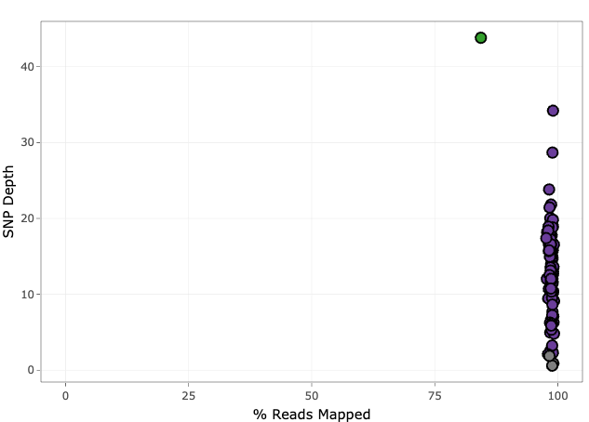
Reference bias may be caused by unmapped reads in diverged samples
Source: Tim Sackton, personal comm.
Notes:
There’s some evidence to suggest this may be happening. In some of our projects around the lab specifically we’ve seen that diverged samples have lower percentages of reads mapped. So here we just need to pay attention to the x-axis which shows the percent of reads mapped to the reference for a bunch of samples.

Slide 11
Reference bias may be caused by unmapped reads in diverged samples
Athene cunicularia (burrowing owl); reference genome for mapping
Source: Tim Sackton, personal comm.
Notes:
In this case the purple points are samples of the burrowing owl, one of which is also the reference genome used for read mapping

Slide 12
Reference bias may be caused by unmapped reads in diverged samples
Glaucidium brasilianum (ferruginous pygmy-owl)
Athene cunicularia (burrowing owl); reference genome for mapping
Source: Tim Sackton, personal comm.
Notes:
This one green point belongs to a different species but was still mapped to the burrowing owl genome, and you can see a shift on the x-axis. While all the burrowing owl samples have almost 100% of reads mapped, this sample has about 80%.

Slide 13
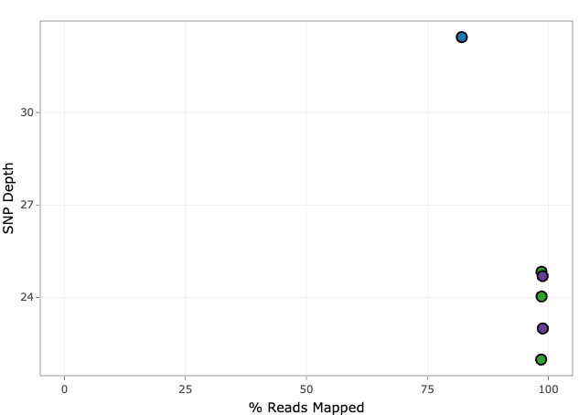
Reference bias may be caused by unmapped reads in diverged samples
Glaucidium brasilianum (ferruginous pygmy-owl)
Cochlearius cochlearius (boat-billed heron)
Athene cunicularia (burrowing owl); reference genome for mapping
Egretta garzetta (little egret); reference genome for mapping
Source: Tim Sackton, personal comm.
Notes:
And this is pervasive across many re-sequencing projects.

Slide 14
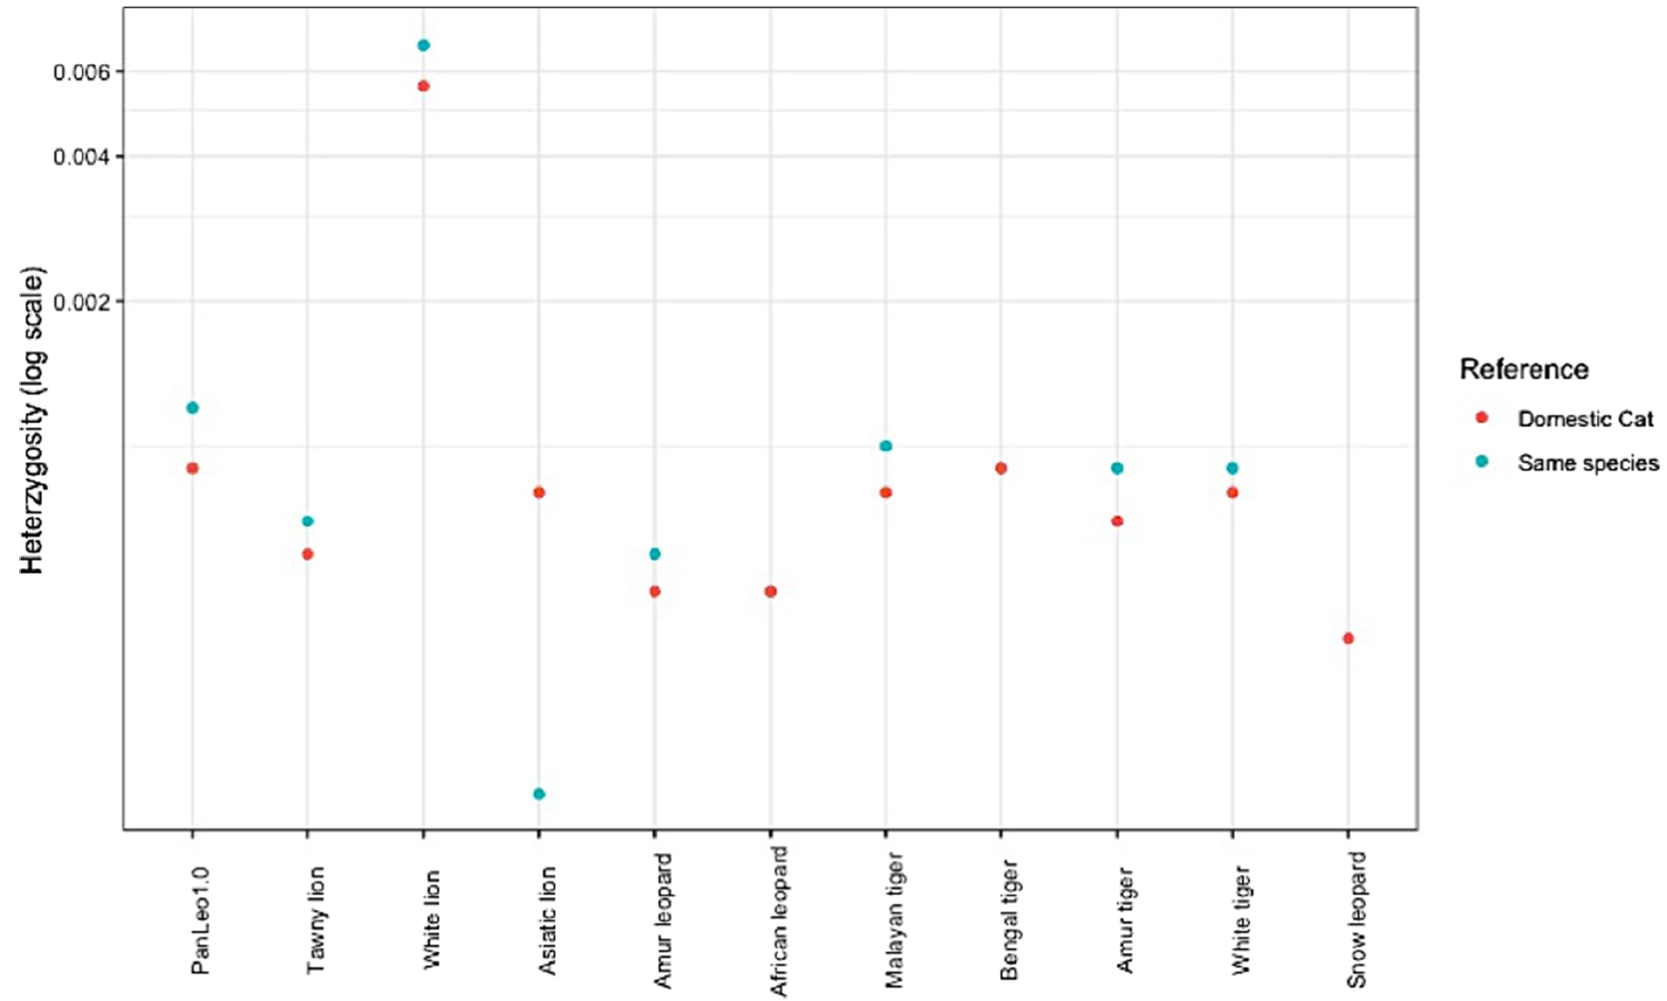
Reference bias can impact measures of sequence variation
Mapping to a more closely related genome results in increased estimates of heterozygosity in felids
Source: Armstrong et al. 2020, BMC Bio
Notes:
And these unmapped reads can have affects on downstream analyses. I’m not aware of many explicit examples of this in the literature, but this one is really nice. In this paper, Armstrong et al. show that when different species of felids are mapped to a genome from their own species in blue, estimates of heterozygosity tend to go up compared to when they are all mapped to the domestic cat genome in red.

Slide 15

Reference bias can impact measures of sequence variation
Source: Armstrong et al. 2020, BMC Bio
Notes:
This may be a case of the variation in some reads preventing them from mapping to a diverged reference, but being able to be mapped in a closer reference and subsequently those variants being captured in these estimates of heterozygosity.

Slide 16
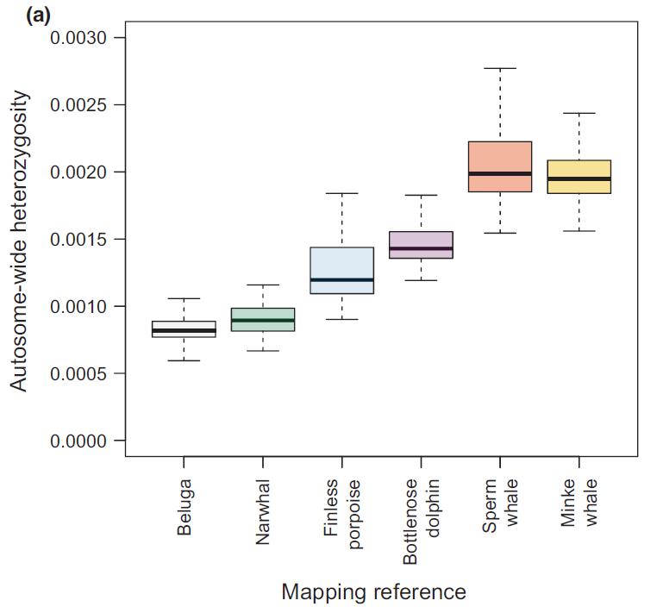
Reference bias can impact measures of sequence variation
The opposite is observed in whales – heterozygosity increases with increasing divergence from the reference
Source: Prasad et al. 2021, MER
Notes:
Strangely enough, the only other explicit test for reference bias I’ve found show’s an opposite pattern. Here, Prasad et al. map the genome of the beluga whale to reference genomes from various other species, here listed on the x-axis in increasing levels of divergence from the beluga. They actually observe increased heterozygosity with increased divergence, unlike what Armstrong et al. saw in the cats. They attribute this to possible mis-alignments, and various other methods they tried suggest different results.

Slide 17
Reference bias can impact measures of sequence variation
The opposite is observed in whales – heterozygosity increases with increasing divergence from the reference
We sought to quantify reference bias by using simulated genomes and reads
Source: Prasad et al. 2021, MER
Notes:
SO clearly reference bias is a problem, but we don’t really know a lot about it, and we wanted to rigorously quantify it by using simulations.

Slide 18
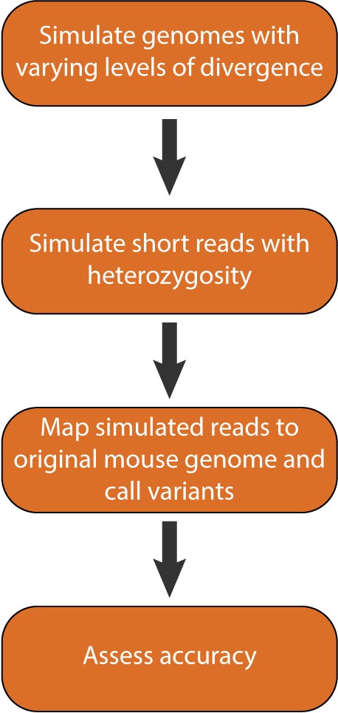
Reference bias simulations
0.02, 0.04, 0.06, 0.08, 0.10
30X coverage,
0.005 heterozygosity
BWA, GATK
Notes:
So I’ll briefly outline our simulation workflow. First, we needed to simulate diverged genomes from which we’d simulate reads to map.

Slide 19
Reference bias simulations
Based off mouse genome
0.02, 0.04, 0.06, 0.08, 0.10
30X coverage,
0.005 heterozygosity
BWA, GATK
Notes:
And we did this based off of the mouse reference genome. We could’ve chosen any genome to do this, but I’m familiar with the mouse genome and it is chromosome level and well annotated, so this seemed good.
And we inserted differences at between 2 and 10% of sites.

Slide 20
Reference bias simulations
Based off mouse genome
0.02, 0.04, 0.06, 0.08, 0.10
30X coverage,
0.005 heterozygosity
BWA, GATK
Notes:
Next we took each of these genomes and simulated short reads from them. And for now we’ve only done 30X coverage and 0.5% heterozygosity.

Slide 21
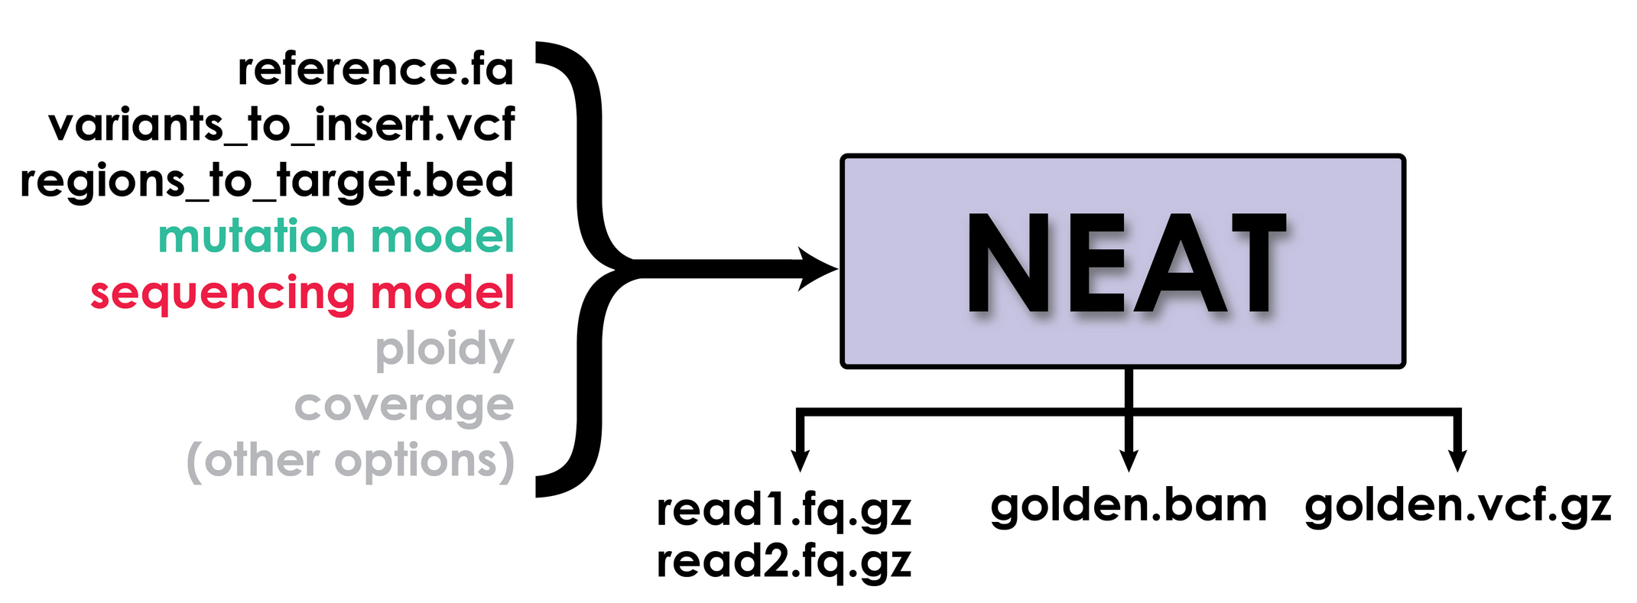
Reference bias simulations
Based off mouse genome
0.02, 0.04, 0.06, 0.08, 0.10
30X coverage,
0.005 heterozygosity
BWA, GATK
NEAT: Stephens et al. 2016, PLoS One; https://github.com/ncsa/NEAT
Notes:
For both of these steps we used this read simulator called NEAT.
Besides attributing the software, the main reason I’m mentioning this so prominently is because NEAT provides as output from each run a golden BAM file and a golden VCF file containing the true locations of where reads should map and where variants were inserted. So this gives us and easy way to compare our calls against the truth.

Slide 22
Reference bias simulations
Based off mouse genome
0.02, 0.04, 0.06, 0.08, 0.10
30X coverage,
0.005 heterozygosity
BWA, GATK
NEAT: Stephens et al. 2016, PLoS One; https://github.com/ncsa/NEAT
Notes:
Then we mapped the simulated reads from each diverged genome back to the original mouse genome and called variants in a pretty typical way with BWA and GATK.

Slide 23
Reference bias simulations
Based off mouse genome
0.02, 0.04, 0.06, 0.08, 0.10
30X coverage,
0.005 heterozygosity
BWA, GATK
% reads correctly mapped
# variants correctly called
NEAT: Stephens et al. 2016, PLoS One; https://github.com/ncsa/NEAT
Notes:
And for each of these we’ll assess accuracy by comparing our BAM and VCF files to the golden files generated by NEAT.

Slide 24
Reference bias simulations
Based off mouse genome
0.02, 0.04, 0.06, 0.08, 0.10
30X coverage,
0.005 heterozygosity
BWA, GATK
?
?
?
?
?
% reads correctly mapped
# variants correctly called
NEAT: Stephens et al. 2016, PLoS One; https://github.com/ncsa/NEAT
Notes:
And this essentially sets us up with this situation except we know the actual level of divergence to compare to. So we’ll be able to fill in these question marks and quantify how divergence effects reference bias

Slide 25
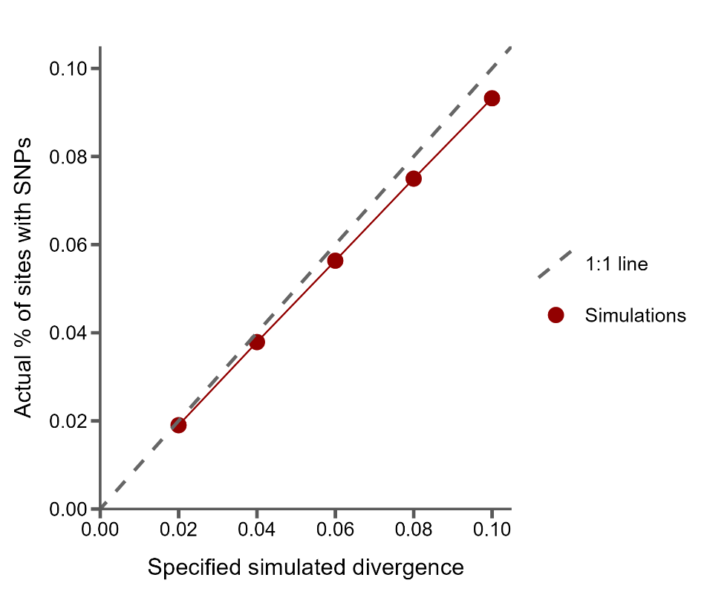
Sanity check: the % of SNPs simulated tracks specified divergence
Notes:
So, what did we find…
First I want to present just a sanity check from our simulations. Here on the x-axis I’m showing the specified divergence level for each simulation, and on the y-axis the actual percentage of sites with SNPs inserted in the golden VCF file.
The dashed grey line is the 1 to 1 line, which is where we hope our simulations fall. Each dot represents one simulated genome. And you can see the program is doing pretty well.

Slide 26
Sanity check: the % of SNPs simulated tracks specified divergence
However, with increasing divergence, fewer SNPs than expected are simulated
Possibly due to double hits
Notes:
Though as divergence increases we are slightly under-simulating variants. We think this is probably due to the simulator double-hitting sites more often as divergence increases. But I just wanted to show this because later on when I compare to expected levels of divergence, I’ll keep labeling as what we simulated, but the underlying numbers are actually slightly lower in some cases.

Slide 27
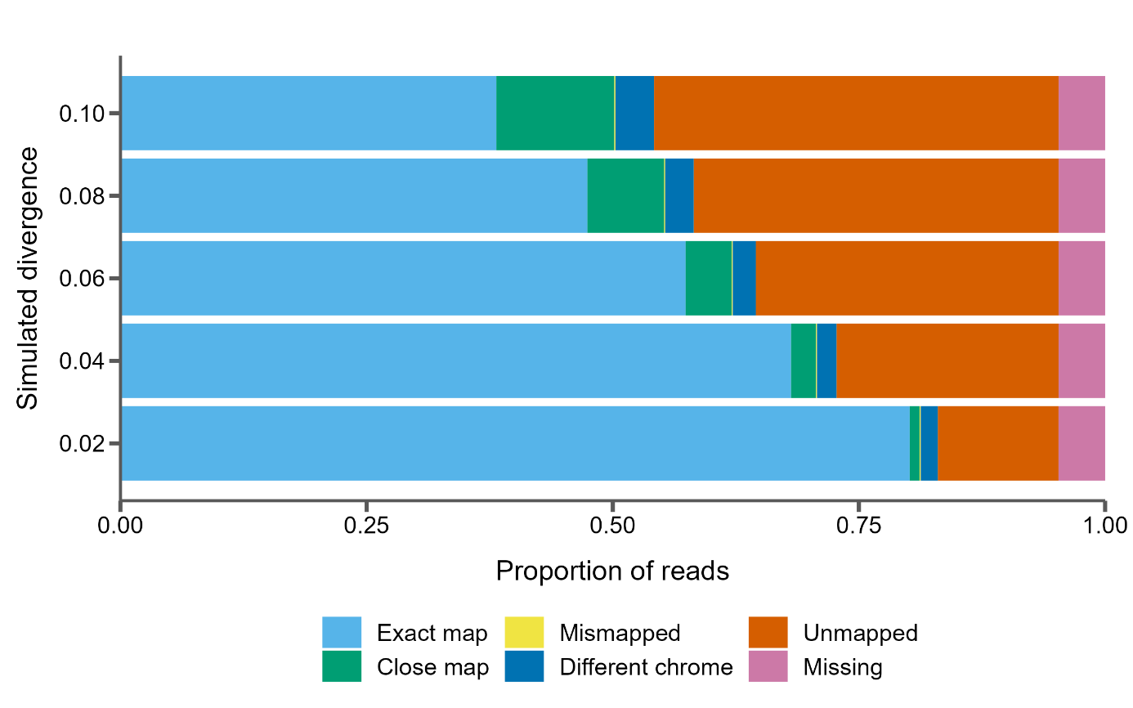
Read mapping accuracy with increasing divergence
Notes:
Next I want to show how well the simulated reads are mapped back to the reference genome for each level of divergence. And I’ll do this by showing proportional bar plots where on the x-axis we have the proportion of reads broken up into different categories based on these colors. I think most of these are self-explanatory, except for “Close map”, which means that read mapped within 1 read length (which is 150bp) of the true mapping position.
And on the y-axis we have the different simulations.
Chrome?

Slide 28
80% of reads mapped correctly at 2% divergence
12% of reads unmapped at 2% divergence
Notes:
I’ll start with our reads simulated with 2% sequence divergence. Here we see that 80% of reads map exactly where they should, these are the ones in light blue in the bar. I think this is good, but it is still kind of striking that nearly 12% of reads are unmapped, that’s this chunk in red.
Chrome?

Slide 29
Only 38% of reads map correctly at 10% divergence
12% of reads unmapped at 2% divergence
40% of reads unmapped at 10% divergence!
Notes:
And as we expected, the proportion of unmapped reads increases with divergence from the reference. But I was surprised by the extent of this increase: at 10% divergence only 38% of reads map correctly and 41% are unmapped! We also see an increase in the number of reads that map close to their expected position, but not exactly correctly.
Get examples?
Chrome?

Slide 30
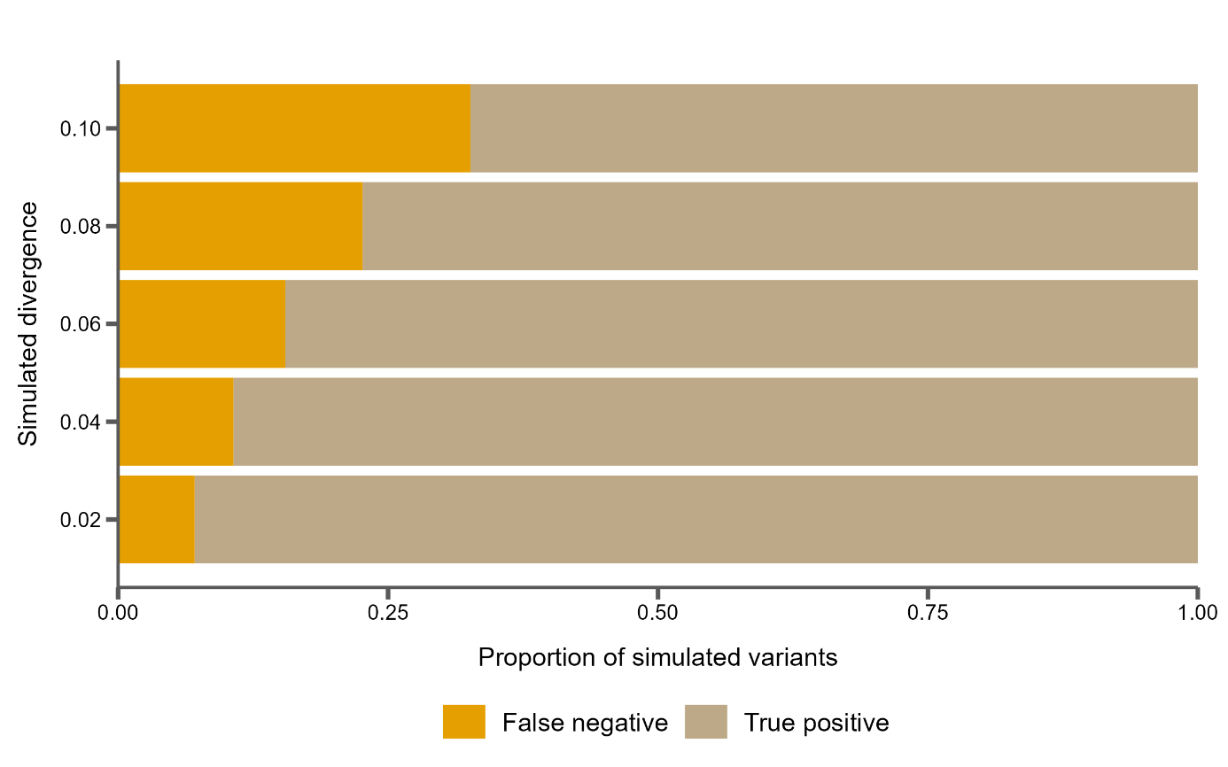
Variant calling accuracy with increasing divergence
Notes:
And we can do something similar for the called variants. Here I’ll show you a similar proportional bar plot, but this time the x-axis has the proportion of SNPs that were called in a couple categories. So here true positive means we simulated a variant there, and we’ve correctly called it as homozygous alternate compared to the reference genome. And false negative means we simulated a variant there, but did not end up calling it.
Chrome?

Slide 31
Variants are increasingly missed as divergence goes up
False negatives rise from 7% to 33% of all variants called
Notes:
And as expected with the increasing number of unmapped reads, we see an increasing number of false negative variant calls. And these range from 7% of all variants at 2% sequence divergence to missing one third of all variants at 10% divergence.
Chrome?
So again, that means we simulated a variant at this position, but after read mapping and variant calling we failed to identify it.

Slide 32
Variants are increasingly missed as divergence goes up
False negatives rise from 7% to 33% of all variants called
The proportion of false positives is small does not increase
Notes:
Interestingly, the proportion of false positive variant calls, which I’m not showing here, does not increase at all. In fact, there are barely any false positive calls. This is good and I think also expected especially in such a clean simulation:
Ok so, we clearly see that reference bias is an issue. It affects how reads map and subsequent variant calls. So what can we do about it?
Chrome? the variant caller isn’t going to call something that doesn’t exist in any of the reads, and unmapped reads shouldn’t somehow introduce evidence for variants that aren’t there.

Slide 33
Iterative mapping to mitigate the effects of reference bias
Notes:
One possible solution that we’ve proposed in the past is iterative mapping. So remember, our goal is to get these unmapped reads with lots of variation to map to the reference genome.

Slide 34
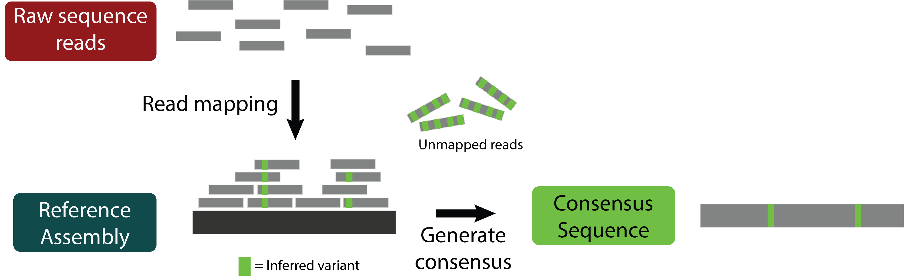
Iterative mapping to mitigate the effects of reference bias
Notes:
So, with iterative mapping, after the first round of mapping, you insert the variants called back into the reference genome, generating a sort of consensus pseudo-assembly for your new sample which includes all the variation you could capture.

Slide 35
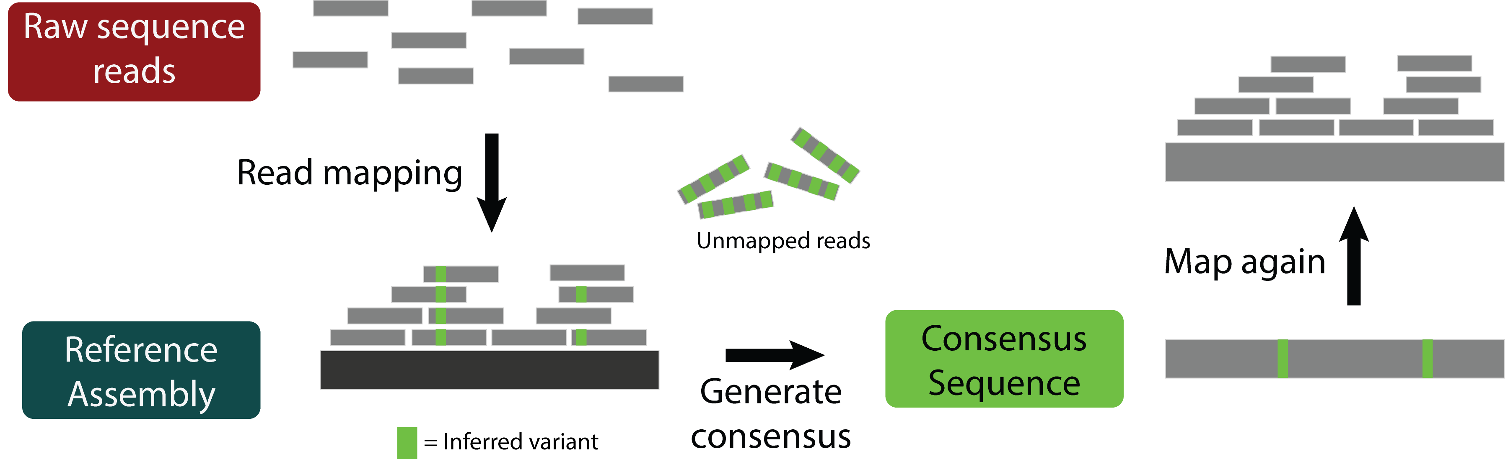
Iterative mapping to mitigate the effects of reference bias
Notes:
Then you map your reads again, this time to the consensus.

Slide 36

Iterative mapping to mitigate the effects of reference bias
Notes:
And the idea is that, since this consensus assembly already has some variation included…

Slide 37
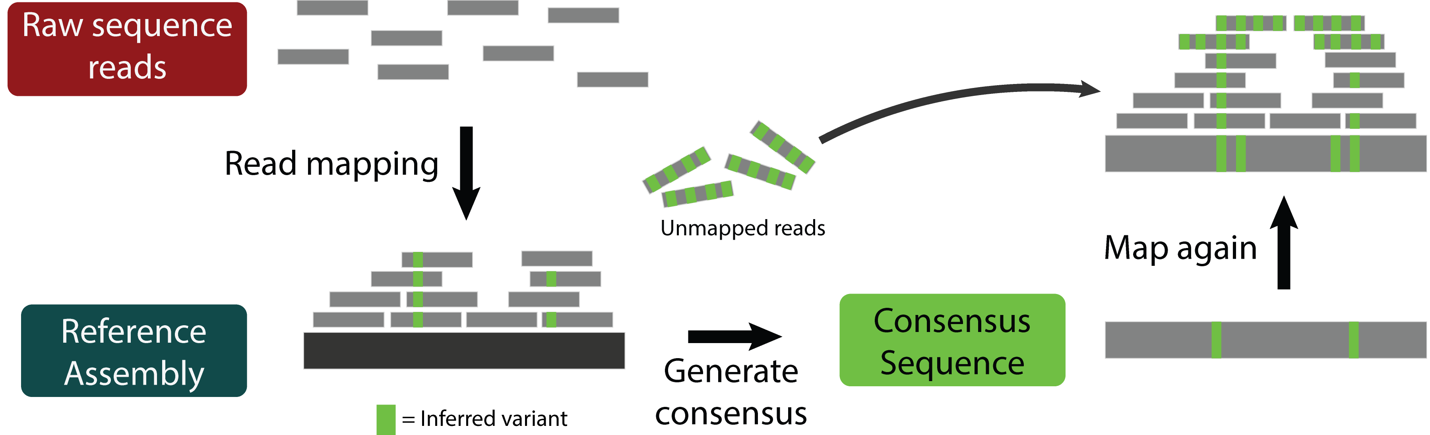
Iterative mapping to mitigate the effects of reference bias
Notes:
That can serve as sort of an anchor point for these unmapped reads to match up to, hopefully allowing them to map and those other variants be called. And you can do this any number of times you want… generate another consensus with all the newly called variation, re-map, etc., possibly each time incorporating more variation.

Slide 38
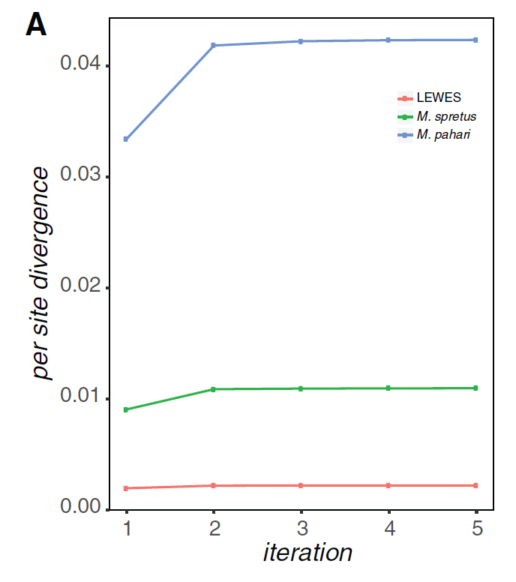
Iterative mapping increases per site divergence estimates in mapped samples
Source: Sarver et al. 2017, GBE
Notes:
And this was done by Brice Sarver and Jeff Good in 2017 on a few species of mice, and you can clearly see, especially for more diverged species, Pahari, that at least two rounds of mapping increases estimates of divergence between this species and the reference mouse genome.

Slide 39
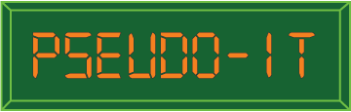
Iterative mapping increases per site divergence estimates in mapped samples
https://github.com/goodest-goodlab/pseudo-it
Source: Sarver et al. 2017, GBE
Notes:
And they implemented this method in software called pseudo-it, which I also worked on a lot when I did a postdoc with Jeff.

Slide 40
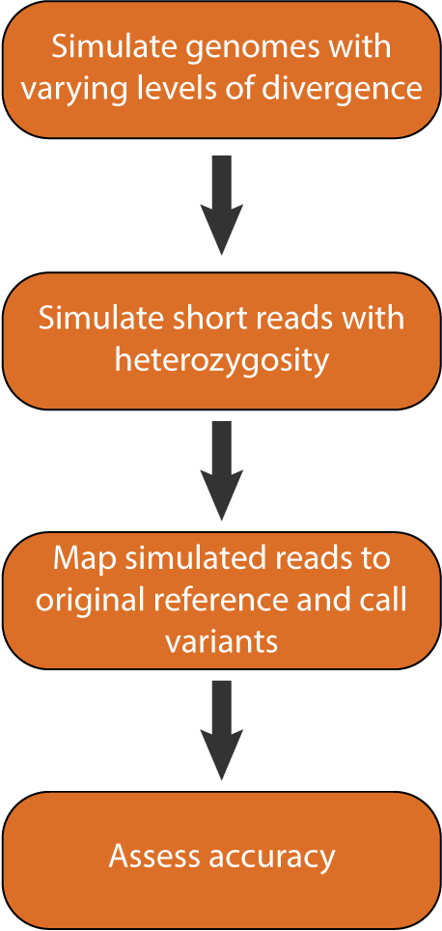
Reference bias simulations
0.02, 0.04, 0.06, 0.08, 0.10
30X coverage,
0.005 heterozygosity
BWA, GATK
Notes:
So that is a great empirical example of iterative mapping, but we also wanted to explicitly quantify its effects with simulations. Do we need to do iterative mapping in every instance to reduce bias? Or are there some cases where it may not be needed. After all, we’ve done a lot to speed things up with pseudo-it, but mapping and variant calling multiple times per sample can be time consuming.

Slide 41
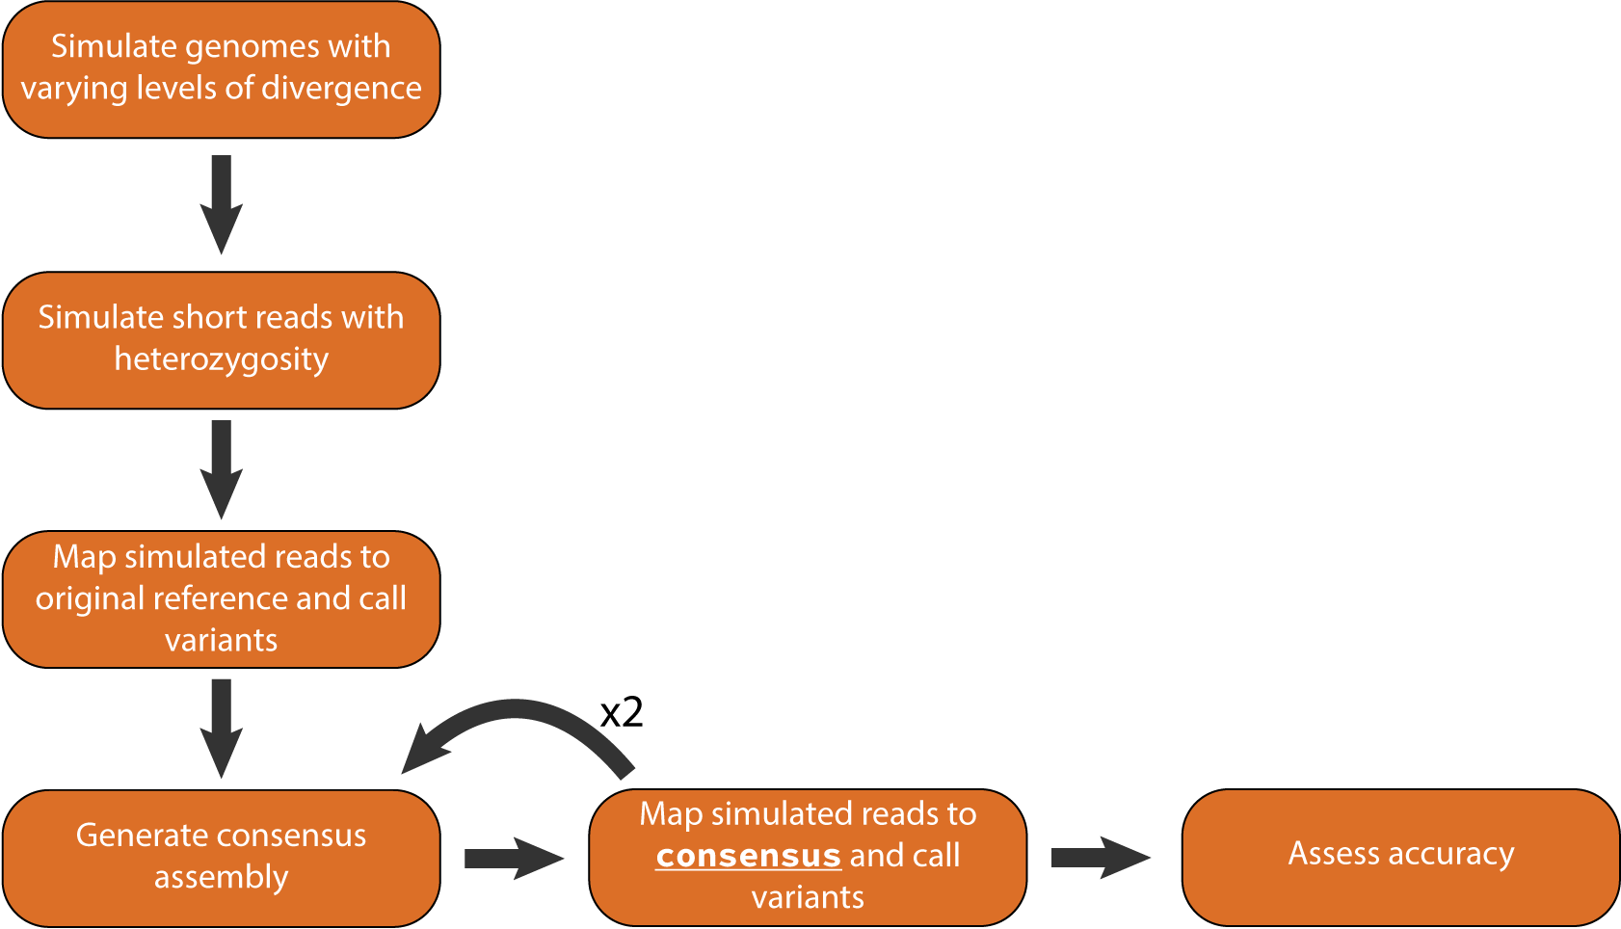
Reference bias simulations with iterative mapping
0.02, 0.04, 0.06, 0.08, 0.10
30X coverage,
0.005 heterozygosity
BWA, GATK
bcftools
BWA, GATK, minimap2
Notes:
So we basically re-implemented the pseudo-it pipeline for our simulations.
Instead of checking accuracy after just one round of mapping, we’ll also generate a consensus pseudo-assembly from the variants we called and re-map to that. And we’ll do this 2 times, so 3 total iterations of mapping, and align the genomes generated from each iteration back to the reference with minimap to assess accuracy.

Slide 42
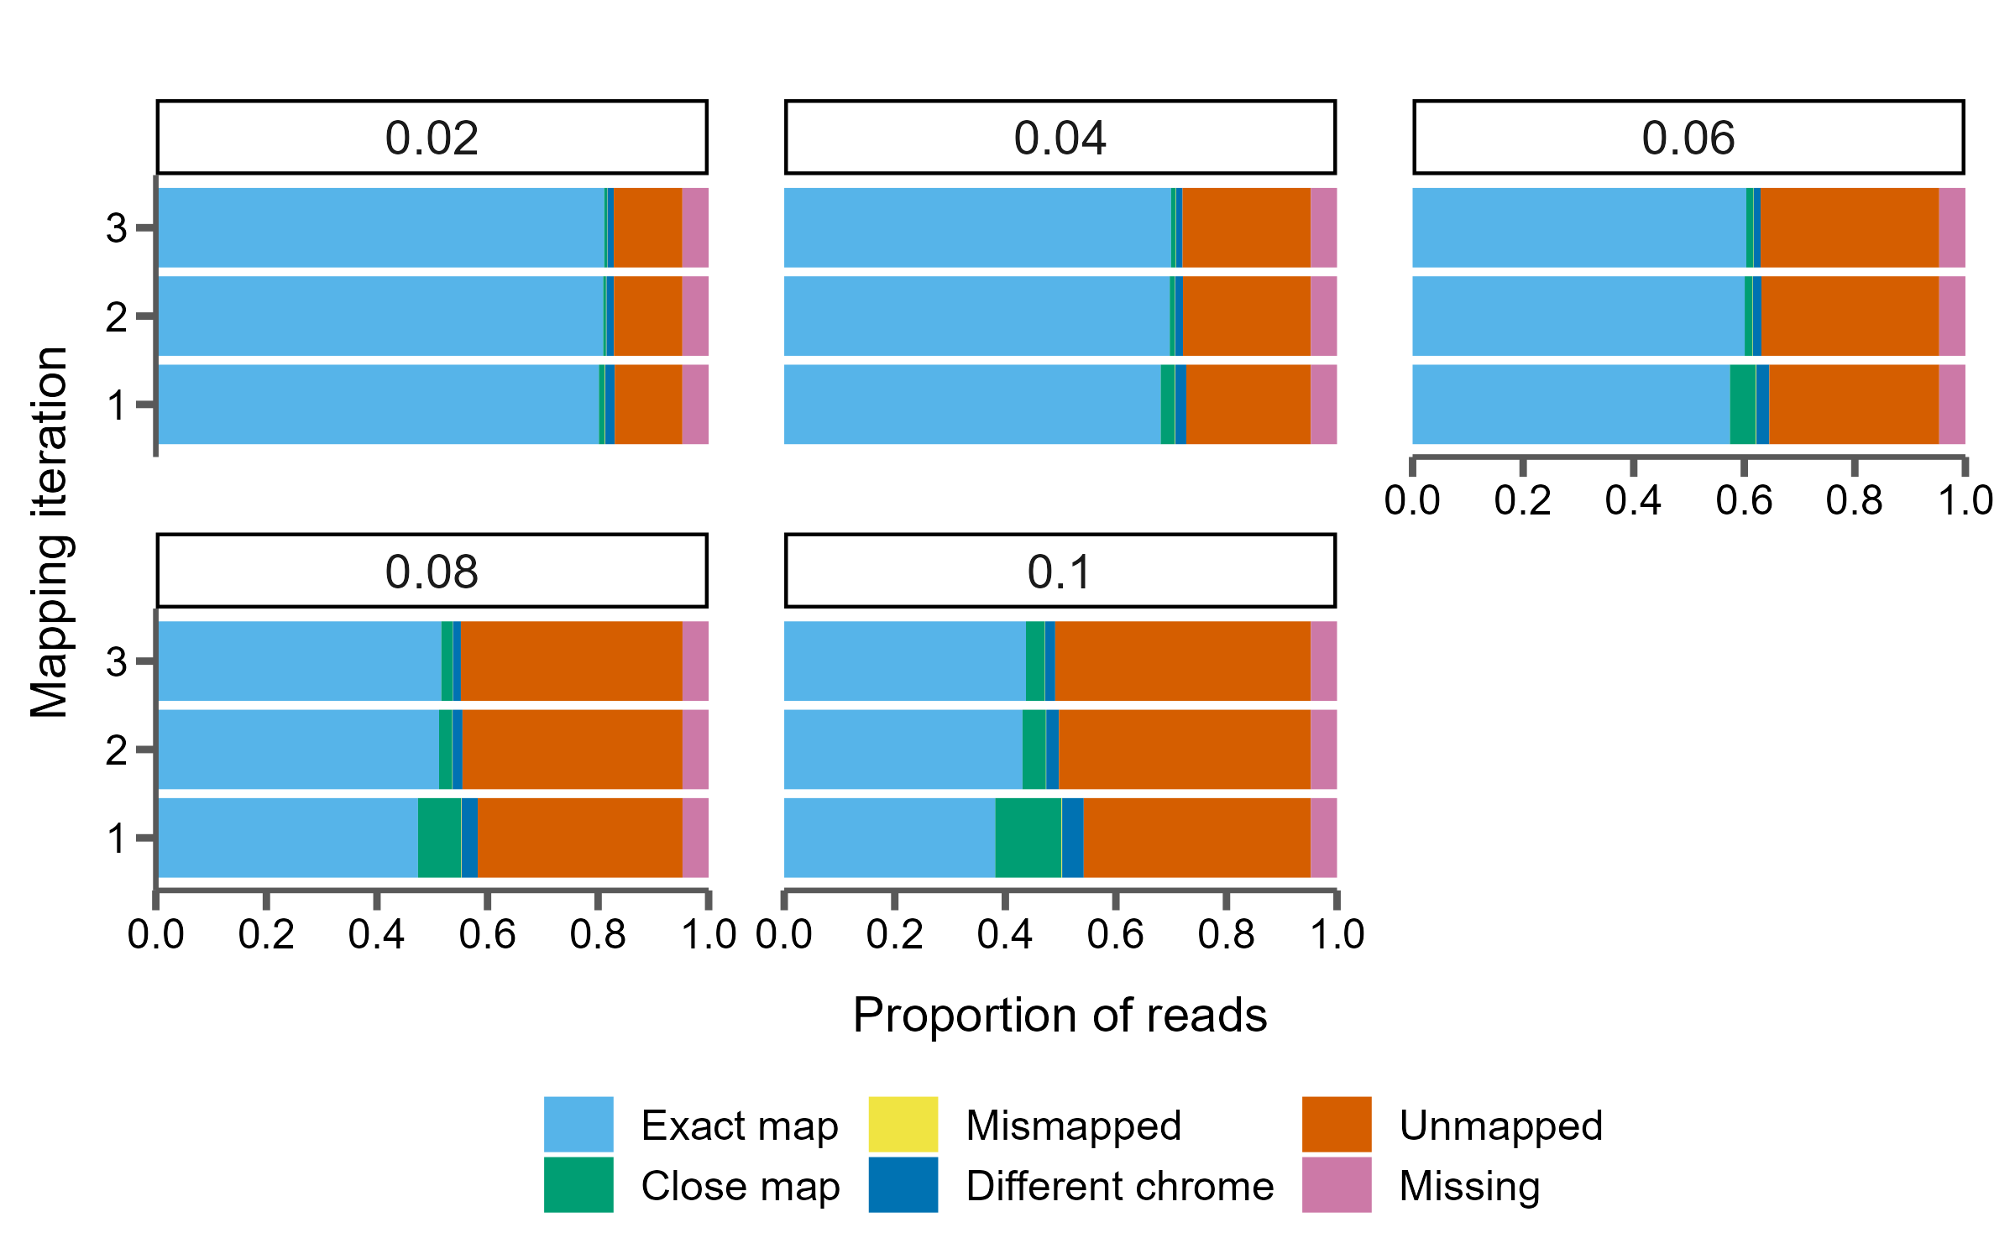
Read mapping accuracy with iterative mapping
Notes:
So how does iterative mapping do?
Well let me just set this up for you again. So again I’ll be showing proportional bar graphs of different classes of reads mapped on the x-axis. This time the y-axis represents the iteration of mapping, and each panel will represent one simulation with some level of divergence.

Slide 43
80% of reads map correctly at 2% divergence regardless of iterative mapping
Notes:
Let’s start with the lowest level of divergence simulated, 2%. And here we see that iterative mapping has basically no effect. We map about 80% of reads correctly each time, and the proportion of unmapped reads stays consistent at about 12%.

Slide 44
Roughly 5% more reads are mapped correctly after iterative mapping at 10% divergence
Notes:
The same trend is true for 4% divergence, roughly no change in the proportion of mapped or unmapped reads.

Slide 45
Roughly 5% more reads are mapped correctly after iterative mapping at 10% divergence
Notes:
However, when we get to higher levels of divergence, we do start to see an effect, however maybe not what we thought it would be.

Slide 46
Roughly 5% more reads are mapped correctly after iterative mapping at 10% divergence
Notes:
Let’s focus on the 10% panel since it’s the easiest to see the pattern: with one iteration of mapping we correctly map 38% of reads. After 3 iterations that goes up to 43%, a 5% improvement. That seems like a pretty good increase.

Slide 47
Roughly 5% more reads are mapped correctly after iterative mapping at 10% divergence
Percentage of unmapped reads increases from 41 to 46
Notes:
But lets notice that the proportion of unmapped reads, the red chunk, also, goes up, from 41% up to now 46%!

Slide 48
Roughly 5% more reads are mapped correctly after iterative mapping at 10% divergence
Percentage of unmapped reads increases from 41 to 46
Most improvement comes from better mapping reads that were closely mapped before
Notes:
It seems like most of the improvement we see comes from more accurately mapping reads that were already mapped, just slightly off from their correct position. So that was unexpected, and we’re still trying to figure out why.
I’ll also note that, like Sarver et al, we also see almost all of our improvement after the second iteration of mapping, so more than that may be unnecessary.
So what does this mean for our called variants?

Slide 49
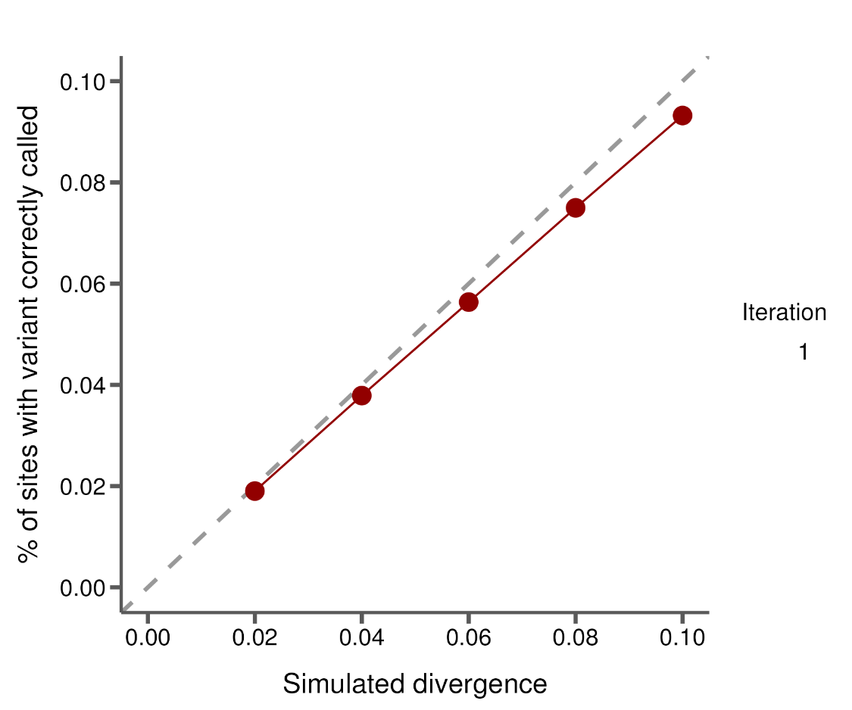

Iterative mapping and variant calling
Notes:
Well, what about the SNPs? Well I showed you this before, which just shows the number of SNPs that actually were inserted into our simulated genomes here as the red dots.

Slide 50
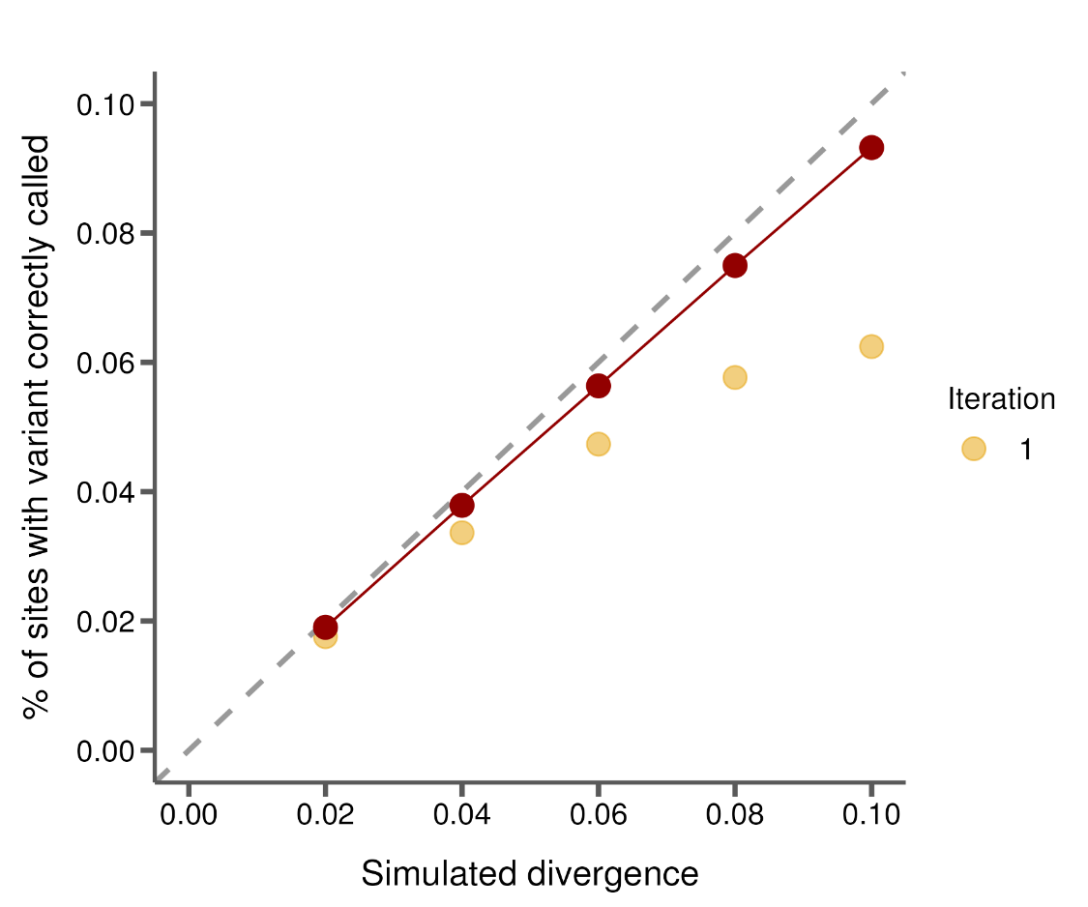
More variants are missed at higher levels of divergence
Notes:
We can look at the number of SNPs correctly called after one iteration of mapping, and this is basically just another way to show you the True Positive rate that I showed before in the bar plots. So as divergence increases, were missing more and more SNPs.
Does iterative mapping improve this?

Slide 51
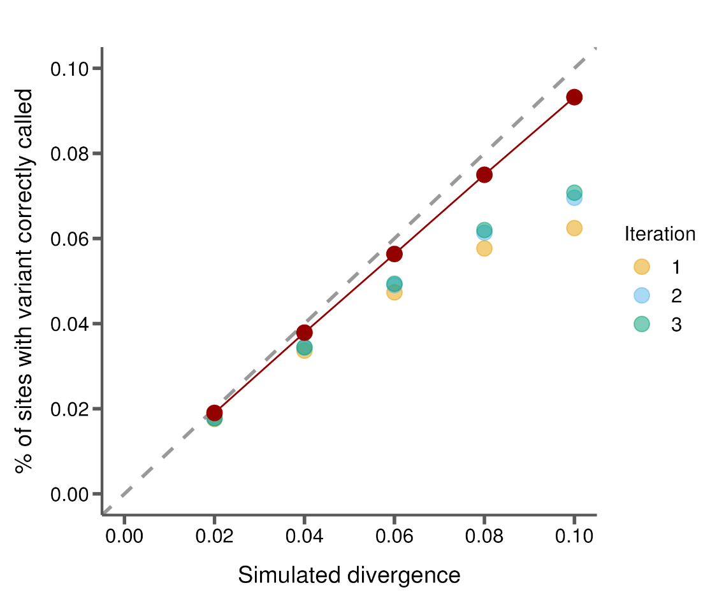
Iterative mapping makes up for some of the missed variation, but not all
Notes:
Well, kind of. At low levels of divergence, where we’re basically calling all the SNPs already, more rounds of mapping doesn’t seem to really do anything. And at higher levels, again lets look at 10% divergence, we do recover a substantial number of SNPs that were missed in the first round of mapping… however, no where near the total number. So we’re still far away from the red point here.
So as it is apparent here, we are making up for some of the missed calls, but definitely not all of them.

Slide 52
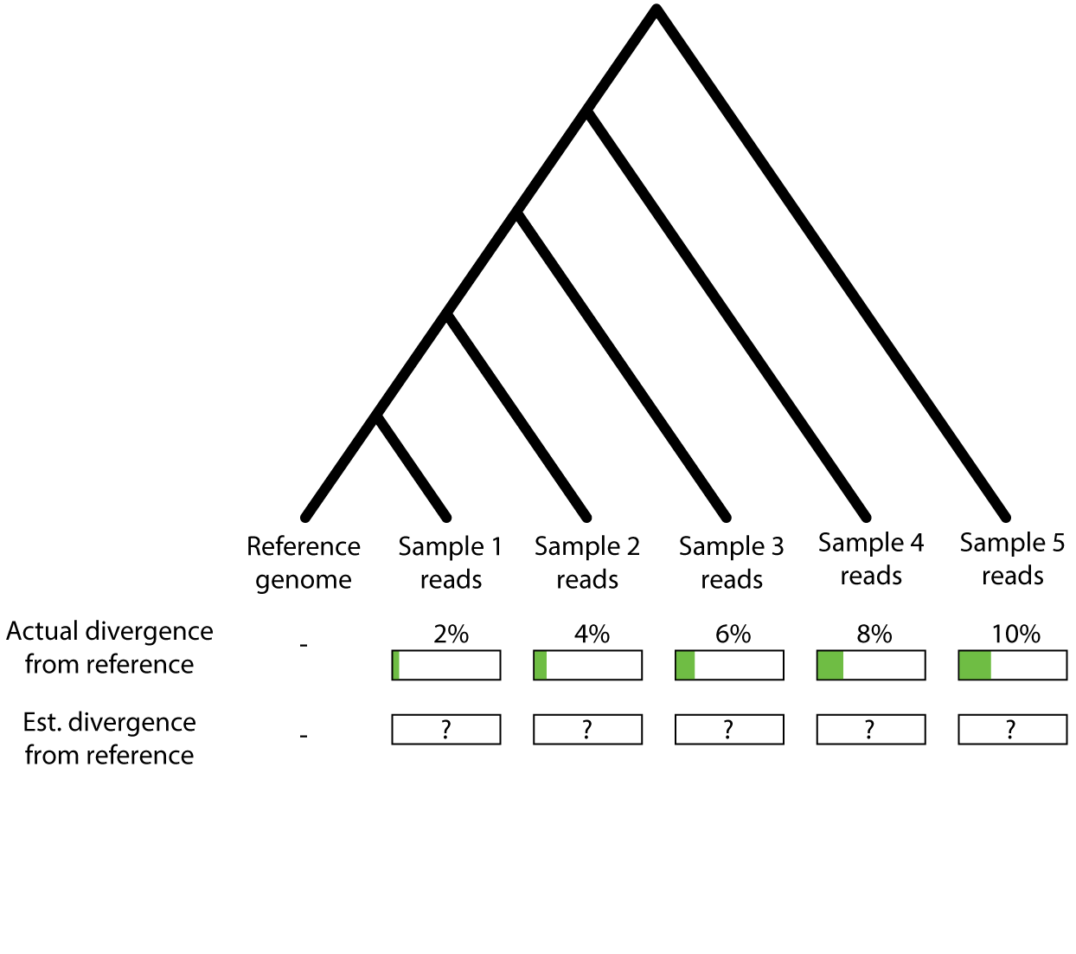
Does read mapping accurately capture variation among samples?
Notes:
So, just to summarize, we were interested in how varying levels of divergence from the reference genome affects how variation is captured from read mapping.

Slide 53
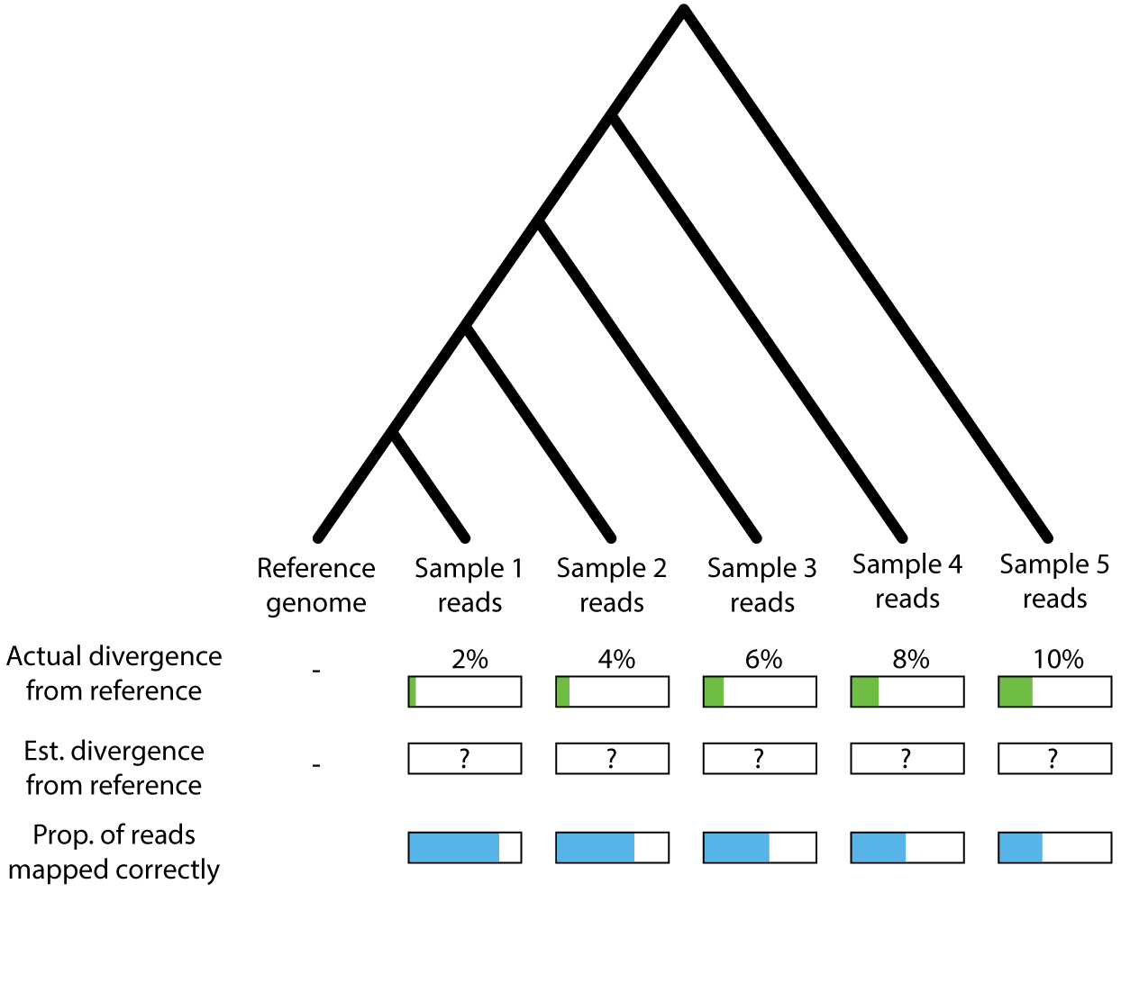
With increasing divergence from the reference:
Fewer reads are mapped correctly

Slide 54
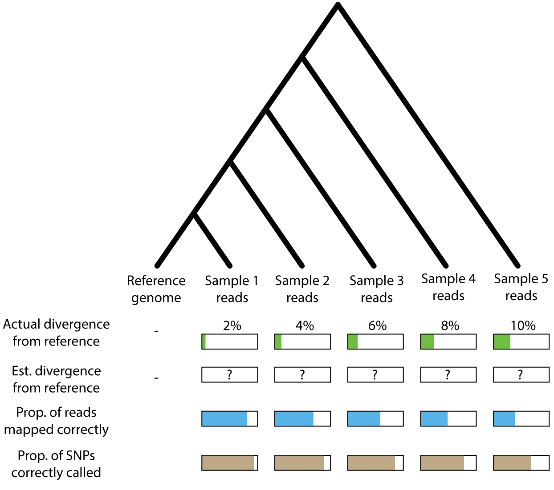
With increasing divergence from the reference:
Fewer reads are mapped correctly
More SNPs are not called

Slide 55
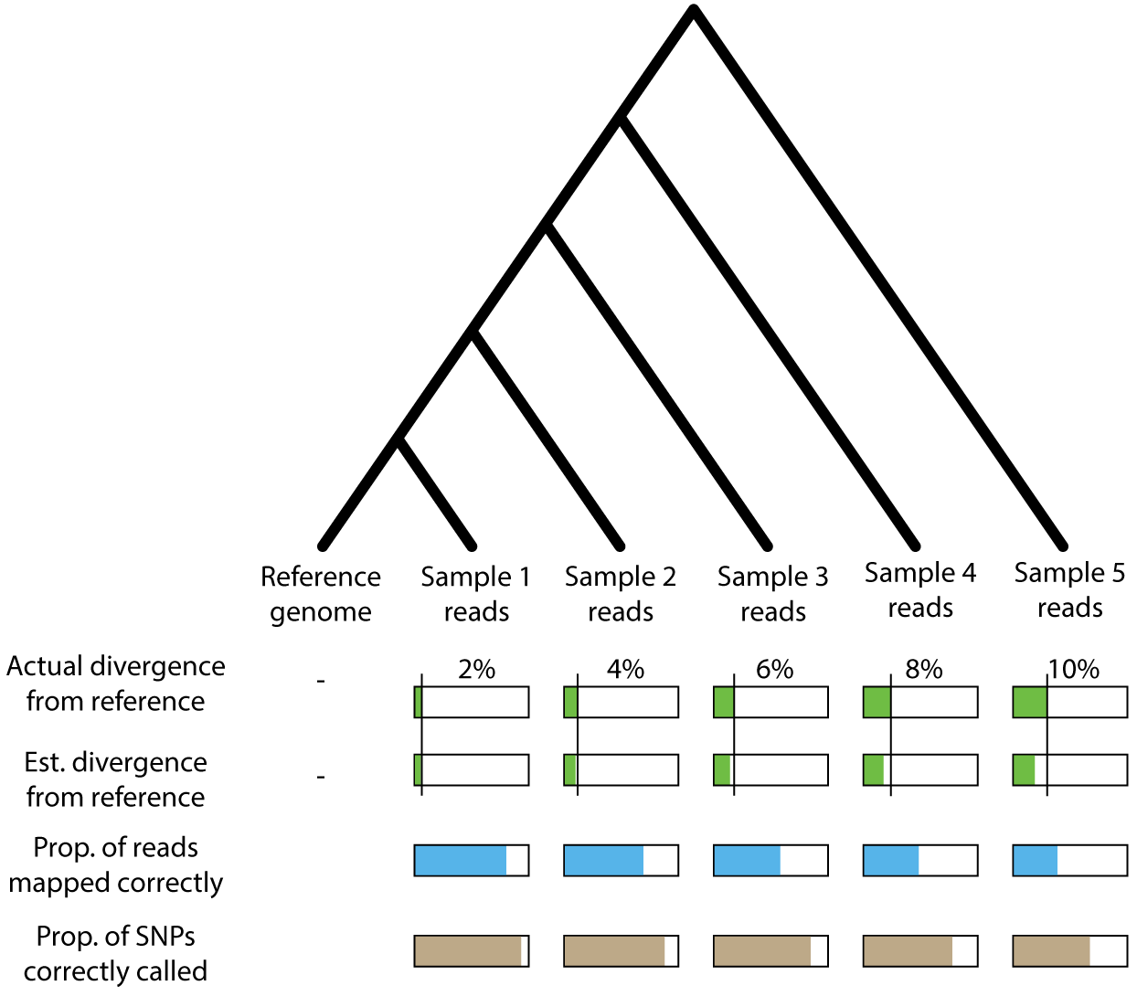
With increasing divergence from the reference:
Fewer reads are mapped correctly
More SNPs are not called
Divergence is underestimated

Slide 56
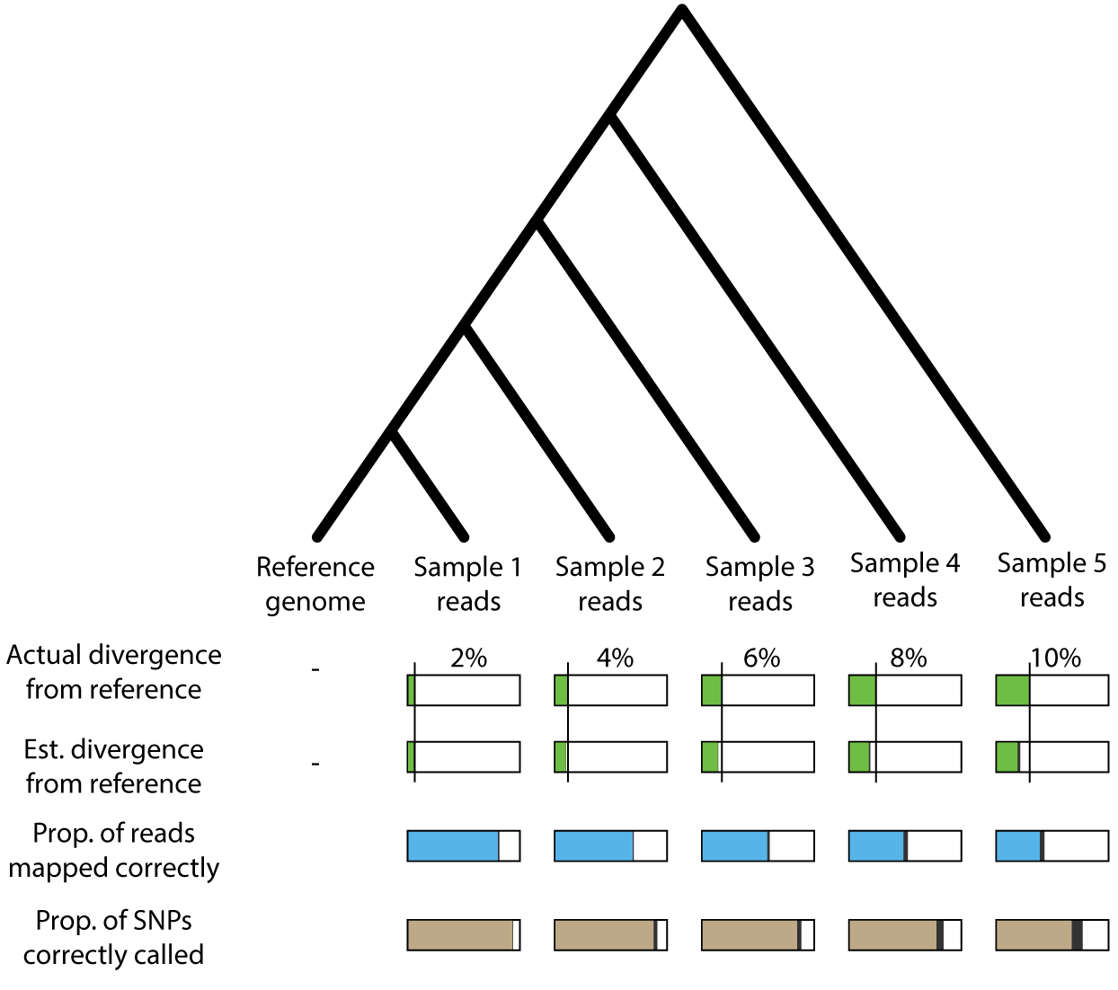
With increasing divergence from the reference:
Fewer reads are mapped correctly
More SNPs are not called
Divergence is underestimated
Iterative mapping helps a bit

Slide 57
Next
Heterozygosity per iteration
Where are the unmapped reads and false negative variants?
Vary coverage and heterozygosity
Long reads and mappers

Slide 58


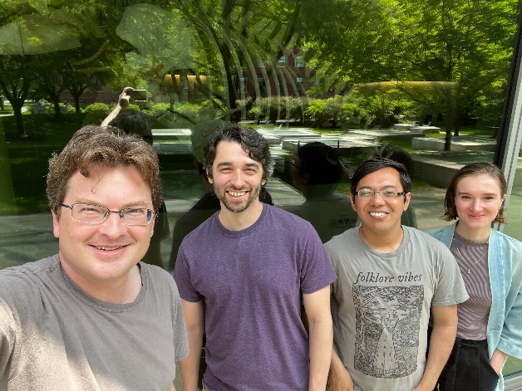
Tim Sackton | Jeff Good | Adam Freedman
Danielle Khost | Nathan Weeks | Subir Shakya
Katya Osipova | Clara Boothby | Brice Sarver
Acknowledgements
Notes:
But with that…

Slide 59
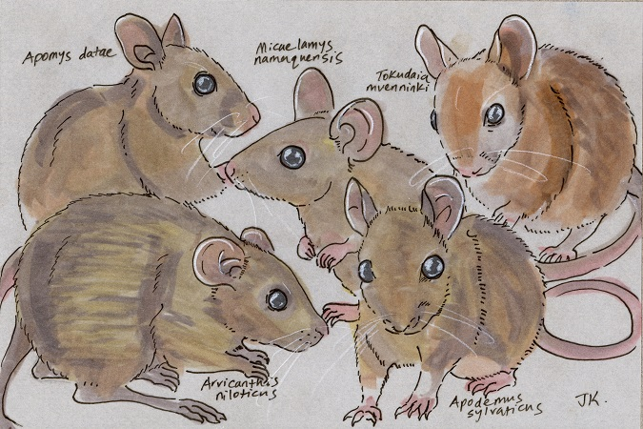
Thanks
http://dailymammal.com/murines-five-ways/

Slide 61
The number of unmapped reads increases linearly with divergence
12% of reads unmapped at 2% divergence
40% of reads unmapped at 10% divergence!
Notes:
We also noticed that the number of unmapped reads increases almost linearly, which I’ve approximated here just by drawing a line over the red bars. This is interesting and suggests that we could possibly model this and estimate sequence divergence between genomes just based on the number of unmapped reads between them. Of course, real data is a lot messier than this so who knows if that will hold true.
Chrome?

Slide 62
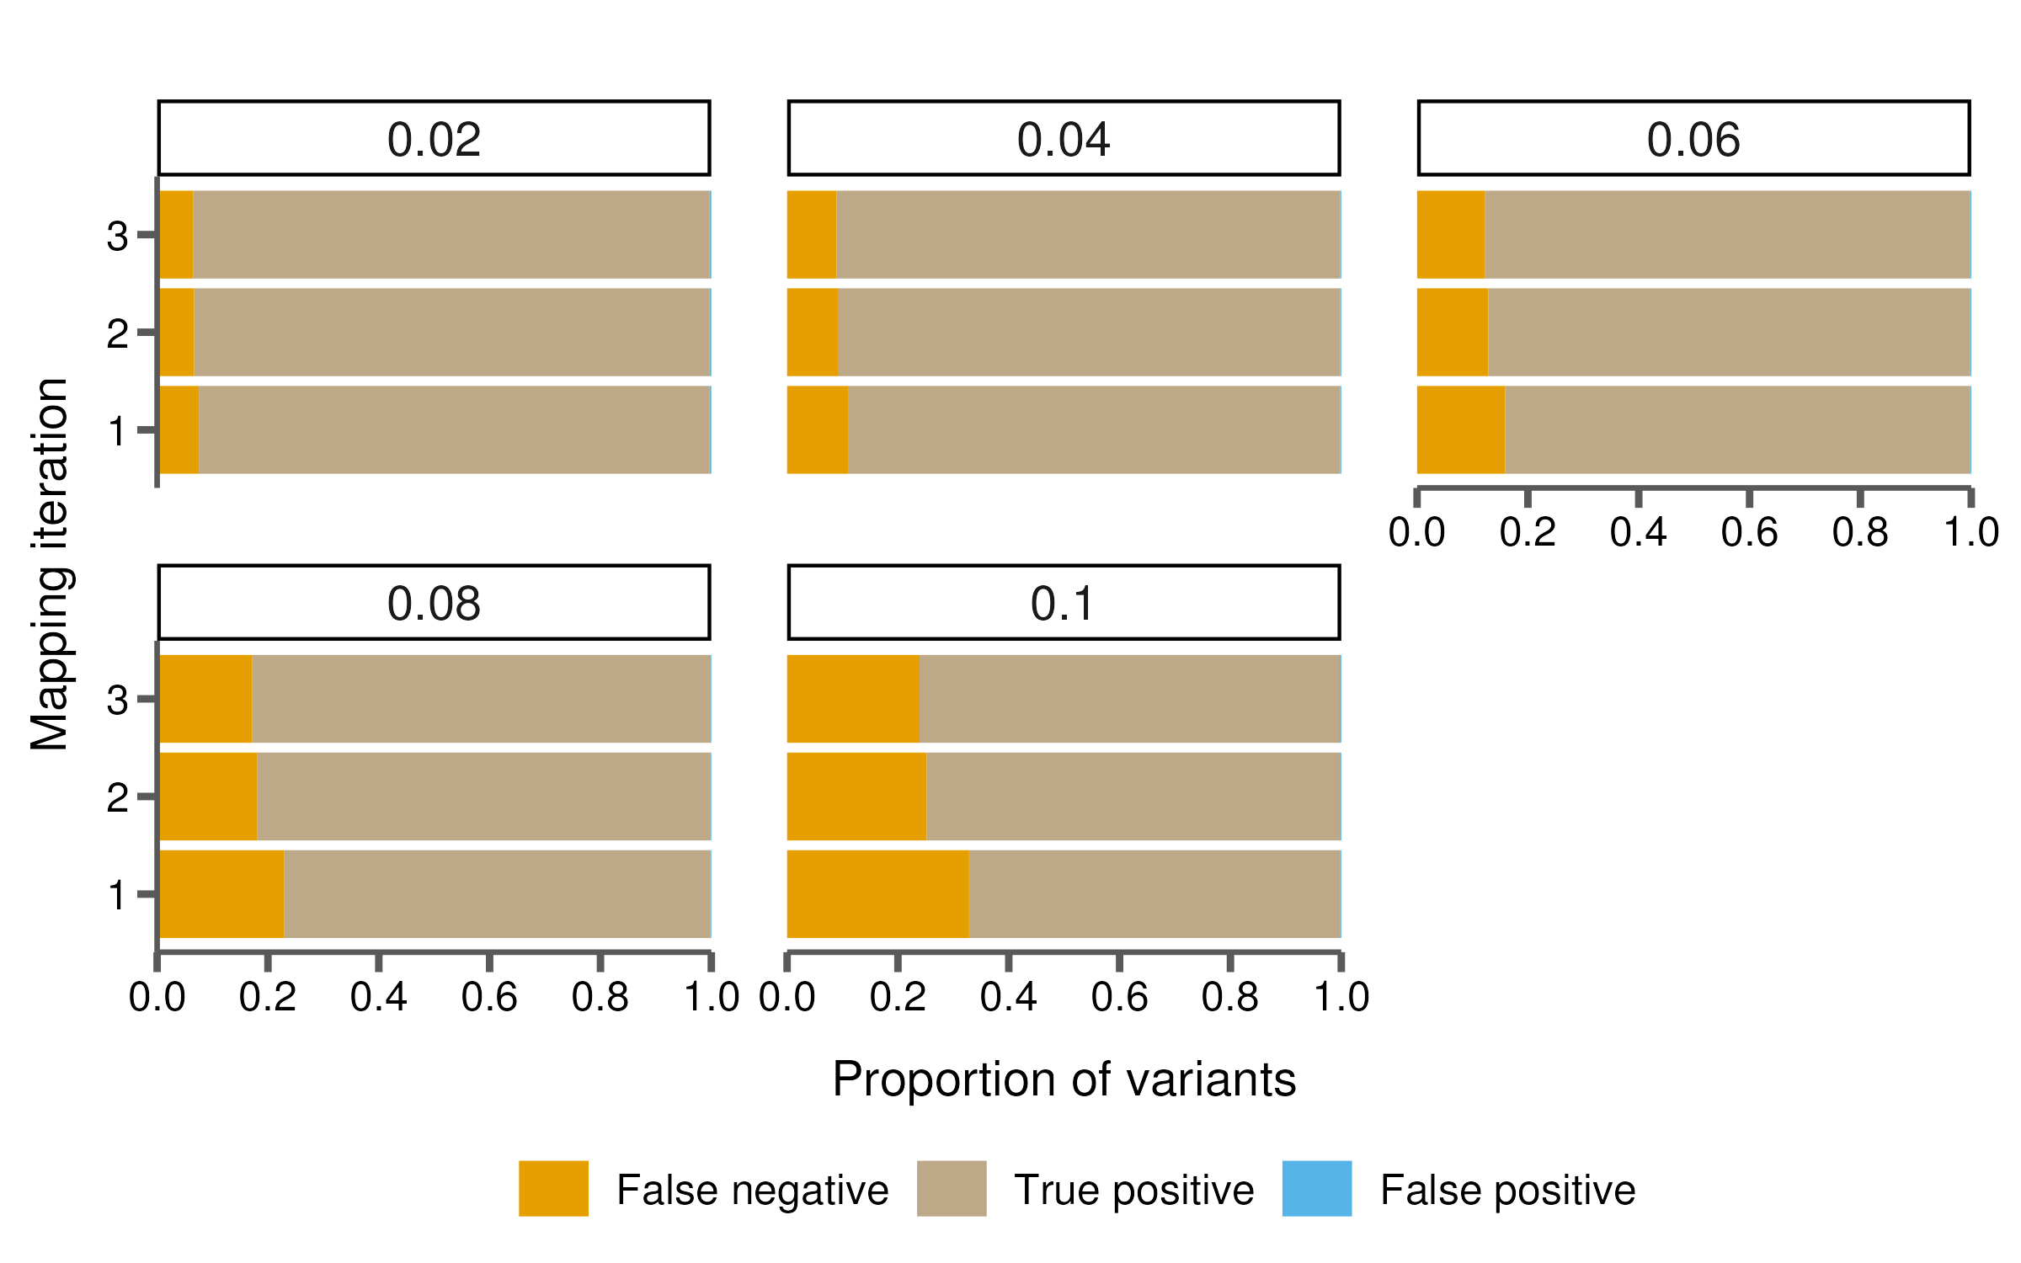
Fewer missed variants after iterative mapping
Notes:
Well, I think unsurprisingly, more accurately mapping those reads results in missing fewer variants. Again this is especially pronounced at the higher levels of divergence we simulated, where we see a marked decrease in false negatives after the second iteration of mapping.

Slide 63
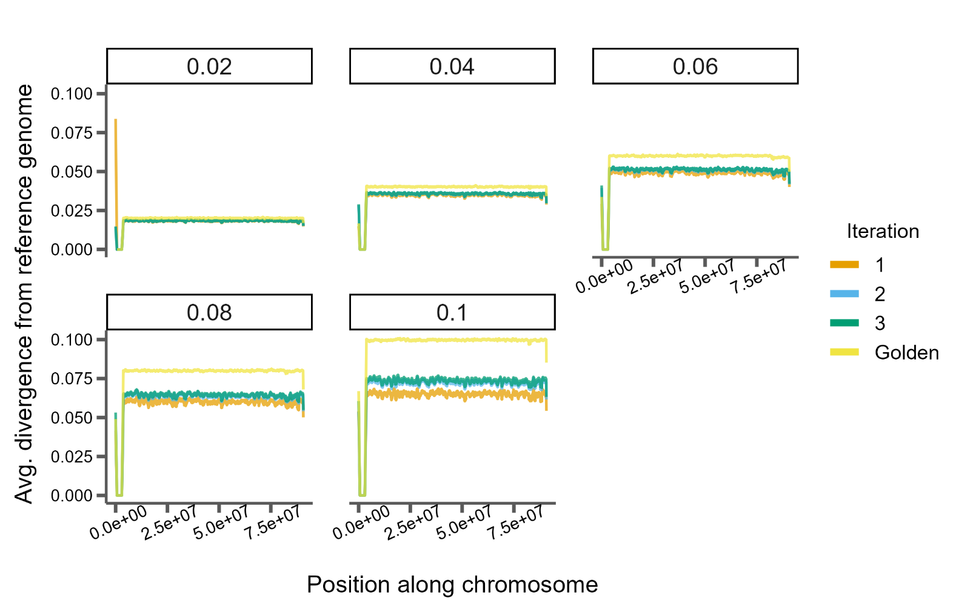
Divergence is underestimated across the genome
Notes:
Just to show this another way, we can look at pairwise divergence in sliding windows across the genome. Here again the colors represent different iterations of mapping, except the yellow color represents divergence estimates using the golden VCF from the simulation… so the actual simulated variants. And as before you can see, lower levels of divergence do well at recovering variation across the genome, so they match up to the yellow line, while higher levels of divergence don’t. And 2 or 3 iterations of mapping only improves on this marginally.

Slide 65
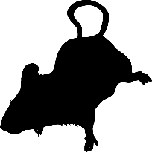

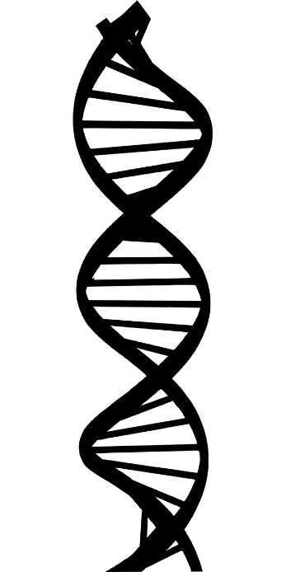

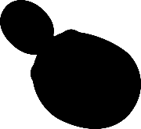
Genome sequencing has changed how we study biology
Allows the study of every aspect of DNA’s structure and variation
We can compare genomes to infer how they change over time
Notes:
So, as we all know genomics has changed how we study biology. With genome sequencing we’re able to exhaustively quantify every aspect of DNA’s structure and variation, with exciting opportunities to link genotype to phenotype… that is to see which elements of an organism’s genome may affect the traits we observe. And genomes from a single species give us a lot of opportunities to do this.
But we’re also able to sequence the genomes of multiple individuals or multiple species and compare them, which allows us to reconstruct or infer how they change over time, giving us a glimpse at how evolution operates.

Slide 66
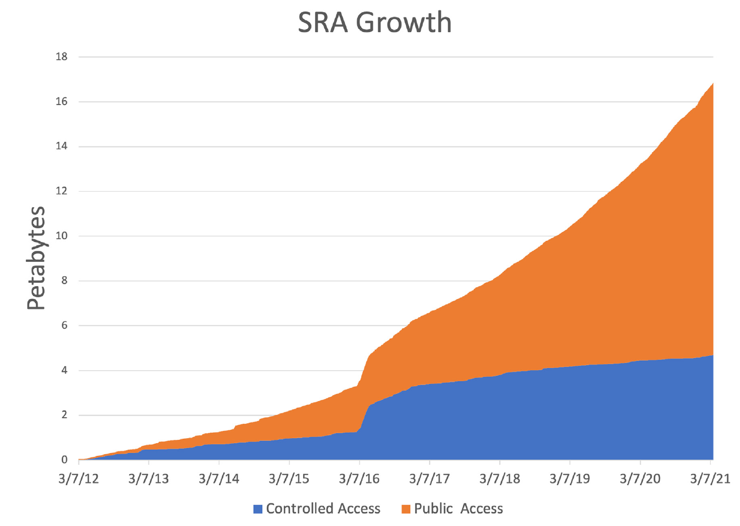
The amount of genome sequences available has grown explosively
Allows the study of every aspect of DNA’s structure and variation
We can compare genomes to infer how they change over time
Source: Katz et al. 2021, NAR
Notes:
And the prospects of the analysis of whole genomes, along with improved and less expensive sequencing technology means we’re in the middle of a sequencing boom. Here is a graph from the people at NCBI which host the sequence read archive, which is a common repository for researchers to submit their raw sequence data for a project. And you can see how its grown over the past decade. Since 2016, when it hosted a little under 4 petabytes of data, we’re up to almost 17pb in 2021, with projected growth of up to 33pb by this year.
So this means that anyone who has questions about the samples in the archive, can go here and download the raw data and do their own analyses.

Slide 67
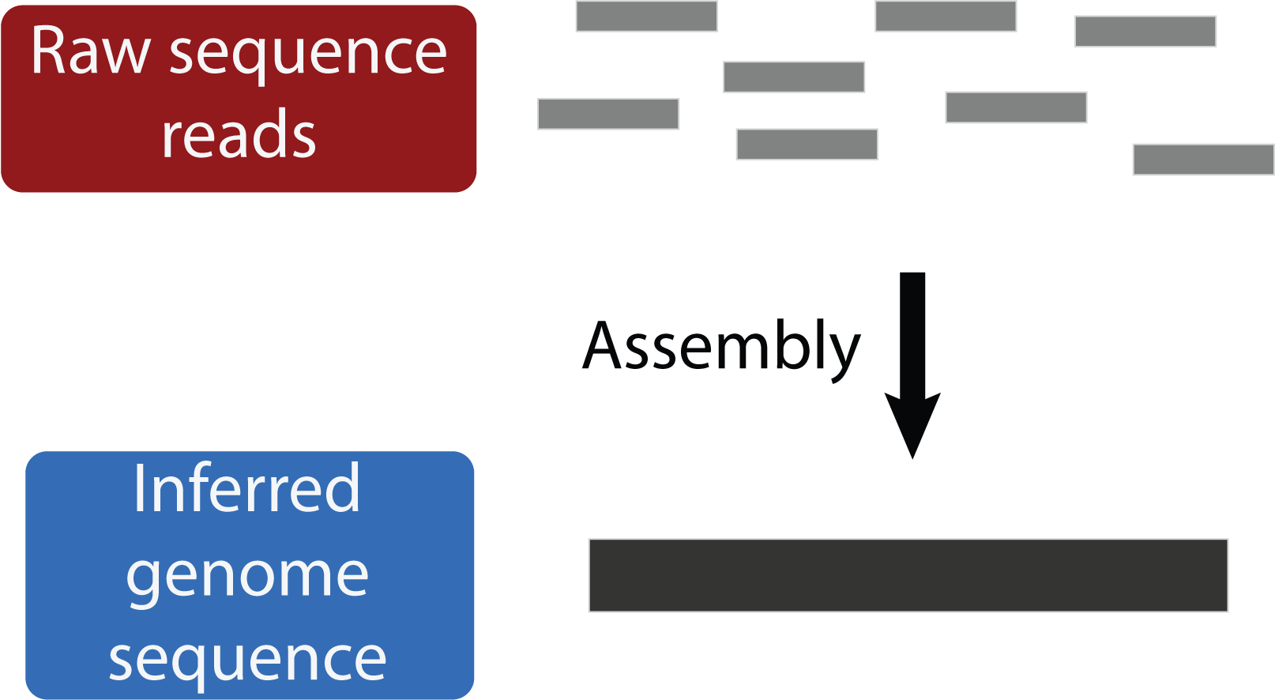
Genome assembly uses sequenced reads to infer the original genome sequence
Often the desired final product
Notes:
Well, what do we do with this data? One of the common and desired outcomes of a genome sequencing project is a whole genome assembly, which is the reconstruction of the short reads that were sequenced into a contiguous inference of the sequence of the original genome.

Slide 68
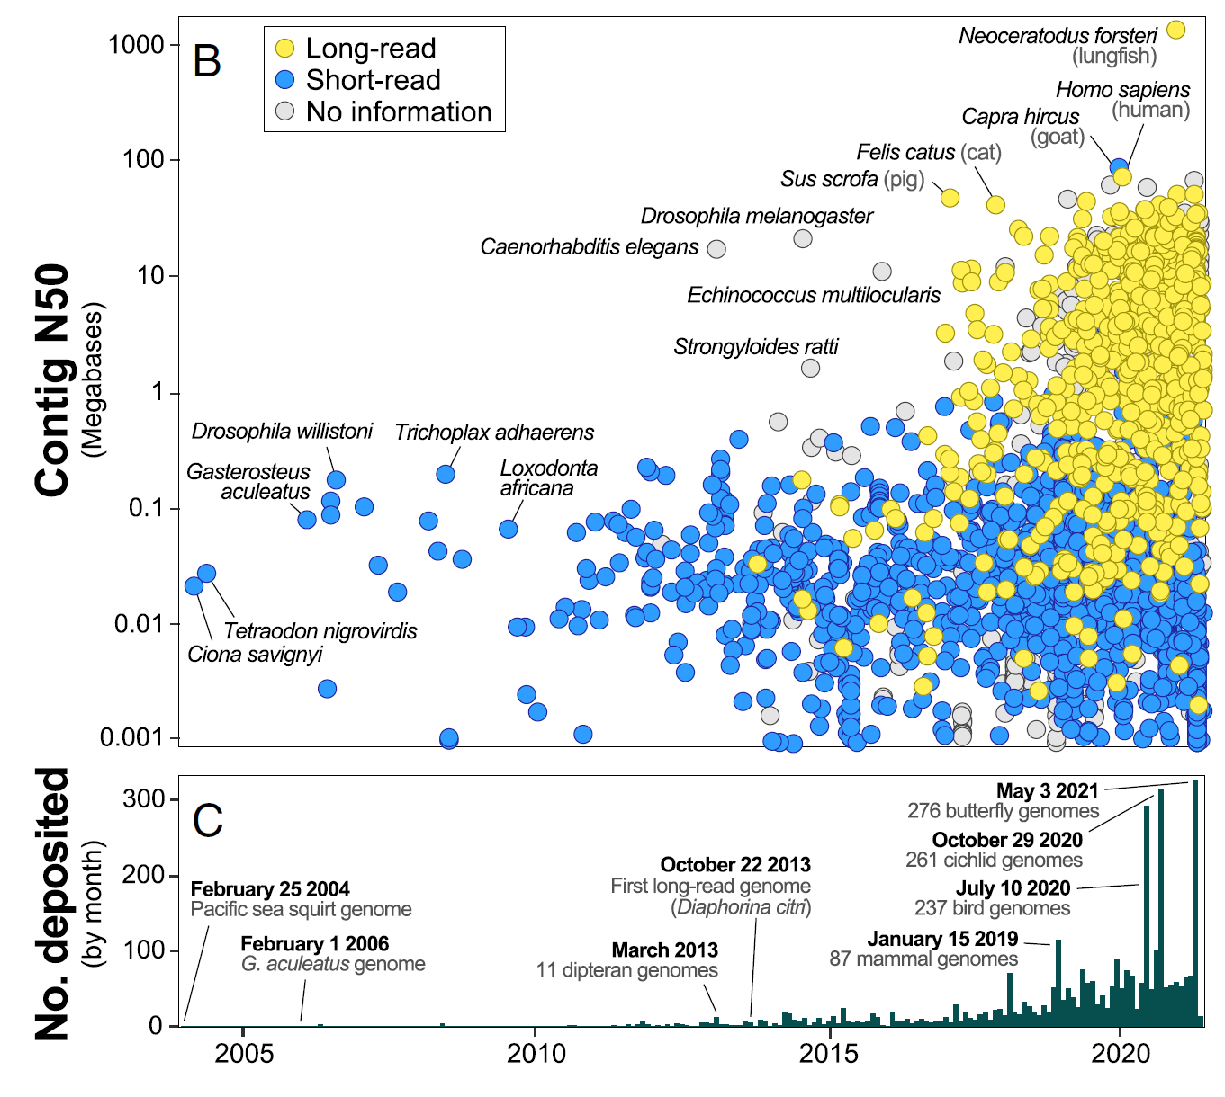
Genome assembly uses sequenced reads to infer the original genome sequence
Often the desired final product
Becoming easier to achieve
Source: Hotaling et al. 2021, PNAS
Notes:
This is becoming easier as well, as methods and technologies evolve. Specifically technologies that provider longer reads mean faster assembly algorithms can be used and longer assemblies can be produced. And you can see here how these long read assemblies in yellow have taken over those present in GenBank, which is NCBI’s repository for genome assemblies. And on the bottom you can see that the number of assemblies submitted per month is also increasing.

Slide 69
Genome assembly uses sequenced reads to infer the original genome sequence
Often the desired final product
Becoming easier to achieve
Still expensive and time-consuming to generate high quality assemblies
Source: Hotaling et al. 2021, PNAS
Notes:
While it is becoming easier to generate whole genome assemblies, it is still expensive and time-consuming to generate high quality assemblies, those that are contiguous at the chromosome level and well annotated.

Slide 70
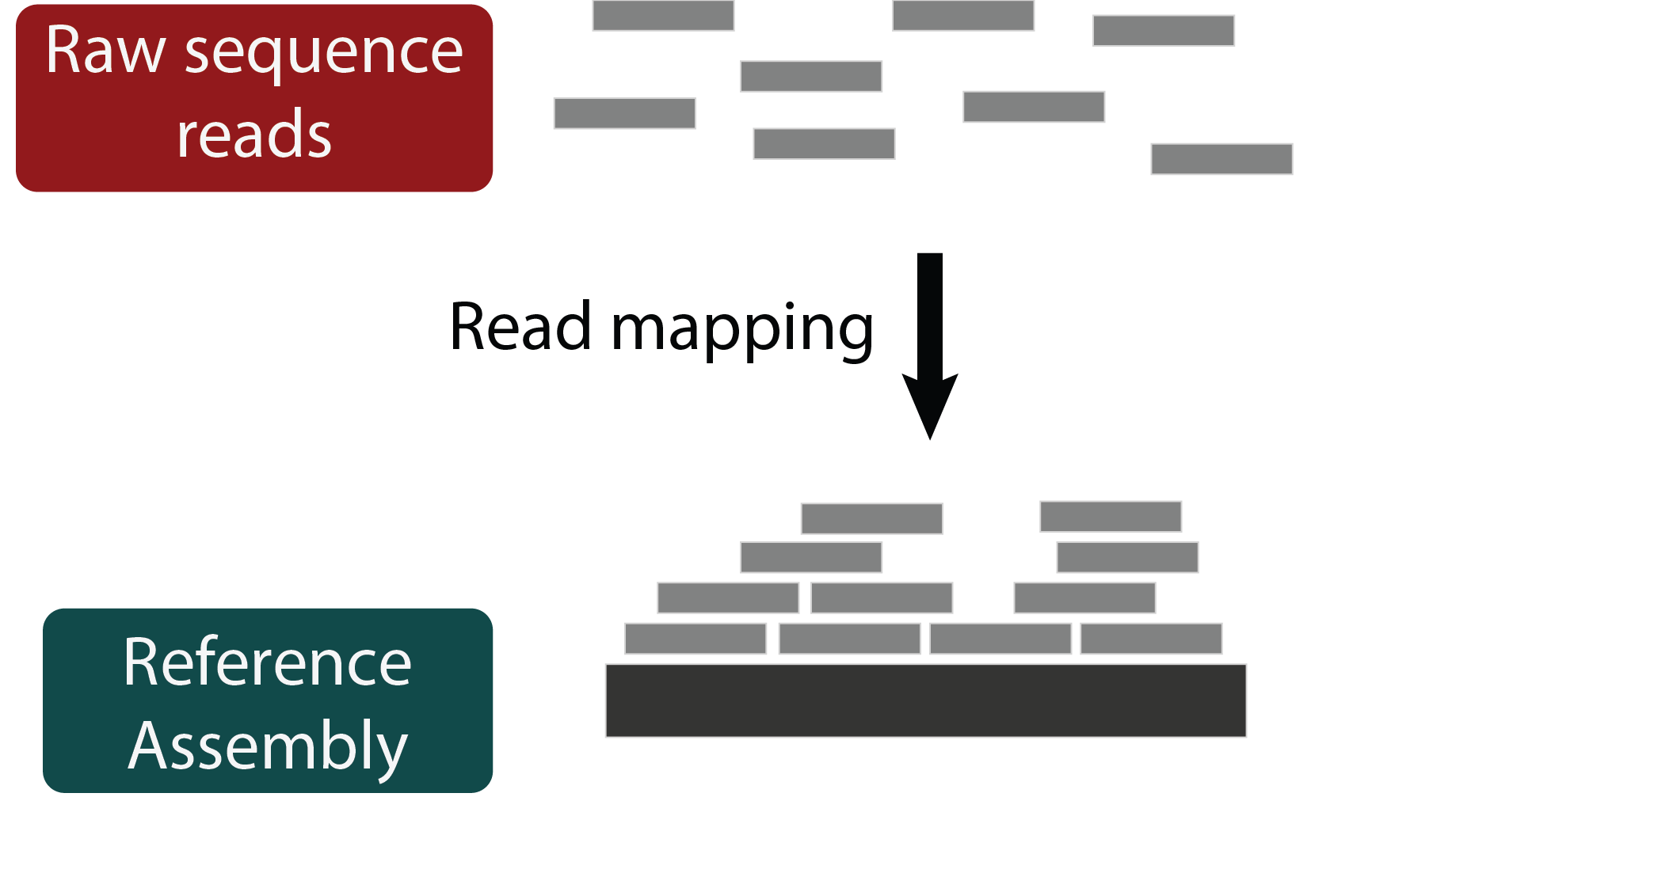
Read mapping is a fast alternative to genome assembly
Commonly done for both population and comparative genomics
Notes:
So a faster alternative to genome assembly may still be preferable in many situations, particularly in large re-sequencing studies or comparative genomics projects. And that alternative has historically been read mapping, which is when we use a previously assembled high quality genome from a closely related species as a reference and simply try to align the raw sequence reads to it.

Slide 71
Read mapping is a fast alternative to genome assembly
Commonly done for both population and comparative genomics
Used for comparing short variation between genomes
Notes:
And we can use these alignments to identify where small variants, like single nucleotide changes or small insertions or deletions have occurred. And there’s a lot we can do with this information: we can estimate divergence or heterozygosity, we can infer substitution rates and phylogenetic relatedness, or lift over annotations from the reference genome to identify functional sites we think may have experienced positive selection.

Slide 72
Read mapping is a fast alternative to genome assembly
Commonly done for both population and comparative genomics
Used for comparing short variation between genomes
Cannot infer large structural variation
Notes:
So read mapping is an integral genomics tool, but it doesn’t let us do everything we could with a whole genome assembly. For instance, large structural variation cannot be inferred, and lifting over coordinate systems between a reference genome and a mapped sample can be tricky.

Slide 73
Read mapping is a fast alternative to genome assembly
Commonly done for both population and comparative genomics
How well does read mapping actually capture short variation in a sample with varying levels of divergence?
Used for comparing short variation between genomes
Cannot infer large structural variation
Notes:
So we can use read mapping for inferences that rely on small-scale variation, and I was interested in asking is how well read mapping can capture that in the common comparative genomics framework where the samples exist at varying levels of divergence from the reference.

Slide 74
Does read mapping accurately capture variation among samples?
Notes:
So, to state my question explicitly, lets say we have a really good reference genome here.

