Slide 1
Easy APIs to Make Your Work Easier
Or, an opportunity to make obscure '80s references
Eric Mattison
Senior Web Developer
FAS Informatics and Scientific Applicaitons Group

Slide 2
Earthquake
This presentation is going to feature lots of live demos. Something is bound to go horribly, horribly wrong.
And I feel fine.

Slide 3
I want my MTV
(Dude, that's Sting singing backing vocals for Dire Straits!)
In his talk “Your Models for Nothing and Your Admin for Free” Raman Prasad showed us the wonderful world of Django.
(https://www.djangoproject.com/)
Terminology Note: Django is a “Model-Template-View” framework. Which may or may not be more understandable than a “Model-View-Controller” framework. But they're essentially the same thing. I believe the creators of Django chose “Model-Template-View” purely as a paean to MTV.

Slide 4
Sweet Child of Mine
I'm going to be talking about creating APIs for Django using Tastypie.
(http://django-tastypie.readthedocs.org)

Slide 5
My Prerogative
However, you should use whatever you feel comfortable with. Just make sure you're using a Model-View-Controller Framework that has a REST plugin or supports REST natively. e.g.:
CakePHP: Native
Symfony: FOSRestBundle
Ruby on Rails: Native
Spring: JAX-RS
Struts: REST Plugin
(and winner of the most creative plugin name)

Slide 6
Put Your Hands Up
(sorry, not an '80s reference)
Who here has added an API to an application?
Have any of you had to write an API?
Fun, yeah?

Slide 7
Ok, fine. Let's look at a simple example.

Slide 8

Mony Mony

Slide 9
Well, How did I get here?
The Story of SPINAL
(Scheduling & Payments for Instruments and Laboratories)
BTW: Raise your hand if you've worked on a massive development project

Slide 10
We Built This City
The Good:
- Avoids scheduling conflicts for 220+ instruments 2000+ researchers
- Provides user permission management for instrument “owners”
- Allows lab admins to assign expense codes to researchers for the use of instruments
- Generates monthly invoices based on frankly insane billing rules

Slide 11
Welcome to the Jungle
The Arrgh:
- SPINAL is (necessarily) complex: 111+ database tables, 100,000+ lines of code, which...
- Makes upgrades difficult to QA
- Takes a long time to build and deploy
- Slows down the development cycle

Slide 12
One Thing Leads to Another
The Fixx:
Much later, a facility administrator asked me to create a publicly available calendar for certain instruments. Rather than build more functionality into SPINAL, I created a new application that used data already in SPINAL.
https://webapps.sciences.fas.harvard.edu/gw-schedule/
(same server, different application)

Slide 13
You Dropped a Bomb on Me
Installing Tastypie meant that I didn't have to write the APIs myself. And yet, I will take the credit.
Well, I'll also mention Phil Durbin. He told me about Tastypie in the first place.
Thanks, Phil.

Slide 14

Smell the Glove
SPINAL + TastyPie =

Slide 15
Let's Dance
Here's the output:
https://webapps.sciences.fas.harvard.edu/spinal/api/v1/reservation/?format=json
The Glasswash Schedule application reads the data from SPINAL and formats it for calendar display.

Slide 16
What I Like About You
- Don't Repeat Yourself
- Less Code → Easier to understand
- More contained → Easier to deploy
- Fewer functions → Easier to debug
- Serialization → Multi-platform support
- Ajaxian → Is that even a word?
- Unixian → What does this mean?

Slide 17
Video Killed the Radio Star
An aside on the greatness of Bruce Molay
The best course I took at Harvard Extension was CSCI E-113 taught by Bruce Molay
(http://www.extension.harvard.edu/about-us/faculty-directory/bruce-molay)
The course was about how to chain very simple Unix tools to build a web server. Web APIs hold the promise to make web applications function the same way.

Slide 18
Back on the Chain Gang
Just as
cal | head -n 5 | tail -n 1 | cut -d ' ' -f 5
should get you the third Thursday of the month, we should be able to “pipe” one web application into another:
JSON → Billing App → Document App → PDF

Slide 19
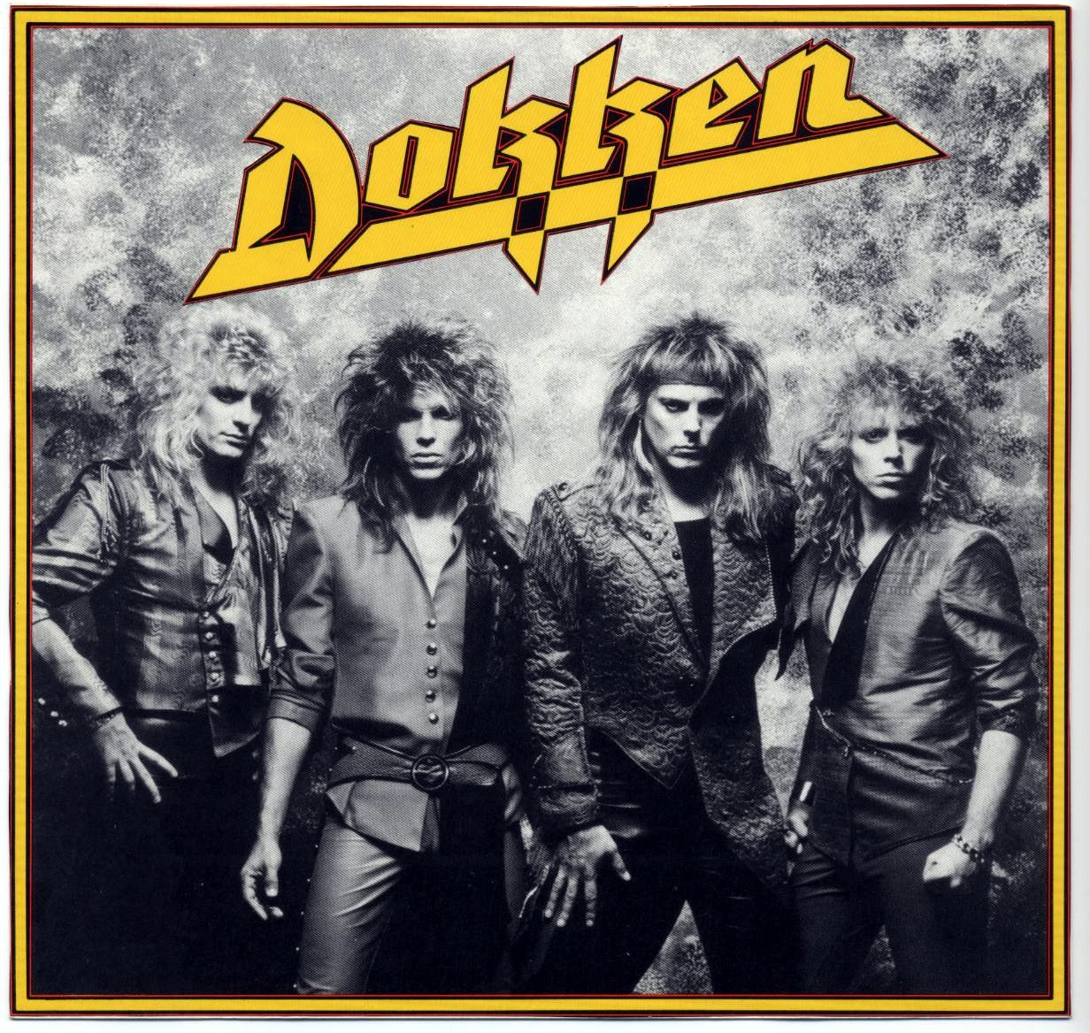
Hell to Pay

Slide 20
We are Family
Schools, Departments, Divisions have different needs. Enterprise applications that meet everyone's requirements are time-consuming, costly, complex and are frequently loathed by the people that have to use them.
A federated approach to software development suits Harvard's organization better. Smaller programs can focus on doing one thing well. Creating sensible APIs for these programs can turn them into building blocks that anyone at Harvard (and beyond) can use.

Slide 21
Gimme All Your Lovin'
I Thank You

Slide 22
Talk to Me
The Question & Answer Part
Also, beer at John Harvard's

