Slide 1
Workflow management introduction
FAS Informatics
Nextflow Run Workshop 2025

Slide 2
Outline of this workshop
Introduction to workflow managers, as a concept
Big picture overview of how Nextflow works
Hands-on walkthrough on how to run Nextflow workflows
Simple workflow outputs
Configuration modifications
Troubleshooting
Presentation and demo on running Nextflow on the Cannon cluster

Slide 3
Not covered
Covered in this seminar
What and Why
Conceptual overview of how it works
Comparison of snakemake and nextflow
Demonstration of nextflow on real pipeline and more detail on cool features
Where to learn for yourself
Syntax on snakemake or nextflow
How to configure workflows for SLURM or Cannon
Details on any other workflow managers
How to run community made workflows

Slide 4
What is a bioinformatics/data workflow?
Step 1:
Index genome
reference genome
indexed genome
Step 3:
Quantify reads
count table of reads
Step 2:
QC reads
raw reads
QC’d reads
Computational actions organized into steps
Can be in separate scripts or in a single long file
Steps may be repeated across multiple files or variables
Notes:
This is an example of a simple RNA seq workflow, with the steps represented as pieces of paper and the files generated represented as stacks of rectangles. You start with your raw data, generate some intermediary files, and ultimately end up with a data product that you can analyze.

Slide 5
What if a program could do all this for you?
Execute your workflow
multiple times reproducibly
stop/start in the middle
add files without re-running steps for old files
automatically
Document your workflow
exact code run
software version used
order of operations and input/output
Debug your workflow
benchmarking resource use
Share/publish your workflow
Notes:
Bioinformatics is complicated. There’s a lot to think about even on top of getting the code to work.

Slide 6



It’s not AI/LLMs…It’s workflow managers

Slide 7

Workflow managers like snakemake and nextflow will make you love data processing and feel like a god

Slide 8
A story about my first workflow
1 species count table
100s
raw fasta
7 different R scripts
Lei@HPC ~/proj_dir $ snakemake
> ...
> done!
Notes:
Let me tell you a story about the first time I used a workflow manager. This was a few years ago during my PhD. I had just gotten my first batch of data back from the portable sequencer. My goal was the process raw amplicon sequences into a single file that will tell me what microbial species were present in each sample and how much. I collected all the stray bits of code and poorly documented scripts and put it all together in a single snakemake workflow. It took a while (like a couple of months of concentrated work) because I was new to programming, but then, with just one command, I was able to go from 100s of raw fasta files (DNA sequences files) to a single species abundance table. Later on, I decided to add more data that was collected previously by other members of my lab. Making this workflow really paid off because I barely had to change a thing to re-run the same process on the new data. This data processing occurred on the HPC, and snakemake would submit the sbatch jobs for me. Afterwards, it was fully documented, so I could include a pointer to the github that had the snakemake script as part of my methods without alteration.

Slide 9
A workflow is made from distinct tasks
Task
My_script
input
output
Notes:
A workflow is made from distinct tasks. Each task has an input, which can be files or parameters, some sort of transformation of that input using scripts or code, and then some output. In the next slide, I’ll show a more concrete example from our work.

Slide 10
Task
My_script
input
output
bwa mem data/genome.fa data/samples/file1.fastq | samtools view -Sb - > file1.bam
Notes:
In this text box, I present you a sample of a very early step in a workflow our group might perform. In this step, we use the programs bwa mem and samtools to align sequencing reads from file1.fastq to a genome, and then convert the resulting file into a *.bam format file, which is a binary space-saving file type. This script has as an input, the genome file and the file we want to align and has as in output the a *.bam file named after our original sample file. The inputs are highlighted in blue while the commands are highlighted in orange.

Slide 11
Task
My_script
input
output
bwa mem data/genome.fa data/samples/file1.fastq | samtools view -Sb - > file1.bam
bwa mem {input}| samtools view -Sb - > {output}
Notes:
To generalize our task, I can replace the file names with generic placeholders called input and output. In this way, we can start seeing that our task is essentially creating a function out of a script. So a function is a piece of code that has some input and some output. In the next slide, we will see how this translates to actual snakemake or nextflow code.

Slide 12
A rule (aka task) in snakemake
rule bwa_map:
input:
genome = "data/genome.fa",
sample = "data/samples/{sample}.fastq"
output:
"mapped_reads/{sample}.bam"
shell:
"bwa mem {input.genome} {input.sample} |
samtools view -Sb - > {output}"
Notes:
In snakemake, tasks are called rules and a snakemake workflow is made up of a sequence of rules. Here is what our previous script would look like as a snakemake rule, which we named bwa_map. You can see that the body of the rule clearly lists the input, output, and shell (in this case, shell means we are using bash to write our function). If our command instead was a python or R script, we can either write it out after specifying the python/R interpreter, or reference a .py or .R file as you would on the bash command line.
Another feature you see in this rule is the use of {sample} inside curly braces. Curly braces in snakemake are wildcards and provide the generalization from a single file to a set of files that share the same naming pattern.

Slide 13
A process (aka task) in Nextflow
process bwa_map {
input:
path genome from 'data/genome.fa’
path sampleFile from 'data/samples/*.fastq’
output:
path "mapped_reads/${sampleFile}.bam"
script:
"""
bwa mem $genome $sampleFile | \
samtools view -Sb - > mapped_reads/${sampleFile}.bam
"""
}
Notes:
Here is the same thing in nextflow. In nextflow, tasks are called processes. We still have the input, output, and instead of shell, it’s script. In nextflow, you can give variable names to individual inputs, which get referenced in the script (genome and sampleFile). You can also use the base name of your sample file to rename your outputs - ${sampleFile.simpleName}. simpleName is a function applied to the sampleFile variable that strips any filepath or file-extensions so you can use it as a name for output files.

Slide 14
A workflow strings processes together
workflow {
files_ch = Channel.fromPath(params.input_dir)
fastqc(files_ch)
bwa_map(params.genome, fastqc.out)
}
Notes:
Here is the same thing in nextflow. In nextflow, tasks are called processes. We still have the input, output, and instead of shell, it’s script. In nextflow, you can give variable names to individual inputs, which get referenced in the script (genome and sampleFile). You can also use the base name of your sample file to rename your outputs - ${sampleFile.simpleName}. simpleName is a function applied to the sampleFile variable that strips any filepath or file-extensions so you can use it as a name for output files.

Slide 15
Tasks are executed independently
task
file1 -> script -> out1
task
file2 -> script -> out2
Task
Script
In
Out
task
file3 -> script -> out3
task
file4 -> script -> out4
Notes:
When a workflow manager runs a task, it creates an instance of that task for each individual input and runs all of it independently - aka in parallel. It does not wait for file1 to be processed before starting the task for file2 because they do not depend on each other. If you are running this on an HPC, it will submit an sbatch job for each file, similar to an array job.

Slide 16
Inputs and outputs are managed dynamically
Task 1
Script
In
Out
File1
… etc
Task 3
Script
In
Out
Task 2
Script
In
Out
FileA
… etc
Notes:
So now that we’ve understood what a single task is, let’s zoom out. While you may not find that a snakemake or nextflow script can be super helpful over a normal bash or python script, the real power of workflow managers comes from its ability to manage a complex workflow compose of multiple interconnected tasks. In this diagram, the outputs of task 1 and task 2 become the inputs of task 3. Tasks that do not depend on each other are also run simultaneously. So in this case, the workflow manager will create instances of task 1 and task 2 at the same time.
Perhaps file1 from task1 is paired with fileA from task2 as inputs to task3. If we were operating this workflow the traditional way, we would run task 1 and task 2 to completion (like an array job), then run task 3 after all files are generated. Workflow managers like snakemake and nextflow are able to detect when the inputs for each instance of a task are available and will automatically run an instance of task 3 once each pair is completed. Multiply this workflow by more steps and you will quickly see how it saves time and oversight.

Slide 17
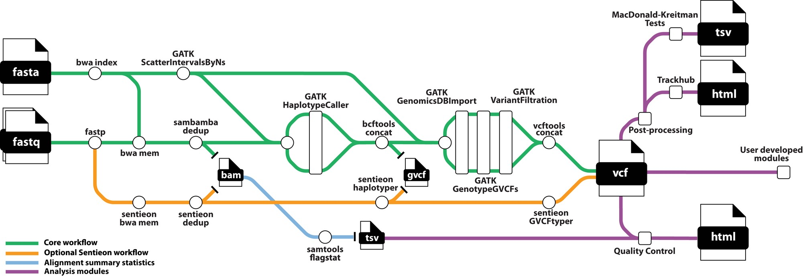
Workflow = data flowing from task to task
an output
an input
a task
SNPArcher workflow from FAS Informatics
Notes:
Workflows can be conceptualized as the flow of data through nodes, where the nodes are tasks. In this visualization from one of our group’s pre-made workflows, file inputs and final outputs are the paper icons and the tasks have been abstracted away to circular nodes. Some intermediate files are shown, but in general, the outputs of each task are implicit. Because each node represents a task that might depends on several previous tasks, you can see how and overarching manager is essential for the execution of this complex workflow. If you are interested in learning more about SNPArcher, which is a workflow for variant calling written in snakemake, we have a workshop coming up in December that will show you how to use this!

Slide 18

Take a moment to think about what your workflow looks like
Notes:
Think about what your workflow looks like and as I describe more about a task, consider whether snakemake or nextflow is best for you

Slide 19
array job vs nextflow
params.output_dir = 'output’
params.input_dir = 'raw/*.fastq'
process fastqc {
executor = 'slurm’
queue = 'shared'
cpus = 4
time = '10m'
memory = '8 GB'
input:
path file
output:
path "${params.output_dir}/${file.simpleName}_fastqc.*"
script:
"""
fastqc --outdir ${params.output_dir} \\
--threads ${task.cpus} $file
"""
}
workflow {
files_ch = Channel.fromPath(params.input_dir)
fastqc(files_ch)
}
#!/bin/bash
#SBATCH -J fastqc
#SBATCH --array=0-7
#SBATCH -c 4
#SBATCH -p serial_requeue
#SBATCH -t 00:10:00
#SBATCH --mem=8000
#SBATCH -o logs/fastqc_%A_%a.out
readarray -t files < <(ls raw/*.fastq)
file=${files[${SLURM_ARRAY_TASK_ID}]}
echo "Working on file ${file}"
fastqc --outdir output --threads 4 $file
Notes:
If you are already familiar with array jobs, here’s how you would convert a single array job script into a nextflow workflow
You may be wondering why you should use nextflow rather than just array jobs...Remember, the power comes from chaining jobs together, which you can’t do using array jobs
job arrays are “dumb” and can’t resume from where you left off

Slide 20
How nextflow works
Head job (nextflow runtime)
Each sub-process has its own work folder
can be in netscratch or local scratch
input files are staged in that folder thru symlinks (default)
Optionally ‘publish’ output files over to a separate directory
Each task is logged and cached
caching is based on a hash generated from the task and file characteristics
allows resuming from partially complete tasks
Software can be conda/spack/containers

Slide 21
The scope of a single task
a single, well-defined task
e.g. fasterq-dump: downloads genomes
a logically grouped set of closely related operations
e.g. bedtools sort then bedtools intersect: you want your intervals in order before you combine the files
minimal dependencies
use just one software or a pair of closely related softwares
matched resource needs
don’t combine a high memory task with a low memory task

Slide 22
Pros/cons of snakemake vs nextflow
Snakemake
Nextflow
Written in python
Syntax is simpler
Simpler features -> easier to debug
Used frequently in academia
Smaller userbase/community
Worse documentation & training
modules
Written in Groovy (Java)
More complicated syntax
More features -> harder to debug
Used frequently in industry
Large userbase/community
Comprehensive online training available
nf-core
Notes:
Snakemake modules (pre-made workflows) are made by various individuals with no quality checking. nf-core is a curated and up to date set of workflows that can easily be incorporated into your own pipeline.

Slide 23
Features/Design of nextflow
Snakemake
Nextflow
“pull” philosophy: works backwards from end file
Can do dry runs because every task has defined outputs
Inputs are files exclusively
Workflow executed in working directory
Tracks file changes
“push” philosophy: start with inputs and push through tasks
Can’t do dry runs because outputs can be variable
Inputs can be files/values/variables
Each instance of a task has its own directory
Tracks file, code, & other changes

Slide 24
Vocabulary
Workflow: a sequence of data processing steps
Workflow management system: software that can automatically run a workflow, among other features
Pipeline: synonym for workflow
DAG: directed acyclic graph representation of bioinformatics pipeline

Slide 25
Resources to learn about workflow managers
Snakemake
Nextflow
https://snakemake.readthedocs.io/en/stable/tutorial/tutorial.html
https://carpentries-incubator.github.io/snakemake-novice-bioinformatics/index.html
https://uppsala.instructure.com/courses/51980/pages/snakemake-1-introduction?module_item_id=243089
https://training.nextflow.io/
https://carpentries-incubator.github.io/workflows-nextflow/index.html
https://seqera.io/blog/learn-nextflow-in-2023/

Slide 26
Nextflow Demo

Slide 27
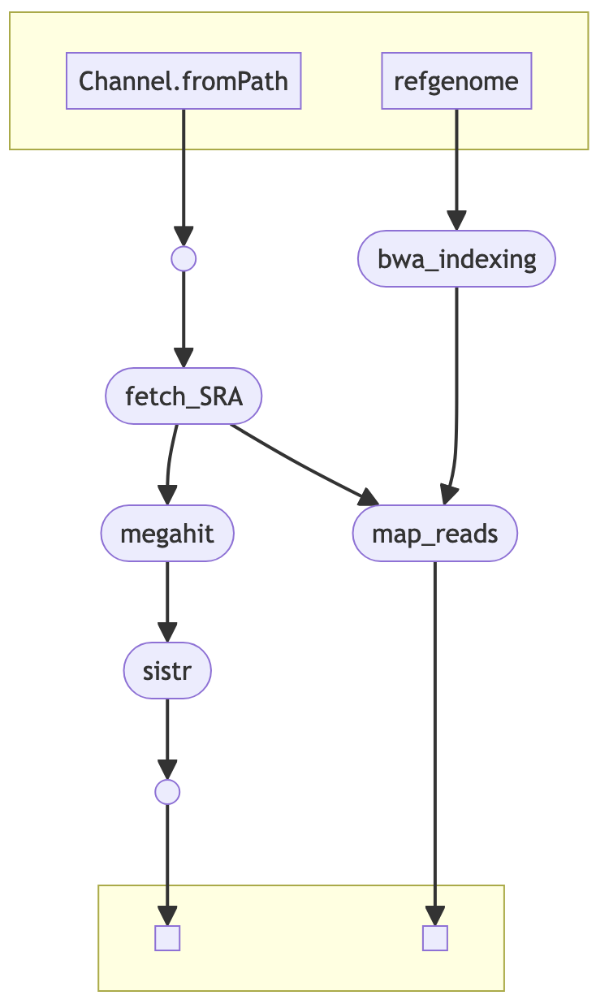
Diagram of workflow
Notes:
Beginning of a variant calling workflow that I made during my postdoc. This is for salmonella genomes.

Slide 28
Outline of demo
Config file
SRA input file
Explain nf file
Run nextflow in interactive session
Show nextflow tower/seqera platform
Show working directory vs publish directory
Rerun with additional file (SRR20634159) to show caching

