Slide 1
$ Command line 101: $ Tips & tricks for aspiring power users $ Work smarter not harder & type less
$ Harvard FAS Informatics virtual training
$ Thursday, February 12, 2026
$

Slide 2





File systems are user-facing ways to organize information on a computer
/
bin/
var/
home/
etc/
usr/
lei/
gregg/
tim/
Desktop/
documents/
music/
Notes:
Mention command prompt and not to use it

Slide 3
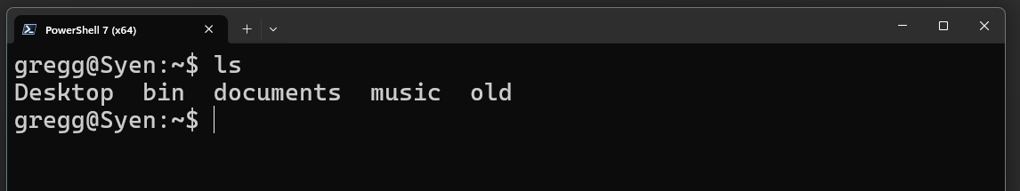
You can interact with the file system of a computer through text interfaces called command lines*
* https://informatics.fas.harvard.edu/resources/glossary/
Notes:
Mention command prompt and not to use it

Slide 4
How does our concept of file systems translate to text-based computing?
/
bin/
var/
home/
etc/
usr/
lei/
gregg/
tim/
Desktop/
documents/
music/
Notes:
Mention command prompt and not to use it

Slide 5
How does our concept of file systems translate to text-based computing?
/
home/
With commands
bin/
var/
etc/
usr/
lei/
gregg/
tim/
Desktop/
documents/
music/
Notes:
Mention command prompt and not to use it

Slide 6
How does our concept of file systems translate to text-based computing?
/
home/
With commands
bin/
var/
etc/
usr/
lei/
gregg/
tim/
A command is a program that is run by typing its name into the terminal and hitting Enter
Many common commands relate to navigating and manipulating the filesystem
Desktop/
documents/
music/
Notes:
Mention command prompt and not to use it

Slide 7
Common commands for interacting with the filesystem
pwd | Print (display) the working directory.
ls <directory> | List the contents of <directory> (current working directory if unspecified).
cd <directory> | Change the current working directory to <directory>.
mkdir <directory> | Create a new directory called <directory>.
mv <directory/file> <directory/file> | Move the first <directory/file> to the second <directory/file>. If location is the same, this acts as a rename command. CAUTION: If the destination file/directory exists IT WILL BE OVERWRITTEN WITH NO CONFIRMATION PROMPT
cp <directory/file> <directory/file> | Copy the first <directory/file> to the second <directory/file>. CAUTION: If the destination file/directory exists IT WILL BE OVERWRITTEN WITH NO CONFIRMATION PROMPT
rm <file> rm –rf <directory> | DELETE the file or directory (AND its contents). WARNING: PERMANENT ACTION WITH NO CONFIRMATION PROMPT
These commands are used in the most common shells (bash, PowerShell)
Notes:
Mention command prompt and not to use it

Slide 8


How do commands work?
/bin/
[gregg]$ ls
ls
Run this program

Slide 9
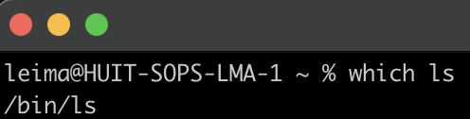
All progams live somewhere in your computer
/bin/
[gregg]$ ls
ls

Slide 10
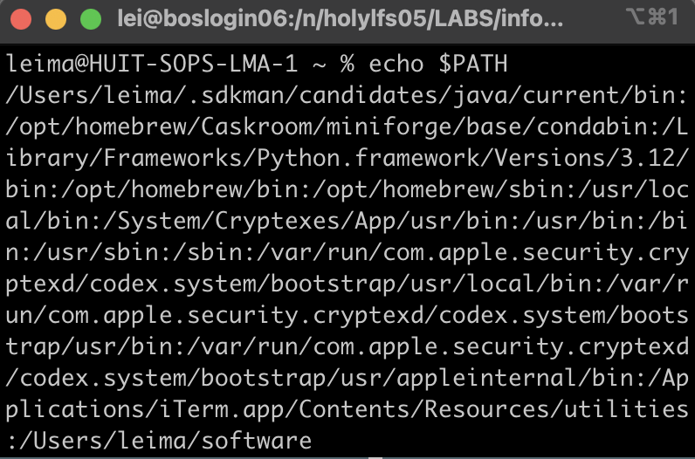
$PATH is list of directories to search for programs
/bin/
[gregg]$ ls

Slide 11
$PATH is an environmental variable
Shortcuts/keywords that are assigned on startup to configure your workspace
Usually starts with $
$PATH | A colon-separated list of directories that contain software
$HOME | points to the home directory
$PWD | the current working directory (print working directory)
$SCRATCH | (on Cannon) points to the scratch directory
$USER | prints the current user of the terminal
printenv lists all environmental variables. Usually set by software to help computer find things

Slide 12
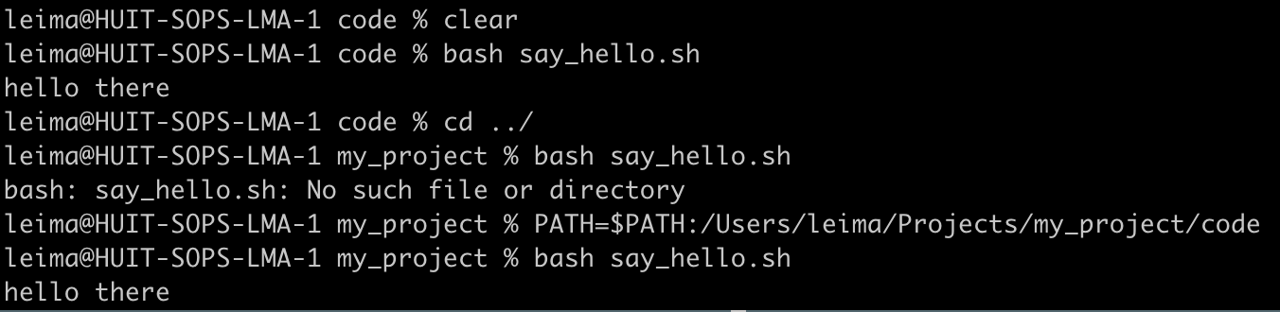
You can modify environmental variables
/Users
leima
Projects
Have an executable you want to reference without typing out the full path?
Add it to the end of the $PATH
>PATH=$PATH:/path/to/directory
say_hello.sh will now be able to be referenced from anywhere
my_project
code
data

Slide 13
You can modify environmental variables
/Users
leima
Projects
Have an executable you want to reference without typing out the full path?
Add it to the end of the $PATH
>PATH=$PATH:/path/to/directory
say_hello.sh will now be able to be referenced from anywhere
my_project
code
data
!!This will only last for this session!!

Slide 14
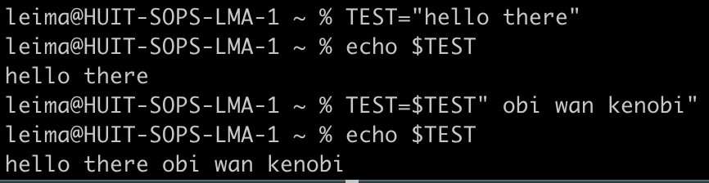
You can make new shell variables
/
n/
TEST=$TEST" obi wan kenobi"
holy*/
home*/
netscratch/
variable you want to set
assign right side to variable on left
<pi name>_lab/
interpolates to hello there
two strings concatenated together to be assigned to the left side
Lab/
software/

Slide 15
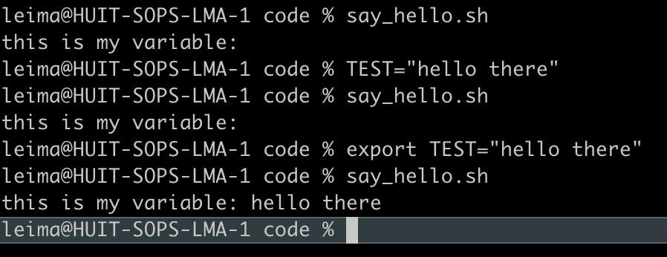
You can make new shell variables
say_hello.sh
#! /bin/sh
echo "this is my variable: "$TEST
shell variables only exist in the shell. Other programs won’t be able to find it unless you export

Slide 16

Aliases: Because some commands are long and I use them a lot
Aliases allow you to create command shortcuts.
cd my/very/very/very/long/path/with/lots/of/numbers235u/for/some/reason/
Notes:
Think of a path like a human readable address for a file on a computer

Slide 17
Aliases: Because some commands are long and I use them a lot
Aliases allow you to create command shortcuts.
cd my/very/very/very/long/path/with/lots/of/numbers235u/for/some/reason/
alias ‘cdp=cd my/very/very/very/long/path/with/lots/of/numbers235u/for/some/reason/’
Notes:
Think of a path like a human readable address for a file on a computer

Slide 18
Aliases: Because some commands are long and I use them a lot
Aliases allow you to create command shortcuts.
cd my/very/very/very/long/path/with/lots/of/numbers235u/for/some/reason/
alias ‘cdp=cd my/very/very/very/long/path/with/lots/of/numbers235u/for/some/reason/’
cdp
Notes:
Think of a path like a human readable address for a file on a computer

Slide 19
Caution: do not overwrite environmental variables with other stuff
Don’t assign anything else to the variables below
$PATH | A colon-separated list of directories that contain software
$HOME | points to the home directory
$PWD | the current working directory (print working directory)
$SCRATCH | (on Cannon) points to the scratch directory
$USER | prints the current user of the terminal

Slide 20

Customizing your environment

Slide 21
Customizing your environment

Slide 22
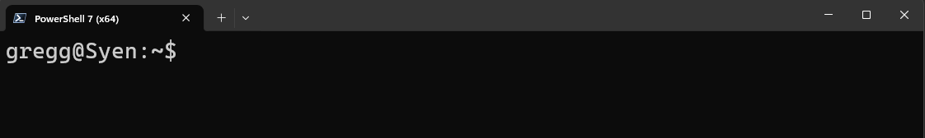
What to we mean by “environment”?
/
bin/
var/
home/
etc/
usr/
lei/
gregg/
tim/
Desktop/
documents/
music/
Notes:
Mention command prompt and not to use it

Slide 23
What to we mean by “environment”?
/
Your current environment
bin/
var/
home/
etc/
usr/
$PATH
other environment variables
.bash_profile
aliases and functions
lei/
gregg/
tim/
$LD_LIBRARY_PATH
.bashrc
Desktop/
documents/
music/
Notes:
Mention command prompt and not to use it

Slide 24
What to we mean by “environment”?
/
Your current environment
bin/
var/
home/
etc/
usr/
$PATH
other environment variables
.bash_profile
aliases and functions
lei/
gregg/
tim/
$LD_LIBRARY_PATH
.bashrc
Desktop/
documents/
music/
On computers where your user does not have full permissions, you will have trouble installing software
Notes:
Mention command prompt and not to use it

Slide 25
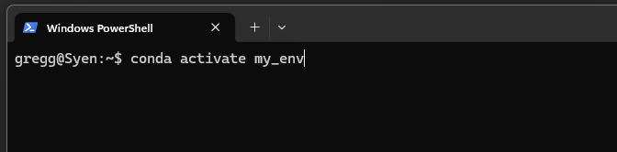

Software environments edit aspects of your default environment
/
Your conda environment
bin/
var/
home/
etc/
usr/
$PATH
other environment variables
.bash_profile
aliases and functions
lei/
gregg/
tim/
$LD_LIBRARY_PATH
.bashrc
Desktop/
documents/
music/
Software environments change environment variables to locations where you have write permission
Notes:
Mention command prompt and not to use it

Slide 26
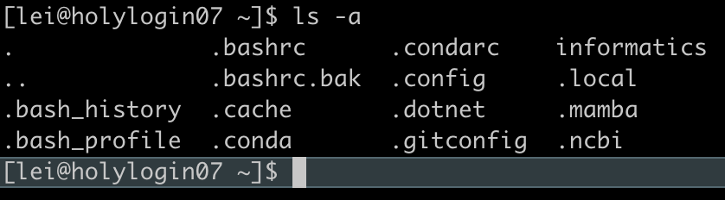
Customizing your shell environment
Run commands (including changing env/shell variables) each time you start a new session
Put commands in a hidden file that begins with a “.”
Use ls -a to see them
That is why they are called dot files
Use caution! It is possible to “break” your shell, and it can be a big pain to fix it…

Slide 27
.bashrc vs .bash_profile
Both are startup config files, usually in your home (aka ~) directory
.bash_profile or .profile is run only once, upon login
Sources (aka runs) the .bashrc file (won’t do so otherwise!)
Generally, this is all you want in here
.bashrc is read anytime a shell is opened (assuming it has been sourced)
E.g. if you connect to an interactive node after logging in using `salloc`
TL;DR when using Cannon, put your customizations in here

Slide 28
What can you put in your .bashrc?
# Source global definitions
if [ -f /etc/bashrc ]; then
. /etc/bashrc
fi
# User specific aliases and functions
# load modules
module load jdk
module load python
# add relevant folders to $PATH
export PATH=$PATH:/n/holylfs05/LABS/informatics/Users/lei/bin/
# make aliases
alias ls='ls --color=always’
alias sal=‘salloc --partition test --mem 8GB -c 2 --time 0-04:00’
# source secret API keys
if [ -f "$HOME/.secrets/api_keys.sh" ]; then
. "$HOME/.secrets/api_keys.sh"
fi
don’t change this part

Slide 29
What can you put in your .bashrc?
# make custom functions
function loadmodules {
module load python
source ~/lab_name/spack/setup-env.sh
}
# customize your command prompt
# complicated syntax, ask an LLM
export PS1="\[\033[36m\]\u\[\033[m\]@\[\033[32m\]\h:\[\033[33;1m\]\w\[\033[m\]\$ "

Slide 30
How do I not mess everything up?
Make a backup of your .bashrc
cp .bashrc .bashrc.bak
Only change one thing at a time
Have two windows open and only edit the .bashrc in one in case you totally mess up
the backup window will have the old settings

Slide 31

multitasking in the terminal

Slide 33

Processes running on your computer are paused or stopped when you turn off your computer

Slide 34
Processes running on your computer are paused or stopped when you turn off your computer

Slide 35


Similarly, when you are connected to a server, processes are stopped when you disconnect

Slide 36
Similarly, when you are connected to a server, processes are stopped when you disconnect

Slide 37
Similarly, when you are connected to a server, processes are stopped when you disconnect
Many programs could take hours or days to run.
How can we keep them running when we disconnect?

Slide 38
Similarly, when you are connected to a server, processes are stopped when you disconnect
Many programs could take hours or days to run.
How can we keep them running when we disconnect?
The nohup command
Submit your job to the cluster with sbatch
Use a terminal multiplexer like screen

Slide 39
Terminal multiplexers allow you to open shells within your shell
screen sessions
other screens you can switch between

Slide 40
Shells within the multiplexer persist even when you log off
screen sessions
still running,
you can find these if you log back in!*
When you disconnect, screens are still active

Slide 41
Shells within the multiplexer persist even when you log off
screen sessions
still running,
you can find these if you log back in!*
When you disconnect, screens are still active
*as long as you login to the same login node

Slide 42
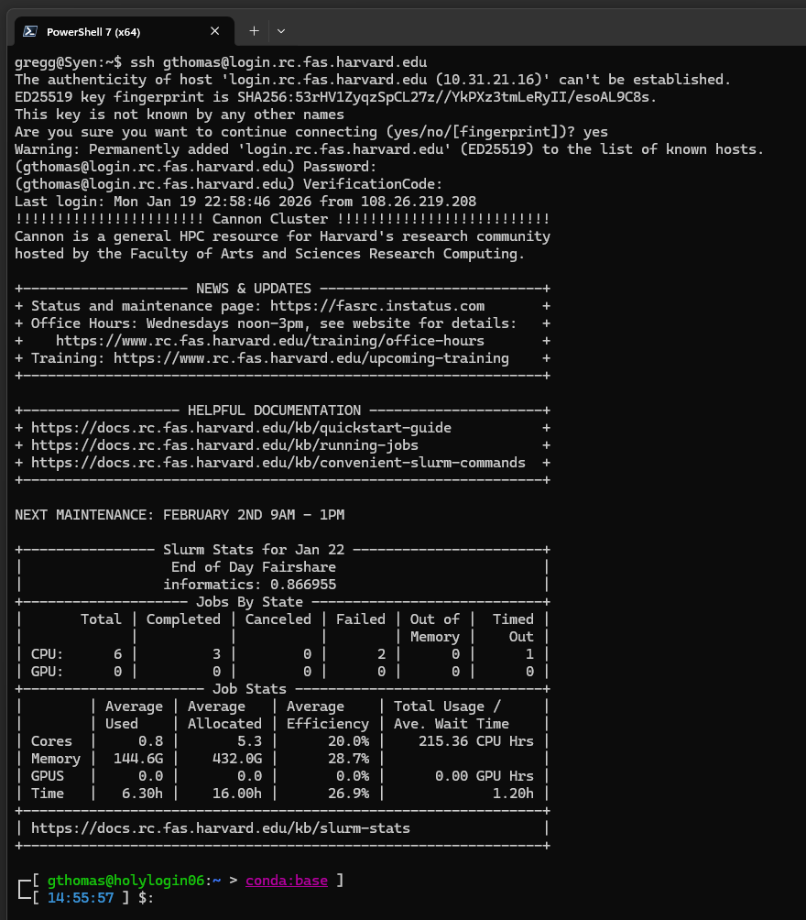


How to connect to a particular login node
Use the ssh command to connect to a remote computer:
ssh <username>@login.rc.fas.harvard.edu

Slide 43
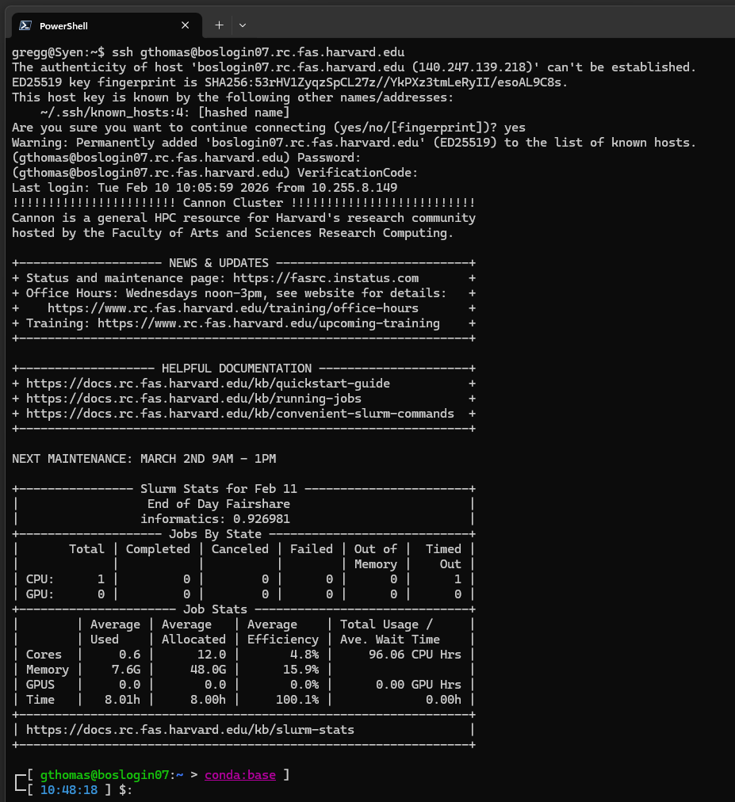
How to connect to a particular login node
Use the ssh command to connect to a remote computer:
ssh <username>@login.rc.fas.harvard.edu
ssh <username>@<login node name>.rc.fas.harvard.edu

Slide 44

Screen allows you to run multiple things at once from a single login
screen session

Slide 45
Very basic screen commands
Command | What it does
screen -S sessionname | Start a new screen session with name sessionname
screen -ls | List all screen sessions
screen -r sessionname | Reconnect to a particular session
Ctrl+a d | Detach (and leave running)
Ctrl+a k or exit | Close current screen
Ctrl+a ? | pull up help menu of shortcuts
Start a screen session with screen or screen -S name if you want to give it a name.
Run your long task.
Detach your screen to go do something else
Go back to your screen with screen -r

Slide 46
Useful shell shortcuts
.. | Shortcut to use in paths meaning, “one directory above”. ../ means one directory above the current working directory ../../ means two directories above the current working directory
~ | Many systems use this to mean, “the path to the current user’s home directory”. cd ~ will change directory to your home directory no matter where you are in the filesystem.
cd - | Change to the previous directory no matter where it is.
[tab] | When typing paths for a command, hitting tab will autocomplete file names. cd dir[tab] -> cd directory1 If more than one file matches the substring typed, they will all be displayed for you to keep typing: cd dir[tab] -> directory1 directory2 directory3 -> cd directory3
[up arrow] | Scroll through previous commands.
Ctrl+C | Cancel currently running process.
Select text to copy, right click to paste.
Notes:
Mention command prompt and not to use it

