Slide 1


Introduction to Genome Annotation
05 March 2025

Slide 2
Workshop Objectives
Gain an understanding of what a genome annotation is and the general approaches for generating an annotation
Enable you to pick an appropriate genome annotation method based upon your research needs and available genomic resources
Develop an understanding of quality assessment metrics necessary to determine whether your annotation is any good

Slide 3
What is not covered in this workshop
Live-coding implementation of any recommended tools
Obtaining functional information such as Gene Ontology (GO) terms or gene symbols

Slide 4
What we mean by genome annotation
The prediction of transcript intervals for a genome, including higher level structures (genes) and transcript constituent parts, e.g.
exons
coding portions of exons (CDS)
UTRs
start and stop codons
Obtaining functional information using resources such as eggNOG-Mapper is NOT covered today

Slide 5
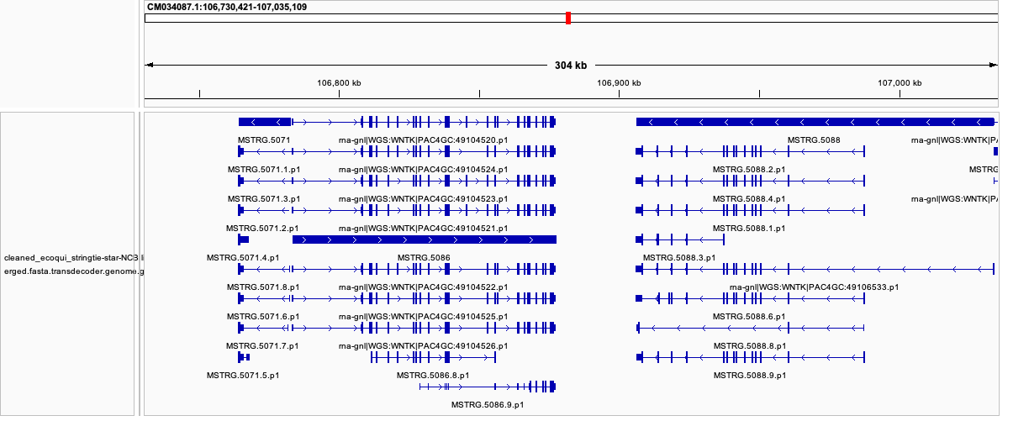
An annotation of the coqui frog (Eleuthrodactylus coqui)

Slide 6
The (somewhat confusing) anatomy of gtf/gff3 files
gtf and gff3 files contain 9 tab-separated columns
Gff3 is the current standard although some tools still output gtf
seqname, source, feature, start, end, score, strand, frame, attribute
Not all annotations include the same features
Some don’t include CDS
Some include, e.g.:
Introns
Various classes of small or non-coding RNAs
Files often violate the standard!
NCBI human genome annotation example
GCF_000001405.39_GRCh38.p13_genomic.gff

Slide 7
Gff files continued
One can find CDS annotations without a specified frame
Transcript features may have an ambiguous strand (“?” or “.”)
What’s in the attribute feature is highly variable among annotations that derive from different sources
Contrast the NCBI gff3 with one produced by converting a Stringtie gtf to gff3
# gffread human_stringtie-hisat2_merge.gtf -o human_stringtie-hisat2_merge.gff3
##gff-version 3
NC_000001.11 StringTie transcript 14359 16856 1000.00 - . ID=MSTRG.1.1;geneID=MSTRG.1
NC_000001.11 StringTie exon 14359 14829 1000.00 - . Parent=MSTRG.1.1
NC_000001.11 StringTie exon 14970 15038 1000.00 - . Parent=MSTRG.1.1
NC_000001.11 StringTie exon 15796 15947 1000.00 - . Parent=MSTRG.1.1
NC_000001.11 StringTie exon 16607 16856 1000.00 - . Parent=MSTRG.1.1
This should be ”Parent” !!

Slide 8
How do genome annotation tools work?

Slide 9
Three flavors
Hidden Markov Model (HMM) approaches
Scans the genome sequence and identifies genomic positions that switch between protein-coding (CDS) and non-coding status
Can use evidence from protein-to-genome or RNA-seq reads/transcripts to genome to guide HMMs
RNA-seq assemblers
Takes RNA-seq reads aligned to a genome to build a splice graph, from which the transcript sequences are extracted
Liftover
Uses whole-genome alignment from a (high quality) source genome to transfer annotation information (ideally also of high quality) to a target genome

Slide 10
Some well-established methods
Annotation Transfer/Liftover
Evidence aware ab initio
Assemby from Reads
Multi-annotation source integration
TOGA
Liftoff
BRAKER
CGP
HISAT2,STAR
MAKER2
BRAKER3
reference genome
Splice alignment
Protein AND RNA-seq data
Protein OR RNA-seq data
ab initio prediction
reference annotation (gff)
Stringtie,Scallop
hints (via alignment)
Transcript assembly
Evidence-based filtering w/ protein and/or RNA-seq
hints
exon-aware liftover
naïve liftover
model training
Transdecoder
model training
prediction
CDS annotation
prediction
prediction

Slide 11
What method should you use? Depends upon whether…
You have paired-end RNA-seq data
There is a high-quality annotate reference genome from a not too distantly related species
Your objectives
Are you interested in gene and isoform-level expression variation?
Are you only interested in protein-coding genes, or recovering amino acid sequences?
Do you only care about conserved orthologs or do you want to recover as many real genes as possible?

Slide 12
The annotation tool performance interlude

Slide 13
Some tools can produce tons of very short transcripts
Human
Freedman and Sackton (2025), Genome Research

Slide 14
And a seeming excess of monoexonic transcripts

Slide 15
Some tools tend to make false positive predictions
from Freedman and Sackton (2025), Genome Research

Slide 16
Tools vary in their recovery of real genes
from Freedman and Sackton, in press @ Genome Research

Slide 17
And in how much RNA-seq data can align to them
from Freedman and Sackton (2025), Genome Research

Slide 18
What metrics should you use to evaluate your new annotation?

Slide 19
Proteome: BUSCO recovery
Compleasm (https://github.com/huangnengCSU/compleasm)
Avoids some problems with BUSCO software
Compleasm score: 1-(# missing BUSCOs/# BUSCOs searched)
If recovery of BUSCOs is poor, likely similar (or worse) performance for less conserved sequences
Need to choose the appropriate BUSCO database
Available at various taxonomic levels

Slide 20
Proteome: coverage of “reference” proteins
If you can construct a “reference” protein BLAST database from genomes that aren’t too distantly related to yours, coverage of those proteins gives an idea as to sensitivity and accuracy of your annotation
from Freedman and Sackton (2025), Genome Research

Slide 21
Proteome: Psauron scores
Psauron (Sommer et al. bioRxiv) uses a machine learning model trained on > 1000 plant and animal genomes to predict accuracy of protein-coding predictions
Produces transcript level scores that estimate likelihood sequence is real
Also produces an overall score for the input fasta (CDS or amino acid sequence)
We have found that the overall score correlates well with the fraction of predictions that have blast hits to a high quality reference annotaton
Potential to use transcript-level scores as part of a filtering regime

Slide 22
Transcriptome: RNA-seq alignment rates
If you have RNA-seq data, if the alignment rate to your annotation is low, may indicate you have not captured the full diversity of the transcriptome
But this can be influenced by things such as the proportion of pre-mRNA and non-coding sequences in an RNA-seq library
Particularly worrisome if your annotation is produced by a method that assembles transcripts FROM THE RNA-SEQ DATA

Slide 23
Ability to obtain functional information
If you can’t obtain functional information, there’s not much to say downstream
E.g. with a reference genome, what do you say when an “uncharacterized protein” is differentially expressed between conditions?
For practical purposes, methods that produce greater proportions of annotations that can return orthology information, gene symbols and GO terms via resources such as EggNOG-mapper, will be more useful
Assuming those functional annotations are correct!

Slide 24
Warning signs …
Poor BUSCO recovery
Low compleasm scores
Large numbers of monoexonic transcripts or isoforms per gene
Low frequency of BLAST hits to reference or consensus protein databases (e.g. Uniref90)
Low coverage of reference proteins
Poor RNA-seq alignment rate (especially if you used RNA-seq data for your annotation)
Genes known to be highly expressed in your study organism are missing in your annotation

Slide 25
Some generic options, (ignoring study-specific considerations)
If have a good, closely related annotation, and focused on protein-coding genes, try TOGA
If have RNA-seq data and no closely related genome, or want the entire transcriptome, use Stringtie + TransDecoder
If don’t have a closely related genome and no RNA-seq data, try BRAKER2
Consider integrating TOGA+Stringtie when have RNA-seq data
Consider integrating BRAKER3 + Stringtie when have RNA-seq but no closely related genome

Slide 26
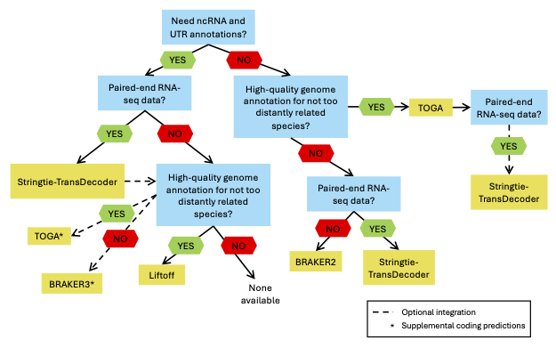
The annotation method choice decision tree

Slide 27
How do I merge/integrate multiple annotation sources?
Naïve approach
Choose one method as “base”
Add features from the second method not found in first
Iterate if > 2 methods
Employ a scoring schema to pick “good” transcripts”
BRAKER3 does this, with (occasionally) favorable results
Other methods (e.g. Mikado) seem to lead to information loss
Merged annotation has lower BUSCO scores than the best of the merged annotations
TOGA
Stringtie
?

Slide 28
Remaining challenges with genome annotation
Better integration tools
Evidence that open reading frame (ORF) detection for RNA-seq assemblies misses terminal CDS exons (and other ORFs)
Freedman and Sackton (2025) , Genome Research

Slide 29
Our Snakemake workflows
Stringtie + CDS annotation with TransDecoder
https://github.com/harvardinformatics/AnnotationRNAseqAssembly
Consumes RNA-seq PE fastq files and a genome fasta
BRAKER2 or BRAKER3
Given public protein resources, if have RNA-seq data should use BRAKER3, as BRAKER1 (RNA-seq only) typically doesn’t doesn’t perform as well
https://github.com/harvardinformatics/AnnotationBRAKER
TOGA
https://github.com/harvardinformatics/GenomeAnnotation/tree/master/TOGA

