Slide 1
$ Command line 101: $ SLURM tips and tricks
$ Harvard FAS Informatics virtual training
$ Friday, March 6, 2026
$

Slide 2
Topics covered
How to go from bash script to SLURM job
Scaling with job arrays
Understanding resource usage
Using jobstats and reportseff

Slide 3
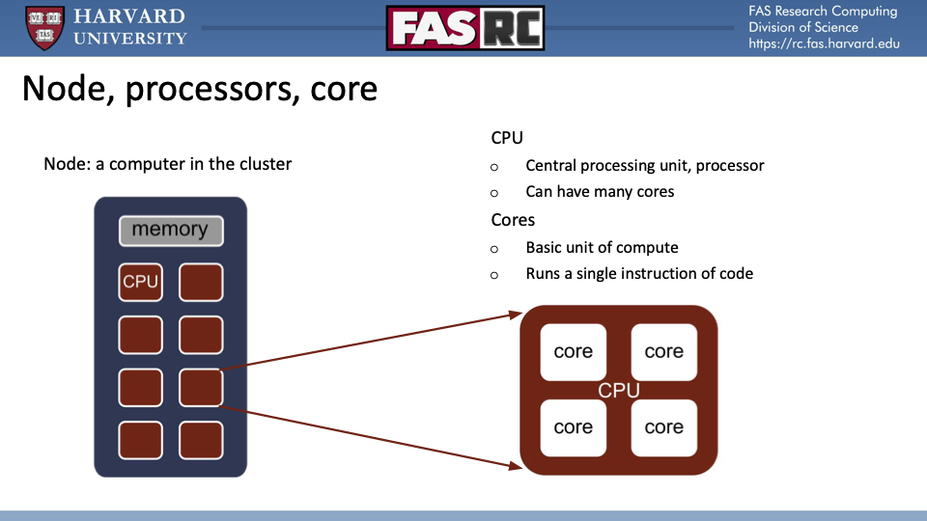
Quick review of compute on the HPC

Slide 4
Initial one-off script
fastqc_script.sh
#!/bin/bash
for i in raw/*.fastq
do fastqc --outdir output --threads 4 $i
done
You have to be logged in to the cluster the whole time the job is running
If one of the files fails, you have to start the job over
If you have a lot of files, it can take a long time to process them all
The resources you need may not be immediately available at the time you request it
Sequentially processing this script
$ salloc -c 4 --mem 8000 --time 3:00:00 --partition test
$ ./fastqc_script.sh

Slide 5
Converting script to SLURM job
#!/bin/sh
#SBATCH --partition=serial_requeue # partition (queue)
#SBATCH -c 4 # this specifies the number of cores
#SBATCH --mem=8G # this specifies memory in GB
#SBATCH --time=00:20:00 # job length of 20 minutes
#SBATCH -J fastqc # add a short job name here
#SBATCH -o fastqc_%A.out # stdout log
#SBATCH -e fastqc_%A.err # stderr log
#SBATCH --mail-type=ALL # send email on job start, end, and fail
for i in raw/*.fastq
do fastqc --outdir output --threads 4 $i
done
SBATCH options tell slurm how to handle your job
partition, core, memory, and time are most important
Assumptions:
fastqc is in your $PATH
sbatch file is run from folder containing raw/ directory w/ fastqs in it

Slide 6
Job arrays
#!/bin/bash
#SBATCH -J fastqc
#SBATCH -c 4 # each of your child jobs will have these resources
#SBATCH -p serial_requeue
#SBATCH -t 00:10:00 # each of your child jobs will have these resources
#SBATCH --array=1-8 # this is the number of child jobs you want to run!!
#SBATCH --mem=8000
#SBATCH -o logs/fastqc_%A_%a.out # each child job will have its own log
#SBATCH -e logs/fastqc_%A_%a.err
#SBATCH --mail-type=BEGIN,END,FAIL # send email on job start, end, and fail (of the whole array)
readarray -t files < <(ls raw/*.fastq) # make the array of files
file=${files[${SLURM_ARRAY_TASK_ID}-1]} # get the path of the file we want
echo "Working on file ${file}" # echo the file path to the log file (will go to the .out file of that job array)
fastqc --outdir output --threads 4 $file # no loop needed! Just type the command as you would in the terminal
Submit multiple independent jobs in one slurm script!
Key points
use SLURM_ARRAY_TASK_ID to index your input files
SBATCH resources are PER JOB

Slide 7
Fairshare
SLURM scheduler uses fairshare to prioritize jobs (only relevant when cluster is busy)
The score is shared for your LAB
CPUs (and GPUs) + Memory + Time = TRES (trackable resources)
sshare --account=LABNAME -a
Usage charges have a half life of 3 days
Use scalc to predict your fairshare
scontrol show job <JOBID> to see predicted time to run

Slide 8
How do I …
know what resources my program uses most?
queue less on the cluster?
diagnose why my job is slow?
benchmark my programs?
optimize and scale my programs and workflows?

Slide 9
What resources programs use
Disk (I/O)
This is the rate at which data can be read from or written to the disk.
Ways you may be limited:
Running blast on a large database across many files
Having a lot of files (1000+) in a directory
Copying/moving large files between storage locations
Memory (RAM)
CPUs (Cores)
Time
Notes:
If you have a program that you want to optimize, you need to know what is the rate limiting resource.

Slide 10
What resources programs use
Disk (I/O)
Memory (RAM)
Used to store data that is being processed by the program. Typically a limiter rather than scaler
Ways you may be limited:
Running a merge sort algorithm on a large dataset (e.g. samtools sort)
Working with large data such as genomes
Python/R objects reside in memory and may exceed allocated RAM
CPUs (Cores)
Time

Slide 11
What resources programs use
Disk (I/O)
Memory (RAM)
CPUs (Cores)
Some programs can subdivide their work into smaller tasks that can be run simultaneously on different cores.
If program isn’t designed for it, adding cores doesn’t help!
Ways you may be limited:
Sequence alignment (e.g. bwa mem)
Genome assembly (e.g. spades)
Running simulations with heavy computations
Time
Notes:
Note: program should have an option to specify the number of threads or processes

Slide 12
What resources programs use
Disk (I/O)
Memory (RAM)
CPUs (Cores)
Time
Queuing & running your jobs takes time. Keep in mind “Time to Science” (TtS)
Examples of ways you might be limited by time:
Running jobs while your fairshare is low and the cluster is busy
Running jobs sequentially instead of in parallel
Scheduling high resource use jobs = more time waiting in queue

Slide 13
What resources programs use
Disk (I/O)
Memory (RAM)
CPUs (Cores)
Time
Know your program
Read the docs, read the paper, etc
Some programs have benchmarking data already, or describe their recommended resource requirements

Slide 14
Use jobstats to see resource usage
https://docs.rc.fas.harvard.edu/kb/jobstats/
Monitors your job’s resource usage
jobstats gives you info on 1 job at a time
Memory usage only works after job is completed

Slide 15
How to Diagnose
Disk Bottleneck
Not enough CPU
Not enough memory or time
Slow for no reason, or unpredictably slow
jobstats results show program not fully utilizing CPU allocation (sometimes)

Slide 16
How to Diagnose
Disk Bottleneck
Not enough CPU
Not enough memory or time
Some programs get exponentially slower with increased input
Allocated CPUs don’t match program defaults/option you chose

Slide 17
How to Diagnose
Disk Bottleneck
Not enough CPU
Not enough memory or time
Job will error out, program’s SLURM output will tell you
If in interactive job, program will stall out and SLURM won’t tell you until you end interactive session

Slide 18
How to benchmark
Get a small test dataset
Run the set on increasing amounts of CPU/mem/time
Evaluate resource usage
Use the /usr/bin/time -v command to measure the time it takes to run a program
Use print statements with time-stamps to get real-time updates in your log file

Slide 19
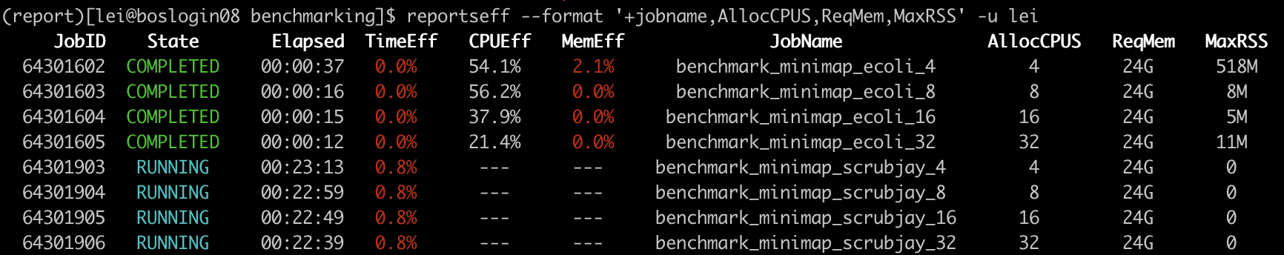
Use reportseff to summarize multiple jobs
Example useage: reportseff --format '+jobname,AllocCPUS,ReqMem,MaxRSS' -u lei
https://github.com/troycomi/reportseff
Install in a conda environment

Slide 20
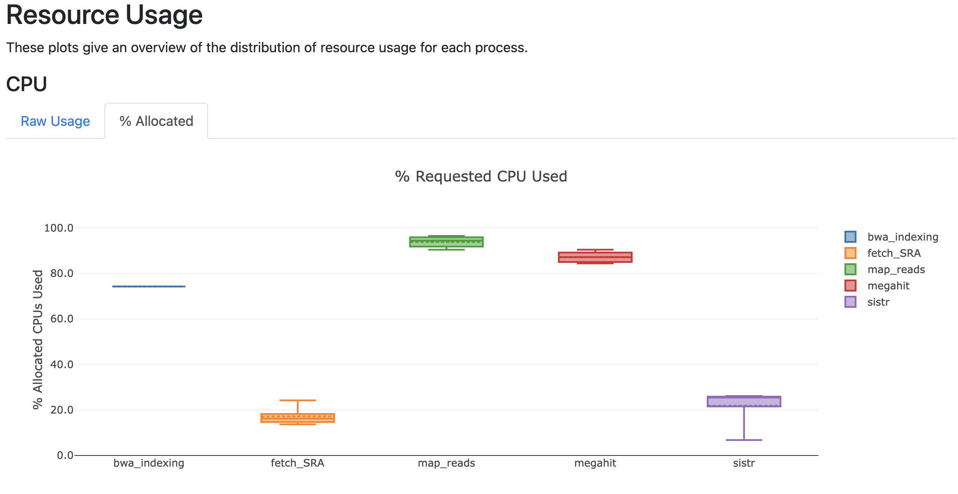
Use workflow managers for complex benchmarking
Workflow managers like snakemake and nextflow have built-in reporting capabilities and can run multi-step jobs by themselves.
Good way to benchmark with 1 well-designed script
See our Nextflow and Snakemake tutorials for more info!

