Slide 1
Transferring files

Slide 2

Cluster file system review
Home directory aka the login node
$HOME
100 GB limit
basically useless for compute
Scratch
/n/netscratch/pi_lab
no size limit
90 day retention
used for compute
Lab directory
path varies
size limit based on what’s purchased
general storage
$HOME
$SCRATCH
pi_lab
Notes:
Caveats: * We are not covering the structure of the cluster. For that see FAS RC’s getting started guide
We are not covering cold storage
Storage is changing but these general concepts will be the same

Slide 3
Cluster file system review
Home directory aka the login node
$HOME
100 GB limit
basically useless for compute
Scratch
/n/netscratch/pi_lab
no size limit
90 day retention
used for compute
Lab directory
path varies
size limit based on what’s purchased
general storage
Tape Storage
archival
size limit based on what’s purchased
$HOME
$SCRATCH
pi_lab
Tape
Notes:
Caveats: * We are not covering the structure of the cluster. For that see FAS RC’s getting started guide
We are not covering cold storage
Storage is changing but these general concepts will be the same

Slide 4

Cluster file system review - permissions
Lab
Only people in your lab can read or write to this folder
Everyone
Everyone on the cluster can read/write to this folder
User
Only specific users can read/write here
Deprecated, don’t use!
In general, you can’t modify/delete/move files created by someone else
X_lab/
Lab/
Everyone/
User/
lei/
projectA
ProjectB
lei
gregg

Slide 5






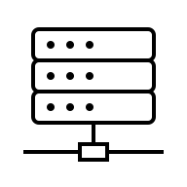

Cluster
netscratch
lab share
tape
Local
Cloud
computer
dropbox
gdrive
lab NAS
usb
Notes:
For all intents and purposes, the Home directory is useless for storing files, so we’re going to collapse that into lab share

Slide 6
Cluster
netscratch
lab share
tape
This is what we will be covering
Local
Cloud
computer
dropbox
gdrive
lab NAS
usb
Notes:
For all intents and purposes, the Home directory is useless for storing files, so we’re going to collapse that into lab share

Slide 7
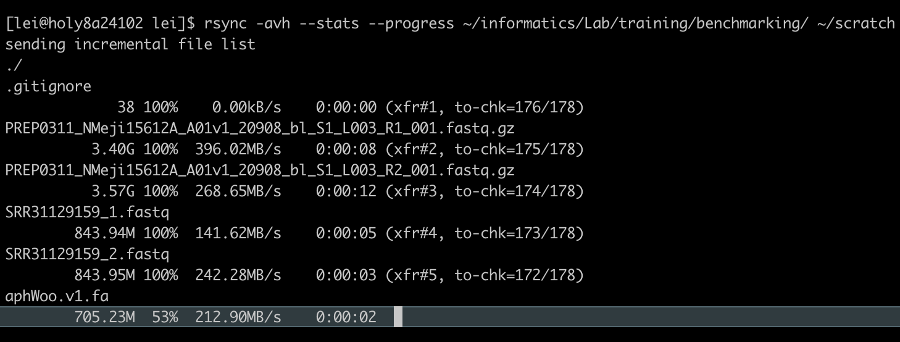
Command line: screen + rsync
Start an interactive session with salloc
Use screen to multitask
Use rsync rather than cp or mv
netscratch
lab share
rsync [OPTIONS] SOURCE DESTINATION
Options I like:
-a “archive mode”, produces most exact copy
-v “verbose”, prints more stuff
-h “human readable” makes file sizes make sense
--progress displays progress
--stats prints stats at the end
Notes:
Pros of rsync: won’t duplicate copy files if it already exists at the destination. Can make exact mirrors of a file system (--delete option). You can do a dry run with -n or --dry-run. You can use rsync to transfer between cluster and your local machine, but we won’t go over that because there are better ways.

Slide 8

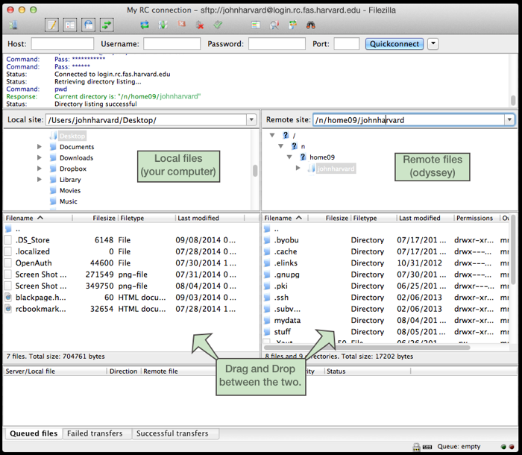
Filezilla
computer
lab share
netscratch

Slide 9
Filezilla
computer
lab share
Secure File Transfer Protocol (SFTP) application
Available on Mac, Windows, and Linux
Instructions to set up on FASRC Docs page
https://docs.rc.fas.harvard.edu/kb/sftp-file-transfer/
Demo
Open site manager
Connect to login.rc.fas.harvard.edu with SFTP and interactive login type
(optional) choose default remote directory
Limit the number of simultaneous connections to 1
netscratch

Slide 10
Mounting labshare to local computer
Only tier 1 and tier 2 storage is mountable, not tier 0 or scratch
Steps (no demo)
Ask someone in your lab if directions exist, if so complete!
Ask FASRC during office hours 😅
computer
lab share

Slide 11

Globus file transfer
All purpose transfer tool
Transfers between clusters and between clusters + your computer
Only way to access tape storage
ONLY scratch and pi_lab/Lab/ folders are available from Cannon
Permissions issue with Everyone folder
Self-paced Globus Training https://canvas.harvard.edu/courses/157915/pages/globus-overview-2
netscratch
lab share
Lab folder only
tape
computer

Slide 12
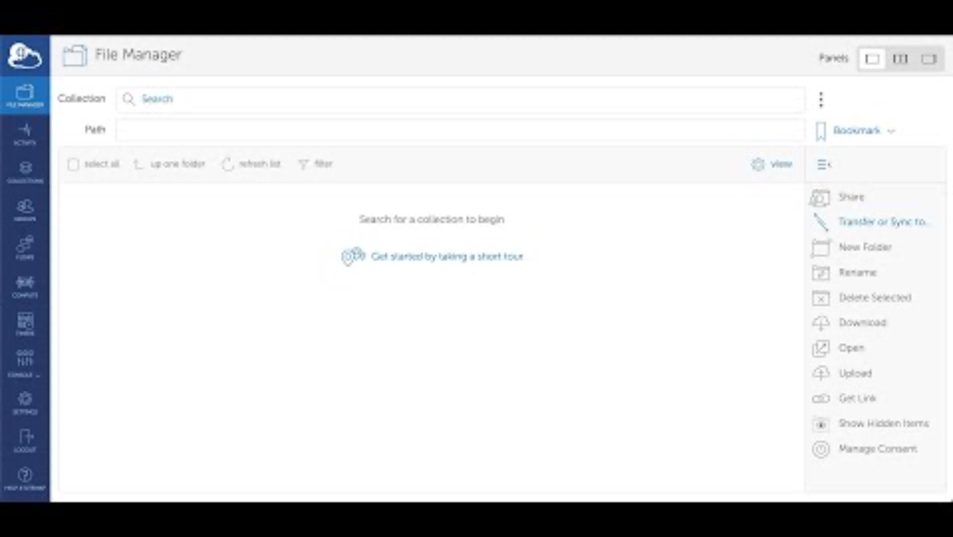

Slide 13
Create globus collections to share data
Demo
Great way to share with collaborates internal and external to Harvard
Collaborates have read-only access so they can copy out but can’t modify
Only shares from the pi_lab/Lab or pi_lab/User directory

Slide 14
Use globus connect personal to transfer locally
Demo
Download globus connect personal
Log in using your HarvardKey
Choose which folder(s) to share
You can now use Globus to transfer from any other collection to your computer

Slide 15
Globus tips
netscratch
lab share
Lab folder only
tape
Bookmark your scratch and lab directory
Set up automatic file sync to back up files
Write down your lab’s Globus protocols
computer

Slide 16
Rclone
gdrive
lab share
netscratch
You can use rclone to move/sync files between FASRC and Google Drive
Command line only
Not great for many small files (2 files per second limit)
FASRC Docs
https://docs.rc.fas.harvard.edu/kb/rclone/
Walkthrough to connect to your google drive
https://rclone.org/drive/

