Slide 1


git/GitHub Introduction
Lei Ma, PhD
Informatics Group
Gregg Thomas, PhD
Informatics Group
Notes:
Welcome to our seminar on publishing your data analysis on GitHub.
We've giving this seminar because as part of the Bioinformatics group, we consult with researchers at Harvard and have found that many researchers are interested in sharing their code as part of their publication, but don't necesssarily know the best way to go about it. Plus, if you are primarily an experimentalist, navigating products such as git or GitHub, which are geared towards computer scientists, can be daunting as there are a lot of concepts and it can be difficult to sort out what is relevant to your use-case of sharing code vs the software developers for which these products were created.

Slide 2
We help FAS researchers with bioinformatic analysis
One-on-one consults
Ongoing collaborations
bioinformatics workshops

Slide 3
Specialized Services
Data Concierge
Office Hours
Newsletter

Slide 4
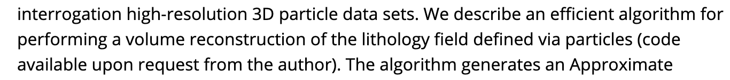
“Data available upon request” is no longer acceptable, shouldn’t it be the same for code?
Don’t do this!
Notes:
I know we're all here because we have presumably bought into the motivation for sharing data, but I want to start off with why sharing the code you use for your analysis is important. Not so long ago, it was common to read papers which had the following phrase "Data available upon request" to the authors. Since then, federal funding agencies, journals, and professional societies have collectively decided that's not good enough for reproducibility and now data is regularly being uploaded to public repositories and many journals have a mandatory "Data availablility" section where authors will link to their raw data. However, raw data isn't the only thing that is needed to reproduce an analysis. Just as it is important to write your methods in enough detail, it should be possible to describe the steps you took to analyze your data such that another reader can perform those same steps. In other words, it is not good practice to say that your analysis code "is available upon request", or worse, not even mention that it's available at all. When I read a paper that says that, I'm always left wondering, if it exsits, why not share it? What are they trying to hide?

Slide 5
Your code is part of your methods: what you include matters
“A differential abundance analysis was conducted using the Wilcoxon Rank Sum Test…These analyses were performed using the R statistical program.”
❓Did they code their own or use a software?
❓ What parameters were given?
❓ What data cleaning was done beforehand?
“Maaslin2 (version 1.14.1) [32] was used for differential abundance analysis on a rarefied dataset with TSS normalization, prevalence set to 15%, and cage household set as a random effect.”
✅ Software and version are listed and cited
✅ Parameters and data cleaning/normalization are listed
✅ Could recreate if we read the tutorial for Maaslin2, maybe
❓Not all parameters are listed, some are assumed
❓Takes a lot of effort to recreate
Notes:
Here are two examples of potential ways we can write out analysis steps in our methods section. In this first example, the name of a statistical analysis is mentioned as well as the programming language used to perform the analysis. However, if you were a reader who wanted to reproduce this analysis, you would have to know whether the authors used a specific implementation of the Wilcoxon rank sum test, such as that found in the "stats" package in R, or if they coded their own, or if they used a different package altogether. In any case, you would be guessing at the exact code that was used.
The second example is much more informative. The authors have provided the name of the R package and the version, and cited the package. Key software packages used in your analysis should be cited just like you would cite a paper. The rest of the sentence describes details about how that software was used, including the parameters that were used and how the data was preprocessed. This level of detail is likely enough for a reader who is familiar with the software to reproduce the analysis, though perhaps not with 100% accuracy. Before we share our real code, let's try to have this level of detail in our methods section.

Slide 6
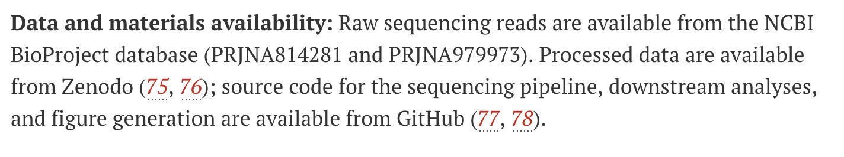
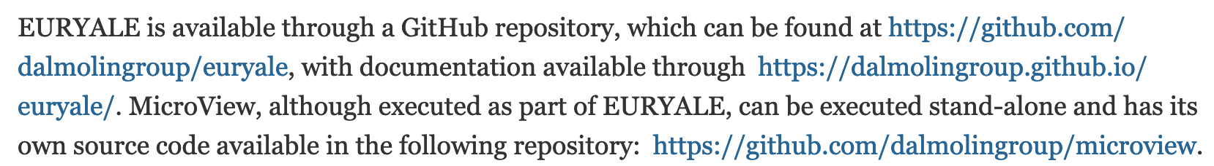
Two types of sharing code: for reproduction and for reuse
Code shared for reproduction
Link to paper by Alejandro Couce et al, Science 2024 “Changing fitness effects of mutations through long-term bacterial evolution”
Code shared for reuse
Link to paper by Cavalcante et al, IEEE 2024 “EURYALE: A versatile Nextflow pipeline for taxonomic classification and functional annotation of metagenomics data”
Notes:
When you do decide to share your code, think about whether you intend to share it in order for others to reproduce the analysis of the paper or whether you intend for others to use something you created on other data. Here are two different data/code availability statements from papers with these intentions. The first is a research paper with a lot of data analysis and both the raw data and the code used to analyze it are shared. The second paper is a computational tool or software, and so the code being shared isn't the analysis that was the proof of concept of how the tool works, but the cleaned up and ready to use software itself. You will notice that both of these papers have shared their code on GitHub. So what exactly is GitHub?

Slide 7


Feature |  | GitHub | GitHub Desktop
Type | Local version control software | Cloud-based hosting service | Software to help manage GitHub repositories with a user interface
Installation | Downloaded and installed locally | Web-based, no installation needed | Downloaded and installed locally
Cost | Free and open-source | Free and paid tiers available | Free
Dependency | Can work independently | Requires Git to function | Comes with its own copy of git
Ownership | Open-source community; (Maintained by the Linux Foundation) | Owned by Microsoft | Owned by Microsoft
Internet Requirement | Works offline | Requires internet connection | Requires internet connection
Primary Function | Version control and code management | Repository hosting and collaboration | Help manage git/GitHub repos
Access | Local machine only | Accessible from anywhere | Local machine only
Features | Basic version control operations | Additional features like issue tracking, pull requests, wikis | Most features of git & GitHub
Security | Local authentication | Two-factor authentication, access control | Connects to GitHub account
Notes:
Because it's often a point of confusion for folks, here is a summary page outlining the differences between git and GitHub (and other remotes or code hosting services). Git is a free and open source version control software that works offline on your local machine. You use it to take snapshots of your folder and track the changes to files in your folder. GitHub is a cloud-based hosting service that allows you to back up your code to computers owned by GitHub/Microsoft and share them with the world. It offers collaboration features and additional ways to interact with your code. Most of the features relevant to us are free, but there are paid features as well.
We will also be using GitHub Desktop, which is an application that helps users perform git actions and connect their git repository to GitHub. Originally, git was purely a command line tool. However, if we are not hard core coders, we can use an app called GitHub Desktop to perform all the actions described previously using a graphical interface.

Slide 8
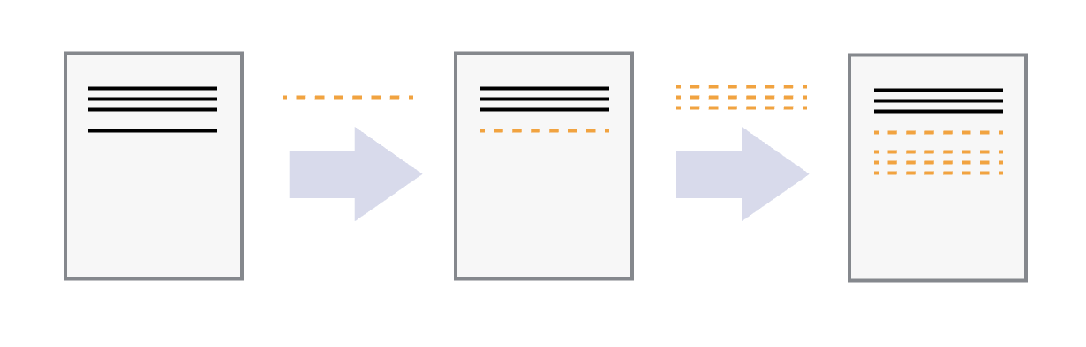
What is git? It’s manual verson control
initial commit
commit 2
commit 3
Allows manual snapshotting of directory
like Time Machine, Dropbox, Google Docs, but not automatic
Works locally (i.e. does not upload to anywhere on the internet)
A hidden folder (.git) tracks changes, not copies
Works line by line

Slide 9
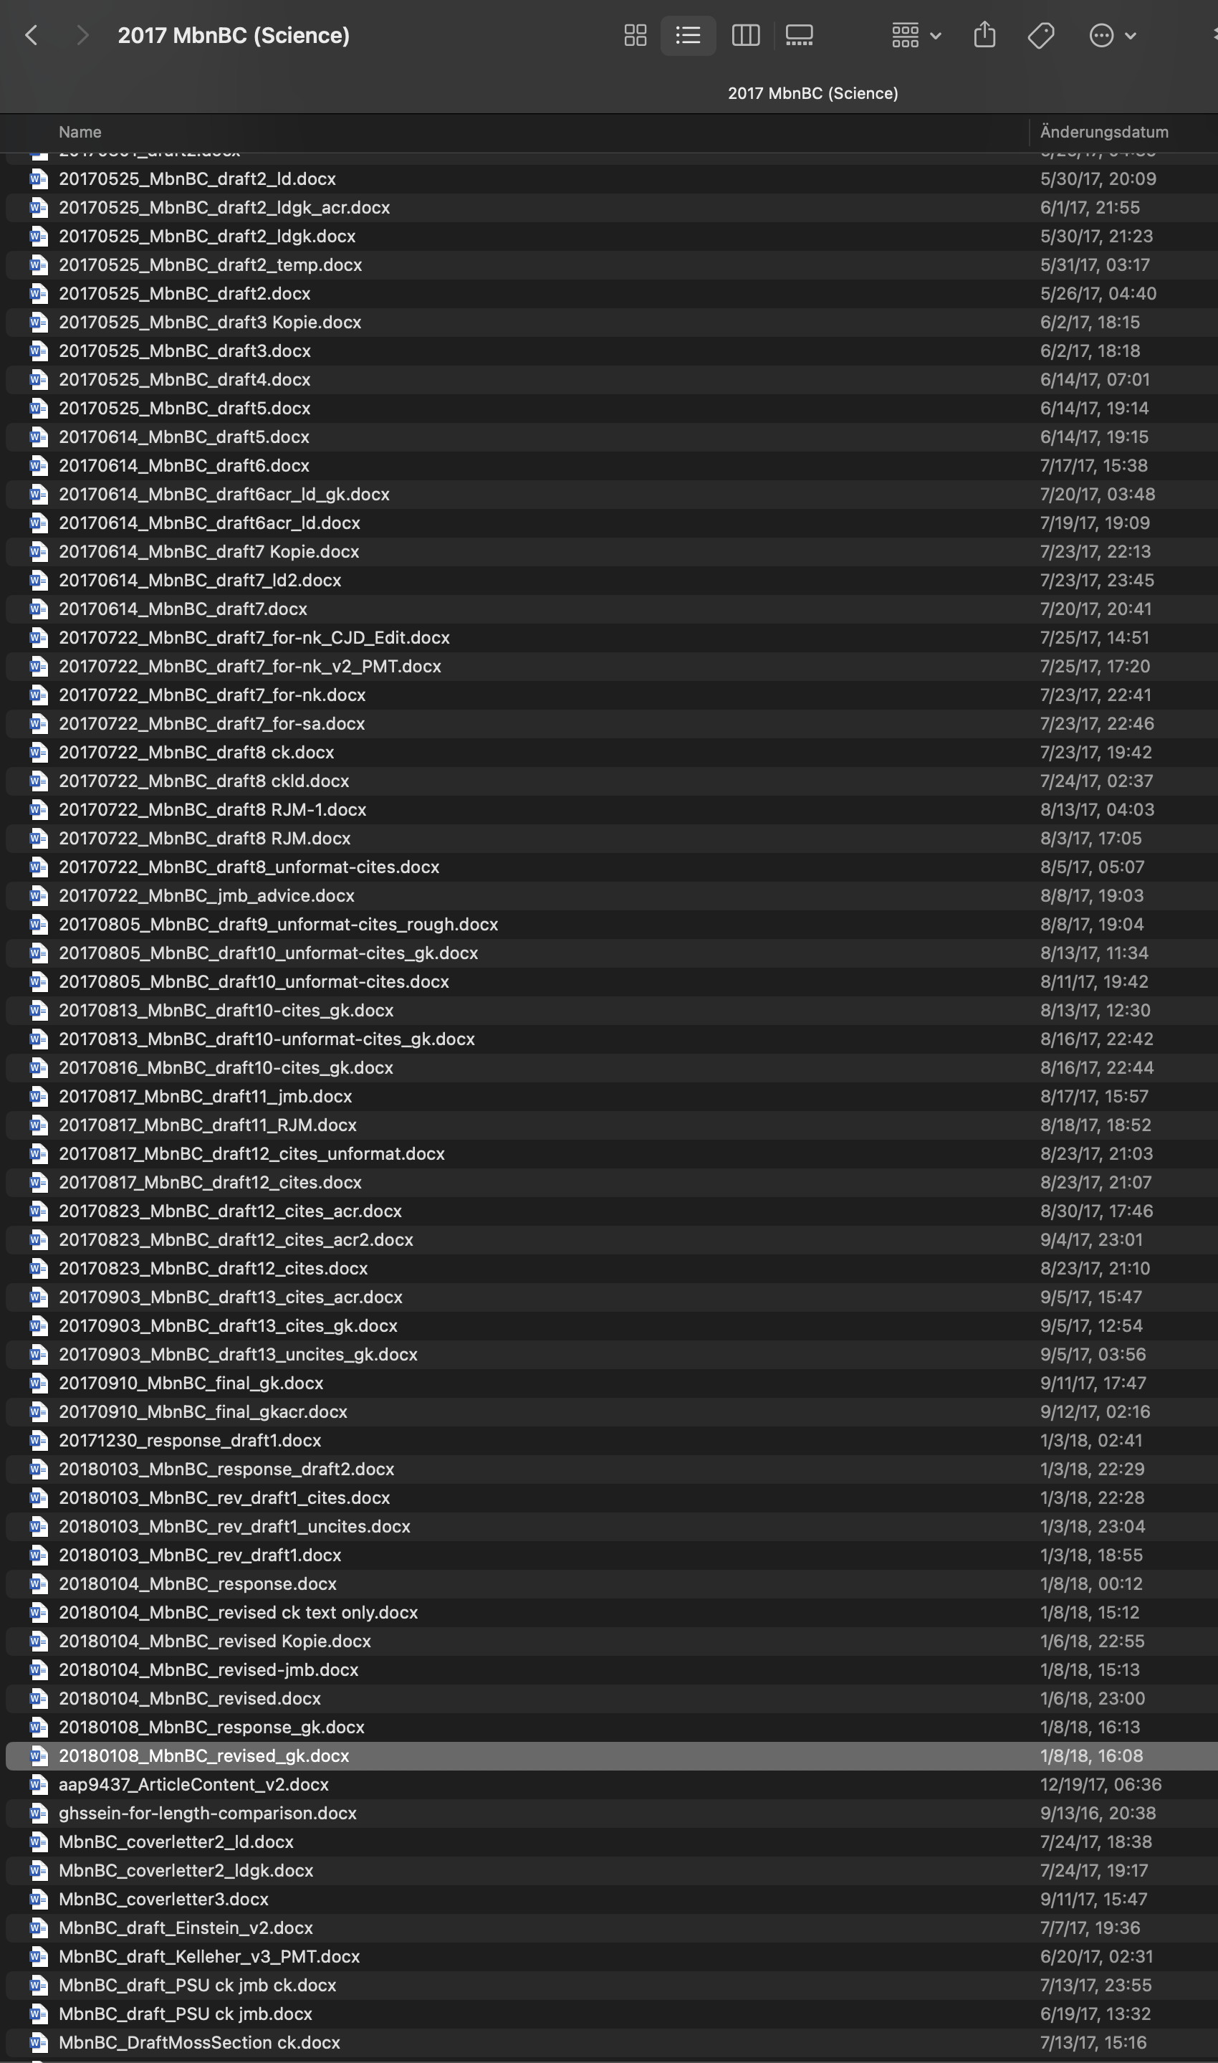

Changing file names is not version control
☹
“notFinal.doc” by Jorge Cham, https://www.phdcomics.com
Notes:
Regardless of where your code comes from, usually throughout a project there is an iterative process of writing, testing, and changing your code until you get to the final version that you use in your publication. This may consist of testing out multiple versions of the same code at a time, or maybe one set of scripts for analysis A and another set for analysis B and there's some overlap between the two... Anyway, it can get messy! Version control is a way to manage this process so that you never lose important work and can clearly distinguish between different version of your code.

Slide 10
Why use git over Google Drive, Word, etc?
Records all changes and who made them
compare to track changes in Word after you’ve “accepted changes”
You have control over snapshots
You can experiment with different versions while keeping a working version intact
Will never accidentally erase something.
You can time travel across different versions of your files

Slide 11
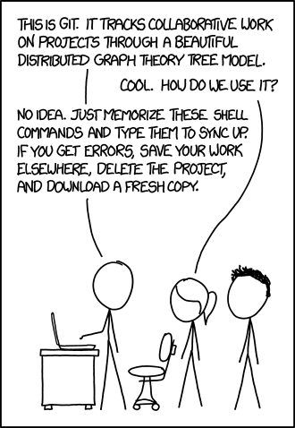
Summary of use cases
Version control
Collaboration
Publication
xkcd.com

Slide 12
Working directory
Staging area
.git directory
Stage file (git add)
Commit (git commit -m “message”)
Retrieve saved version (git checkout or git restore)
Notes:
For our purposes, since we likely just have one final version of our code, we can ignore some of the more complex features of git. Here's how git works in a nutshell: Think of it like taking a group photo. There are three virtual areas in your directory. One is your working directory, where you are doing your editing and saving as usual. Then there's the virtual staging area, which is like right in front of the camera. You decide which files you want in the photo by telling git to add them to the staging area. This tells git which files to keep track of for this snapshot. Then you commit the files in the staging area, which is like taking the photo. And this snapshot will be saved in the .git directory. You can then retrieve older versions from the .git directory if you want to. But we will primarily focus on the forward direction, where you are adding new files.

Slide 13

Local repo
Backup to remote (git push)
Remote
Your_name/repo-name
Working directory
Staging area
.git directory
Retrieve from remote (git pull)
Stage
Commit
Checkout
git on your local machine
GitHub on remote servers
Notes:
So what is GitHub? GitHub is a website owned and run by Microsoft where you can upload your git repositories. It essentially hosts you code for free (with additional paid features) on Microsoft servers, aka the cloud. The copy of your code on your personal computer is called the "local" copy while the copy on the website is called the "remote" copy. Remote repositories are useful for sharing your code with others and having a cloud backup of your code. Other remote repositories include GitLab, Bitbucket, and others. GitHub is by far the most popular, and has a lot of features that make it easy for non-coders to use, like a web interface and a desktop app. When you want to upload your local git repository changes to the GitHub website, it's called "pushing to the remote" and when you want to retrieve changes it's called "pulling". Again, we'll focus on the forward direction for now.
Look at this overview picture. You can see that, if you follow the forward arrows, there's essentially three steps to using git and GitHub. First on your local computer you stage your files, then you commit them, then you push them to the remote.

Slide 14
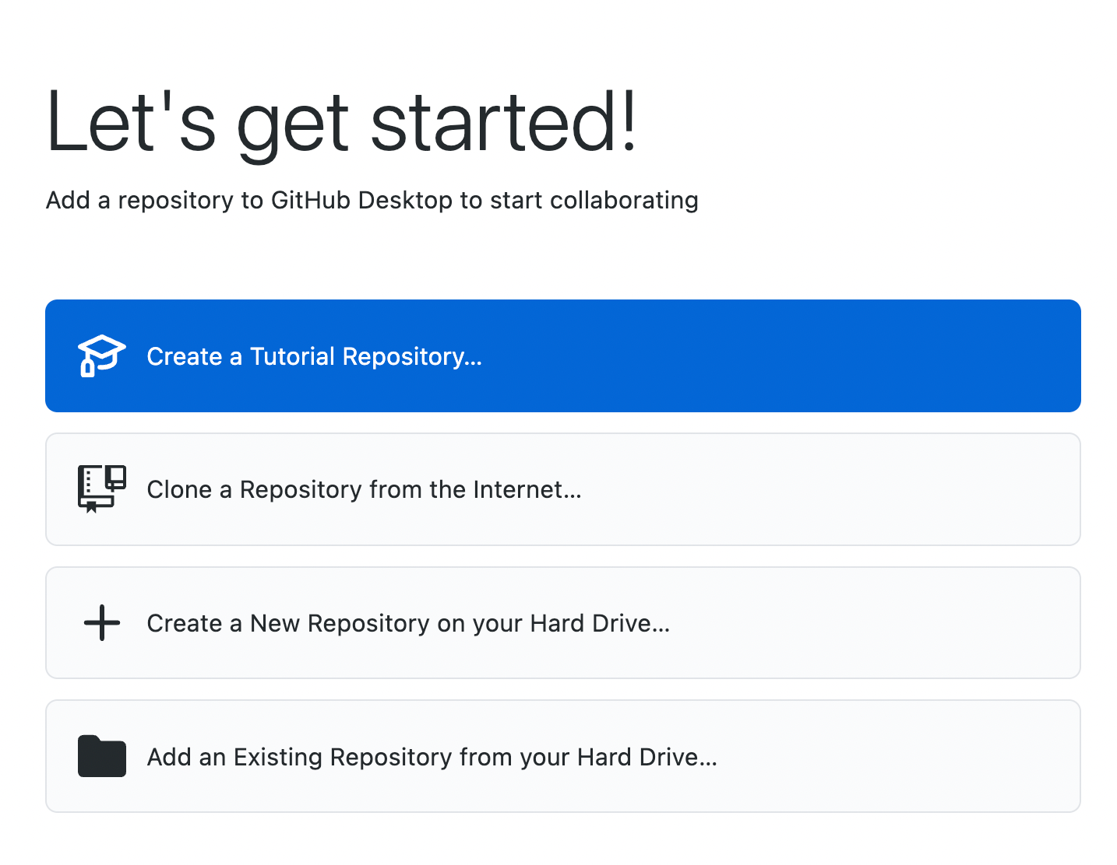
First steps
Create a GitHub account
Download and install GitHub Desktop
Link GitHub Desktop to your account
You should see something like this ->
Click “Create a New Repository”
Notes:
In order to use GitHub Desktop, first you will need to create a GitHub account. Then, you can go to [https://github.com/apps/desktop](https://github.com/apps/desktop) to download the application for your operation system and connect it to your account by going to "GitHub Desktop -> Settings -> Accounts -> Sign Into GitHub.com". If you've never put something on GitHub before, this landing page for the app will look a little like this, with 4 options, including "+ Create a New Repository on your Hard Drive". This is the option we want.

Slide 15
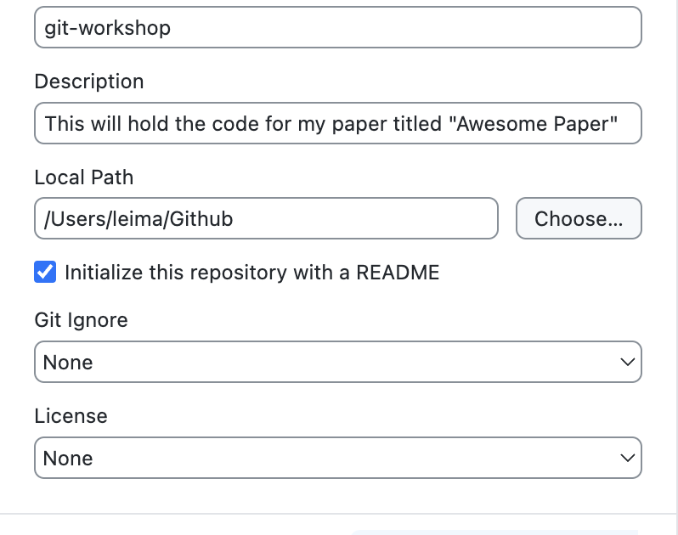
Creating your first repo
Makes a new folder AKA repo
No spaces in repo name
MIT license: Anyone can use (including commercially) as long as credit is given
GNU GPLv3: Anyone can use (including commercially) as long as credit is given and changes are record. No proprietary uses.
Notes:
We'll make a new repository called "git-workshop" and we'll add a short description. I like to put all my GitHub repositories in one folder on my computer, so that will be the local path. We will initialize it with an empty README file, no gitignore, and a license of MIT. For academic papers, the MIT license is a good choice because it allows others to use your code as long as they give credit. Another good option for licensing is the GNU GPLv3 license, which allows anyone to use and adapt the work, but they have to give credit and list changes. This restricts someone from taking your code and making it proprietary.

Slide 16
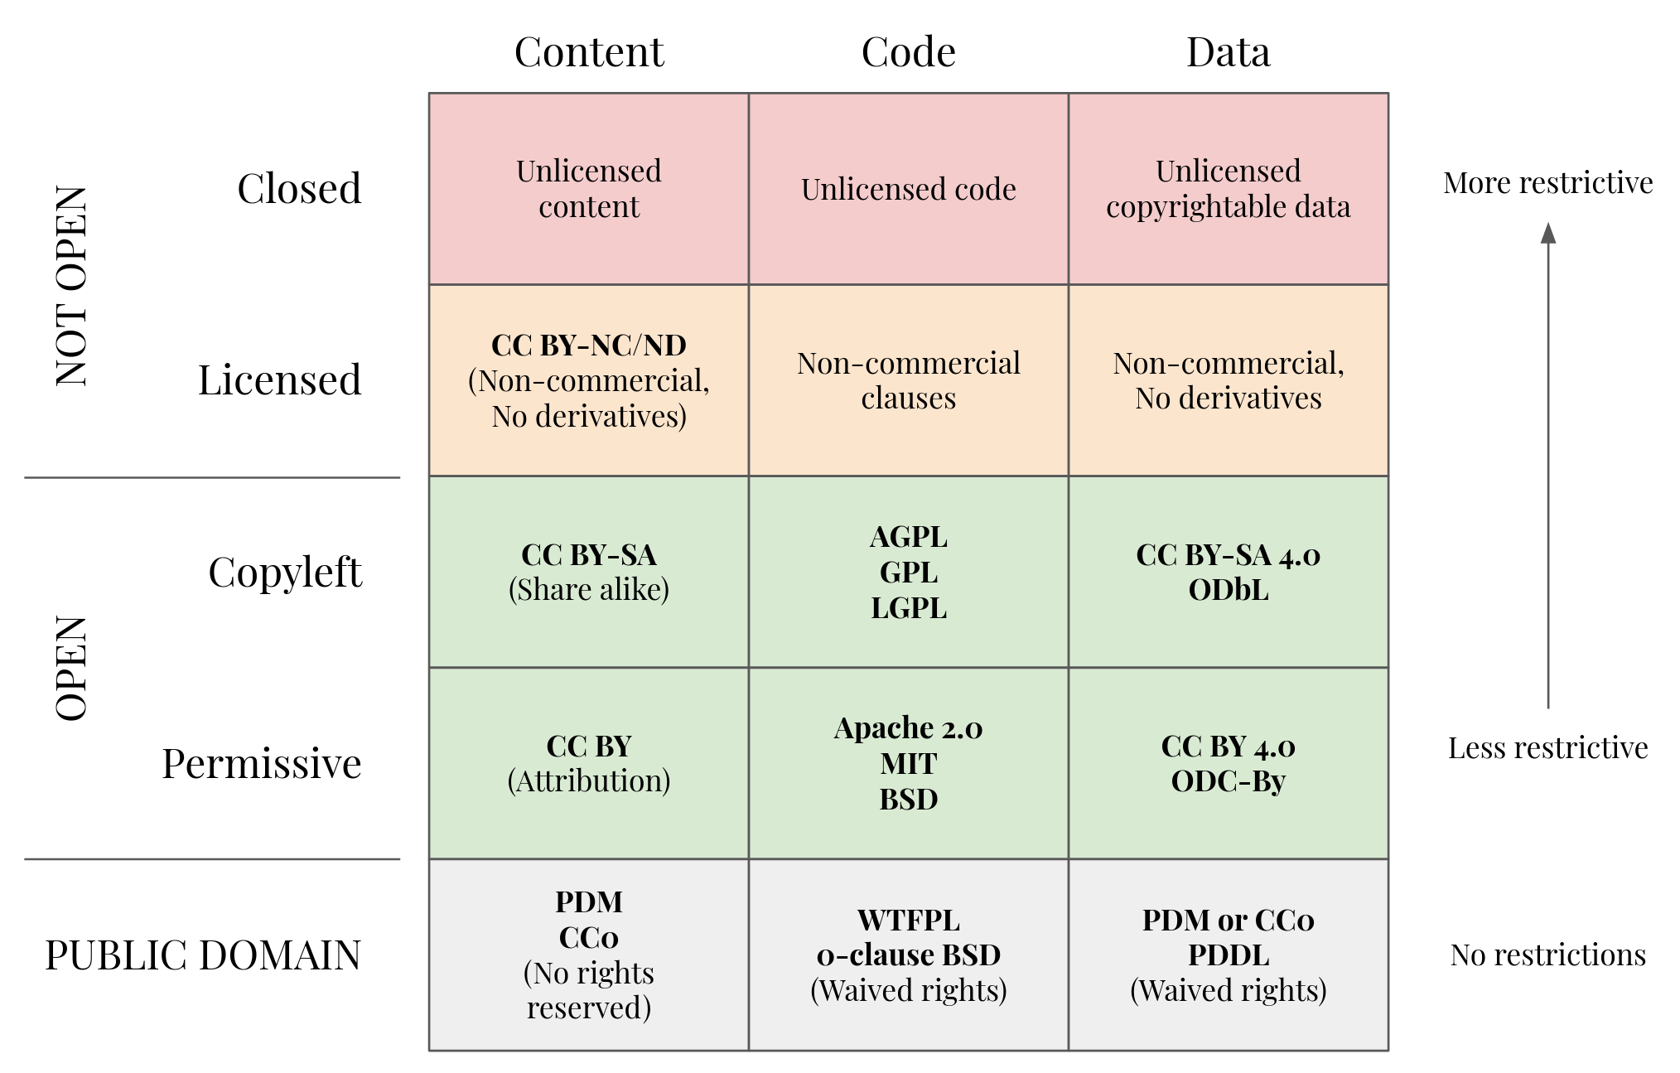
Open Licenses
Hall, M. (2021, February 17). Which open licence should I choose? Agile Scientific. Retrieved February 12, 2025, from https://agilescientific.com/blog/2021/2/17/which-open-licence-should-i-choose
Notes:
* If you want maximum adoption and simplicity: Choose MIT
* If you need patent protection: Choose Apache 2.0
* If you want to prevent others from creating closed-source versions: Choose GPL
* If you want basic protection with minimal restrictions: Choose BSD-2 or BSD-3
The most important distinction is between permissive licenses (MIT, BSD, Apache) which allow commercial and private use with few restrictions, and copyleft licenses (GPL) which require sharing modifications under the same terms
This repository should now contain two files, "LICENSE" and "README.md". The README files is a markdown file, which is a way to format text. You can edit this file using any text editor. So let's start by doing that. I'll add some simple description to the README and save it. Now let's move some files to it. Let's naively move all the files from a project into the repository.

Slide 17
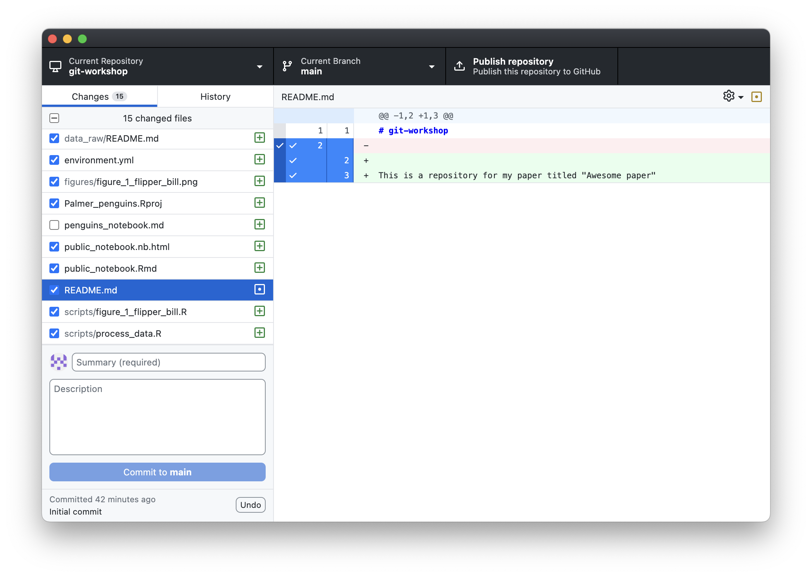
staged
new files
not staged
modified
Notes:
Let's look at the layout of the application. On the top you have three buttons. The first has your repository name on it and if you click it, will allow you to switch between other repositories you own on this computer. The middle button is the "Current Branch" button, which we won't worry about. The third button is the "Publish Repository" button, which will push this local repository to your online GitHub account. We're not going to do that yet.
Underneath the top bar are two panels. The left panel is the "Changes" panel, which shows all the changes to your directory since the last commit. The last commit is the last snapshot you took and every new repository has an "initial commit". If a file has been added, it'll appear on this panel with a green "+" symbol, indicating that it's a new file. If a file has been modified, like our README file, it'll appear with a yellow dot symbol. And on the right you can see which lines have been added (in green) or removed (in red). To the left of each new or modified file is a checkbox. This is how you add files to the "staging area".
Below the "Changes" panel is where we make our commits. Each commit needs a short summary of what was changed. But before we make a commit, we need to talk about which files should be added to your git repository and which files should not.

Slide 18
☑︎ = file is staged and ready to be committed
Push/upload all commits to GitHub
commit message
commit button
undo commits that haven’t been pushed/uploaded
Notes:
We can create a file called `.gitignore` in which we can list all the files and folders we don't want to include in our repository. You can exclude all files in a folder by putting the folder name followed by a slash, like `raw/`. You can exclude all files of a certain type by putting `*.extension`, like `*.Rproj`. You can also exclude specific files by putting the file name, like `.DS_Store` or `penguins_notebook.md`.
Now we are ready to make the commit that adds the files to the repository. If you've made a mistake in adding a file, you can click the "undo" button on the bottom left of window as long as you haven't yet pushed the commit to the website (aka the remote). Now let's click "Publish Repository" to upload our repository to the GitHub website (aka push to the remote). If you are not ready to make your code public, you can click "Keep this code private" and it will be hidden. For example, you might want to keep this private until your paper has been acceppted.

Slide 19
What to upload
What to include | What NOT to include
Scripts Notebooks READMEs Configuration files (yamls, config files) Metadata files (maybe) | Data Software (conda envs, containers) Files >50 MB Passwords and sensitive information (!!!) Log files (slurm logs, error logs, etc) Junk files (temp, OS-generated junk)
Notes:
Let's take a look at our repository. Currently, we have two folders of data, raw and processed. We don't want to include anything in there because typically data files are too large to be stored on GitHub. In our case it isn't but let's pretend. We also have some R junk like `.Rhistory` and `.Rproj` files, as well as OS junk like `.DS_Store`. These are all of no use to the person who wants to reproduce our analysis. There's also a `penguins_notebook.md` file in which I had put down my exploratory analysis. This is also not necessary. Another thing you should absolutely never include in your git repository are files containing sensitive information. For example, if you have passwords, API keys, or non-de-identified metadata of your research subjects, do NOT include those files! Once it's tracked in git it is a whole separate process to scrub your git history.

Slide 20
git terminology
Term | Definition
repository (repo) | a folder tracked by git
remote | a repository hosted on a server (e.g. GitHub)
add/stage | add file to staging area (start tracking it), a checkbox in GH Desktop
staging area | intermediate area where files are tracked before they are added to git
commit | make a snapshot of staging area to repository with commit message
push | upload changes to remote repo (GitHub)
gitignore | a file called “.gitignore” that lists files to be ignored by git and GH desktop
README | a top level file called “README.md” that appears on your repo landing page
license | needed upon publication to tell others how to use your code
Notes:
Here's a review of terminology that we've covered. There's a fair bit more that you may hear about, but it is not immediately relevant for simply sharing your code online.

Slide 21
How to organize for reproduction vs reuse
Reproduction (analysis):
Examples here and here
Reuse (software):
Example here
Provide installation instructions for the software dependencies
GitHub README should provide links or instructions for downloading raw or intermediate data, link to paper, describe folder structure
Folder organization based on Data, Metadata, Analysis, etc.
Organize your code in the order that it was run for your paper
Label each script with a number or put them into folders marking different aspects of your analysis
Add readme files or notebooks to each level
Provide installation instructions for the software dependencies
GitHub README should be comprehensive and tell you what the inputs and outputs are, and what each parameter means
Folder structure is different and split based on configuration, dependencies, modules, scripts, etc.
Provide a small test dataset to demonstrate program andd check that it is running properly.
Write a documentation page if it's a larger project
Remove hard-coded or personalized parameters as much as possible
Notes:
So you've got the mechanics of how to share your code, but it's also important to consider what to share so that a reader has an easier time using it.
Sharing for reproduction
Examples:
https://zenodo.org/records/10236681
https://zenodo.org/records/10155524
* Provide installation instructions for the software dependencies
* GitHub README should provide links or instructions for downloading raw or intermediate data, link to paper, describe folder structure
* Folder organization based on Data, Metadata, Analysis, etc.
* Organize your code in the order that it was run for your paper
* Label each script with a number or put them into folders marking different aspects of your analysis
* Add readme files or notebooks to each level
Sharing for reuse/adaptation
Example: https://github.com/dalmolingroup/euryale
* Provide installation instructions for the software dependencies
* GitHub README should be comprehensive and tell you what the inputs and outputs are, and what each parameter means
* Folder structure is different and split based on configuration, dependencies, modules, scripts, etc.
* Provide a small test dataset to demonstrate program andd check that it is running properly
* Write a documentation page if it's a larger project
* Remove hard-coded or personalized parameters as much as possible
We'll now talk about two features of GitHub that are helpful for sharing your code. These are optional, but they are nice to do.

Slide 22


GitHub Remote
Version DB
Commit 2
Commit 1
Personal Computer
Cluster Computer
File(s)
File(s)
Version DB
Version DB
1. git commit
Commit 3
Commit 2
Commit 2
Commit 1
Commit 1
Notes:
Use case for forks: One of the best things about GitHub is that it allows you to share code with others. Raise your hand if you've ever been handed code from a previous student or lab member, but it didn't work for whatever reason. Or perhaps there are just loose scripts floating around, each version slightly different from the last but nobody knows which one is current or which one is the best. One way to avoid this is to have a lab GitHub account where known working versions of scripts are posted and users can fork the repo of helpful scripts to adjust to their own needs. Then, if a user fixes a bug or adds a feature, they can make a pull request and update the lab's version. This way, everyone in the lab can benefit from the work of others and the lab's scripts are always up to date.
The above image illustrates the relationship between a forked repo, the original repo, and local clones of the forked repo. If the repo you forked gets updated, you can sync your fork with the original repo but changes you make on your fork does not affect the original repo. Then, when you're working on a local clone of your repo (on the computer and on the cluster), the way to get them to sync is to push and pull between the two. When you have multiple local clones like this, do not work on the same file in two different places before syncing them by pushing and pulling.

Slide 23
GitHub Remote
Version DB
Commit 3
Commit 2
Commit 1
2. git push
Personal Computer
Cluster Computer
File(s)
File(s)
Version DB
Version DB
1. git commit
Commit 3
Commit 2
Commit 2
Commit 1
Commit 1
Notes:
Use case for forks: One of the best things about GitHub is that it allows you to share code with others. Raise your hand if you've ever been handed code from a previous student or lab member, but it didn't work for whatever reason. Or perhaps there are just loose scripts floating around, each version slightly different from the last but nobody knows which one is current or which one is the best. One way to avoid this is to have a lab GitHub account where known working versions of scripts are posted and users can fork the repo of helpful scripts to adjust to their own needs. Then, if a user fixes a bug or adds a feature, they can make a pull request and update the lab's version. This way, everyone in the lab can benefit from the work of others and the lab's scripts are always up to date.
The above image illustrates the relationship between a forked repo, the original repo, and local clones of the forked repo. If the repo you forked gets updated, you can sync your fork with the original repo but changes you make on your fork does not affect the original repo. Then, when you're working on a local clone of your repo (on the computer and on the cluster), the way to get them to sync is to push and pull between the two. When you have multiple local clones like this, do not work on the same file in two different places before syncing them by pushing and pulling.

Slide 24
GitHub Remote
Version DB
Commit 3
Commit 2
Commit 1
2. git push
Personal Computer
Cluster Computer
File(s)
File(s)
3. git pull
Version DB
Version DB
1. git commit
Commit 3
Commit 3
Commit 2
Commit 2
Commit 1
Commit 1
Notes:
Use case for forks: One of the best things about GitHub is that it allows you to share code with others. Raise your hand if you've ever been handed code from a previous student or lab member, but it didn't work for whatever reason. Or perhaps there are just loose scripts floating around, each version slightly different from the last but nobody knows which one is current or which one is the best. One way to avoid this is to have a lab GitHub account where known working versions of scripts are posted and users can fork the repo of helpful scripts to adjust to their own needs. Then, if a user fixes a bug or adds a feature, they can make a pull request and update the lab's version. This way, everyone in the lab can benefit from the work of others and the lab's scripts are always up to date.
The above image illustrates the relationship between a forked repo, the original repo, and local clones of the forked repo. If the repo you forked gets updated, you can sync your fork with the original repo but changes you make on your fork does not affect the original repo. Then, when you're working on a local clone of your repo (on the computer and on the cluster), the way to get them to sync is to push and pull between the two. When you have multiple local clones like this, do not work on the same file in two different places before syncing them by pushing and pulling.

Slide 25
Start day
Pull changes
Make commits
Push changes
GitHub Remote
Version DB
Commit 3
Commit 2
Commit 1
2. git push
Personal Computer
Cluster Computer
File(s)
File(s)
3. git pull
Version DB
Version DB
1. git commit
Commit 3
Commit 3
Commit 2
Commit 2
Commit 1
Commit 1
Notes:
Use case for forks: One of the best things about GitHub is that it allows you to share code with others. Raise your hand if you've ever been handed code from a previous student or lab member, but it didn't work for whatever reason. Or perhaps there are just loose scripts floating around, each version slightly different from the last but nobody knows which one is current or which one is the best. One way to avoid this is to have a lab GitHub account where known working versions of scripts are posted and users can fork the repo of helpful scripts to adjust to their own needs. Then, if a user fixes a bug or adds a feature, they can make a pull request and update the lab's version. This way, everyone in the lab can benefit from the work of others and the lab's scripts are always up to date.
The above image illustrates the relationship between a forked repo, the original repo, and local clones of the forked repo. If the repo you forked gets updated, you can sync your fork with the original repo but changes you make on your fork does not affect the original repo. Then, when you're working on a local clone of your repo (on the computer and on the cluster), the way to get them to sync is to push and pull between the two. When you have multiple local clones like this, do not work on the same file in two different places before syncing them by pushing and pulling.

Slide 26
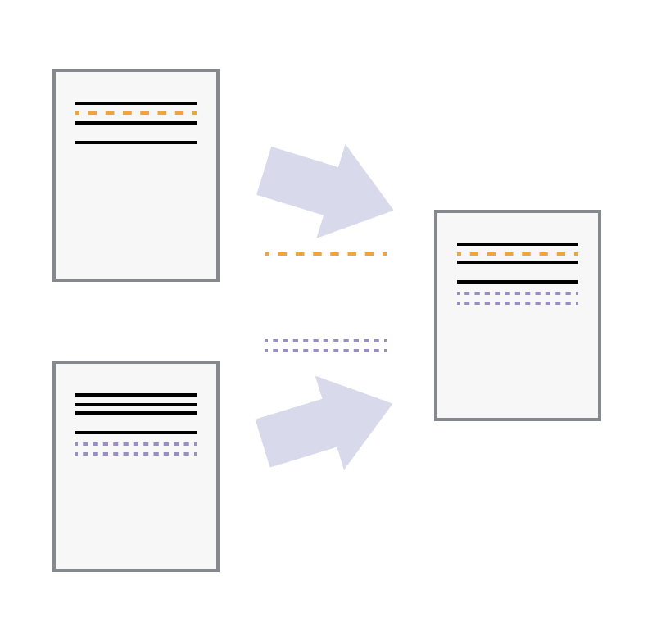
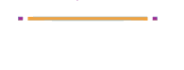
merging conflicts
Edits to different lines:
no conflict, automatically merge
Edits to the same line:
conflict, cannot merge

Slide 27
Git takeaways
1. Commits are NOT automatic. You have to tell git when and what to commit every time. So do it frequently, or you won't be able to go back to a version that you didn't commit.
2. Always pull to get the latest changes from the remote before you start working on your local version. Again, git does NOT operate automatically at all. Everything is manual.
3. Always be aware of what you're committing as permanently deleting things is annoying
4. Everything is recorded and almost everything can be undone, so don’t be afraid

Slide 28
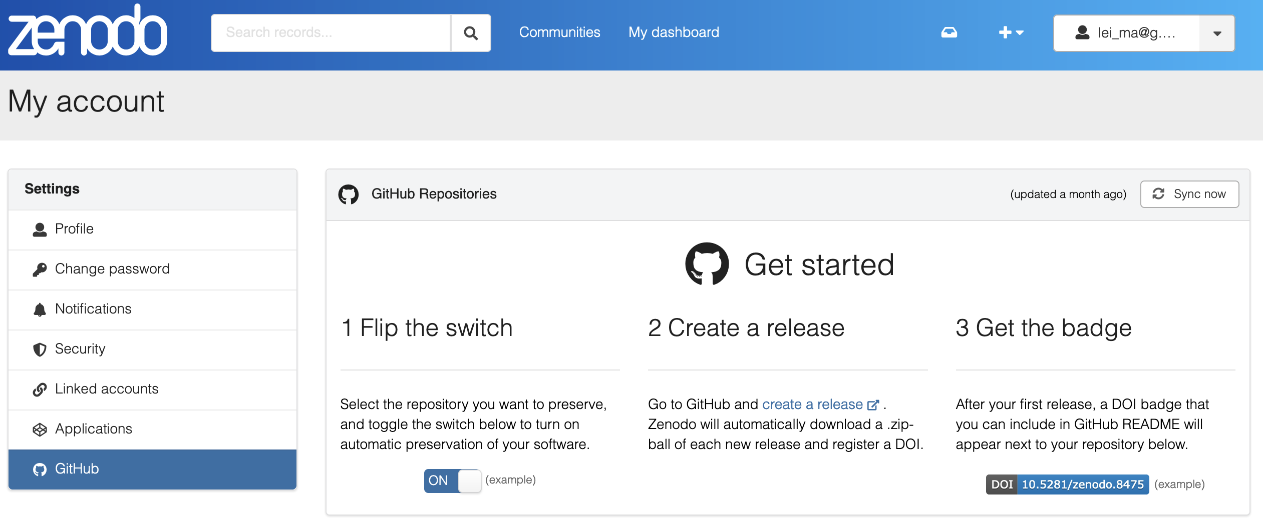
Getting a DOI and archiving your code
Notes:
There's one last thing that is good to do after your GitHub repository has been finalized, and that is to archive it and make it citable with a DOI (Digital Object Identifier). One of the ways to do this is to connect your GitHub account to Zenodo, which is a general purpose repository that can be linked to your GitHub account. Once you have created an account with your email or ORCID, click your username in the upper right to pull up a dropdown menu and select "GitHub". Then, follow the steps to link your accounts. Once that's done, you can archive any of your repositories by a click of the button.

Slide 29
Summary
4 steps to sharing your code
Decide if you are sharing for reuse or reproduction
Write your READMEs and organize your folders
Upload to GitHub
Link to Zenodo
Notes:
So to sum up, here are the big ideas to remember if you want to share your code on GitHub:
1. Decide if you are sharing for reuse or reproduction
2. Write your READMEs and organize your folders
3. Upload to GitHub
4. Link to Zenodo

Slide 30
Bonus topics Pick one!
git branching & merging
collaboration (forking and pull requests)
GitHub pages
GitHub lab organization
Notes:
So to sum up, here are the big ideas to remember if you want to share your code on GitHub:
1. Decide if you are sharing for reuse or reproduction
2. Write your READMEs and organize your folders
3. Upload to GitHub
4. Link to Zenodo

Slide 31
git branching explanation

Slide 32
visual demo of branching
Demo on learngitbranching : https://learngitbranching.js.org/
git branch bugfix
git commit
git switch main
git commit
git merge bugFix
git branch -d bugFix

Slide 33
Navigating your git history: the HEAD pointer
HEAD
main
c1
c2
c3
git commit
git commit
git commit
Notes:
Git history can be viewed as a "gitflow" diagram (image above), with commits as nodes and branches as lines. You can see the history of your project with using command line options such as: `git log`, `git log --graph --oneline --all`, or by clicking on the "commits" link on GitHub. In VSCode, you can use the extension "Git Graph" to visualize your git history. Commits are identified by a unique **hash**, which is a long string of letters and numbers. Commits also always have a message, which the user writes at the moment they commit. There is a pointer called "HEAD" which points to the current commit you're one. Usually, this is the most recent commit, but HEAD can change if you switch to a different branch or checkout a different commit.

Slide 34
main
c1
c2
c3
HEAD
git commit
git commit
git commit
git branch test
git commit
git commit
test
c4
c5
Notes:
Git history can be viewed as a "gitflow" diagram (image above), with commits as nodes and branches as lines. You can see the history of your project with using command line options such as: `git log`, `git log --graph --oneline --all`, or by clicking on the "commits" link on GitHub. In VSCode, you can use the extension "Git Graph" to visualize your git history. Commits are identified by a unique **hash**, which is a long string of letters and numbers. Commits also always have a message, which the user writes at the moment they commit. There is a pointer called "HEAD" which points to the current commit you're one. Usually, this is the most recent commit, but HEAD can change if you switch to a different branch or checkout a different commit.

Slide 35
HEAD
main
c1
c2
c3
git commit
git commit
git commit
git branch test
git commit
git commit
git switch main
test
c4
c5
Notes:
Git history can be viewed as a "gitflow" diagram (image above), with commits as nodes and branches as lines. You can see the history of your project with using command line options such as: `git log`, `git log --graph --oneline --all`, or by clicking on the "commits" link on GitHub. In VSCode, you can use the extension "Git Graph" to visualize your git history. Commits are identified by a unique **hash**, which is a long string of letters and numbers. Commits also always have a message, which the user writes at the moment they commit. There is a pointer called "HEAD" which points to the current commit you're one. Usually, this is the most recent commit, but HEAD can change if you switch to a different branch or checkout a different commit.

Slide 36
HEAD
main
c1
c2
c3
c6
c7
git commit
git commit
git commit
git branch test
git commit
git commit
git switch main
git merge test
git commit
test
c4
c5
Notes:
Git history can be viewed as a "gitflow" diagram (image above), with commits as nodes and branches as lines. You can see the history of your project with using command line options such as: `git log`, `git log --graph --oneline --all`, or by clicking on the "commits" link on GitHub. In VSCode, you can use the extension "Git Graph" to visualize your git history. Commits are identified by a unique **hash**, which is a long string of letters and numbers. Commits also always have a message, which the user writes at the moment they commit. There is a pointer called "HEAD" which points to the current commit you're one. Usually, this is the most recent commit, but HEAD can change if you switch to a different branch or checkout a different commit.

Slide 37
collaboration (forking and pull requests)

Slide 38
Remote
collab/repo-name
Remote
Your_name/repo-name
Make copy to account (fork)
Update original repo
(pull request)
Local repo
Copy to your local computer (git clone)
Notes:
When you want to collaborate with others, you can "fork" their repository, which makes a copy of their repo on your own GitHub account. You can then "clone" this repo to your local machine, make changes, push those changes to the remote, and then make a "pull request" to merge your changes to the original repository.

Slide 39
Original Repo
(lab repo)
GitHub Remote
(your fork)
Version DB
Version DB
Commit 3
Commit 2
Commit 2
Commit 1
Commit 1
Personal Computer
Cluster Computer
File(s)
File(s)
Version DB
Version DB
Commit 3
Commit 3
Commit 2
Commit 2
Commit 1
Commit 1
Notes:
Use case for forks: One of the best things about GitHub is that it allows you to share code with others. Raise your hand if you've ever been handed code from a previous student or lab member, but it didn't work for whatever reason. Or perhaps there are just loose scripts floating around, each version slightly different from the last but nobody knows which one is current or which one is the best. One way to avoid this is to have a lab GitHub account where known working versions of scripts are posted and users can fork the repo of helpful scripts to adjust to their own needs. Then, if a user fixes a bug or adds a feature, they can make a pull request and update the lab's version. This way, everyone in the lab can benefit from the work of others and the lab's scripts are always up to date.
The above image illustrates the relationship between a forked repo, the original repo, and local clones of the forked repo. If the repo you forked gets updated, you can sync your fork with the original repo but changes you make on your fork does not affect the original repo. Then, when you're working on a local clone of your repo (on the computer and on the cluster), the way to get them to sync is to push and pull between the two. When you have multiple local clones like this, do not work on the same file in two different places before syncing them by pushing and pulling.

Slide 40

Original
Informatics/github-intro
1. Fork
4-5. add, commit
Remote fork
Your_name/github-intro
7-8. pull request
merge
9. sync
Local
~/path/github-intro
2. clone
6. push
9. pull
https://github.com/harvardinformatics/github-intro
Notes:
We’re going to do part 1 of the github intro on link

Slide 41
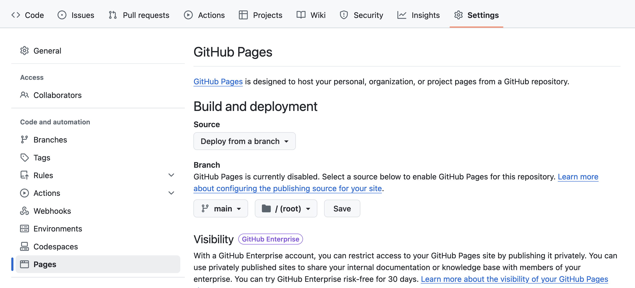
GitHub Pages: a website for your repo
Notes:
A bonus perk of using GitHub is that you can easily turn your analysis notebook into a website to share. Rather than write a long README markdown explaining everything, or expecting readers to dig through your folders of analysis code, you can present your paper using a jupyter or RMarkdown generated html file. In our example repository I have created a `public_notebook.Rmd` file and "knitted" it into an html file with the same name. I can then go to "Setting" -> "Pages" on the left navbar and enable this repository to be built into a webpage. It'll take a couple of minutes to build, but it'll be ready once you see a round green checkmark. The URL for your site will be by default https://\<your-username\>.github.io/\<repo-name>/. Add your html file to the end of that and you now have a nice explainer to accompany your paper. You can add this URL to the description of your repo by clicking the gear icon next to the "About" on the right side of you repo page.
While the specifics of how to generate a notebook using RMarkdown or Jupyter is out of the scope of this workshop, I hope this can get you started.

Slide 42
GitHub Website
Website walkthrough
Your repo will be found at www.github.com/Your_name/repo-name
<> Code is your landing page
⚙ Settings for repo-specific preferences
go to “Danger Zone” to change visibility
README.md will render on your landing page
Notes:
You can navigate to your repository by searching for it on the left hand side. Or you can click your profile button on the right which opens a dropdown menu from which you can select "Your repositories". There's a lot of information and buttons on your repository, the vast majority of which are not relevant for our purpose of simply sharing completed code. You will see that whatever you put in the `README.md` file will be displayed on the front page of your repository. This is a good place to put information that will help readers understand what your code does, how to install any required software, and connect your code to your paper.
You can use the search bar to search within a repository. Handy if you're exploring someone else's work. You can also create a new repository on the website first rather than locally. Of the various tabs that are on the second level, "<> Code", which gets you to your files, and "Settings" are the most important.
Once you are comfortable with how your repository looks, you can make it public by going to the "Settings" tab and scrolling down to the "Danger Zone" section. Here you can change the visibility of your repository.

Slide 43
GitHub Organizations
Create a lab organization
Your data belongs to Harvard, which needs to archive for 7 years
Transfer ownership of your repository to your lab
Easier to pass on project for others to manage
Example: https://github.com/schlosslab
Notes:
If you are a student or postdoc at Harvard, the research records you create while at Harvard are property of Harvard and need to be archived for 7 years following the researcher's departure. This may include code or software that you create. Alternatively, you may have a project that is not yet published by the time you leave that you plan to hand it over to someone else in the lab. In both these cases, it is helpful for the owner of the repository to be the lab and not your personal github account. Why is this helpful? In our demo git workshop right now, only the owner, that is myself, can change any settings related to the repository and only I can make edits to it. I could add collaborators, but I need to do that on a per repo basis. If I leave the lab and others want to manage this repository, then they will first have to contact me to make these changes.
GitHub has a feature called "Organizations" where you can create an organization that associates a bunch of GitHub accounts together. The organization is the owner of all the repositories. So instead of seeing "my_username/repo-name" it's "PI_lab/repo-name". Everybody in the organization will have access to public and private repositories owned by the organization, so onboarding somebody can be as simple as adding their name to the organization. If you already have a repo under your personal GitHub account, you can go to "Settings" for that repo and **Transfer Owneership** to an organization.

