Slide 1
$ Command line 101: $ What’s the deal with directories? $ Intro to filesystems
$ Harvard FAS Informatics virtual training
$ Thursday, February 5, 2026
$

Slide 2

How is information stored on a computer?
Binary

Slide 3

How is information stored on a computer?
Binary
Encoding

Slide 4






How is information stored on a computer?
Binary
Encoding
Files

Slide 5
How is information stored on a computer?
Winamp
VLC
Notepad
Acrobat
Binary
Paint
Encoding
Word
Files

Slide 6
How is information stored on a computer?
Winamp
VLC
Notepad
Acrobat
Binary
Paint
Encoding
Decoding
Word
Files

Slide 7

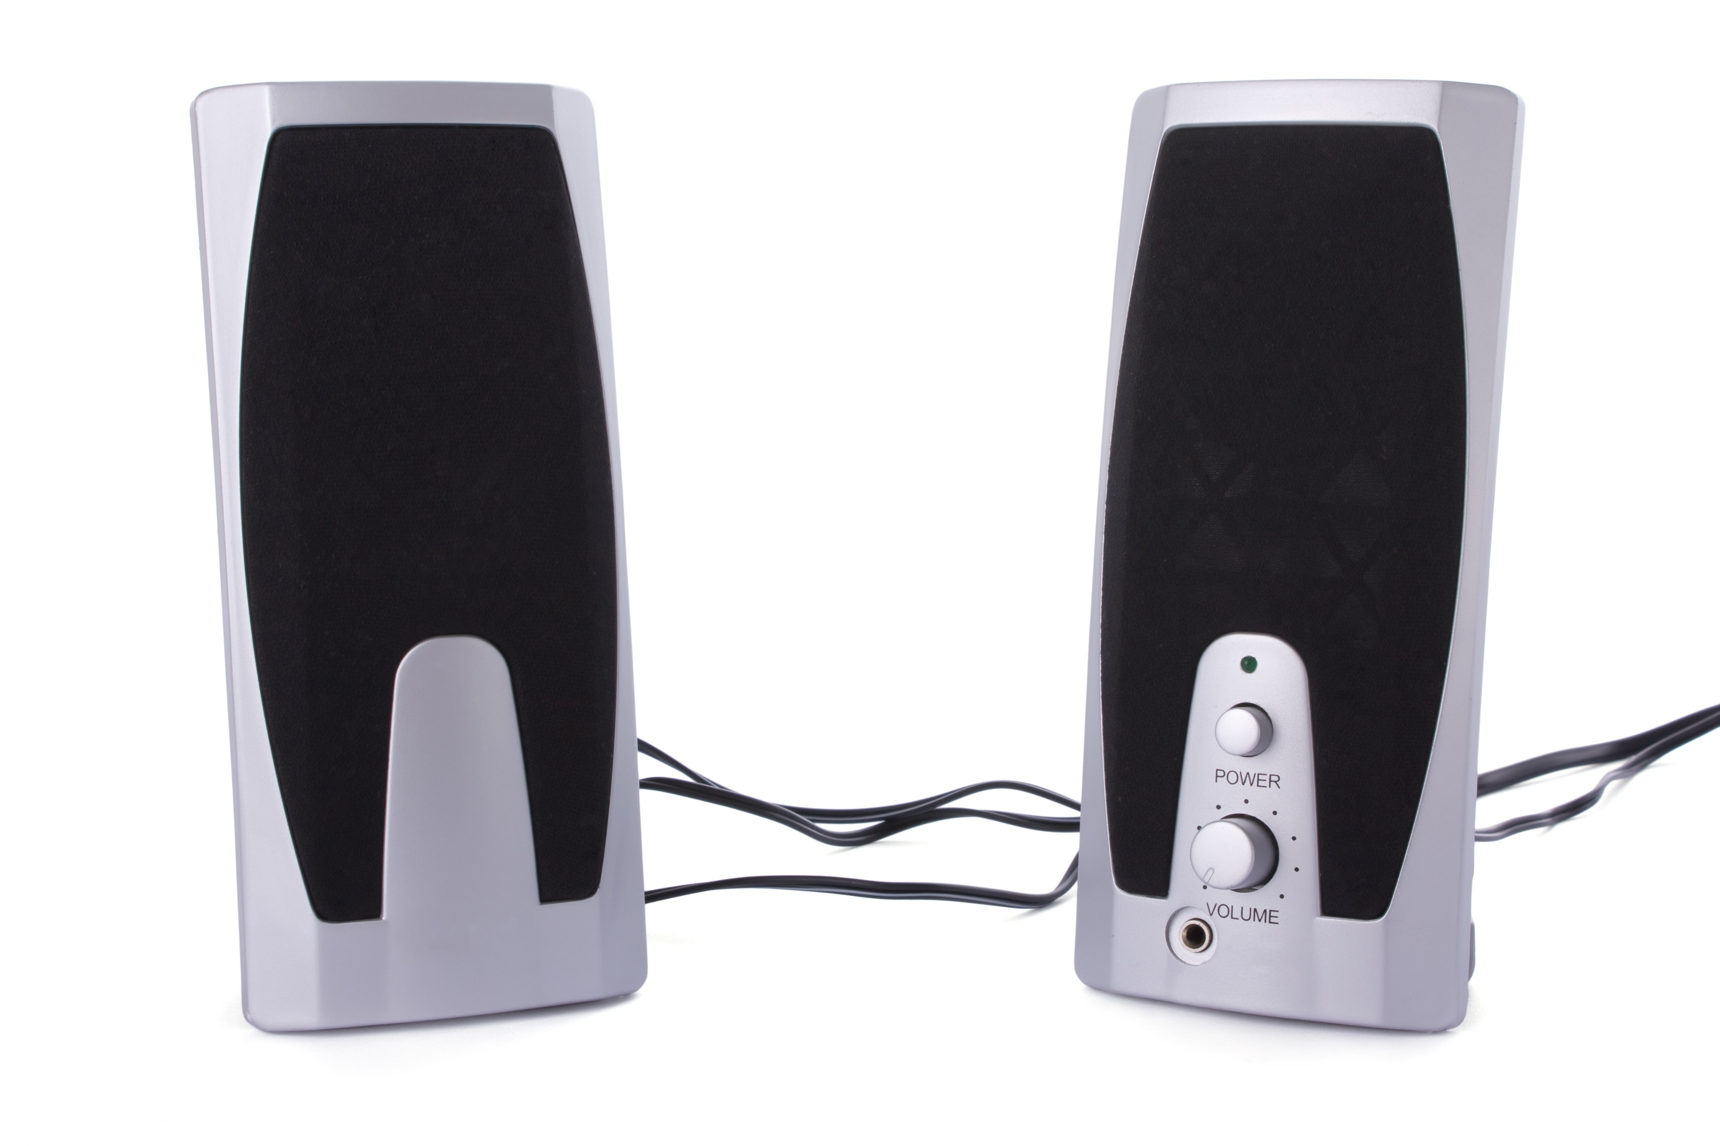
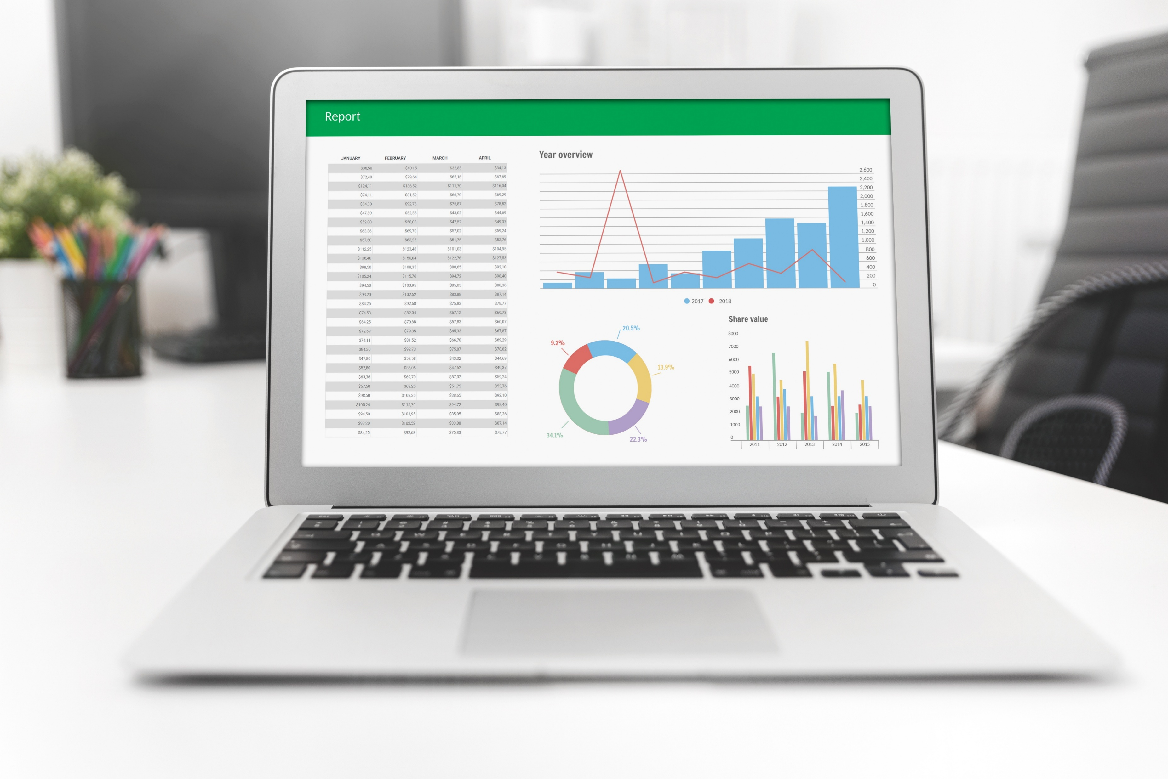
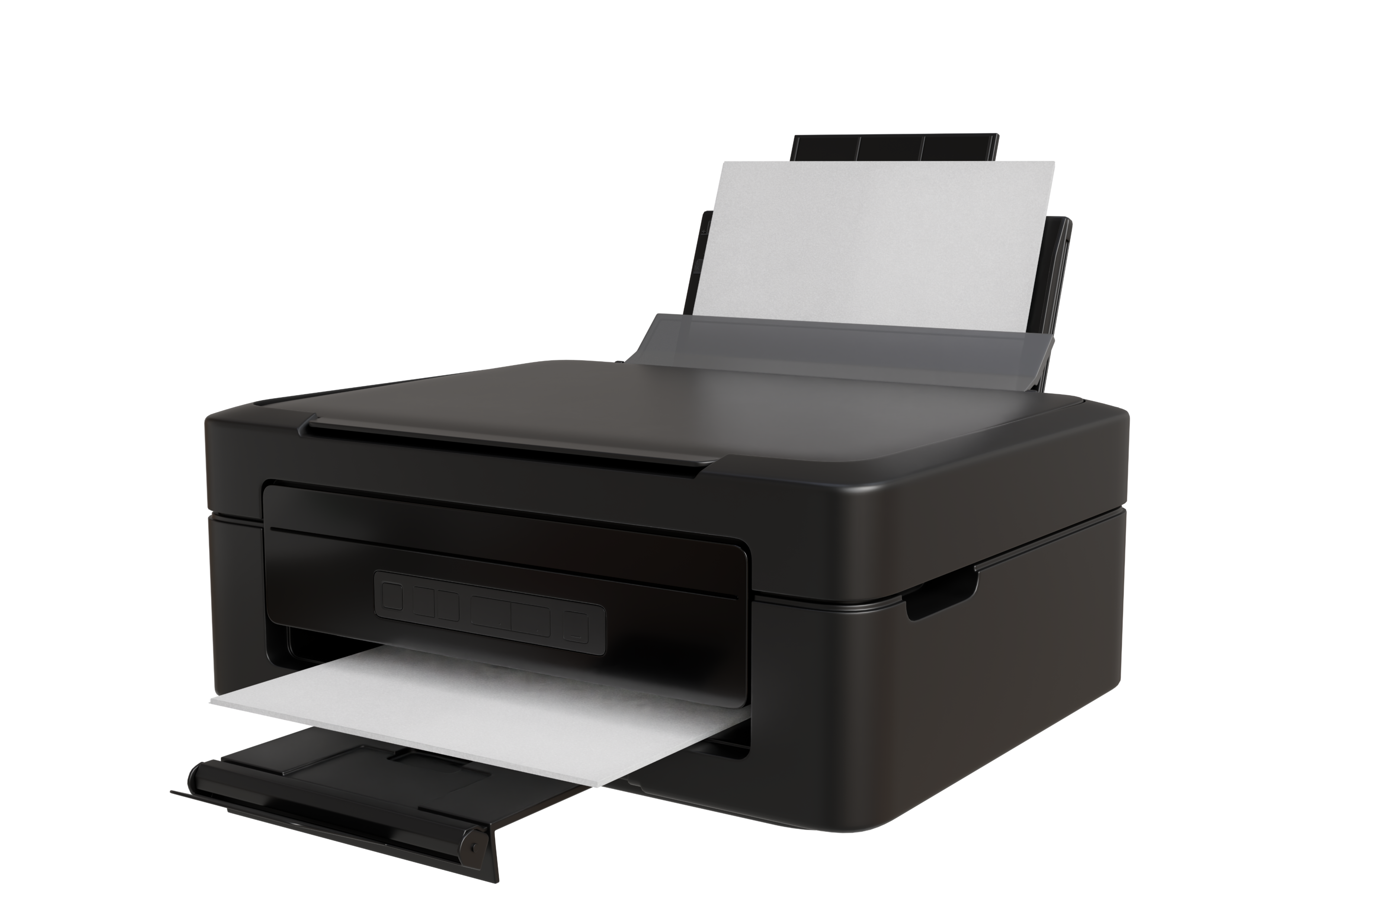
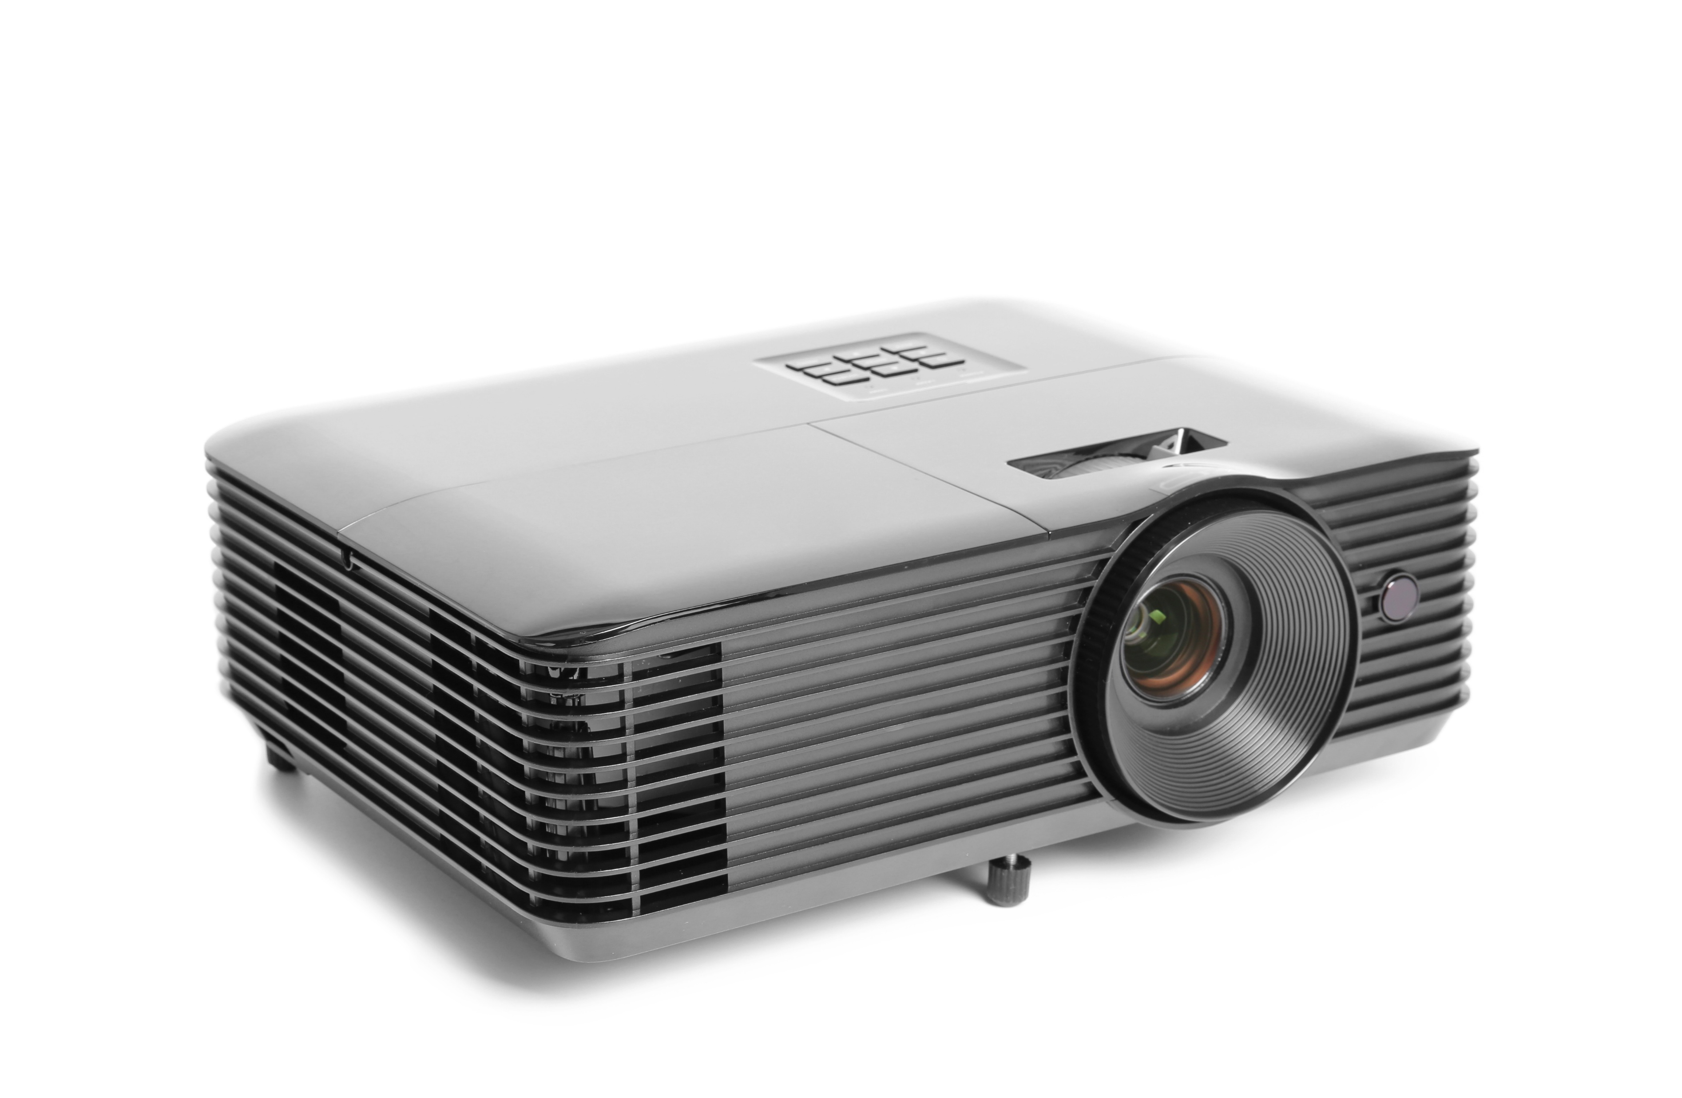
How is information stored on a computer?
Winamp
VLC
Notepad
Acrobat
Binary
Paint
Encoding
Decoding
Word
Output
Files

Slide 8
How is information stored on a computer?
Winamp
VLC
Notepad
Acrobat
Binary
Paint
Encoding
Decoding
Word
Output
Files

Slide 9

How is information stored on a computer?
are files
Winamp
VLC
Notepad
Acrobat
Binary
Paint
Encoding
Decoding
Word
Output
Files

Slide 10
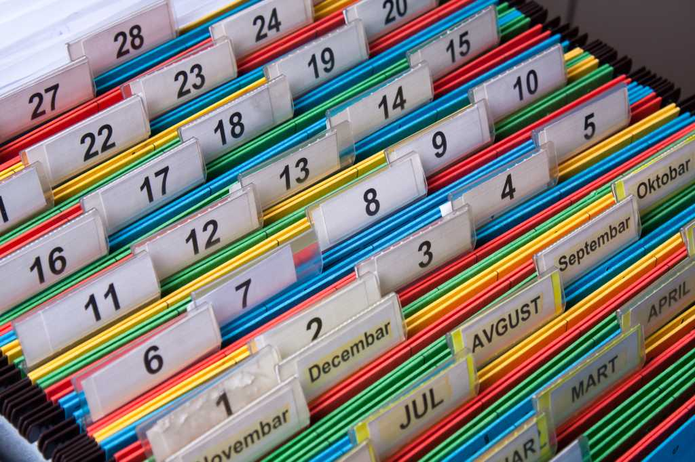


Filesystems organize files on a computer
Filesystems use directories to locate files
(Mac/Unix)
(Windows)
Also called folders
A directory could be empty or contain one or many files
A directory can contain other directories!
Directories themselves have names

Slide 11
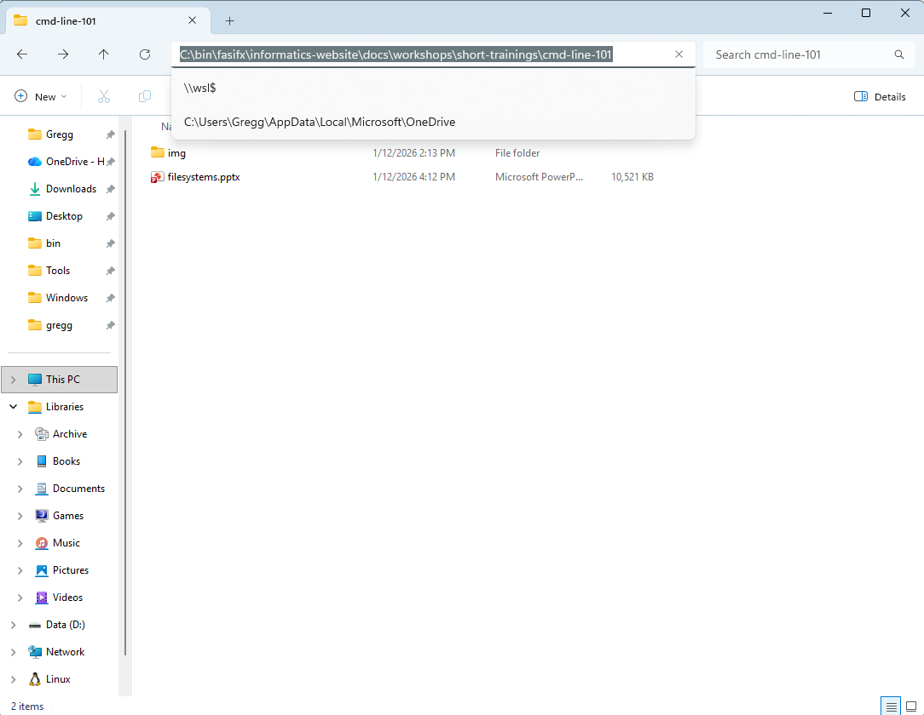
A file’s exact location is determined by its path
A path lists all directories, separated by / (or \ on Windows) from the root directory to the current file or directory
Note: this is the definition of an absolute path
Notes:
Think of a path like a human readable address for a file on a computer

Slide 12
The root directory is where all other directories and sub-directories exist
Mac/Unix
Windows
/
C:\
Notes:
Think of a path like a human readable address for a file on a computer

Slide 13
The root directory contains other folders with files crucial for the operating system to work
Mac/Unix
Windows
/
C:\
bin/
var/
home/
etc/
usr/
Apps\
Windows\
Users\
Program Files\
Program Files (x86)\
Notes:
Think of a path like a human readable address for a file on a computer

Slide 14
These sub-folders contain their own sub-folders and files
Mac/Unix
Windows
/
C:\
bin/
var/
home/
etc/
usr/
Apps\
Windows\
Users\
Program Files\
Program Files (x86)\
Notes:
Think of a path like a human readable address for a file on a computer

Slide 15
These sub-folders contain their own sub-folders and files
Mac/Unix
Windows
/
C:\
bin/
var/
home/
etc/
usr/
Apps\
Windows\
Users\
Program Files\
Program Files (x86)\
Most users won’t need to worry about these folders or files, or even have permission to change their content
Notes:
Think of a path like a human readable address for a file on a computer

Slide 16
Each operating system has a special folder for user data
Mac/Unix
Windows
/
C:\
bin/
var/
home/
etc/
usr/
Apps\
Windows\
Users\
Program Files\
Program Files (x86)\
Notes:
Think of a path like a human readable address for a file on a computer

Slide 17
Each person that uses the computer (a user) gets their own folder
Mac/Unix
Windows
/
C:\
bin/
var/
home/
etc/
usr/
Apps\
Windows\
Users\
Program Files\
Program Files (x86)\
lei/
gregg/
tim/
lei\
gregg\
tim\
Notes:
Think of a path like a human readable address for a file on a computer

Slide 18
Each person that uses the computer (a user) gets their own folder
Mac/Unix
Windows
/
C:\
bin/
var/
home/
etc/
usr/
Apps\
Windows\
Users\
Program Files\
Program Files (x86)\
lei/
gregg/
tim/
lei\
gregg\
tim\
Users should have permission to fully manipulate all the files in their user folder, but not in other users’ folders
Notes:
Think of a path like a human readable address for a file on a computer

Slide 19
A particular user’s folder is populated with standard sub-folders
Mac/Unix
Windows
/
C:\
bin/
var/
home/
etc/
usr/
Apps\
Windows\
Users\
Program Files\
Program Files (x86)\
lei/
gregg/
tim/
lei\
gregg\
tim\
Desktop/
documents/
music/
Desktop\
Documents\
Music\
Notes:
Think of a path like a human readable address for a file on a computer

Slide 20
The user is free to create, delete, and modify folders and files in their user directory
Mac/Unix
Windows
/
C:\
bin/
var/
home/
etc/
usr/
Apps\
Windows\
Users\
Program Files\
Program Files (x86)\
lei/
gregg/
tim/
lei\
gregg\
tim\
Desktop/
documents/
music/
Desktop\
Documents\
Music\
Notes:
Think of a path like a human readable address for a file on a computer

Slide 21
Other users can do the same in their user folder
Mac/Unix
Windows
/
C:\
bin/
var/
home/
etc/
usr/
Apps\
Windows\
Users\
Program Files\
Program Files (x86)\
lei/
gregg/
tim/
lei\
gregg\
tim\
Desktop/
documents/
music/
Desktop\
Documents\
Music\
Notes:
Think of a path like a human readable address for a file on a computer

Slide 22
What would be the full path from the root to my-doc.pdf?
Mac/Unix
Windows
/
C:\
bin/
var/
home/
etc/
usr/
Apps\
Windows\
Users\
Program Files\
Program Files (x86)\
lei/
gregg/
tim/
lei\
gregg\
tim\
Desktop/
documents/
music/
Desktop\
Documents\
Music\
my-doc.pdf
Notes:
Think of a path like a human readable address for a file on a computer

Slide 23
What would be the full path from the root to my-doc.pdf?
Mac/Unix
Windows
/
C:\
bin/
var/
home/
etc/
usr/
Apps\
Windows\
Users\
Program Files\
Program Files (x86)\
/home/gregg/documents/my-doc.pdf
lei/
gregg/
tim/
lei\
gregg\
tim\
Desktop/
documents/
music/
Desktop\
Documents\
Music\
my-doc.pdf
Notes:
Think of a path like a human readable address for a file on a computer

Slide 24
What would be the full path from the root to my-doc.pdf on Windows?
Mac/Unix
Windows
/
C:\
bin/
var/
home/
etc/
usr/
Apps\
Windows\
Users\
Program Files\
Program Files (x86)\
lei/
gregg/
tim/
lei\
gregg\
tim\
Desktop/
documents/
music/
Desktop\
Documents\
Music\
my-doc.pdf
Notes:
Think of a path like a human readable address for a file on a computer

Slide 25
What would be the full path from the root to my-doc.pdf on Windows?
Mac/Unix
Windows
/
C:\
bin/
var/
home/
etc/
usr/
Apps\
Windows\
Users\
Program Files\
Program Files (x86)\
C:\Users\Gregg\Documents\my-doc.pdf
lei/
gregg/
tim/
lei\
gregg\
tim\
Desktop/
documents/
music/
Desktop\
Documents\
Music\
my-doc.pdf
Notes:
Think of a path like a human readable address for a file on a computer

Slide 26
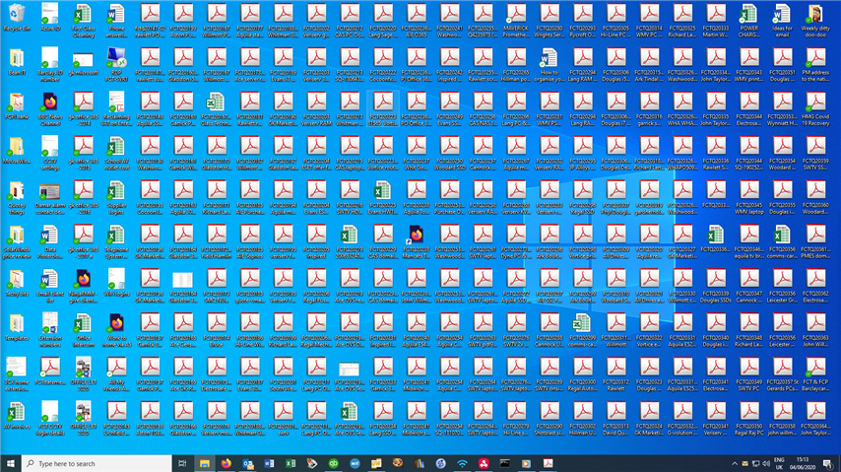
Modern OS search functions have obviated the need for average users to organize files, and therefore understand filesystems
Notes:
Think of a path like a human readable address for a file on a computer

Slide 27
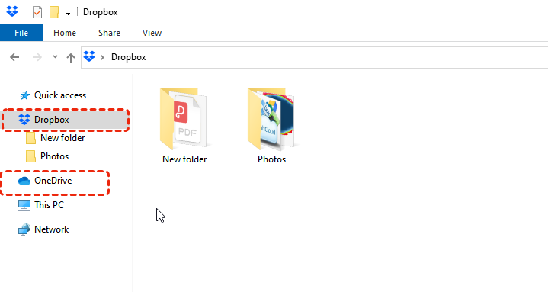
Cloud storage makes things even more confusing
Notes:
Think of a path like a human readable address for a file on a computer

Slide 28
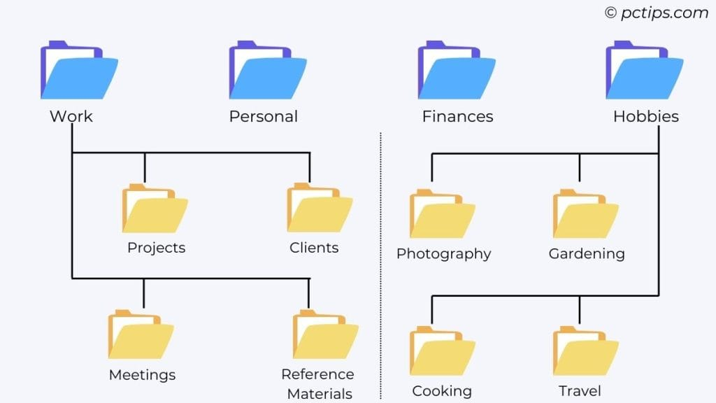
As a data scientist, well organized project files are a necessity for reproducibility and version control
Notes:
Think of a path like a human readable address for a file on a computer

Slide 29
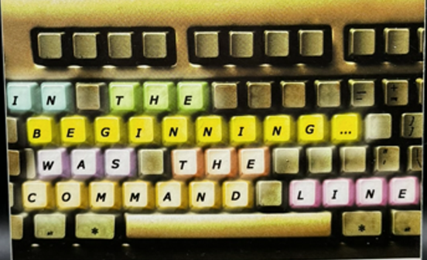
Interacting with the computer through text

Slide 30
> The first modern computers didn’t have graphical interfaces (no point/click/tap), just text.
> Text is still the foundation of computing. Code is text.
> Most modern data analysis is text based.
Notes:
Think of a path like a human readable address for a file on a computer

Slide 31
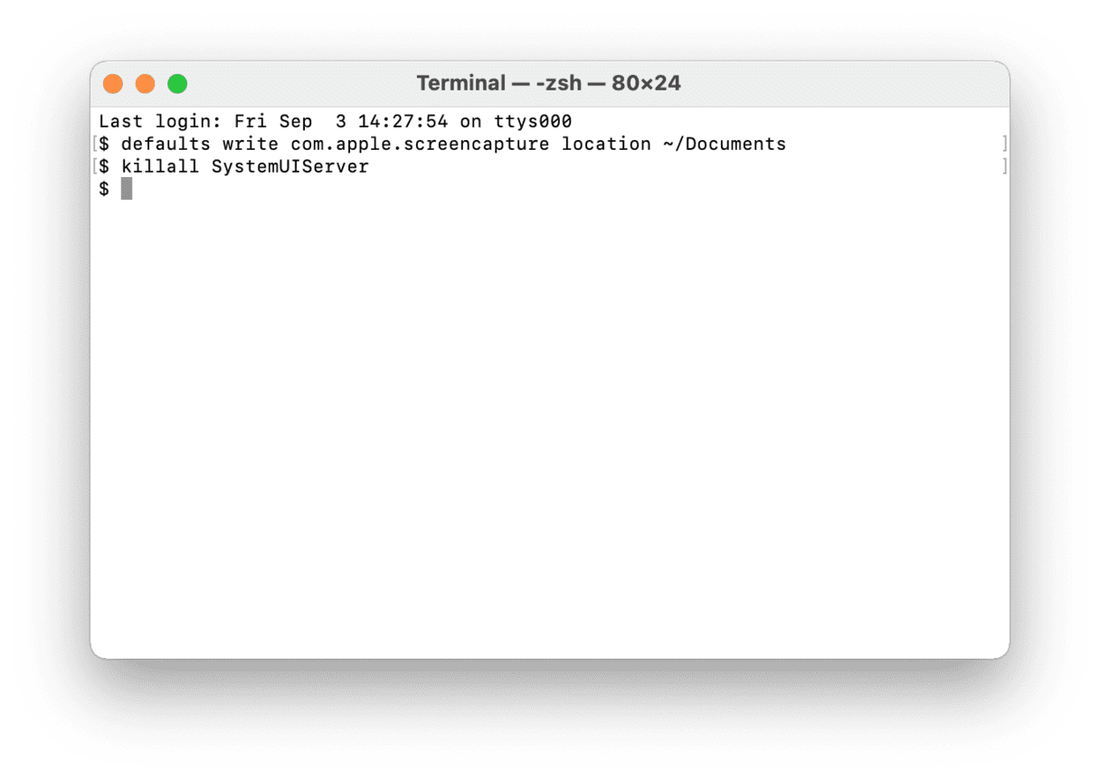
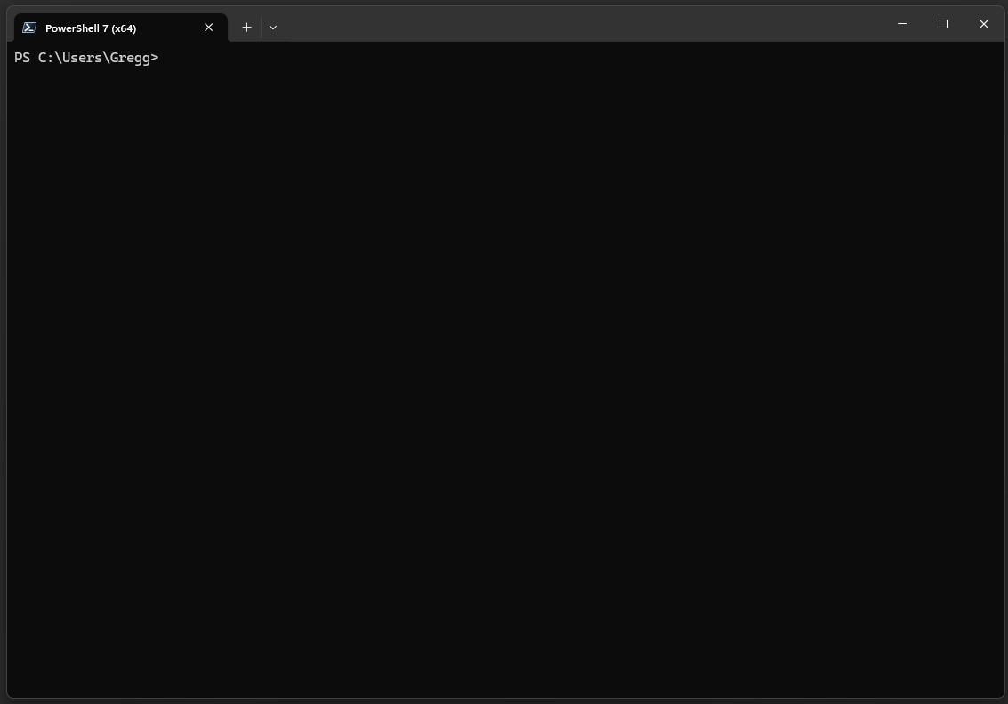
Each computer will have a program that can be used to interact with it via text
Mac Terminal
Windows PowerShell
Notes:
Mention command prompt and not to use it

Slide 32
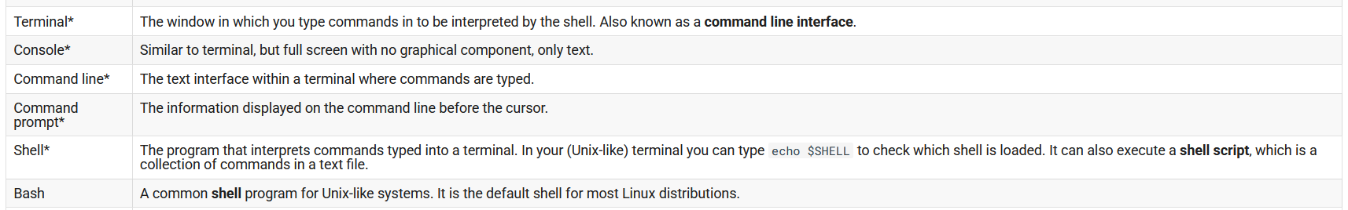
Vocabulary relating to text interactions
Notes:
Mention command prompt and not to use it

Slide 33
Vocabulary relating to text interactions
While technically meaning different things, these terms may be used interchangeably to generally refer to where you type commands into the computer.
Notes:
Mention command prompt and not to use it

Slide 34
Vocabulary relating to text interactions
While technically meaning different things, these terms may be used interchangeably to generally refer to where you type commands into the computer.
https://informatics.fas.harvard.edu/resources/glossary/
Notes:
Mention command prompt and not to use it

Slide 35
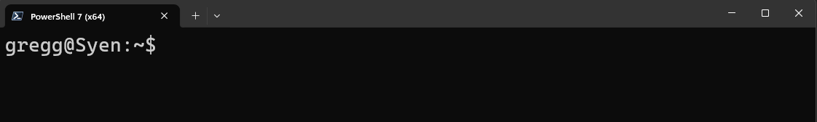
How does our concept of file systems translate to text-based computing?
/
bin/
var/
home/
etc/
usr/
lei/
gregg/
tim/
Desktop/
documents/
music/
Notes:
Mention command prompt and not to use it

Slide 36
How does our concept of file systems translate to text-based computing?
/
Current working directory
(in many shells, ~ is a shortcut for the current user’s home directory)
home/
Username
bin/
var/
etc/
usr/
lei/
gregg/
tim/
Computer (host) name
Desktop/
documents/
music/
Notes:
Mention command prompt and not to use it

Slide 37
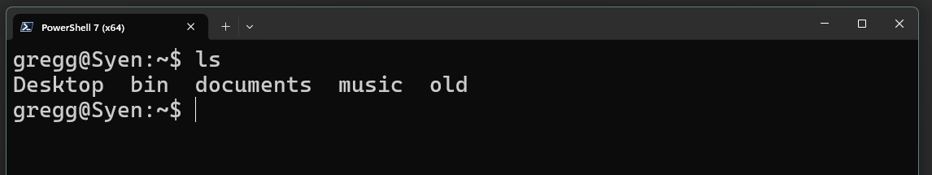
How does our concept of file systems translate to text-based computing?
/
home/
With commands
bin/
var/
etc/
usr/
lei/
gregg/
tim/
Desktop/
documents/
music/
Notes:
Mention command prompt and not to use it

Slide 38
How does our concept of file systems translate to text-based computing?
/
home/
With commands
bin/
var/
etc/
usr/
lei/
gregg/
tim/
A command is a program that is run by typing its name into the terminal and hitting Enter
Many common commands relate to navigating and manipulating the filesystem
Desktop/
documents/
music/
Notes:
Mention command prompt and not to use it

Slide 39
Common commands for interacting with the filesystem
pwd | Print (display) the working directory.
ls <directory> | List the contents of <directory> (current working directory if unspecified).
cd <directory> | Change the current working directory to <directory>.
mkdir <directory> | Create a new directory called <directory>.
mv <directory/file> <directory/file> | Move the first <directory/file> to the second <directory/file>. If location is the same, this acts as a rename command. CAUTION: If the destination file/directory exists IT WILL BE OVERWRITTEN WITH NO CONFIRMATION PROMPT
cp <directory/file> <directory/file> | Copy the first <directory/file> to the second <directory/file>. CAUTION: If the destination file/directory exists IT WILL BE OVERWRITTEN WITH NO CONFIRMATION PROMPT
rm <file> rm –rf <directory> | DELETE the file or directory (AND its contents). WARNING: PERMANENT ACTION WITH NO CONFIRMATION PROMPT
Notes:
Mention command prompt and not to use it

Slide 40
Common commands for interacting with the filesystem
pwd | Print (display) the working directory.
ls <directory> | List the contents of <directory> (current working directory if unspecified).
cd <directory> | Change the current working directory to <directory>.
mkdir <directory> | Create a new directory called <directory>.
mv <directory/file> <directory/file> | Move the first <directory/file> to the second <directory/file>. If location is the same, this acts as a rename command. CAUTION: If the destination file/directory exists IT WILL BE OVERWRITTEN WITH NO CONFIRMATION PROMPT
cp <directory/file> <directory/file> | Copy the first <directory/file> to the second <directory/file>. CAUTION: If the destination file/directory exists IT WILL BE OVERWRITTEN WITH NO CONFIRMATION PROMPT
rm <file> rm –rf <directory> | DELETE the file or directory (AND its contents). WARNING: PERMANENT ACTION WITH NO CONFIRMATION PROMPT
These commands are used in the most common shells (bash, PowerShell)
Notes:
Mention command prompt and not to use it

Slide 41
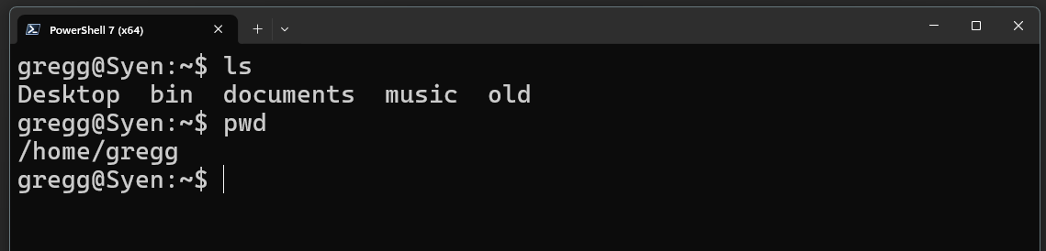
The working directory is the directory you are currently in
/
Use pwd to display your current working directory
bin/
var/
home/
etc/
usr/
lei/
gregg/
tim/
We say we are in this directory (/home/gregg)
We can then move in the filesystem’s tree
Desktop/
documents/
music/
Notes:
Mention command prompt and not to use it

Slide 42
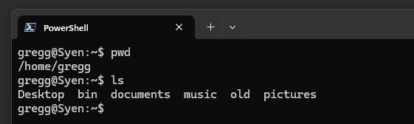
Use ls to list the files in a directory
/
With no path specified, ls displays the contents of the current working directory
bin/
var/
home/
etc/
usr/
lei/
gregg/
tim/
Desktop/
documents/
music/
Notes:
Mention command prompt and not to use it

Slide 43
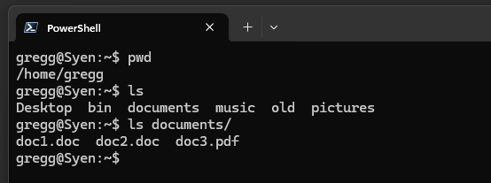
Use ls to list the files in a directory
/
ls displays the contents of the specified path.
bin/
var/
home/
etc/
usr/
lei/
gregg/
tim/
Desktop/
documents/
music/
Notes:
Mention command prompt and not to use it

Slide 44
Use ls to list the files in a directory
/
ls displays the contents of the specified path.
bin/
var/
home/
etc/
usr/
lei/
gregg/
tim/
Notice that I did not type the absolute path from the root (e.g. ls /home/gregg/documents/), but just the path relative to the working directory (ls documents/).
Most shell commands accept relative paths, but absolute paths are always acceptable
Desktop/
documents/
music/
Notes:
Mention command prompt and not to use it

Slide 45
Relative vs. absolute (full) paths
Current working directory:
/
/home/gregg/
bin/
var/
home/
etc/
usr/
lei/
gregg/
tim/
Desktop/
documents/
music/
my-doc.pdf
Notes:
Mention command prompt and not to use it

Slide 46
Relative vs. absolute (full) paths
Current working directory:
/
/home/gregg/
bin/
var/
home/
etc/
usr/
Absolute path to my-doc.pdf:
/home/gregg/documents/my-doc.pdf
lei/
gregg/
tim/
Desktop/
documents/
music/
my-doc.pdf
Notes:
Mention command prompt and not to use it

Slide 47
Relative vs. absolute (full) paths
Current working directory:
/
/home/gregg/
bin/
var/
home/
etc/
usr/
Absolute path to my-doc.pdf:
/home/gregg/documents/my-doc.pdf
lei/
gregg/
tim/
Relative path to my-doc.pdf:
documents/my-doc.pdf
Desktop/
documents/
music/
my-doc.pdf
Notes:
Mention command prompt and not to use it

Slide 48
Relative vs. absolute (full) paths
Current working directory:
/
/home/gregg/Desktop/
bin/
var/
home/
etc/
usr/
lei/
gregg/
tim/
Desktop/
documents/
music/
my-doc.pdf
Notes:
Mention command prompt and not to use it

Slide 49
Relative vs. absolute (full) paths
Current working directory:
/
/home/gregg/Desktop/
bin/
var/
home/
etc/
usr/
Absolute path to my-doc.pdf:
/home/gregg/documents/my-doc.pdf
lei/
gregg/
tim/
Desktop/
documents/
music/
my-doc.pdf
Notes:
Mention command prompt and not to use it

Slide 50
Relative vs. absolute (full) paths
Current working directory:
/
/home/gregg/Desktop/
bin/
var/
home/
etc/
usr/
Absolute path to my-doc.pdf:
/home/gregg/documents/my-doc.pdf
lei/
gregg/
tim/
Relative path to my-doc.pdf:
../documents/my-doc.pdf
Desktop/
documents/
music/
my-doc.pdf
Notes:
Mention command prompt and not to use it

Slide 51
Relative vs. absolute (full) paths
Current working directory:
/
/home/gregg/Desktop/
bin/
var/
home/
etc/
usr/
Absolute path to my-doc.pdf:
/home/gregg/documents/my-doc.pdf
lei/
gregg/
tim/
Relative path to my-doc.pdf:
..
../documents/my-doc.pdf
Desktop/
documents/
music/
Use .. to move up the directory tree
my-doc.pdf
Notes:
Mention command prompt and not to use it

Slide 52
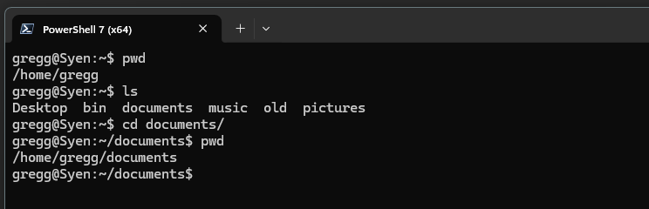
We use the change directory command, cd, to move around the filesystem
/
Use cd to change your current working directory
bin/
var/
home/
etc/
usr/
lei/
gregg/
tim/
Notice that I did not type the absolute path from the root (e.g. cd /home/gregg/documents/), but just the path relative to the working directory (cd documents).
Most shell commands accept relative paths, but absolute paths are always acceptable
Desktop/
documents/
music/
Notes:
Mention command prompt and not to use it

Slide 53
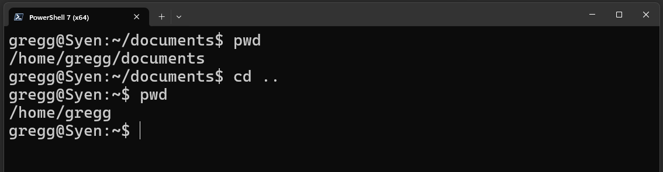
Moving up the tree with the .. shortcut
/
Use cd .. to move up the directory tree
bin/
var/
home/
etc/
usr/
lei/
gregg/
tim/
.. can be used multiple times when constructing a path, e.g. from documents/, I could type cd ../../tim/ to end up in the tim/ user folder (if I have permission to be there)
Or from documents, cd ../music/ would put me in the music/ folder
Desktop/
documents/
music/
Notes:
Mention command prompt and not to use it

Slide 54
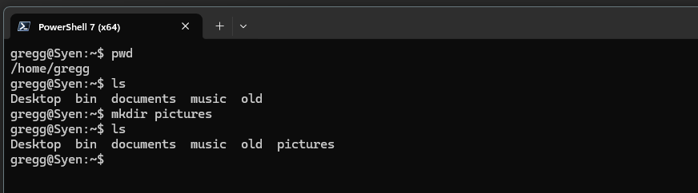
Creating directories with mkdir
/
bin/
var/
home/
etc/
usr/
lei/
gregg/
tim/
Desktop/
documents/
music/
pictures/
Notes:
Mention command prompt and not to use it

Slide 55
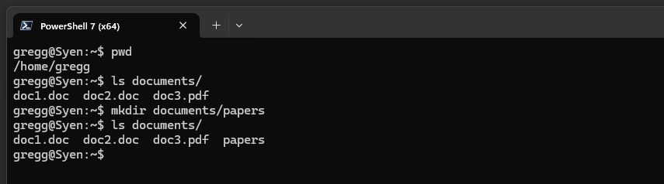
Creating directories with mkdir
/
Use paths to create directories in other locations
bin/
var/
home/
etc/
usr/
lei/
gregg/
tim/
Desktop/
documents/
music/
pictures/
Notes:
Mention command prompt and not to use it

Slide 56
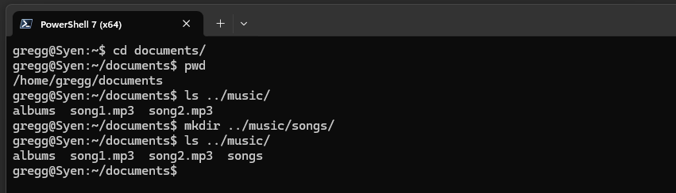
Creating directories with mkdir
/
Use paths to create directories in other locations
bin/
var/
home/
etc/
usr/
lei/
gregg/
tim/
Desktop/
documents/
music/
pictures/
.. can be to create directories above your current working directory
Notes:
Mention command prompt and not to use it

Slide 57
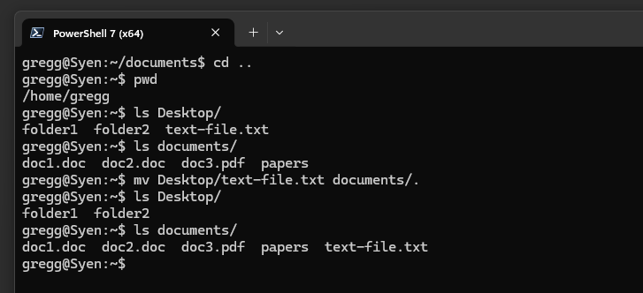
Moving files and directories with mv
/
bin/
var/
home/
etc/
usr/
lei/
gregg/
tim/
Desktop/
documents/
music/
pictures/
.. can be to create directories above your current working directory
Notes:
Mention command prompt and not to use it

Slide 58
Moving files and directories with mv
/
bin/
var/
home/
etc/
usr/
lei/
gregg/
tim/
Desktop/
documents/
music/
pictures/
The . means “use the same file name.”
Notes:
Mention command prompt and not to use it

Slide 59
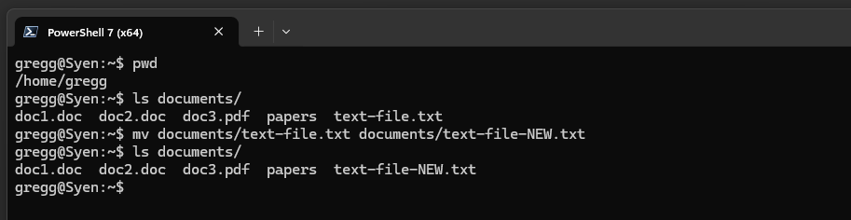
Renaming files and directories with mv
/
bin/
var/
home/
etc/
usr/
lei/
gregg/
tim/
Desktop/
documents/
music/
pictures/
Notes:
Mention command prompt and not to use it

Slide 60
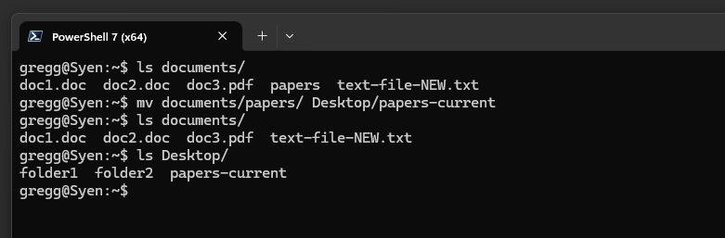
Moving AND renaming files and directories with mv
/
bin/
var/
home/
etc/
usr/
lei/
gregg/
tim/
Desktop/
documents/
music/
pictures/
Notes:
Mention command prompt and not to use it

Slide 61
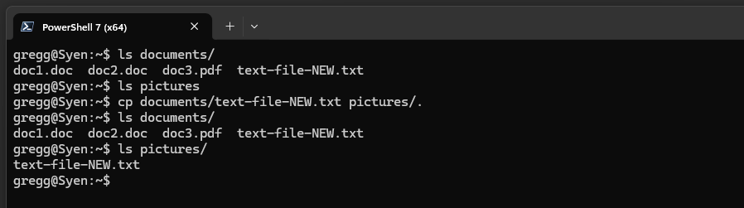
Copying files and directories with cp
/
bin/
var/
home/
etc/
usr/
lei/
gregg/
tim/
Desktop/
documents/
music/
pictures/
The . means “use the same file name.”
Notes:
Mention command prompt and not to use it

Slide 62
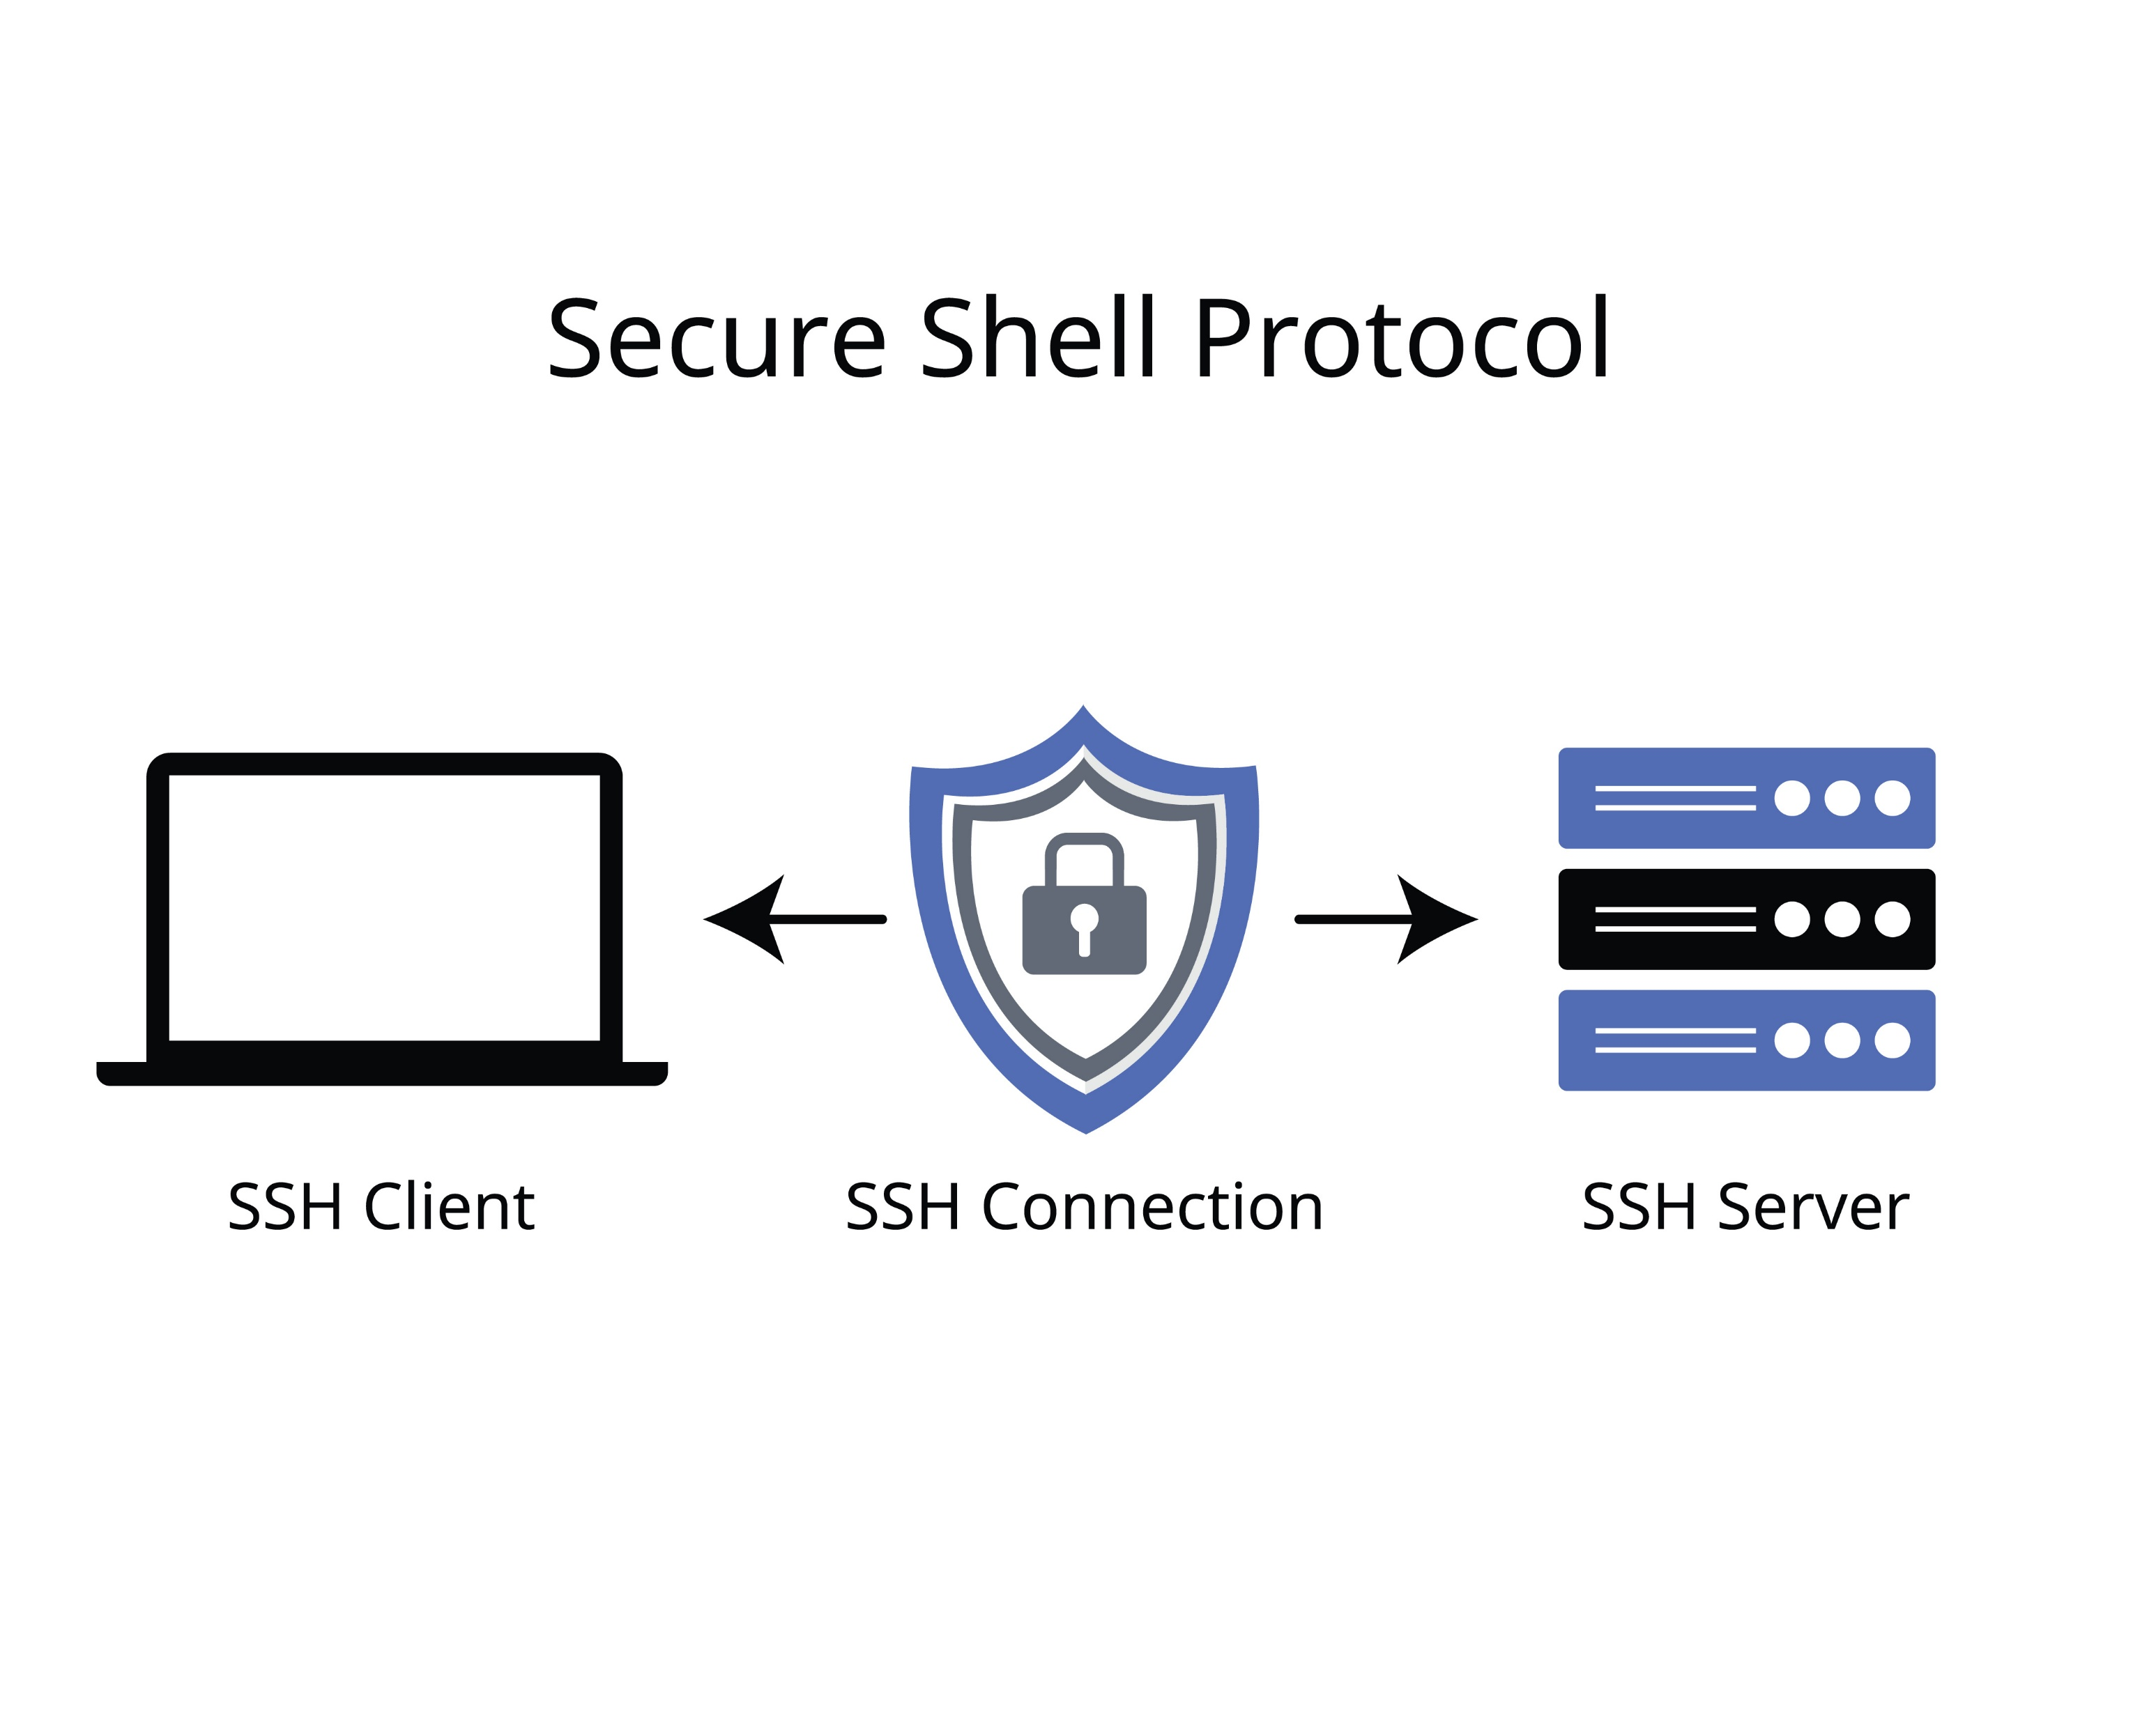
Interacting with remote computers through text

Slide 63
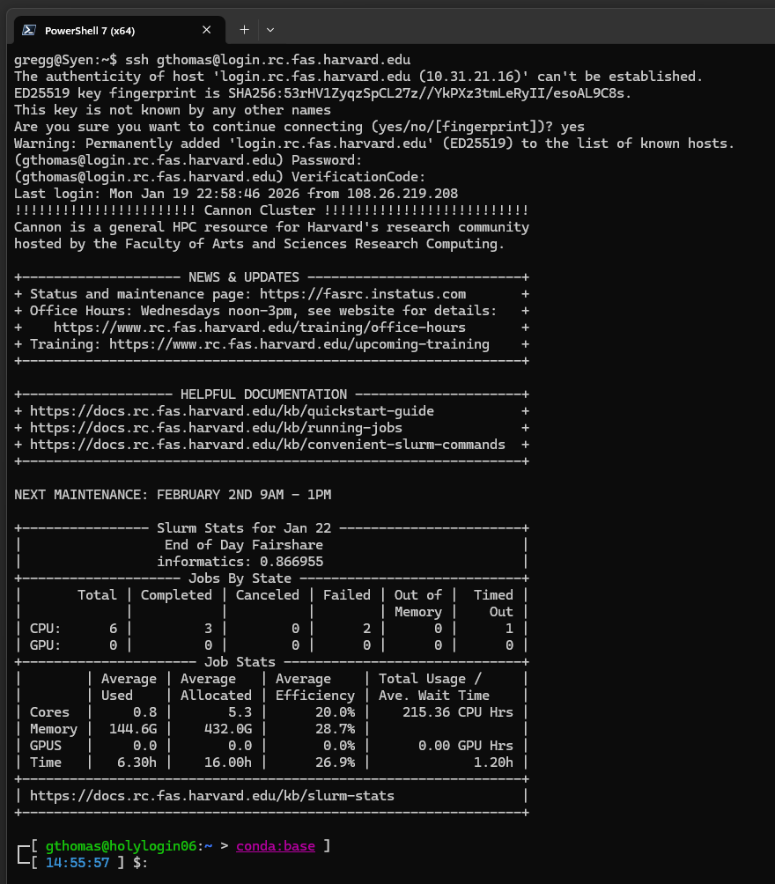


Connecting to a remote computer
Use the ssh command to connect to a remote computer:
ssh <username>@<server name>
The first time you connect (or if the server updates its keys), you will have to trust the server.
For Cannon, you will need your RC password and two-factor code

Slide 64
Connecting to a remote computer
Use the ssh command to connect to a remote computer:
ssh <username>@<server name>
The first time you connect (or if the server updates its keys), you will have to trust the server.
For Cannon, you will need your RC password and two-factor code

Slide 65
Connecting to a remote computer
Use the ssh command to connect to a remote computer:
ssh <username>@<server name>
The first time you connect (or if the server updates its keys), you will have to trust the server.
For Cannon, you will need your RC password and two-factor code

Slide 66
Connecting to a remote computer
Cannon displays an informative welcome message.

Slide 67
Connecting to a remote computer
Local working directory
(in many shells, ~ is a shortcut for the current user’s home directory)
Local user name
Cannon displays an informative welcome message.
But you will mostly know you are connected to a server by the changes to the prompt
Local computer (host) name
Remote computer (host) name
Remote working directory
(in many shells, ~ is a shortcut for the current user’s home directory)
Remote user name

Slide 68
Cluster file system*
Home directory aka the login node
$HOME
100 GB limit
basically useless for compute
Scratch
/n/netscratch/pi_lab
no size limit
90 day retention
used for compute
Lab directory
path varies
size limit based on what’s purchased
general storage
$HOME
$SCRATCH
pi_lab
*caveats
Notes:
Caveats: * We are not covering the structure of the cluster. For that see FAS RC’s getting started guide
We are not covering cold storage
Storage is changing but these general concepts will be the same

Slide 69
Basic Unix commands work the same
pwd | Print (display) the working directory.
ls <directory> | List the contents of <directory> (current working directory if unspecified).
cd <directory> | Change the current working directory to <directory>.
mkdir <directory> | Create a new directory called <directory>.
mv <directory/file> <directory/file> | Move the first <directory/file> to the second <directory/file>. If location is the same, this acts as a rename command. CAUTION: If the destination file/directory exists IT WILL BE OVERWRITTEN WITH NO CONFIRMATION PROMPT
cp <directory/file> <directory/file> | Copy the first <directory/file> to the second <directory/file>. CAUTION: If the destination file/directory exists IT WILL BE OVERWRITTEN WITH NO CONFIRMATION PROMPT
rm <file> rm –rf <directory> | DELETE the file or directory (AND its contents). WARNING: PERMANENT ACTION WITH NO CONFIRMATION PROMPT

Slide 70
Basic Unix commands work the same
pwd | Print (display) the working directory.
ls <directory> | List the contents of <directory> (current working directory if unspecified).
cd <directory> | Change the current working directory to <directory>.
mkdir <directory> | Create a new directory called <directory>.
mv <directory/file> <directory/file> | Move the first <directory/file> to the second <directory/file>. If location is the same, this acts as a rename command. CAUTION: If the destination file/directory exists IT WILL BE OVERWRITTEN WITH NO CONFIRMATION PROMPT
cp <directory/file> <directory/file> | Copy the first <directory/file> to the second <directory/file>. CAUTION: If the destination file/directory exists IT WILL BE OVERWRITTEN WITH NO CONFIRMATION PROMPT
rm <file> rm –rf <directory> | DELETE the file or directory (AND its contents). WARNING: PERMANENT ACTION WITH NO CONFIRMATION PROMPT
But: you will have to consider permissions

Slide 71
Permissions
Because a computer may have many different users, permissions are set on what files an individual user may manipulate
Permission | File | Directory
[none] | A user with no permissions on a file cannot open, view, or manipulate the file in any way. | A user with no permissions on a directory cannot enter (cd to) the directory or list its contents (ls).
read | A user with read permission can open, view, and copy a file, but not edit, move, or delete it. Upon copying, the user has full permissions on the copy. | A user with read permission can list the contents (ls) of a directory but not modify them or enter (cd to) the directory.
write | A user with write permission can edit a file. | A user can enter (cd) into a directory and create, delete, or rename files within it with write permission.
execute | A user with execute permission may run the file if it is an executable program. | A user with execute permission in a directory may run commands in it.

Slide 72
Cluster file system
/ is the root of whichever login node you are connected to
/
Notes:
Mention command prompt and not to use it

Slide 73
Cluster file system
/ is the root of whichever login node you are connected to
/
bin/
var/
etc/
usr/
Notes:
Mention command prompt and not to use it

Slide 74
Cluster file system
/
bin/
var/
n/
etc/
usr/
/n/ is network attached storage, which allows login nodes to access the same files
Notes:
Mention command prompt and not to use it

Slide 75
Cluster file system
/
bin/
var/
n/
etc/
usr/
holy*/
home*/
netscratch/
Notes:
Mention command prompt and not to use it

Slide 76
Cluster file system
/
bin/
var/
n/
etc/
usr/
holy*/
home*/
netscratch/
user1/
gthomas/
user2/
user3/
Notes:
Mention command prompt and not to use it

Slide 77
Cluster file system
/
bin/
var/
n/
etc/
usr/
holy*/
home*/
netscratch/
user1/
gthomas/
user2/
user3/
Notes:
Mention command prompt and not to use it

Slide 78
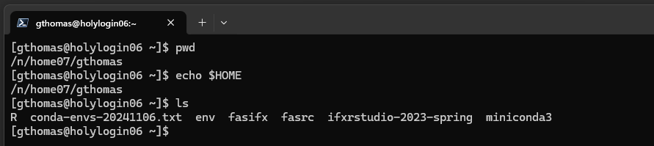
Cluster file system
/
bin/
var/
n/
etc/
usr/
holy*/
home*/
netscratch/
user1/
gthomas/
user2/
user3/
Notes:
Mention command prompt and not to use it

Slide 79
Cluster file system: Home directory
/
In many shells, ~ is a shortcut for the current user’s home directory.
bin/
var/
n/
etc/
usr/
holy*/
home*/
netscratch/
user1/
gthomas/
user2/
user3/
Notes:
Mention command prompt and not to use it

Slide 80
Cluster file system : Home directory
/
In many shells, ~ is a shortcut for the current user’s home directory.
bin/
var/
n/
etc/
usr/
On Cannon, the full path to your home directory is stored in the environment variable $HOME
holy*/
home*/
netscratch/
user1/
gthomas/
user2/
user3/
Notes:
Mention command prompt and not to use it

Slide 81
Cluster file system : Home directory
/
In many shells, ~ is a shortcut for the current user’s home directory.
bin/
var/
n/
etc/
usr/
On Cannon, the full path to your home directory is stored in the environment variable $HOME
holy*/
home*/
netscratch/
user1/
gthomas/
user2/
user3/
$HOME has a 100GB storage limit per user: not suitable for data storage or compute.
Notes:
Mention command prompt and not to use it

Slide 82
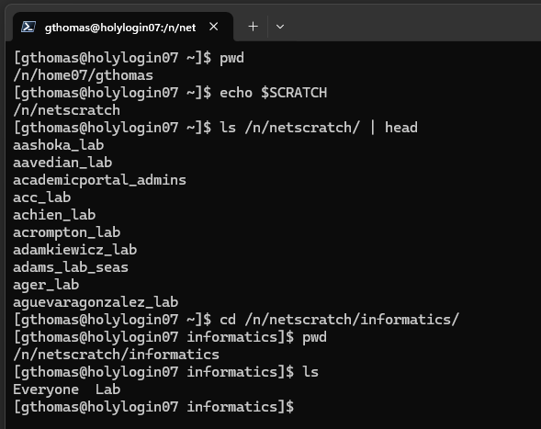
Cluster file system: Scratch directory
On Cannon, the full path to the scratch directory is stored in the environment variable $SCRATCH
/
bin/
var/
n/
etc/
usr/
holy*/
home*/
netscratch/
<pi name>_lab/
Everyone/
$SCRATCH has no storage limit, but files are deleted after 90 days
Lab/
Notes:
Mention command prompt and not to use it

Slide 83
Cluster file system: Scratch directory
On Cannon, the full path to the scratch directory is stored in the environment variable $SCRATCH
/
bin/
var/
n/
etc/
usr/
holy*/
home*/
netscratch/
Only members of the lab can see, copy, edit files
ANYONE on the cluster can see, copy, edit files
<pi name>_lab/
Everyone/
$SCRATCH has no storage limit, but files are deleted after 90 days
Lab/
Notes:
Mention command prompt and not to use it

Slide 84
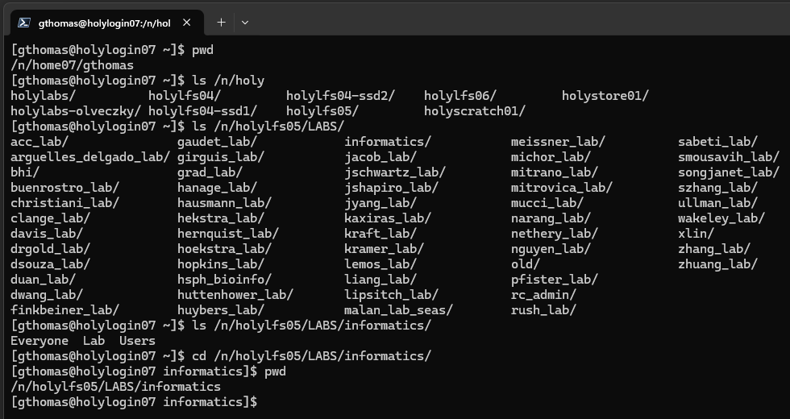
Cluster file system: Lab directory
/
bin/
var/
n/
etc/
usr/
holy*/
home*/
netscratch/
<pi name>_lab/
Everyone/
Lab/
Storage amount based on purchase
Users/
Notes:
Mention command prompt and not to use it

Slide 85
Cluster file system: Lab directory
/
bin/
var/
n/
etc/
usr/
holy*/
home*/
netscratch/
<pi name>_lab/
Everyone/
Lab/
Storage amount based on purchase
Users/
Notes:
Mention command prompt and not to use it

Slide 86
Cluster file system: Lab directory
/
bin/
var/
n/
etc/
usr/
holy*/
home*/
netscratch/
<pi name>_lab/
Everyone/
Lab/
Storage amount based on purchase
Users/
Notes:
Mention command prompt and not to use it

Slide 87
Cluster file system: Lab directory
/
bin/
var/
n/
etc/
usr/
holy*/
home*/
netscratch/
ANYONE on the cluster can see, copy, edit files
<pi name>_lab/
Only members of the lab can see, copy, edit files
Everyone/
Lab/
Storage amount based on purchase
Only individual users can see, copy, edit files
Users/
Notes:
Mention command prompt and not to use it

Slide 88
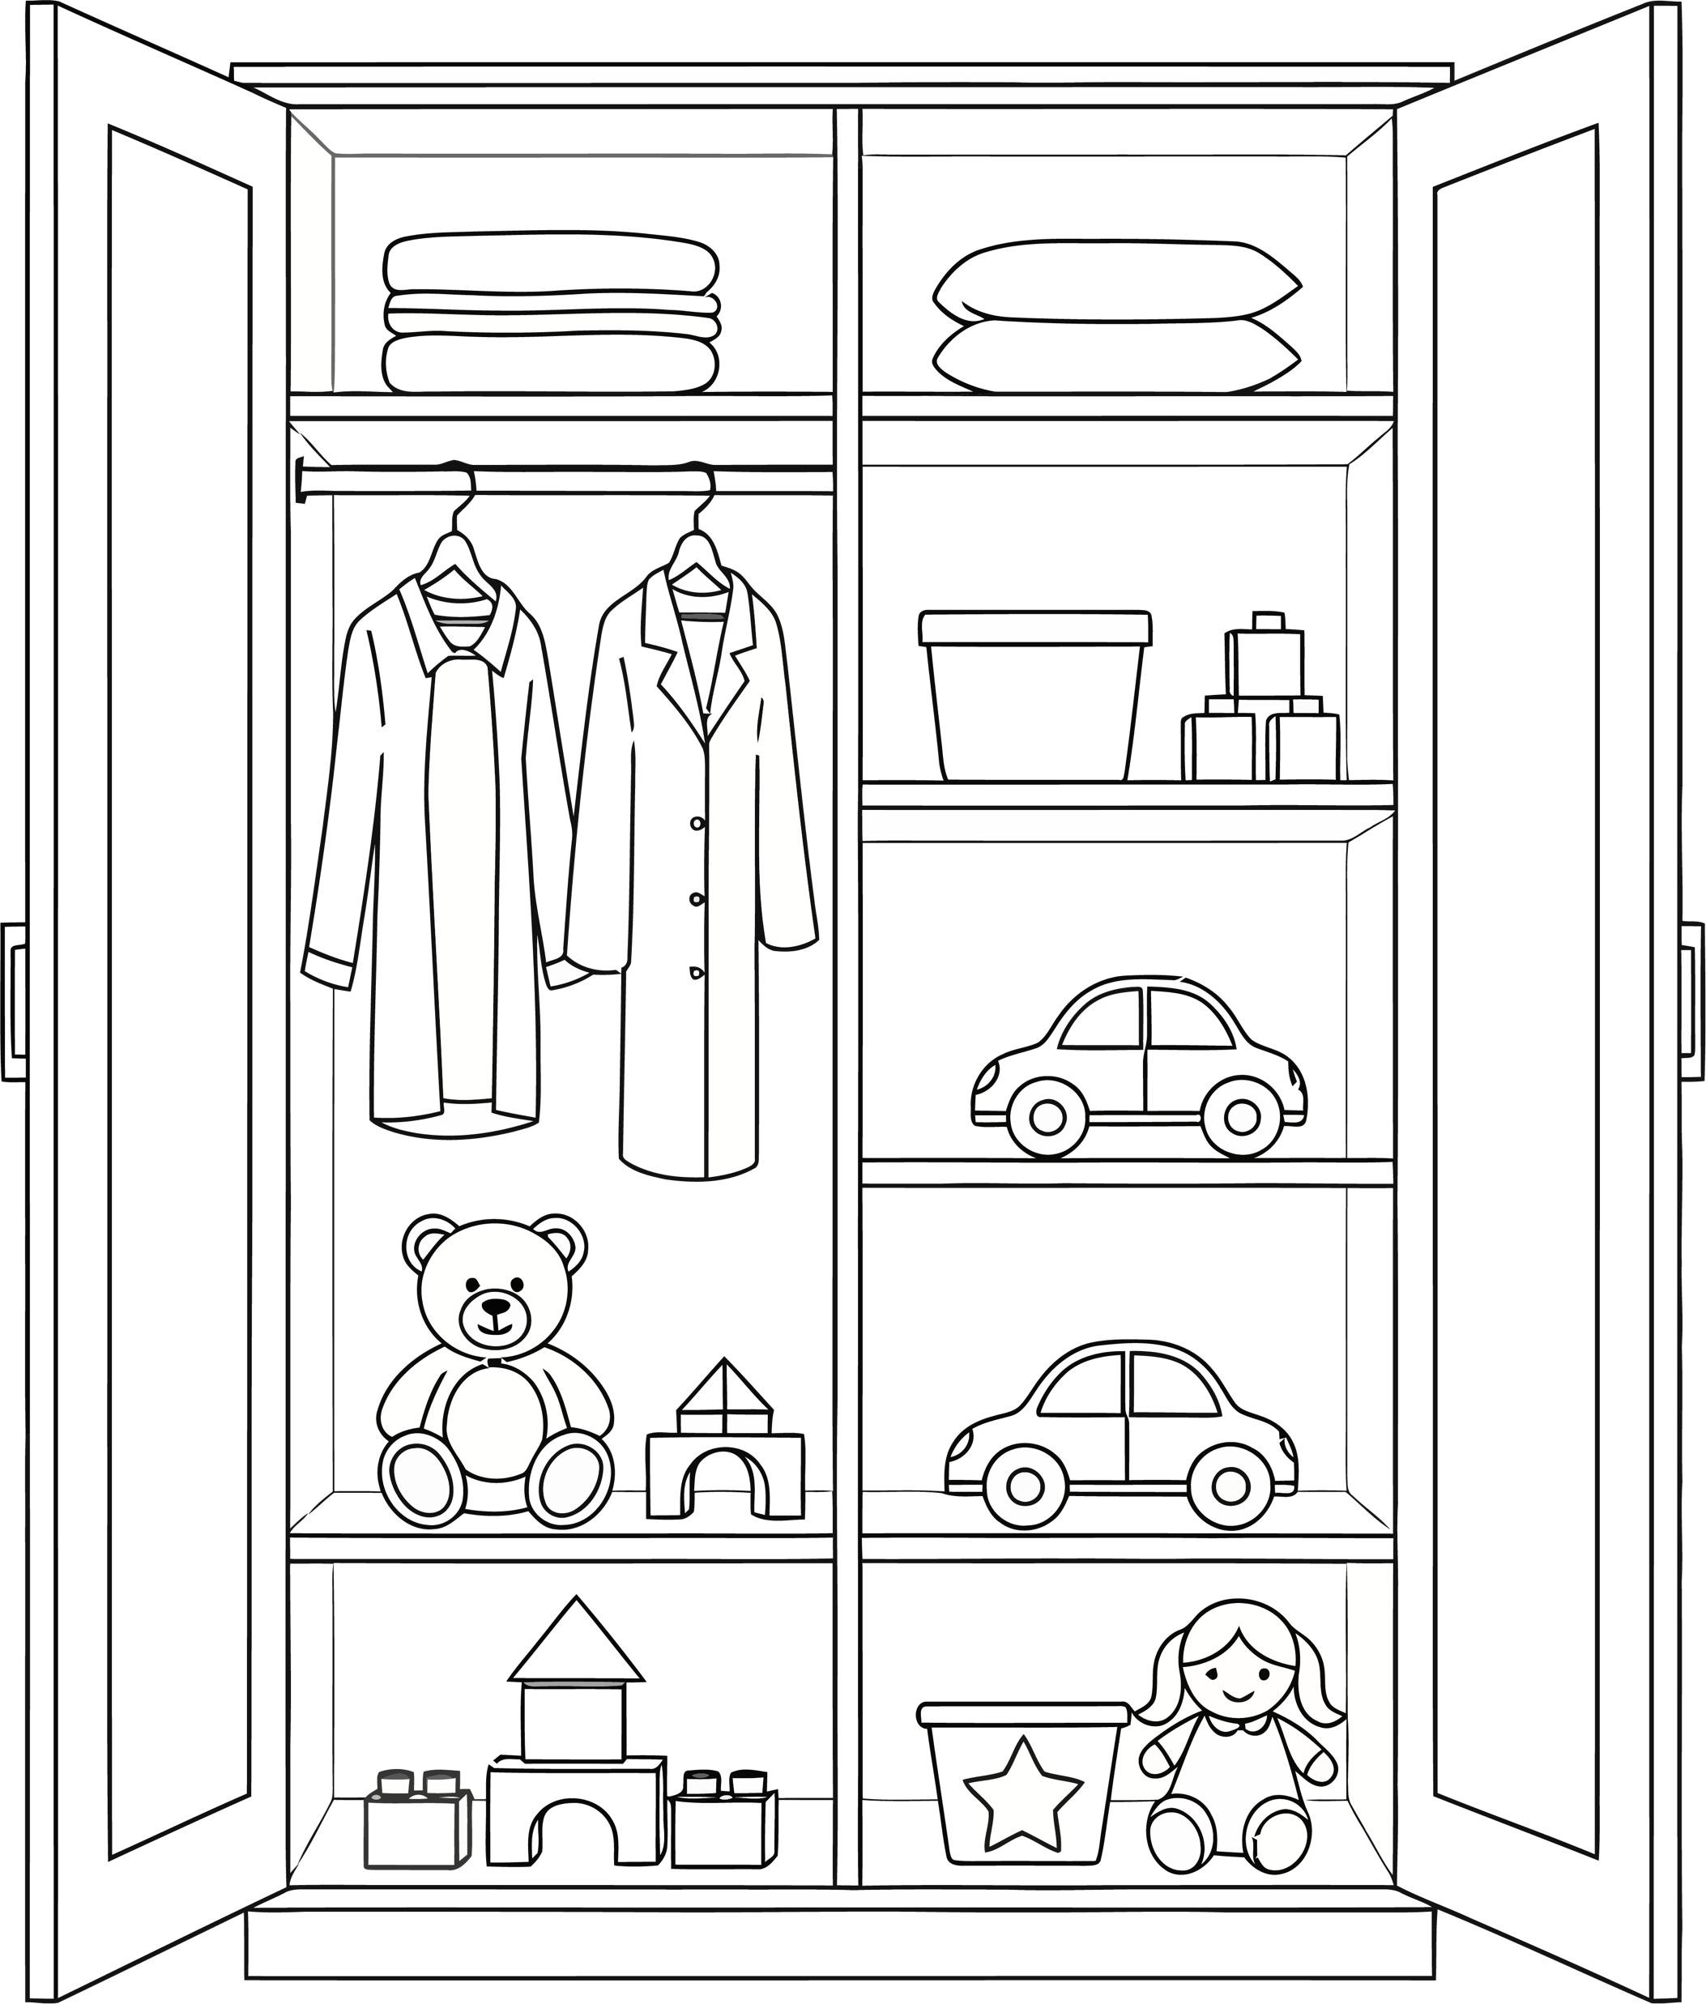
Project Organization
my_project/
data/
code/
manuscript/
raw/
processed/
Notes:
Just an example
Think of it like organizing a room

Slide 89
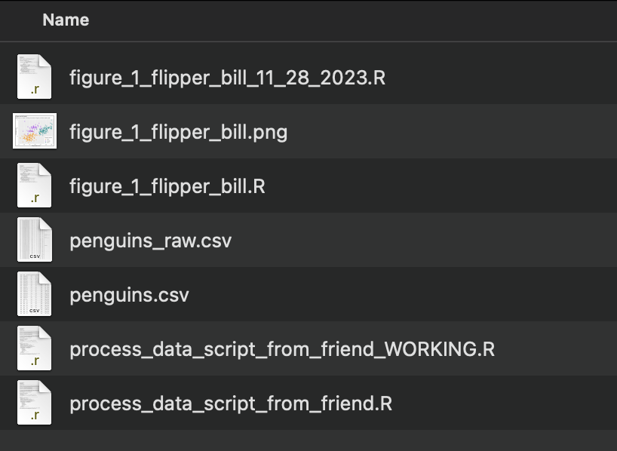
Project Organization

Slide 90
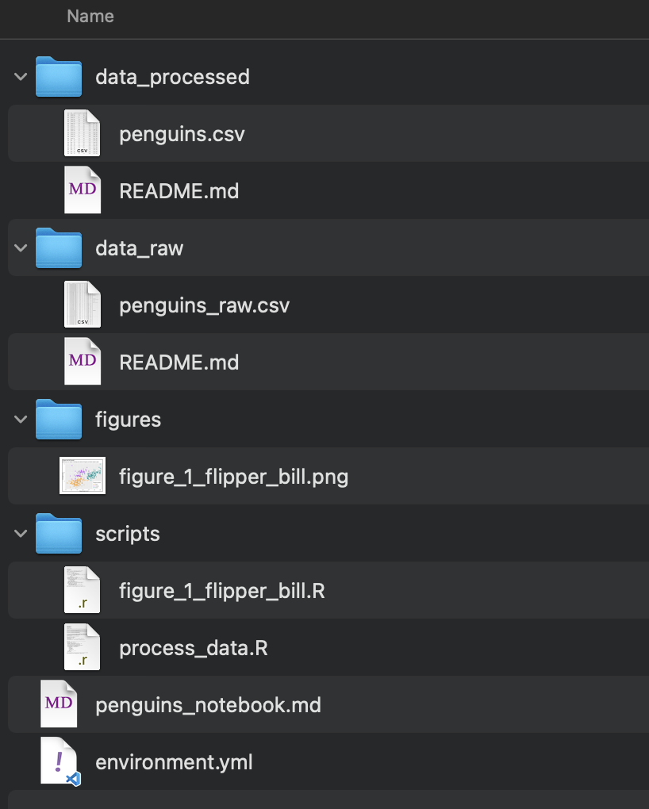
Project Organization

Slide 91
Useful shell shortcuts
.. | Shortcut to use in paths meaning, “one directory above”. ../ means one directory above the current working directory ../../ means two directories above the current working directory
~ | Many systems use this to mean, “the path to the current user’s home directory”. cd ~ will change directory to your home directory no matter where you are in the filesystem.
cd - | Change to the previous directory no matter where it is.
[tab] | When typing paths for a command, hitting tab will autocomplete file names. cd dir[tab] -> cd directory1 If more than one file matches the substring typed, they will all be displayed for you to keep typing: cd dir[tab] -> directory1 directory2 directory3 -> cd directory3
[up arrow] | Scroll through previous commands.
Ctrl+C | Cancel currently running process.
Select text to copy, right click to paste.
Notes:
Mention command prompt and not to use it

