Slide 1
$ Command line 101: $ Tips & tricks for aspiring power users $ Work smarter not harder & type less
$ Harvard FAS Informatics virtual training
$ Thursday, February 12, 2026
$

Slide 2



How do commands work?
/bin/
[gregg]$ ls
ls
Run this program

Slide 3
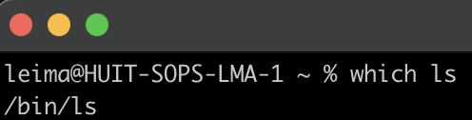
All progams live somewhere in your computer
/bin/
[gregg]$ ls
ls

Slide 4
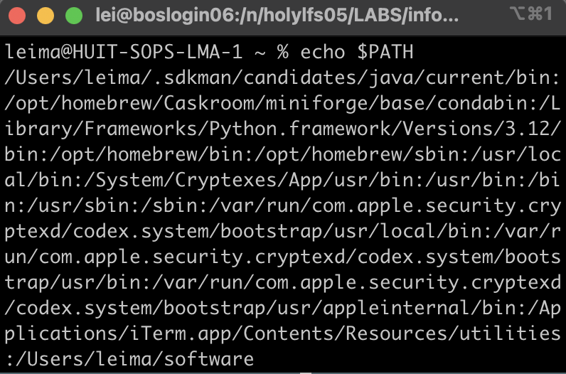
$PATH is list of directories to search for programs
/bin/
[gregg]$ ls

Slide 5
$PATH is an environmental variable
Shortcuts/keywords that are assigned on startup to configure your workspace
Usually starts with $
$PATH | A colon-separated list of directories that contain software
$HOME | points to the home directory
$PWD | the current working directory (print working directory)
$SCRATCH | (on Cannon) points to the scratch directory
$USER | prints the current user of the terminal
printenv lists all environmental variables. Usually set by software to help computer find things

Slide 6
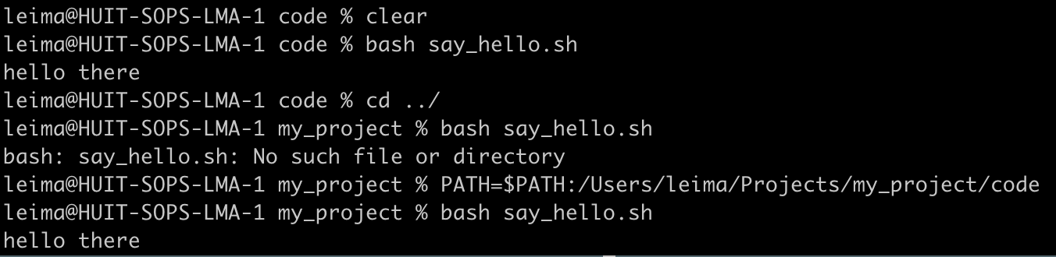
You can modify environmental variables
/Users
leima
Projects
Have an executable you want to reference without typing out the full path?
Add it to the end of the $PATH
>PATH=$PATH:/path/to/directory
say_hello.sh will now be able to be referenced from anywhere
my_project
code
data

Slide 7
You can modify environmental variables
/Users
leima
Projects
Have an executable you want to reference without typing out the full path?
Add it to the end of the $PATH
>PATH=$PATH:/path/to/directory
say_hello.sh will now be able to be referenced from anywhere
my_project
code
data
!!This will only last for this session!!

Slide 8
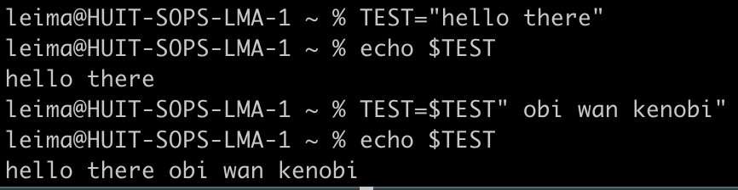
You can make new shell variables
/
n/
TEST=$TEST" obi wan kenobi"
holy*/
home*/
netscratch/
variable you want to set
assign right side to variable on left
<pi name>_lab/
interpolates to hello there
two strings concatenated together to be assigned to the left side
Lab/
software/

Slide 9
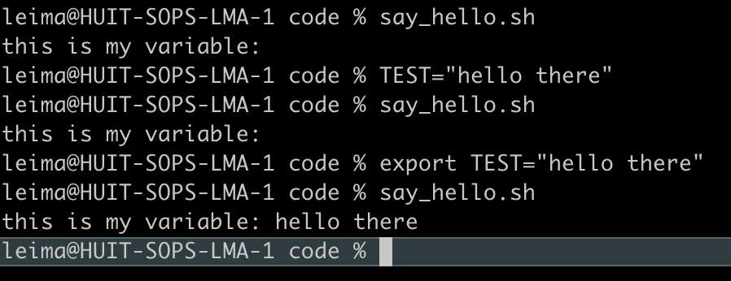
You can make new shell variables
say_hello.sh
#! /bin/sh
echo "this is my variable: "$TEST
shell variables only exist in the shell. Other programs won’t be able to find it unless you export

Slide 10
Caution: do not overwrite environmental variables with other stuff
Don’t assign anything else to the variables below
$PATH | A colon-separated list of directories that contain software
$HOME | points to the home directory
$PWD | the current working directory (print working directory)
$SCRATCH | (on Cannon) points to the scratch directory
$USER | prints the current user of the terminal

Slide 11
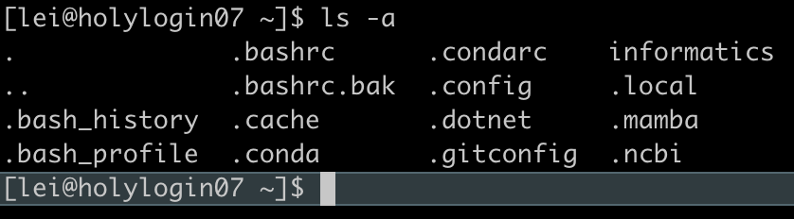
Customizing your bash shell
Run commands (including changing env/shell variables) each time you start a new session
Put commands in a hidden file that begins with a “.”
Use ls -a to see them
That is why they are called dot files
Use caution! It is possible to “break” your shell, and it can be a big pain to fix it…

Slide 12
.bashrc vs .bash_profile
Both are startup config files, usually in your home (aka ~) directory
.bash_profile is run only once, upon login
Sources (aka runs) the .bashrc file (won’t do so otherwise!)
Generally, this is all you want in here
.bashrc is read anytime a shell is opened (assuming it has been sourced)
E.g. if you connect to an interactive node after logging in using `salloc`
TL;DR when using Cannon, put your customizations in here

Slide 13
What can you put in your .bashrc?
# Source global definitions
if [ -f /etc/bashrc ]; then
. /etc/bashrc
fi
# User specific aliases and functions
# load modules
module load jdk
module load python
# add relevant folders to $PATH
export PATH=$PATH:/n/holylfs05/LABS/informatics/Users/lei/bin/
# make aliases
alias ls='ls --color=always’
alias sal=‘salloc --partition test --mem 8GB -c 2 --time 0-04:00’
# source secret API keys
if [ -f "$HOME/.secrets/api_keys.sh" ]; then
. "$HOME/.secrets/api_keys.sh"
fi
don’t change this part

Slide 14
What can you put in your .bashrc? cont…
# make custom functions
function loadmodules {
module load python
source ~/lab_name/spack/setup-env.sh
}
# customize your command prompt
# complicated syntax, ask an LLM
export PS1="\[\033[36m\]\u\[\033[m\]@\[\033[32m\]\h:\[\033[33;1m\]\w\[\033[m\]\$ "

Slide 15
How do I not mess everything up?
Make a backup of your .bashrc
cp .bashrc .bashrc.bak
Only change one thing at a time
Have two windows open and only edit the .bashrc in one in case you totally mess up
the backup window will have the old settings

Slide 16
multitasking in the terminal

Slide 17




When you log in, you have an ssh connection to a node on the cluster
You view this session through a shell, like a window
But when you close the window, the other side suspense all activity
screen creates a process that holds all the activity and presents you with a new window that is independent of

Slide 18
screen session
other screens you can switch between

Slide 19
screen session
still running,
you can find these if you log back in!*
When you disconnect the screen keeps all instances of your shell running
* if you log into the same node, the shells will still be there!

Slide 20

screen session
Screen is also useful for doing something else while you wait for a slow task to finish

Slide 21
Very basic screen commands
Command | What it does
screen -S sessionname | Start a new screen session with name sessionname
screen -ls | List all screen sessions
screen -r sessionname | Reconnect to a particular session
Ctrl+a d | Detach (and leave running)
Ctrl+a k | Kill current window
Ctrl+a ? | pull up help menu of shortcuts
Start a screen session with screen or screen -S name if you want to give it a name.
Run your long task.
Detach your screen to go do something else
Go back to your screen with screen -r

Slide 22
Terminal multiplexers
Programs that let you run multiple terminal sessions within a single window
Can ‘detach’ a session without closing in-progress programs (continue running in the background)
‘Reattach’ to a session later
Can have complex session layouts (split panes, multiple windows, etc.)
Great for running multiple programs and for saving your runs from disconnects
And for making you feel like a proper hacker

Slide 23
Terminal multiplexers
Terminology
Windows: your terminal screen. Can think of like a browser tab. Windows can be split into…
Panes: a rectangular subarea of a window. Each pane within a window has its own command line
Session: your whole workspace. It can hold multiple windows (with panes). Using multiplexers, sessions can be
Detached: “closing” the terminal, but without terminating the processes running in that session, and can…
Reattached: can reconnect to that session without interruption

Slide 24
Terminal multiplexers
GNU Screen: the O.G. multiplexer

Slide 25
Terminal multiplexers
TMUX: a more modern, actively developed option

Slide 26
Environmental variables
When you type a command at the terminal and it executes, what is actually happening?
E.g. `ls`
Or, when you type a command and you get a “command not found” error even tho you’ve installed it, why is that?
“Behind the scenes” the shell sets variables that contain important configuration data (paths to executables, etc)
Environmental variables
Inherited by all child processes upon shell startup

Slide 27
Environmental variables
Consider the `ls` command:
`ls` is a program/executable that “lives” somewhere in the filesystem
We can see where it lives by: `which ls`
It lives in a directory called `/bin/`
The shell “knows” to look in the `/bin` directory when you type `ls` because of the `$PATH` environmental variable
`$PATH` contains a list of directories that the shell will search in for executables
`echo $PATH`

Slide 28
Environmental variables
`$PATH` is just one of many environmental variables…
`printenv` will list all of them
Most of these are set by the system automatically
Some are static and don’t change (or shouldn’t…)
e.g. `echo $HOME`
Others are updated automatically
`echo $PWD` (present working directory)
`cd ..`
`echo $PWD`

Slide 29
Environmental variables
Like any variables, we can modify or add env variables
Tho that doesn’t mean we should, for some!
E.g. you’ve downloaded an executable and want to run it without having to type out the full path to where it’s downloaded
Option 1: copy the executable to a directory in your $PATH
Option 2: modify your $PATH by appending a directory to it:
`PATH=$PATH:/path/to/directory`
The shell will now search that directory for executables

Slide 30
Environmental variables
We can also add new variables to the shell:
By convention, bash variables are named in uppercase
`TEST=“hello there”`
`echo $TEST`
IMPORTANT: what we did here was make a shell variable, not an environmental variable
What’s the difference??

Slide 31
Environmental variables
Environmental variables vs shell variables:
Env variables are shared across all processes or programs created from the shell
Can be “seen” by other programs
Shell variables are local to only the shell; they aren’t “seen” by child processes
E.g. if you ran a script that referenced a shell variable, it would not find it!

Slide 32
Environmental variables
`TEST=“bingus”`
`cat print_test.sh`
`echo $TEST`
`sh print_test.sh` -> no output!
This is because the `$TEST` variable only exists in the shell…any subprocesses (e.g. our `print_test` script) will not inherit it
We can convert shell variables to environmental variables!
`export TEST`(note the lack of “$”!)
Now we can run the script successfully

Slide 33
Environmental variables
Another important consideration with env/shell variables…
Try making a variable: `TEST=“bingus”`
`echo $TEST`
Now open a new terminal window…
`echo $TEST`
Nothing happens! What’s going on…

Slide 34
Environmental variables
Any changes to default env variables or new shell/env variables are only saved for that specific bash session!
You’ll have to re-set the values each time you reopen the shell
Or…

Slide 35
Customizing your bash shell
…we can modify our bash profile to load our custom env variables automatically!
This is just one of the things you can do with profiles…
Add custom directories to $PATH
Make a command alias
Customize the colors/themes and behavior of your shell
Etc.

Slide 36
Customizing your bash shell
Bash profiles are configuration files that are run on startup of the shell
Use caution! It is possible to “break” your shell, and it can be a big pain to fix it…
There are several different bash config files with some subtle differences
Generally they are “hidden” files, meaning they start with a “.” and will not be visible when listing contents unless use `ls –a`

Slide 37
Customizing your bash shell
`.bashrc` vs `.bash_profile`
Both are startup config files, usually in your home `~` directory
`.bash_profile` is run only once, upon login
Sources the `.bashrc` file (won’t do so otherwise!)
Generally, this is all you want in here
`.bashrc`is read anytime a shell is opened (assuming it has been sourced)
E.g. if you connect to an interactive node after logging in using `salloc`
TL;DR when using Cannon, put your customizations in here

Slide 38
Customizing your bash shell
Let’s have a look at what a `.bashrc` profile looks like on Cannon
Will be run whenever you log in, by any jobs you submit or create a new shell
The ‘global definitions’ section sources cluster-wide definitions, allows jobs to run properly
Don’t modify this part!!
Customization goes under the ‘user specific’ section
# .bashrc
# Source global definitions
if [ -f /etc/bashrc ]; then
. /etc/bashrc
fi
# User specific aliases and functions

Slide 39
Customizing your bash shell
On the Cannon cluster, say there are several modules you commonly use
You could append `module load` statements to `.bashrc`:
# .bashrc
# Source global definitions
if [ -f /etc/bashrc ]; then
. /etc/bashrc
fi
# User specific aliases and functions
module load jdk
module load python

Slide 40
Customizing your bash shell
However, it is better practice to instead use a shell function
Shell functions: like other programming languages, a re-usuable modular “block” of code
Given a custom name and invoked at command line like any shell program
Executes the commands inside the function body
Note functions don’t only go in your profile, can be part of shell scripts, etc.
function function_name {
shell command(s)
}

Slide 41
Customizing your bash shell
In your `.bashrc` we can add a custom function `mymodules`:
Type `mymodules` to run the function and load the listed modules
# .bashrc
# Source global definitions
if [ -f /etc/bashrc ]; then
. /etc/bashrc
fi
# User specific aliases and functions
function mymodules { module load jdk module load python }

Slide 42
Customizing your bash shell
Other useful things to put in your profile: command aliases
Similar to a function, an alias is a shortcut for a long command
Invoke the alias like any program
E.g. whenever you use `ls`, want to include the `-l` and `-h` flags to show file details and make size human-readable
Note here we are setting an alias for an already existing program
alias name_of_alias=‘full command to run’
alias ls=‘ls -l -h’
ls

Slide 43
Customizing your bash shell
More customization: making your bash prompt cute!
Changing fonts, colors, etc.
Modify the `$PS1` variable
Unfortunately the syntax is quite cryptic…
Easiest to just copy a template someone else made…here’s mine:
Make username cyan, add ‘@’, make hostname green, add ‘:’, display PWD in yellow, add ‘$’ and a space
export PS1="\[\033[36m\]\u\[\033[m\]@\[\033[32m\]\h:\[\033[33;1m\]\w\[\033[m\]\$ "

Slide 44
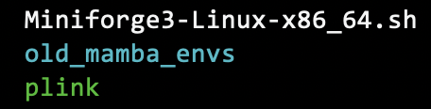
Customizing your bash shell
More customization: coloring `ls`output based on file type
When using GNU `ls` (i.e. Cannon, but can be different e.g. on MacOS!):
Set an alias for `ls` to auto-enable color (otherwise would need to specify every time)
Set the LS_COLORS environmental variable
Again, the syntax is awful…here is mine:
Dirs in cyan, symlinks in magenta, executables in green, regular files in white, etc.
alias ls='ls --color=auto'
export LS_COLORS="di=36:ln=35:ex=32:fi=0:pi=33:so=35:bd=33;1:cd=33;1"

