Slide 1
$ Command line 101: $ Integrating local and cluster environments
$ Harvard FAS Informatics virtual training
$ Thursday, February 5, 2026
$

Slide 2
$ Command line 101: $ Integrating local and cluster environments
$ Harvard FAS Informatics virtual training
$ Thursday, February 5, 2026
$

Slide 3

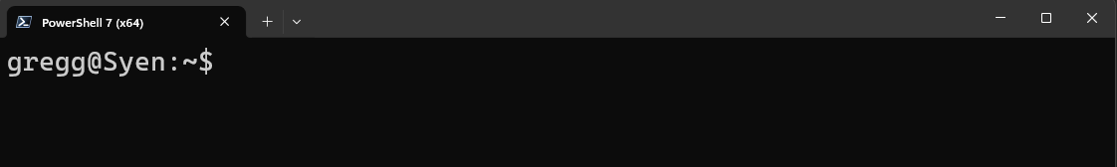




What to we mean by “environment”?
/
bin/
var/
home/
etc/
usr/
lei/
gregg/
tim/
Desktop/
documents/
music/
Notes:
Mention command prompt and not to use it

Slide 4
What to we mean by “environment”?
/
Your current environment
bin/
var/
home/
etc/
usr/
$PATH
other environment variables
.bash_profile
aliases and functions
lei/
gregg/
tim/
$LD_LIBRARY_PATH
.bashrc
Desktop/
documents/
music/
Notes:
Mention command prompt and not to use it

Slide 5
What to we mean by “environment”?
/
Your current environment
bin/
var/
home/
etc/
usr/
$PATH
other environment variables
.bash_profile
aliases and functions
lei/
gregg/
tim/
$LD_LIBRARY_PATH
.bashrc
Desktop/
documents/
music/
On computers where your user does not have full permissions, you will have trouble installing software
Notes:
Mention command prompt and not to use it

Slide 6
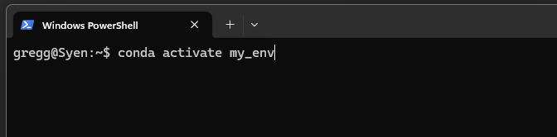

Software environments edit aspects of your default environment
/
Your conda environment
bin/
var/
home/
etc/
usr/
$PATH
other environment variables
.bash_profile
aliases and functions
lei/
gregg/
tim/
$LD_LIBRARY_PATH
.bashrc
Desktop/
documents/
music/
Software environments change environment variables to locations where you have write permission
Notes:
Mention command prompt and not to use it

Slide 7
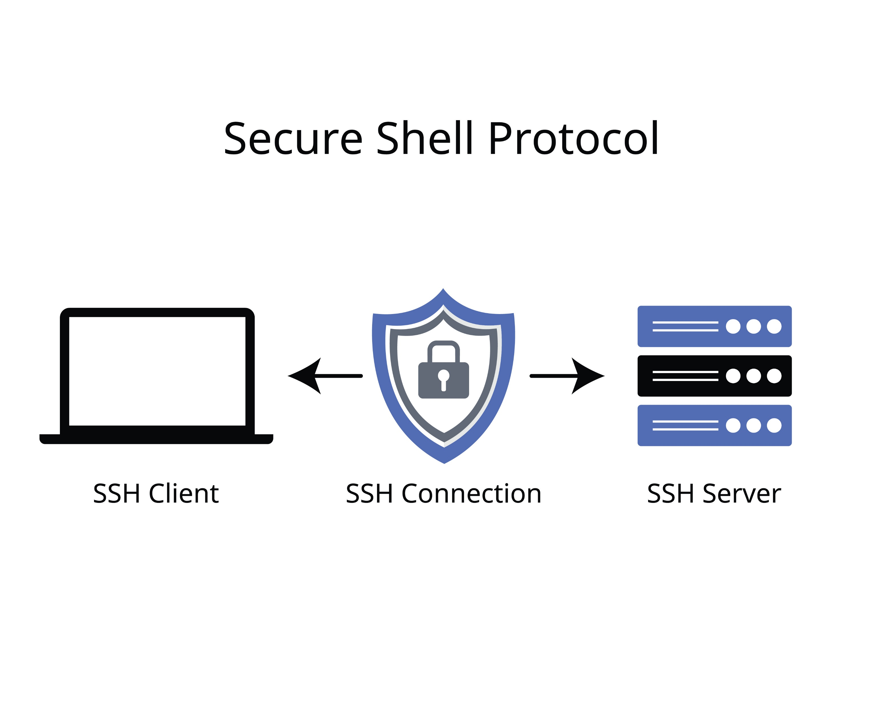
Connecting to the cluster with ssh

Slide 8
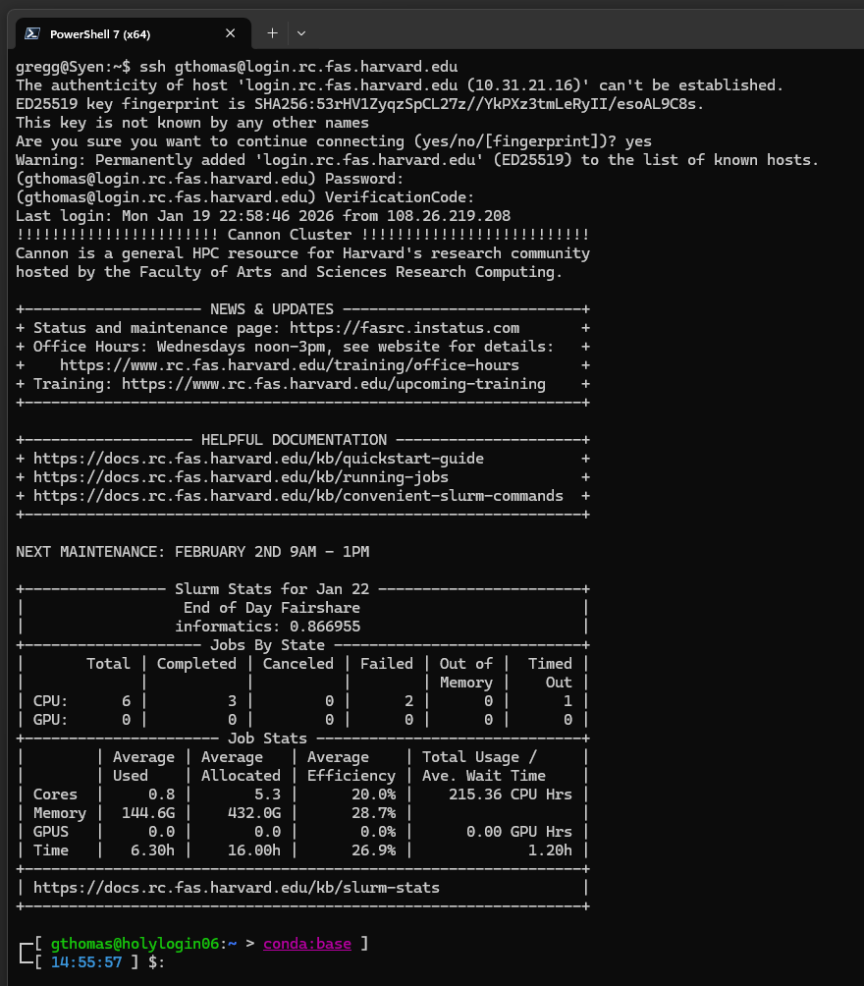


Connecting to a remote computer
Use the ssh command to connect to a remote computer:
ssh <username>@<server name>
The first time you connect (or if the server updates its keys), you will have to trust the server.
For Cannon, you will need your RC password and two-factor code

Slide 9
Connecting to a remote computer
Use the ssh command to connect to a remote computer:
ssh <username>@login.rc.fas.harvard.edu
The first time you connect (or if the server updates its keys), you will have to trust the server.
For Cannon, you will need your RC password and two-factor code

Slide 10
Connecting to a remote computer
Use the ssh command to connect to a remote computer:
ssh <username>@login.rc.fas.harvard.edu
The first time you connect (or if the server updates its keys), you will have to trust the server.
For Cannon, you will need your RC password and two-factor code

Slide 11
Connecting to a remote computer
Use the ssh command to connect to a remote computer:
ssh <username>@login.rc.fas.harvard.edu
The first time you connect (or if the server updates its keys), you will have to trust the server.
For Cannon, you will need your RC password and two-factor code

Slide 12
Connecting to a remote computer
Cannon displays an informative welcome message.

Slide 13
Connecting to a remote computer
Local working directory
(in many shells, ~ is a shortcut for the current user’s home directory)
Local user name
Cannon displays an informative welcome message.
But you will mostly know you are connected to a server by the changes to the prompt
Local computer (host) name
Remote computer (host) name
Remote working directory
(in many shells, ~ is a shortcut for the current user’s home directory)
Remote user name

Slide 14
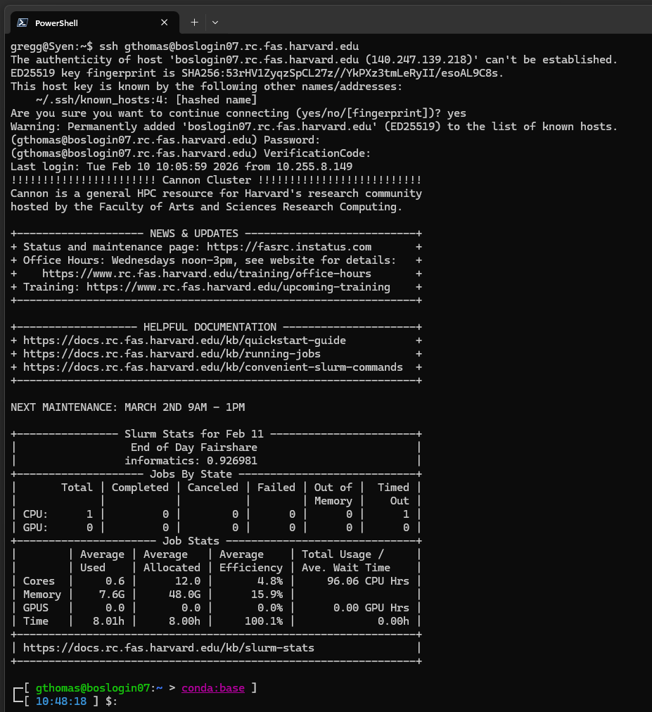
How to connect to a particular login node
Use the ssh command to connect to a remote computer:
ssh <username>@login.rc.fas.harvard.edu
ssh <username>@<login node name>.rc.fas.harvard.edu

Slide 15

Transferring files to and from the cluster

Slide 16

Viewing and editing files on the cluster

Slide 17
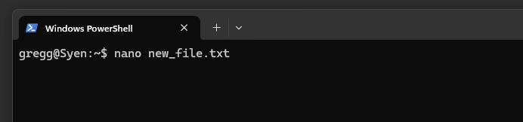
In-terminal text editors and viewers: nano
nano is a command line text-editor invoked by typing:
nano <filename or path>
And then hitting Enter

Slide 18
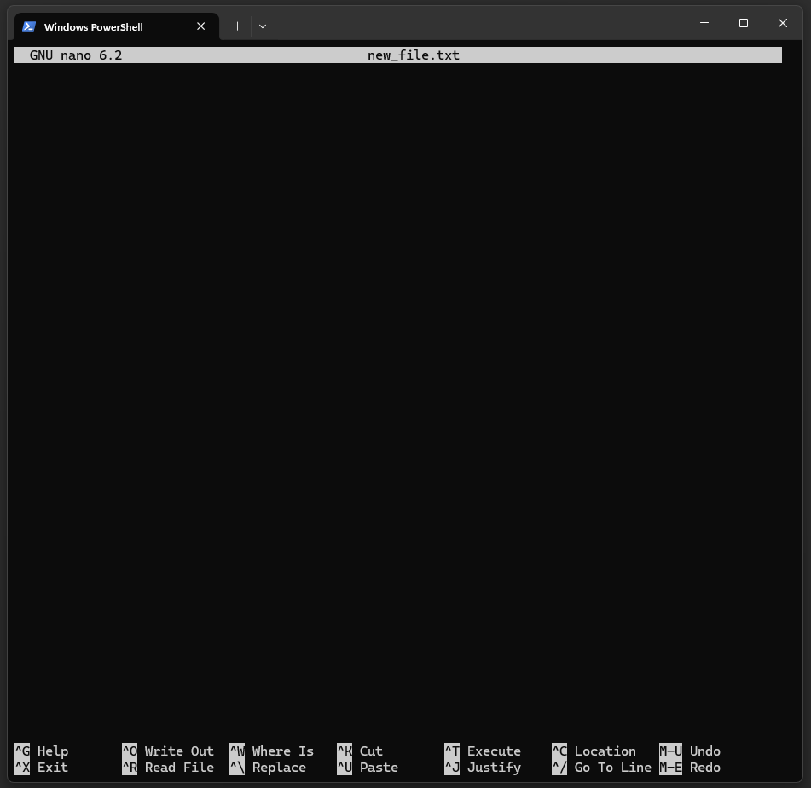
In-terminal text editors and viewers: nano
nano is a command line text-editor invoked by typing:
nano <filename or path>
And then hitting Enter.
This will change the entire terminal interface to the text editor.

Slide 19
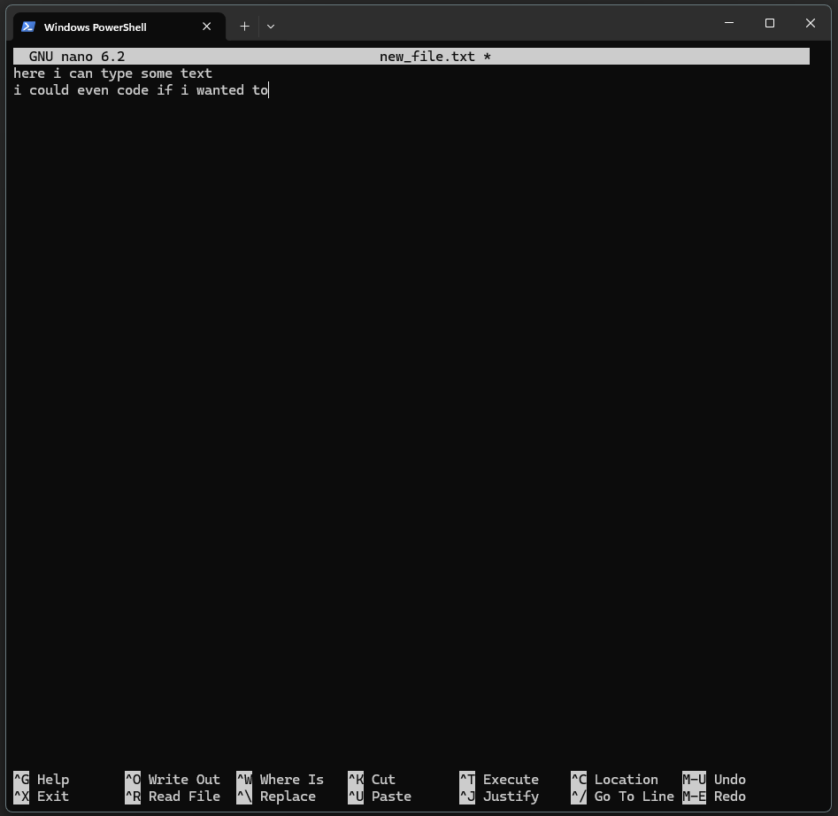
In-terminal text editors and viewers: nano
Within the nano editor, you can enter any text. You could even manually enter formatted text or code!

Slide 20
In-terminal text editors and viewers: nano
Within the nano editor, you can enter any text. You could even manually enter formatted text or code!
Tedious to navigate lines and hard to view large files.
Best for quick and small edits.

Slide 21
In-terminal text editors and viewers: nano
Keyboard commands to move around and perform file operations.
^ means ctrl key

Slide 22
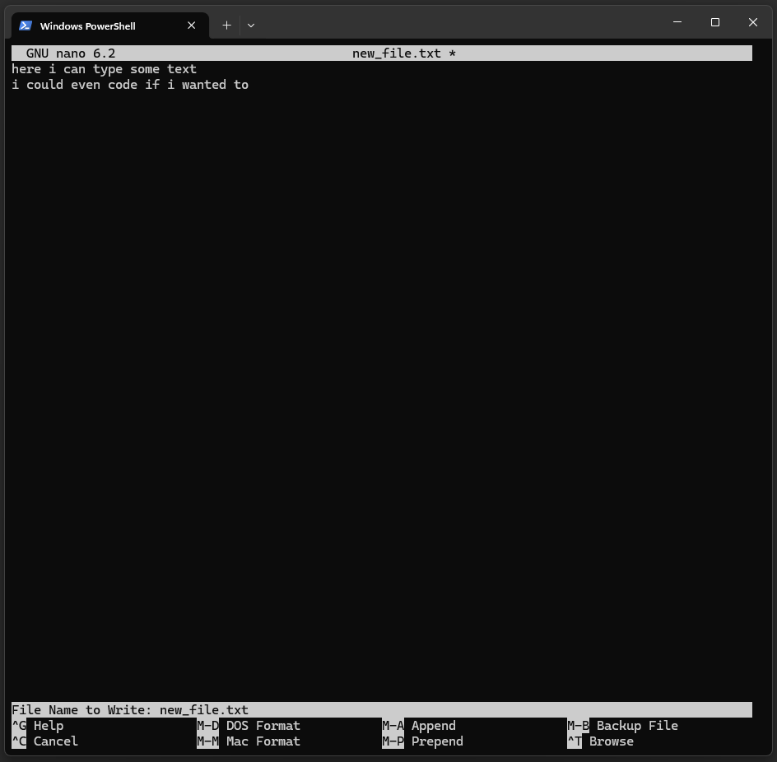
In-terminal text editors and viewers: nano
Common commands
save file (Write Out): ctrl-W, which brings up dialog to name or re-name file. Hit Enter to keep filename
Exit the nano interface and return to terminal: ctrl X

Slide 23
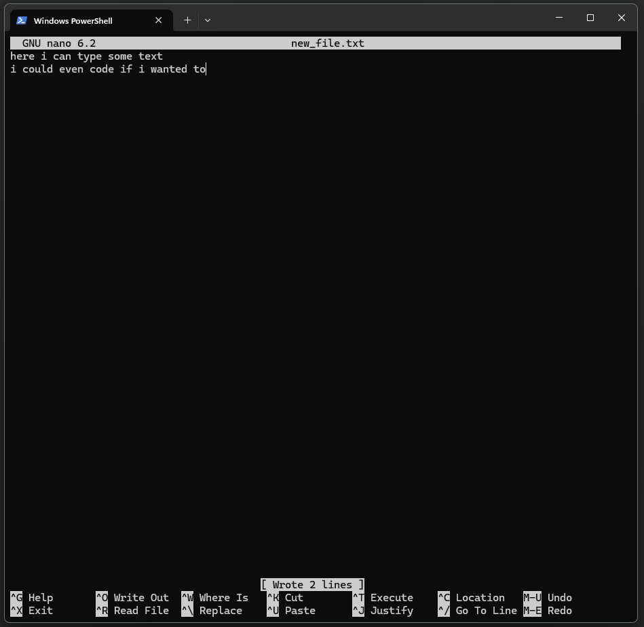
In-terminal text editors and viewers: nano
Common commands
Save file (Write Out): ctrl-W, which brings up dialog to name or re-name file. Hit Enter to keep filename
Exit the nano interface and return to terminal: ctrl X

Slide 24
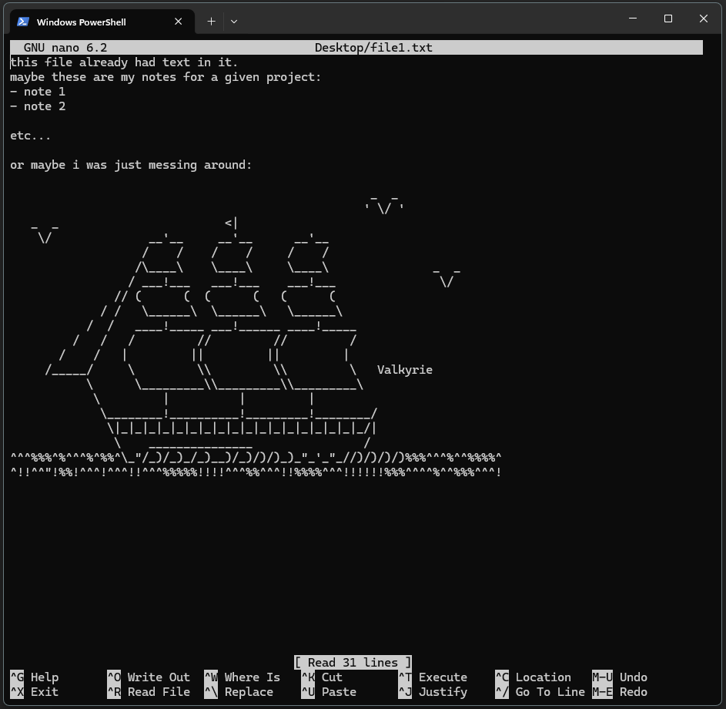
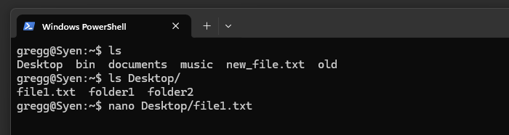
In-terminal text editors and viewers: nano
Open pre-existing files to view/edit their content by providing their path.

Slide 25
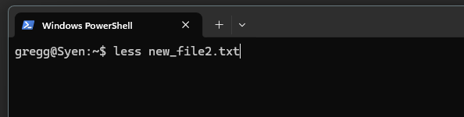
In-terminal text editors and viewers: less
less is a command line text viewer invoked by typing:
less <filename or path>
And then hitting Enter

Slide 26
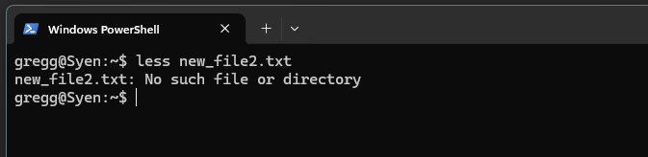
In-terminal text editors and viewers: less
less is a command line text viewer invoked by typing:
less <filename or path>
And then hitting Enter
less cannot be used to create files!

Slide 27
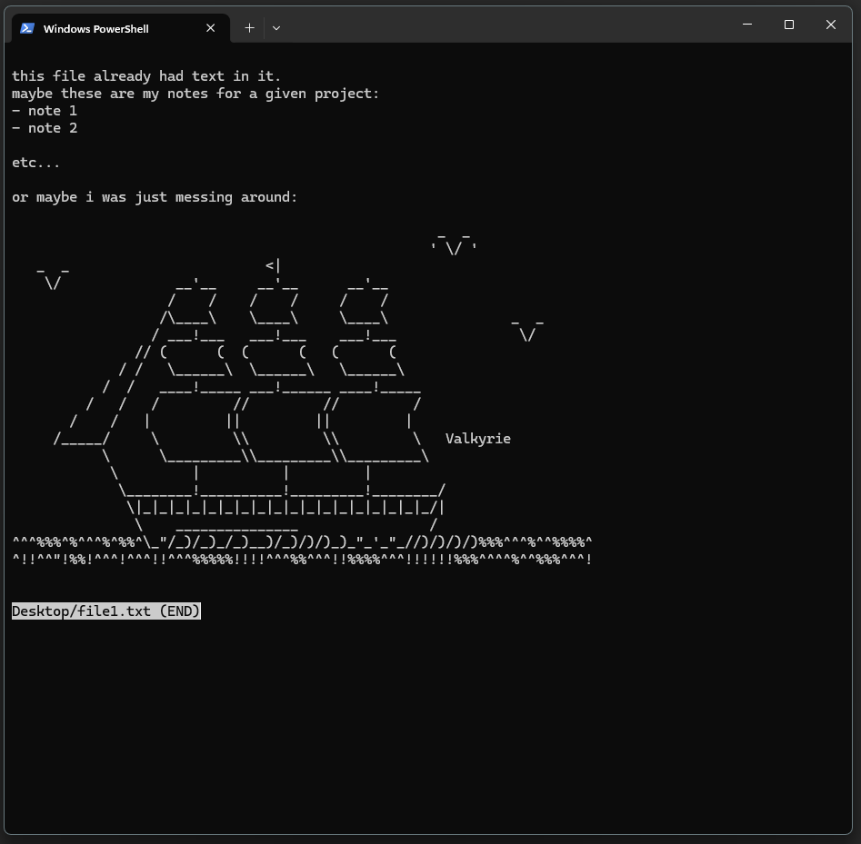
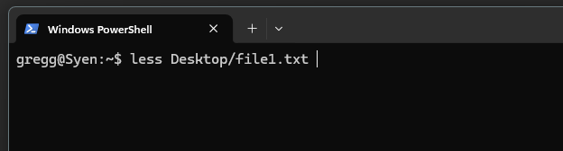
In-terminal text editors and viewers: less
less is a command line text viewer invoked by typing:
less <filename or path>
And then hitting Enter

Slide 28
In-terminal text editors and viewers: less
less does not load the entire file into memory, so it is good for previewing large files.

Slide 29
In-terminal text editors and viewers: less
Navigation
Up/down arrows: move up and down 1 line
<space>: move down one page
<b>: move up (back) one page
<q>: exit the viewer

Slide 30
In-terminal text editors and viewers: less
Tip: use the -S option to disable line wrapping:
less -S <file name or path>
Navigation
Up/down arrows: move up and down 1 line
<space>: move down one page
<b>: move up (back) one page
<q>: exit the viewer

Slide 31
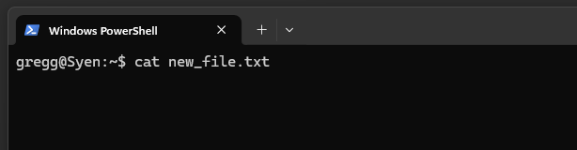
Printing a file to the terminal: cat
cat (short for concatenate) displays file contents on the screen

Slide 32
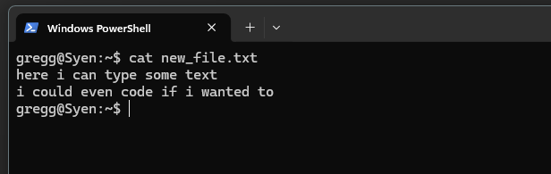
Printing a file to the terminal: cat
cat (short for concatenate) displays file contents on the screen

Slide 33
Printing a file to the terminal: cat
cat (short for concatenate) displays file contents on the screen
Best for small files!

Slide 34
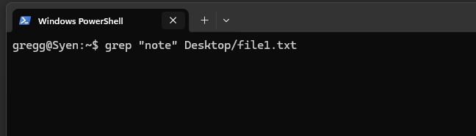
Finding text in a file: grep
grep reads a file line-by-line and searches for a provided pattern, displaying lines that contain matches to the pattern

Slide 35
Finding text in a file: grep
The string or pattern to search for
The file to search
The call to grep
grep reads a file line-by-line and searches for a provided pattern, displaying lines that contain matches to the pattern

Slide 36
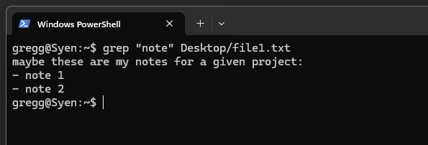
Finding text in a file: grep
The string or pattern to search for
The file to search
The call to grep
grep reads a file line-by-line and searches for a provided pattern, displaying lines that contain matches to the pattern

Slide 37
Table of terminal text review
.. | Shortcut to use in paths meaning, “one directory above”. ../ means one directory above the current working directory ../../ means two directories above the current working directory
~ | Many systems use this to mean, “the path to the current user’s home directory”. cd ~ will change directory to your home directory no matter where you are in the filesystem.
cd - | Change to the previous directory no matter where it is.
[tab] | When typing paths for a command, hitting tab will autocomplete file names. cd dir[tab] -> cd directory1 If more than one file matches the substring typed, they will all be displayed for you to keep typing: cd dir[tab] -> directory1 directory2 directory3 -> cd directory3
[up arrow] | Scroll through previous commands.
Ctrl+C | Cancel currently running process.
Select text to copy, right click to paste.
Notes:
Mention command prompt and not to use it

Slide 38
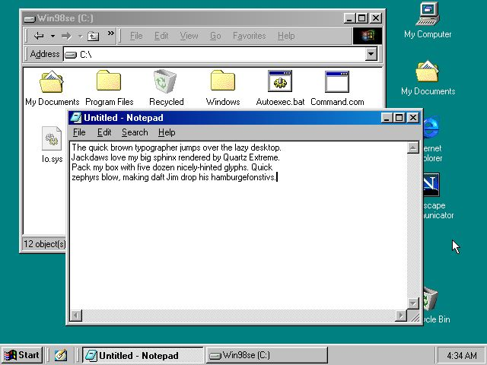
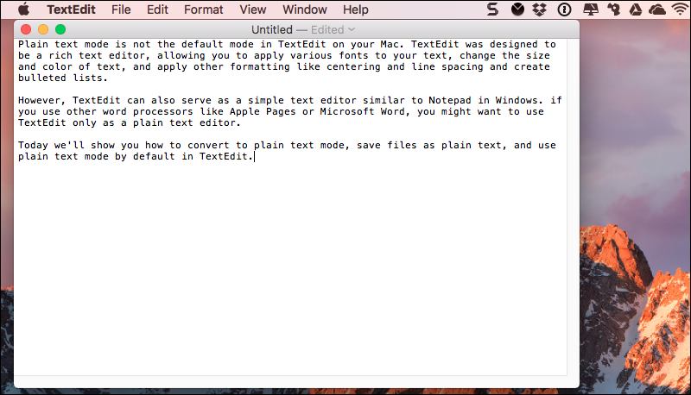
Graphical text editors

Slide 39
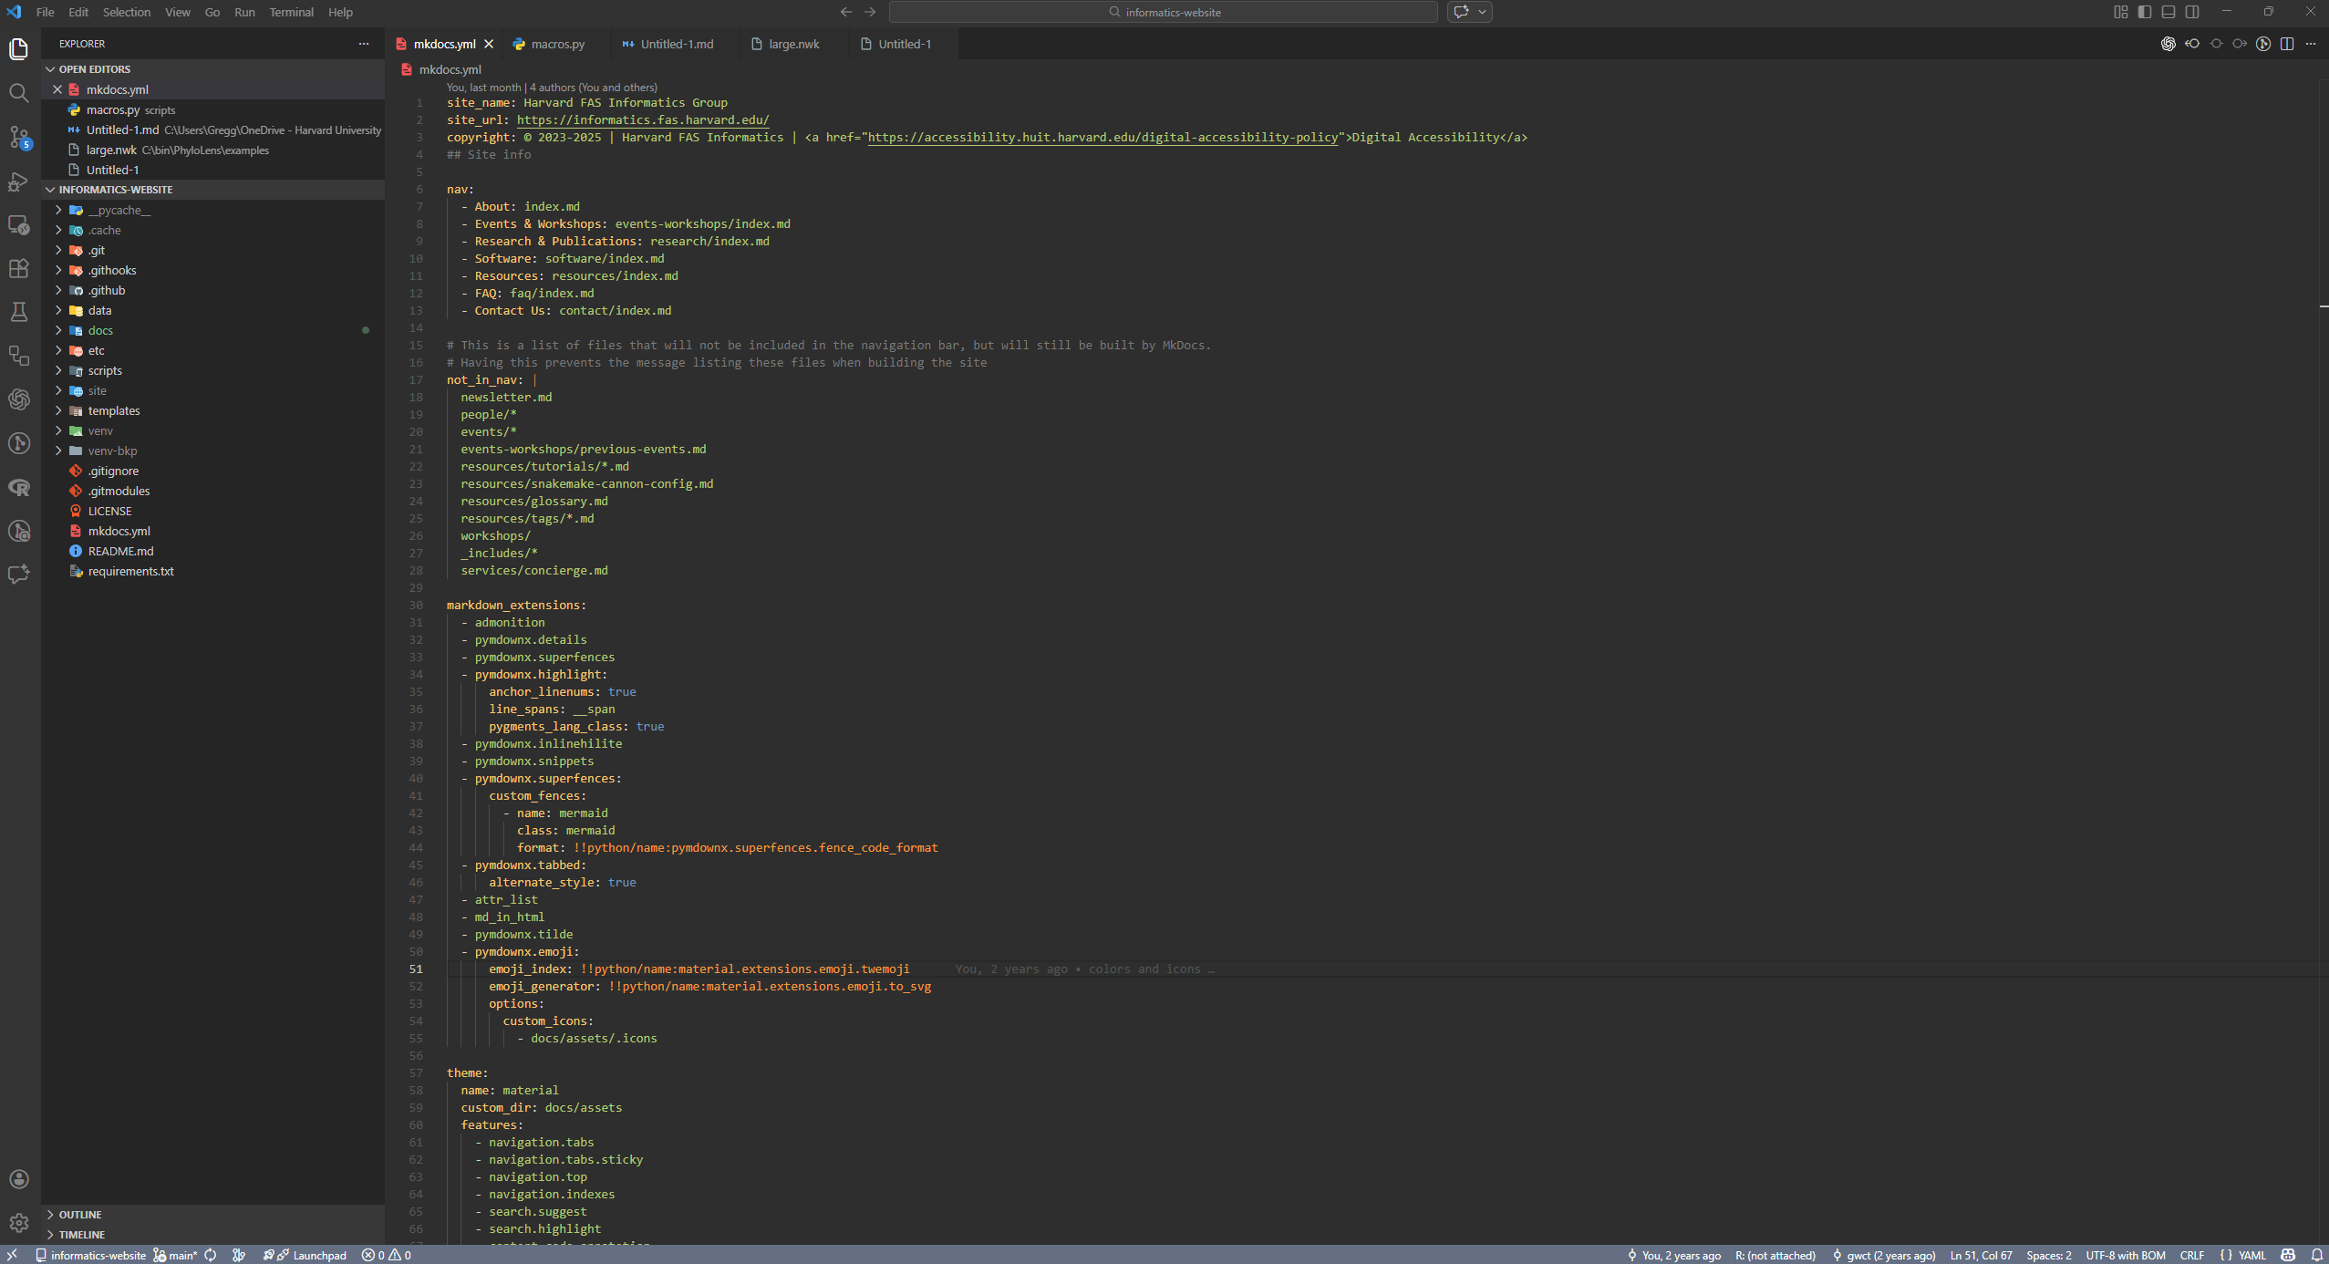
Graphical text editors: VSCode

Slide 40
Graphical text editors: VSCode
How can this be integrated with files on the cluster?

Slide 41
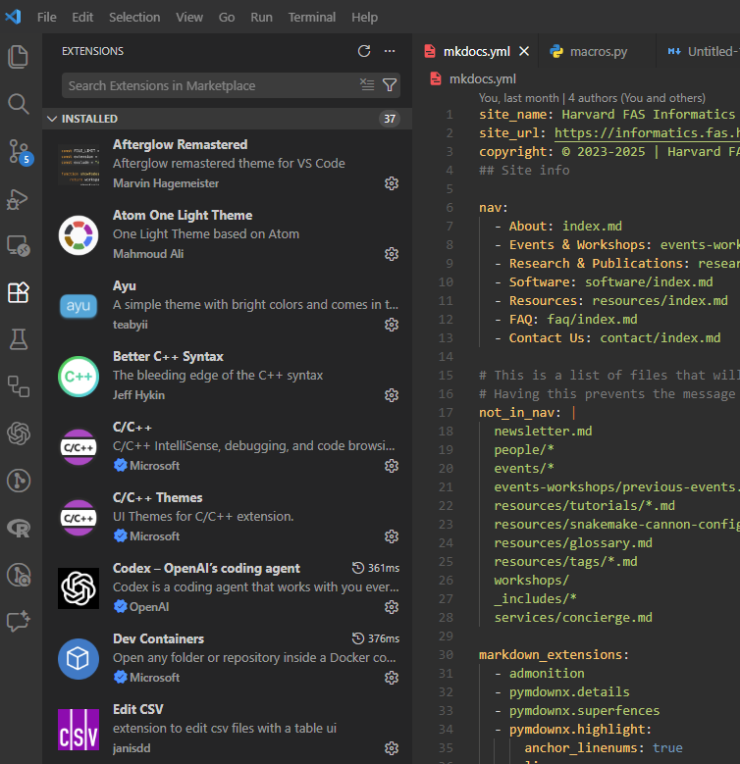
VSCode has many extensions

Slide 42
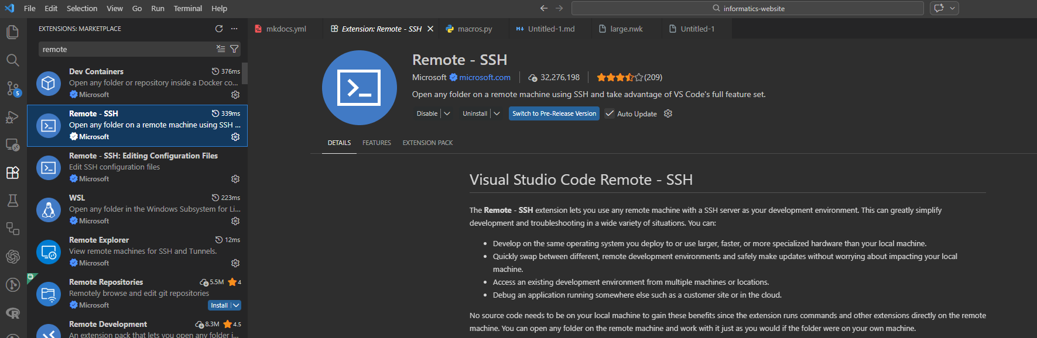
VSCode has many extensions
https://code.visualstudio.com/docs/remote/remote-overview
https://docs.rc.fas.harvard.edu/kb/vscode-remote-development-via-ssh-or-tunnel/

Slide 43
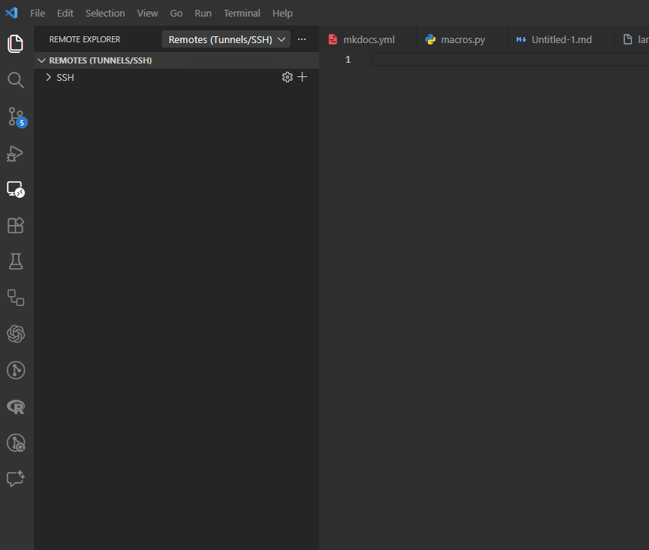
VSCode has many extensions

Slide 44
VSCode has many extensions

Slide 45
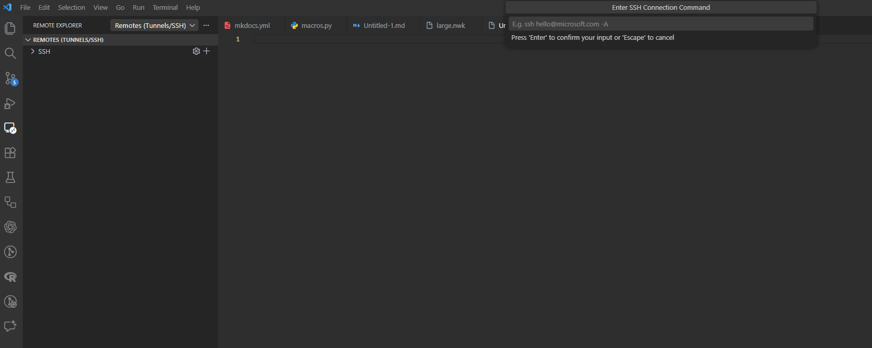
VSCode has many extensions
ssh <username>@login.rc.fas.harvard.edu

Slide 46
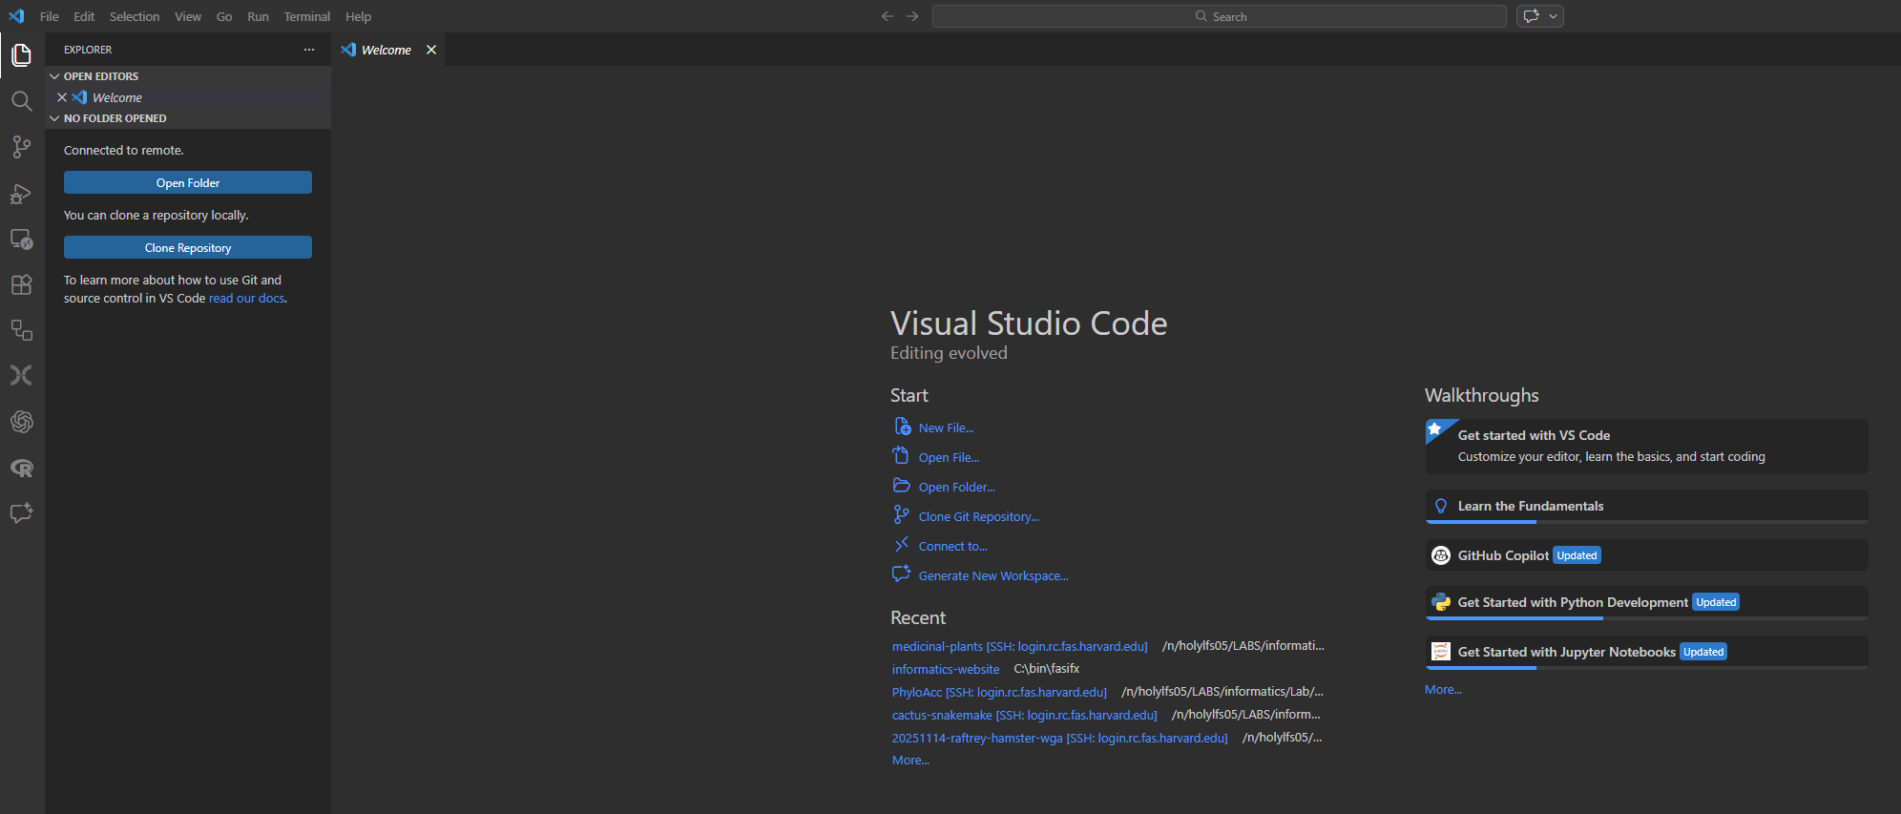
VSCode has many extensions

Slide 47
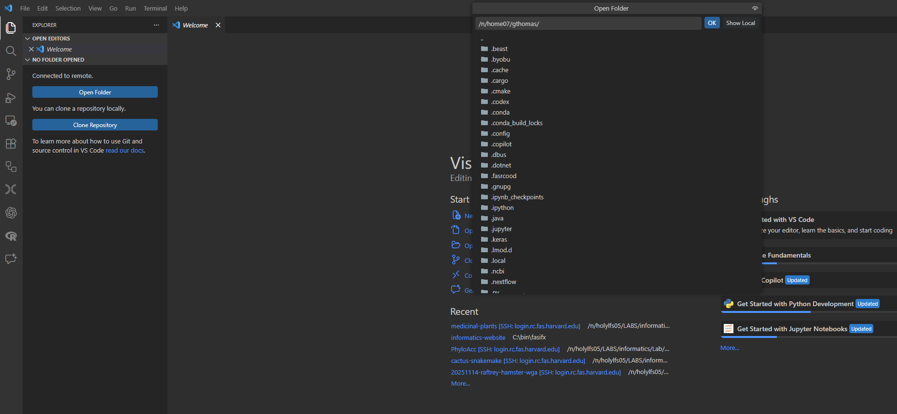
VSCode has many extensions

Slide 48
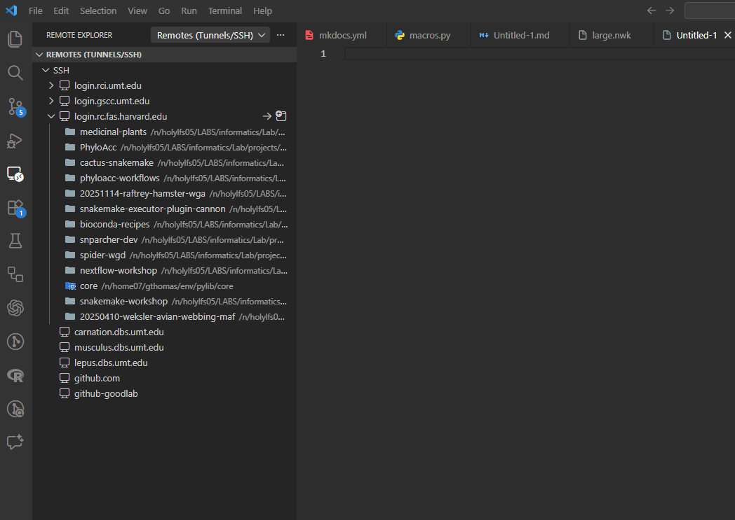
VSCode has many extensions

Slide 49
Useful shell shortcuts
.. | Shortcut to use in paths meaning, “one directory above”. ../ means one directory above the current working directory ../../ means two directories above the current working directory
~ | Many systems use this to mean, “the path to the current user’s home directory”. cd ~ will change directory to your home directory no matter where you are in the filesystem.
cd - | Change to the previous directory no matter where it is.
[tab] | When typing paths for a command, hitting tab will autocomplete file names. cd dir[tab] -> cd directory1 If more than one file matches the substring typed, they will all be displayed for you to keep typing: cd dir[tab] -> directory1 directory2 directory3 -> cd directory3
[up arrow] | Scroll through previous commands.
Ctrl+C | Cancel currently running process.
Select text to copy, right click to paste.
Notes:
Mention command prompt and not to use it

