Slide 1
$ Command line 101: $ Integrating local and cluster environments
$ Harvard FAS Informatics virtual training
$ Thursday, February 5, 2026
$

Slide 2
Topics covered
Running commands on the cluster
Transferring files to and from the cluster
Viewing and editing files on the cluster

Slide 3
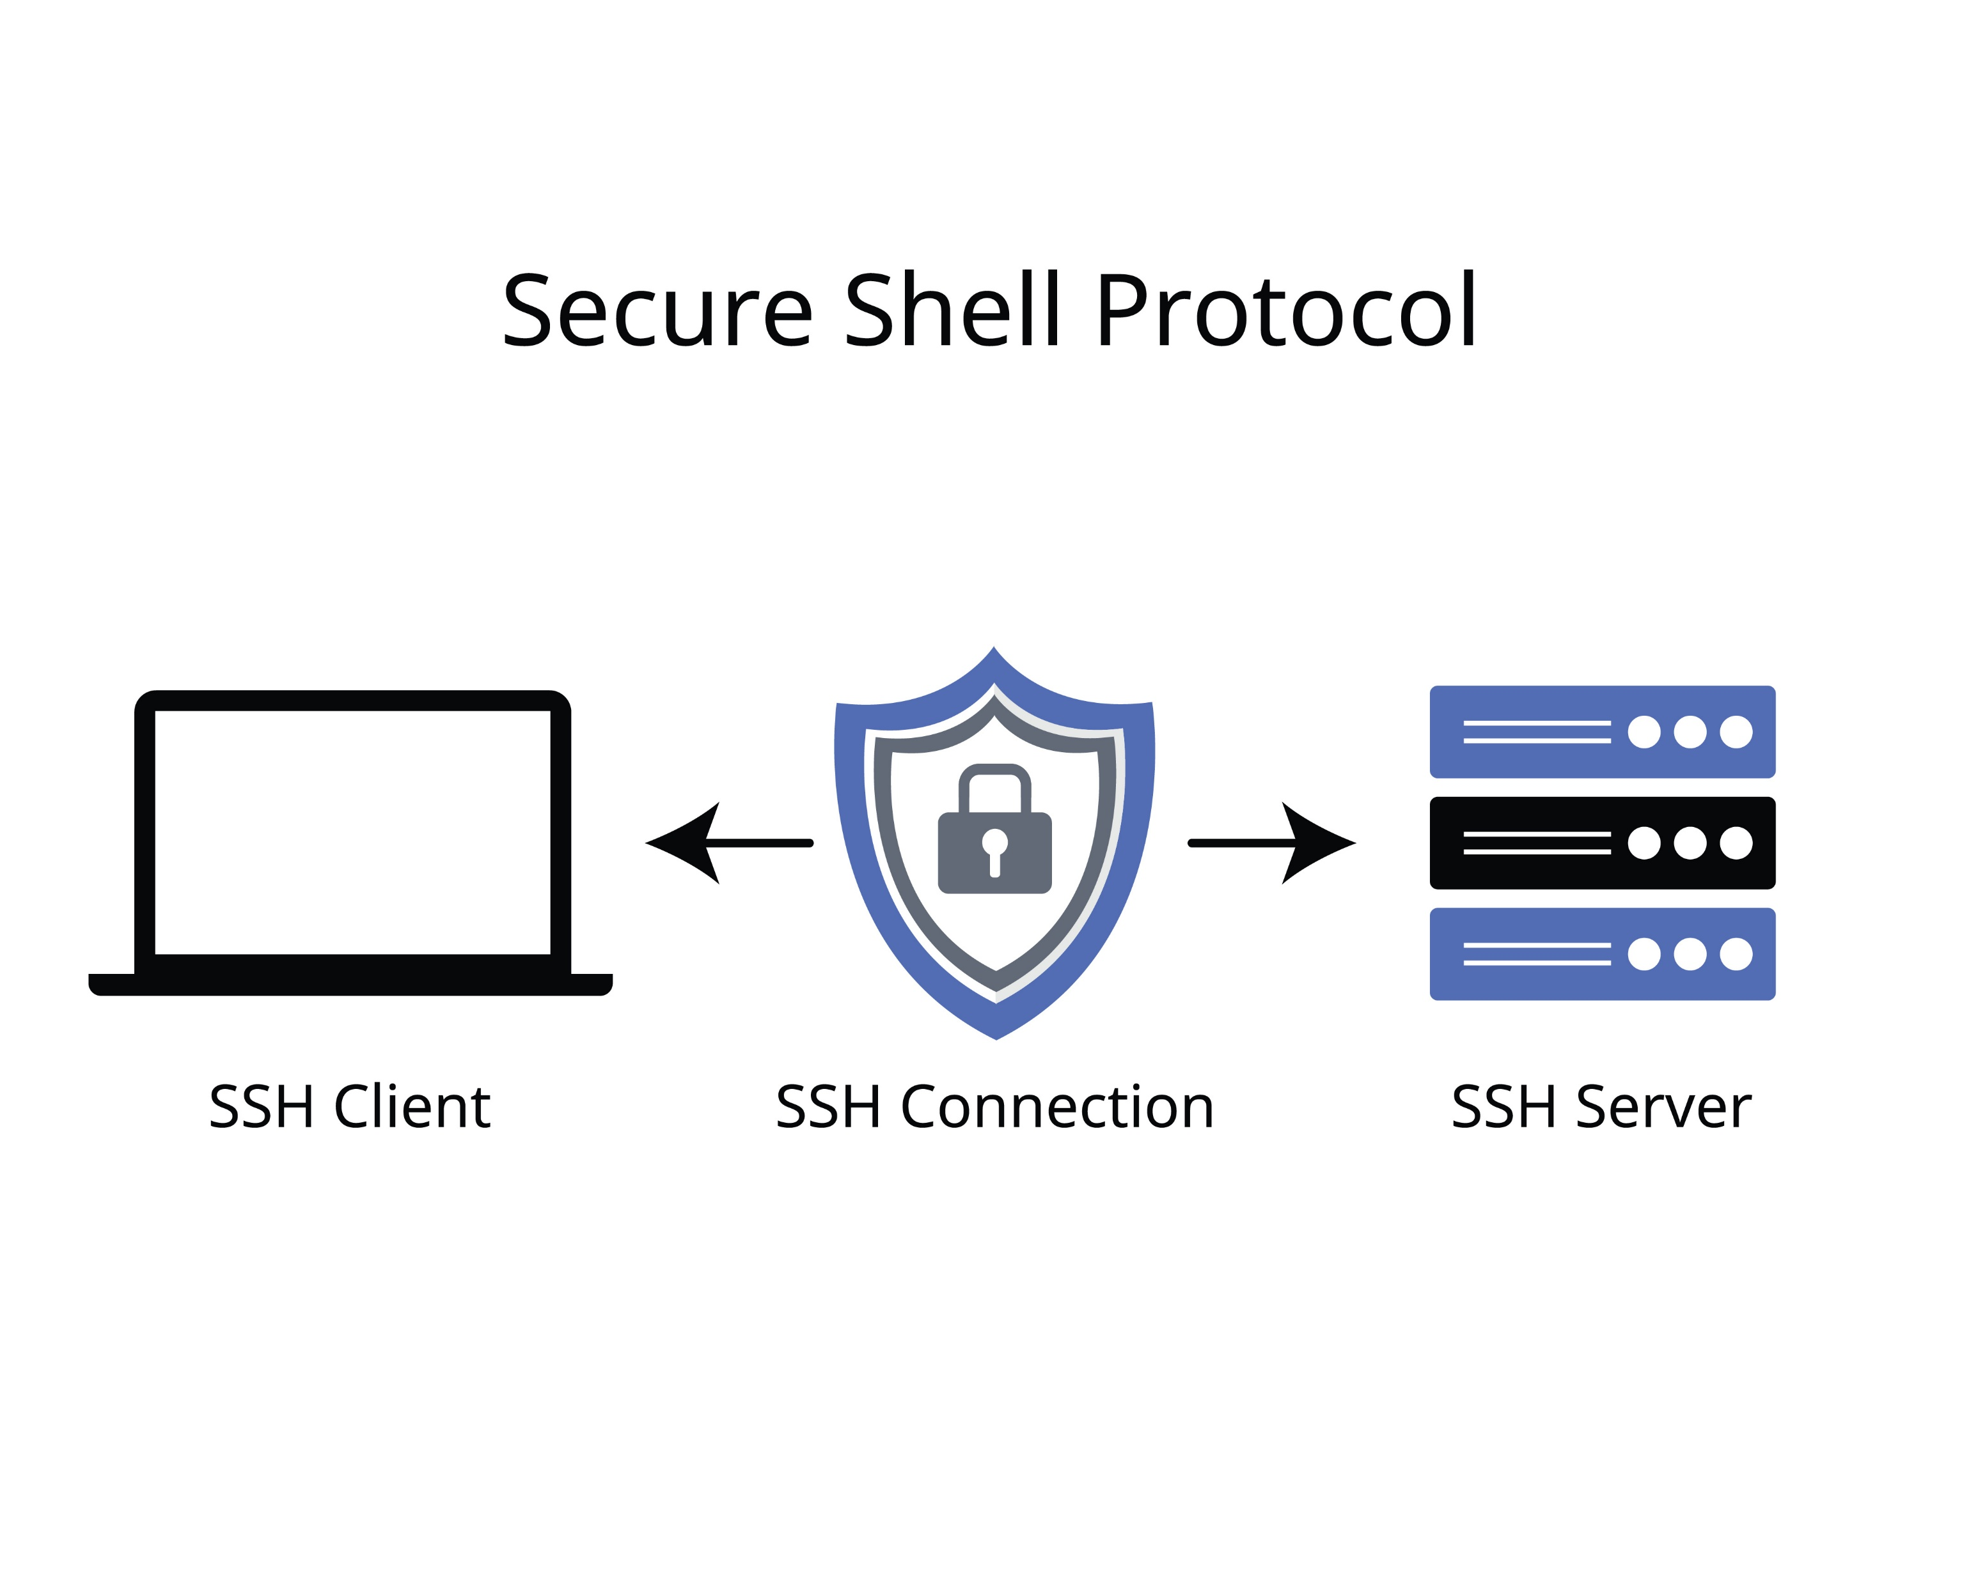
Running commands on the cluster:
Connecting to the cluster with ssh

Slide 4
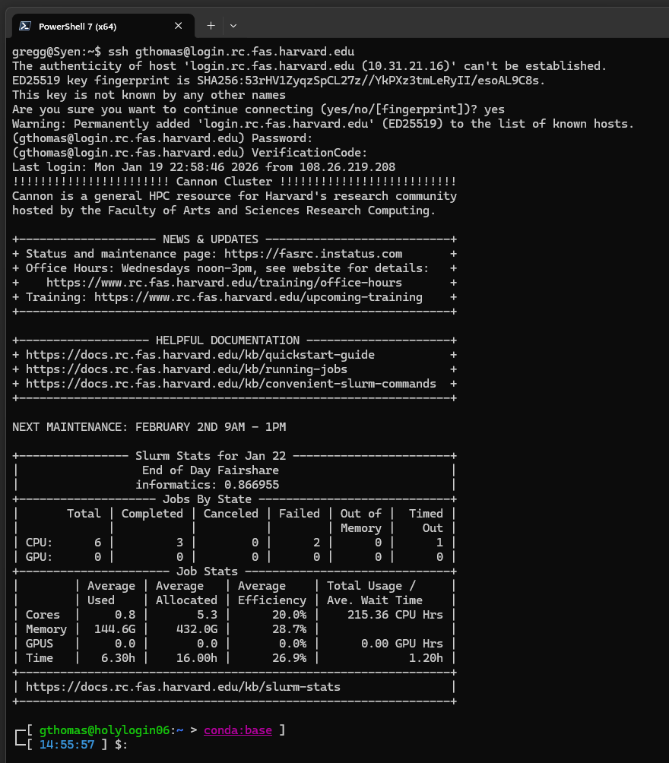


Connecting to a remote computer
Use the ssh command to connect to a remote computer:
ssh <username>@<server name>
The first time you connect (or if the server updates its keys), you will have to trust the server.
For Cannon, you will need your RC password and two-factor code

Slide 5
Connecting to a remote computer
Use the ssh command to connect to a remote computer:
ssh <username>@login.rc.fas.harvard.edu
The first time you connect (or if the server updates its keys), you will have to trust the server.
For Cannon, you will need your RC password and two-factor code

Slide 6
Connecting to a remote computer
Use the ssh command to connect to a remote computer:
ssh <username>@login.rc.fas.harvard.edu
The first time you connect (or if the server updates its keys), you will have to trust the server.
For Cannon, you will need your RC password and two-factor code

Slide 7
Connecting to a remote computer
Use the ssh command to connect to a remote computer:
ssh <username>@login.rc.fas.harvard.edu
The first time you connect (or if the server updates its keys), you will have to trust the server.
For Cannon, you will need your RC password and two-factor code

Slide 8
Connecting to a remote computer
Cannon displays an informative welcome message.

Slide 9
Connecting to a remote computer
Local working directory
(in many shells, ~ is a shortcut for the current user’s home directory)
Local user name
Cannon displays an informative welcome message.
But you will mostly know you are connected to a server by the changes to the prompt
Local computer (host) name
Remote computer (host) name
Remote working directory
(in many shells, ~ is a shortcut for the current user’s home directory)
Remote user name

Slide 10
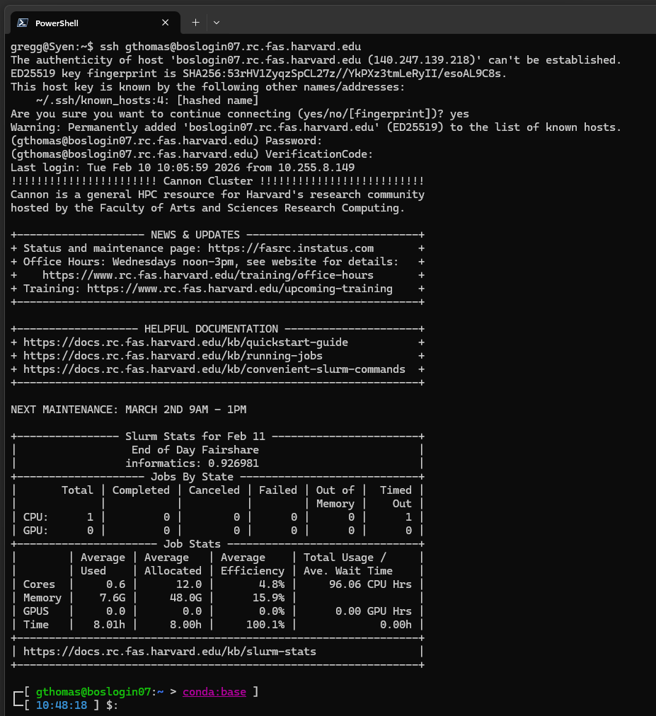
How to connect to a particular login node
Use the ssh command to connect to a remote computer:
ssh <username>@login.rc.fas.harvard.edu
ssh <username>@<login node name>.rc.fas.harvard.edu

Slide 11
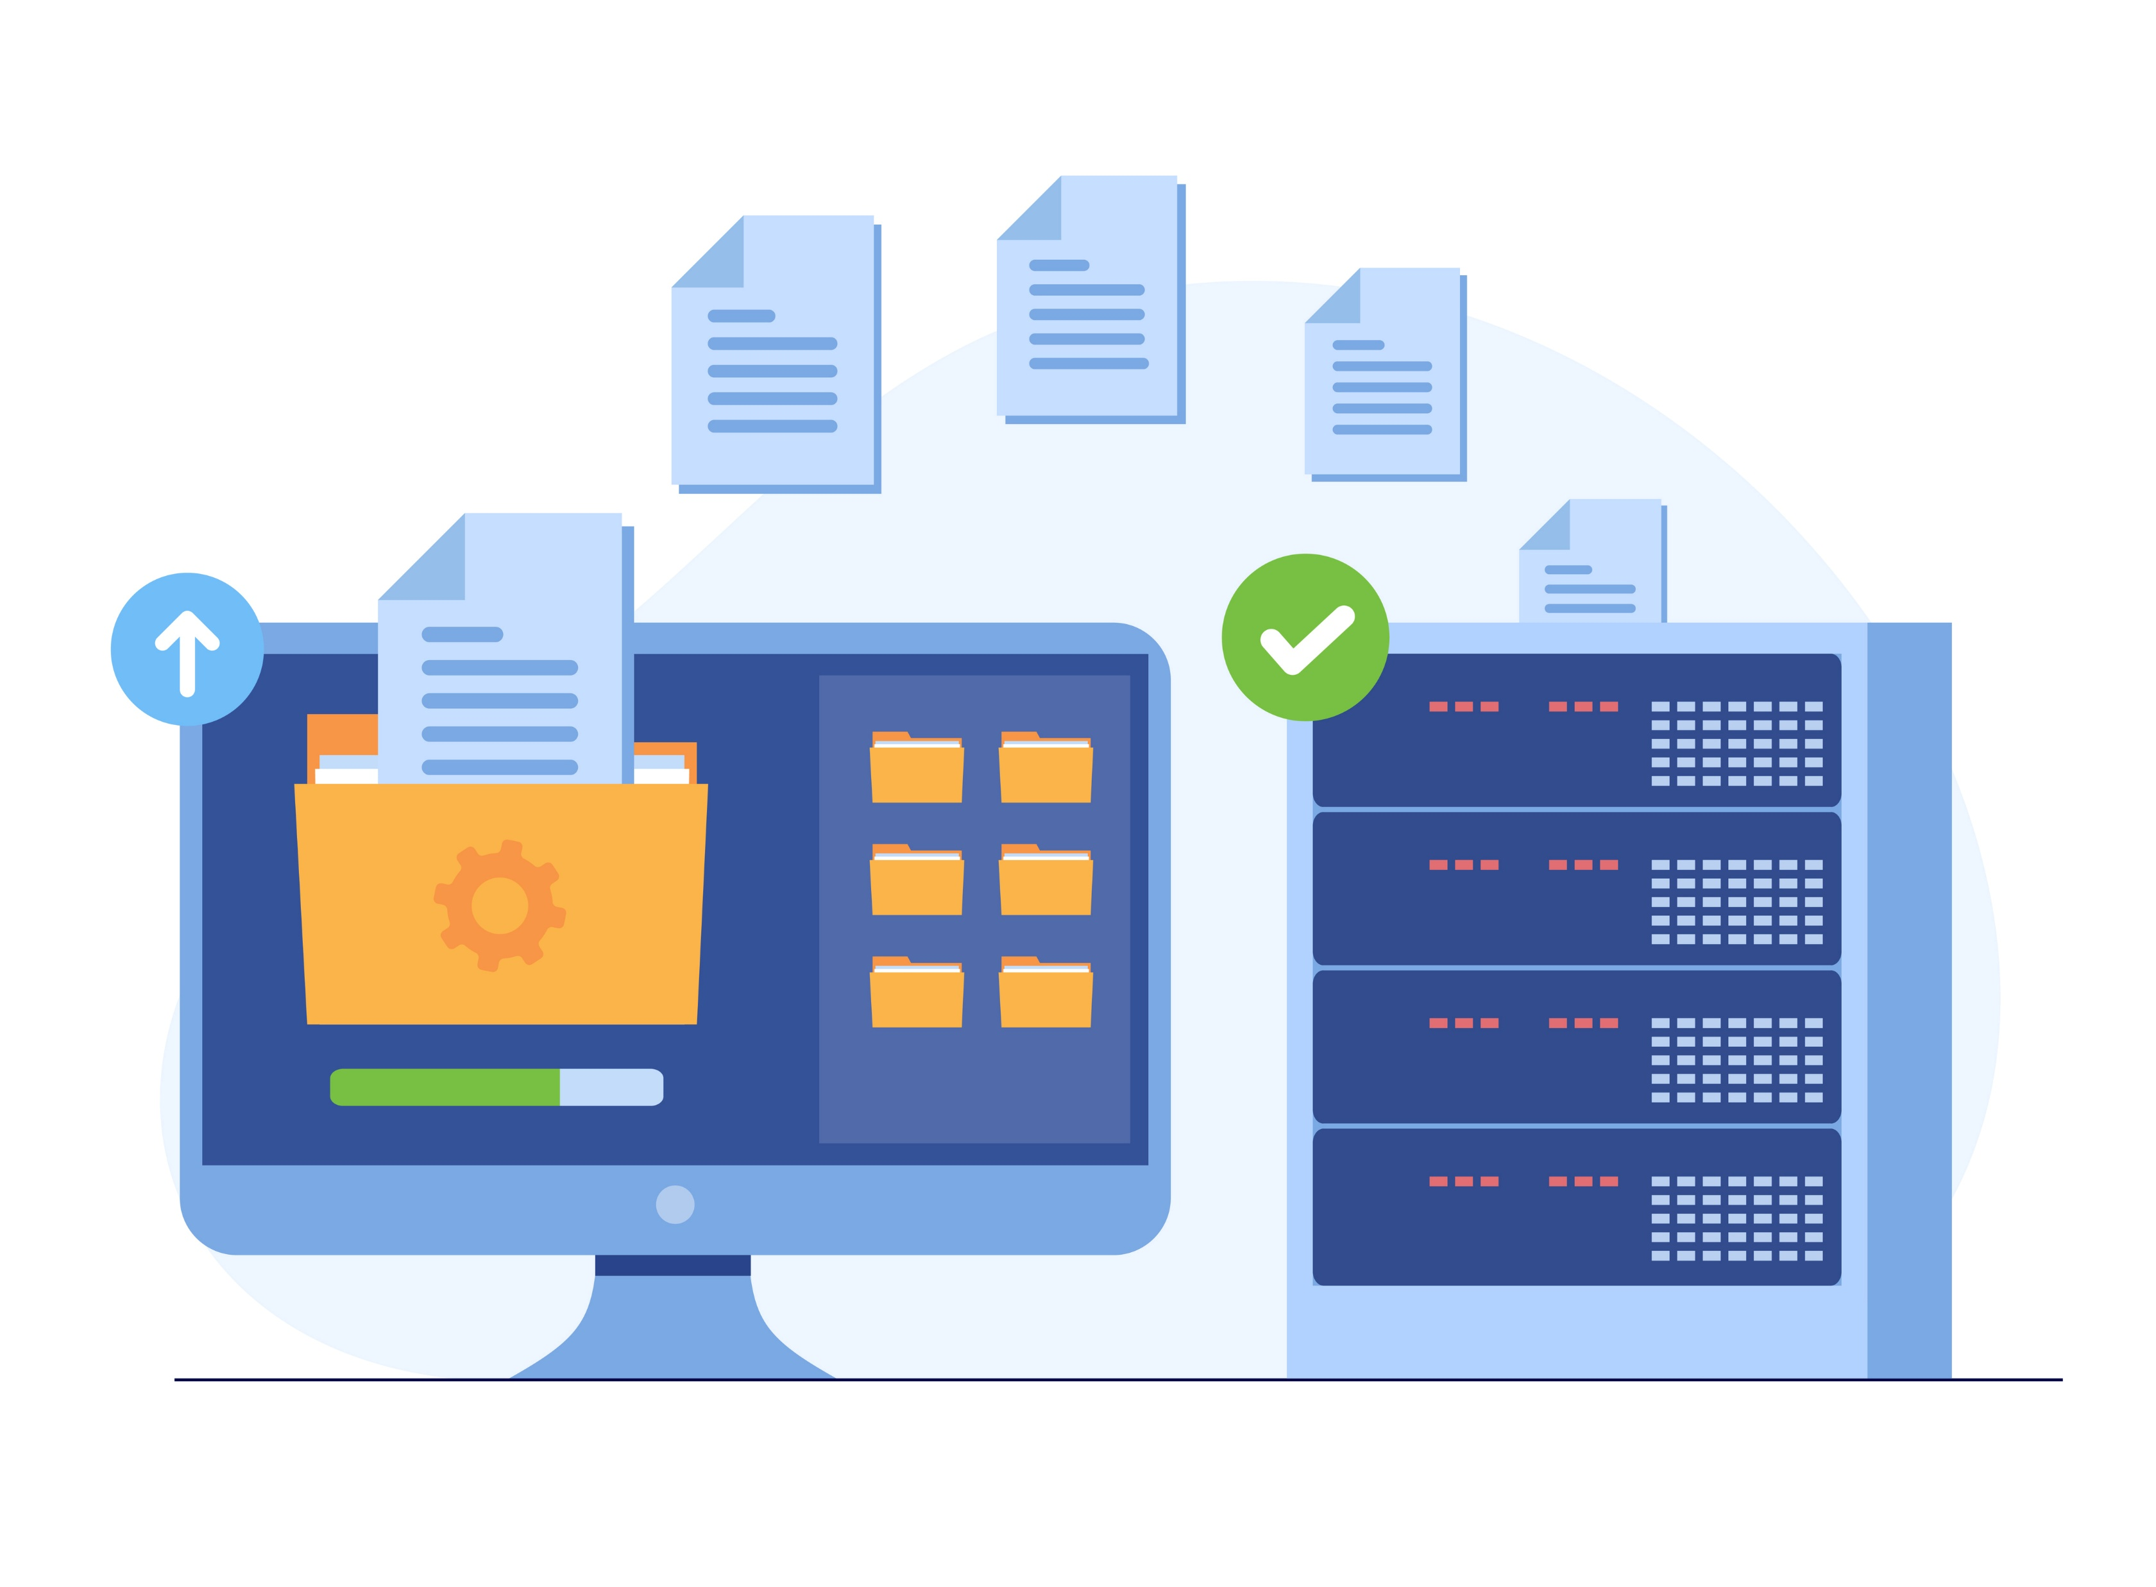
Transferring files to and from the cluster

Slide 12

Cluster file system review
Home directory aka the login node
$HOME
100 GB limit
Should not be used for compute
Scratch
/n/netscratch/pi_lab/
No size limit
90 day retention: files DELETED after 90 days
Used for compute
Lab directory
Path varies
Size limit based on what’s purchased
General storage
$HOME
$SCRATCH
<pi>_lab/
Notes:
Caveats: * We are not covering the structure of the cluster. For that see FAS RC’s getting started guide
We are not covering cold storage
Storage is changing but these general concepts will be the same

Slide 13
Cluster file system review
Home directory aka the login node
$HOME
100 GB limit
Should not be used for compute
Scratch
/n/netscratch/pi_lab/
No size limit
90 day retention: files DELETED after 90 days
Used for compute
Lab directory
Path varies
Size limit based on what’s purchased
General storage
Tape Storage
archival
size limit based on what’s purchased
$HOME
$SCRATCH
<pi>_lab/
Tape
Notes:
Caveats: * We are not covering the structure of the cluster. For that see FAS RC’s getting started guide
We are not covering cold storage
Storage is changing but these general concepts will be the same

Slide 14

Cluster file system review - Permissions
Lab
Only people in your lab can read or write to this folder
Everyone
Everyone on the cluster can read/write to this folder
User
Only specific users can read/write here
Deprecated, don’t use!
In general, you can’t modify/delete/move files created by someone else
<pi>_lab/
Lab/
Everyone/
User/
lei/
projectA
ProjectB
lei
gregg

Slide 15






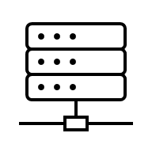

Cluster
netscratch
lab share
tape
computer
dropbox
gdrive
usb
Cloud
lab NAS
Local
Notes:
For all intents and purposes, the Home directory is useless for storing files, so we’re going to collapse that into lab share

Slide 16
Cluster
netscratch
lab share
tape
computer
dropbox
gdrive
usb
Cloud
lab NAS
Local
Notes:
For all intents and purposes, the Home directory is useless for storing files, so we’re going to collapse that into lab share

Slide 17
Cluster
netscratch
lab share
tape
This is what we will be covering
computer
dropbox
gdrive
usb
Cloud
lab NAS
Local
Notes:
For all intents and purposes, the Home directory is useless for storing files, so we’re going to collapse that into lab share

Slide 18
Command line file transfers: screen + rsync
rsync
netscratch
lab share
Notes:
Pros of rsync: won’t duplicate copy files if it already exists at the destination. Can make exact mirrors of a file system (--delete option). You can do a dry run with -n or --dry-run. You can use rsync to transfer between cluster and your local machine, but we won’t go over that because there are better ways.

Slide 19
Command line file transfers: screen + rsync
rsync
netscratch
rsync
lab share
computer
Notes:
Pros of rsync: won’t duplicate copy files if it already exists at the destination. Can make exact mirrors of a file system (--delete option). You can do a dry run with -n or --dry-run. You can use rsync to transfer between cluster and your local machine, but we won’t go over that because there are better ways.

Slide 20
Command line file transfers: screen + rsync
rsync
netscratch
rsync
lab share
Start an interactive session with salloc
Use screen to multitask
Use rsync rather than cp or mv
computer
Notes:
Pros of rsync: won’t duplicate copy files if it already exists at the destination. Can make exact mirrors of a file system (--delete option). You can do a dry run with -n or --dry-run. You can use rsync to transfer between cluster and your local machine, but we won’t go over that because there are better ways.

Slide 21
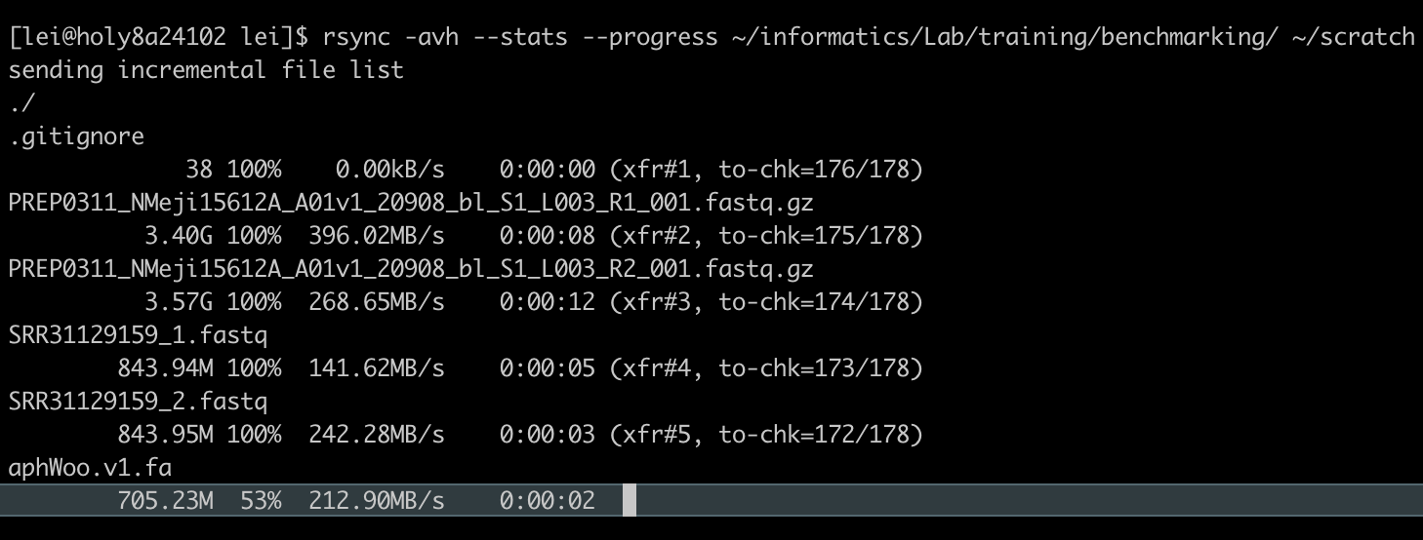
Command line file transfers: screen + rsync
rsync
netscratch
rsync
lab share
Start an interactive session with salloc
Use screen to multitask
Use rsync rather than cp or mv
computer
rsync [OPTIONS] SOURCE DESTINATION
Notes:
Pros of rsync: won’t duplicate copy files if it already exists at the destination. Can make exact mirrors of a file system (--delete option). You can do a dry run with -n or --dry-run. You can use rsync to transfer between cluster and your local machine, but we won’t go over that because there are better ways.

Slide 22
Command line file transfers: screen + rsync
rsync
netscratch
rsync
lab share
Start an interactive session with salloc
Use screen to multitask
Use rsync rather than cp or mv
computer
Helpful options for rsync
rsync [OPTIONS] SOURCE DESTINATION
-a | “archive mode”, produces most exact copy
-v | “verbose”, prints more stuff
-h | “human readable” makes file sizes make sense
--progress | displays progress
--stats | prints stats at the end
Notes:
Pros of rsync: won’t duplicate copy files if it already exists at the destination. Can make exact mirrors of a file system (--delete option). You can do a dry run with -n or --dry-run. You can use rsync to transfer between cluster and your local machine, but we won’t go over that because there are better ways.

Slide 23
Transfer between the cluster and Google Drive: rclone
rclone
rclone
gdrive
lab share
netscratch

Slide 24
Transfer between the cluster and Google Drive: rclone
rclone
rclone
gdrive
lab share
netscratch
Not great for many small files (2 files per second limit)
FASRC Docs
https://docs.rc.fas.harvard.edu/kb/rclone/
Walkthrough to connect to your google drive
https://rclone.org/drive/

Slide 25
Command line file transfer commands summary
cp/mv | Computers must be networked already. Good for small transfers.
rsync [OPTIONS] <SOURCE FILE> <DESTINATION FILE> | Can transfer between networked and non-networked machines.
rclone | Good for longer file transfers, cloning without overwriting, and transferring from cloud services.
scp | Similar to rsync.
sftp | Similar to rsync.
lftp | Similar to rsync.
curl | Similar to rsync.
Notes:
Mention command prompt and not to use it

Slide 26
Graphical file transfer programs:
FTP clients
FTP
computer
lab share
FTP
netscratch

Slide 27
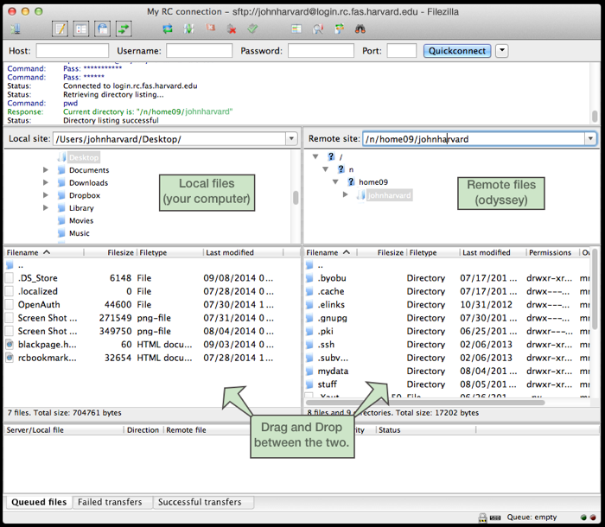

Graphical file transfer programs:
FTP clients
FileZilla
computer
lab share
FileZilla
netscratch
https://filezilla-project.org/

Slide 28
Filezilla
FileZilla
computer
lab share
FileZilla
Secure File Transfer Protocol (SFTP) application
Available on Mac, Windows, and Linux
Instructions to set up on FASRC Docs page
https://docs.rc.fas.harvard.edu/kb/sftp-file-transfer/
netscratch

Slide 29
Filezilla
FileZilla
computer
lab share
FileZilla
Secure File Transfer Protocol (SFTP) application
Available on Mac, Windows, and Linux
Instructions to set up on FASRC Docs page
https://docs.rc.fas.harvard.edu/kb/sftp-file-transfer/
Demo
Open site manager
Connect to login.rc.fas.harvard.edu with SFTP and interactive login type
(optional) choose default remote directory
Limit the number of simultaneous connections to 1
netscratch

Slide 30
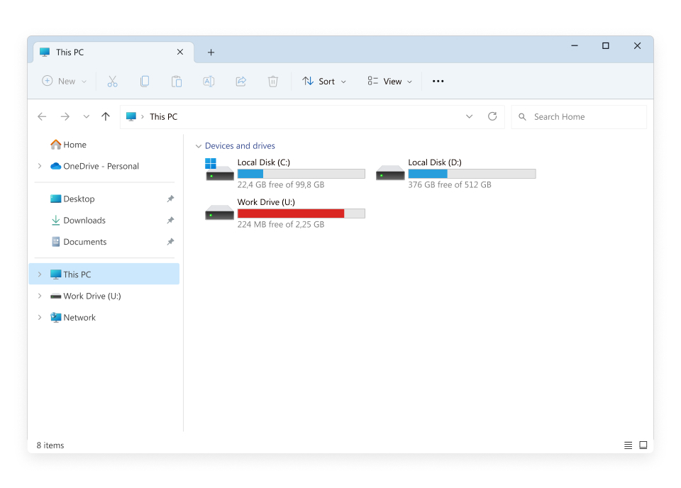
Mounting folders to local computer
Mount
lab share
computer
Most intuitive, but limited potential use: only tier 1 and tier 2 storage is mountable, not tier 0 or scratch
https://docs.rc.fas.harvard.edu/kb/mounting-storage/

Slide 31

Globus file transfer
Globus
netscratch
lab share
(Lab/ folder only)
tape
Globus
Globus
computer

Slide 32
Globus file transfer
All purpose transfer tool
Transfers between clusters and between clusters + your computer
Only way to access tape storage
Great for sharing data with collaborators at other institutions or on other clusters
Globus
netscratch
lab share
(Lab/ folder only)
tape
Globus
Globus
computer

Slide 33
Globus file transfer
All purpose transfer tool
Transfers between clusters and between clusters + your computer
Only way to access tape storage
Great for sharing data with collaborators at other institutions or on other clusters
Globus
netscratch
lab share
(Lab/ folder only)
tape
Globus
Globus
ONLY scratch/ and <pi>_lab/Lab/ folders are available from Cannon
(Permissions issue with Everyone folder)
computer

Slide 34
Globus file transfer
All purpose transfer tool
Transfers between clusters and between clusters + your computer
Only way to access tape storage
Great for sharing data with collaborators at other institutions or on other clusters
Globus
netscratch
lab share
(Lab/ folder only)
tape
Globus
Globus
ONLY scratch/ and <pi>_lab/Lab/ folders are available from Cannon
(Permissions issue with Everyone folder)
computer
Self-paced Globus Training
https://canvas.harvard.edu/courses/157915/pages/globus-overview-2

Slide 35
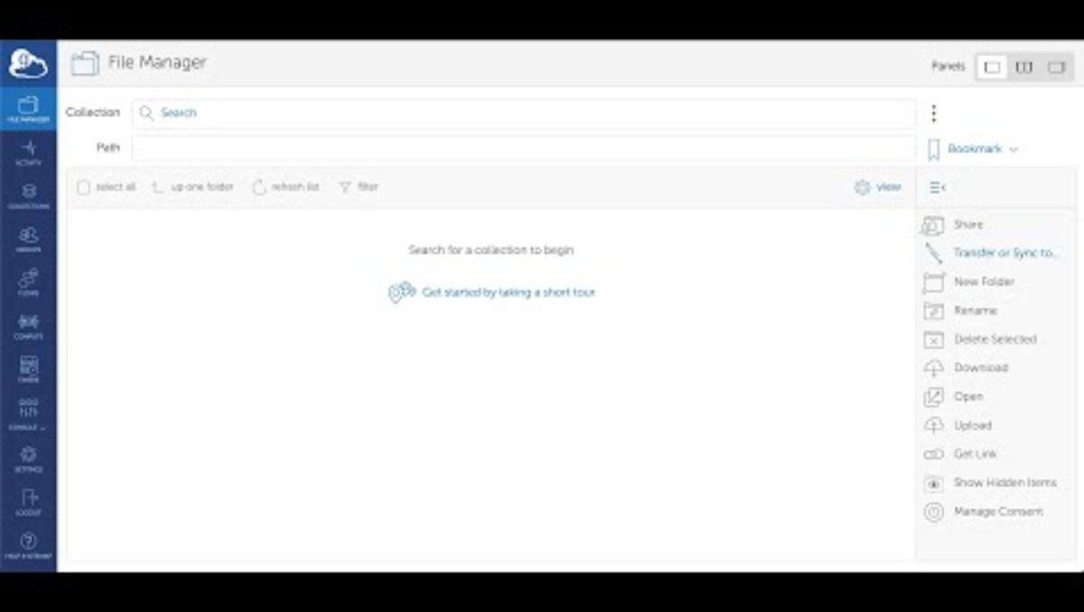
https://www.youtube.com/watch?v=YSOlgZpC9K4

Slide 36
Create globus collections to share data
Demo
Great way to share with collaborates internal and external to Harvard
Collaborators have read-only access so they can copy out but can’t modify
Only shares from the <pi>_lab/Lab/ or <pi>_lab/User/ directory
Self-paced Globus Training
https://canvas.harvard.edu/courses/157915/pages/globus-overview-2

Slide 37
Use globus connect personal to transfer locally
Demo
Download globus connect personal
Log in using your HarvardKey
Choose which folder(s) to share
You can now use Globus to transfer from any other collection to your computer

Slide 38
Globus tips
Bookmark your scratch and lab directory
Set up automatic file sync to back up files
Write down your lab’s Globus protocols
Globus
netscratch
lab share
(Lab/ folder only)
tape
Globus
Globus
computer

Slide 39
Graphical file transfer program summary
FTP clients (FileZilla) | Easy to use, reliable, good for small to large transfers.
Mounting | Intuitive, interfaces directly with OS file system. Difficult to set up?
Globus | Great for large file transfers between remote computers (doesn’t need to use your computer as an intermediary). Great for transferring data to collaborators.
Notes:
Mention command prompt and not to use it

Slide 40
Cluster
cp
rsync
netscratch
lab share
tape
Globus
Mount
FileZilla (FTP)
rsync
Globus
Mount
FileZilla (FTP)
rsync
rclone
computer
dropbox
gdrive
usb
Cloud
lab NAS
Local
Notes:
For all intents and purposes, the Home directory is useless for storing files, so we’re going to collapse that into lab share

Slide 41
Cluster
cp
rsync
Globus
netscratch
lab share
tape
computer
cluster
Globus
Mount
FileZilla (FTP)
rsync
Globus
Mount
FileZilla (FTP)
rsync
Collaborators
rclone
computer
dropbox
gdrive
usb
Cloud
lab NAS
Local
Notes:
For all intents and purposes, the Home directory is useless for storing files, so we’re going to collapse that into lab share

Slide 42

Viewing and editing files on the cluster

Slide 43
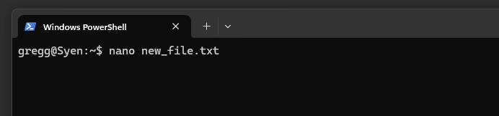
In-terminal text editors and viewers: nano
nano is a command line text-editor invoked by typing:
nano <filename or path>
And then hitting Enter.

Slide 44
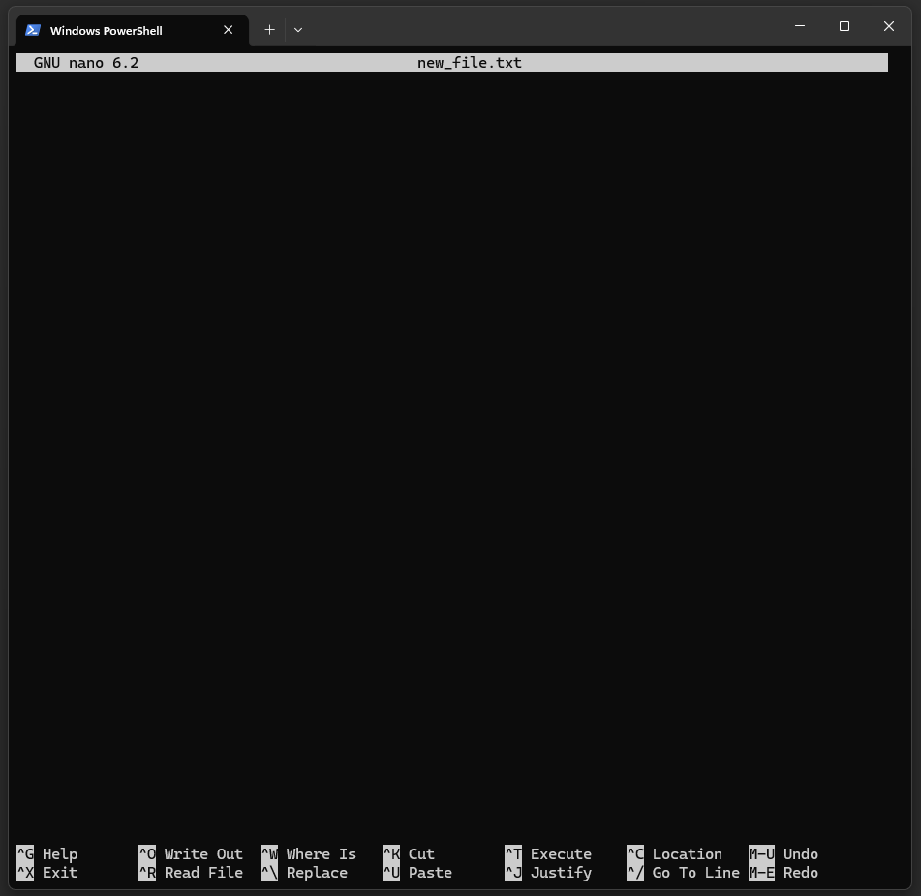
In-terminal text editors and viewers: nano
nano is a command line text-editor invoked by typing:
nano <filename or path>
And then hitting Enter.
This will change the entire terminal interface to the text editor.

Slide 45
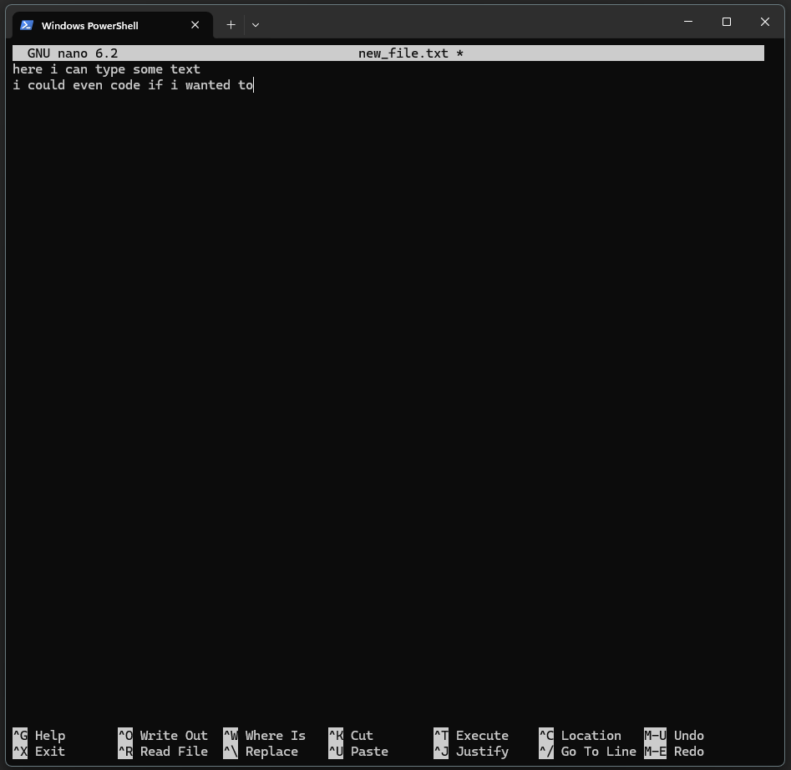
In-terminal text editors and viewers: nano
Within the nano editor, you can enter any text. You could even manually enter formatted text or code!

Slide 46
In-terminal text editors and viewers: nano
Within the nano editor, you can enter any text. You could even manually enter formatted text or code!
Tedious to navigate lines and hard to view large files.
Best for quick and small edits.

Slide 47
In-terminal text editors and viewers: nano
Keyboard commands to move around and perform file operations.
^ means ctrl key

Slide 48
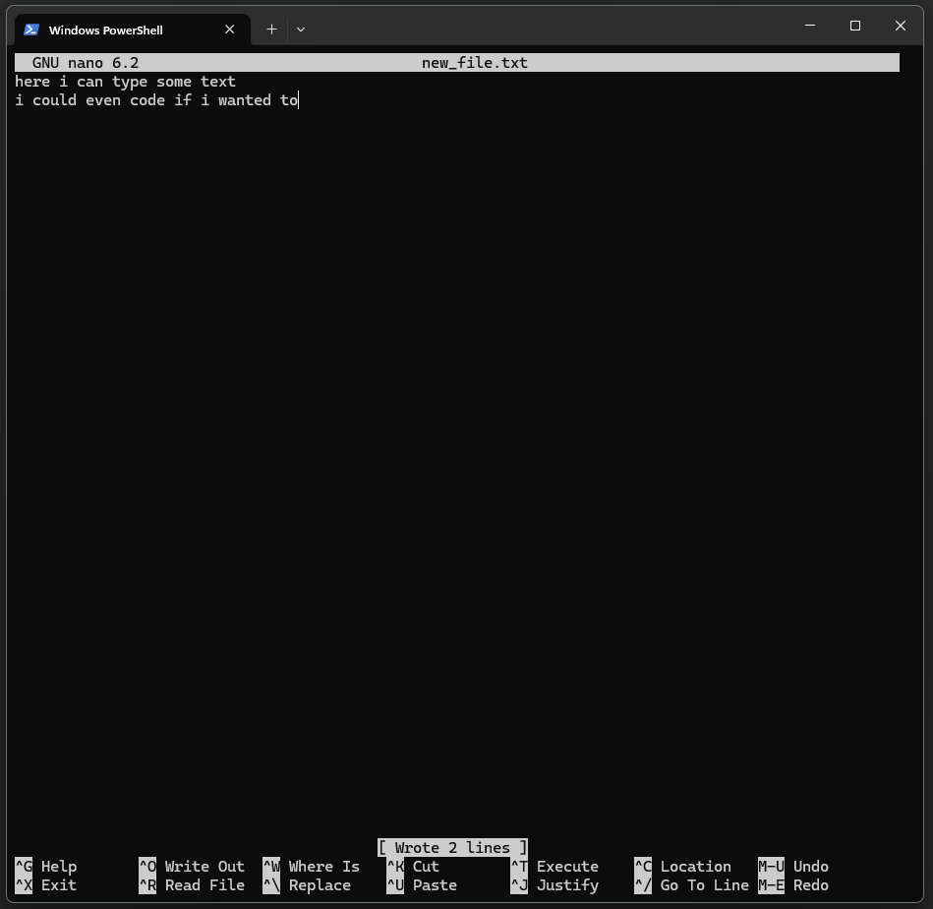
In-terminal text editors and viewers: nano
Common commands
Save file (Write Out): ctrl-W, which brings up dialog to name or re-name file. Hit Enter to keep filename
Exit the nano interface and return to terminal: ctrl X

Slide 49
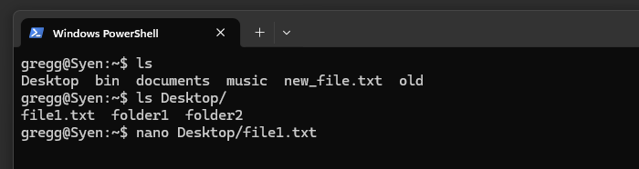
In-terminal text editors and viewers: nano
Open pre-existing files to view/edit their content by providing their path.

Slide 50
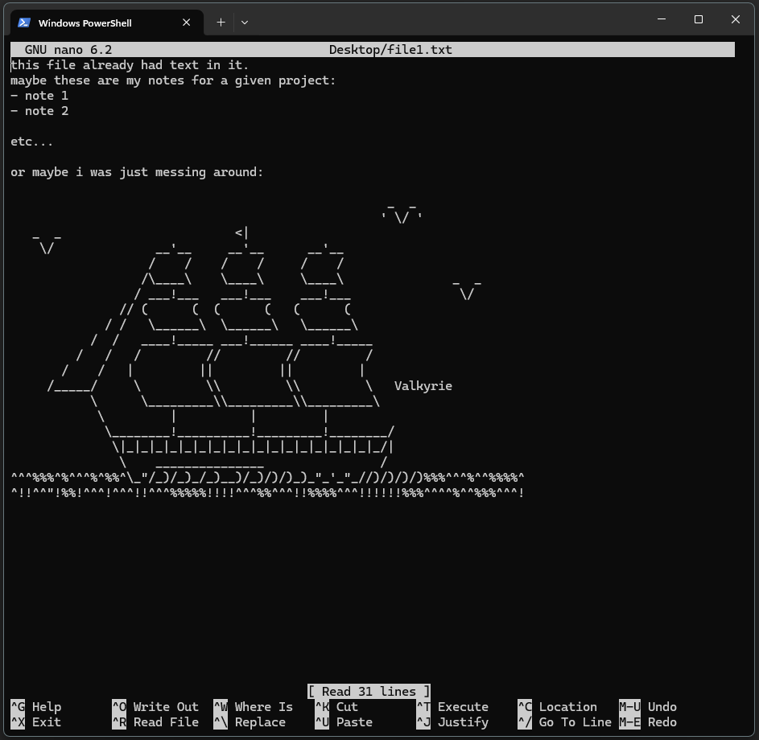
In-terminal text editors and viewers: nano
Open pre-existing files to view/edit their content by providing their path.

Slide 51
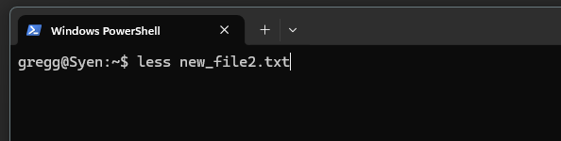
In-terminal text editors and viewers: less
less is a command line text viewer invoked by typing:
less <filename or path>
And then hitting Enter

Slide 52
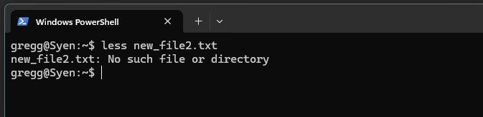
In-terminal text editors and viewers: less
less is a command line text viewer invoked by typing:
less <filename or path>
And then hitting Enter
less cannot be used to create files!

Slide 53
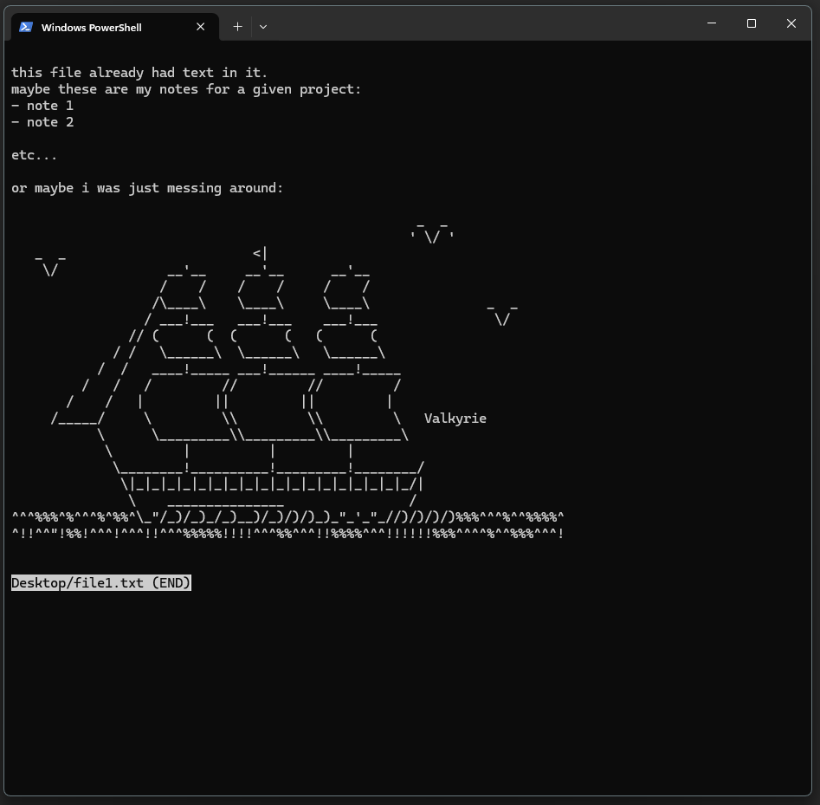
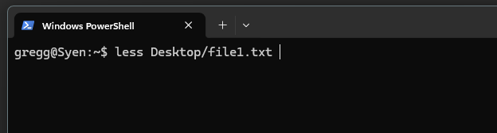
In-terminal text editors and viewers: less
less is a command line text viewer invoked by typing:
less <filename or path>
And then hitting Enter

Slide 54
In-terminal text editors and viewers: less
less does not load the entire file into memory, so it is good for previewing large files.

Slide 55
In-terminal text editors and viewers: less
Navigation
Up/down arrows: move up and down 1 line
<space>: move down one page
<b>: move up (back) one page
<q>: exit the viewer

Slide 56
In-terminal text editors and viewers: less
Tip: use the -S option to disable line wrapping:
less -S <file name or path>
Navigation
Up/down arrows: move up and down 1 line
<space>: move down one page
<b>: move up (back) one page
<q>: exit the viewer

Slide 57
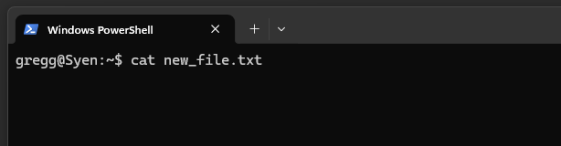
Printing a file to the terminal: cat
cat (short for concatenate) displays file contents on the screen

Slide 58
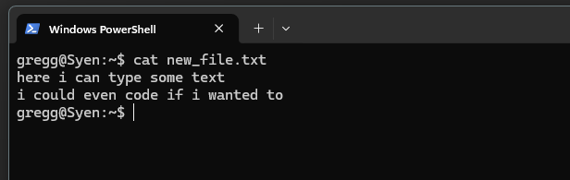
Printing a file to the terminal: cat
cat (short for concatenate) displays file contents on the screen

Slide 59
Printing a file to the terminal: cat
cat (short for concatenate) displays file contents on the screen
Best for small files!

Slide 60
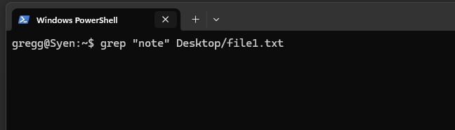
Finding text in a file: grep
grep reads a file line-by-line and searches for a provided pattern, displaying lines that contain matches to the pattern

Slide 61
Finding text in a file: grep
The string or pattern to search for
The file to search
The call to grep
grep reads a file line-by-line and searches for a provided pattern, displaying lines that contain matches to the pattern

Slide 62
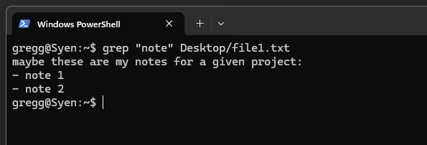
Finding text in a file: grep
The string or pattern to search for
The file to search
The call to grep
grep reads a file line-by-line and searches for a provided pattern, displaying lines that contain matches to the pattern

Slide 63
Viewing and editing text from the terminal
touch <filename/path> | Command to create empty file at <filename/path>. Will simply change modified timestamp on existing files.
nano <filename/path> | Very basic text editor. Opens <filename/path> for editing. Can be used to create and manipulate files.
less <filename/path> | Very basic text viewer. Opens <filename/path> for viewing. Cannot create files. Good to preview large files because it doesn’t load the whole file into memory.
cat <filename/path> | Print the contents of <filename/path> to the screen. Good for short files since you are limited by screen size and scrolling.
grep <pattern> <filename/path> | Search for <pattern> within <filename/path>. Display any lines in the file that contain <pattern>.
vim and emacs | More advanced in-terminal text editors.
Notes:
Mention command prompt and not to use it

Slide 64
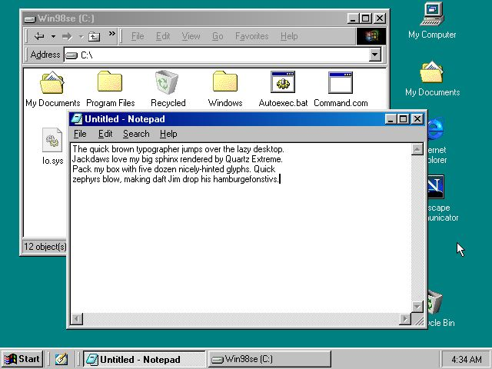
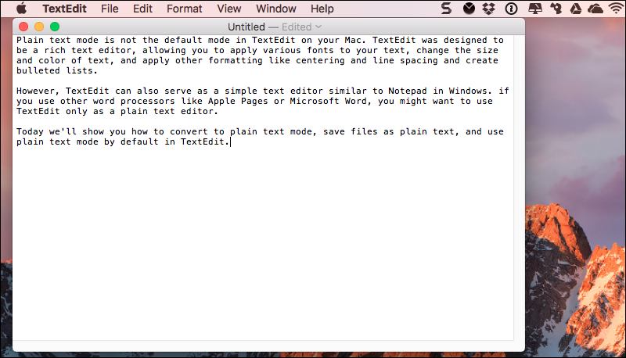
Graphical text editors

Slide 65
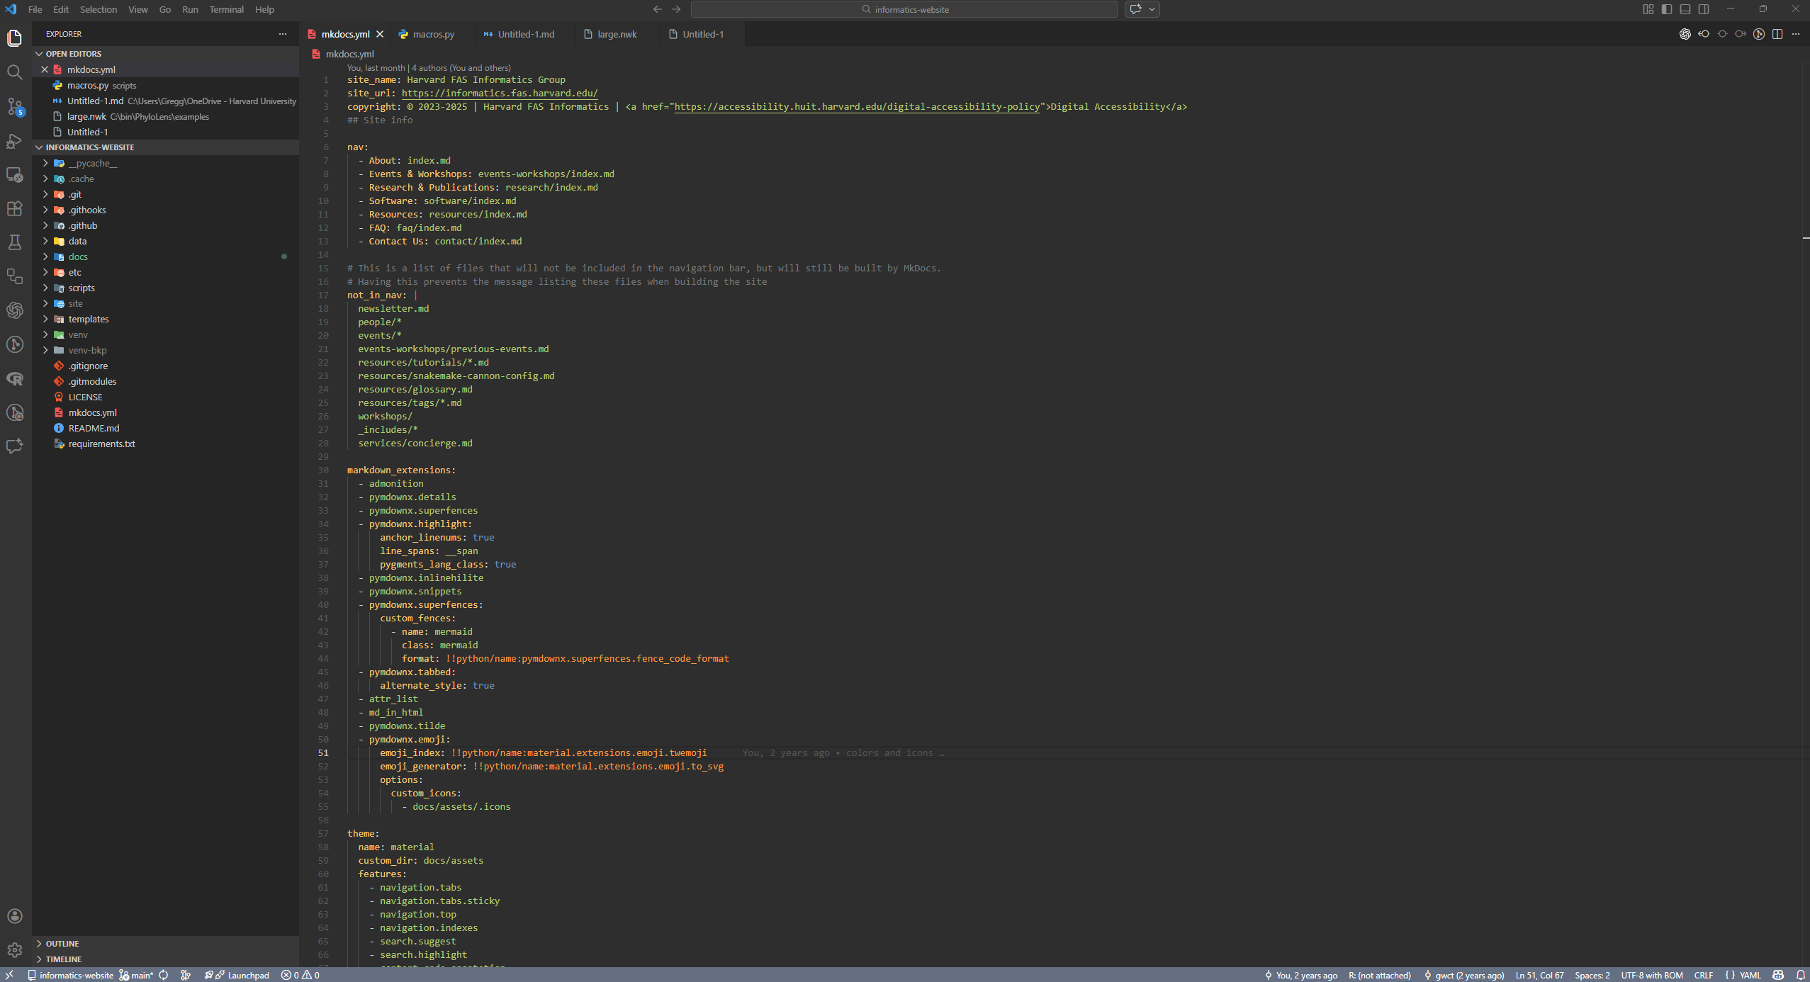
Graphical text editors: VSCode
https://code.visualstudio.com/download

Slide 66
Graphical text editors: VSCode
How can this be integrated with files on the cluster?
https://code.visualstudio.com/download

Slide 67
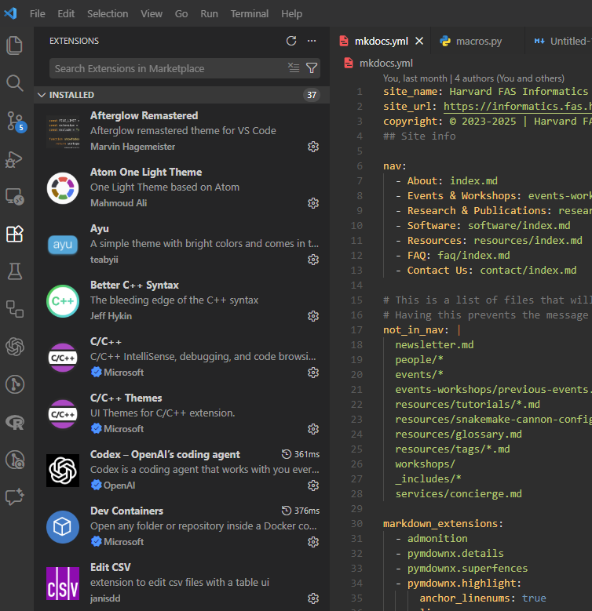
VSCode has many extensions
VSCode can be a simple, light-weight text editor

Slide 68
VSCode has many extensions
VSCode can be a simple, light-weight text editor
But it is also highly customizable, with extensions that allow it to act like a full fledged IDE across many languages

Slide 69
VSCode has many extensions
VSCode can be a simple, light-weight text editor
But it is also highly customizable, with extensions that allow it to act like a full fledged IDE across many languages
Anyone can write an extension!
Make sure you trust the publisher before installing.

Slide 70
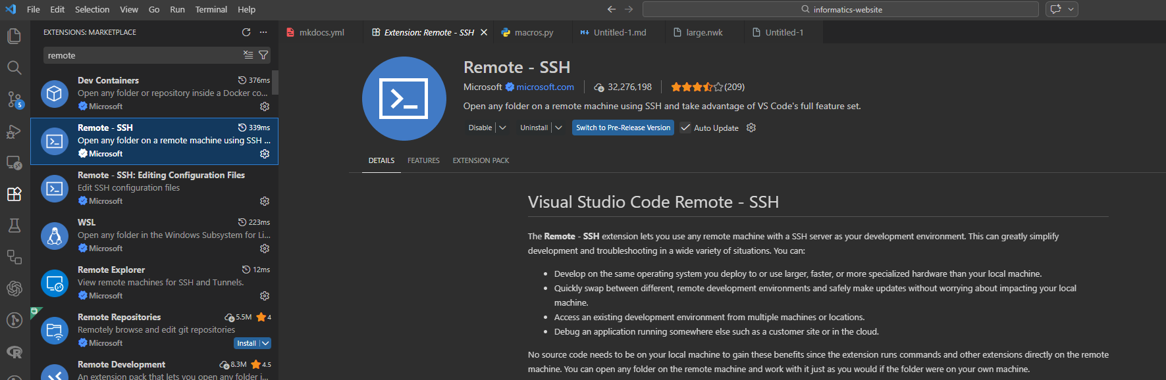
The Remote – SSH extension allows you to connect to a server
https://code.visualstudio.com/docs/remote/remote-overview
https://docs.rc.fas.harvard.edu/kb/vscode-remote-development-via-ssh-or-tunnel/

Slide 71
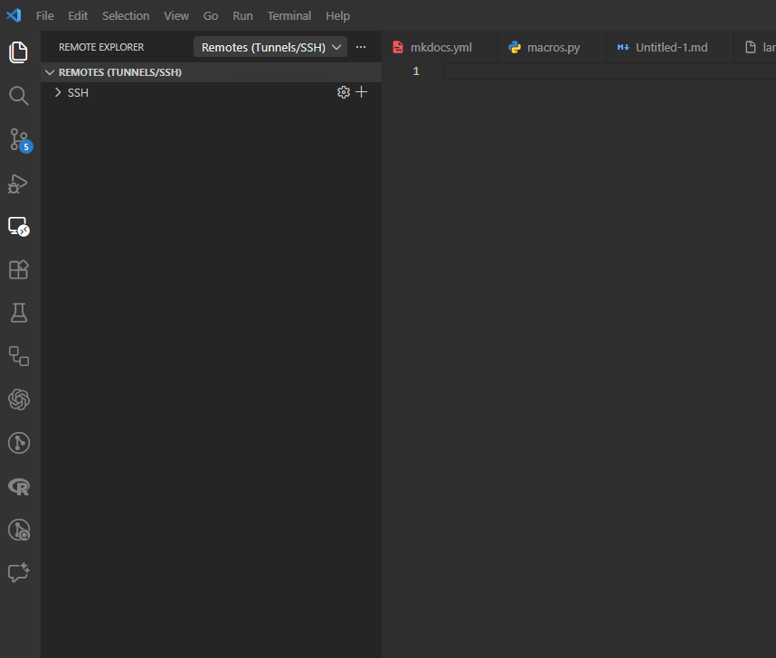
The Remote – SSH extension allows you to connect to a server
Once the extension is installed, an icon will appear on the left-side toolbar

Slide 72
VSCode has many extensions
Once the extension is installed, an icon will appear on the left-side toolbar
Connect to a server by clicking the + icon in the Remote Explorer

Slide 73
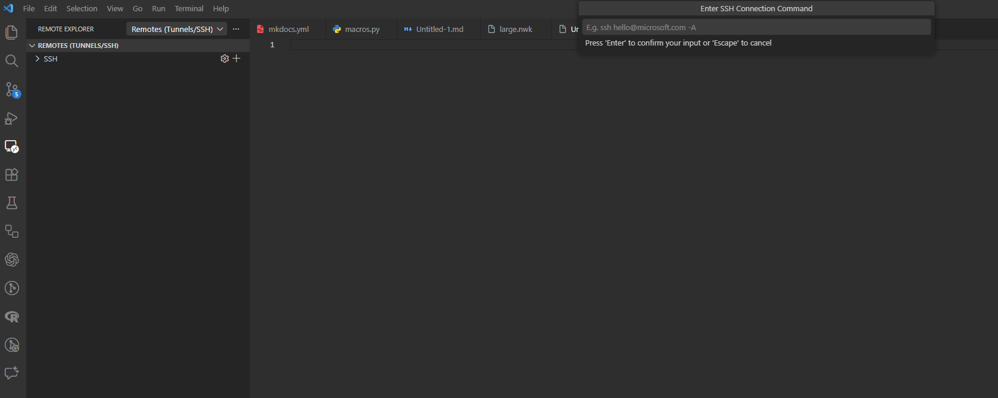
In the login dialog, use the same command you would use to ssh to the cluster from the terminal, followed by your two-factor code
ssh <username>@login.rc.fas.harvard.edu

Slide 74
In the login dialog, use the same command you would use to ssh to the cluster from the terminal, followed by your two-factor code
If you have trouble with this login pop-up menu, enable the following setting:
Always Show Login Terminal: remote.SSH.showLoginTerminal
ssh <username>@login.rc.fas.harvard.edu

Slide 75
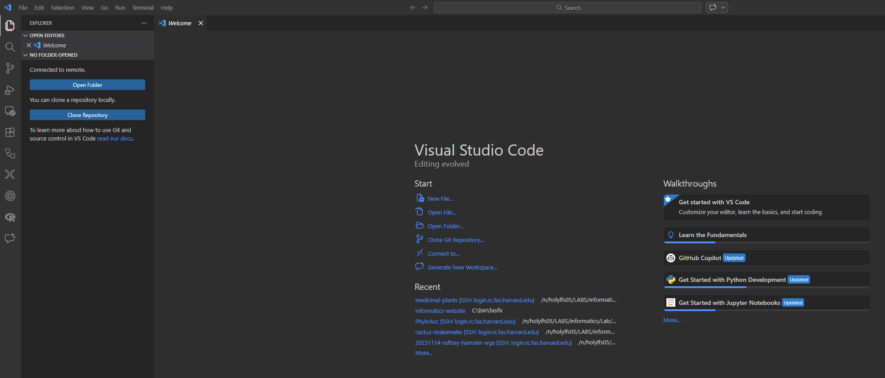
Once logged in, click on the file browser icon in the left-side toolbar

Slide 76
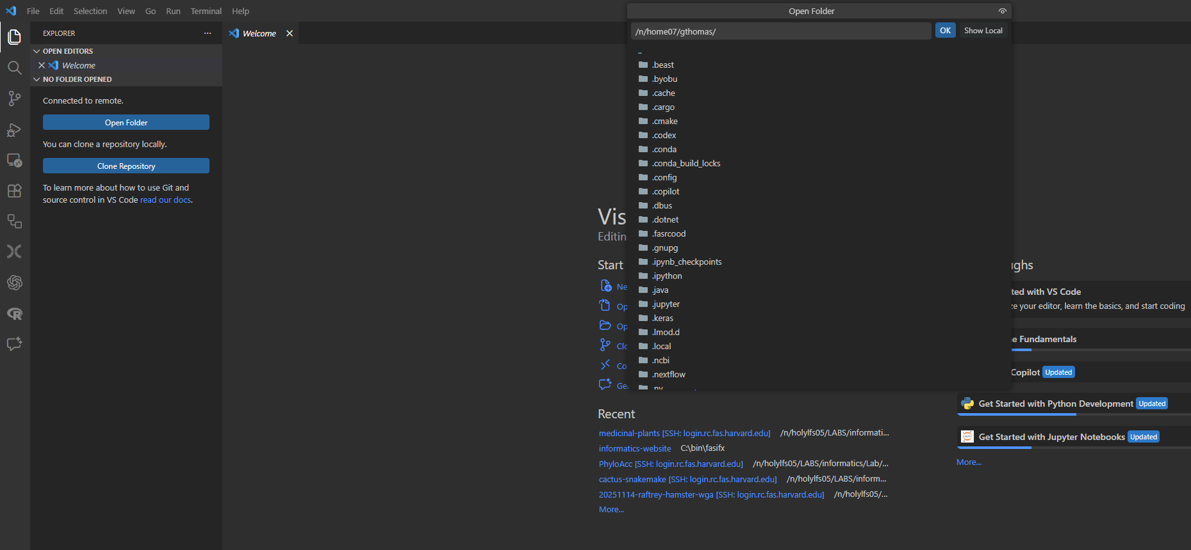
Select or type the path to a folder to open

Slide 77
Select or type the path to a folder to open
You may be asked to enter your credentials again after selecting a folder

Slide 78
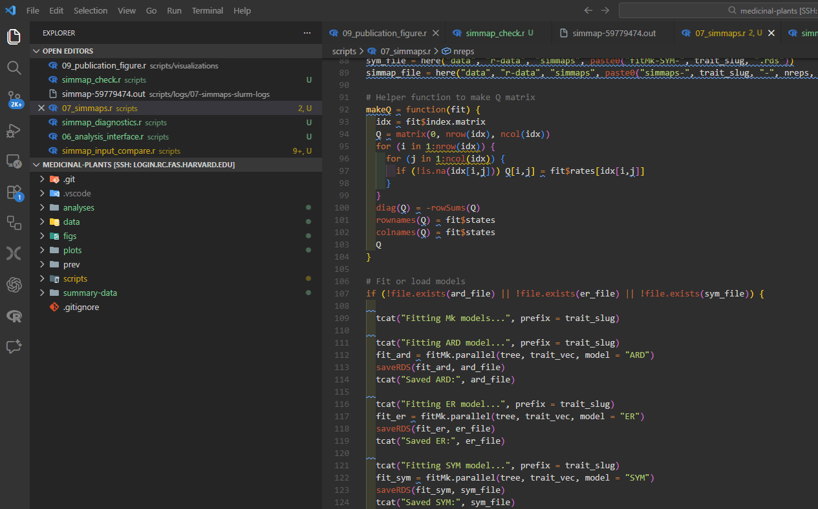
Your file browser should now show the contents of your selected folder
Open and edit files directly in VSCode

Slide 79
Your file browser should now show the contents of your selected folder
Open and edit files directly in VSCode
Edits are synced to the cluster instantly upon saving

Slide 80
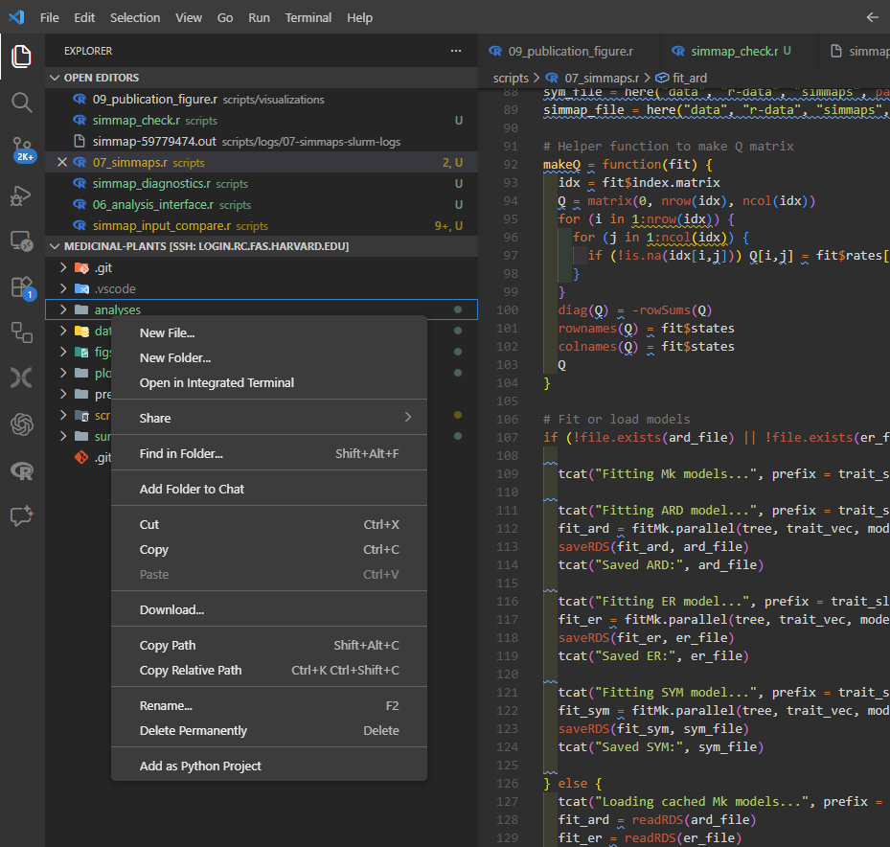
Your file browser should now show the contents of your selected folder
Open and edit files directly in VSCode
Edits are synced to the cluster instantly upon saving
Basic file manipulation with right-click context menu

Slide 81
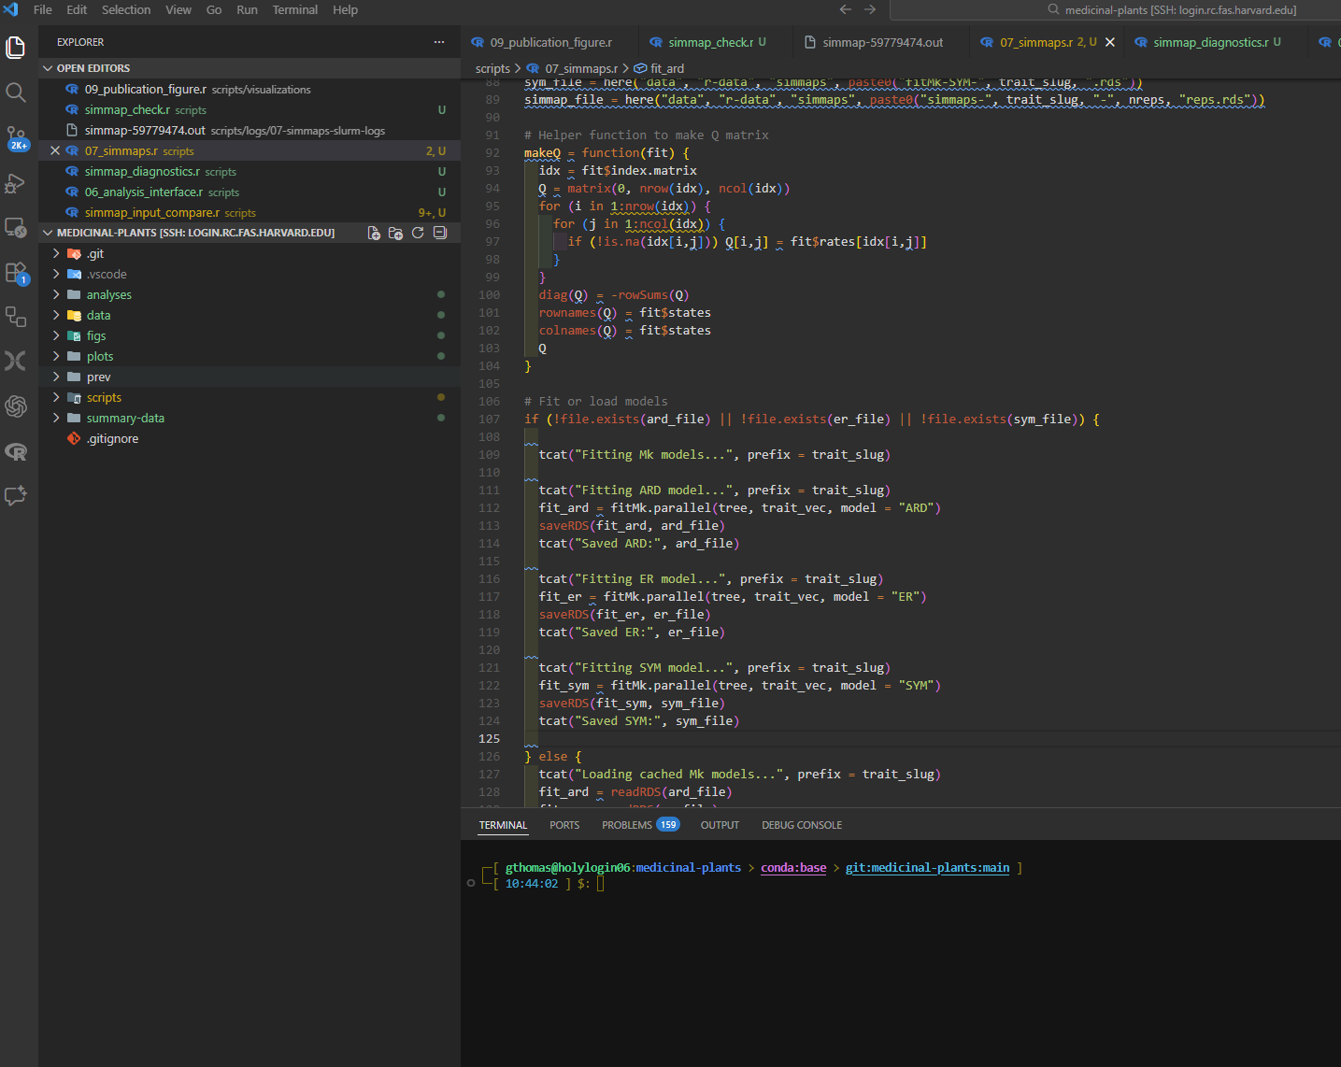
The ctrl-` shortcut also opens a terminal directly in VSCode’s interface!

Slide 82
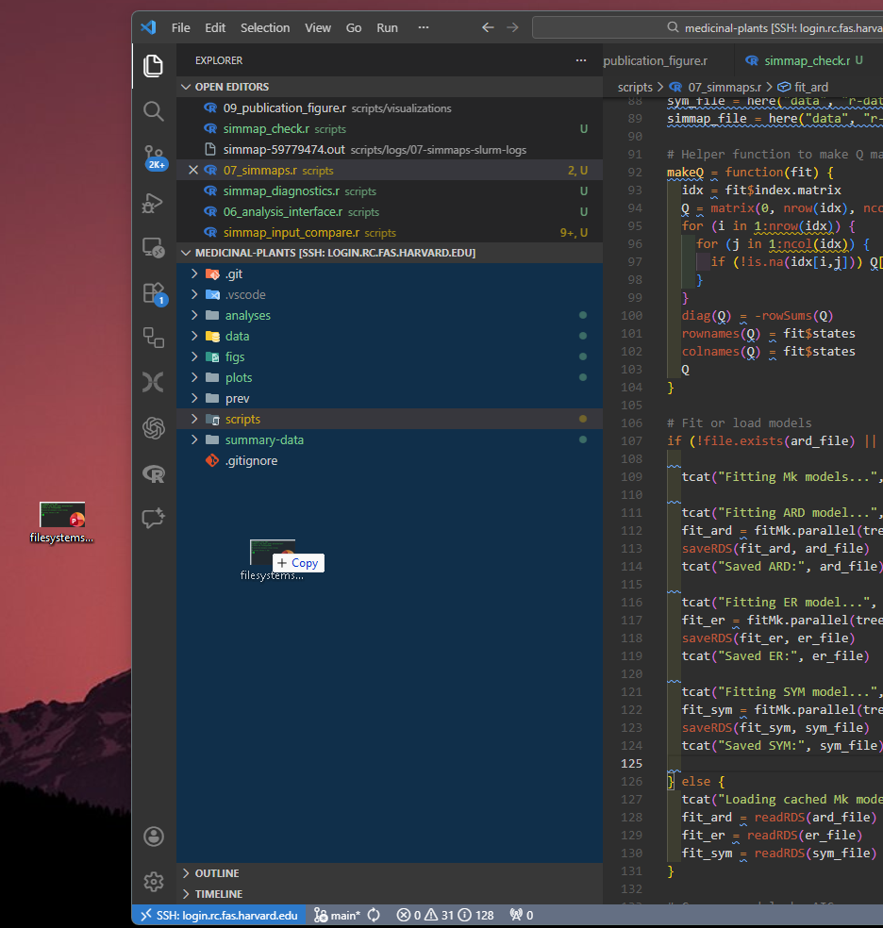
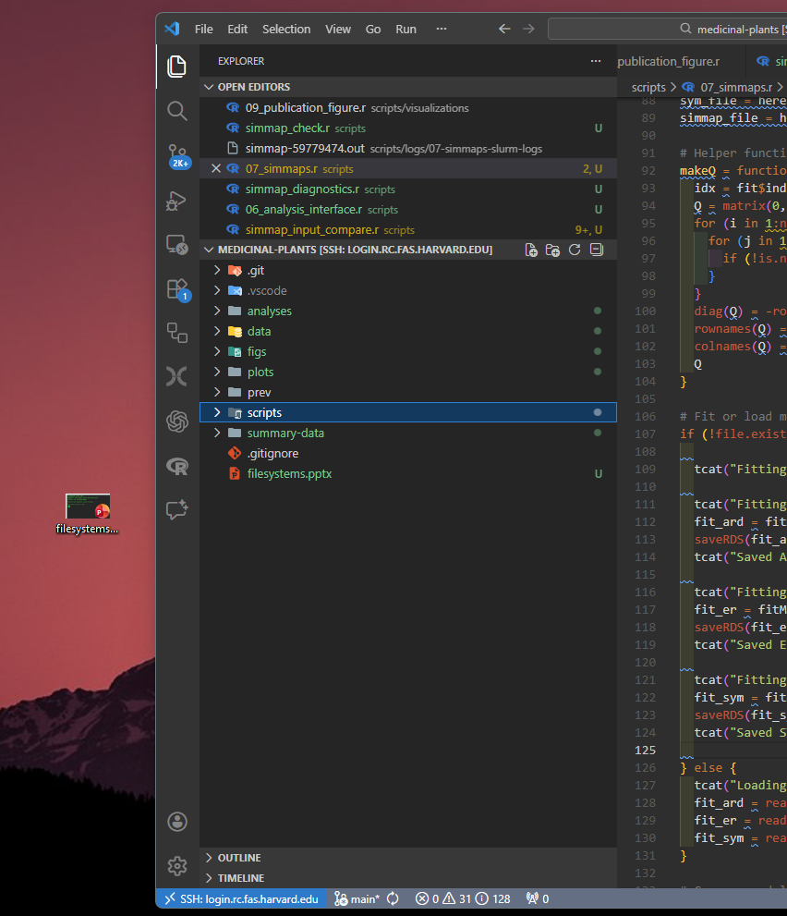
Drag-and-drop upload of local files is supported

Slide 83
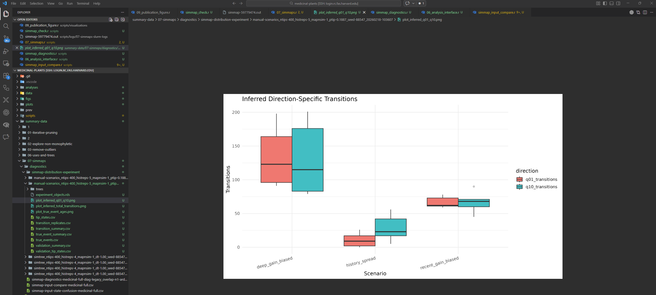
View generated figures directly in the editor

Slide 84
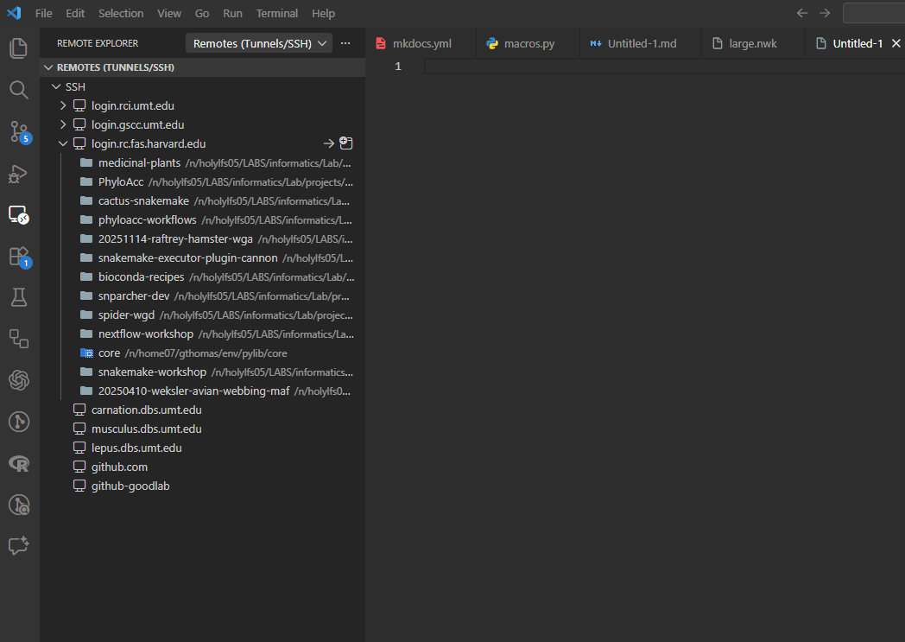
Recent folders appear in the Remote Explorer tab
After logging off (closing the window), easily reconnect to recent folders in the Remote Explorer tab

Slide 85
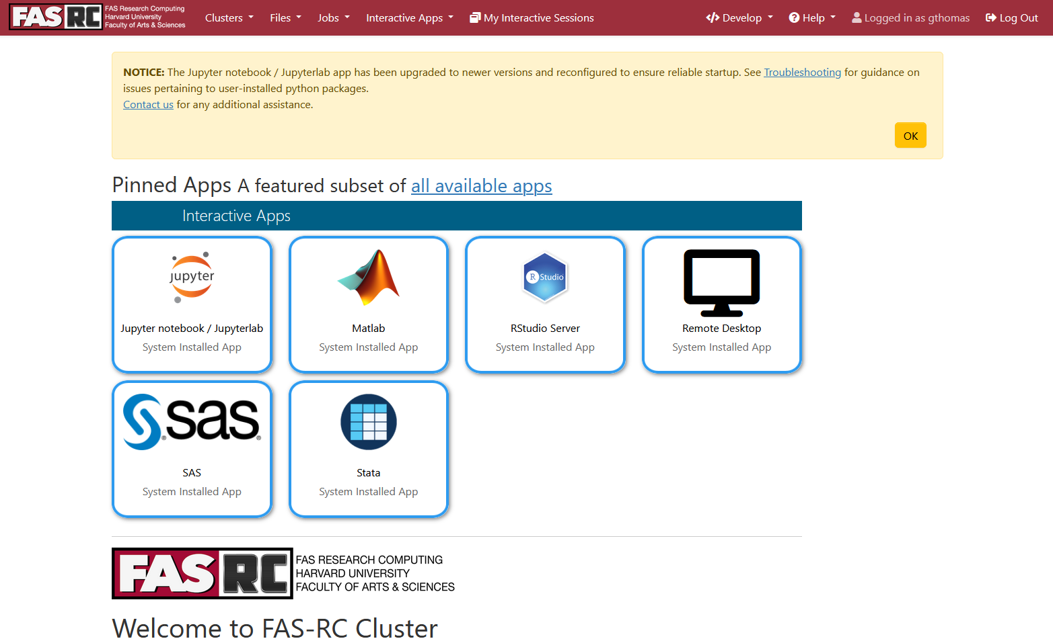
Virtual desktop with Open On Demand (OOD)
Virtual desktop, RStudio, Jupyter
Runs on compute nodes
Must be on Harvard VPN
https://docs.rc.fas.harvard.edu/kb/virtual-desktop/

Slide 86
Useful shell shortcuts
.. | Shortcut to use in paths meaning, “one directory above”. ../ means one directory above the current working directory ../../ means two directories above the current working directory
~ | Many systems use this to mean, “the path to the current user’s home directory”. cd ~ will change directory to your home directory no matter where you are in the filesystem.
cd - | Change to the previous directory no matter where it is.
[tab] | When typing paths for a command, hitting tab will autocomplete file names. cd dir[tab] -> cd directory1 If more than one file matches the substring typed, they will all be displayed for you to keep typing: cd dir[tab] -> directory1 directory2 directory3 -> cd directory3
[up arrow] | Scroll through previous commands.
Ctrl+C | Cancel currently running process.
Select text to copy, right click to paste.
Notes:
Mention command prompt and not to use it

