Slide 1
$ Command line 101: $ git/GitHub on the cluster & your computer
$ Harvard FAS Informatics virtual training
$ Thursday, February 26, 2026
$

Slide 2
Topics covered
What is git version control
Using git on the command line
Collaborating with others
Resolving merge conflicts

Slide 3
Steps to participate in hands on workshop
Make a GitHub Account
https://github.com/
Download GitHub Desktop (if you wan to follow along on your local computer)
https://desktop.github.com/
Download and install gh CLI (if you want to use command line/on the cluster)
https://cli.github.com/
Recommend using a conda environment on cluster or homebrew for macOS
Notes:
note: poll to see who just wants to follow along vs do the demo

Slide 4
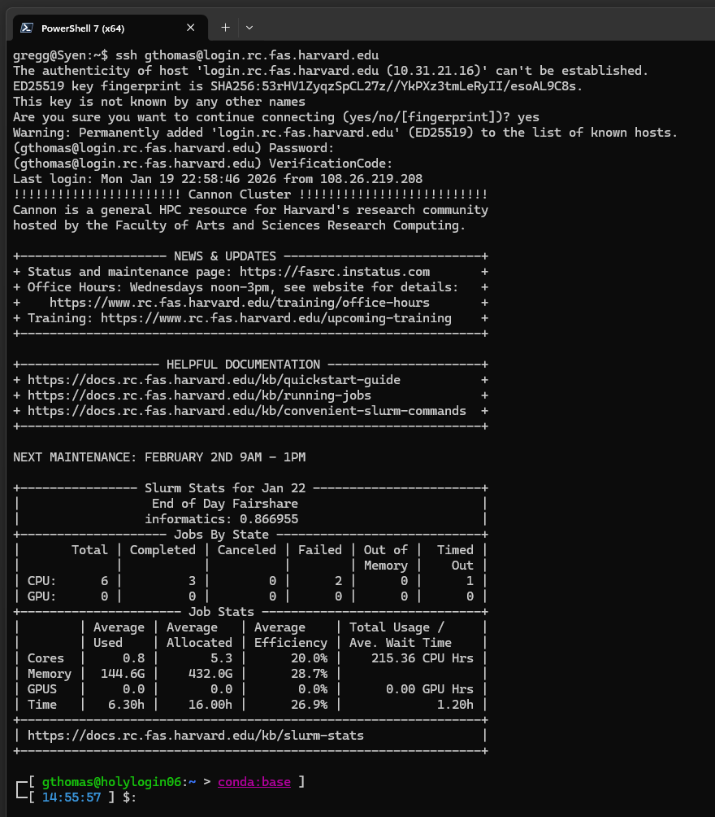


Connecting to the cluster
Use the ssh command to connect to the cannon cluster:
ssh <username>@login.rc.fas.harvard.edu

Slide 5
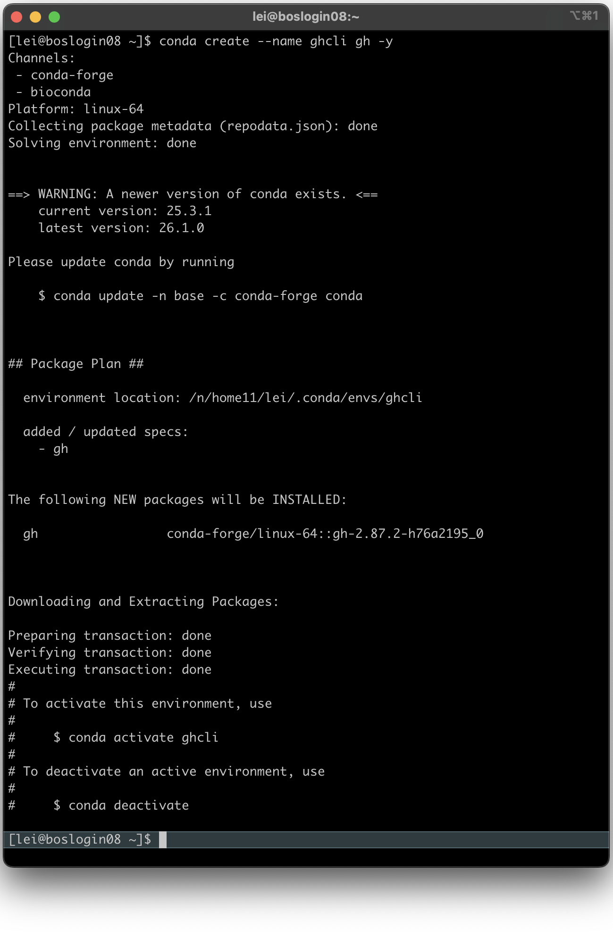
Create conda env for gh CLI
This is mainly a simpler way to authenticate & perform other GitHub specific actions
module load python
conda create --name ghcli gh -y
conda activate ghcli

Slide 6
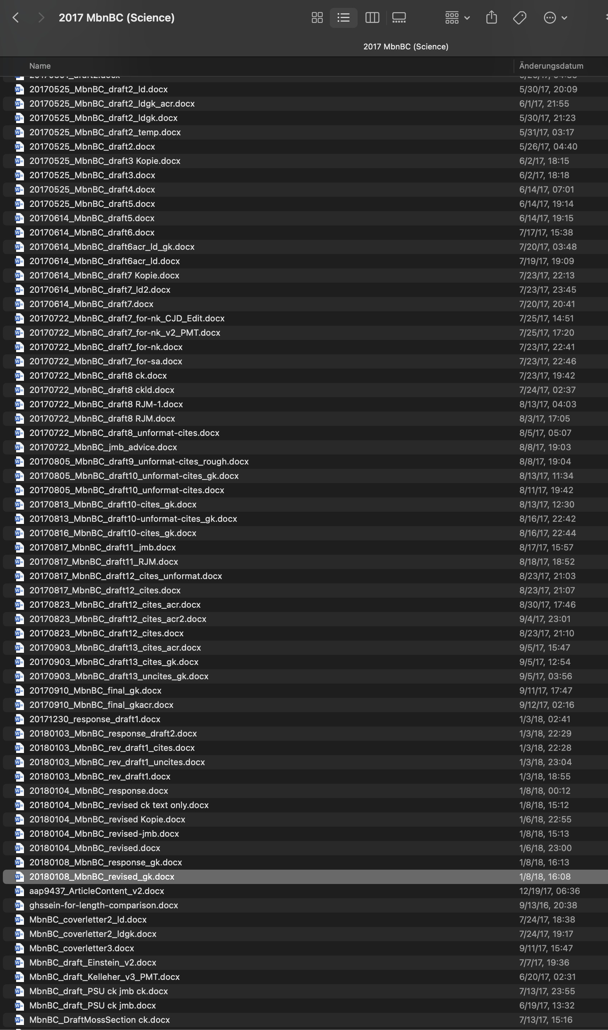
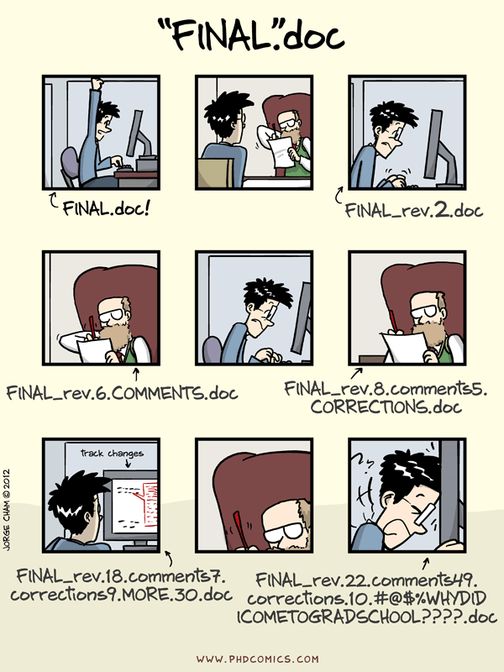
Changing file names is not version control
☹
“notFinal.doc” by Jorge Cham, https://www.phdcomics.com
Notes:
Regardless of where your code comes from, usually throughout a project there is an iterative process of writing, testing, and changing your code until you get to the final version that you use in your publication. This may consist of testing out multiple versions of the same code at a time, or maybe one set of scripts for analysis A and another set for analysis B and there's some overlap between the two... Anyway, it can get messy! Version control is a way to manage this process so that you never lose important work and can clearly distinguish between different version of your code.

Slide 7
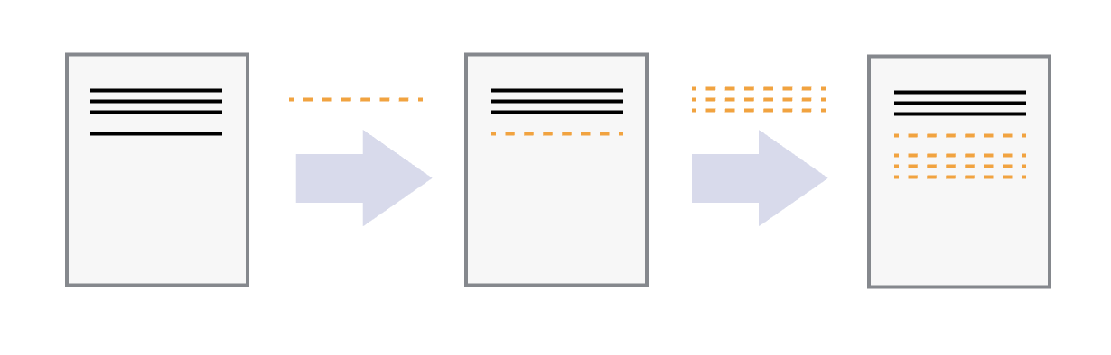
Git is manual version control
initial commit
commit 2
commit 3
Allows manual snapshotting of directory
like Time Machine, Dropbox, Google Docs, but not automatic
Works locally (i.e. does not upload to anywhere on the internet)
A hidden folder (.git) tracks changes, not copies
Works line by line

Slide 8
Why use git over Google Drive, Word, etc?
Records all changes and who made them
compare to track changes in Word after you’ve “accepted changes”
You have control over snapshots
You can experiment with different versions while keeping a working version intact
Will never accidentally erase something.
You can time travel across different versions of your files

Slide 9
What is git?
Version control software used by developers
Allows manual snapshotting of directory
like Time Machine, Dropbox, Google Docs, but not automatic
Works locally (i.e. does not upload to anywhere on the internet)
A hidden folder (.git) is how it tracks changes
Notes:
Before we talk about GitHub, we need to talk about git. Git is a version control system that allows you to track changes in your code. It's made for people who want to take snapshots of their code as they work on it, like google docs or dropbox, which allow you to see the history of your document and revert to previous versions. The difference is you have to manually take these snapshots, whereas the other services do it automatically. Another difference is, this version control works locally rather than by uploading your files to some cloud storage service. It does this by creating a hidden .git folder in your directory that stores all the changes you've made in each snapshot.

Slide 10
Working directory
Staging area
.git directory
Stage file (git add)
Commit (git commit -m “message”)
Retrieve saved version (git checkout or git restore)
Notes:
This is the central concept of git: You have a working directory where you are interacting with files, changing and and saving them as normal. Then when you want to save a version of your file, you "stage" the file, telling git you want to track the current version. When you've staged all the files you want to take a snapshot of, you "commit" the changes along with a descriptive message.
When you want to time travel to a previous commit, that is called "checking out" a commit. You can check out a whole commit or just a single file from a commit. Checking out a commit/file will change your working directory. We'll go more into detail on checking out commits later. Right now, let's focus on the arrows going to the right, which save your changes to git.

Slide 11
Working directory
Staging area
.git directory
Stage file (git add)
Commit (git commit -m “message”)
Retrieve saved version (git checkout or git restore)
Notes:
This is the central concept of git: You have a working directory where you are interacting with files, changing and and saving them as normal. Then when you want to save a version of your file, you "stage" the file, telling git you want to track the current version. When you've staged all the files you want to take a snapshot of, you "commit" the changes along with a descriptive message.
When you want to time travel to a previous commit, that is called "checking out" a commit. You can check out a whole commit or just a single file from a commit. Checking out a commit/file will change your working directory. We'll go more into detail on checking out commits later. Right now, let's focus on the arrows going to the right, which save your changes to git.

Slide 12

Local repo
Backup to remote (git push)
Remote
Your_name/repo-name
Working directory
Staging area
.git directory
Retrieve from remote (git pull)
Stage
Commit
Checkout
git on your local machine
GitHub on remote servers
Notes:
Now that you know what git is, this is how GitHub relates. GitHub is a website that hosts git repositories. It's a place where you can share your code with the general public, or just to back up your code. The jargon for this is called a "remote", while the version of your repository on your computer is called the "local" version. You can have multiple local versions (clones) but it's up to you to keep them up to date.
To transfer code between your local and remote repositories, you use "push" and "pull" commands. "Push" sends your changes to the remote while "pull" grabs the changes from the remote. You can push after a series of commits and all that history will be transferred to the remote. Let's say you're working on the cluster and have been making commits and pushes. Those changes will not be reflected on your local machine until you "pull" the changes from the remote.

Slide 13


Feature |  | GitHub | GitHub Desktop
Type | Local version control software | Cloud-based hosting service | Software to help manage GitHub repositories with a user interface
Installation | Downloaded and installed locally | Web-based, no installation needed | Downloaded and installed locally
Cost | Free and open-source | Free and paid tiers available | Free
Dependency | Can work independently | Requires Git to function | Comes with its own copy of git
Ownership | Open-source community; (Maintained by the Linux Foundation) | Owned by Microsoft | Owned by Microsoft
Internet Requirement | Works offline | Requires internet connection | Requires internet connection
Primary Function | Version control and code management | Repository hosting and collaboration | Help manage git/GitHub repos
Access | Local machine only | Accessible from anywhere | Local machine only
Features | Basic version control operations | Additional features like issue tracking, pull requests, wikis | Most features of git & GitHub
Security | Local authentication | Two-factor authentication, access control | Connects to GitHub account
Notes:
Because it's often a point of confusion for folks, here is a summary page outlining the differences between git and GitHub (and other remotes or code hosting services). Git is a free and open source version control software that works offline on your local machine. You use it to take snapshots of your folder and track the changes to files in your folder. GitHub is a cloud-based hosting service that allows you to back up your code to computers owned by GitHub/Microsoft and share them with the world. It offers collaboration features and additional ways to interact with your code. Most of the features relevant to us are free, but there are paid features as well.
We will also be using GitHub Desktop, which is an application that helps users perform git actions and connect their git repository to GitHub. Originally, git was purely a command line tool. However, if we are not hard core coders, we can use an app called GitHub Desktop to perform all the actions described previously using a graphical interface.

Slide 14
git terminology part 1
Term | Definition
repository (repo) | a folder tracked by git
clone | copy a repo from a remote onto your local computer
add | add file to staging area (start tracking it)
commit | make a snapshot of staging area to repository
push | upload changes to remote repo
remote | a repository hosted on a server (e.g. GitHub)
staging area | intermediate area where files are tracked before they are added to git
pull | fetch changes from a remote and merge into existing branch
status | check the status of your git repo
init | make a folder into a git repo

Slide 15
What to upload
What to include | What NOT to include
Scripts Notebooks READMEs Configuration files (yamls, config files) Metadata files (maybe) | Data Software (conda envs, containers) Files >50 MB Passwords and sensitive information (!!!) Log files (slurm logs, error logs, etc) Junk files (temp, OS-generated junk)

Slide 16
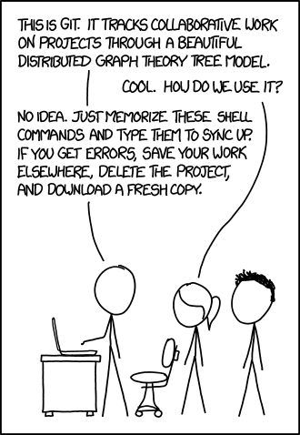
Steps to create a repo on GitHub using git and gh cli
git init
git status
git add <filename>
git commit -m “first commit”
gh auth login
gh repo create
xkcd.com

Slide 17
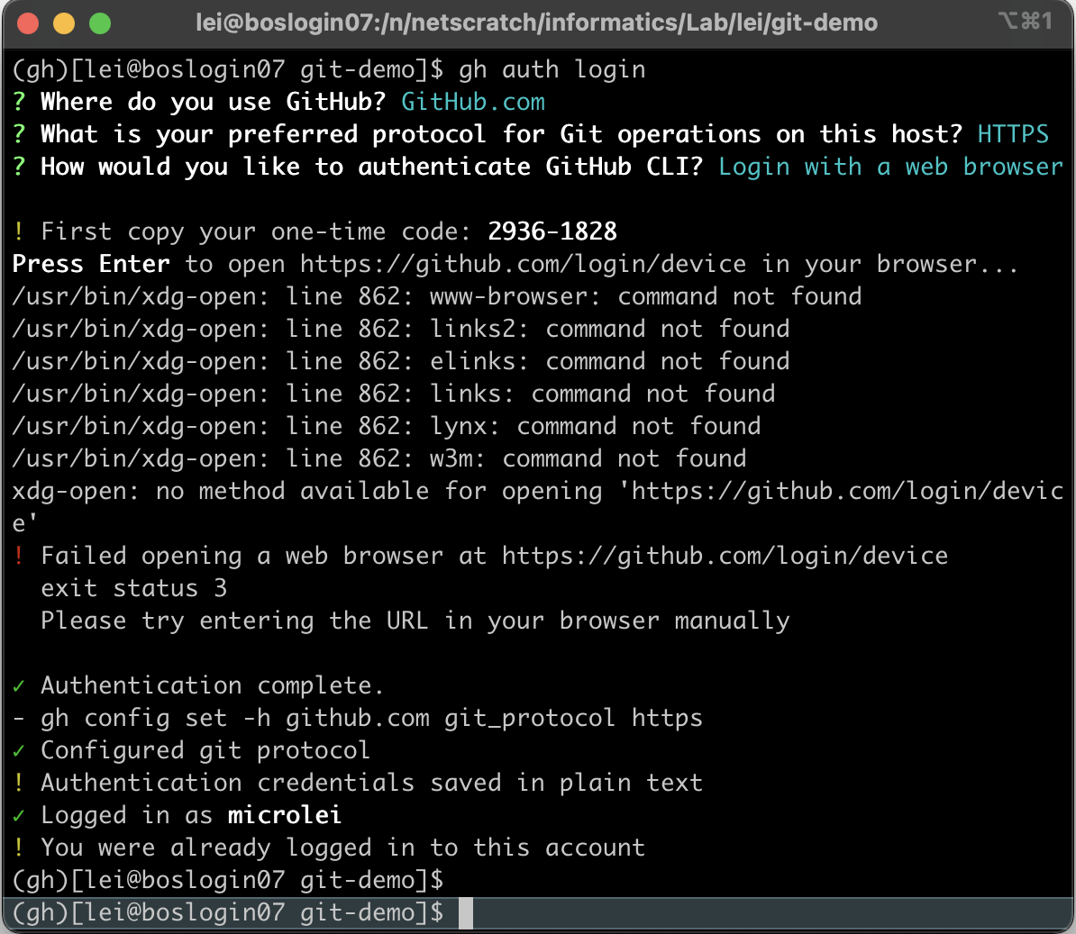
Steps to create a repo on GitHub using git and gh cli
gh auth login
go here manually on your local web browser. Pressing enter gets you the error shown

Slide 18
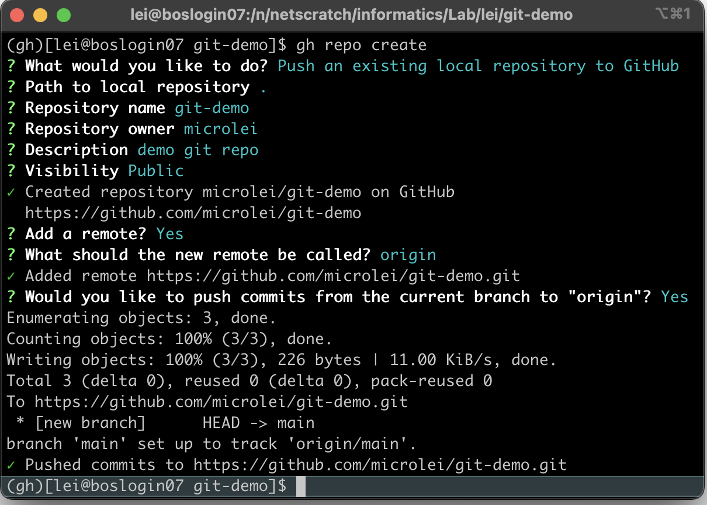
Steps to create a repo on GitHub using git and gh cli
gh repo create

Slide 19
Steps to create a repo on GitHub using GitHub Desktop
If you already have a folder:
Add -> Add Existing Repository (choose folder one above your folder)
If you want to start with a new folder:
Add -> Create New Repository
xkcd.com

Slide 20
Making and pushing new commits
Remote
Your_name/repo-name
git pull
[do some work]
git status
git add [files]
git commit -m “commit message”
git push
Retrieve from remote (git pull)
Local repo
Backup to remote (git push)
Working directory
Staging area
.git directory
add
commit
Checkout

Slide 21
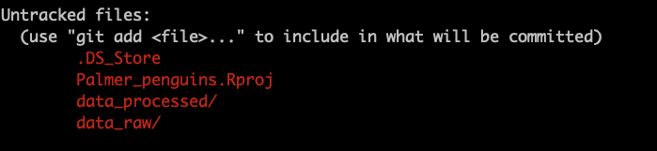
Use a gitignore document
.gitignore
If you have a lot of files you don’t want git to track, add them to a .gitignore.
Put .gitignore at the top level of your repo
What to add?
junk files, data directories, binary files, large files, etc.
.DS_Store
data_raw/*
data_processed/*
*.Rproj

Slide 22
Git takeaways
1. Commits are NOT automatic. You have to tell git when and what to commit every time. So do it frequently, or you won't be able to go back to a version that you didn't commit.
2. Always pull to get the latest changes from the remote before you start working on your local version. Again, git does NOT operate automatically at all. Everything is manual.
3. Always be aware of what you're committing as permanently deleting things is annoying
4. Everything is recorded and almost everything can be undone, so don’t be afraid

Slide 23
Collaborating using GitHub
Forks and PRs

Slide 24
Remote
collab/repo-name
Remote
Your_name/repo-name
Make copy to account (fork)
Update original repo
(pull request)
Local repo
Copy to your local computer (git clone)
Notes:
When you want to collaborate with others, you can "fork" their repository, which makes a copy of their repo on your own GitHub account. You can then "clone" this repo to your local machine, make changes, push those changes to the remote, and then make a "pull request" to merge your changes to the original repository.

Slide 25


Original Repo
(lab repo)
GitHub Remote
(your fork)
Version DB
fork
Version DB
Commit 2
Commit 2
Commit 1
Commit 1
Notes:
Use case for forks: One of the best things about GitHub is that it allows you to share code with others. Raise your hand if you've ever been handed code from a previous student or lab member, but it didn't work for whatever reason. Or perhaps there are just loose scripts floating around, each version slightly different from the last but nobody knows which one is current or which one is the best. One way to avoid this is to have a lab GitHub account where known working versions of scripts are posted and users can fork the repo of helpful scripts to adjust to their own needs. Then, if a user fixes a bug or adds a feature, they can make a pull request and update the lab's version. This way, everyone in the lab can benefit from the work of others and the lab's scripts are always up to date.
The above image illustrates the relationship between a forked repo, the original repo, and local clones of the forked repo. If the repo you forked gets updated, you can sync your fork with the original repo but changes you make on your fork does not affect the original repo. Then, when you're working on a local clone of your repo (on the computer and on the cluster), the way to get them to sync is to push and pull between the two. When you have multiple local clones like this, do not work on the same file in two different places before syncing them by pushing and pulling.

Slide 26
Original Repo
(lab repo)
GitHub Remote
(your fork)
Version DB
fork
Version DB
Commit 2
Commit 2
Commit 1
Commit 1
clone
Personal Computer
File(s)
Version DB
Commit 2
Commit 1
Notes:
Use case for forks: One of the best things about GitHub is that it allows you to share code with others. Raise your hand if you've ever been handed code from a previous student or lab member, but it didn't work for whatever reason. Or perhaps there are just loose scripts floating around, each version slightly different from the last but nobody knows which one is current or which one is the best. One way to avoid this is to have a lab GitHub account where known working versions of scripts are posted and users can fork the repo of helpful scripts to adjust to their own needs. Then, if a user fixes a bug or adds a feature, they can make a pull request and update the lab's version. This way, everyone in the lab can benefit from the work of others and the lab's scripts are always up to date.
The above image illustrates the relationship between a forked repo, the original repo, and local clones of the forked repo. If the repo you forked gets updated, you can sync your fork with the original repo but changes you make on your fork does not affect the original repo. Then, when you're working on a local clone of your repo (on the computer and on the cluster), the way to get them to sync is to push and pull between the two. When you have multiple local clones like this, do not work on the same file in two different places before syncing them by pushing and pulling.

Slide 27
Original Repo
(lab repo)
GitHub Remote
(your fork)
Version DB
fork
Version DB
Commit 2
Commit 2
Commit 1
Commit 1
clone
clone
Personal Computer
Cluster Computer
File(s)
File(s)
Version DB
Version DB
Commit 2
Commit 2
Commit 1
Commit 1
Notes:
Use case for forks: One of the best things about GitHub is that it allows you to share code with others. Raise your hand if you've ever been handed code from a previous student or lab member, but it didn't work for whatever reason. Or perhaps there are just loose scripts floating around, each version slightly different from the last but nobody knows which one is current or which one is the best. One way to avoid this is to have a lab GitHub account where known working versions of scripts are posted and users can fork the repo of helpful scripts to adjust to their own needs. Then, if a user fixes a bug or adds a feature, they can make a pull request and update the lab's version. This way, everyone in the lab can benefit from the work of others and the lab's scripts are always up to date.
The above image illustrates the relationship between a forked repo, the original repo, and local clones of the forked repo. If the repo you forked gets updated, you can sync your fork with the original repo but changes you make on your fork does not affect the original repo. Then, when you're working on a local clone of your repo (on the computer and on the cluster), the way to get them to sync is to push and pull between the two. When you have multiple local clones like this, do not work on the same file in two different places before syncing them by pushing and pulling.

Slide 28
Original Repo
(lab repo)
GitHub Remote
(your fork)
Version DB
Version DB
Commit 2
Commit 2
Commit 1
Commit 1
Personal Computer
Cluster Computer
File(s)
File(s)
Version DB
Version DB
Commit 3
Commit 2
Commit 2
Commit 1
Commit 1
Notes:
Use case for forks: One of the best things about GitHub is that it allows you to share code with others. Raise your hand if you've ever been handed code from a previous student or lab member, but it didn't work for whatever reason. Or perhaps there are just loose scripts floating around, each version slightly different from the last but nobody knows which one is current or which one is the best. One way to avoid this is to have a lab GitHub account where known working versions of scripts are posted and users can fork the repo of helpful scripts to adjust to their own needs. Then, if a user fixes a bug or adds a feature, they can make a pull request and update the lab's version. This way, everyone in the lab can benefit from the work of others and the lab's scripts are always up to date.
The above image illustrates the relationship between a forked repo, the original repo, and local clones of the forked repo. If the repo you forked gets updated, you can sync your fork with the original repo but changes you make on your fork does not affect the original repo. Then, when you're working on a local clone of your repo (on the computer and on the cluster), the way to get them to sync is to push and pull between the two. When you have multiple local clones like this, do not work on the same file in two different places before syncing them by pushing and pulling.

Slide 29
Original Repo
(lab repo)
GitHub Remote
(your fork)
Version DB
Version DB
Commit 3
Commit 2
Commit 2
Commit 1
Commit 1
push
Personal Computer
Cluster Computer
File(s)
File(s)
Version DB
Version DB
Commit 3
Commit 2
Commit 2
Commit 1
Commit 1
Notes:
Use case for forks: One of the best things about GitHub is that it allows you to share code with others. Raise your hand if you've ever been handed code from a previous student or lab member, but it didn't work for whatever reason. Or perhaps there are just loose scripts floating around, each version slightly different from the last but nobody knows which one is current or which one is the best. One way to avoid this is to have a lab GitHub account where known working versions of scripts are posted and users can fork the repo of helpful scripts to adjust to their own needs. Then, if a user fixes a bug or adds a feature, they can make a pull request and update the lab's version. This way, everyone in the lab can benefit from the work of others and the lab's scripts are always up to date.
The above image illustrates the relationship between a forked repo, the original repo, and local clones of the forked repo. If the repo you forked gets updated, you can sync your fork with the original repo but changes you make on your fork does not affect the original repo. Then, when you're working on a local clone of your repo (on the computer and on the cluster), the way to get them to sync is to push and pull between the two. When you have multiple local clones like this, do not work on the same file in two different places before syncing them by pushing and pulling.

Slide 30
Original Repo
(lab repo)
GitHub Remote
(your fork)
Version DB
Version DB
Commit 3
Commit 2
Commit 2
Commit 1
Commit 1
pull
Personal Computer
Cluster Computer
File(s)
File(s)
Version DB
Version DB
Commit 3
Commit 3
Commit 2
Commit 2
Commit 1
Commit 1
Notes:
Use case for forks: One of the best things about GitHub is that it allows you to share code with others. Raise your hand if you've ever been handed code from a previous student or lab member, but it didn't work for whatever reason. Or perhaps there are just loose scripts floating around, each version slightly different from the last but nobody knows which one is current or which one is the best. One way to avoid this is to have a lab GitHub account where known working versions of scripts are posted and users can fork the repo of helpful scripts to adjust to their own needs. Then, if a user fixes a bug or adds a feature, they can make a pull request and update the lab's version. This way, everyone in the lab can benefit from the work of others and the lab's scripts are always up to date.
The above image illustrates the relationship between a forked repo, the original repo, and local clones of the forked repo. If the repo you forked gets updated, you can sync your fork with the original repo but changes you make on your fork does not affect the original repo. Then, when you're working on a local clone of your repo (on the computer and on the cluster), the way to get them to sync is to push and pull between the two. When you have multiple local clones like this, do not work on the same file in two different places before syncing them by pushing and pulling.

Slide 31
Original Repo
(lab repo)
GitHub Remote
(your fork)
Version DB
Version DB
Commit 3
Commit 3
Commit 2
pull request
Commit 2
Commit 1
Commit 1
Personal Computer
Cluster Computer
File(s)
File(s)
Version DB
Version DB
Commit 3
Commit 3
Commit 2
Commit 2
Commit 1
Commit 1
Notes:
Use case for forks: One of the best things about GitHub is that it allows you to share code with others. Raise your hand if you've ever been handed code from a previous student or lab member, but it didn't work for whatever reason. Or perhaps there are just loose scripts floating around, each version slightly different from the last but nobody knows which one is current or which one is the best. One way to avoid this is to have a lab GitHub account where known working versions of scripts are posted and users can fork the repo of helpful scripts to adjust to their own needs. Then, if a user fixes a bug or adds a feature, they can make a pull request and update the lab's version. This way, everyone in the lab can benefit from the work of others and the lab's scripts are always up to date.
The above image illustrates the relationship between a forked repo, the original repo, and local clones of the forked repo. If the repo you forked gets updated, you can sync your fork with the original repo but changes you make on your fork does not affect the original repo. Then, when you're working on a local clone of your repo (on the computer and on the cluster), the way to get them to sync is to push and pull between the two. When you have multiple local clones like this, do not work on the same file in two different places before syncing them by pushing and pulling.

Slide 32

Original
Informatics/github-intro
1. Fork
4-5. add, commit
Remote fork
Your_name/github-intro
7-8. pull request
merge
9. sync
Local
~/path/github-intro
2. clone
6. push
9. pull
https://github.com/harvardinformatics/github-intro
Notes:
Optional

Slide 33
Branching, merging, and conflicts

Slide 34
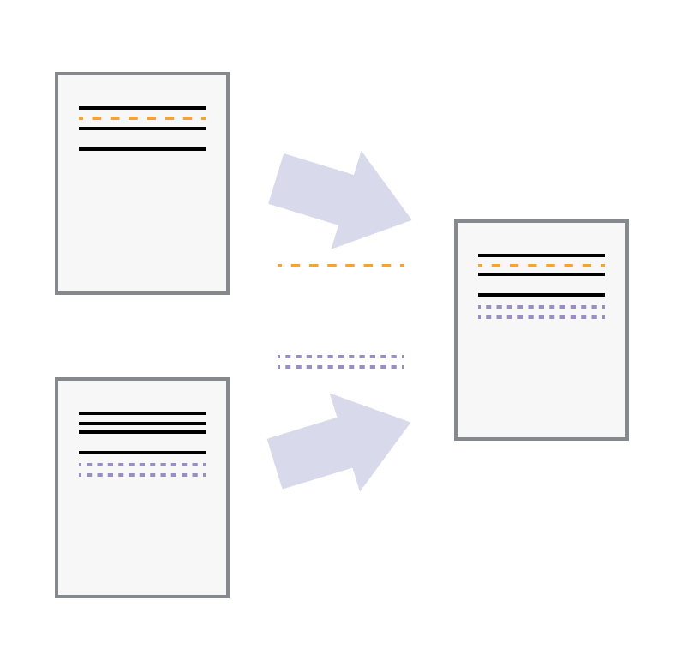
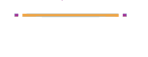
Branching, merging, and conflicts
Edits to different lines:
no conflict, automatically merge
Edits to the same line:
conflict, cannot merge

Slide 35
visual demo of branching
Demo on learngitbranching : https://learngitbranching.js.org/
git switch -c bugfix
git commit
git switch main
git commit
git merge bugFix
git branch -d bugFix

Slide 36

6. pull request, merge,
resolve conflict
1. add empty haiku.md
4. git switch main
5. add haiku lines & push
main
c1
c3
haiku-test
c2
Remote
push/pull
2. git checkout -b haiku-test
3. add haiku lines & push
https://github.com/harvardinformatics/github-intro

Slide 37
git terminology part 2
Term | Definition
fork | copy someone else’s repo into your own account/ “your fork” refers to your copy of some other owner’s repo
branch | and isolated development path that was diverted from the main line at a specific commit
upstream | on a fork, refers to the parent repo
pull request | proposal to merge code changes from one stream to another can be branch to branch in a single repo can be fork to upstream

