Slide 1


Population genomics with snpArcher
https://informatics.fas.harvard.edu/
Workshop December 2024
https://snparcher.readthedocs.io/

Slide 2
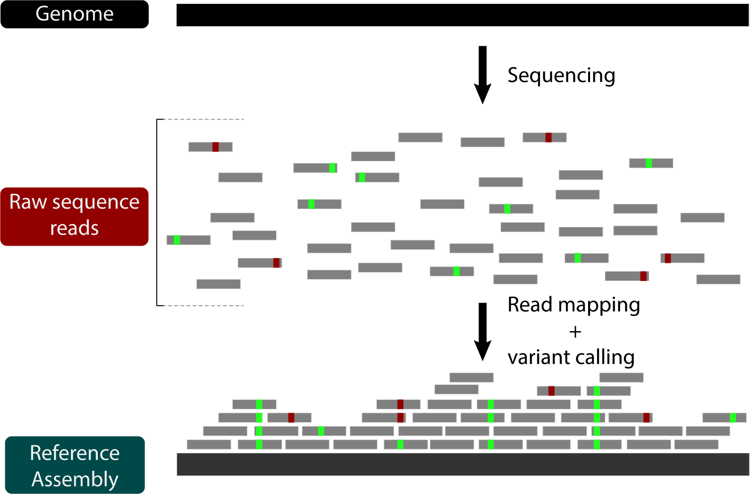
SNP calling is a cornerstone of population genomics
Individual 1
Individual 2

Slide 3
SNP calling is a cornerstone of population genomics
Individual 1
Where do they differ??
Individual 2

Slide 4
SNP calling is a cornerstone of population genomics
Individual 1
Previously sequenced and assembled Reference genome
Individual 2

Slide 5
SNP calling is a cornerstone of population genomics
Individual 1
Previously sequenced and assembled Reference genome
Individual 2

Slide 6
SNP calling is a cornerstone of population genomics
Individual 1
Previously sequenced and assembled Reference genome
Individual 2

Slide 7
SNP calling is a cornerstone of population genomics
Individual 1
Previously sequenced and assembled Reference genome
Individual 2

Slide 8
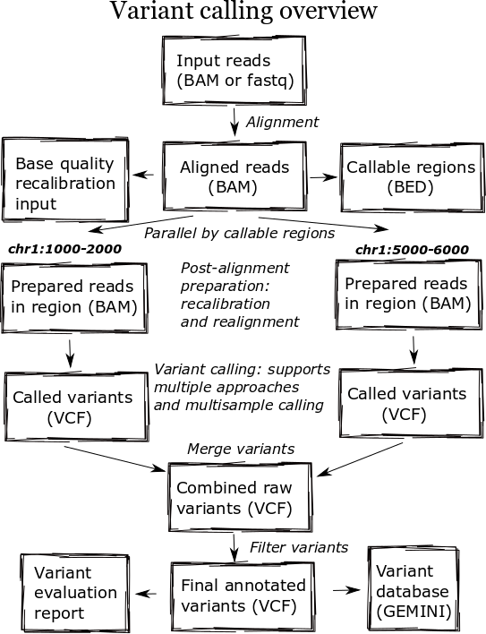
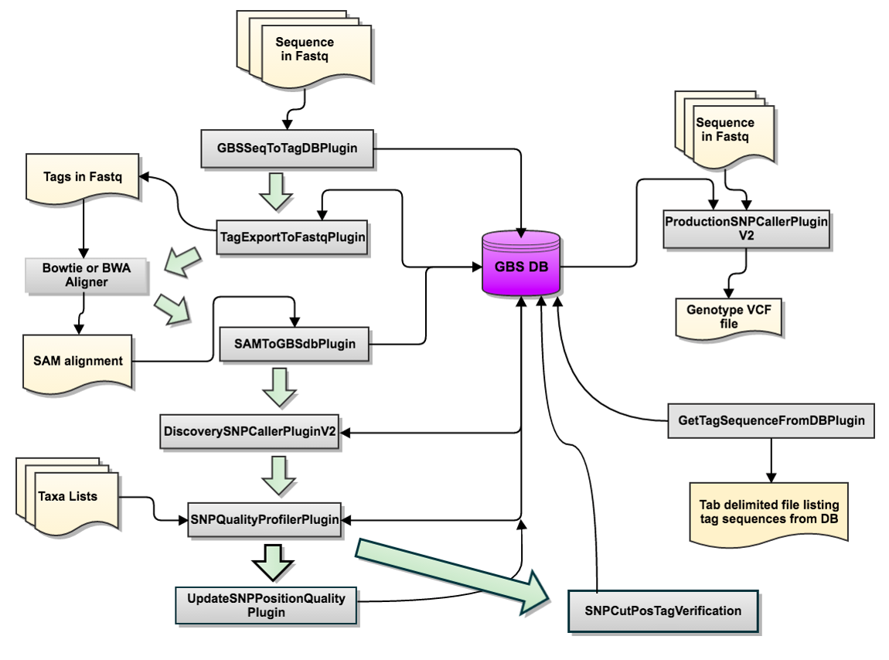
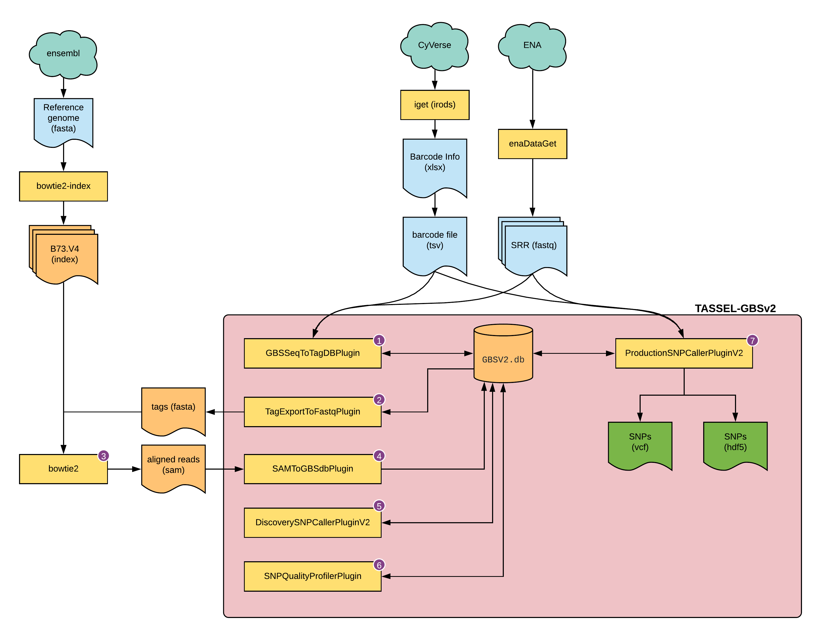
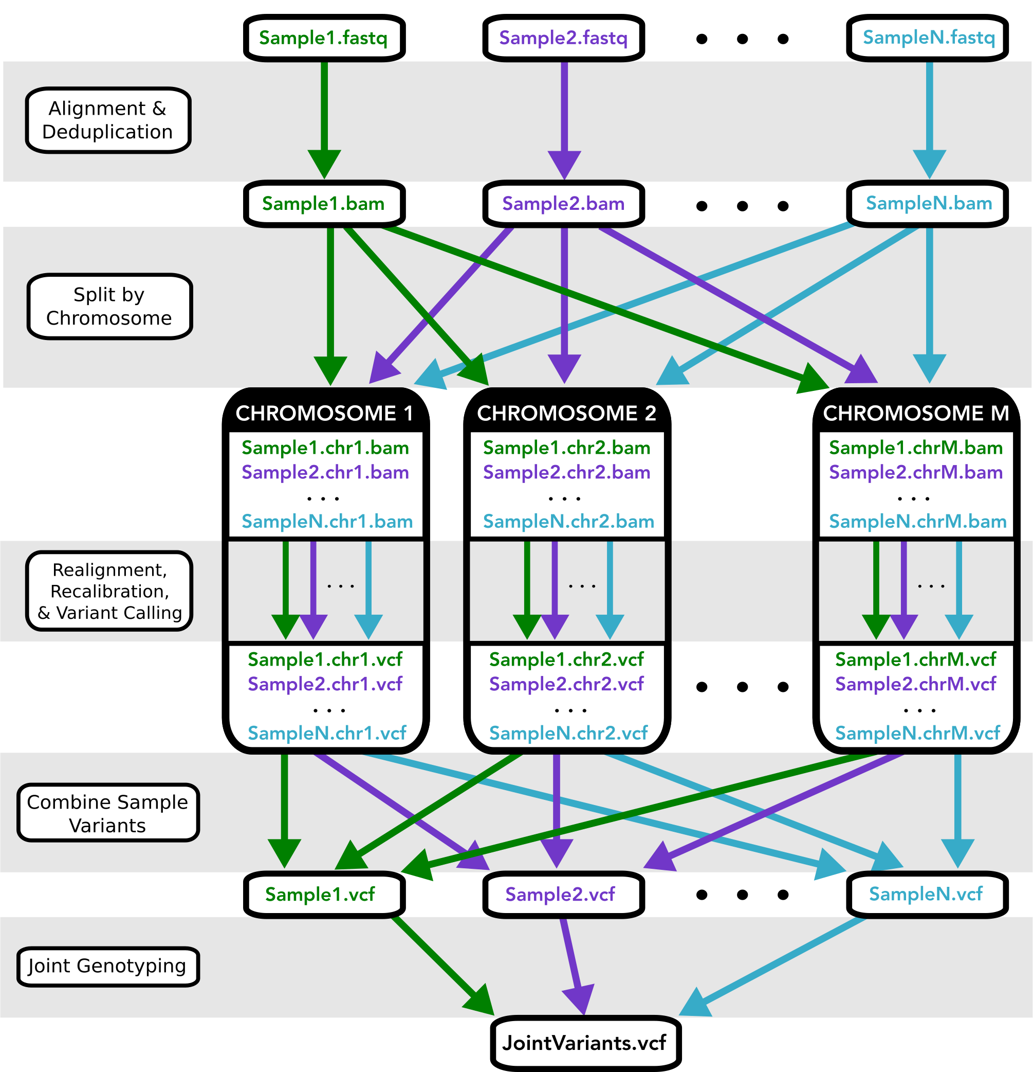
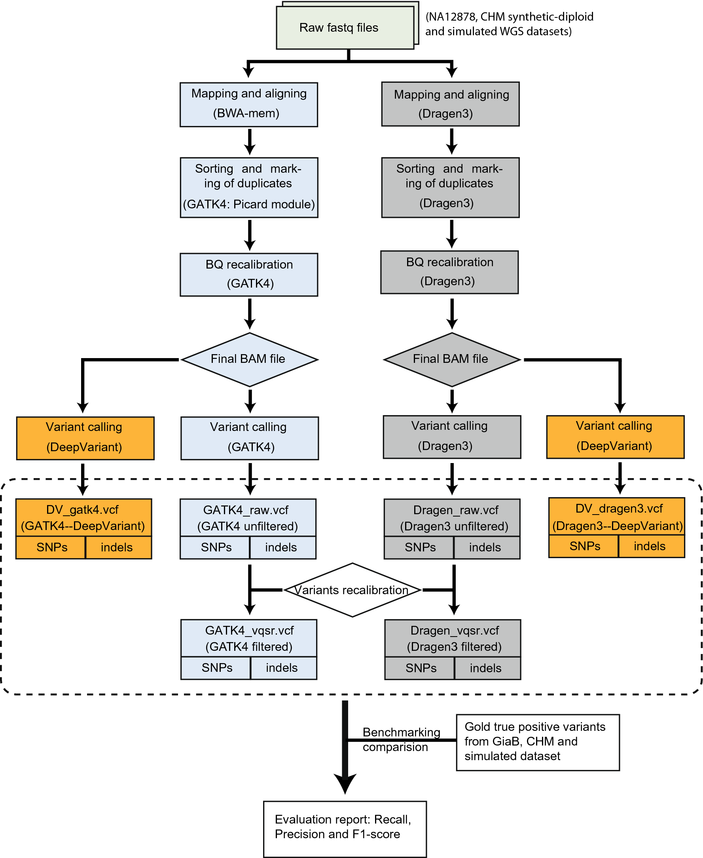
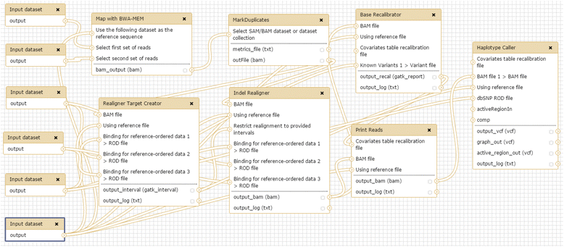
SNP calling is technically challenging
Notes:
Lots of confusing and technical steps depending on the goal

Slide 9
SNP calling is technically challenging
https://snparcher.readthedocs.io/
snpArcher is a Snakemake workflow that handles every step of the mapping and variant calling process for multiple samples

Slide 10
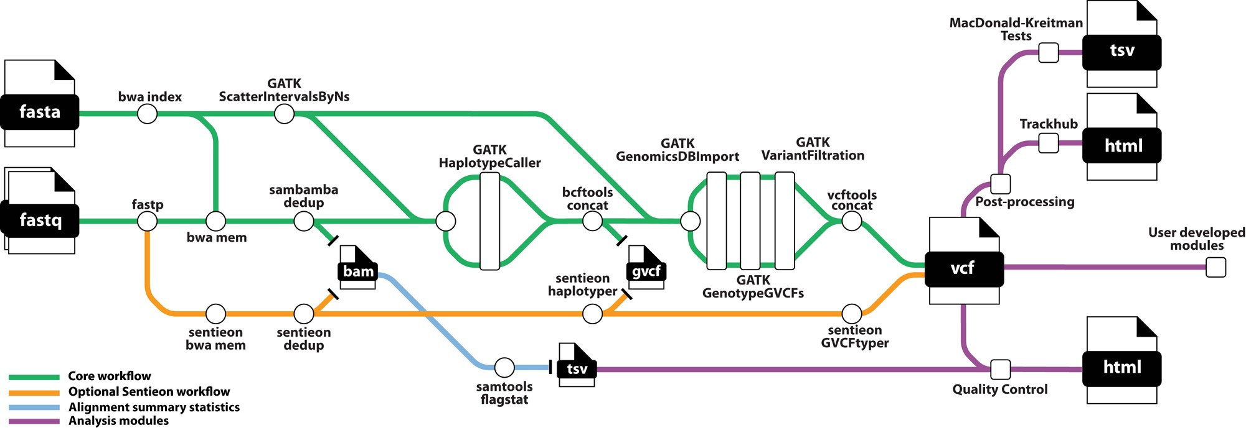
YAVCWI: Yet another variant calling workflow image
Notes:
Still confusing, but everything is done automatically

Slide 11
https://snparcher.readthedocs.io/
A single command!
Notes:
Still confusing, but everything is done automatically

Slide 12
A reference genome and samples with sequenced reads are the only inputs
A single command!
Previously sequenced and assembled Reference genome
Sequenced reads of samples to call variants
Notes:
Still confusing, but everything is done automatically

Slide 13
A variant call format (VCF) file is the main output
A single command!
Previously sequenced and assembled Reference genome
Sequenced reads of samples to call variants
Variant calls
Notes:
Still confusing, but everything is done automatically

Slide 14
snpArcher has a range of other features
A single command!
Notes:
Still confusing, but everything is done automatically

Slide 15
https://snparcher.readthedocs.io/
What is Snakemake?

Slide 16
Snakemake is a Python-based workflow management language
Snakemake is based on rules – each rule is a step in the workflow (e.g. read mapping or variant filtering)
  The output of one rule is the input for the next rule in the workflow
Wildcards allow rules to be run on multiple files
Snakemake integrates with SLURM and automatically submits each step in a rule as a single job

Slide 17

Installing Snakemake
Notes:
Depending on how much time we want to spend here, we could expand each step and do a bit of a walkthrough

Slide 18
Installing Snakemake
Install the package manager mamba
https://github.com/conda-forge/miniforge
If you already have mamba installed (type mamba to check) you should skip this step.
Notes:
Depending on how much time we want to spend here, we could expand each step and do a bit of a walkthrough

Slide 19
Installing Snakemake
Install the package manager mamba
https://github.com/conda-forge/miniforge
If you already have mamba installed (type mamba to check) you should skip this step.
If you have conda installed and don’t wish to mess with your setup, you should skip this step. Just use the conda command instead whenever you see mamba.
Notes:
Depending on how much time we want to spend here, we could expand each step and do a bit of a walkthrough

Slide 20
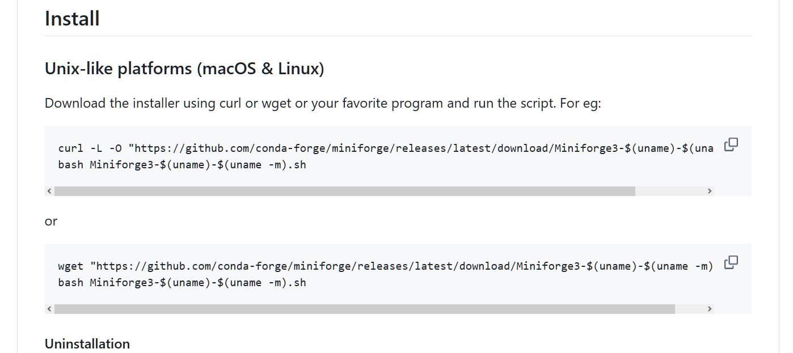
Installing Snakemake
Install the package manager mamba
https://github.com/conda-forge/miniforge
Scroll to the Install section and copy and paste these commands into your shell
Follow the onscreen prompts to accept the license agreement and choose an install location ($HOME, by default)
When prompted to initialize mamba, say yes. You will have to reconnect.
Notes:
Depending on how much time we want to spend here, we could expand each step and do a bit of a walkthrough

Slide 21

Installing Snakemake
Install the package manager mamba
https://github.com/conda-forge/miniforge
If the install was successful, you should now see (base) appended to your command prompt.
(base) indicates you are in the base conda environment from which you create other environments.
Notes:
Depending on how much time we want to spend here, we could expand each step and do a bit of a walkthrough

Slide 22
Installing Snakemake
Setup your channels for bioconda
https://bioconda.github.io/
conda config --add channels bioconda
conda config --add channels conda-forge
conda config --set channel_priority strict
Notes:
Depending on how much time we want to spend here, we could expand each step and do a bit of a walkthrough

Slide 23
Installing Snakemake
Create and activate an environment for Snakemake
Create:
mamba create -n snakemake-env
Activate:
mamba activate snakemake-env
Notes:
Depending on how much time we want to spend here, we could expand each step and do a bit of a walkthrough

Slide 24
Installing Snakemake
Install the snakemake-minimal and snakemake slurm packages
https://anaconda.org/bioconda/snakemake-minimal
https://anaconda.org/bioconda/snakemake-executor-plugin-slurm
snakemake-minimal:
mamba install bioconda::snakemake-minimal
SLURM snakemake plugin:
mamba install bioconda::snakemake-executor-plugin-slurm
Notes:
Depending on how much time we want to spend here, we could expand each step and do a bit of a walkthrough

Slide 25
Installing snpArcher
Notes:
Depending on how much time we want to spend here, we could expand each step and do a bit of a walkthrough

Slide 26
Installing snpArcher
snpArcher is installed directly from github:
https://github.com/harvardinformatics/snpArcher/
Make a project folder
mkdir my-project/
Notes:
Assumes they are on the cluster or another machine with git.

Slide 27
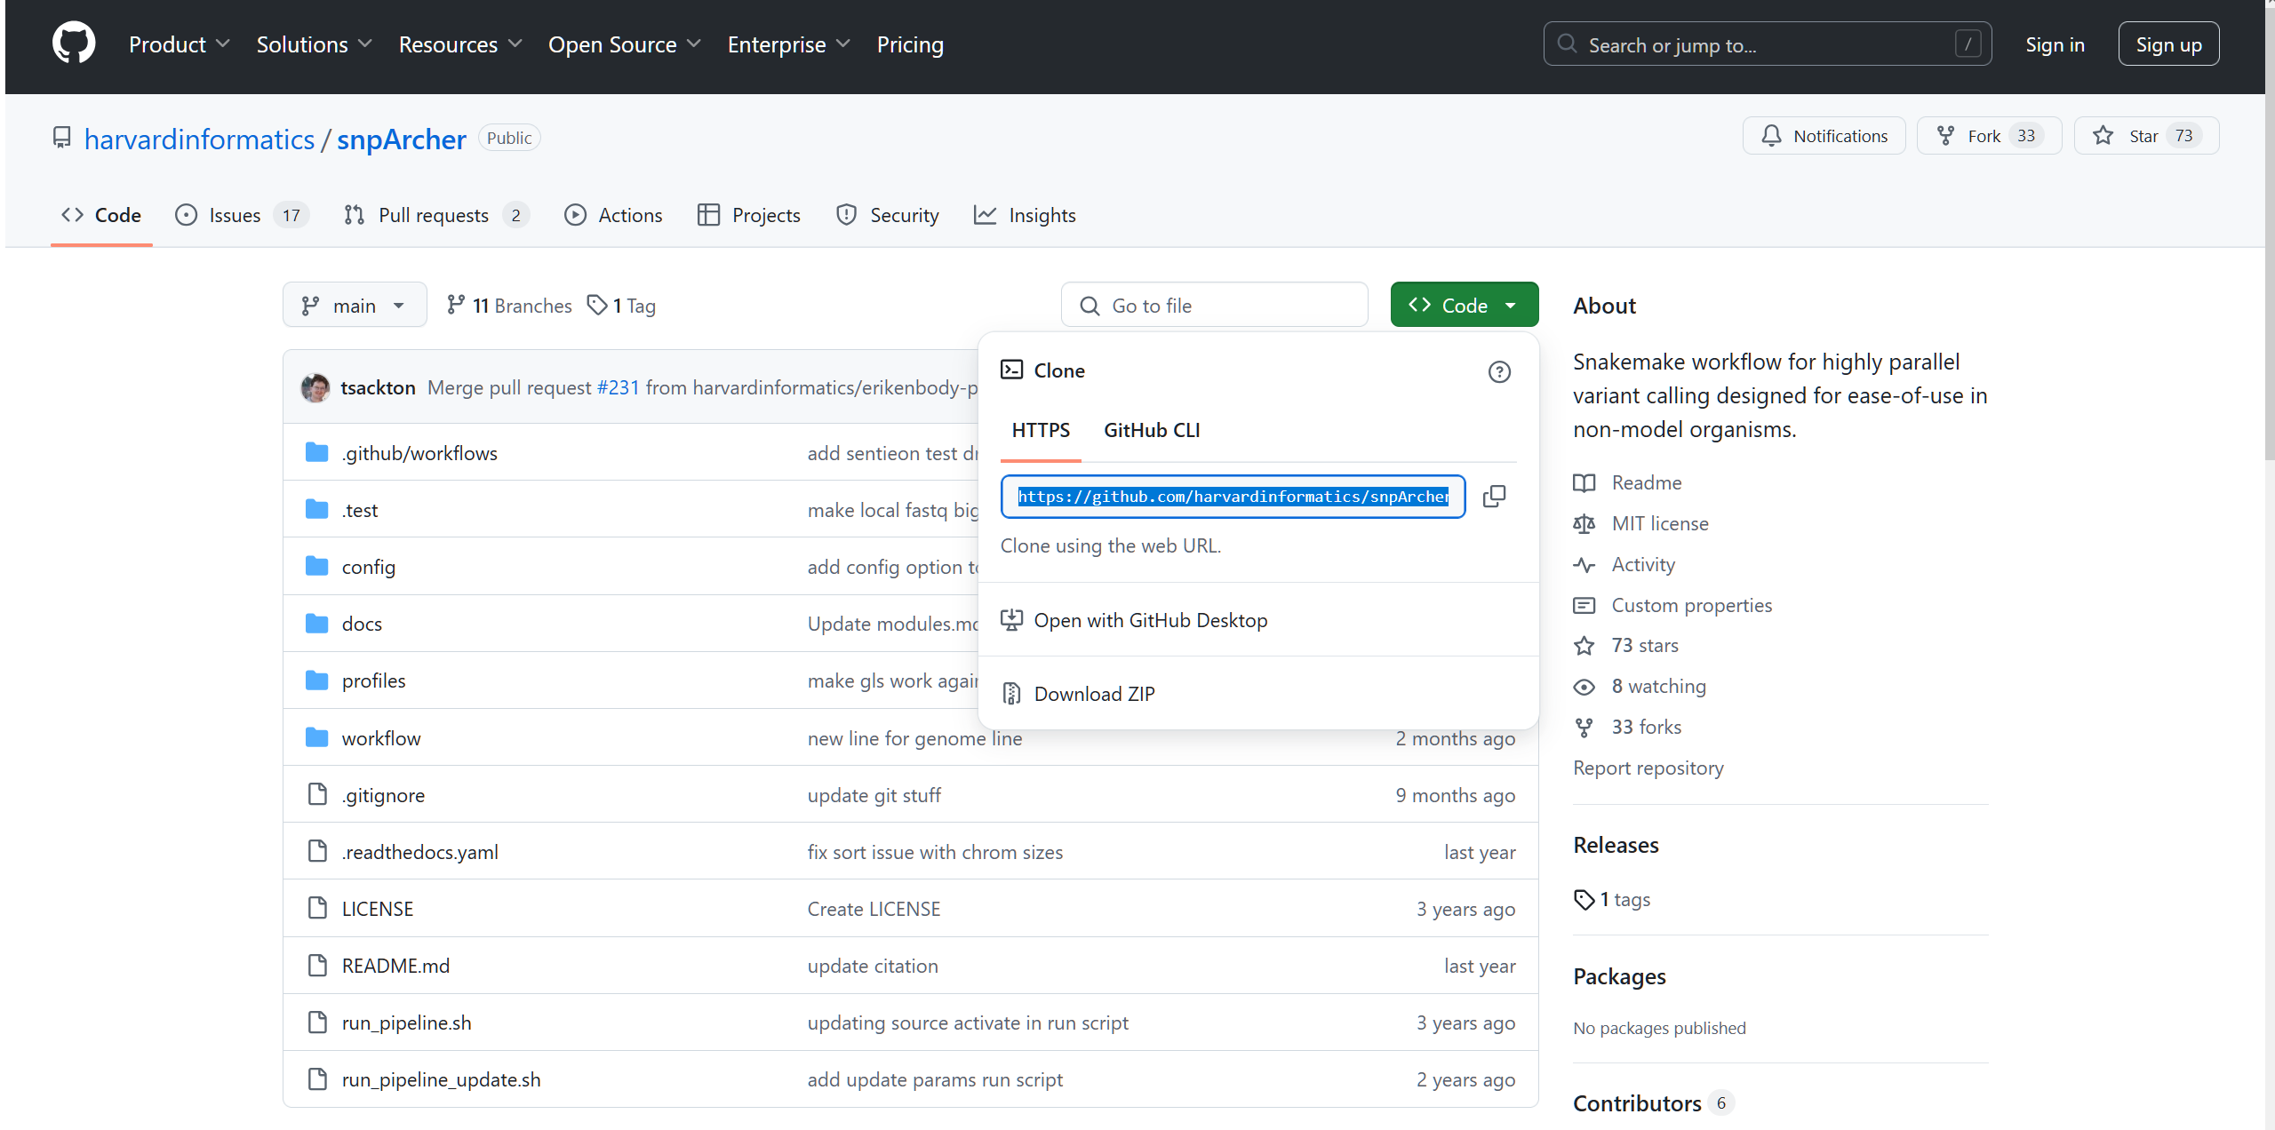
Installing snpArcher
snpArcher is installed directly from github:
https://github.com/harvardinformatics/snpArcher/
Make a project folder
mkdir my-project/
Copy the link from github
In your project folder type:
git clone <link>
Notes:
Assumes they are on the cluster or another machine with git.

Slide 28
Preparing your data for snpArcher
Notes:
Depending on how much time we want to spend here, we could expand each step and do a bit of a walkthrough

Slide 29
Preparing your data for snpArcher
You will need:
A sample sheet (.csv file)
A Snakemake config file (template provided in github repo)
OPTIONAL: To adjust the resources in the Snakemake profile

Slide 30
Preparing your data for snpArcher
You will need:
A sample sheet (.csv file)
A Snakemake config file (template provided in github repo)
OPTIONAL: To adjust the resources in the Snakemake profile

Slide 31
Preparing your data for snpArcher:
sample sheet
Data can be used locally or by automatically downloading from NCBI.
You will need:
 | NCBI | Local
Reference genome | Assembly accession | Path to FASTA file
For each sample | The SRR run accession for the raw reads | Paths to FASTQ files

Slide 32
Preparing your data for snpArcher: sample sheet
Data can be used locally or by automatically downloading from NCBI.
You will need:
Other optional information for each sample includes sample type, and map coordinates (lat and lon).
 | NCBI | Local
Reference genome | Assembly accession | Path to FASTA file
For each sample | The SRR run accession for the raw reads | Paths to FASTQ files

Slide 33
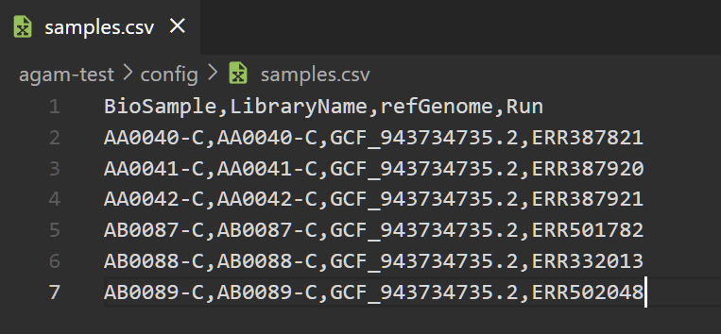
Preparing your data for snpArcher: sample sheet
Compile your input data into a sample sheet, a CSV file with one sample per row:
Save your samples.csv file in your project folder

Slide 34
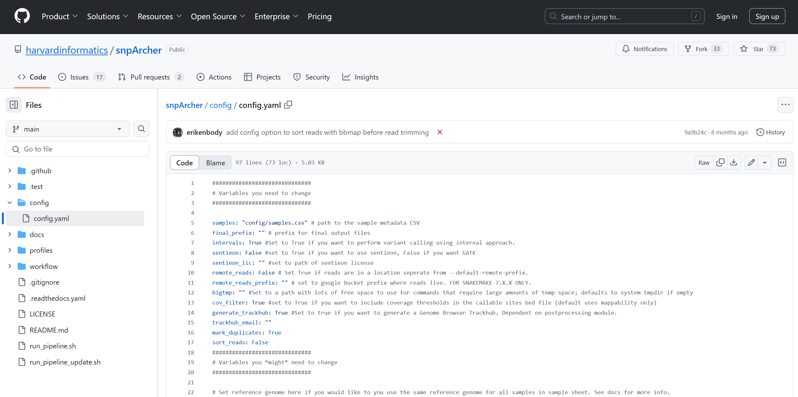
Preparing your data for snpArcher: snakemake config file
You will also need to set-up the Snakemake config file. A template is provided in the repository you downloaded:

Slide 35
Preparing your data for snpArcher: snakemake config file
You will also need to set-up the Snakemake config file. A template is provided in the repository you downloaded:
In your project folder, create a sub-folder called configs:
mkdir configs/
Copy the template config file:
cp snpArcher/config/config.yaml configs/.

Slide 36
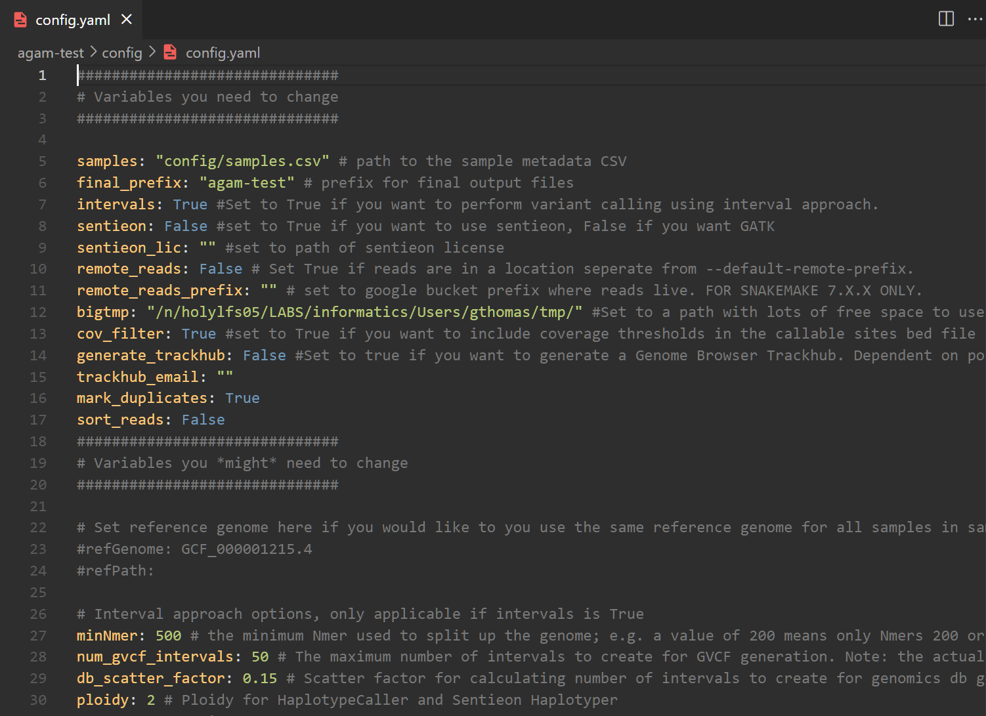
Preparing your data for snpArcher: snakemake config file
You will also need to set-up the Snakemake config file. A template is provided in the repository you downloaded:
In your project folder, create a sub-folder called configs:
mkdir configs/
Copy the template config file:
cp snpArcher/config/config.yaml configs/.
Edit the relevant parts of the copied config file

Slide 37
Preparing your data for snpArcher: snakemake config file
You will also need to set-up the Snakemake config file. A template is provided in the repository you downloaded:
In your project folder, create a sub-folder called configs:
mkdir configs/
Copy the template config file:
cp snpArcher/config/config.yaml configs/.
Edit the relevant parts of the copied config file
You are now ready to run snpArcher!

Slide 38
Running snpArcher
Notes:
Depending on how much time we want to spend here, we could expand each step and do a bit of a walkthrough

Slide 39
Running snpArcher
From your project folder and with your Snakemake environment activated, snpArcher can be run with a single command:
snakemake -p -s snpArcher/workflow/Snakefile --cores 8 --use-conda --workflow-profile \ snpArcher/profiles/default/ --dryrun

Slide 40
Running snpArcher
From your project folder and with your Snakemake environment activated, snpArcher can be run with a single command:
snakemake -p -s snpArcher/workflow/Snakefile --cores 8 --use-conda --workflow-profile \ snpArcher/profiles/default/ --dryrun
Automatically finds your config file in configs/config.yaml

Slide 41
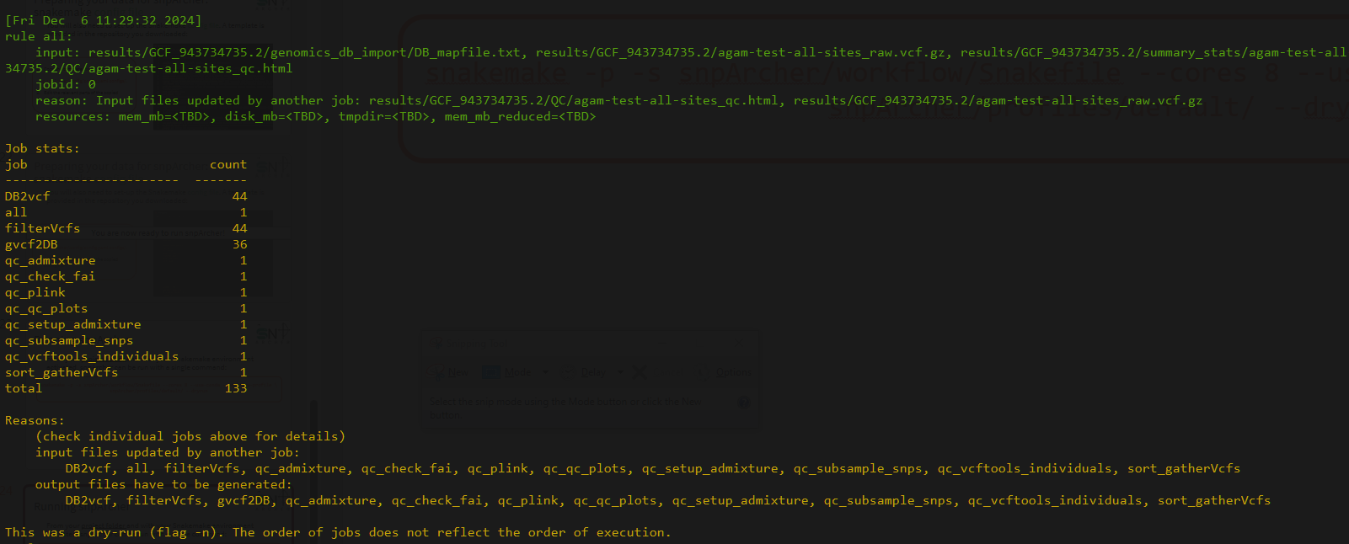
Running snpArcher
From your project folder and with your Snakemake environment activated, snpArcher can be run with a single command:
snakemake -p -s snpArcher/workflow/Snakefile --cores 8 --use-conda --workflow-profile \ snpArcher/profiles/default/ --dryrun

Slide 42
Running snpArcher
From your project folder and with your Snakemake environment activated, snpArcher can be run with a single command:
snakemake -p -s snpArcher/workflow/Snakefile --cores 8 --use-conda --workflow-profile \ snpArcher/profiles/default/ --dryrun
This didn’t actually run anything!
Always do a --dryrun first!

Slide 43
Running snpArcher
When actually running jobs, you will need to ensure that the main snakemake process is persistent even if you disconnect from the server.
Submit the snakemake command itself as a SLURM job
Use nohup
Use a terminal multiplexer (e.g. screen or tmux)
Notes:
Can elaborate more if needed

Slide 44
Running snpArcher
When actually running jobs, you will need to ensure that the main snakemake process is persistent even if you disconnect from the server.
Submit the snakemake command itself as a SLURM job
Use nohup
Use a terminal multiplexer (e.g. screen or tmux)
Notes:
Terminal multiplexers will still be shut down during maintenance -> +1 for slurm job

Slide 45
Running snpArcher
When your dryrun completes without errors, you have a persistent connection, and you are ready to start submitting jobs:
snakemake -p -s snpArcher/workflow/Snakefile --cores 8 --use-conda --workflow-profile \ snpArcher/profiles/default/
Notes:
Can elaborate more if needed

Slide 46
Running snpArcher
Test data is provided if you’d like to quickly ensure everything works before you run your own data:
snakemake -d .test/ecoli --cores 1 --use-conda --dryrun
Notes:
Can elaborate more if needed

Slide 47
Running snpArcher
Test data is provided if you’d like to quickly ensure everything works before you run your own data:
snakemake -d .test/ecoli --cores 1 --use-conda --dryrun
Remember the --dryrun option! Remove it if you want to actually run the pipeline on the test data
Notes:
Can elaborate more if needed

Slide 48
snpArcher output and modules
Notes:
Depending on how much time we want to spend here, we could expand each step and do a bit of a walkthrough

Slide 49
snpArcher has a range of other modules
Notes:
Still confusing, but everything is done automatically

Slide 50
snpArcher has a range of other modules
Notes:
Still confusing, but everything is done automatically

Slide 51
snpArcher’s main output is a VCF file
Notes:
Still confusing, but everything is done automatically

Slide 52
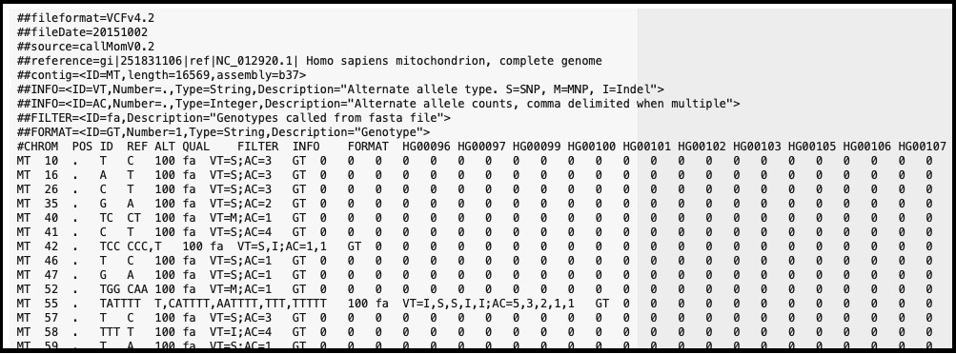
snpArcher’s main output is a VCF file
Notes:
zless .test/ecoli/results/GCA_003018455.1/ecoli_test_raw.vcf.gz

Slide 53
Summary statistics are provided as an HTML page
Notes:
Still confusing, but everything is done automatically

Slide 54
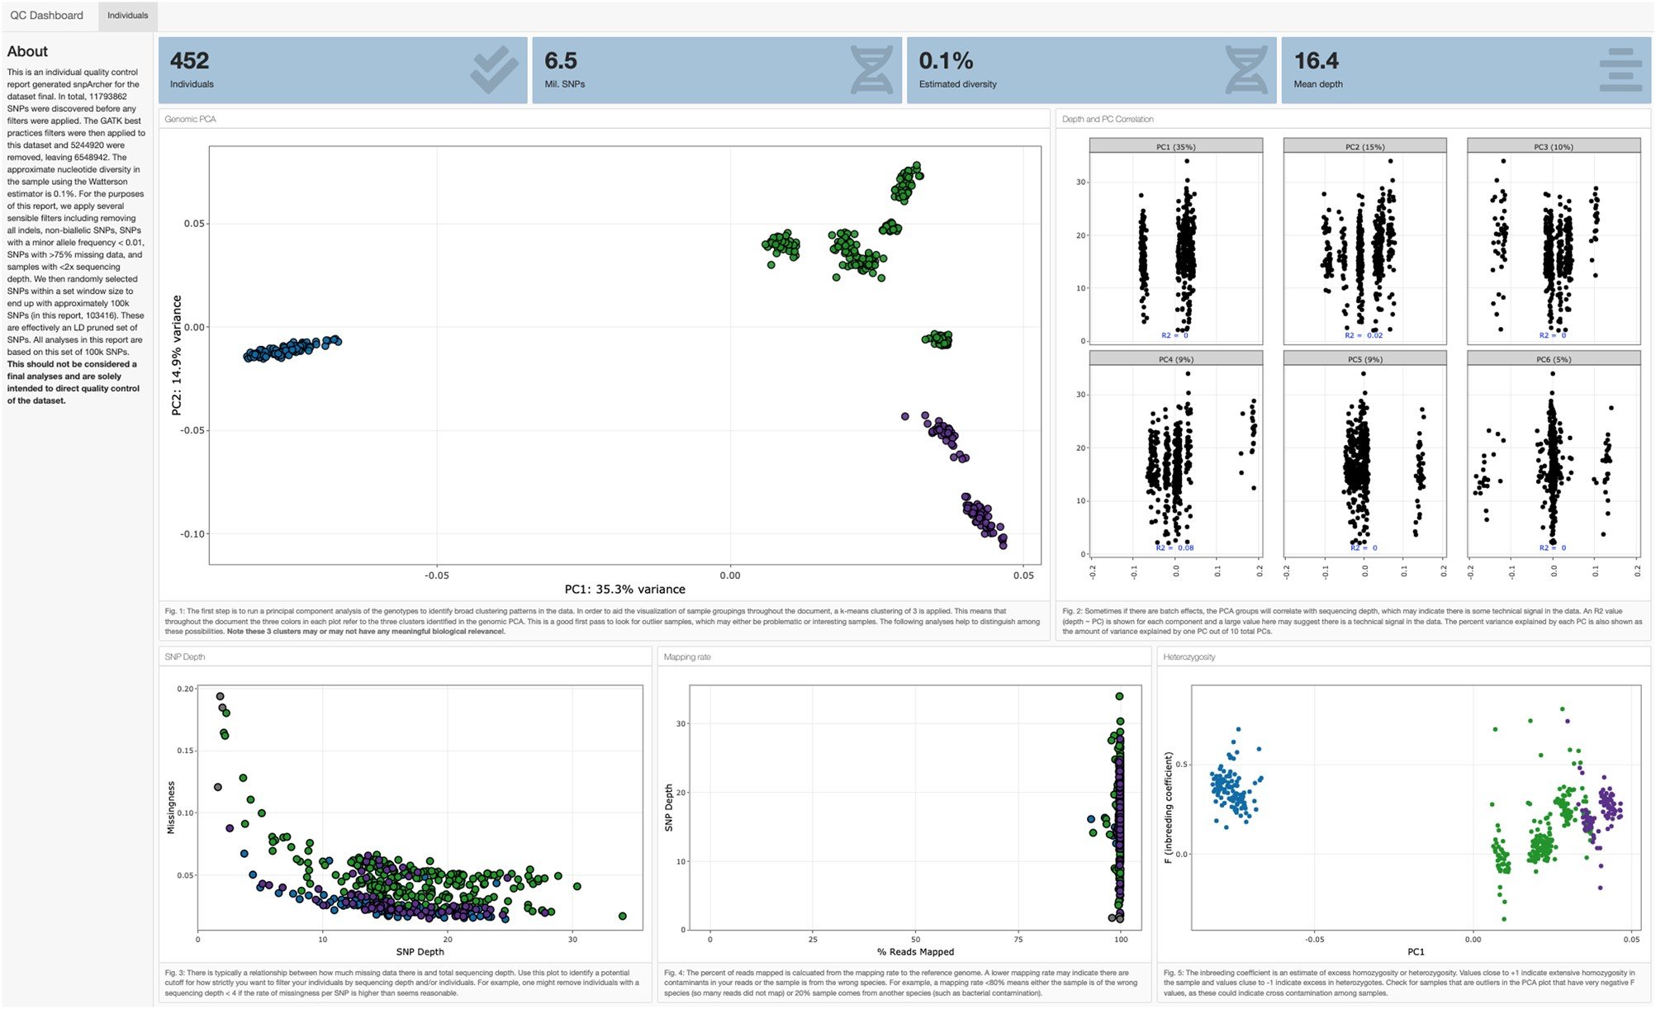
Summary statistics are provided as an HTML page

Slide 55
Trackhubs can be generated to visualize where SNPs occur
Notes:
Still confusing, but everything is done automatically

Slide 56
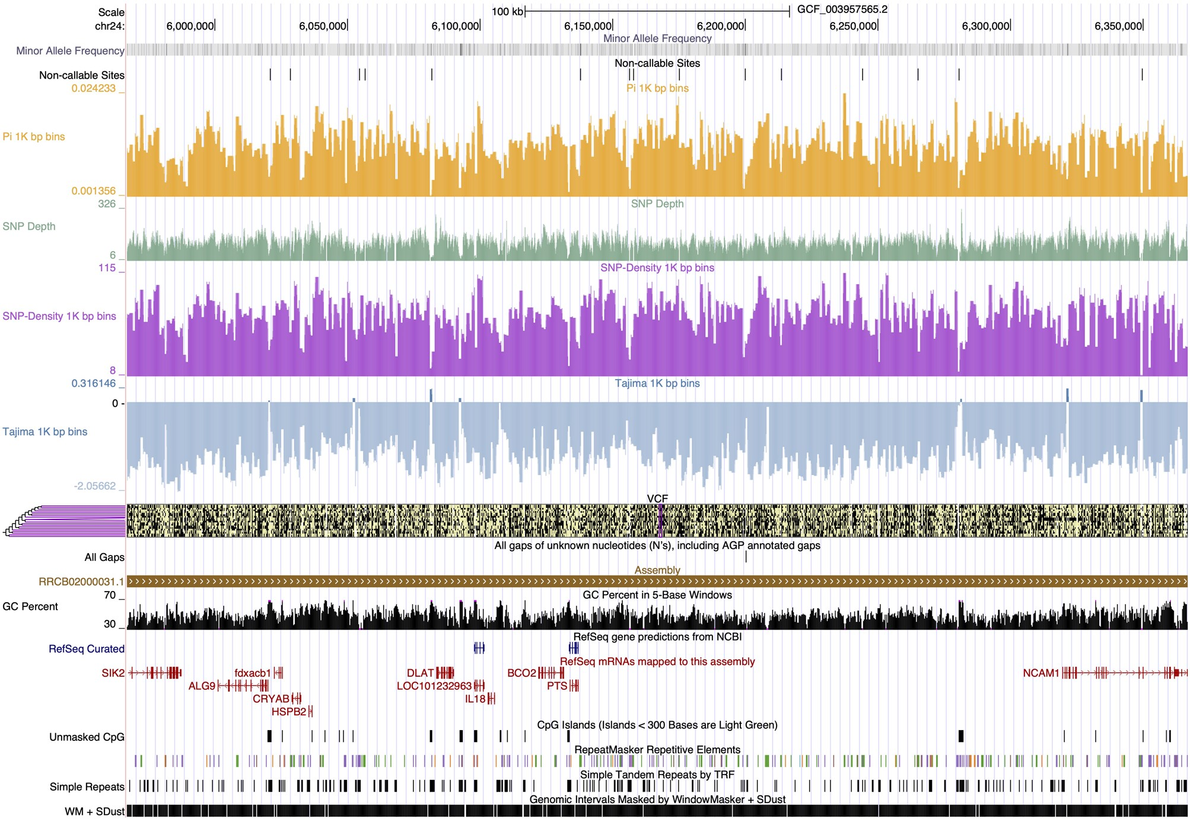
Trackhubs can be generated to visualize where SNPs occur

Slide 57
MK tests can be performed to test for selection
Notes:
Still confusing, but everything is done automatically

Slide 58
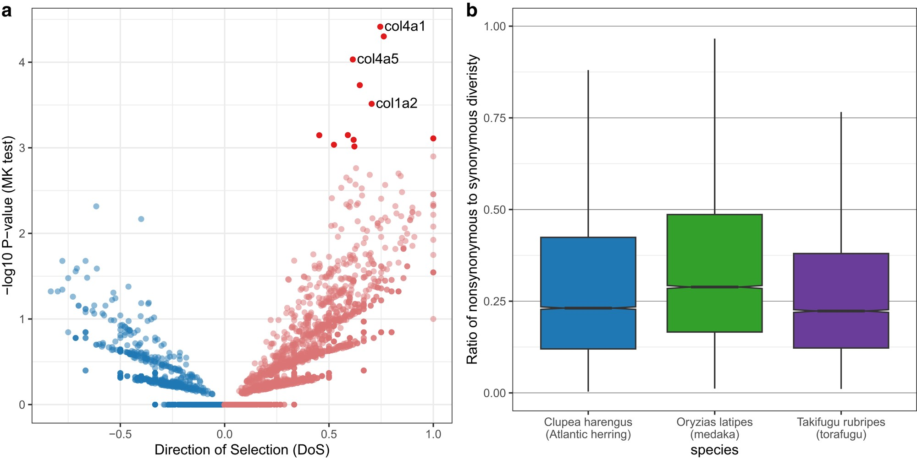
MK tests can be performed to test for selection
Notes:
Still confusing, but everything is done automatically

Slide 59

MK tests can be performed to test for selection
https://github.com/harvardinformatics/degenotate
A (user-developed) module!
Notes:
Still confusing, but everything is done automatically

Slide 60
Users can develop their own modules and integrate them into snpArcher
Notes:
Still confusing, but everything is done automatically

Slide 61
Users can develop their own modules and integrate them into snpArcher
Module to infer population size: https://github.com/tforest/popsize
Notes:
Still confusing, but everything is done automatically

Slide 62
Thanks for your time!
https://snparcher.readthedocs.io/
Notes:
Depending on how much time we want to spend here, we could expand each step and do a bit of a walkthrough

